Slide 1
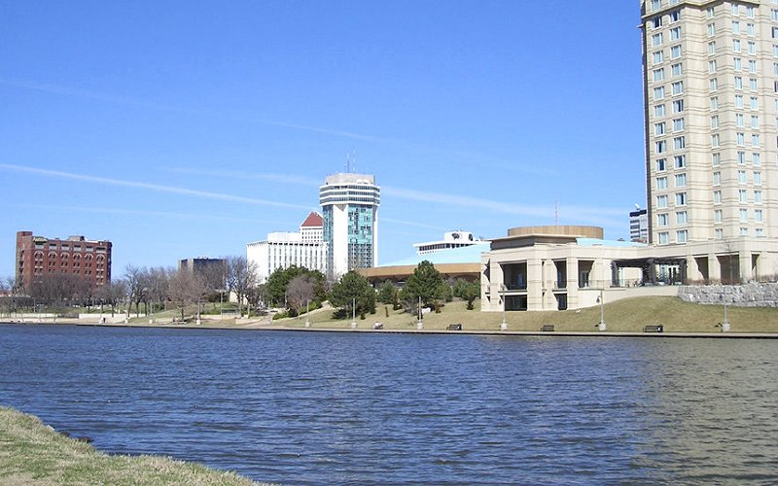
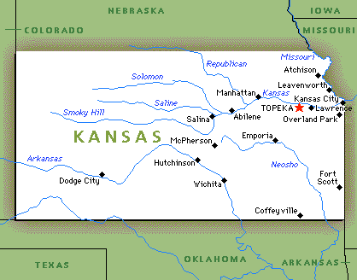
Wichita
State of Kansas

Slide 2
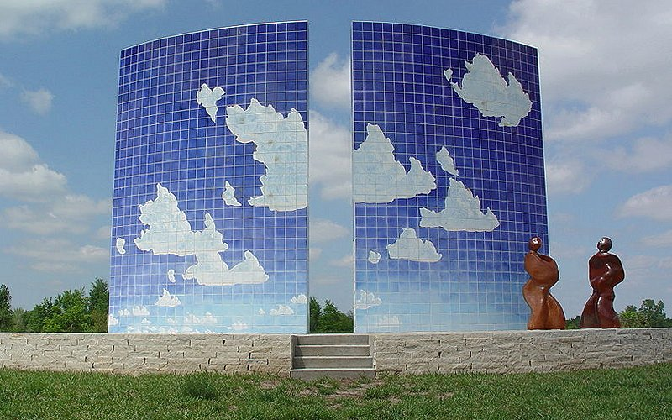
Newton Blue Sky-Blue Sky Sculpture, Centennial Park

Slide 3
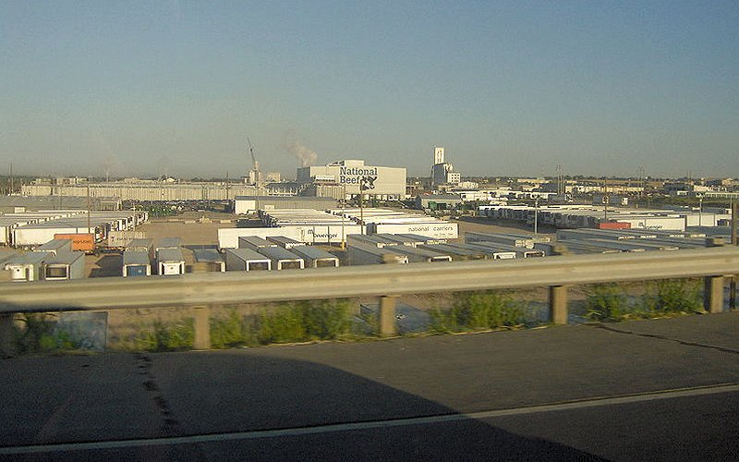
Dodge City Meat

Slide 4
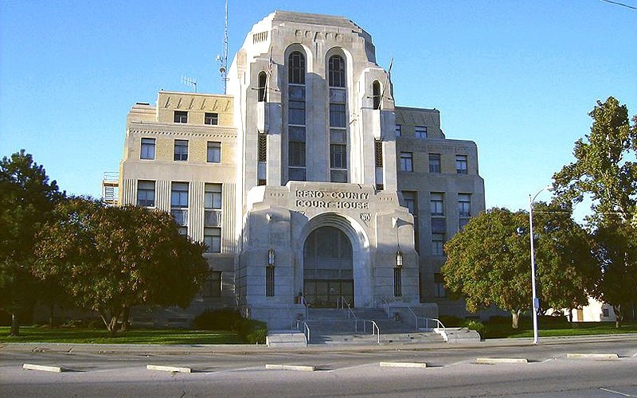
Reno County Courthouse Hutchinson

Slide 5
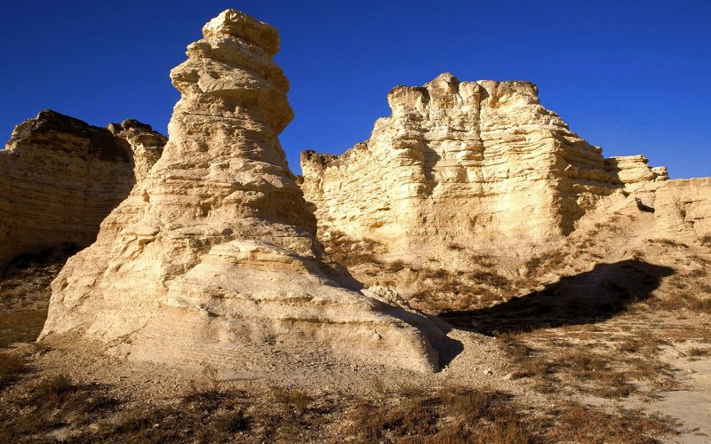
Chalk Formations at Smoky Hills, Gove County

Slide 6
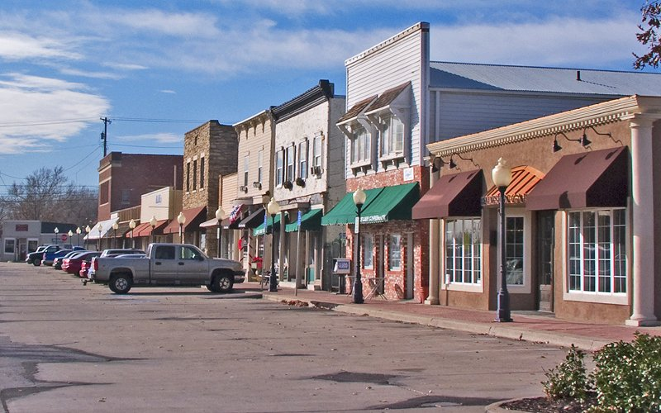
Downtown Lenexa

Slide 7
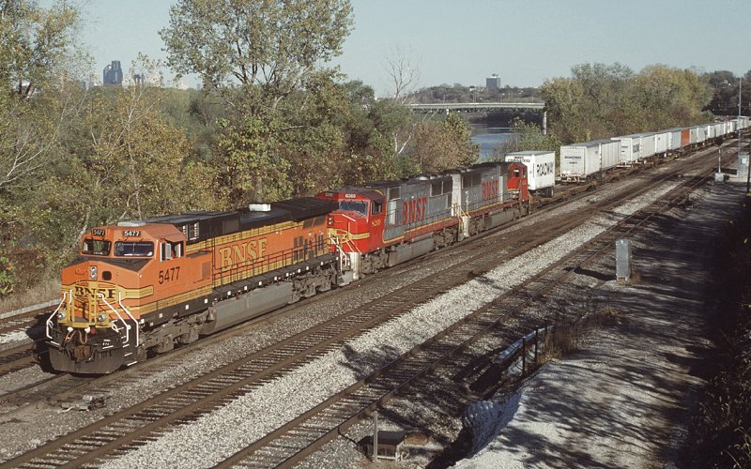
From Kansas City

Slide 8
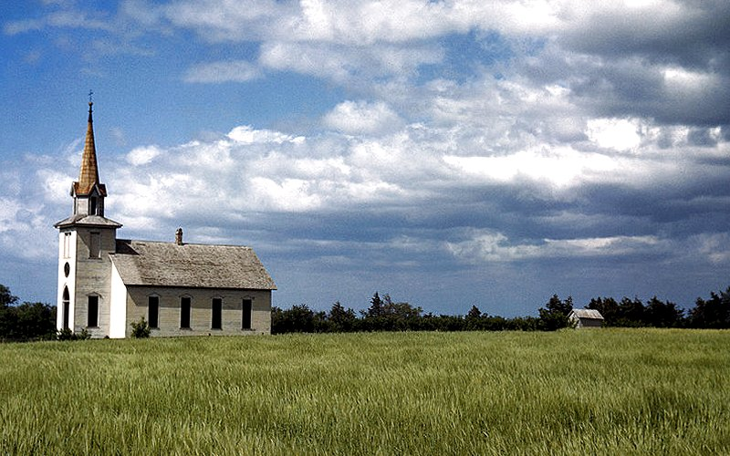
Church near Junction City

Slide 9
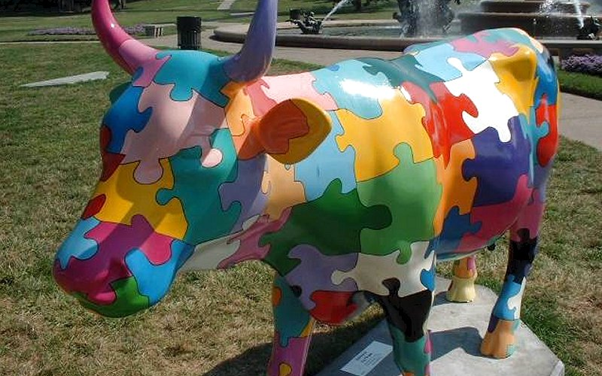

Slide 10
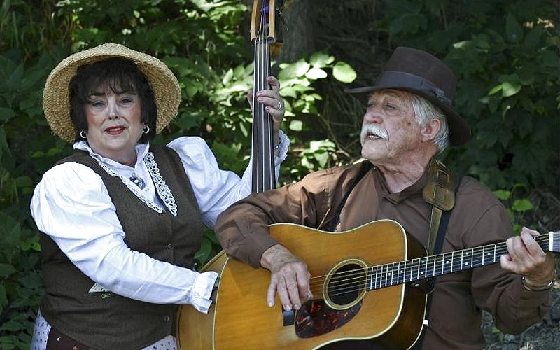

Slide 11
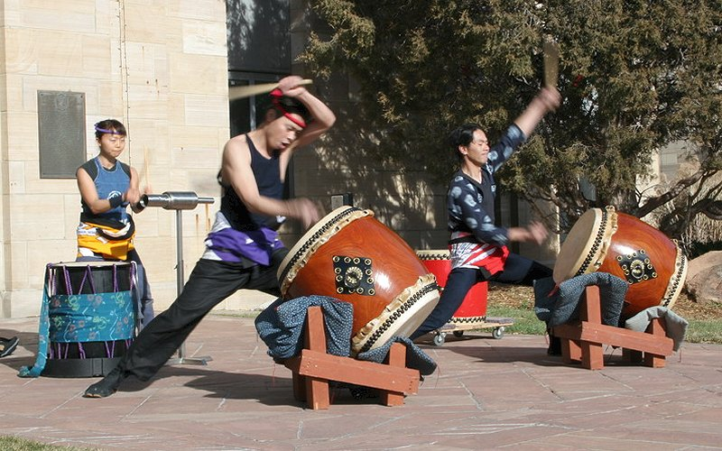

Slide 12
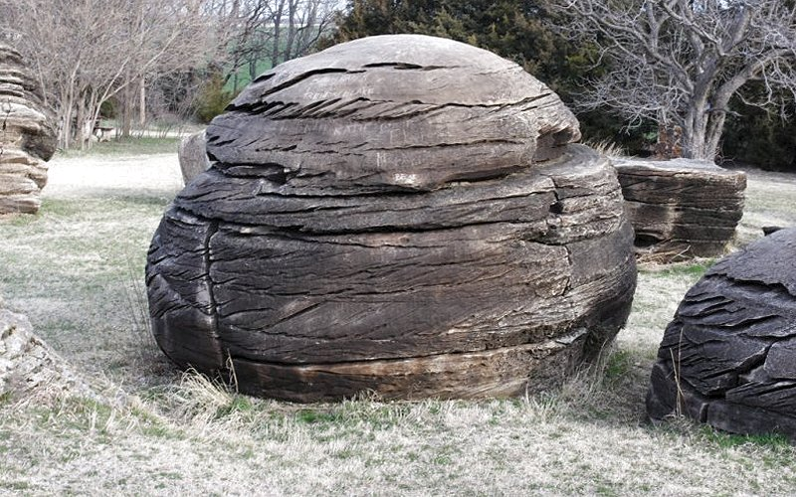

Slide 13
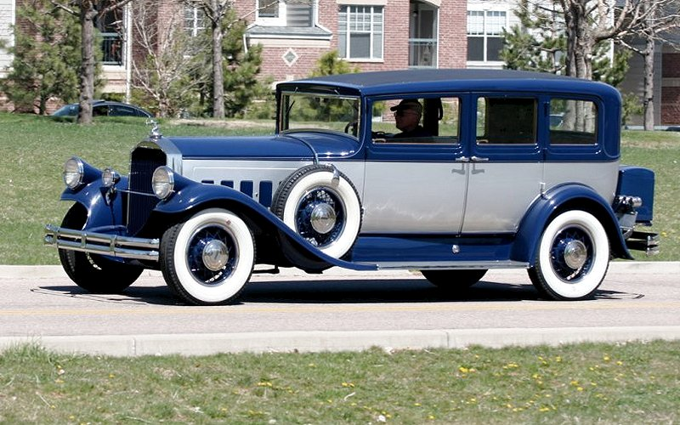

Slide 14
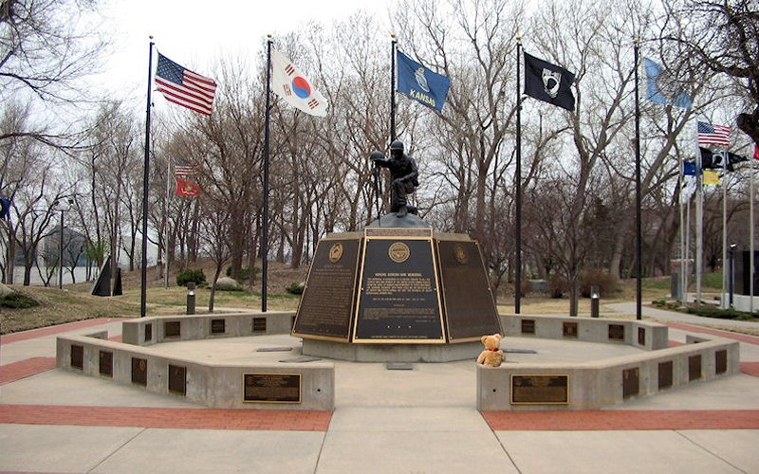

Slide 15
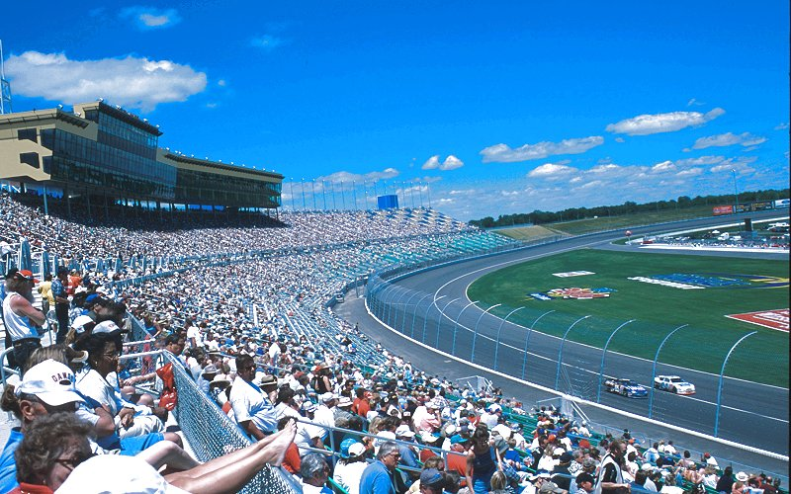
Kansas Speedway

Slide 16
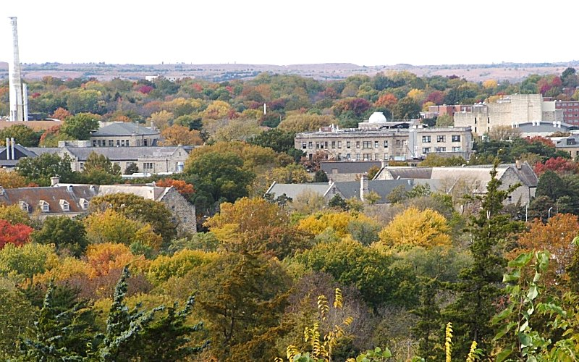
Kansas State University Campus

Slide 17
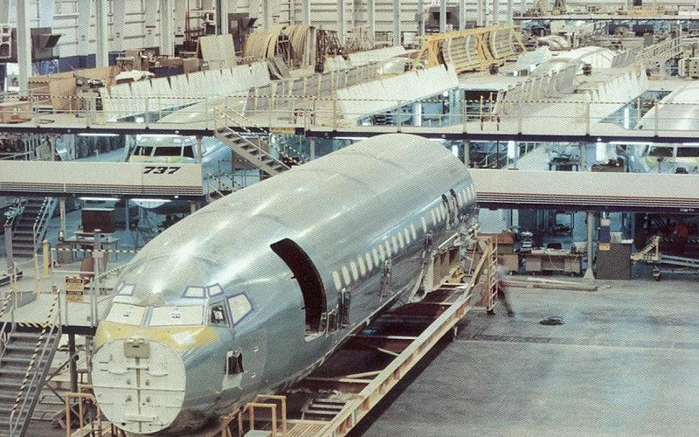
Lear Jet (Wichita)

Slide 18
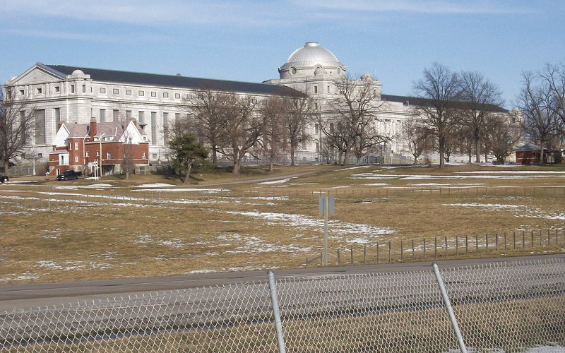
Leavenworth Federal Prison

Slide 19
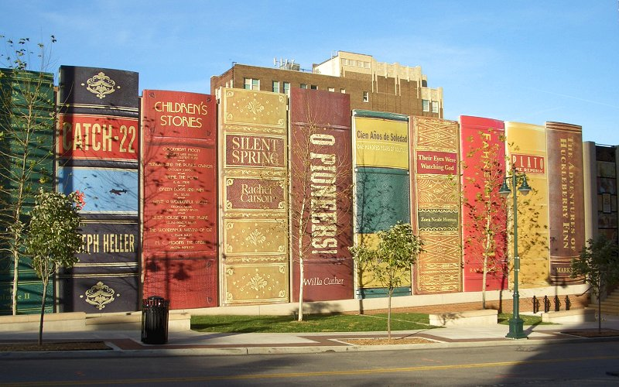
Library Garage Art

Slide 20
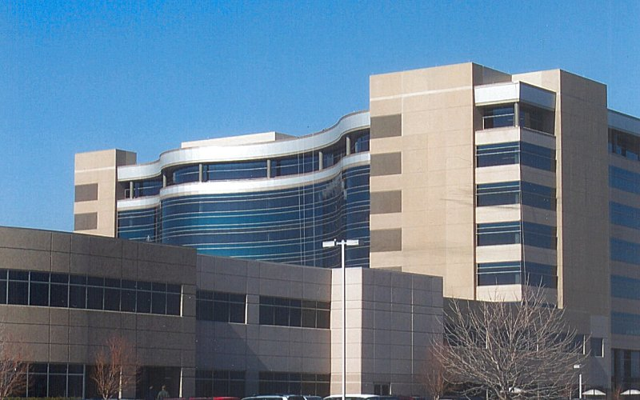
City of Olathe Kansas

Slide 21
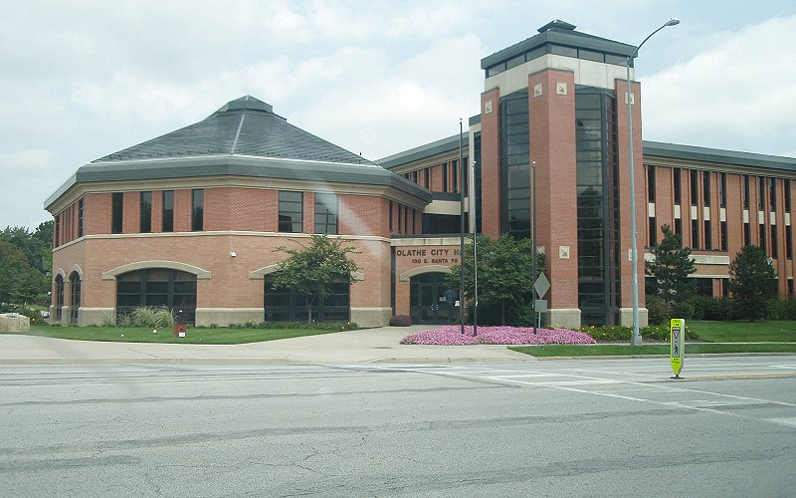
Olathe Kansas city hall

Slide 22
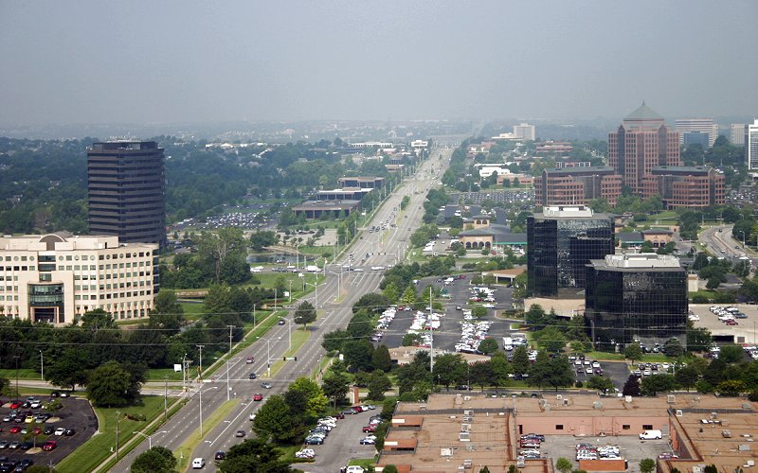
Overland Park

Slide 23
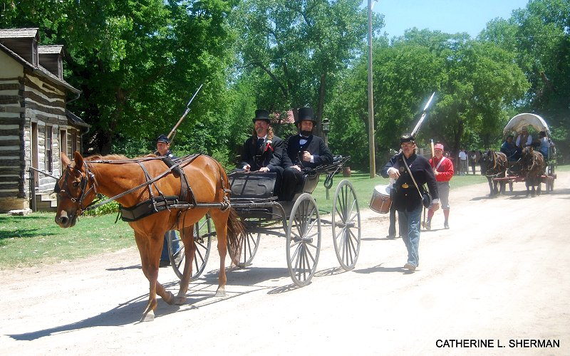
Museum in Wichita

Slide 24
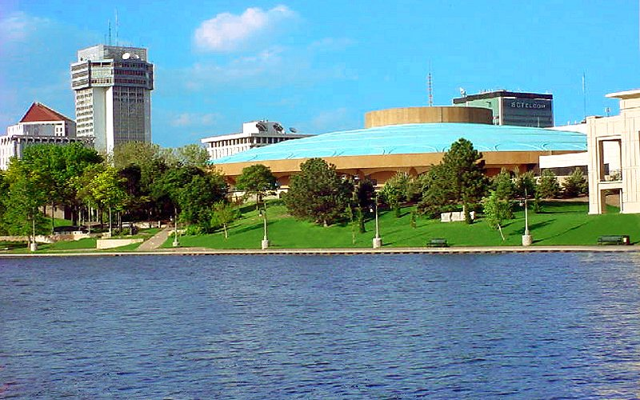

Wichita
Photographs taken on the net
Émile
Music : “ Mack the knife ”

Slide 25







¿Te ha gustado?
Puedes ver más entrando
Aquí
Además puedes recibir powerpoints en tu correo electrónico suscribiéndote aquí:

