Slide 1
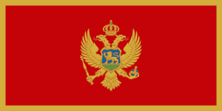
MONTENEGR​O
Region: Southeastern Europe
Area total: 13,812 km2
Coast line: Adriatic Sea
Capital: Podgorica
Music:Andrijana Bozovic
Moja zeljo Najveca
Presentation by:NILGUN

Slide 2
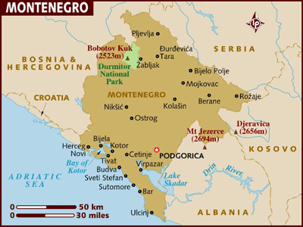

Slide 3
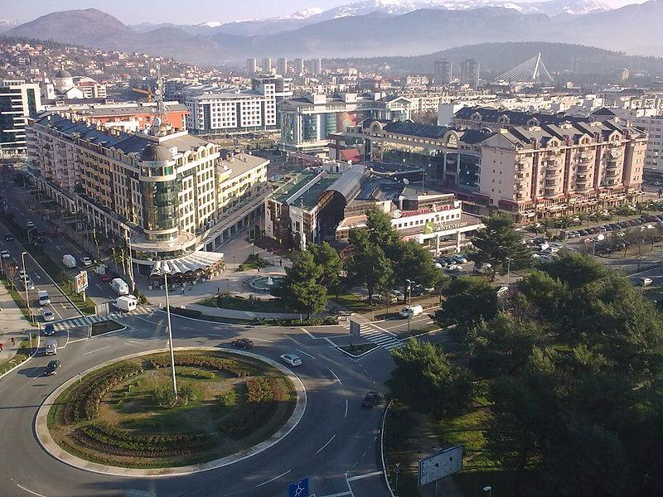
Podgorica

Slide 4
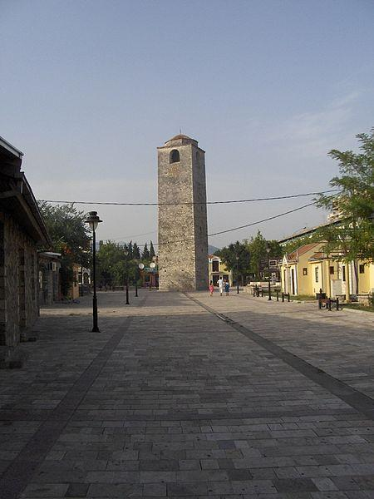
Sahat kula, an Ottoman clock tower, one of the very few Ottoman landmarks that survived WW2 bombings

Slide 5
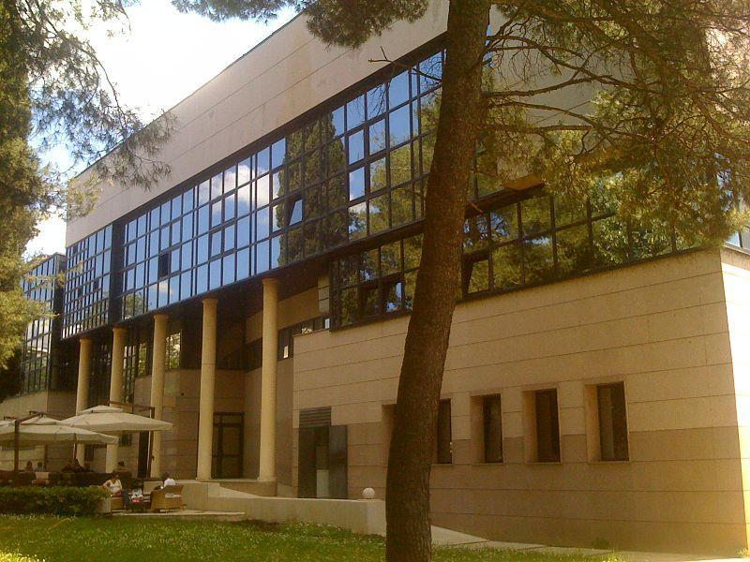
National theatre

Slide 6
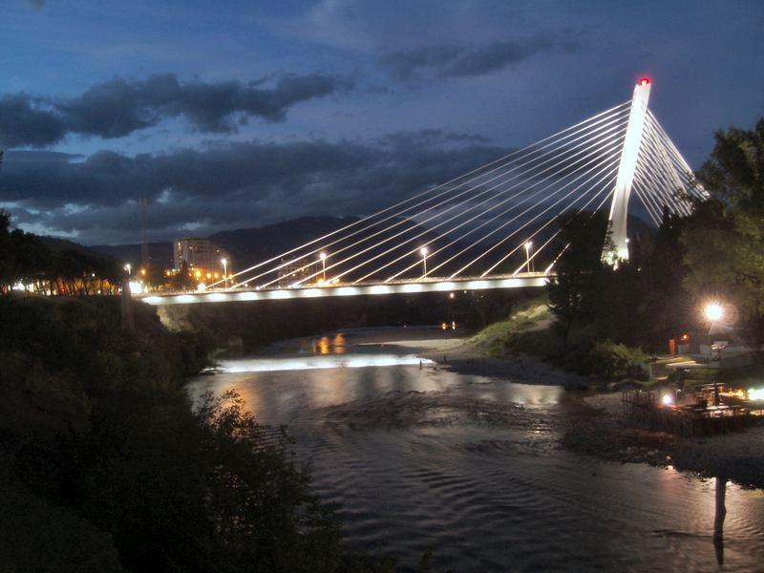
Millenium Bridge, Podgorica

Slide 7
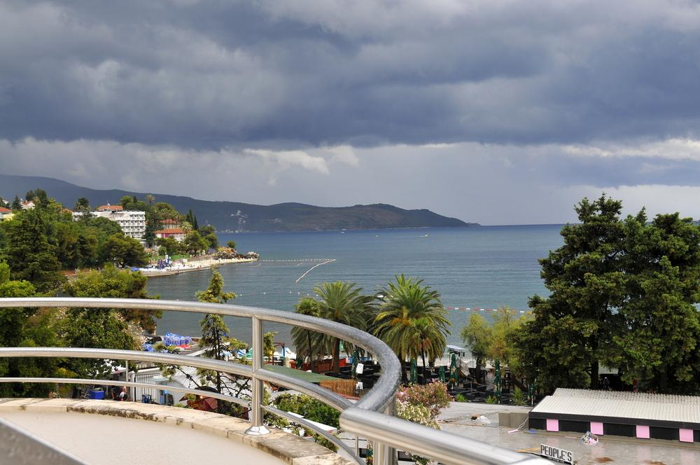
Herceg Novi

Slide 8
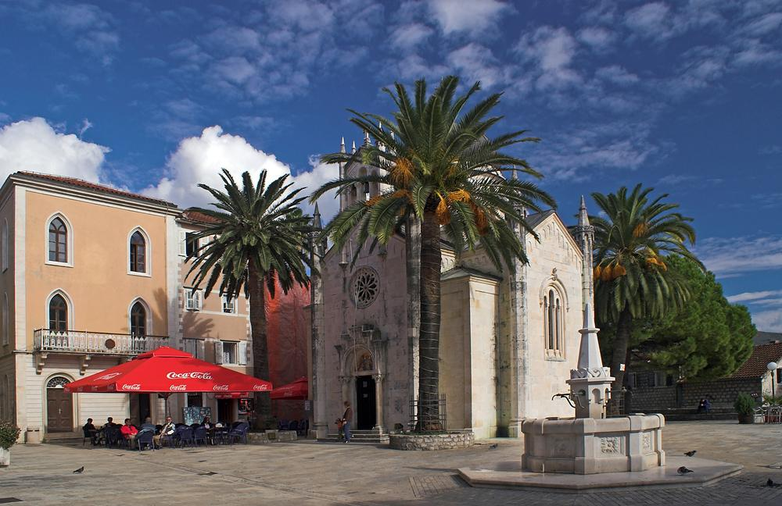
Herceg Novi

Slide 9
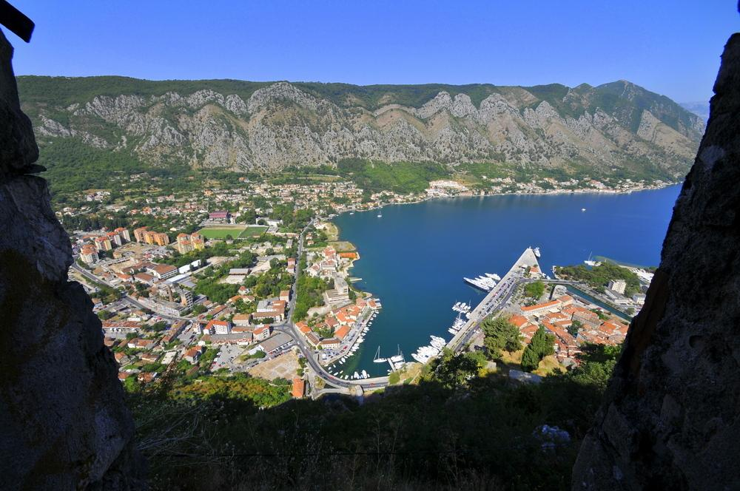
Kotor

Slide 10
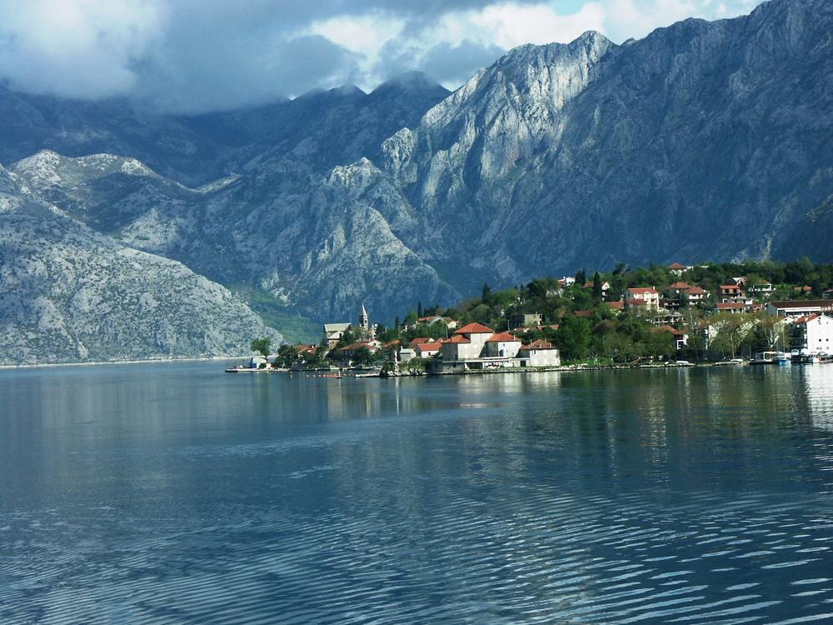
Kotor

Slide 11
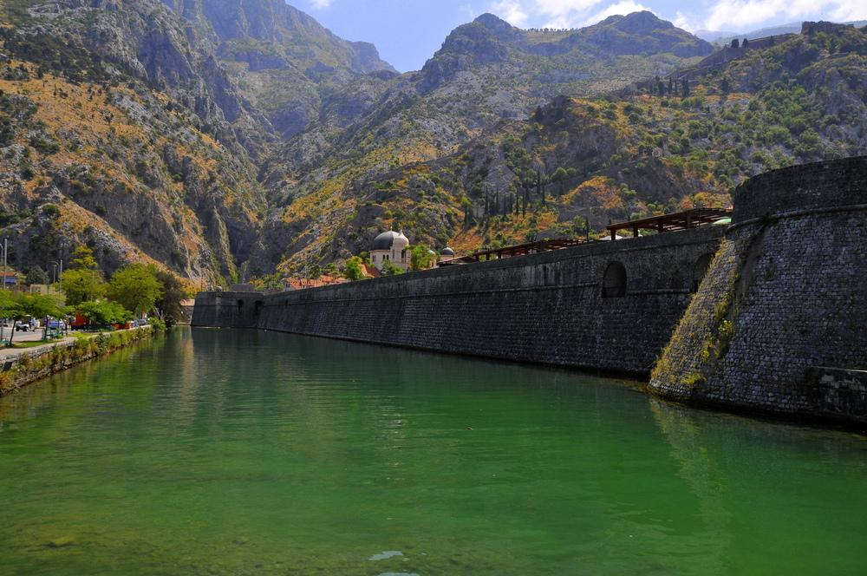
Fortress - Kotor

Slide 12
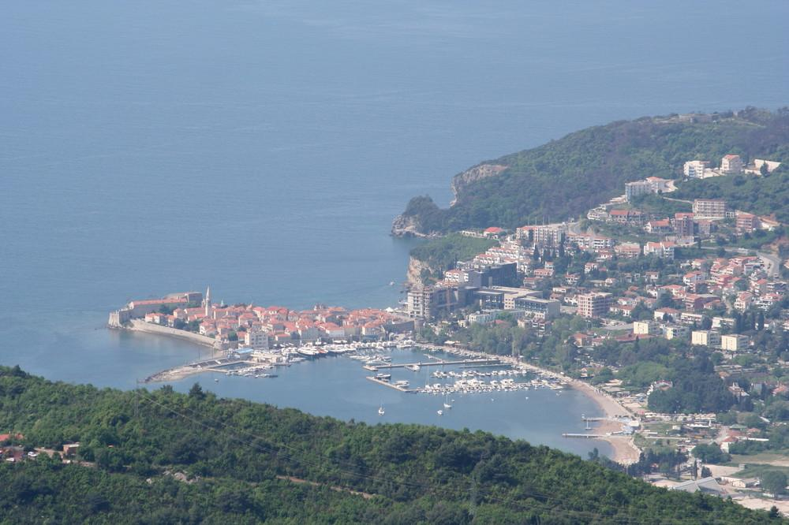
Budva

Slide 13
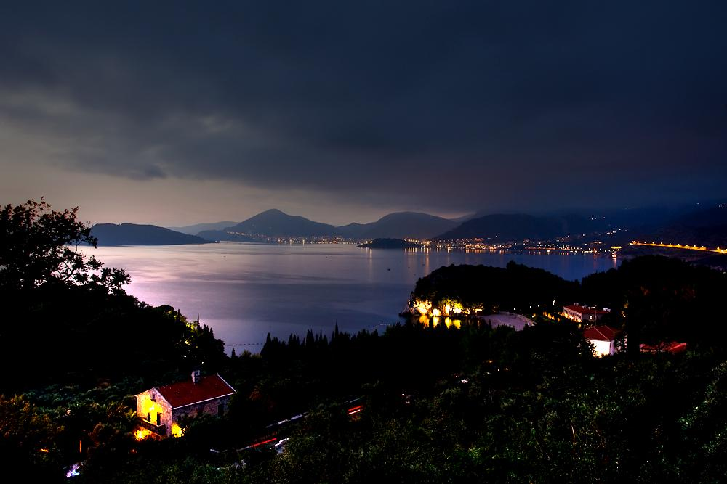
Budva

Slide 14
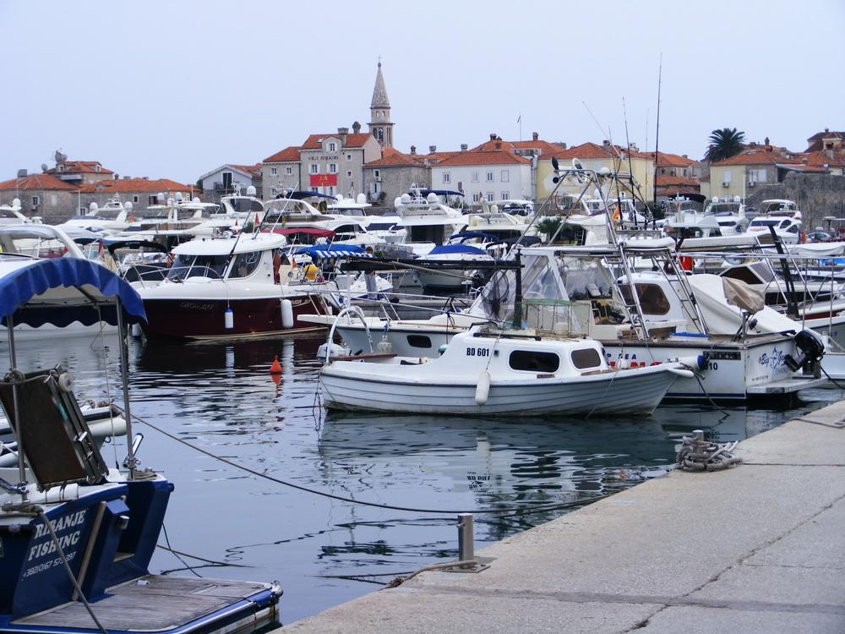
Budva harbour

Slide 15
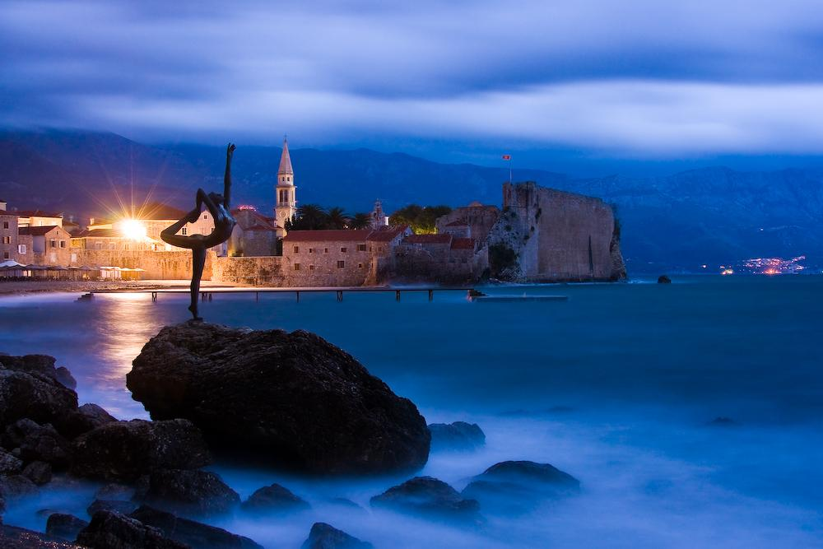
Budva

Slide 16
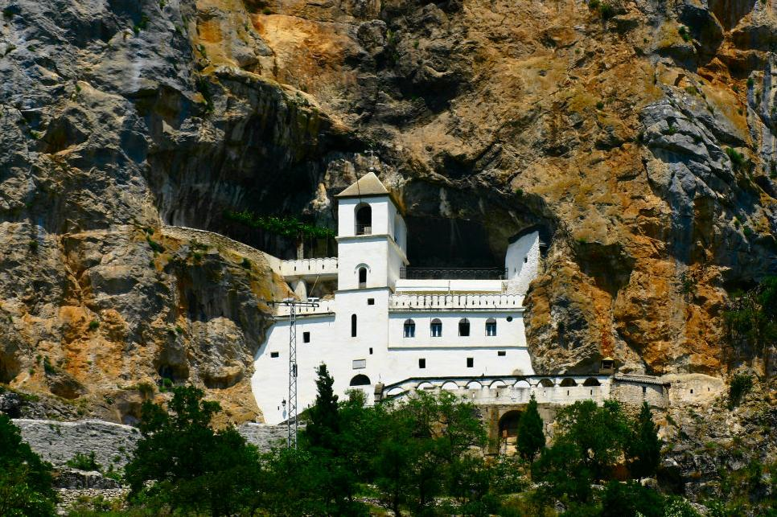
The mountain monastery of Ostrog. It was built over the River Zeta into the rock

Slide 17
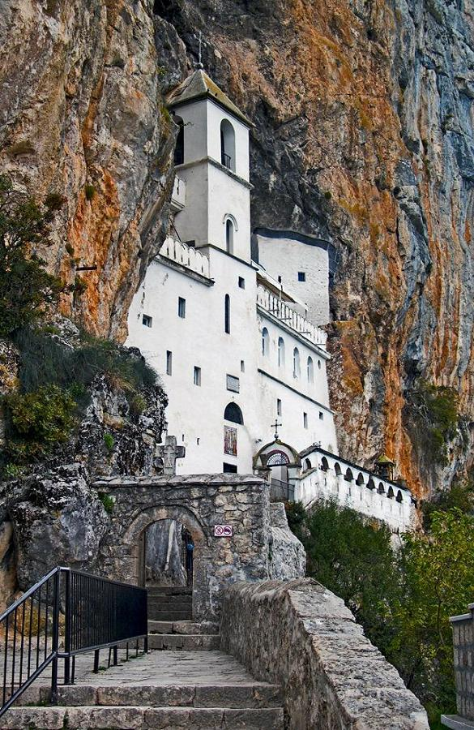
Ostrog

Slide 18
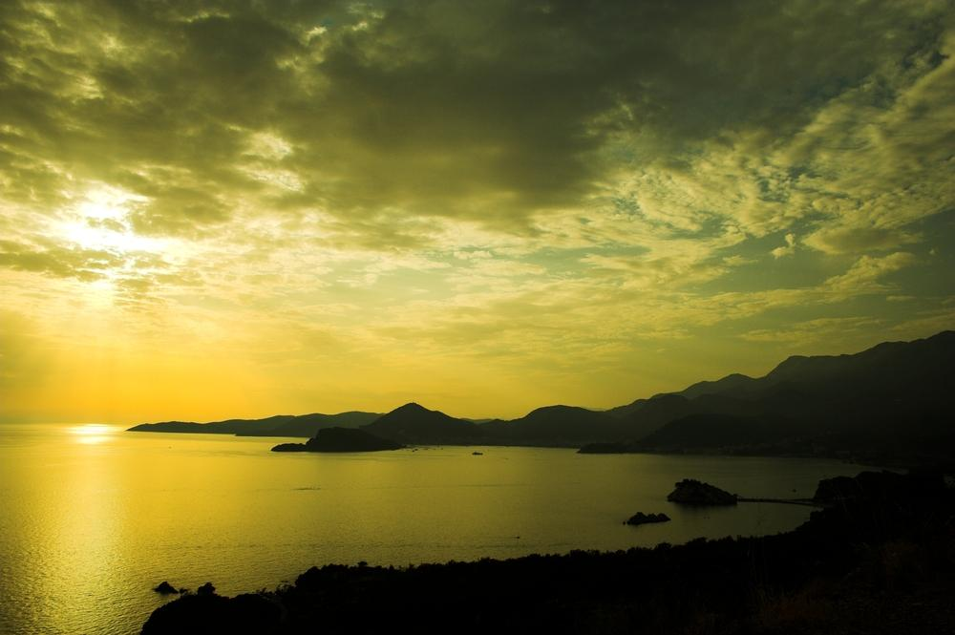

Slide 19
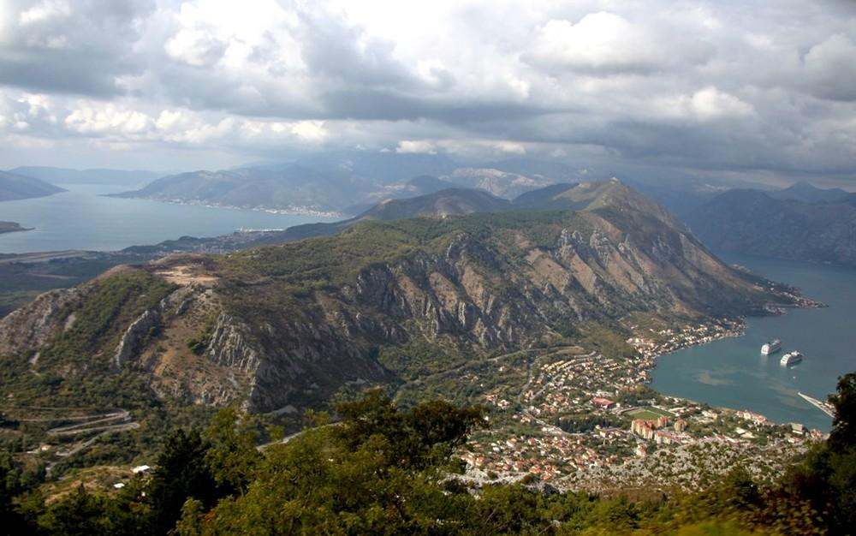

Slide 20
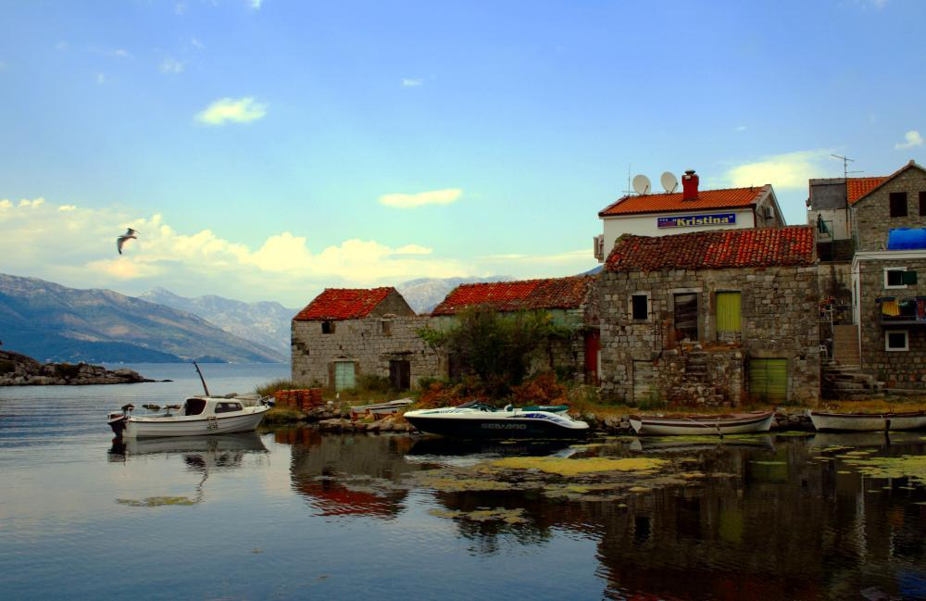
Fishing village Bjelila

Slide 21
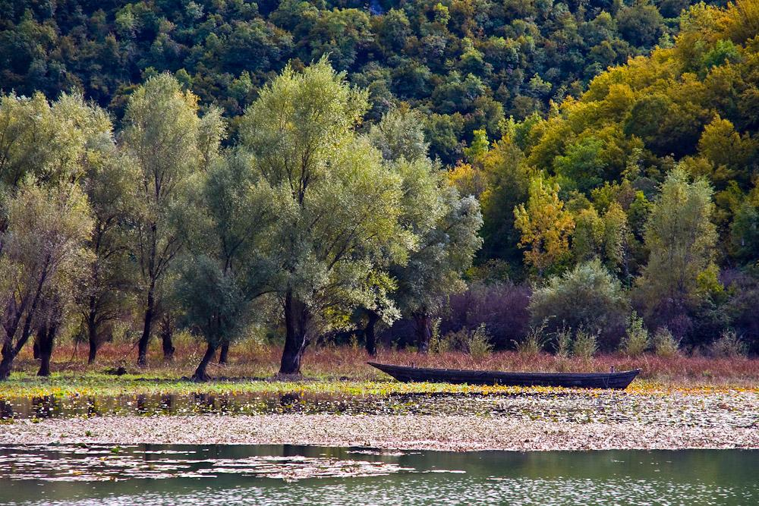
Autumn in Montenegro

Slide 22
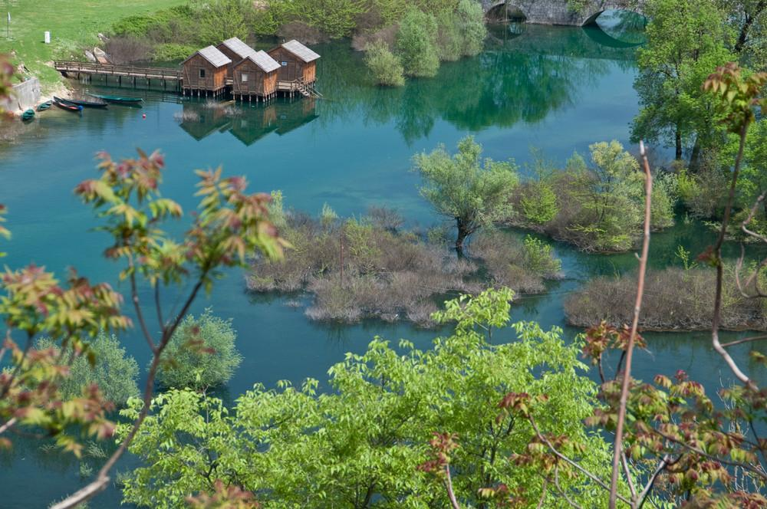
Rijeka Crnojevica

Slide 23
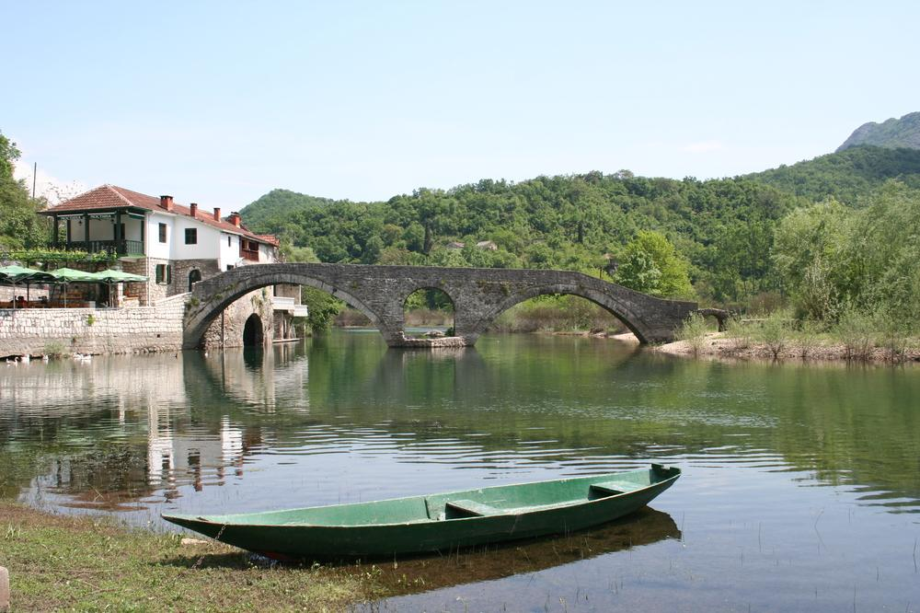
Rijeka Crnojevica - stone bridge from the old times

Slide 24
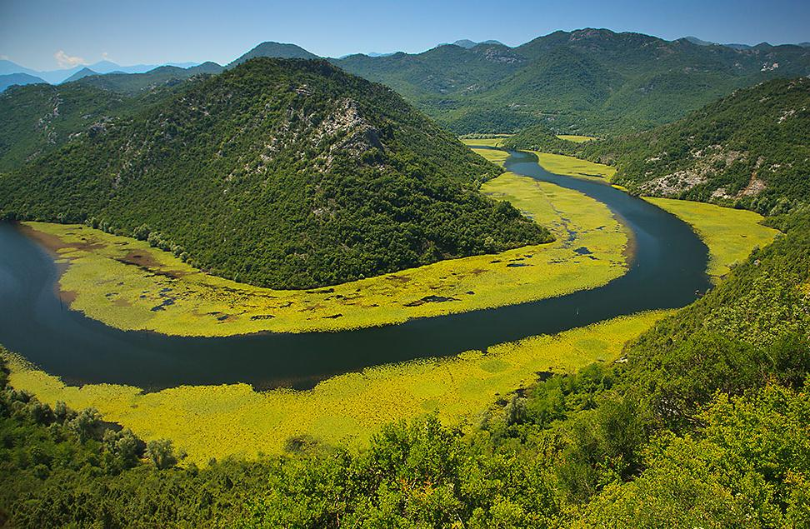
Rijeka Crnojevica

Slide 25
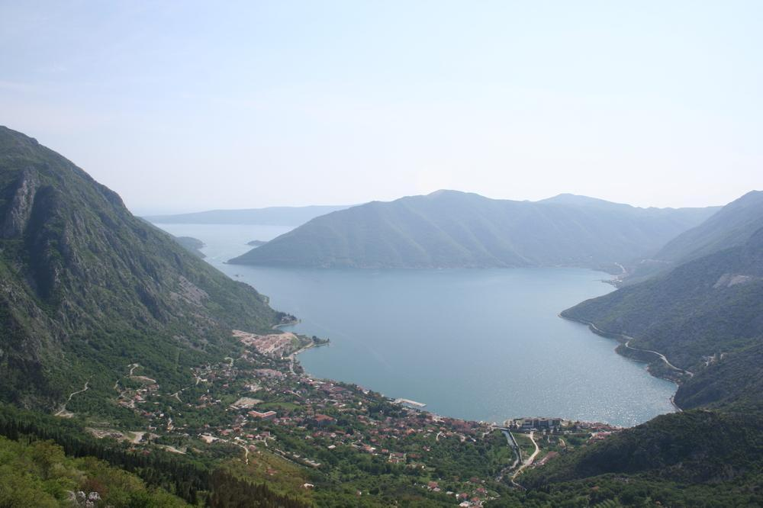
Risan

Slide 26
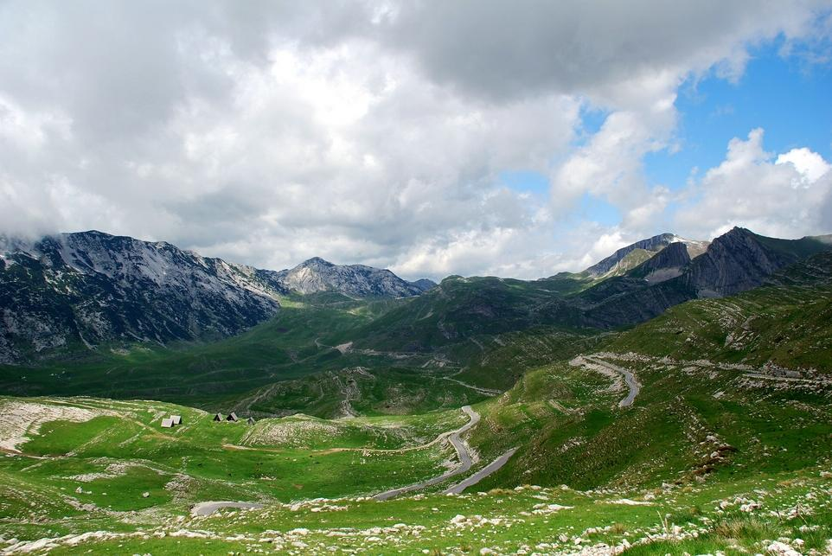
Durmitor Nationalpark

Slide 27
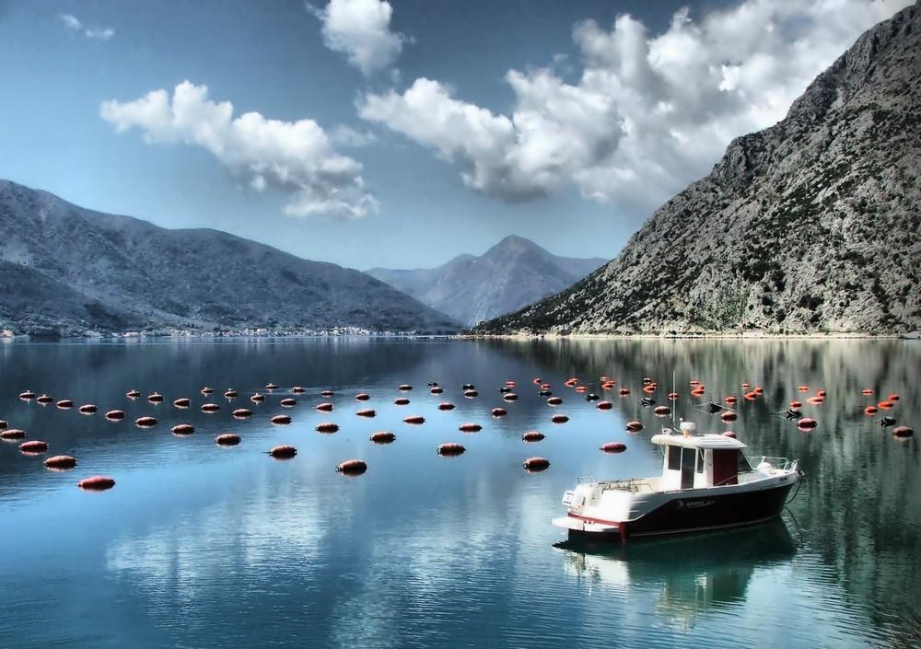
Boka Kotorska

Slide 28
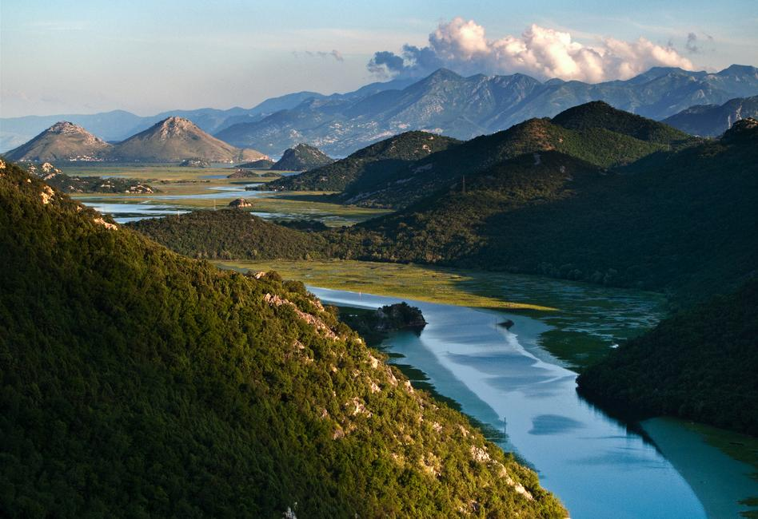
Delta

Slide 29
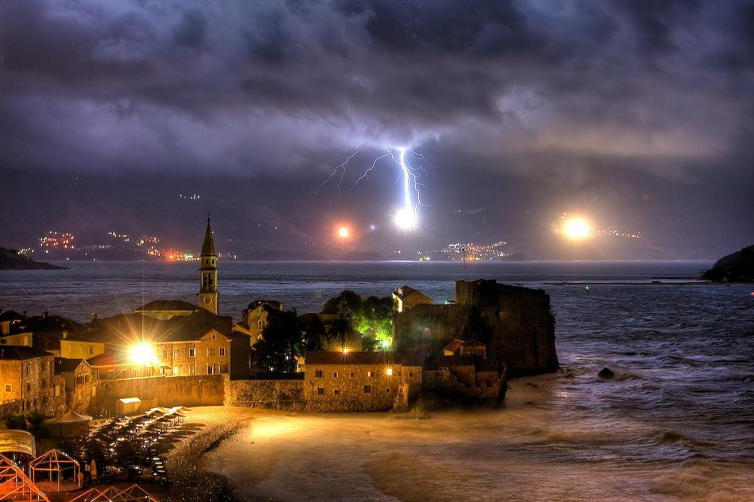
Budva

Slide 30
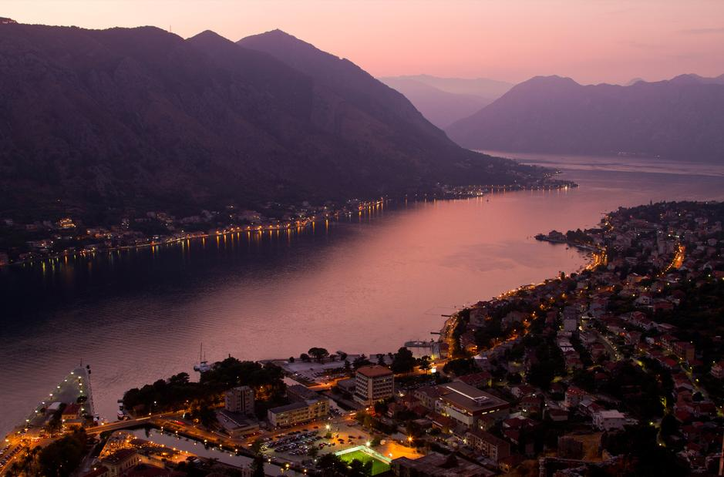

Slide 31
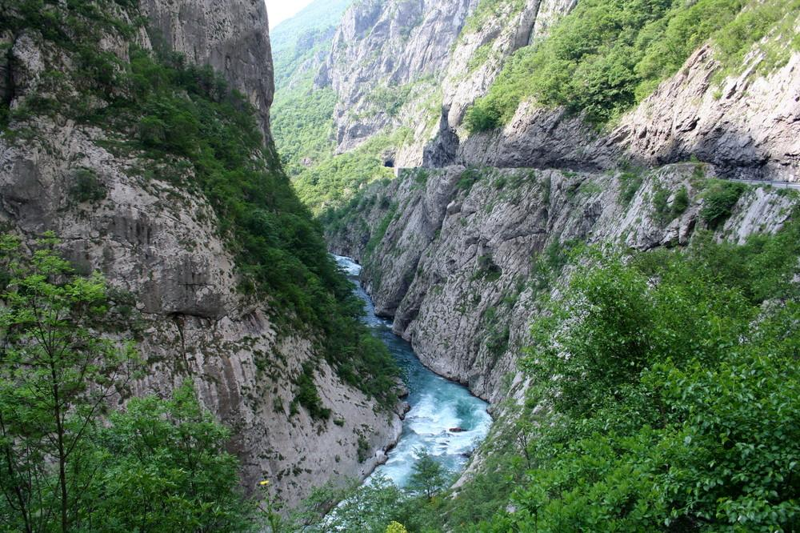
River Moraca

Slide 32
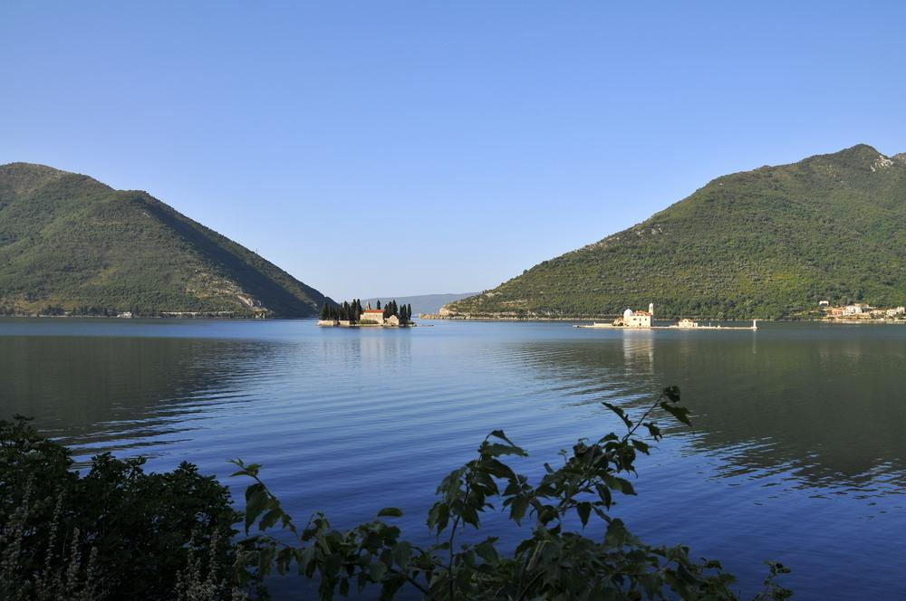
Gospa-od-krpjela-and-Sveti-Dorde(Our Lady of the rock and St.george island)

Slide 33
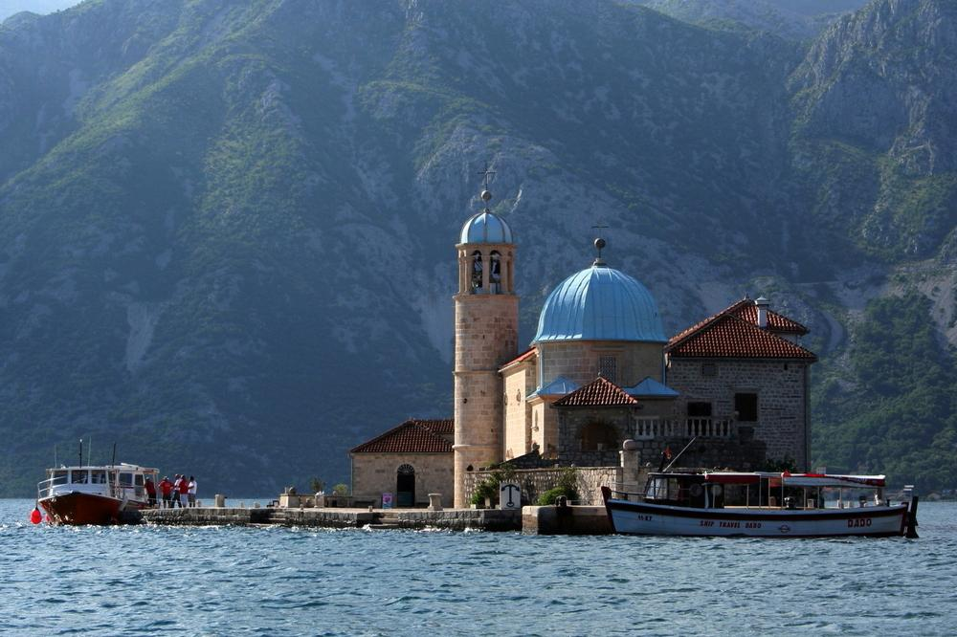
Gospa-od-krpjela(Our Lady of the rock)

Slide 34
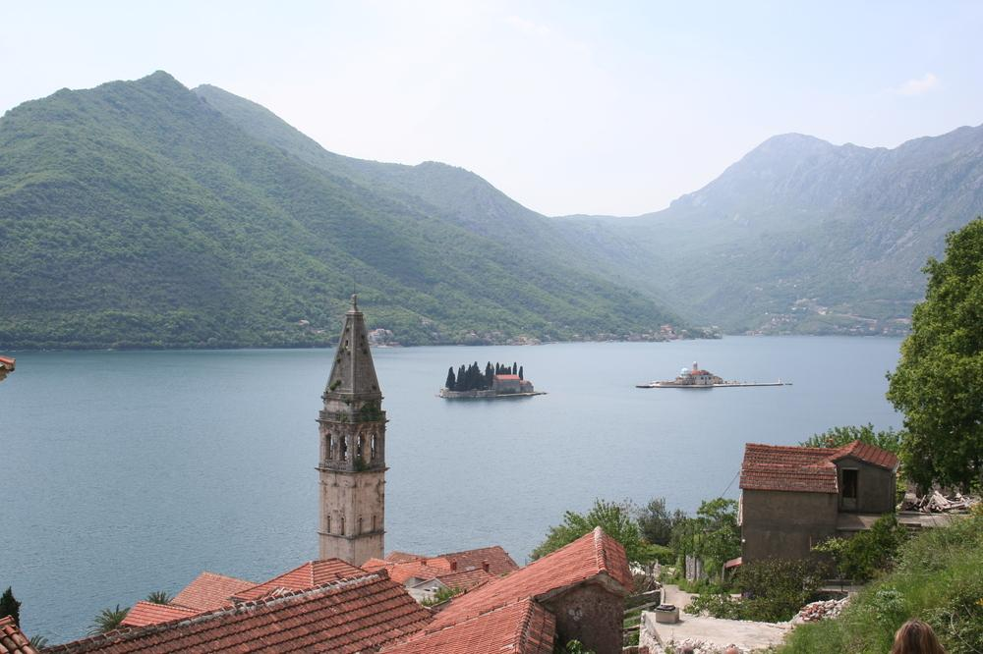
Perast

Slide 35
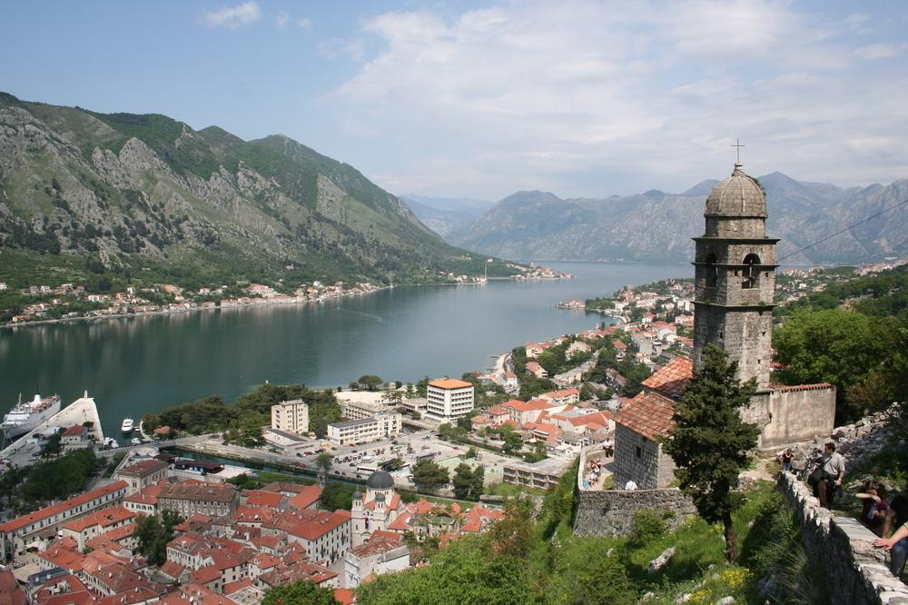
Perast

Slide 36
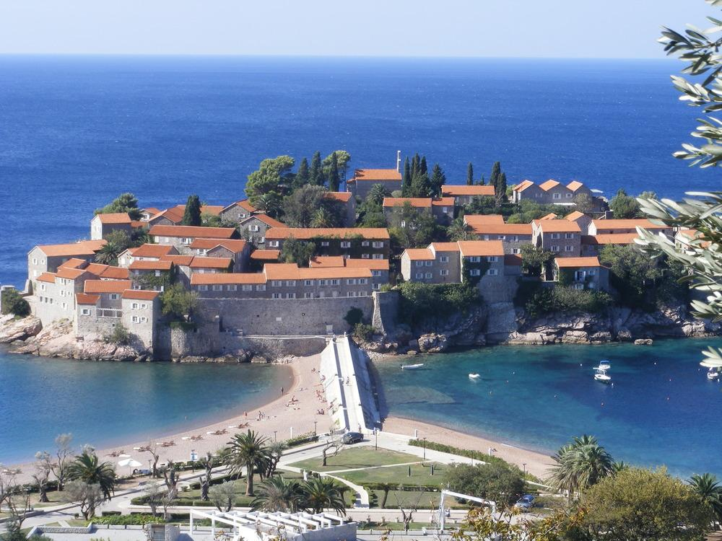
Sveti Stefan

Slide 37
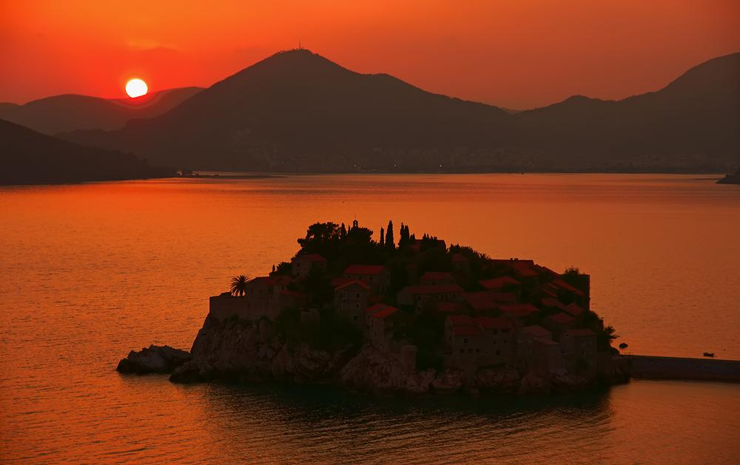
Sveti Stefan

Slide 38
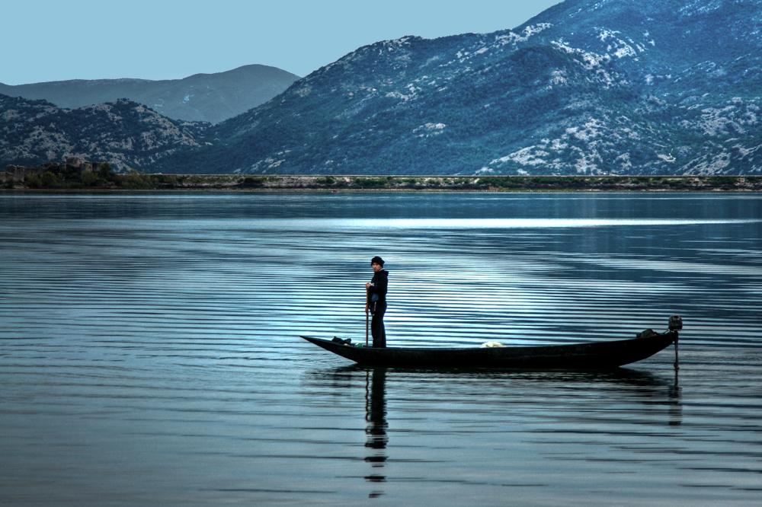
Skutar Lake

Slide 39
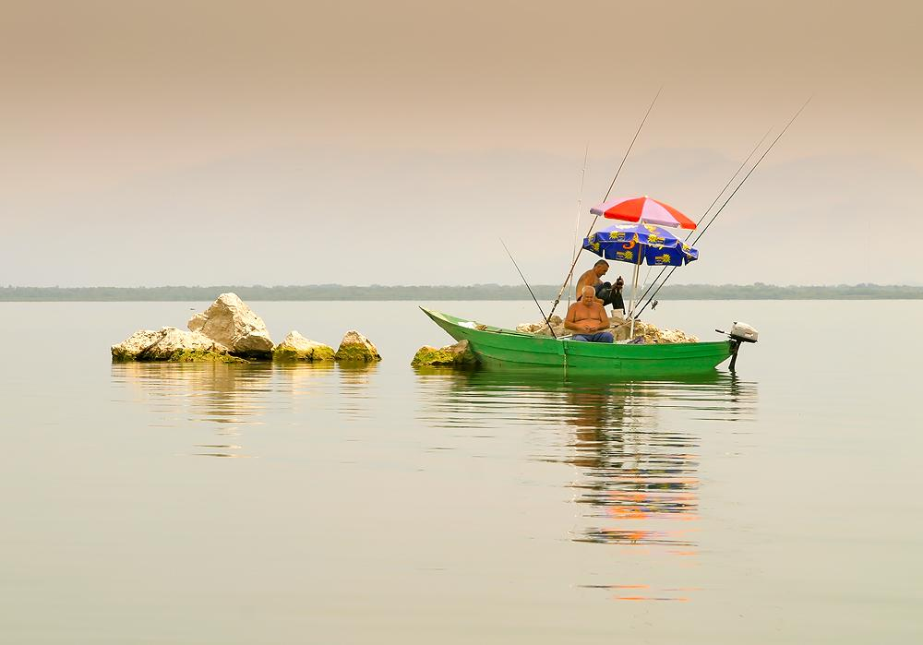
Skutar Lake

Slide 40
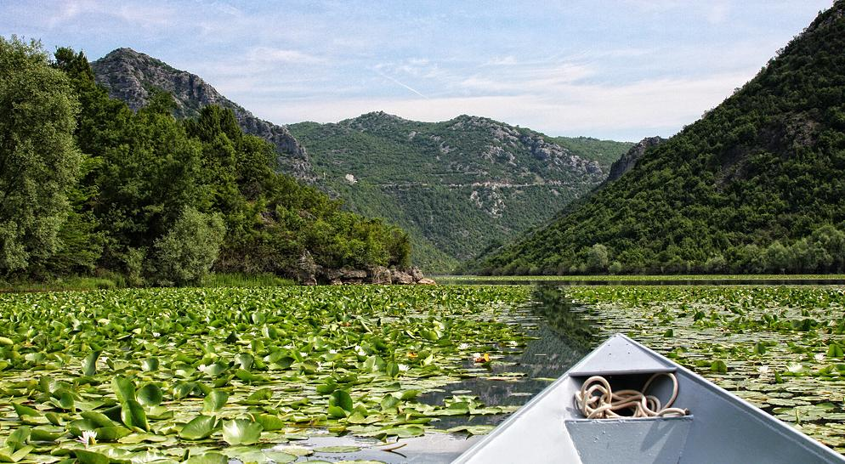
In the midst of the lilies

Slide 41
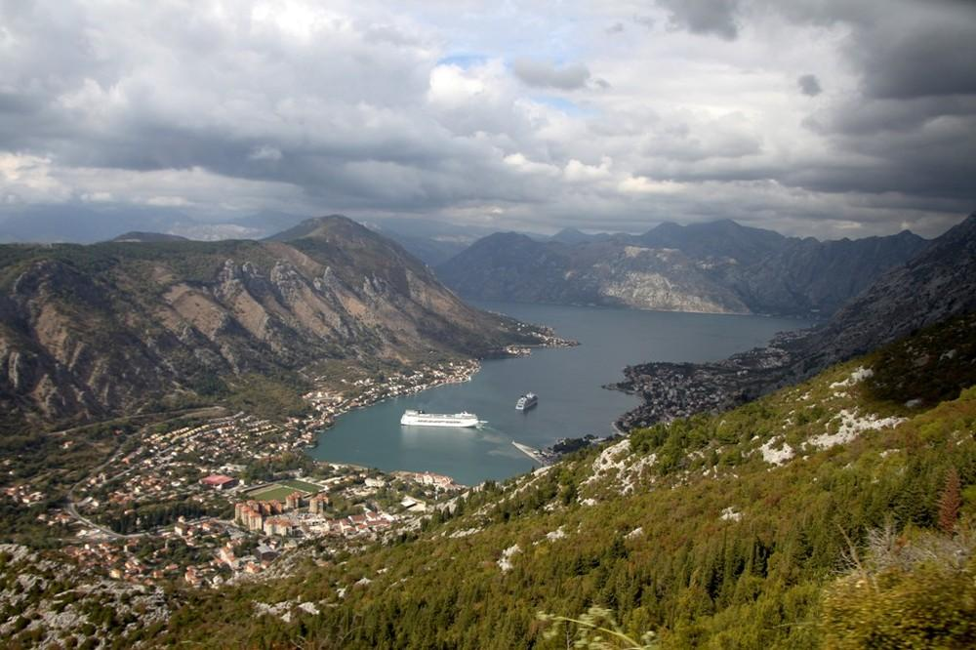

Slide 42
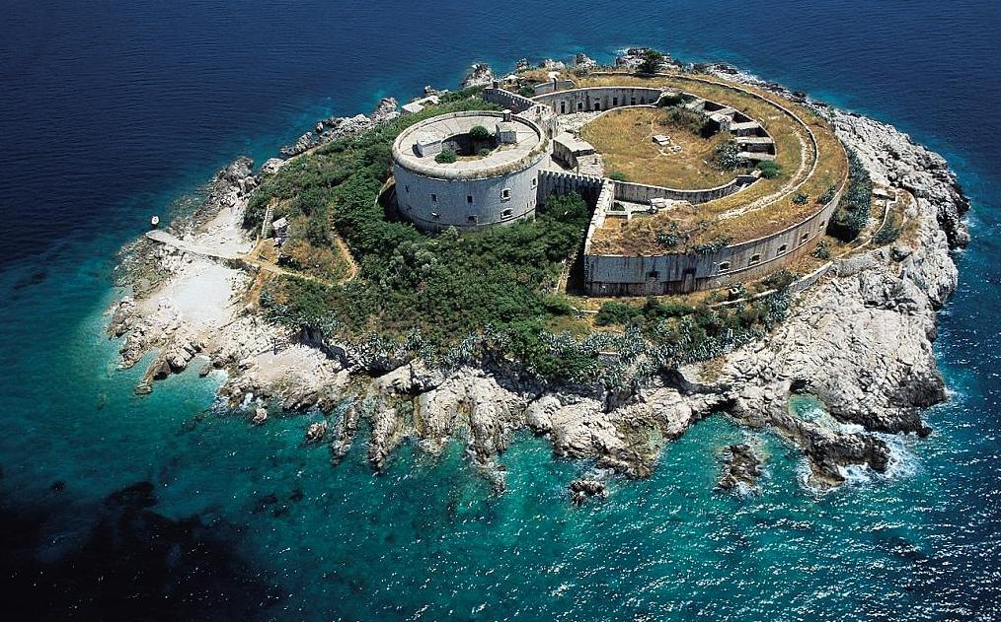
Mamula

Slide 43
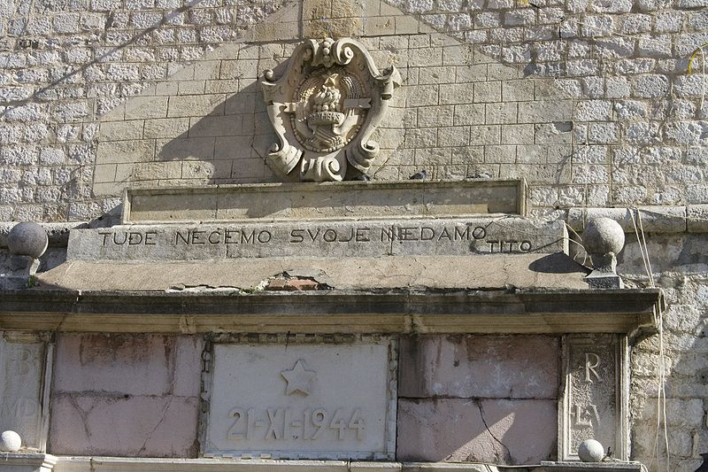
Entrance of old town Kotor with sign - What belongs to others we don't want, what is ours we will never surrender.

Slide 44
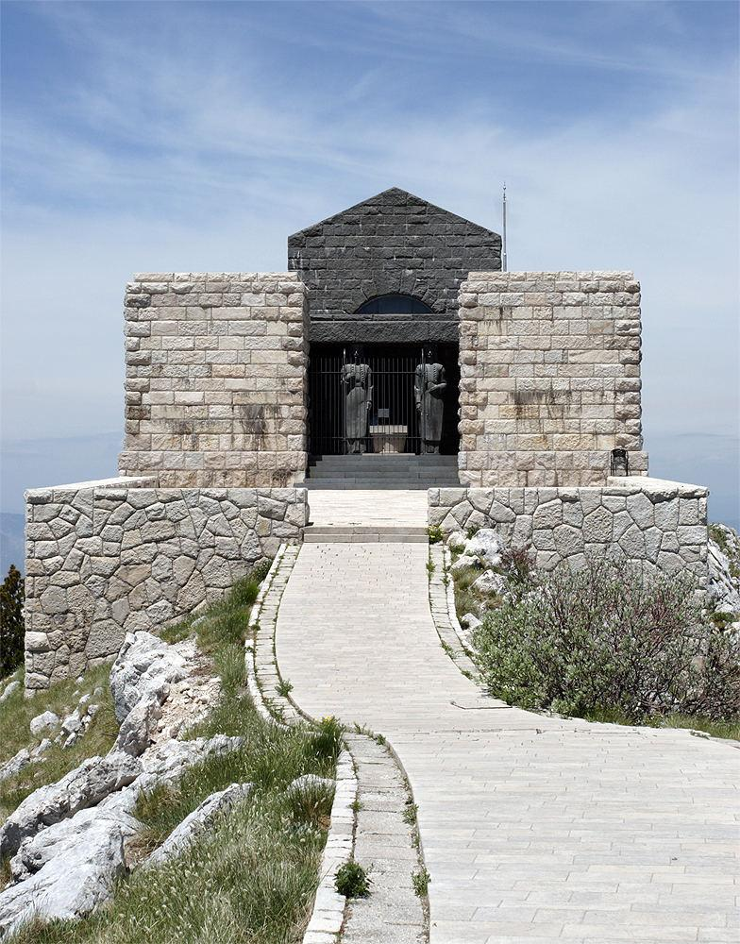
Njegos mausoleum

Slide 45
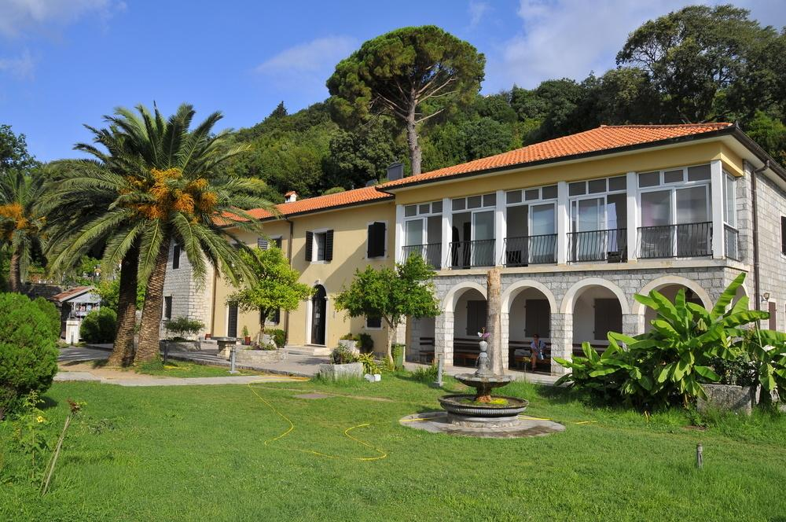
Savina monastery, Meljine

Slide 46
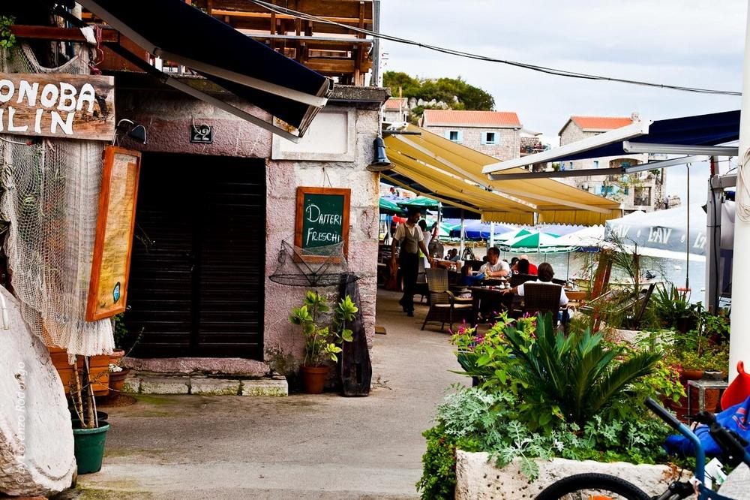

Slide 47
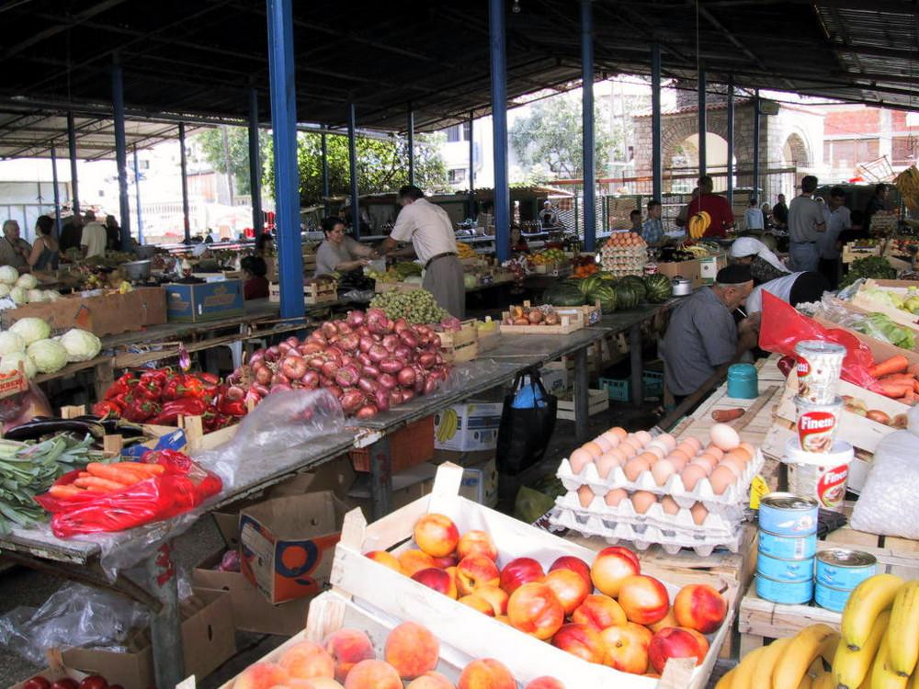

Slide 48
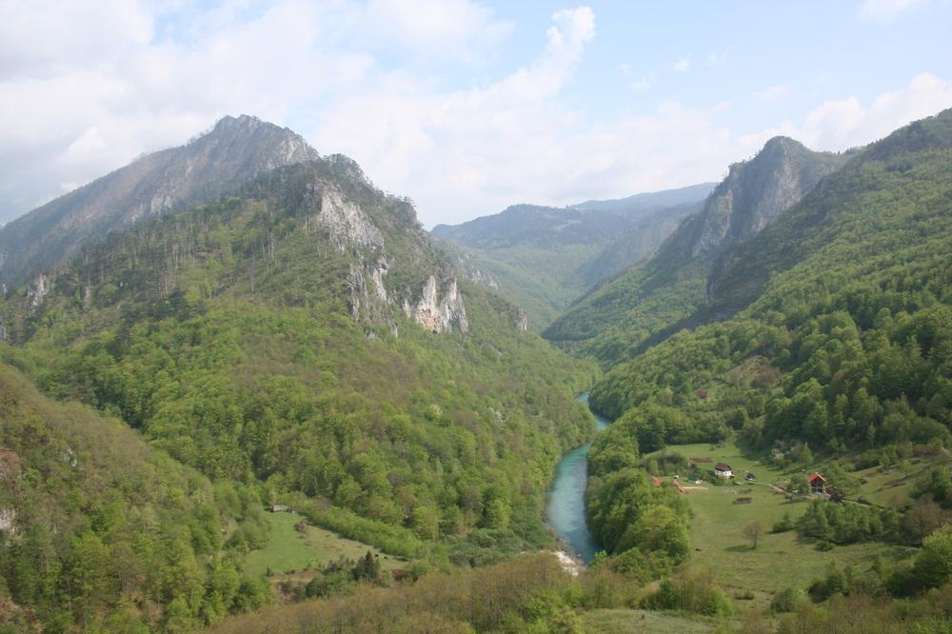
The canyons of Tara

Slide 49
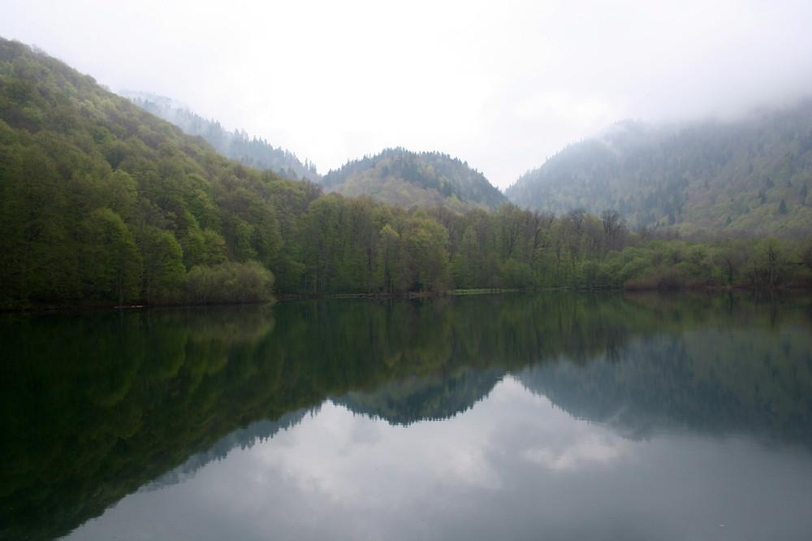
Lake Biograd

Slide 50
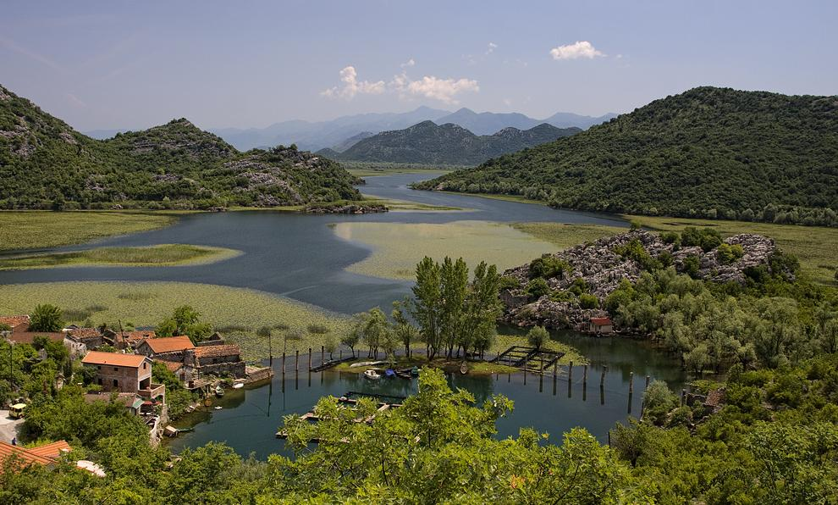
Karuc - Skadar Lake

Slide 51







¿Te ha gustado?
Puedes ver más entrando
Aquí
Además puedes recibir powerpoints en tu correo electrónico suscribiéndote aquí:

