Slide 1
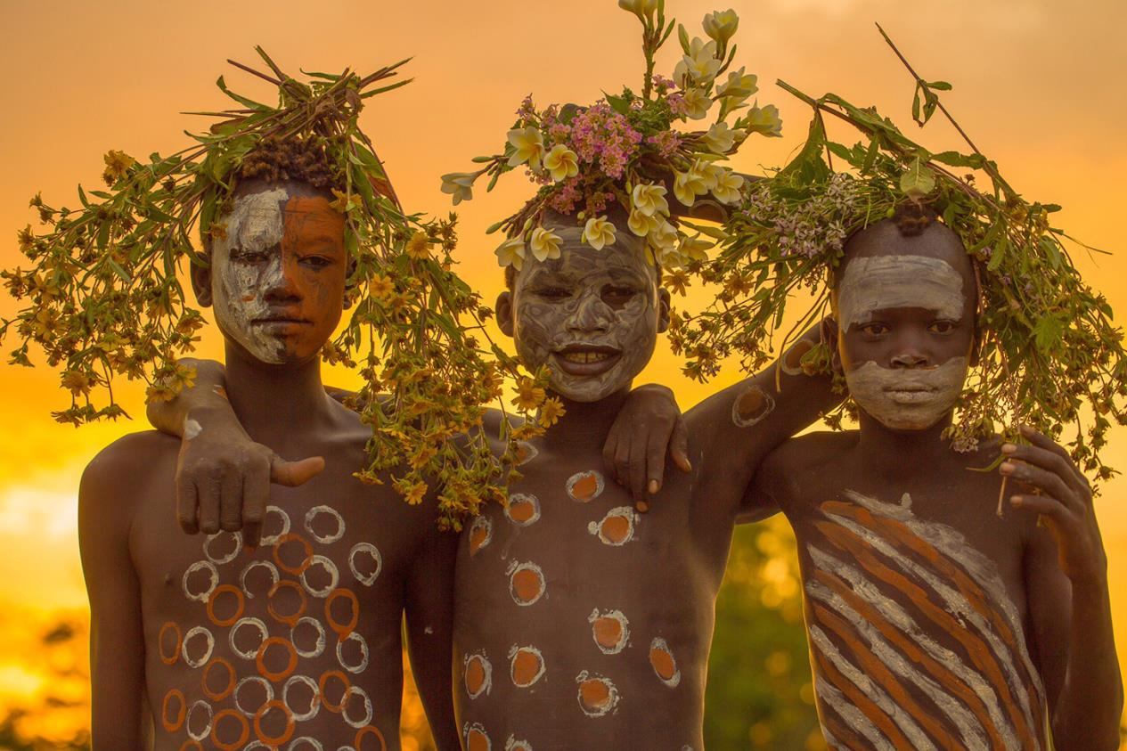

- Maravillas de África -.
Rise and shine in Omo Valley, Ethiopia ©Robin Yong

Slide 2
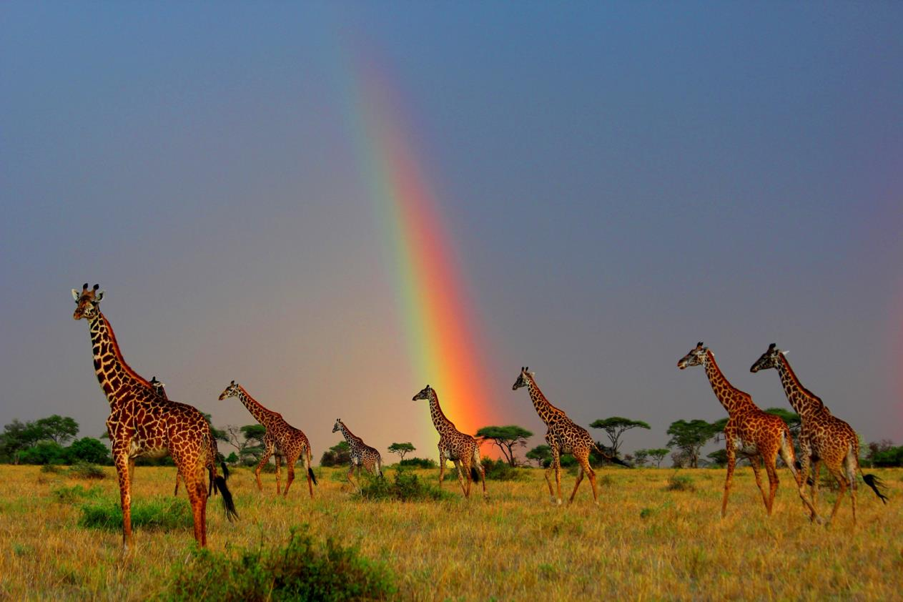
Mark Nicholson-giraffe pot of gold

Slide 3
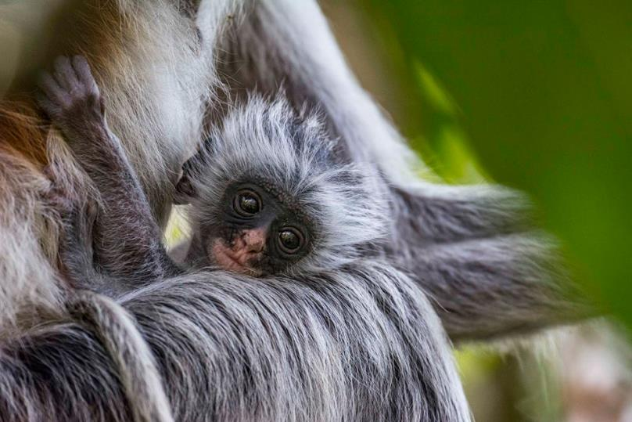
Felix Bartelke - the face of hope - Jozani Chwaka-Bay National Park, Tansania

Slide 4
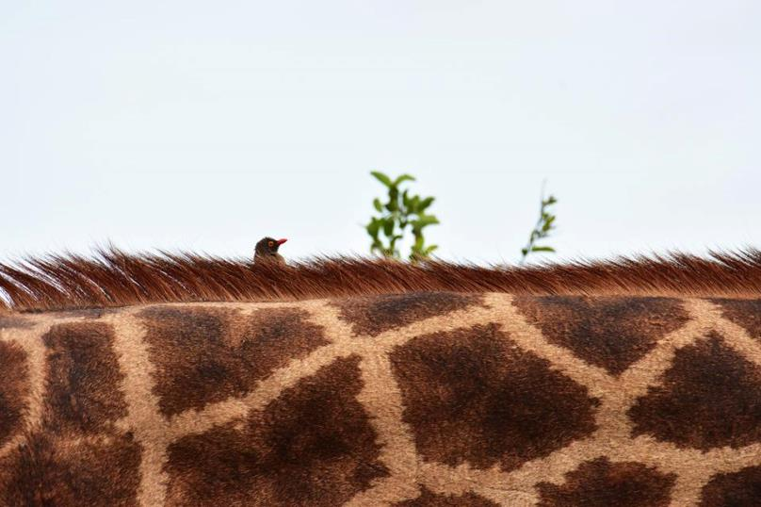
Luke Street - Forward!

Slide 5
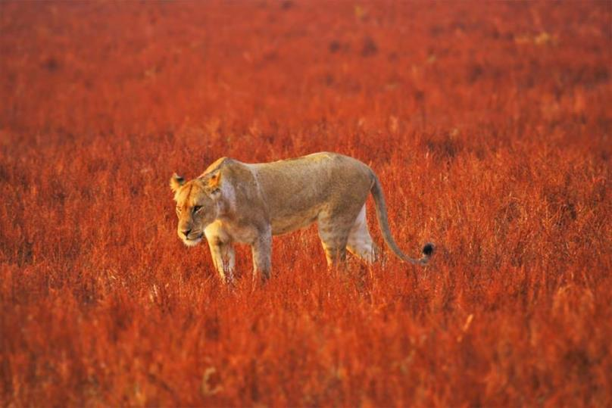
Storm Rothbarth - Lioness strolling through the fiery red grass - South Luangwa, Zambia

Slide 6
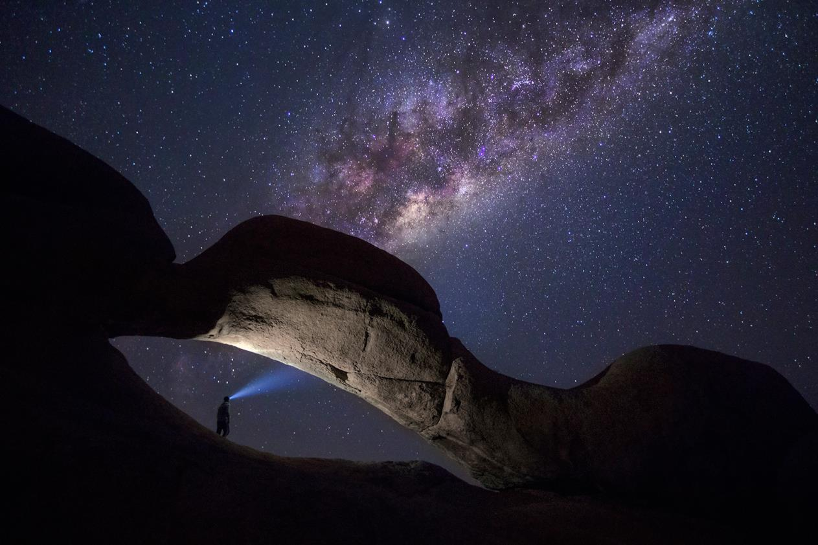
Shining a light on Spitzkoppe, Namibia ©Ben McRae

Slide 7
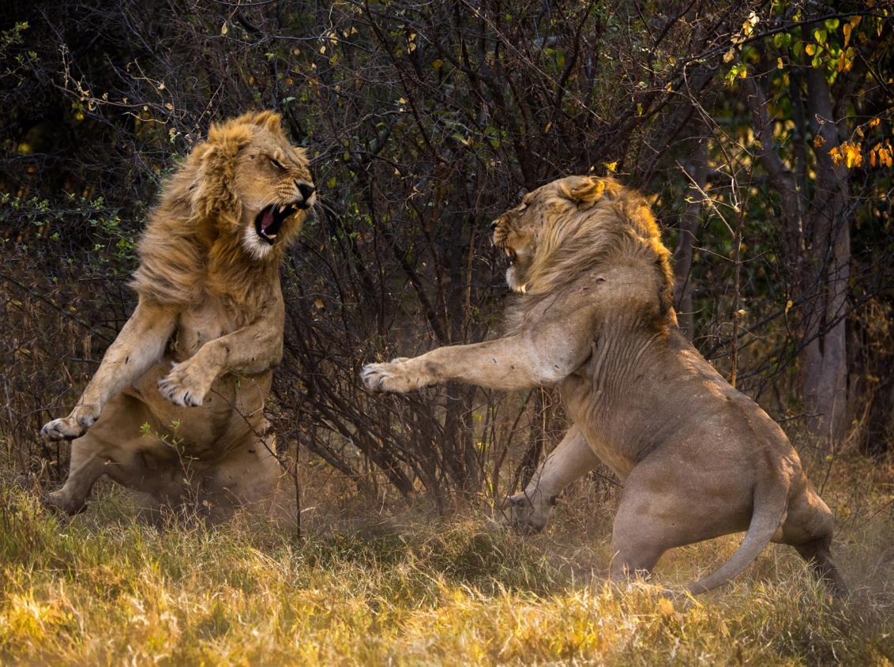
Confrontation on the plains of the Okavango Delta, Botswana ©Barry Cain

Slide 8
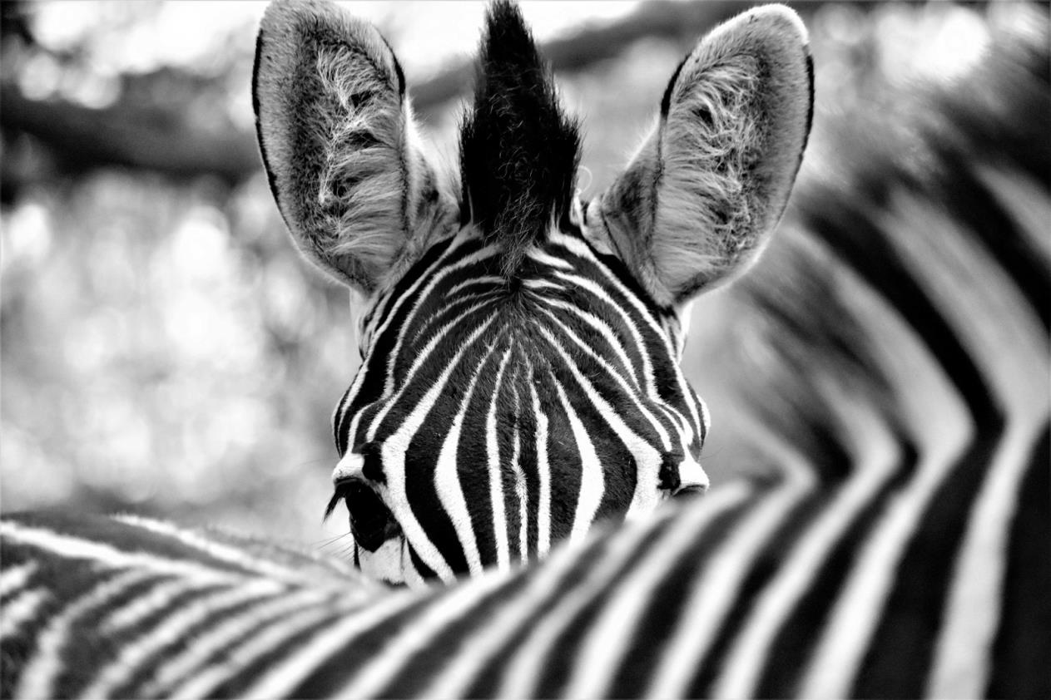
Curious zebra in Timbavati Game Reserve, South Africa ©Anne Van Dam

Slide 9
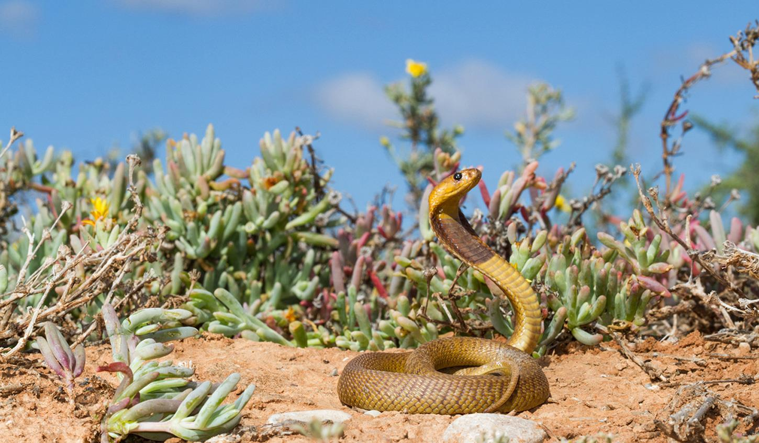
Young and deadly in Oudtshoorn, Klein Karoo, South Africa ©Tyrone Ping

Slide 10
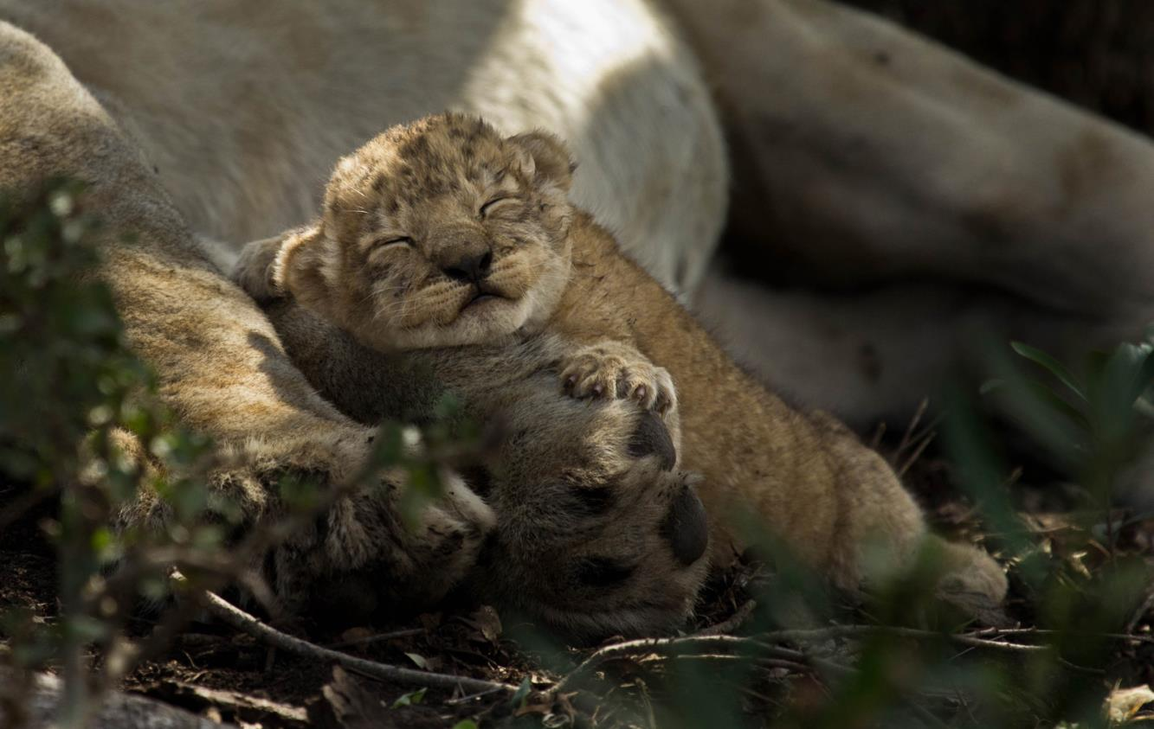
A cub finds solace in a pride member's arms ©Matthew James

Slide 11
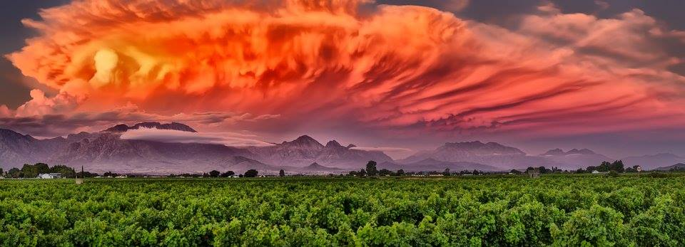
Neil Preyer - Hex River Valley, South Africa

Slide 12
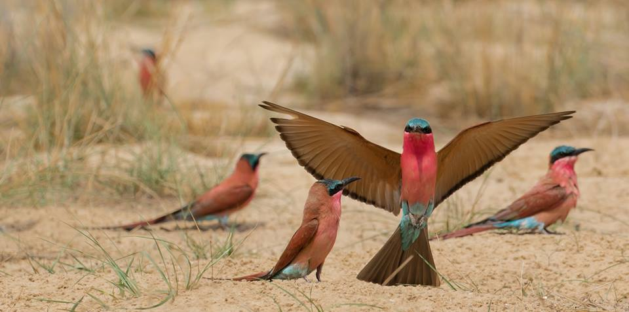
Carrie Pretorius -Showing off - southern Africa

Slide 13
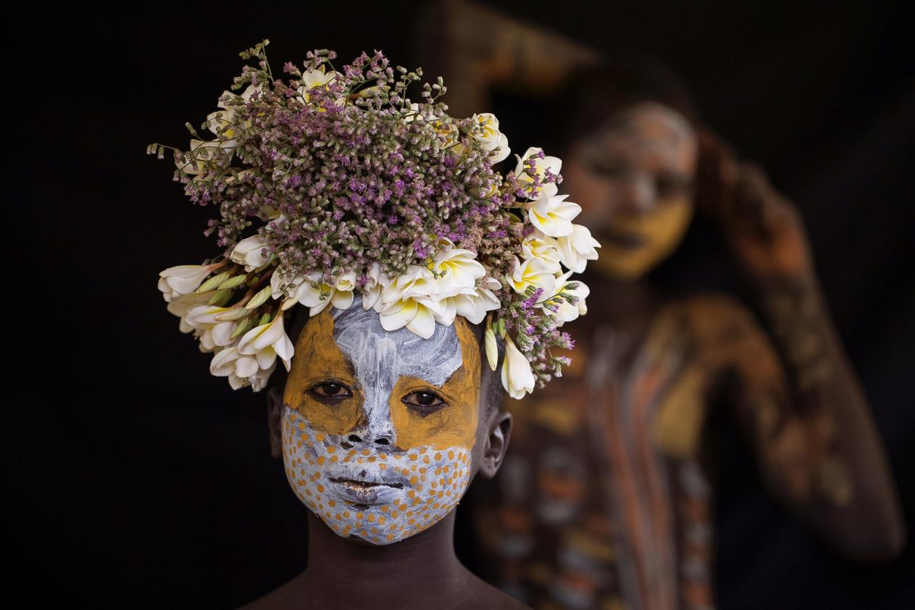
As beautiful as a bumble bee in Omo Valley, Ethiopia ©Robin Yong

Slide 14
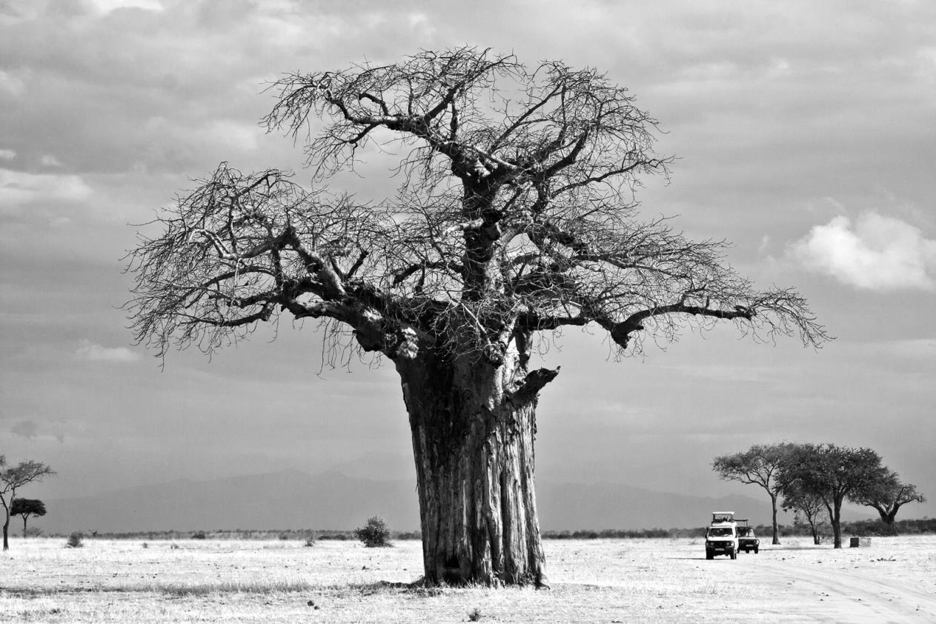
Baobab majesty in Tarangire National Park, Tanzania ©Cynthia Norman

Slide 15
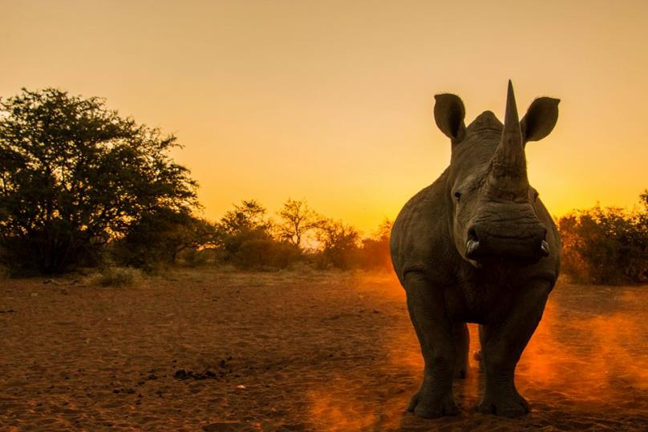
Rhinos - noble, mighty and majestic!
#WisdomWednesday

Slide 16
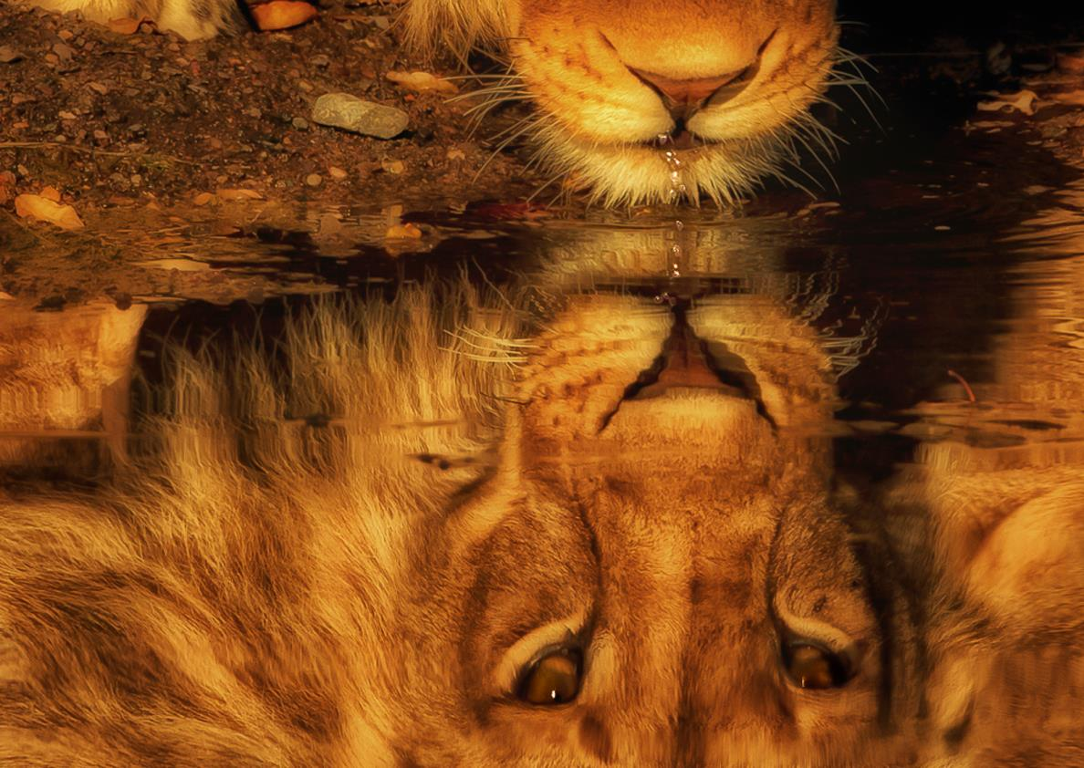
Golden lion in Botswana ©Carolyn Greathead

Slide 17
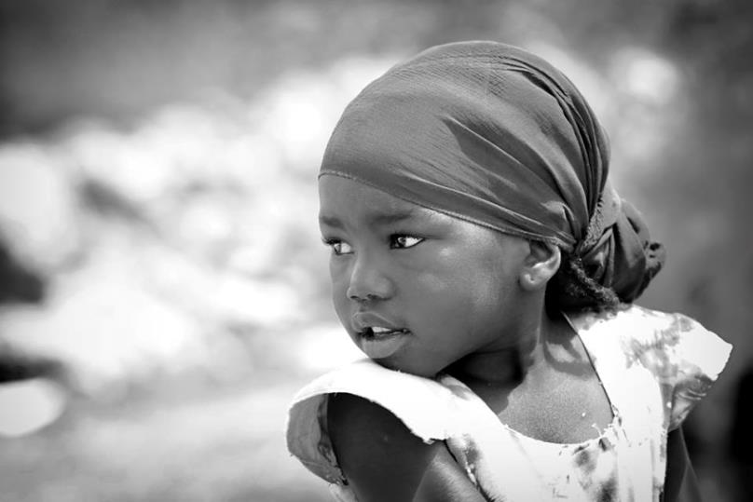
Paolo Maccarone - The great beauty, Zanzibar Tanzania

Slide 18
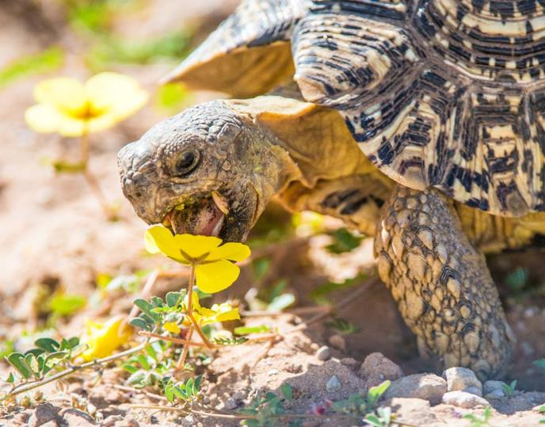
Denis Roschlau - Flower eating Tortoise, Kgalagadi TP, South Africa

Slide 19
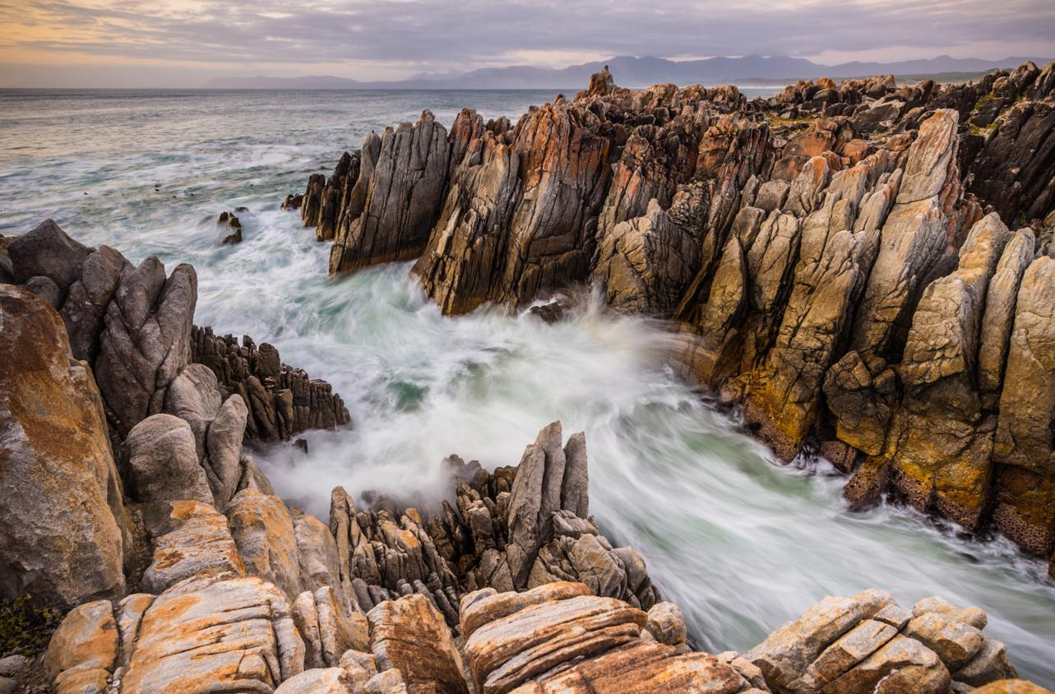
A rocky De Kelders Sunset in South Africa ©Denis Roschlau

Slide 20
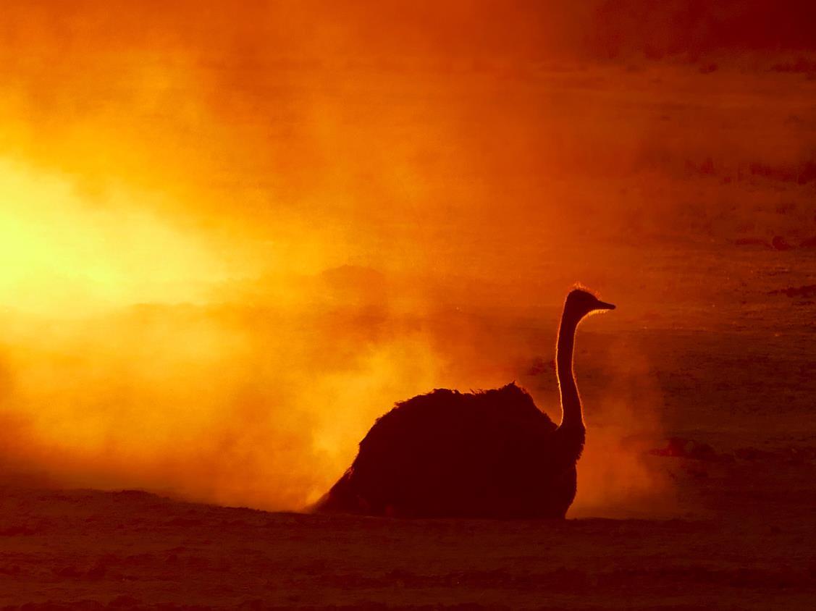
Ostrich dust-bathing in fading light ©Gerald Raath

Slide 21
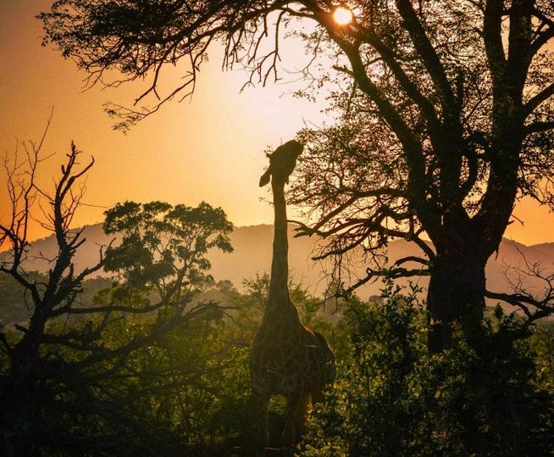
Sean Ferguson -Giraffe silhouette as another day begins in the Kruger

Slide 22
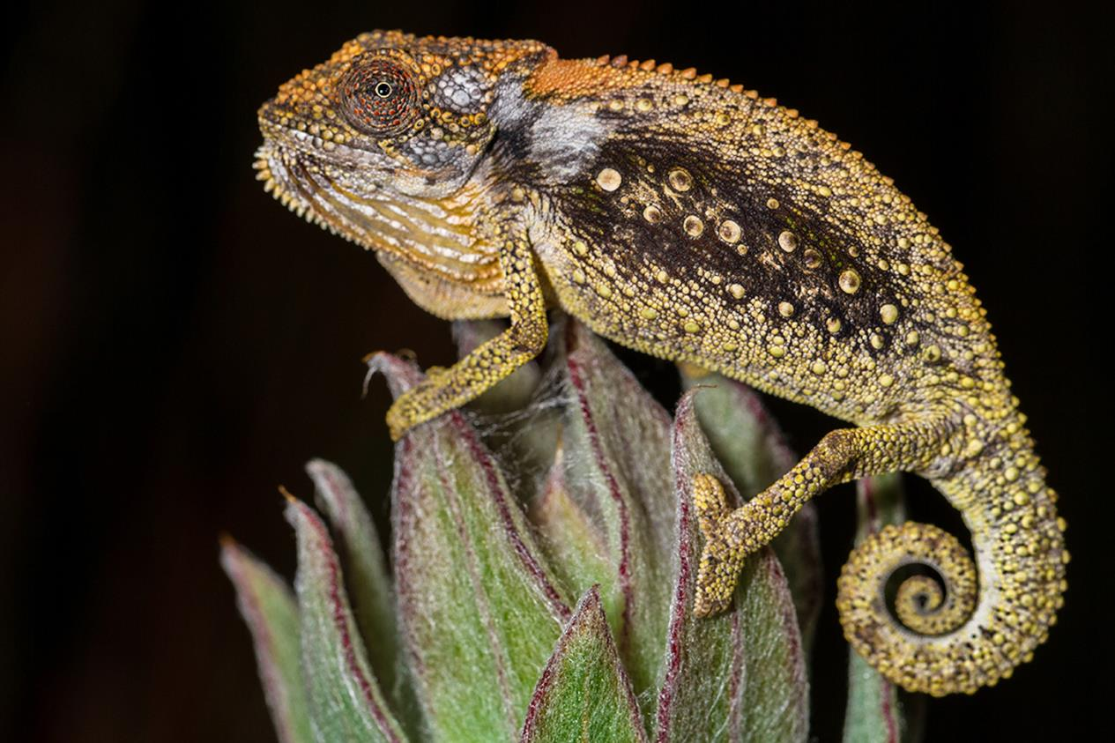
Unimpressed in the Swartberg Mountains, Western Cape, South Africa ©Tyrone Ping

Slide 23
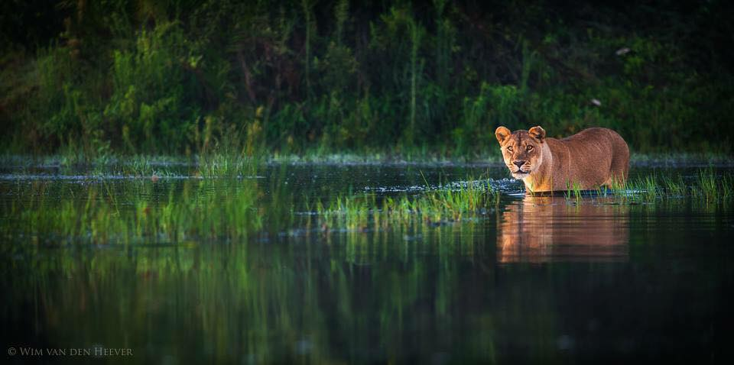

Slide 24
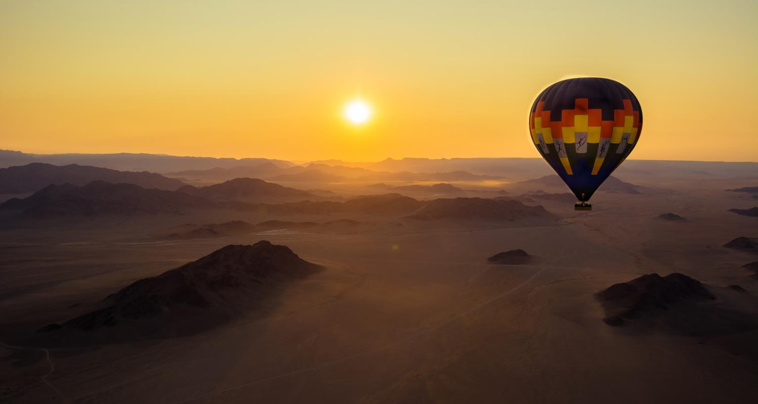
Sunrise over the NamibRand Nature Reserve, Namibia ©Tom Stables

Slide 25
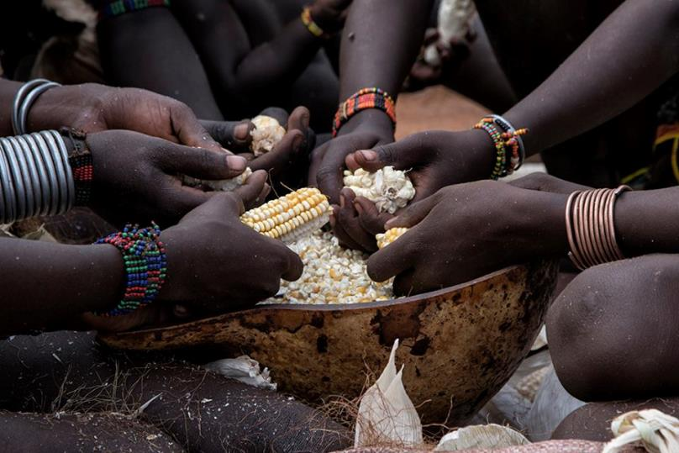

Slide 26
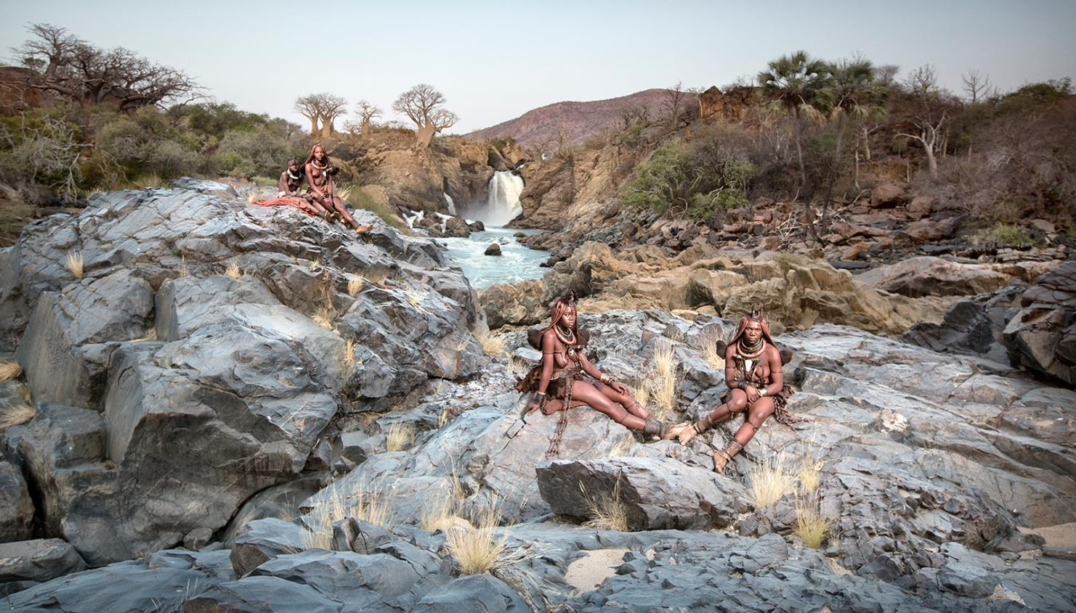
Himba women at Epupa Falls, northern Namibia ©Ben McRae

Slide 27
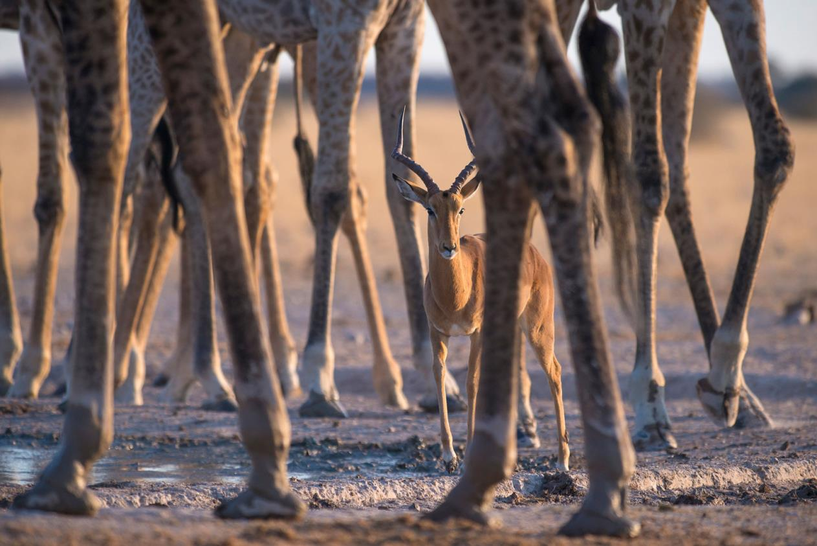
A forest of legs in Nxai Pan National Park, Botswana ©Andrew Schoeman

Slide 28
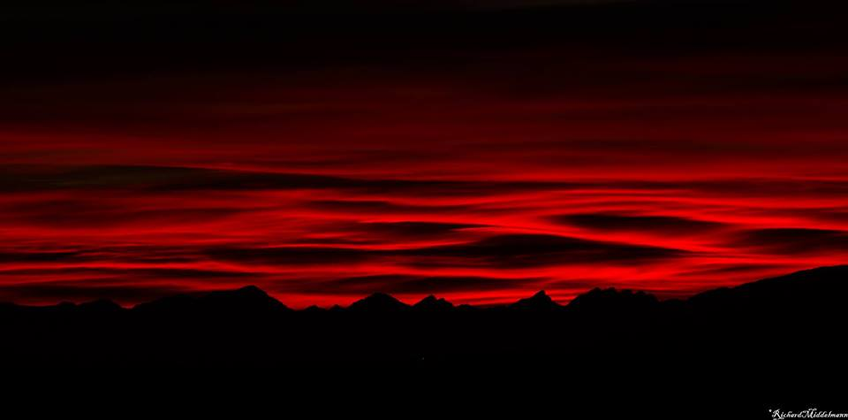
Surreal sunrise in the Botriver valley, Honingklip, South Africa. Image by Richard Middelmann

Slide 29
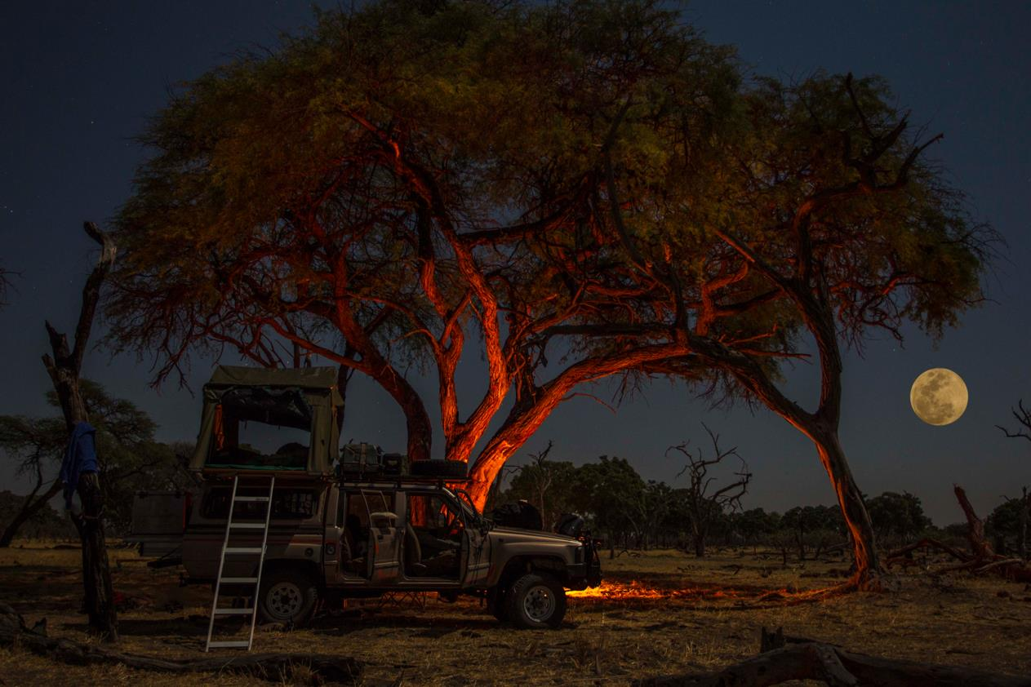
Khwai camping in Khwai River, Botswana ©Neil Preyer

Slide 30
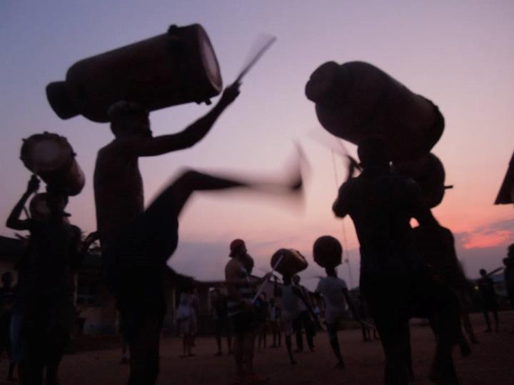
Maria de Lourdes Haddad - music-of-africa, Burundi

Slide 31
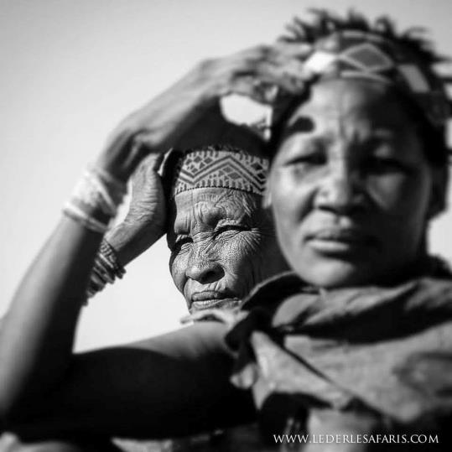
Two San ladies by Lederle Safaris

Slide 32
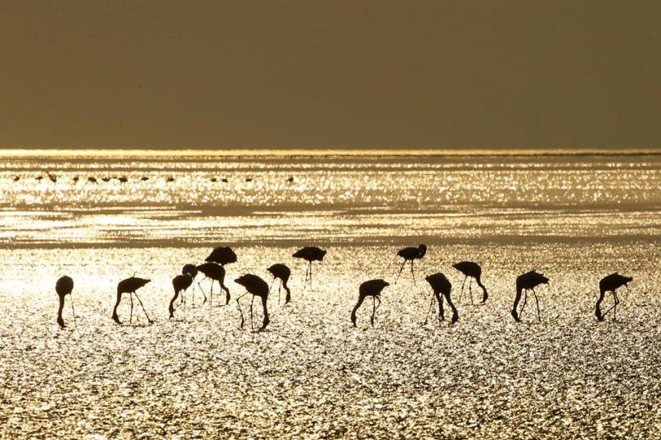
Gregory M. Peterson - Birds of gold - Lake Natron – Tanzania

Slide 33
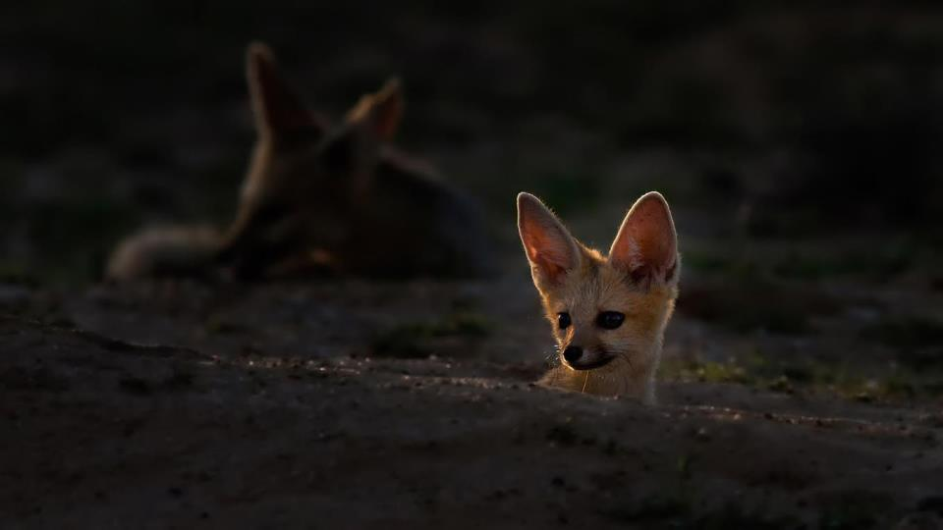
A Cape fox in the Kgalagadi Transfrontier Park, South Africa ©Johan J Botha

Slide 34
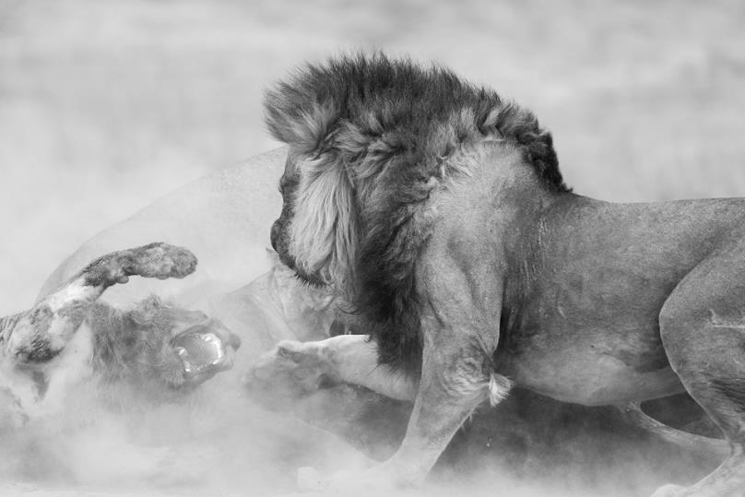
Setting things straight the lion way in Kgalagadi Transfrontier Park ©Johan Mocke

Slide 35
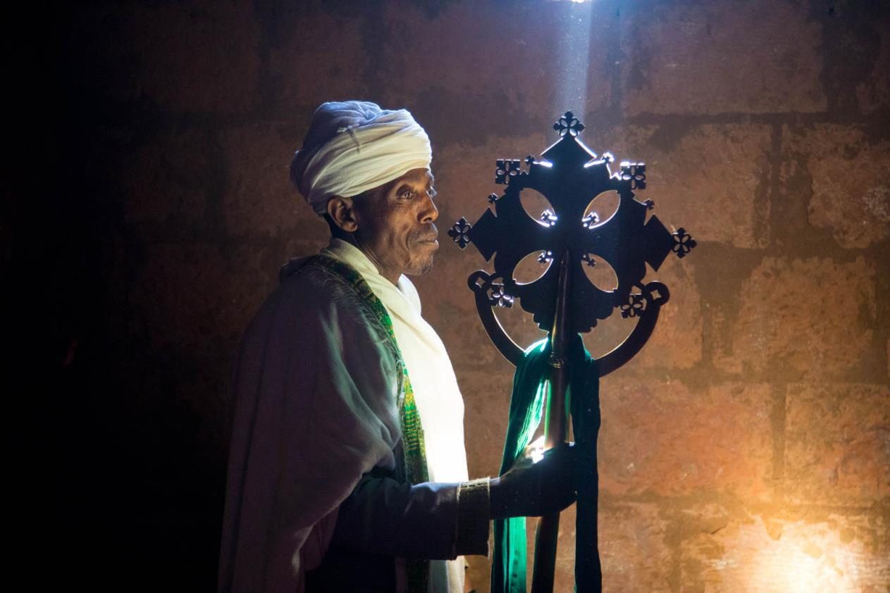
Father Abebe Sisay reading his bible in Lalibela, Ethiopia ©Inger Vandyke

Slide 36
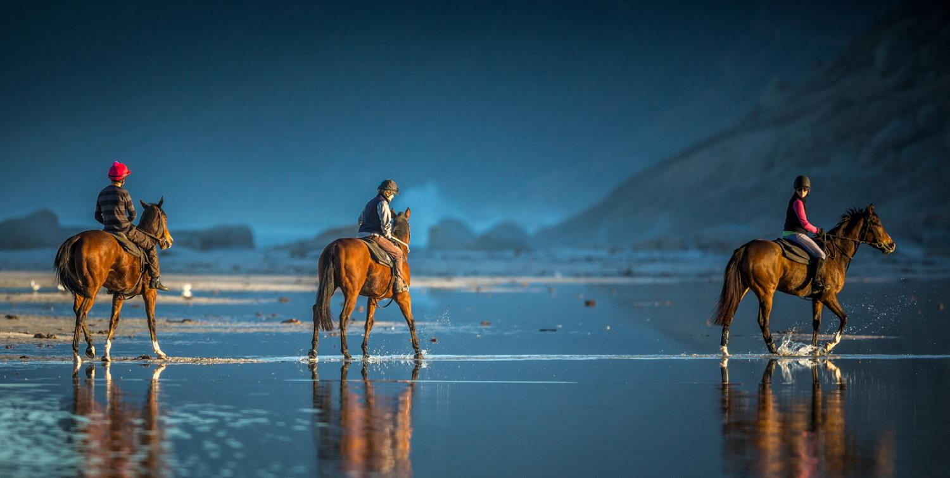
At the hoek in Noordhoek beach, Cape Town, South Africa ©Neil Preyer

Slide 37
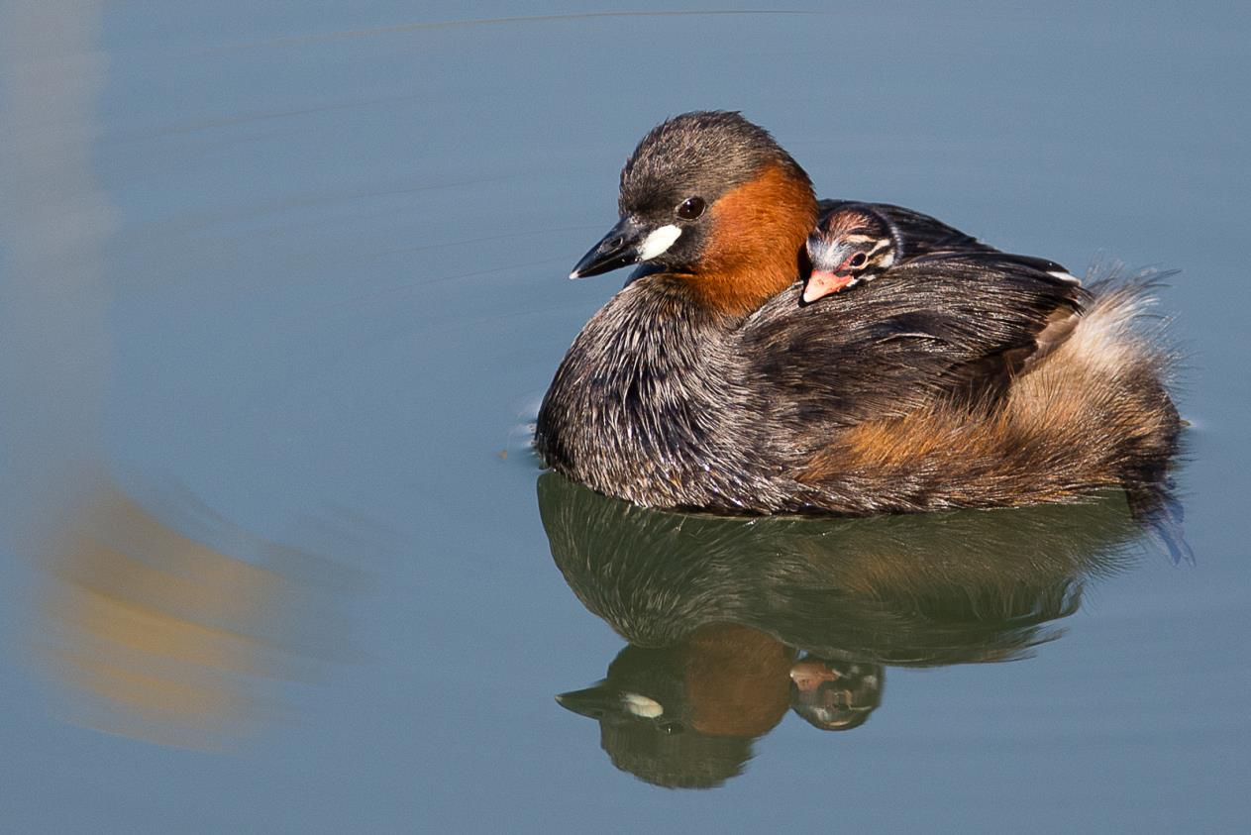
"Safe with mommy" in the Pilanesberg, South Africa ©Jan Roos

Slide 38
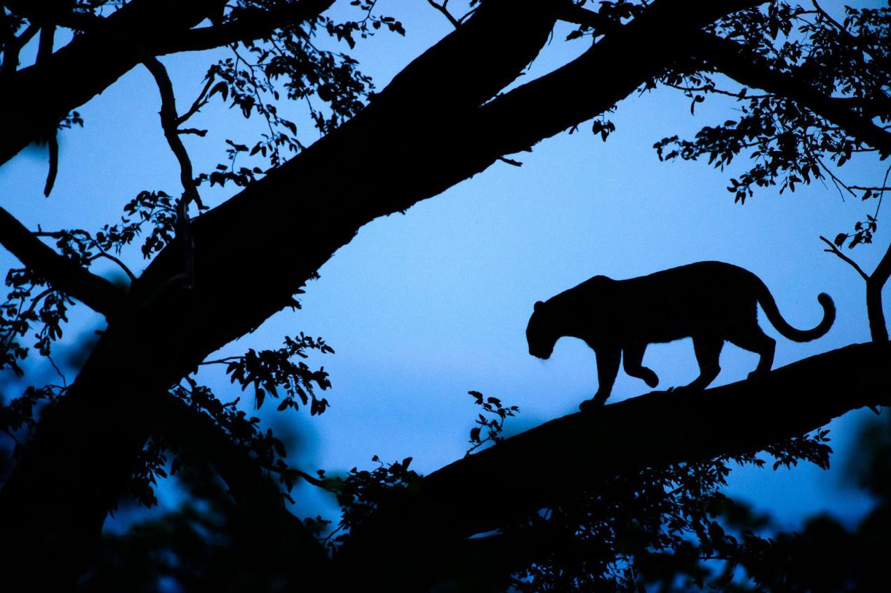
Female leopard in blue light in the Okavango Delta, Botswana ©Chris Schmid

Slide 39
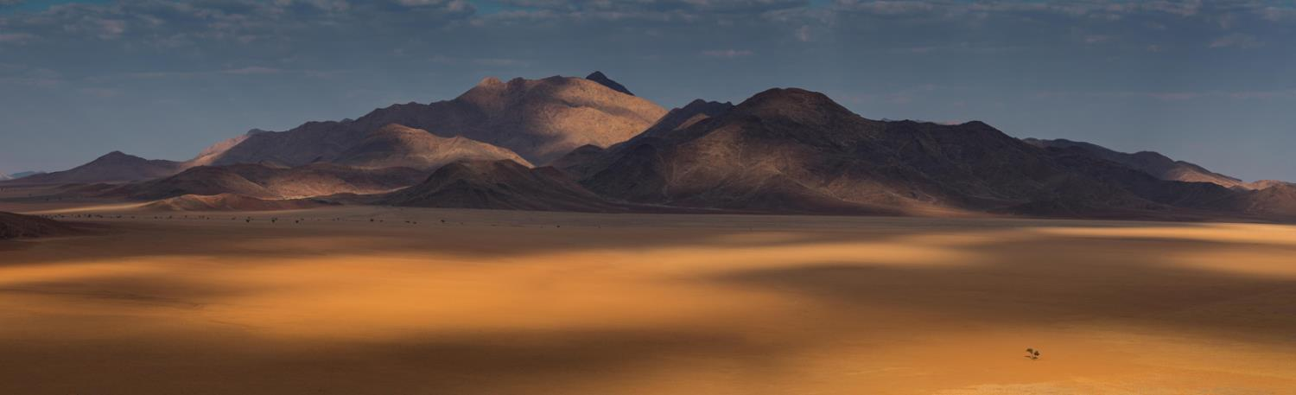
The lonely tree in Namibia ©Jashika Patel

Slide 40
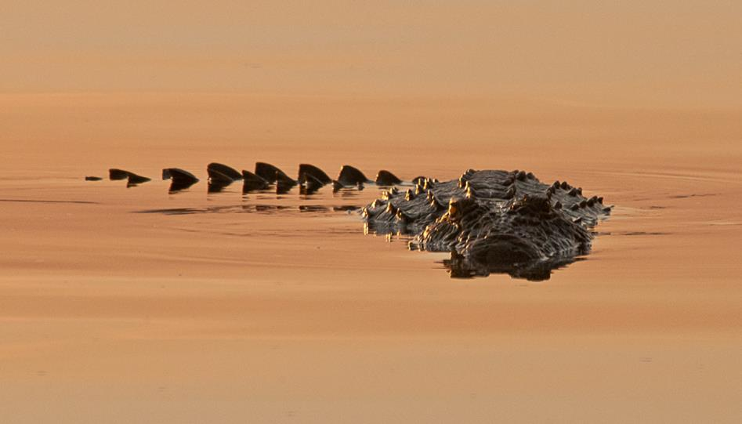
Ronald Glazier - Zambezi crocodile- Zambezi river at sunset, Zambia

Slide 41
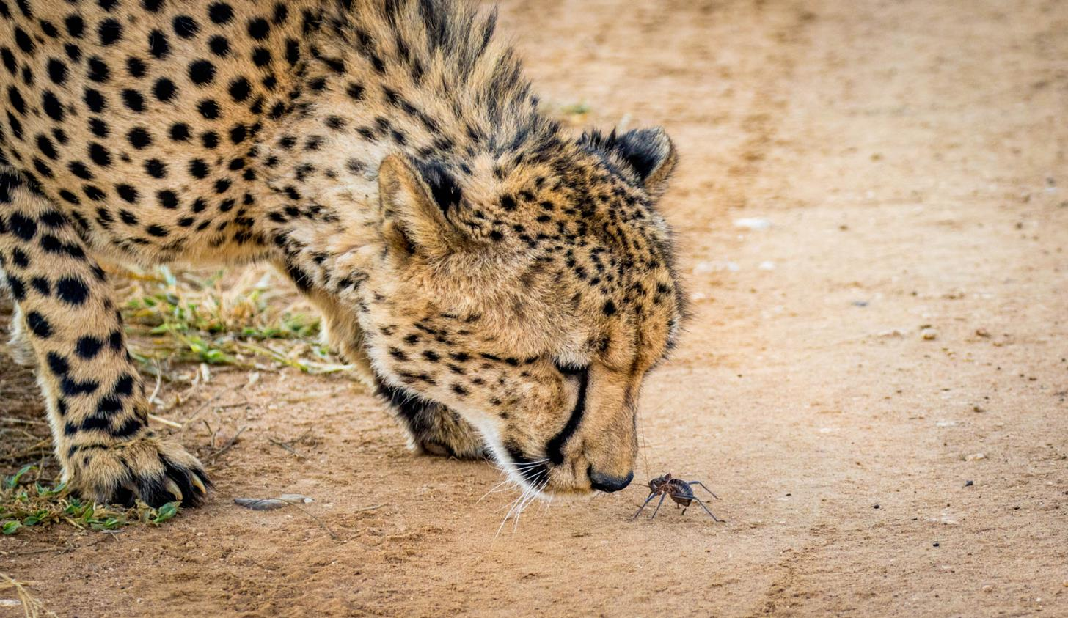
A David and Goliath moment between a male cheetah and an armoured cricket in Madikwe Game Reserve, South Africa ©Samuel Cox

Slide 42
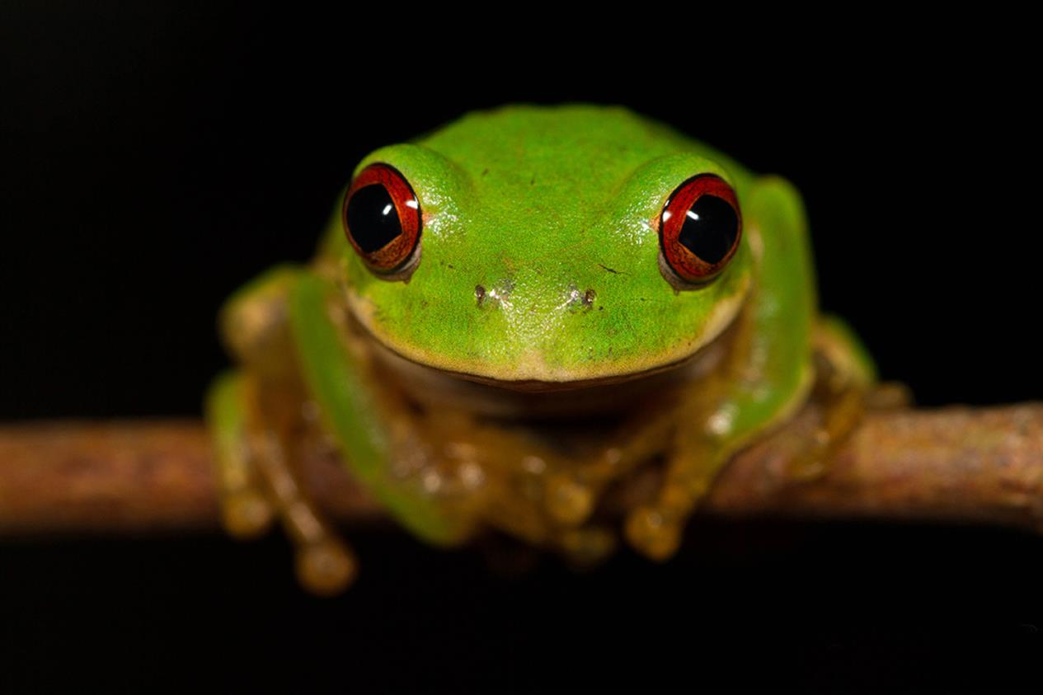
A young Natal forest tree frog in iSimangaliso Wetland Park, KwaZulu-Natal, South Africa ©Tyrone Ping

Slide 43
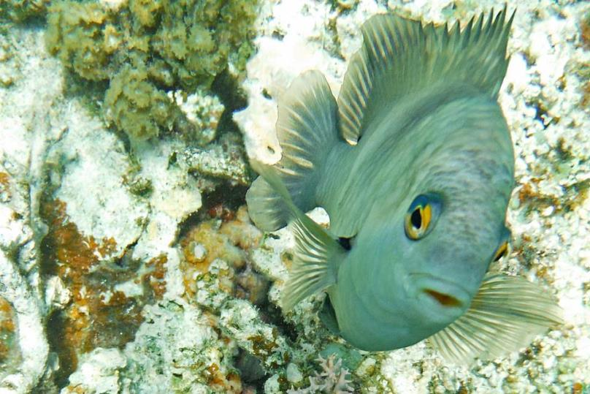
A curious fish just popping in to see what your plans are for the weekend and to wish you a happy friday!

Slide 44
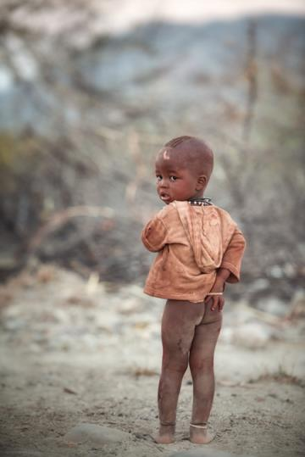
The innocence of a child in Namibia ©Cohan Zarnoch

Slide 45
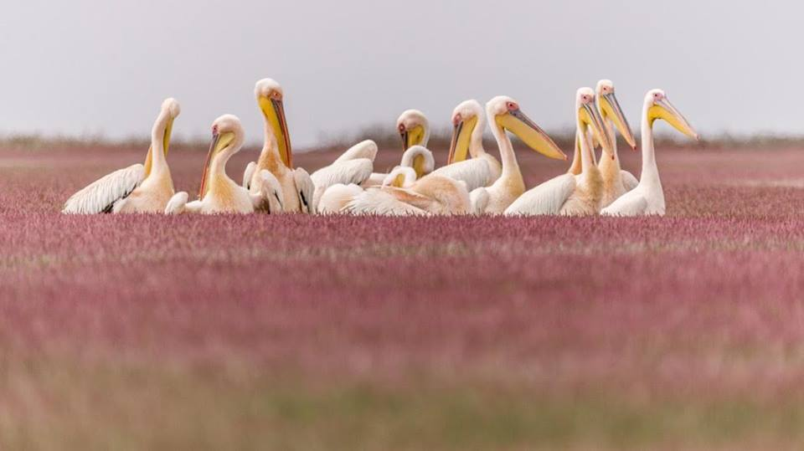
Anna-Mart Kruger - Pelican group, Walvis Bay, Namibia

Slide 46
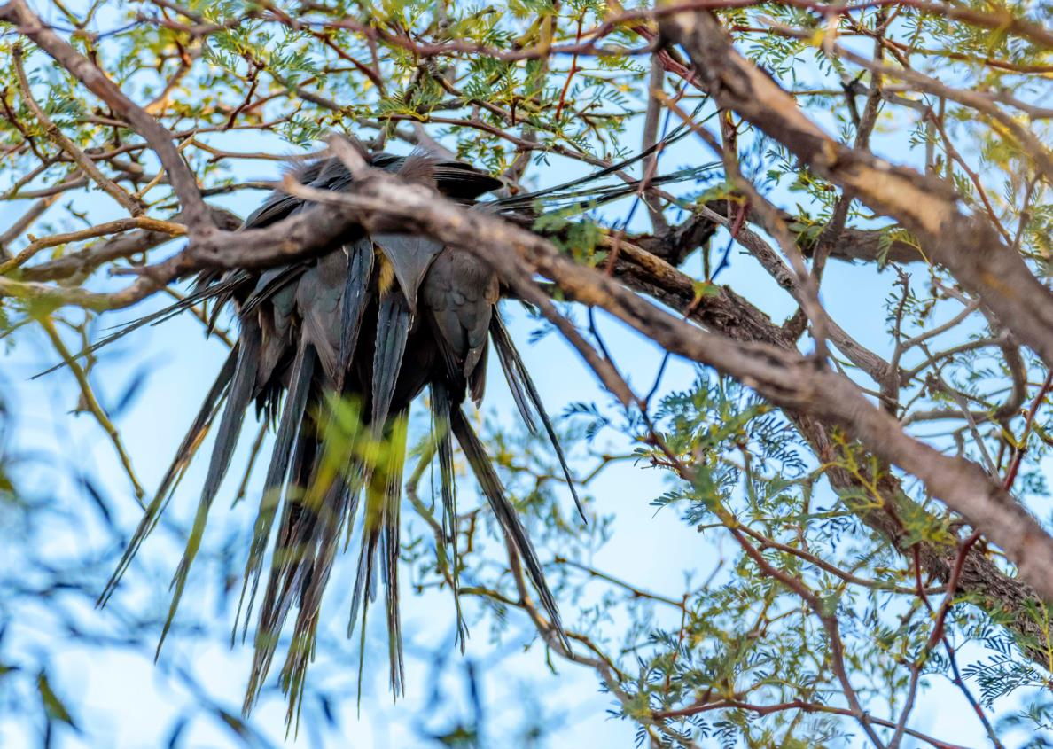
Mousebirds desperately tring to keep warm in Namibia ©Memory Coetzee

Slide 47
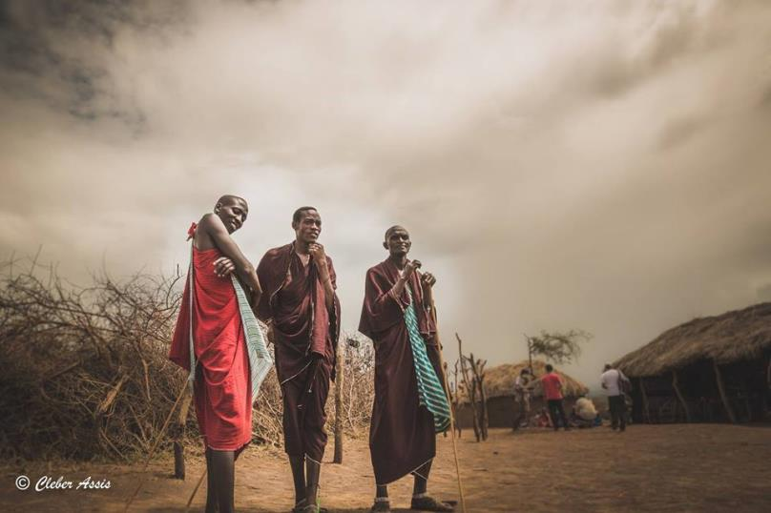
The Massai located in Kenya and Northern Tanzania

Slide 48
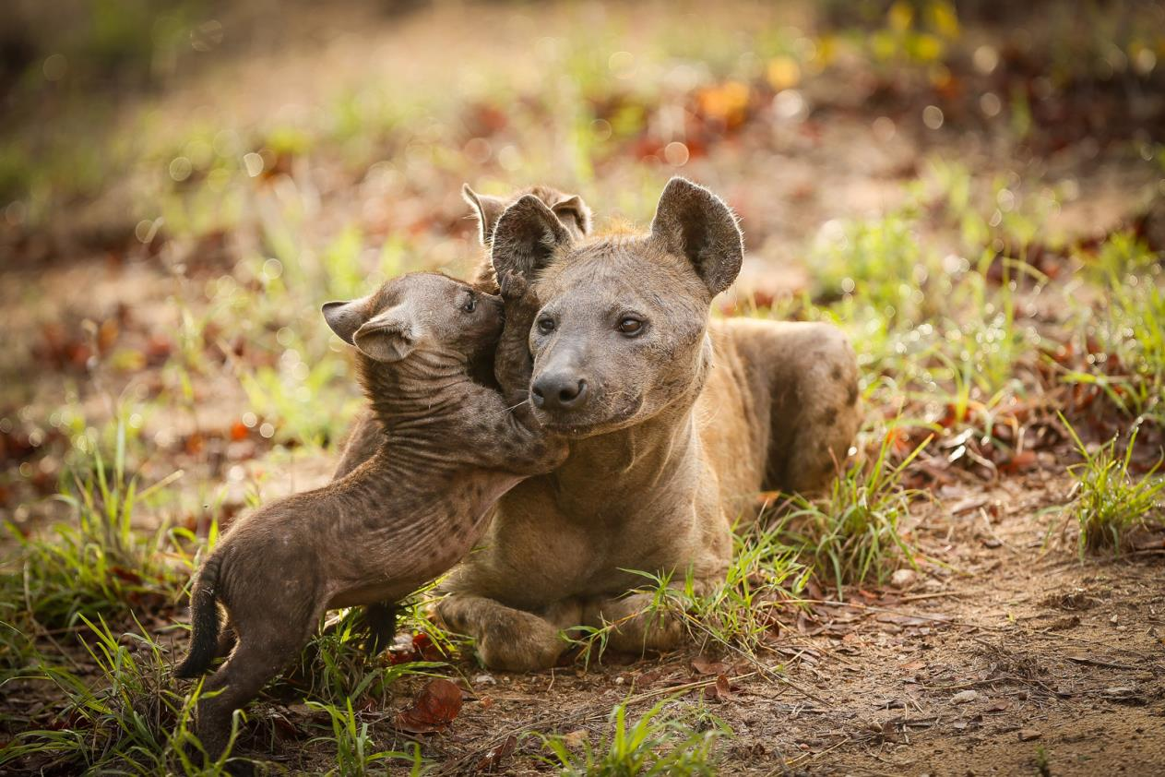
"Can I tell you a secret?" in Kruger National Park, South Africa ©Ricci Goldstein

Slide 49
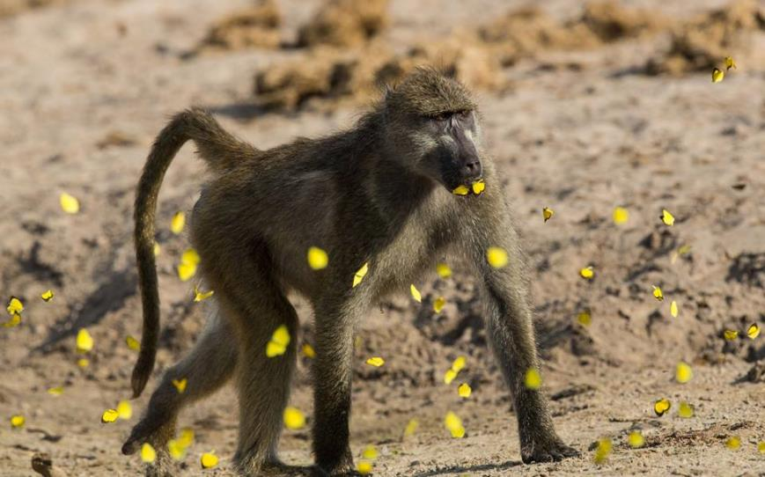
Stephan Swanepoel - butterfly-kisses - Chobe Nation Park, Botswana

Slide 50
31-ENERO-2017
END

Slide 51







¿Te ha gustado?
Puedes ver más entrando
Aquí
Además puedes recibir powerpoints en tu correo electrónico suscribiéndote aquí:

