Slide 1
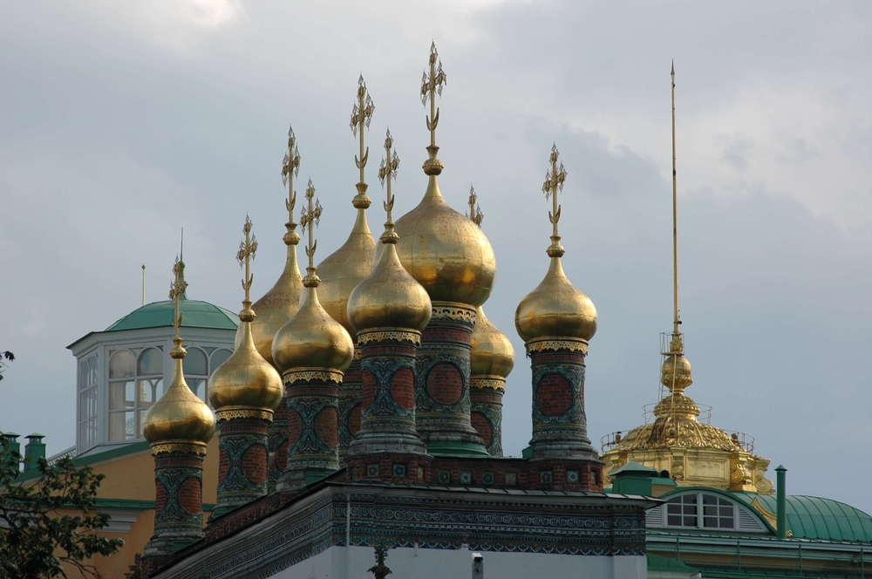
FASCINANTE…
Madre Rusia

Slide 2


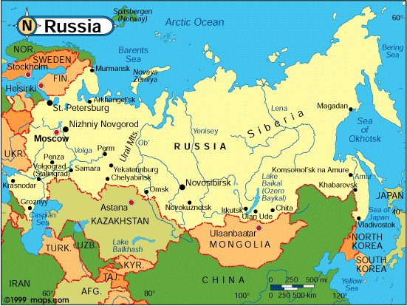
Region: Eastern Europe
Area total: 6,592,800 km2
Coast line: Sea of Okhotsk, Bering Sea, Barents Sea
Capital: Moscow

Slide 3
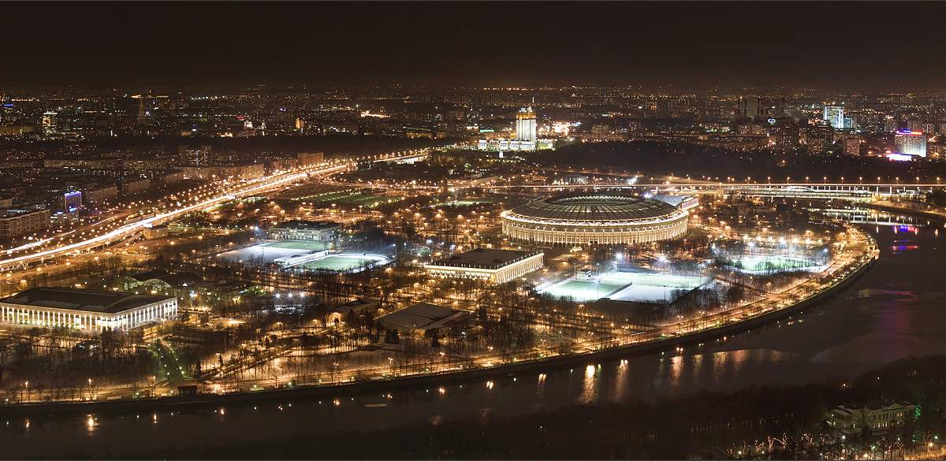


Slide 4
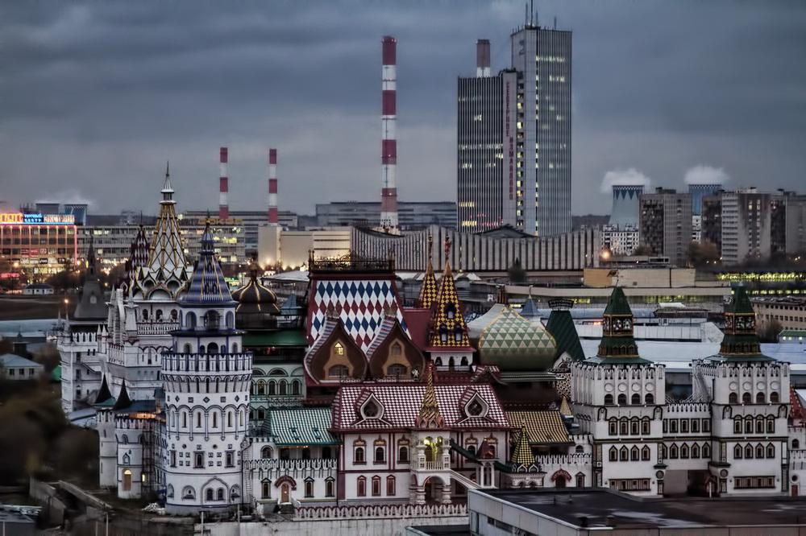

Slide 5
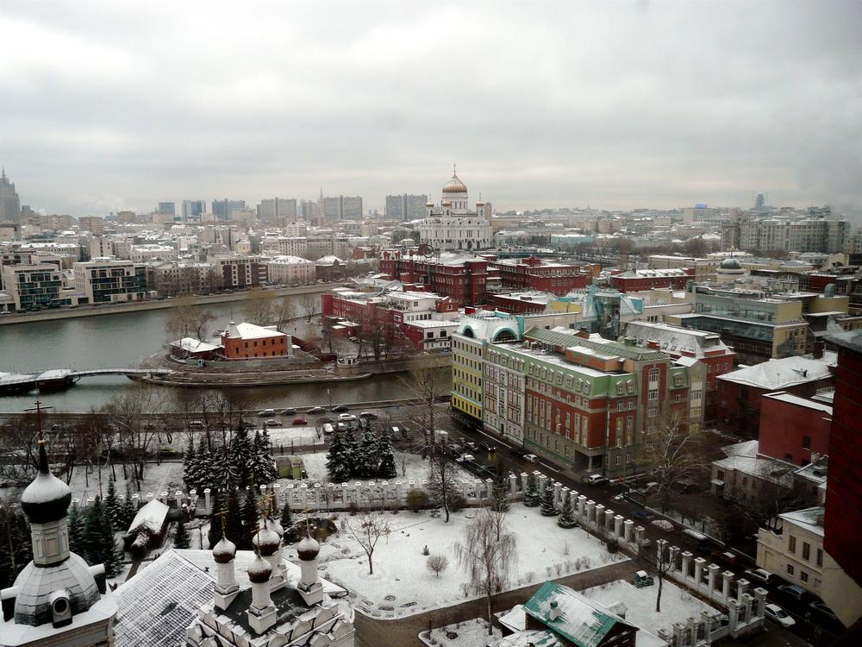

Slide 6
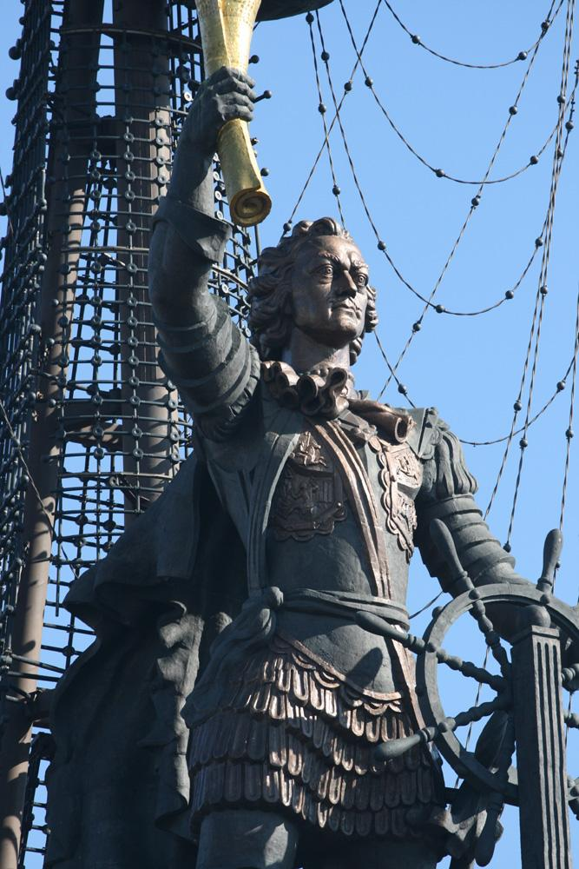
PETER
THE GREAT

Slide 7
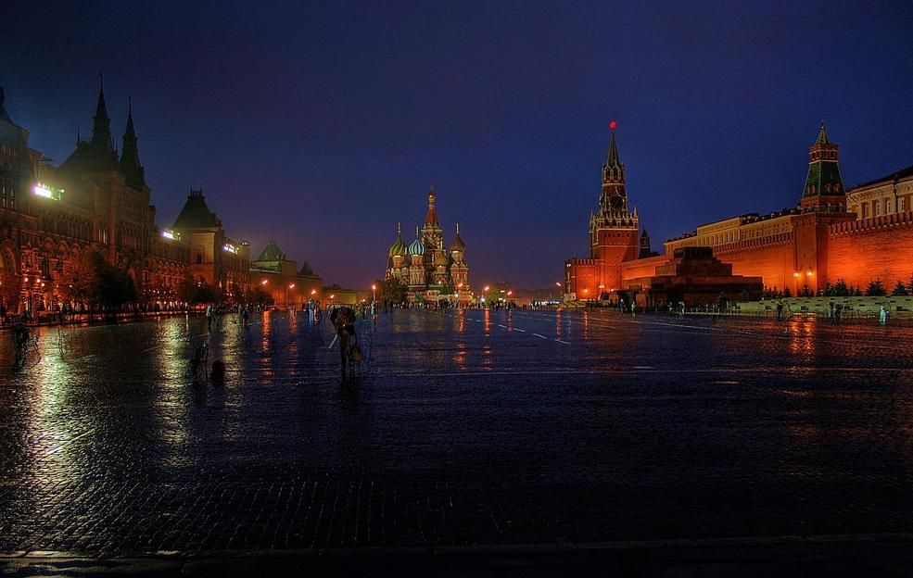
RED SQUARE

Slide 8
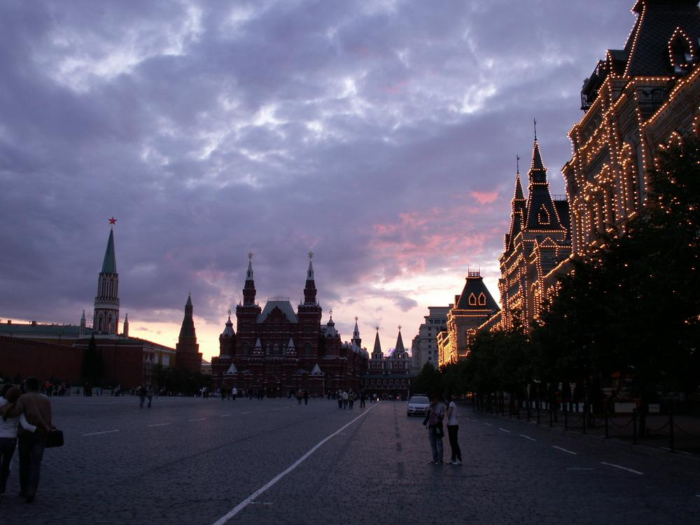
RED SQUARE

Slide 9
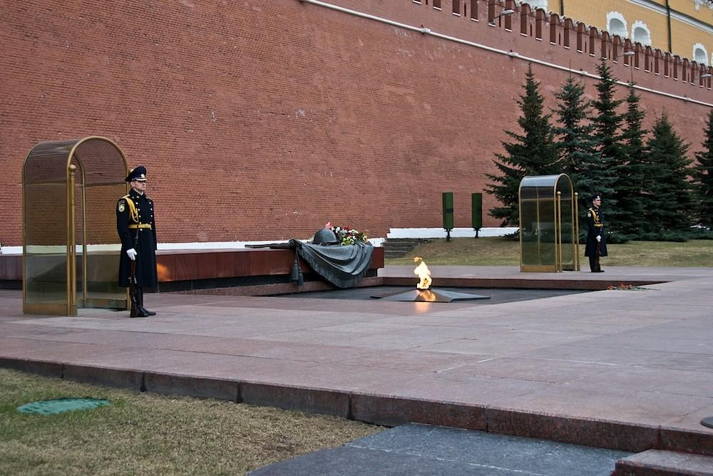
MONUMENT OF UNKNOWN SOLDIER

Slide 10
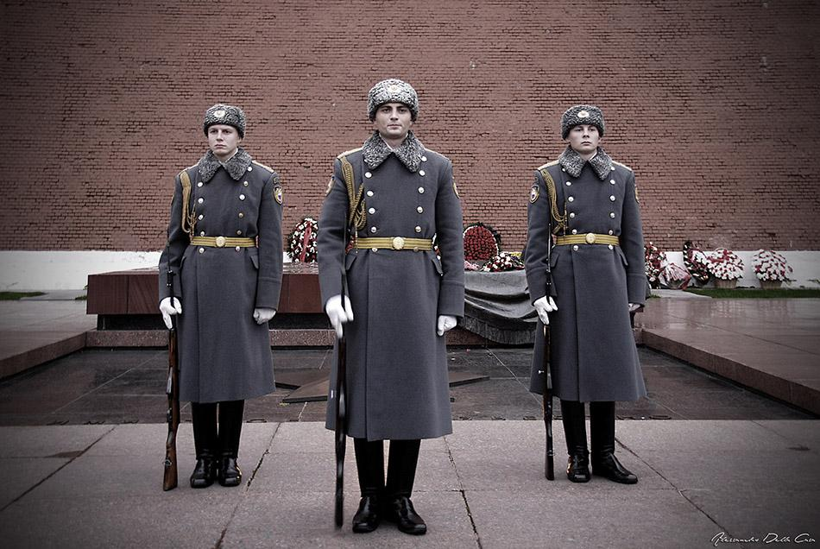
GUARDS

Slide 11
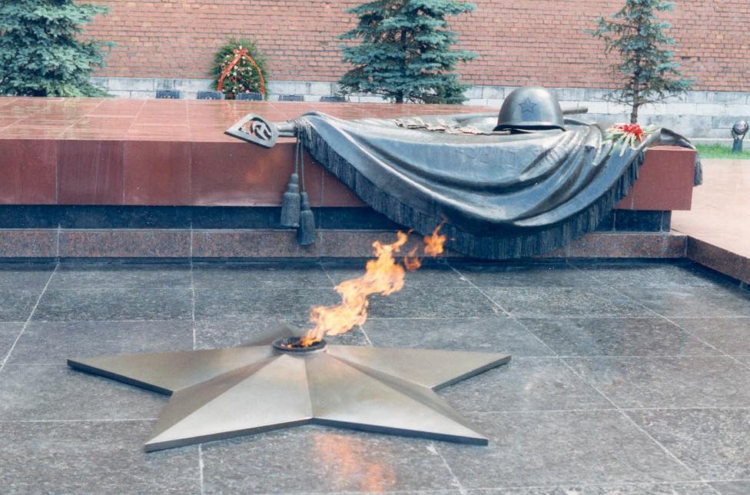
ETERNAL FLAME

Slide 12
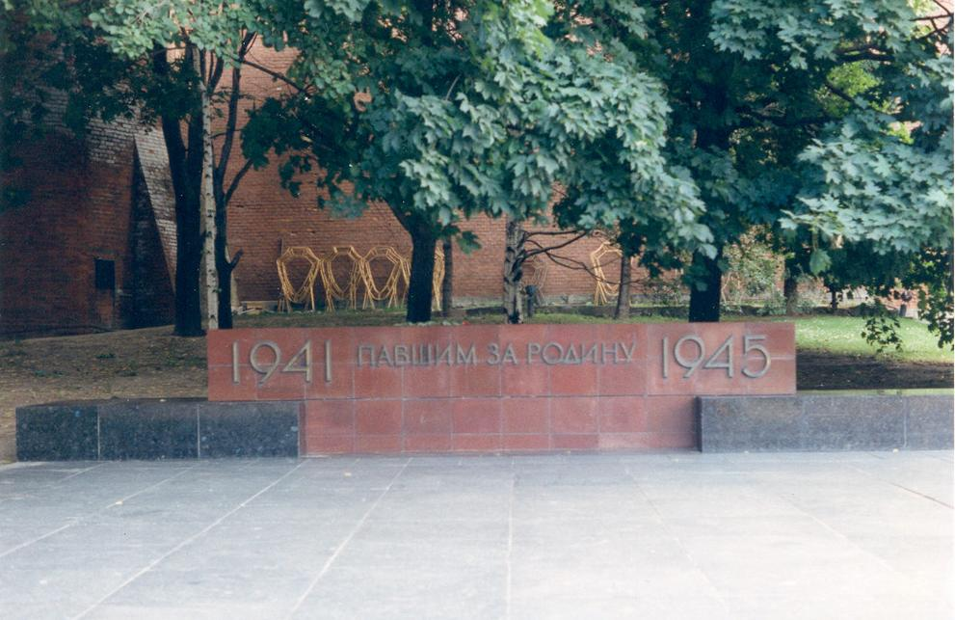
MEMOIRES OF THE PATRIOTS

Slide 13
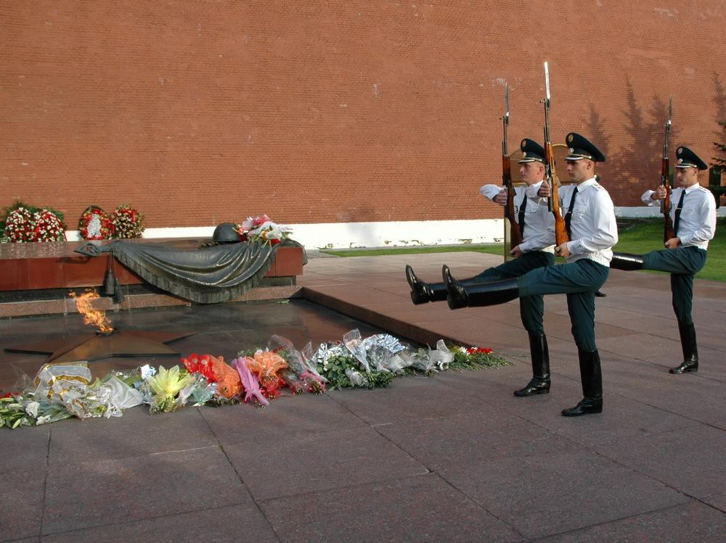
CHANGING OF THE GUARD

Slide 14
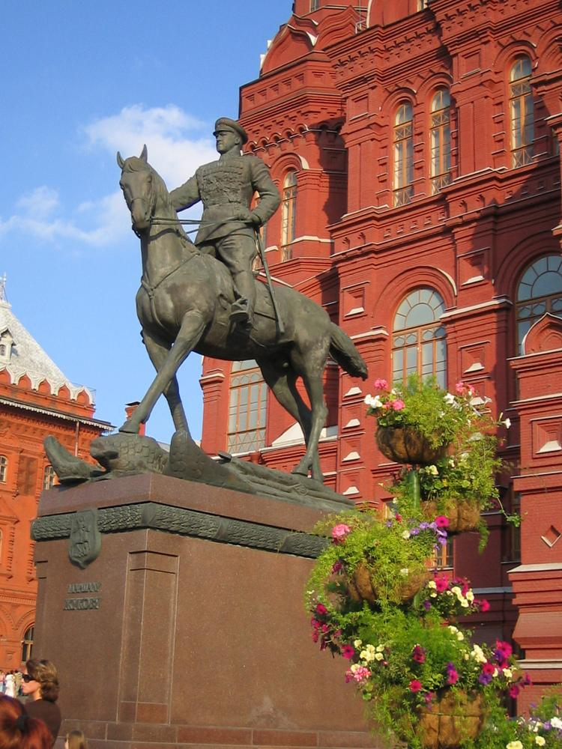
GENERAL SZUKOV

Slide 15
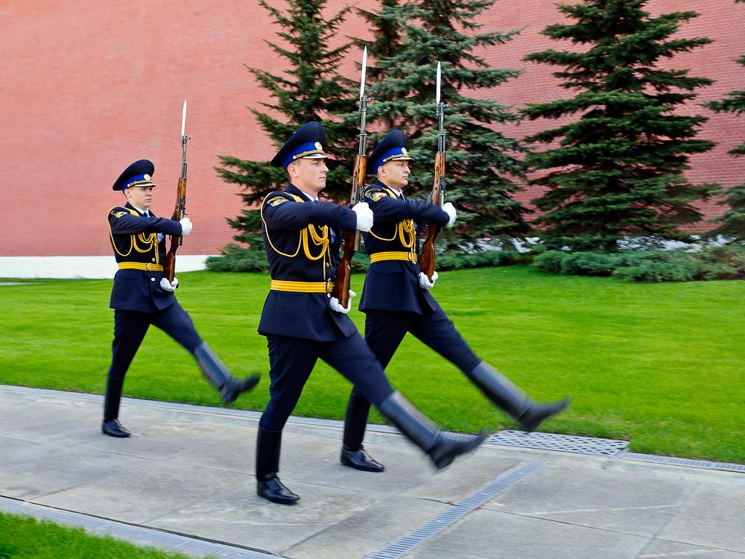
HONOUR GUARD

Slide 16
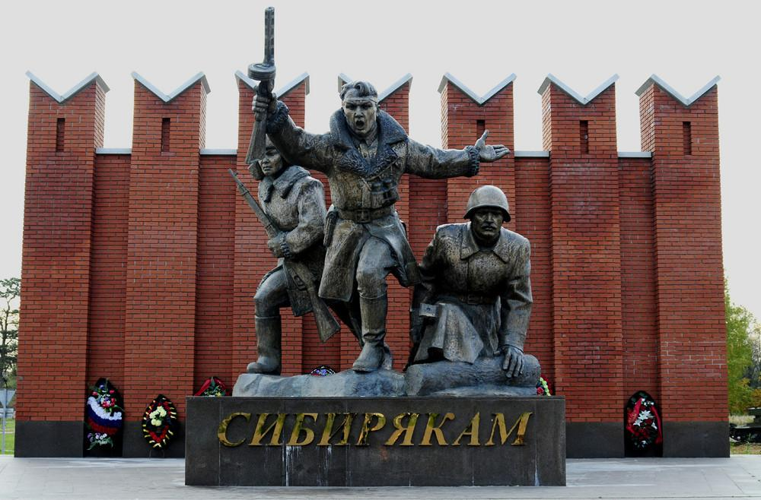
MONUMENT OF THE HERO

Slide 17
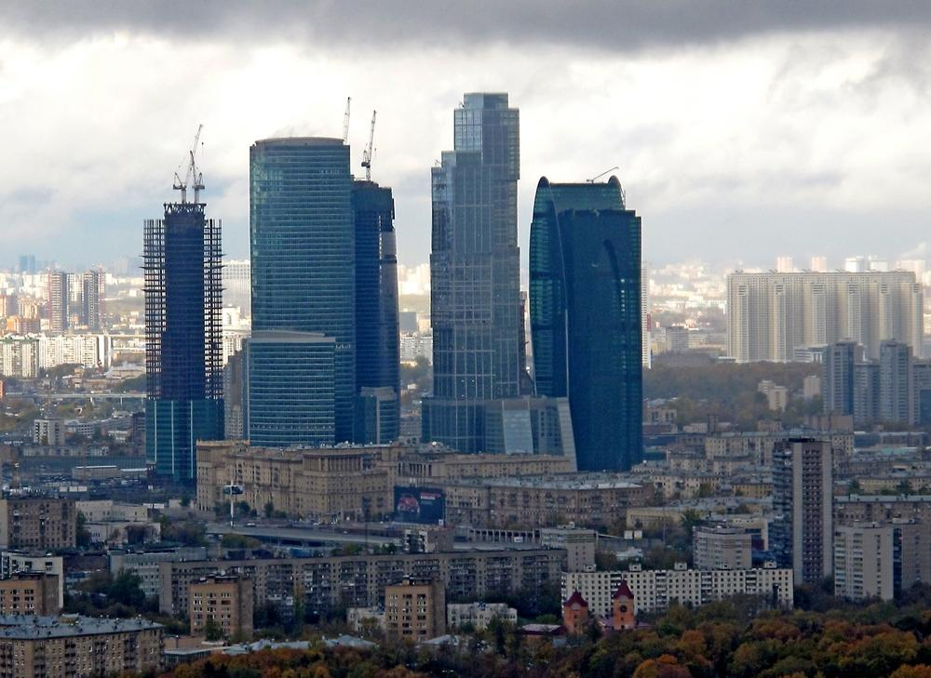
THE NEW FINANCIAL CENTER

Slide 18
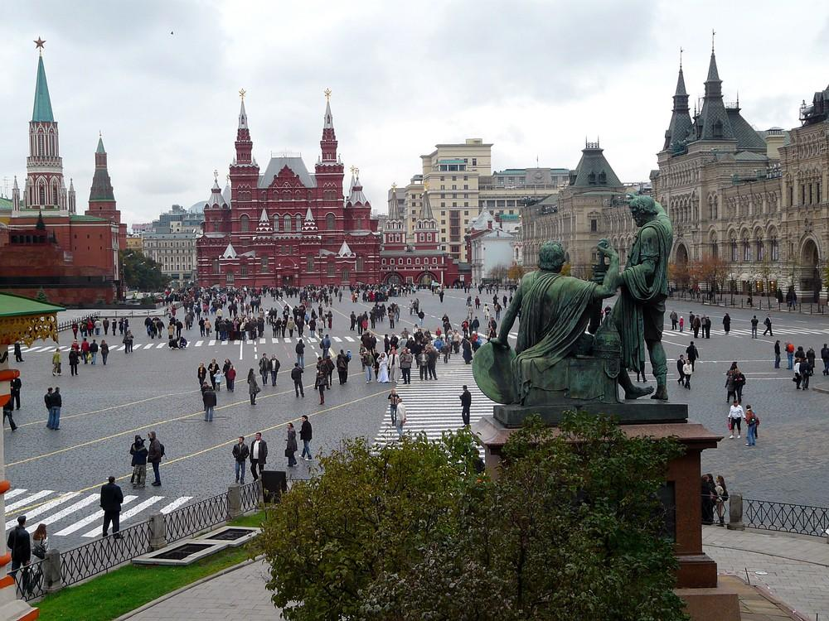

Slide 19
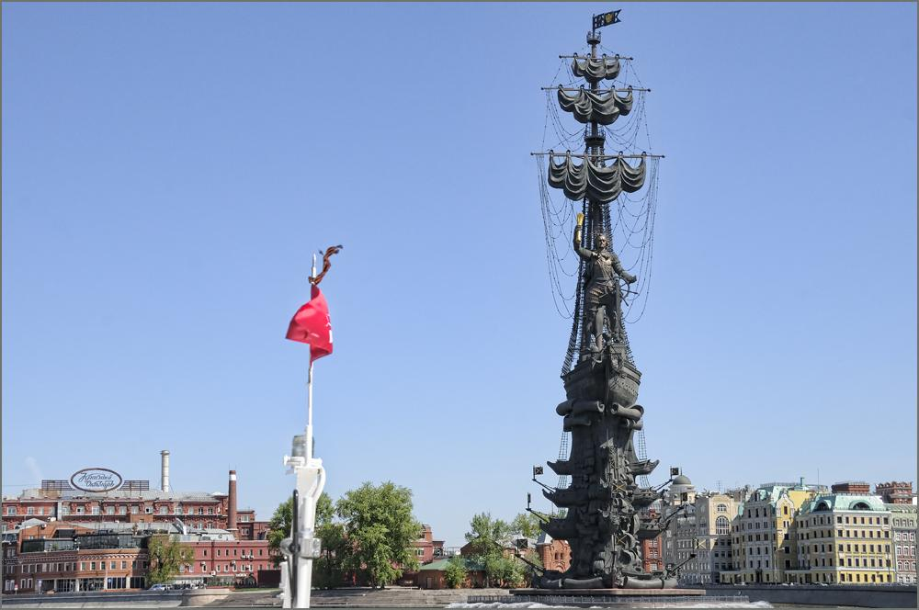
The founder of Russia

Slide 20
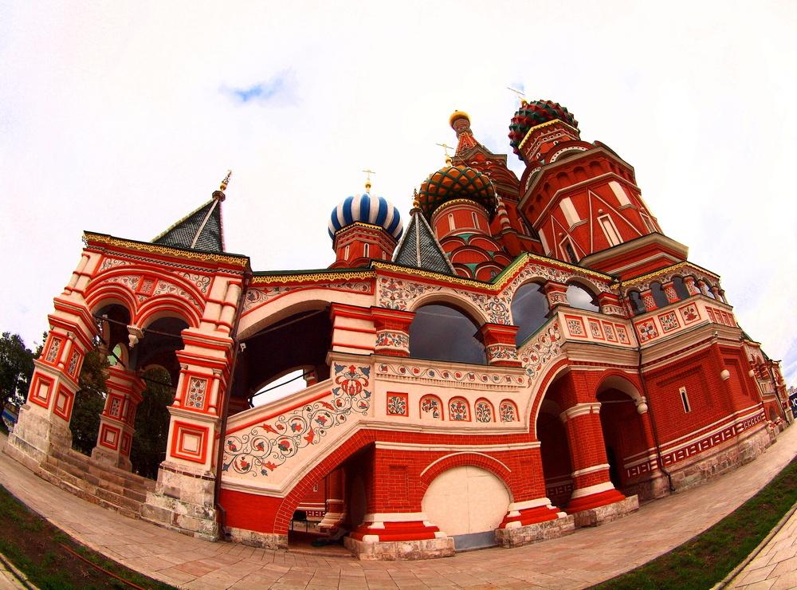
SAN BASIL CATHEDRAL

Slide 21
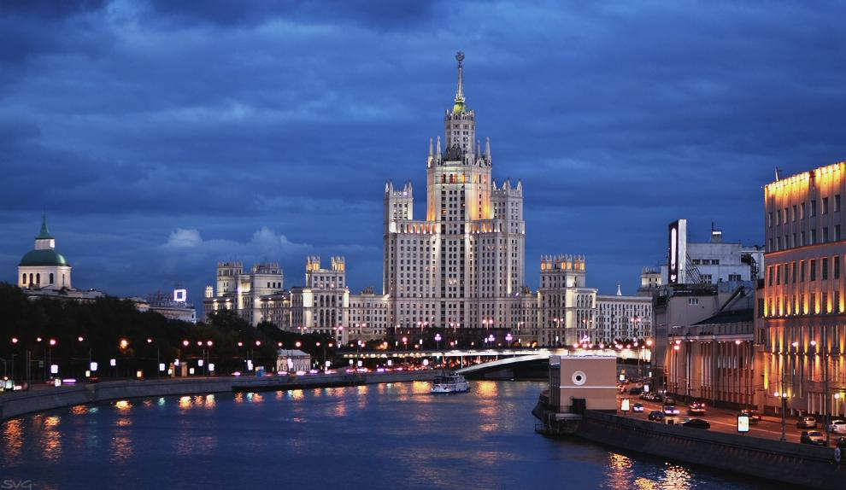
KOTELSKAIA EMBANK
Acest templu unic se află la 640 km nord-est de Bangkok, în orașul Khun Han, la frontiera cu Cambogia.

Slide 22
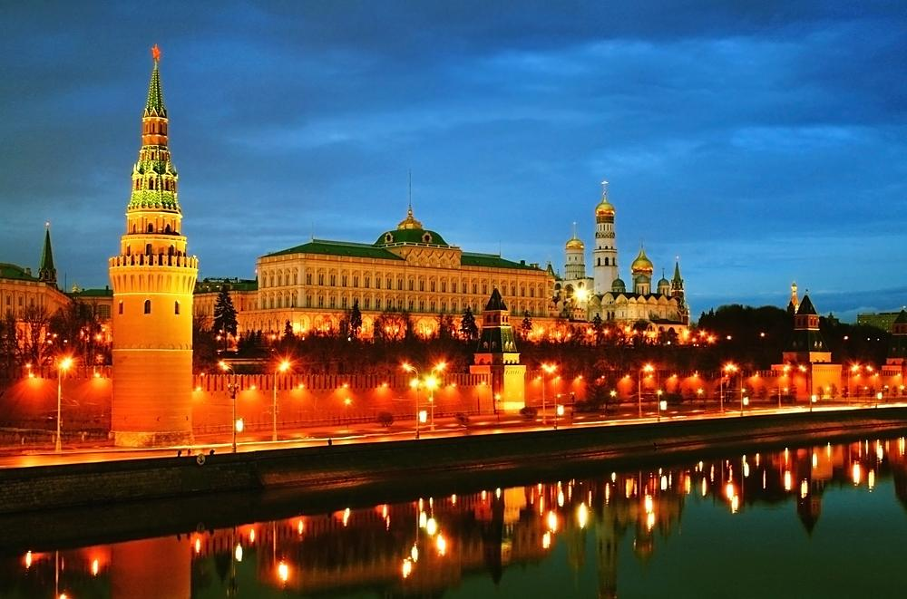
KREMLIN

Slide 23
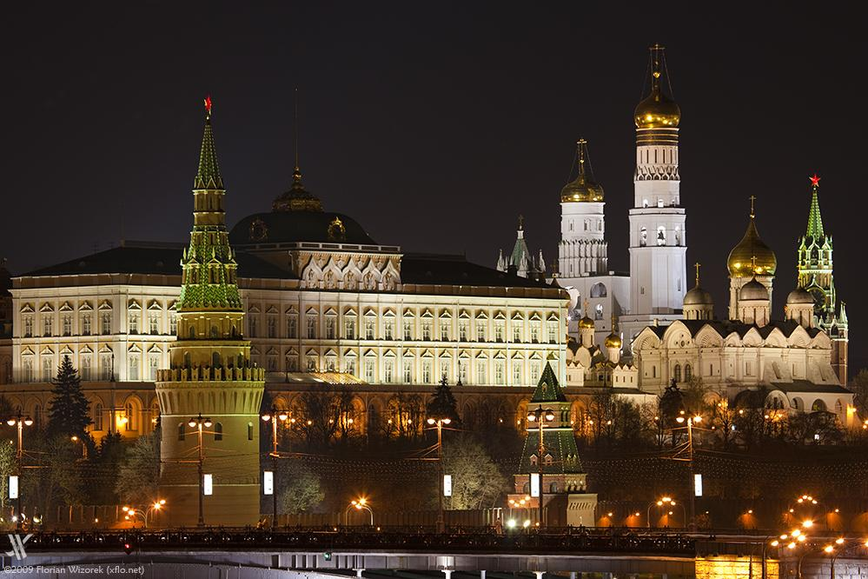

Slide 24
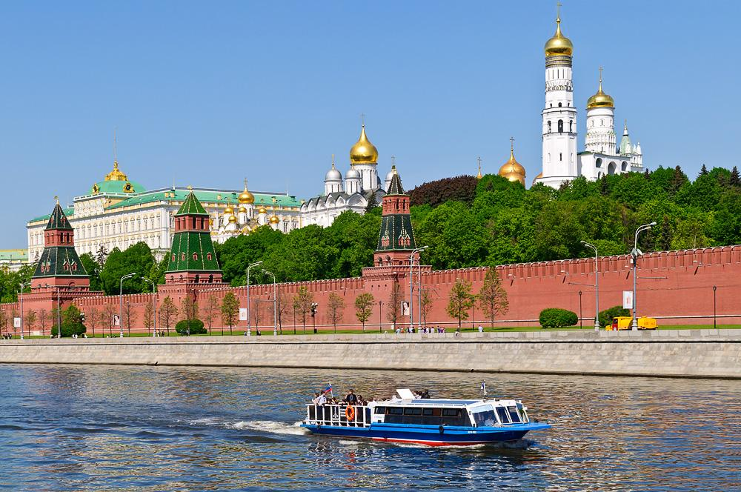
View of the MOSCOW KREMLIN

Slide 25
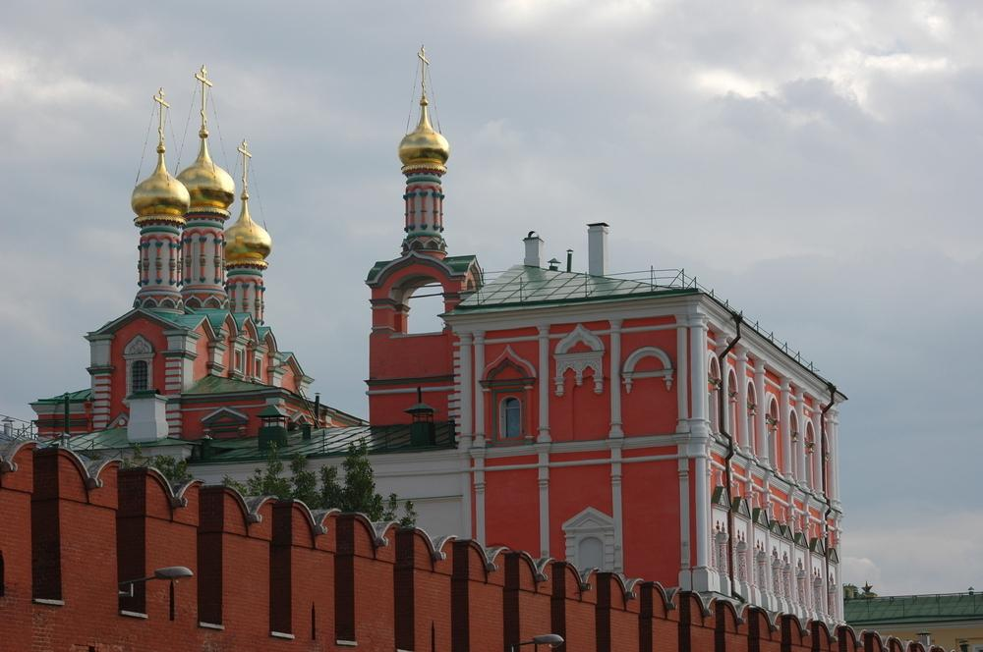

Slide 26
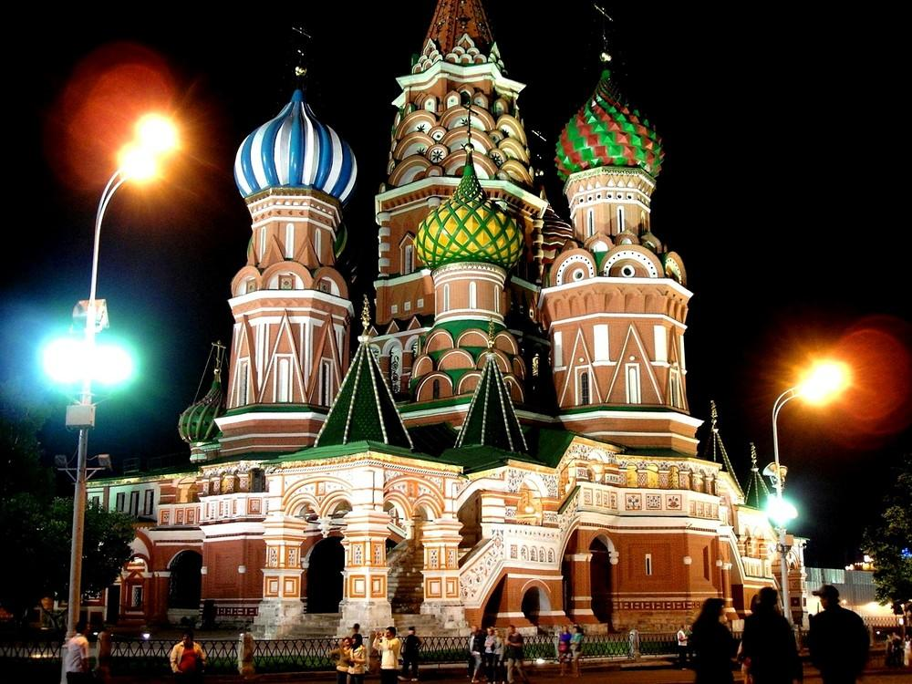
SAN BASILIC CATHEDRAL

Slide 27
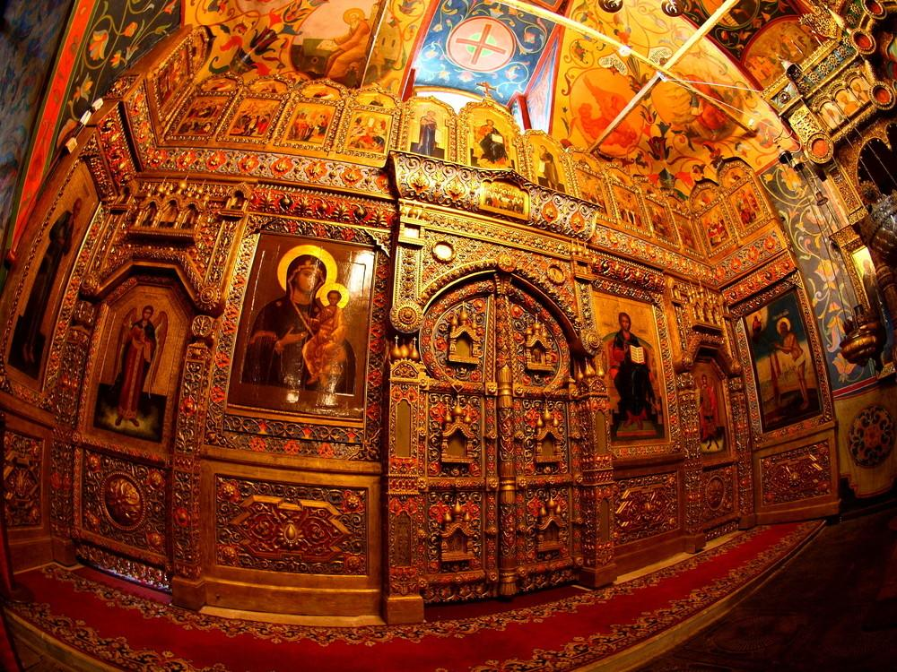

Slide 28
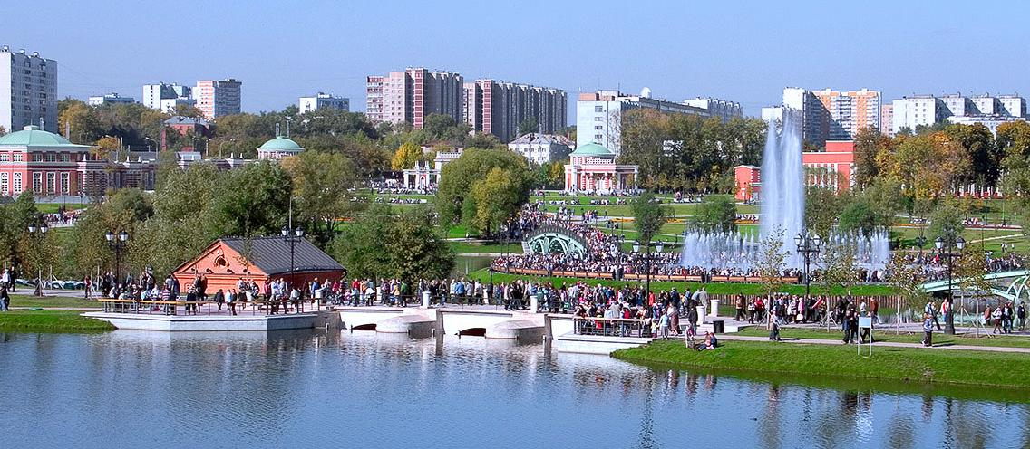

Slide 29
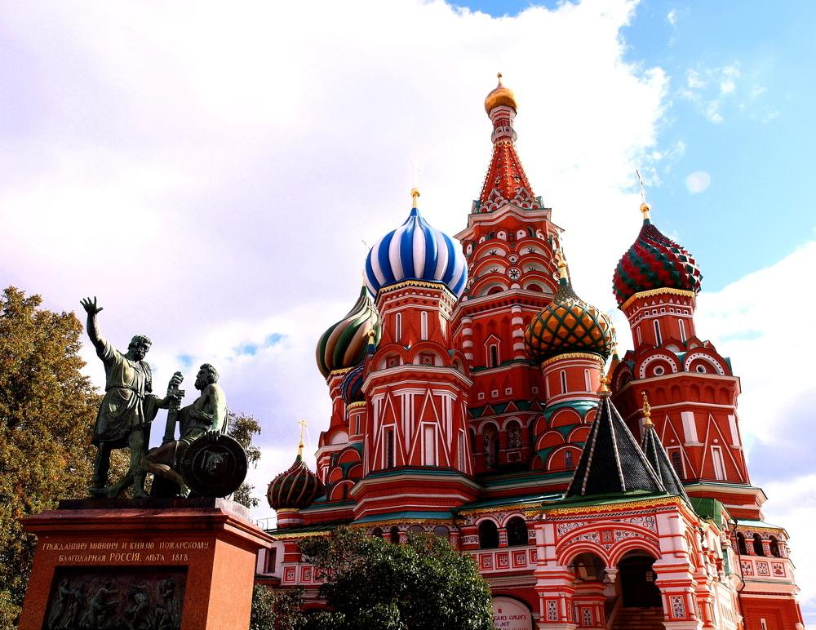
SAN BASILIC CATHEDRAL

Slide 30
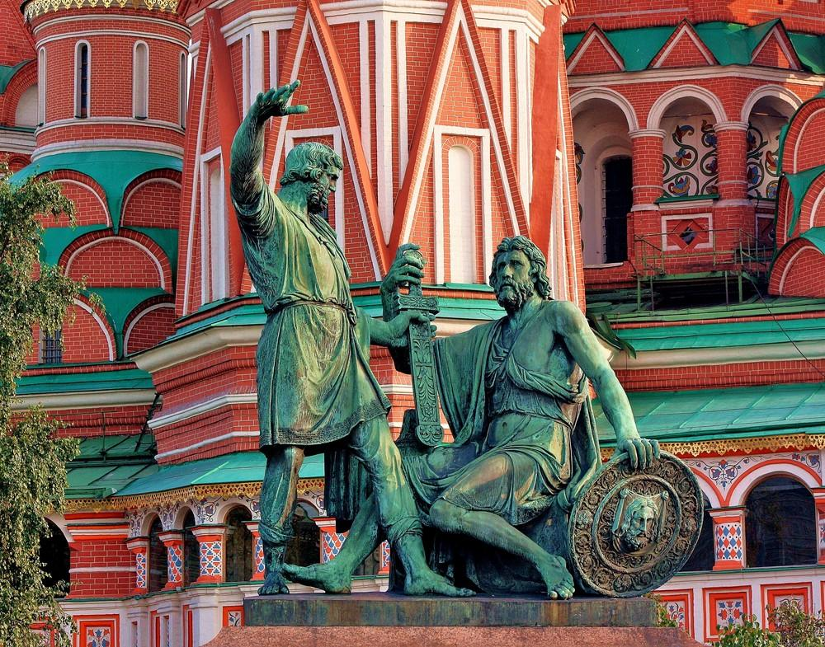

Slide 31
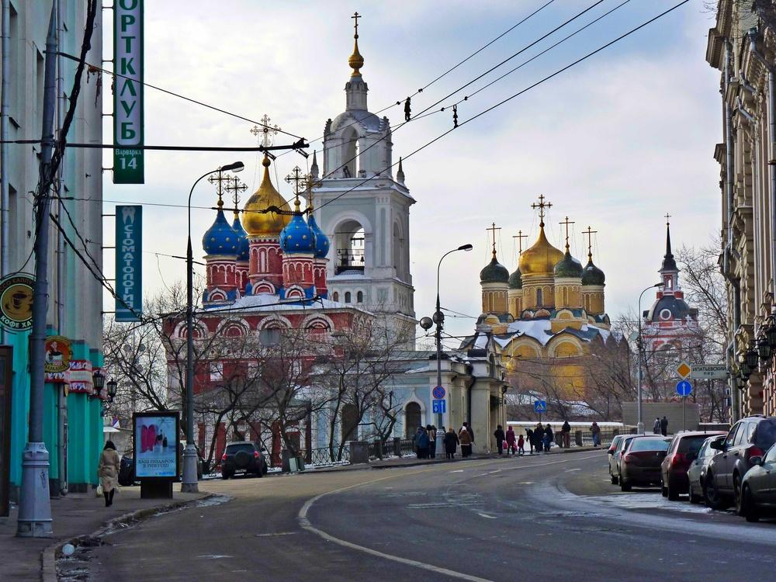
VARVAKA STREET

Slide 32
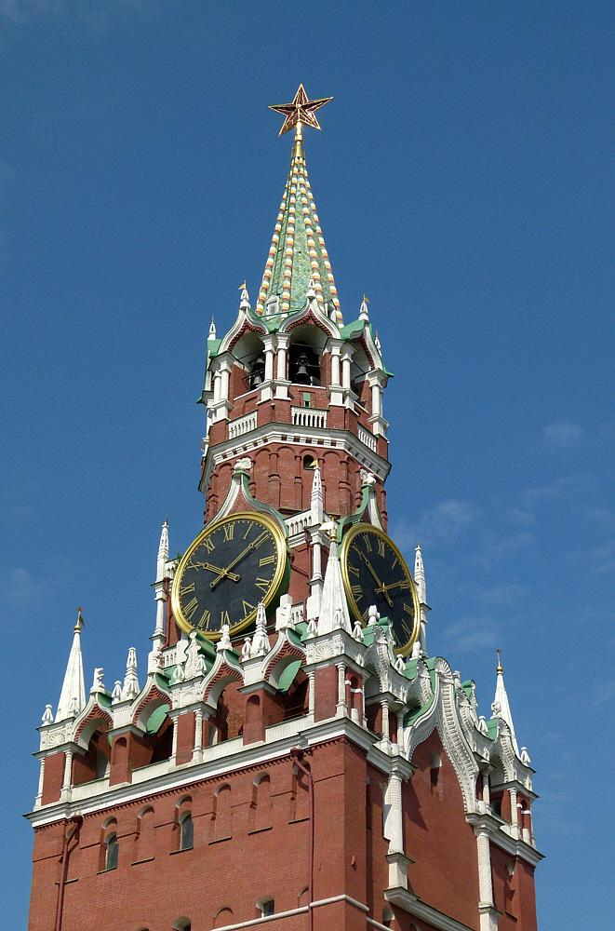
KREMLIN CLOCK

Slide 34
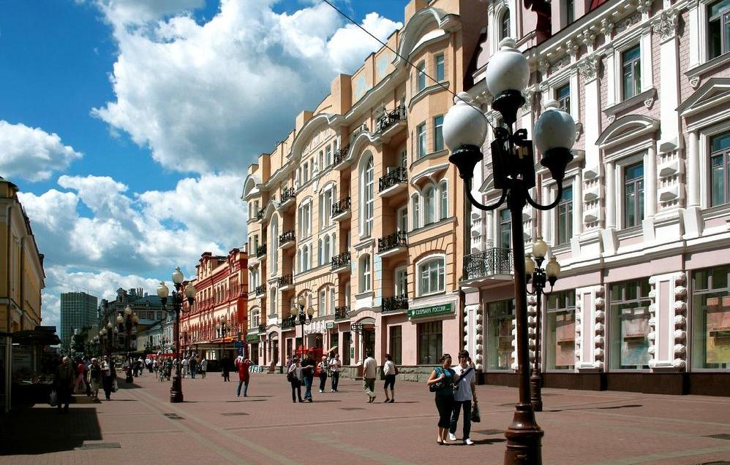
ARBAT STREET

Slide 35
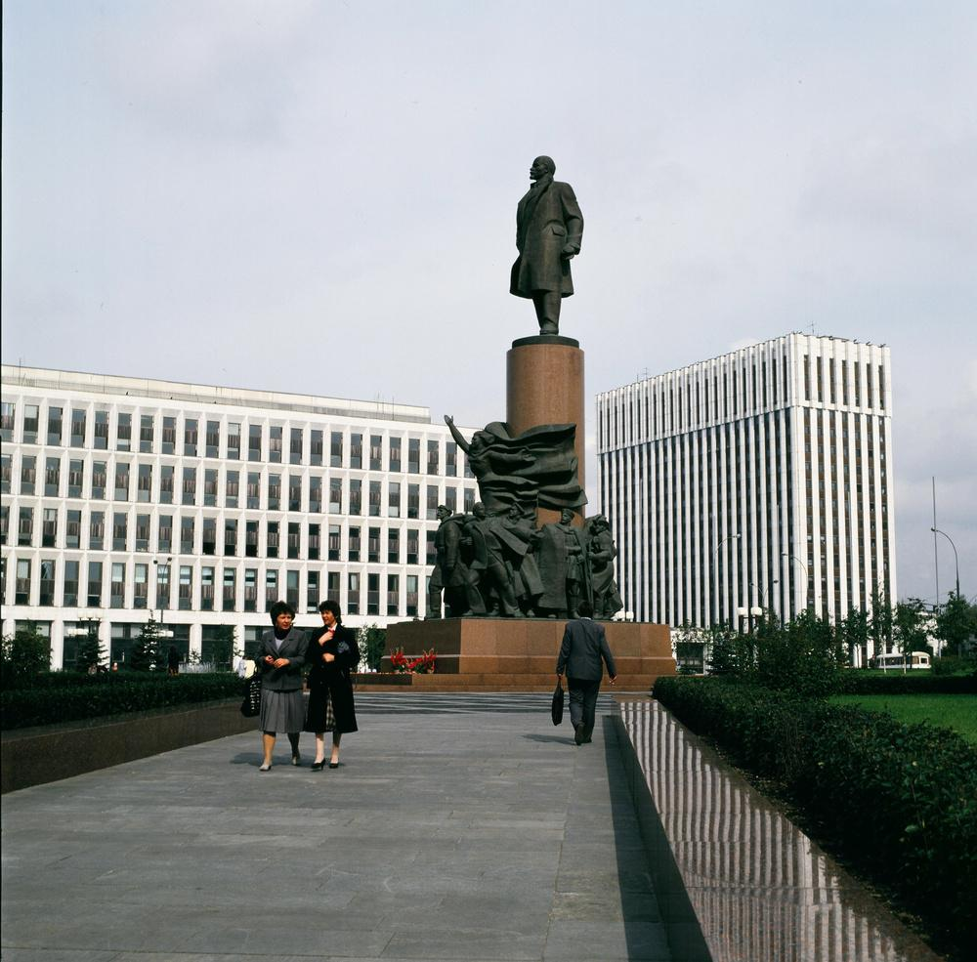
MONUMENT OF LENIN

Slide 36
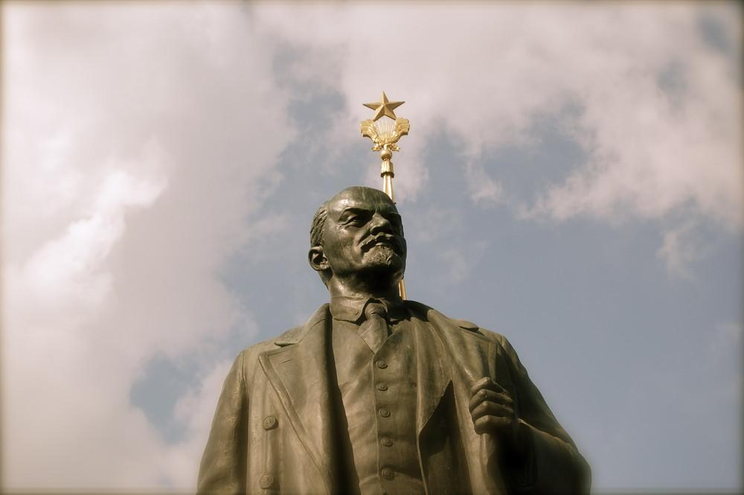
LENIN

Slide 37
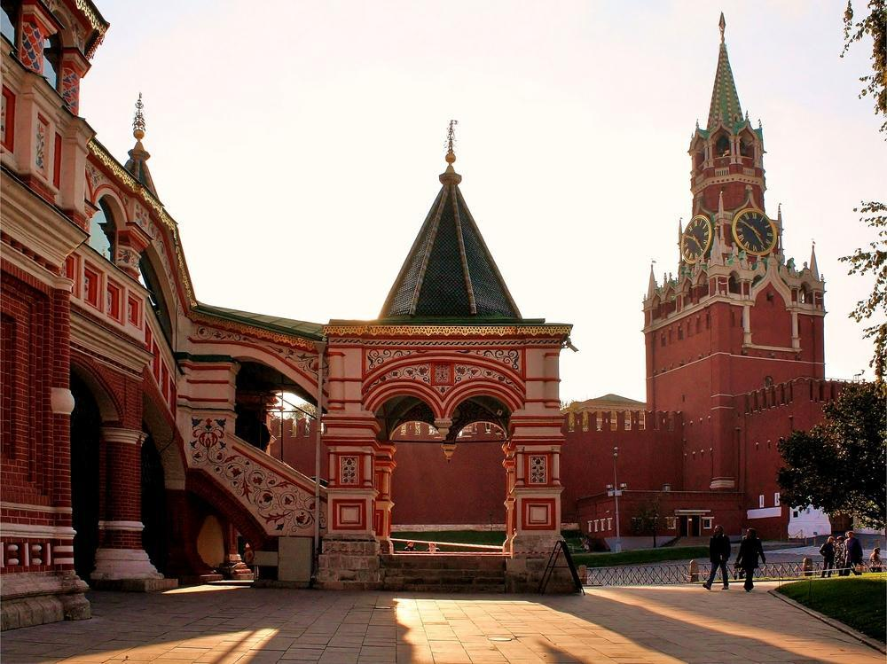
STAIR CHAIRS OF SAN BASILIC

Slide 38
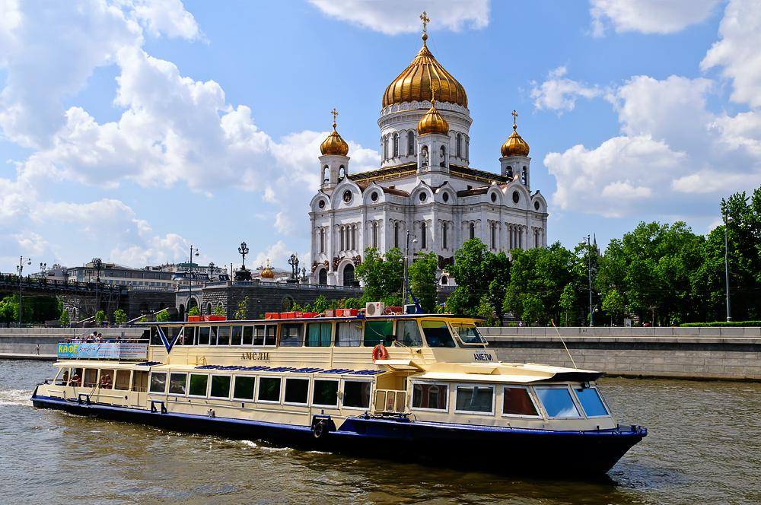

Slide 39
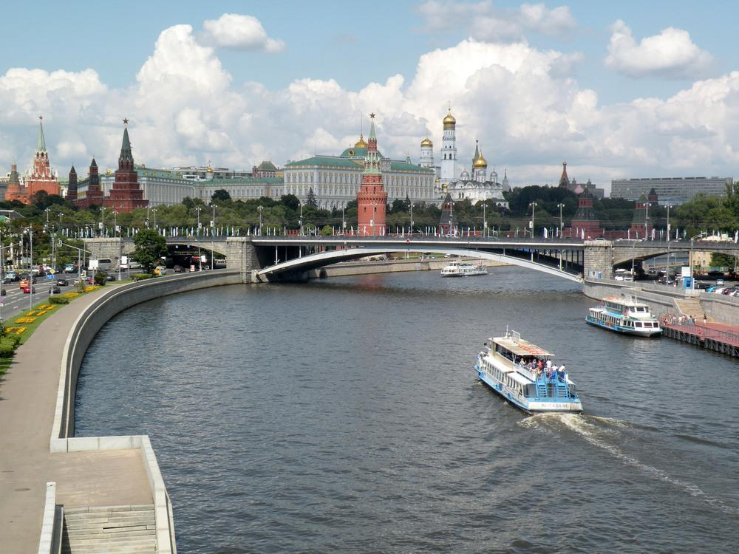

Slide 40
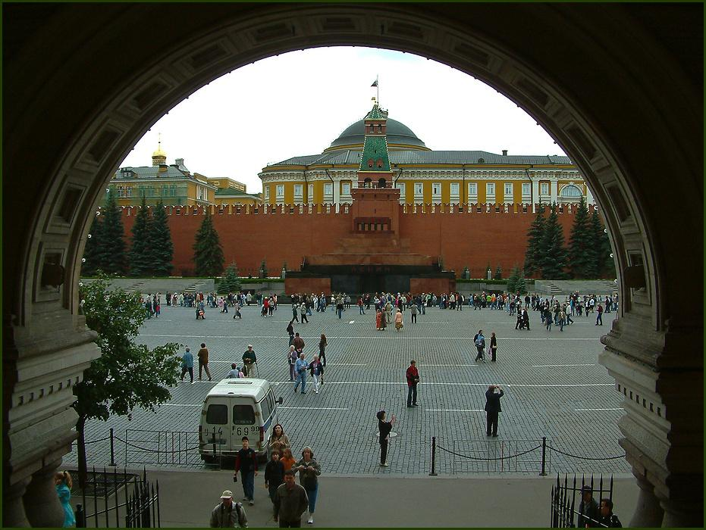
LENIN MAUSOLEUM

Slide 41
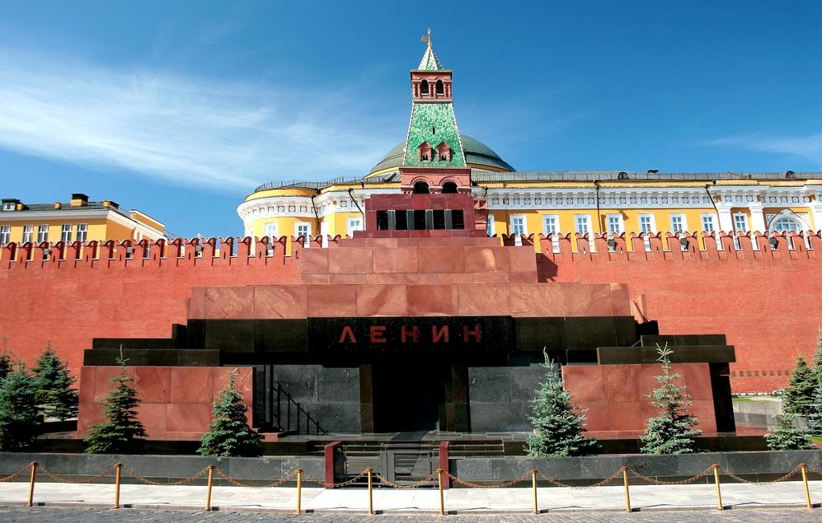
LENIN MAUSOLEUM

Slide 42
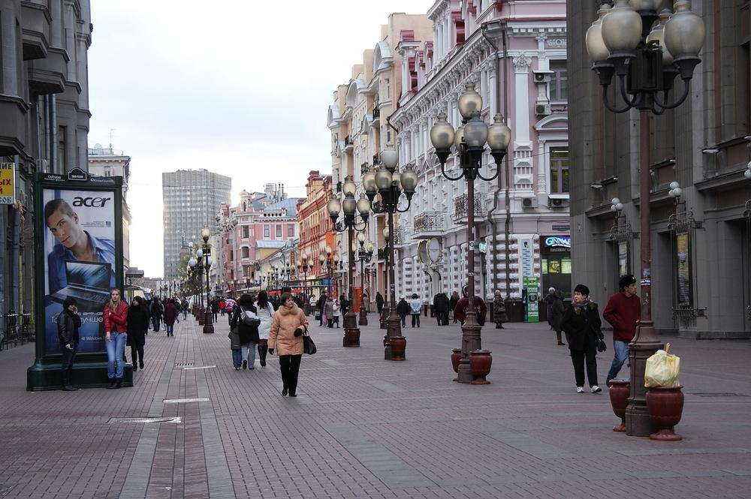
SHOPPING STREET

Slide 43
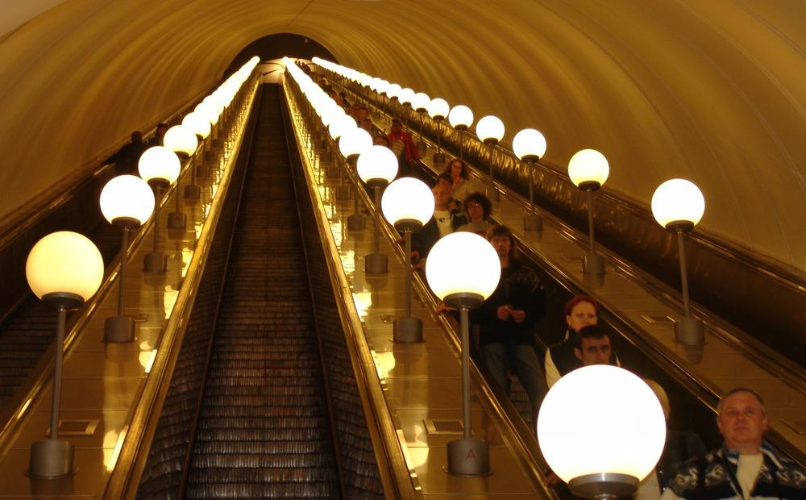
STAIRS FOR THE SUBWAY

Slide 44
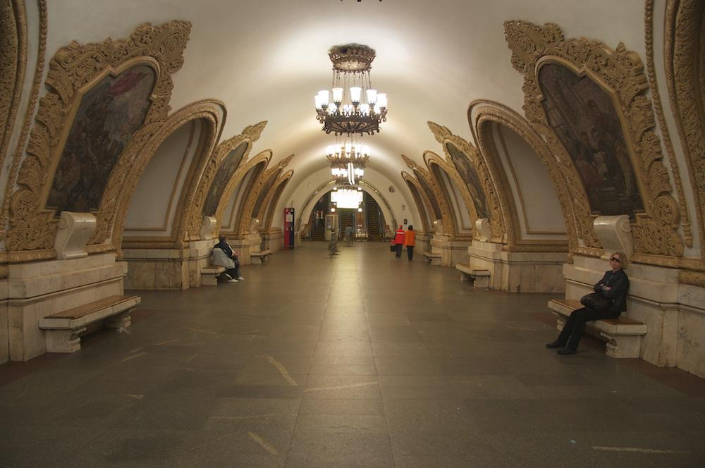
WAITING STATIONS

Slide 45
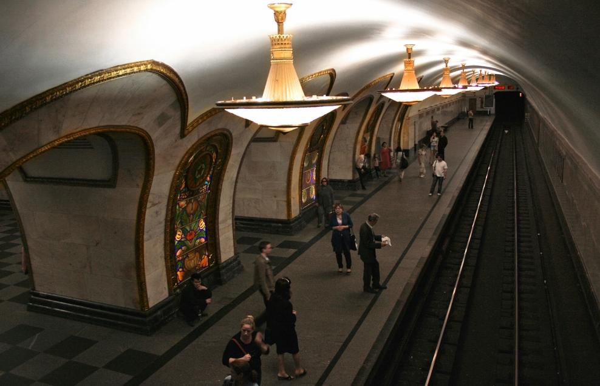
THE SUBWAY

Slide 46
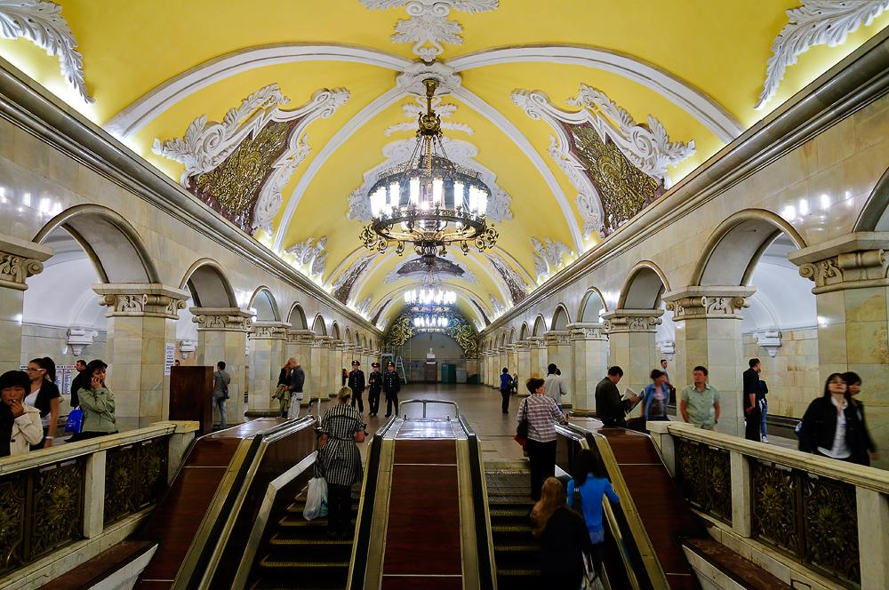
THE SUBWAY

Slide 47
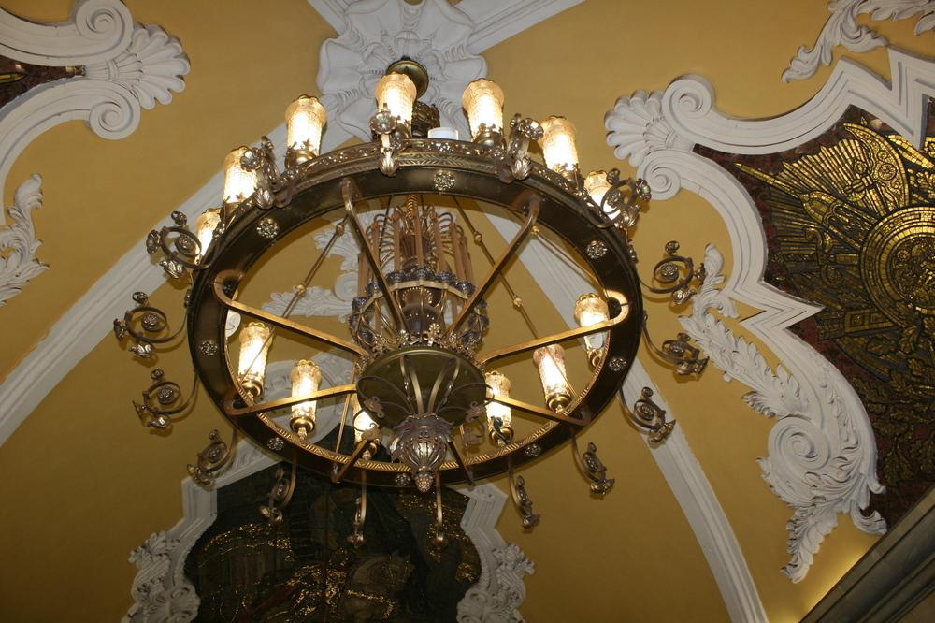

Slide 48
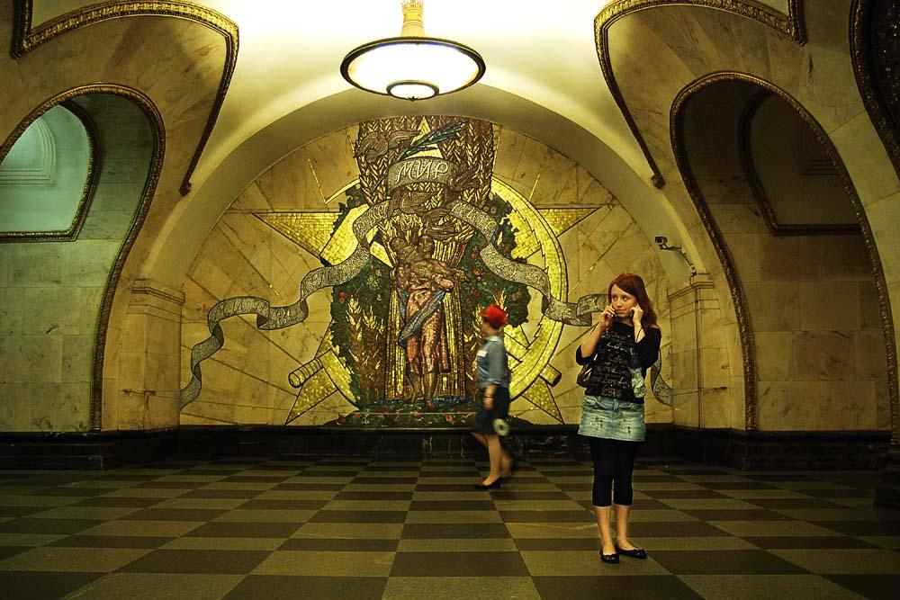

Slide 49
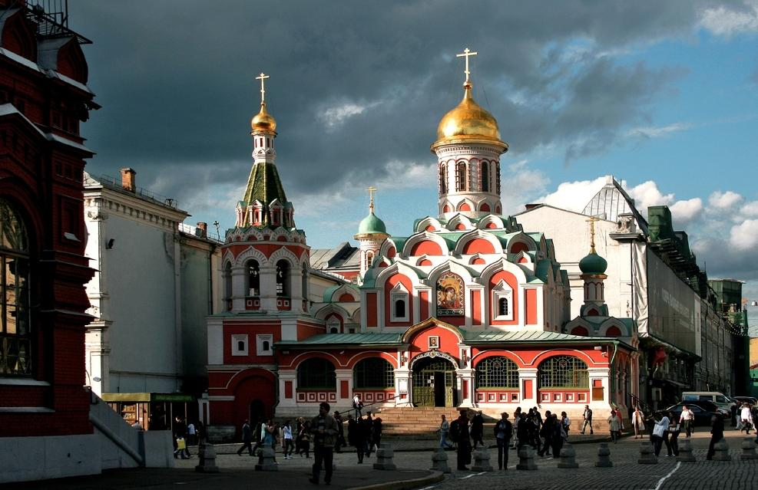
KAZAN CATHEDRAL

Slide 50
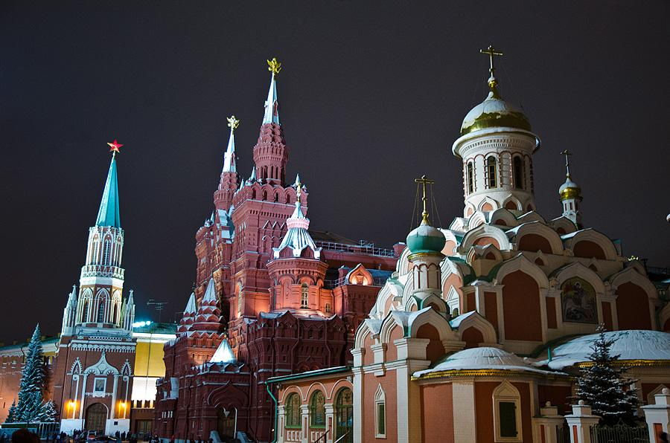
KAZAN CATHEDRAL

Slide 51
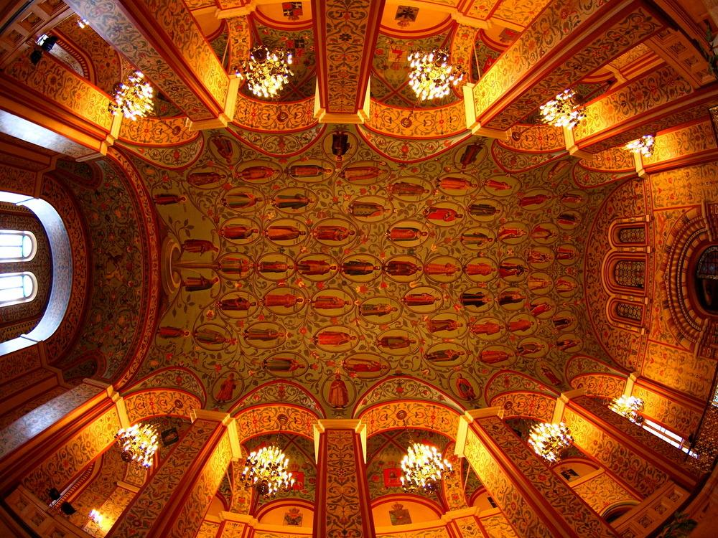
THE DOME OF THE CATHEDRAL

Slide 52

STATE HISTORICAL MUSEUM

Slide 53

RESURRECTION GATE

Slide 54

GUM STORE DEPARTMENT

Slide 55

GALLERY GUM

Slide 56

BASILICUM KREMLINA BY NIGHT

Slide 57


The End
Music: Rachmaninoff - Rhapsody

Slide 58







¿Te ha gustado?
Puedes ver más entrando
Aquí
Además puedes recibir powerpoints en tu correo electrónico suscribiéndote aquí:

