Slide 1

Las mejores playas de Australia Queensland, Tasmania, Victoria, Australia Occidental

Slide 2
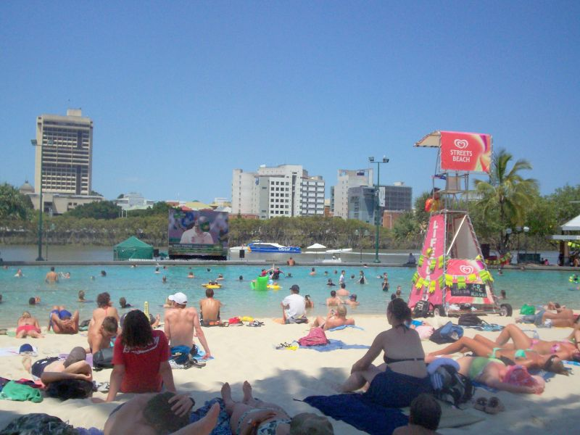
Queensland- Brisbane

Slide 3
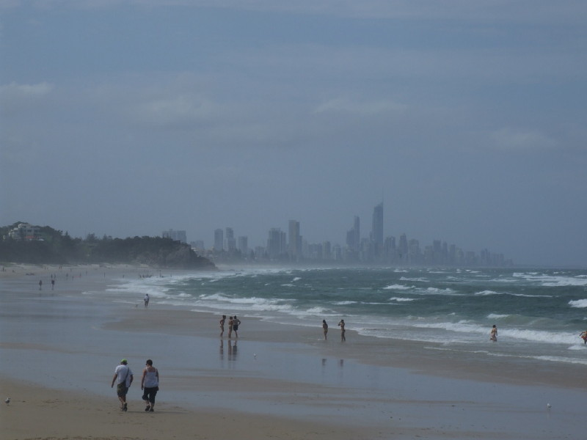
Queensland - Burleigh Heads

Slide 4
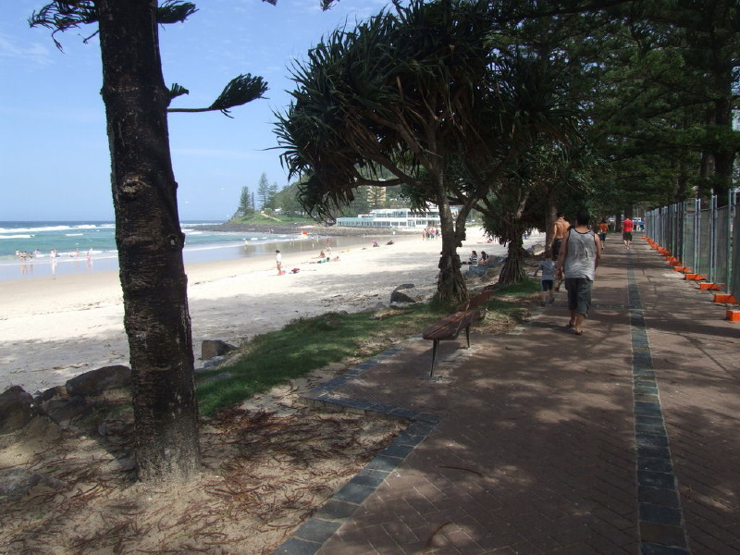

Slide 5
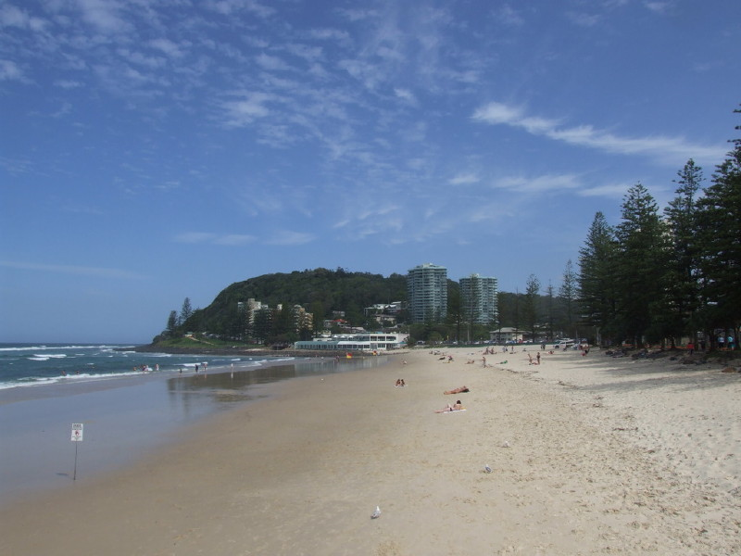

Slide 6
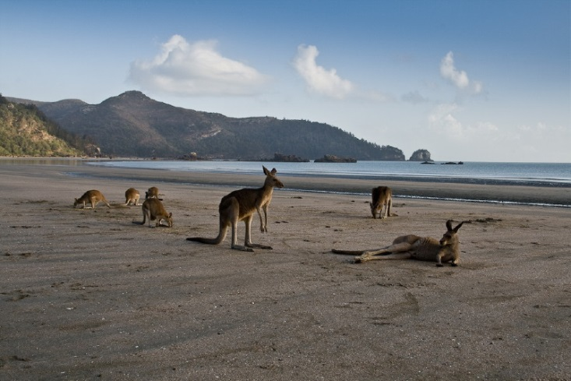
Queensland - Cape Hillsborough National Park

Slide 7

Queensland - Cape Tribulation

Slide 8


Slide 9

Queensland - Coolangatta beach

Slide 10
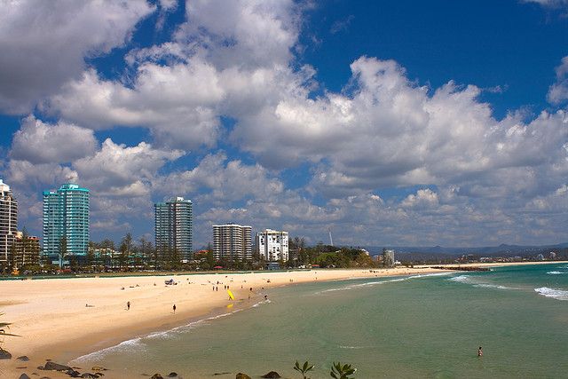

Slide 11

Queensland - Four Mile Beach in Port Douglas

Slide 12


Slide 13


Slide 14

Queensland - Gold Coast

Slide 15
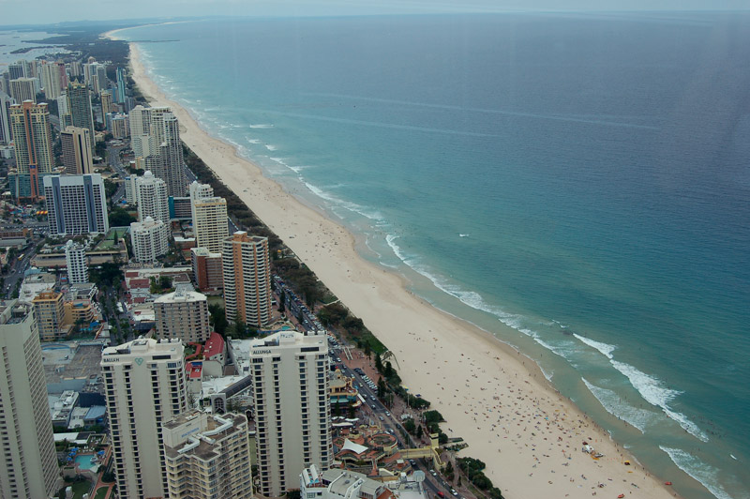
Queensland - Surfers Paradise Beach

Slide 16
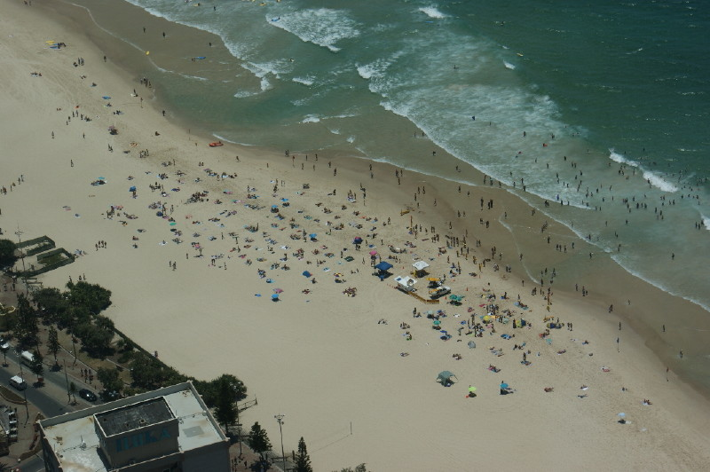

Slide 17

Queensland - Hideaway Bay beach

Slide 18

Queensland - Lake McKenzie- Fraser Island

Slide 19


Slide 20

Queensland - Margate Beach

Slide 21

Queensland - Palm Cove Cairns

Slide 22
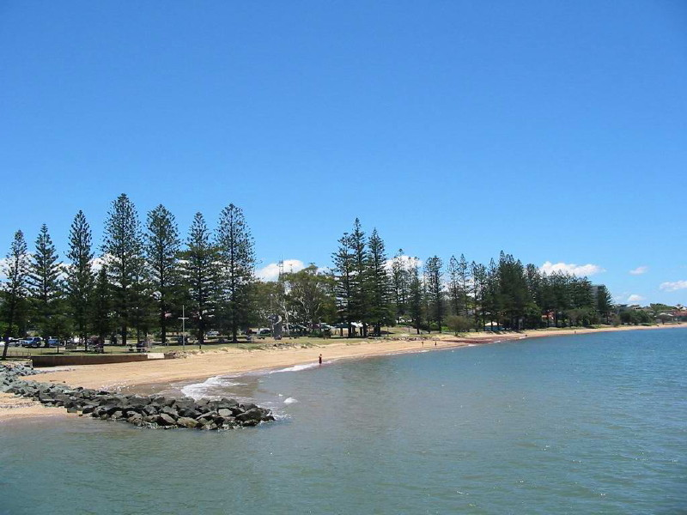
Queensland - Redcliffe Beach

Slide 23


Slide 24

Queensland - Tangalooma

Slide 25

Queensland - Townsville

Slide 26


Slide 27

Queensland - Whitehaven beach

Slide 28


Slide 29

Tasmania - Bay of Fires

Slide 30


Slide 31


Slide 32
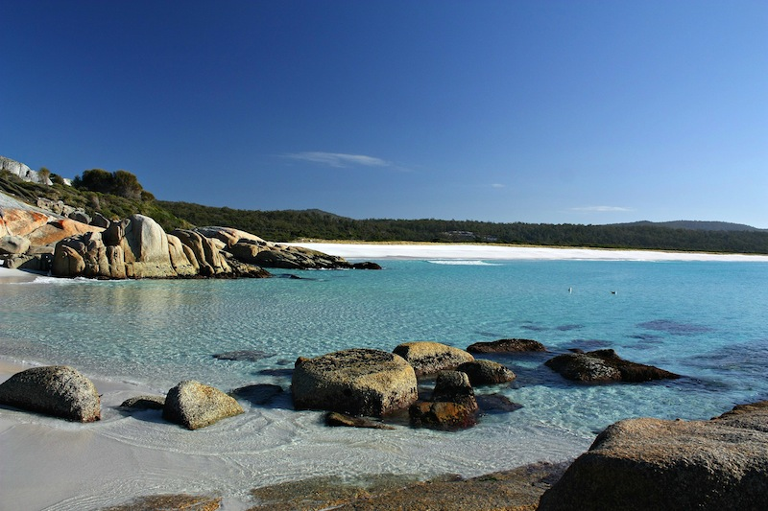

Slide 33

Tasmania - Wine Glass Bay

Slide 34


Slide 35
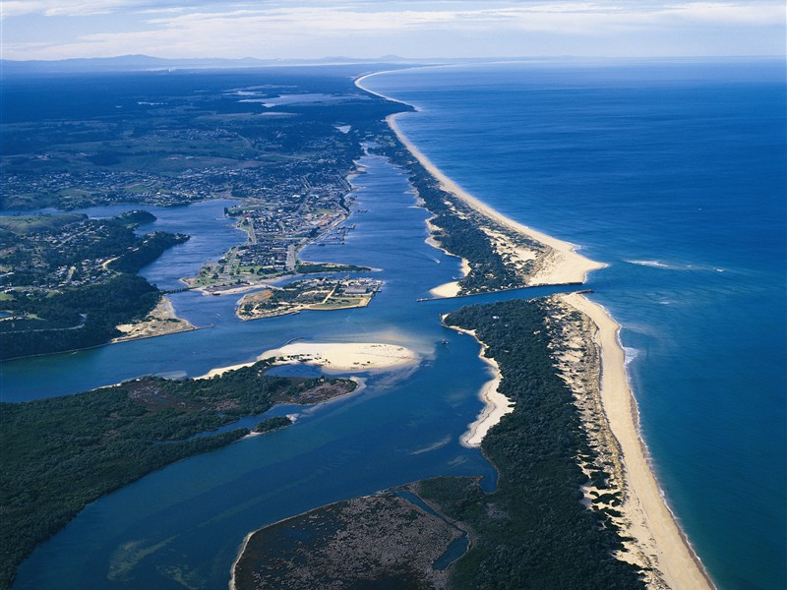
Victoria - 90 Mile Beach

Slide 36

Victoria - Mornington Beach in Melbourne

Slide 37

Victoria - Oberon Bay

Slide 38

Victoria - Refuge Cove

Slide 39
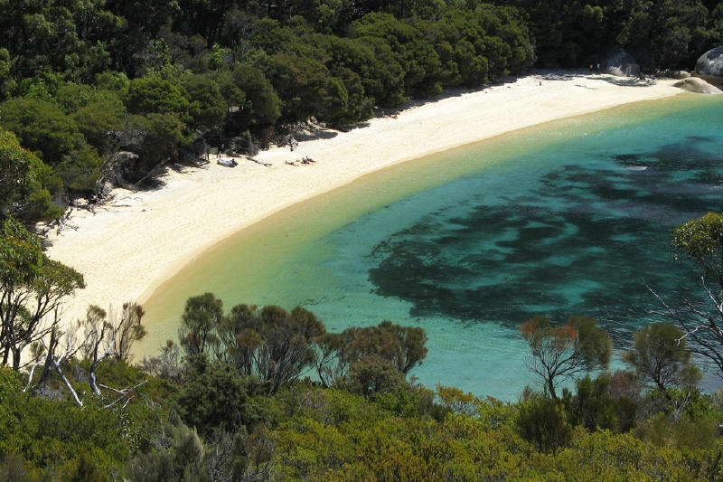

Slide 40

Victoria - Sealers Cove

Slide 41


Slide 42

Victoria - Waterloo Bay

Slide 43

Western Australia - Beaches in Perth

Slide 44
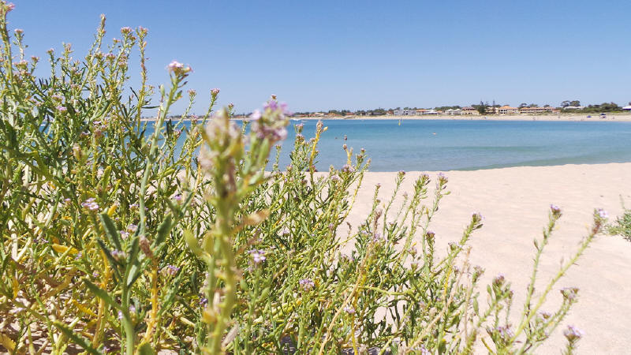

Slide 45
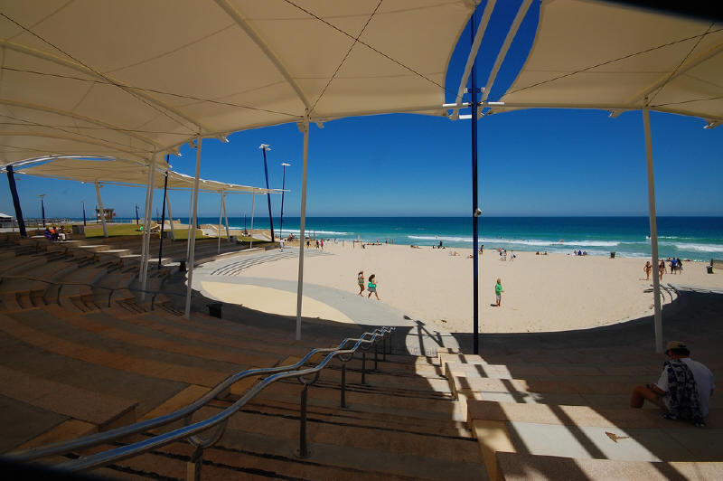

Slide 46
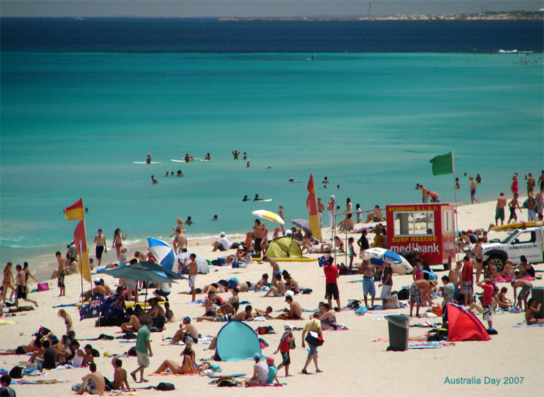

Slide 47
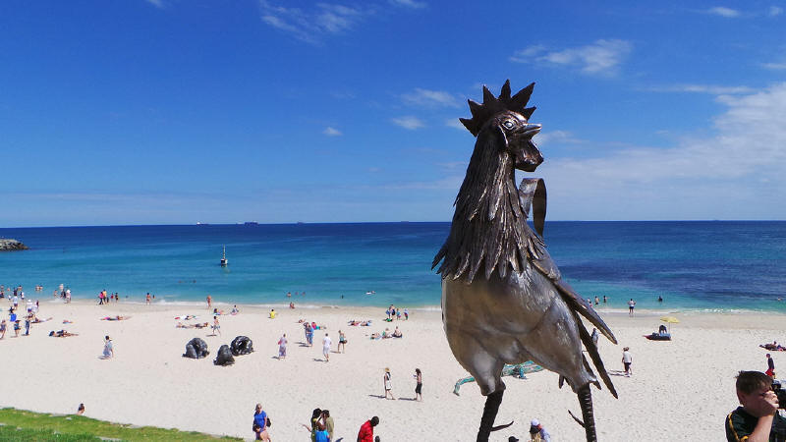

Slide 48
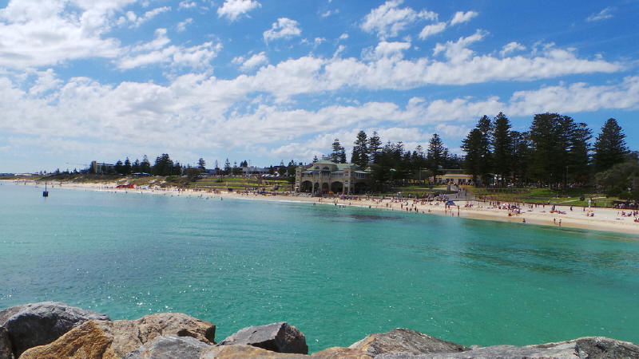

Slide 49
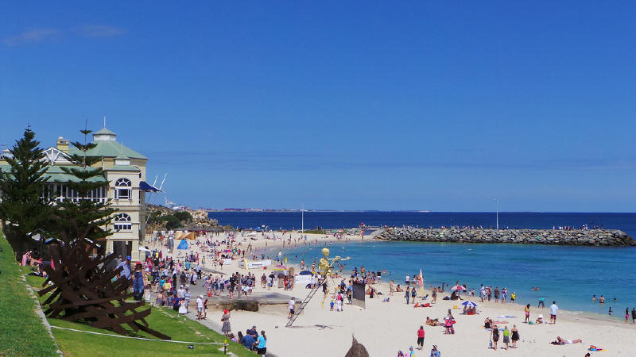

Slide 50
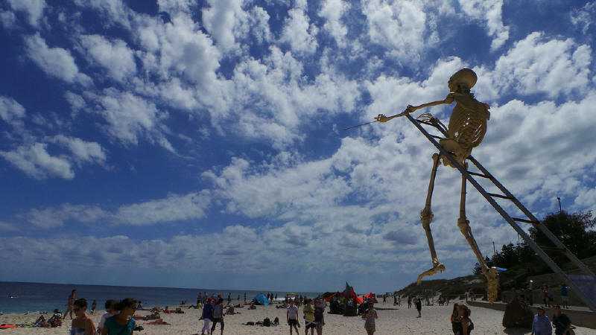

Slide 51
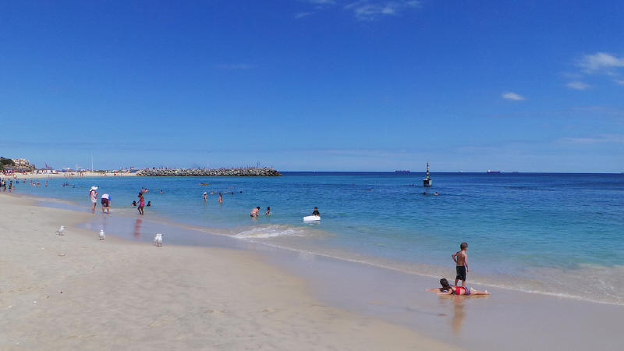

Slide 52


Slide 53
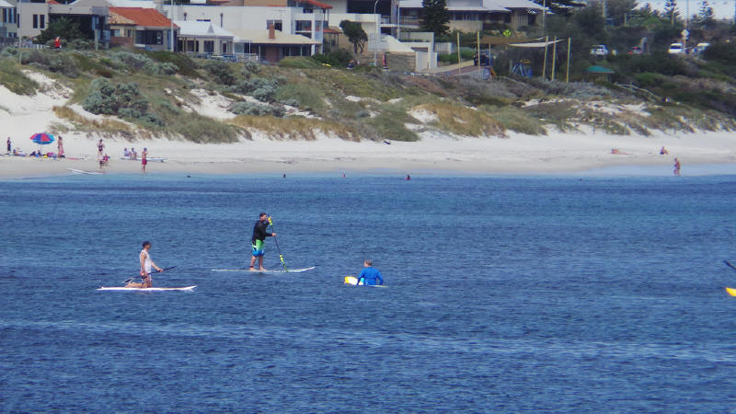

Slide 54
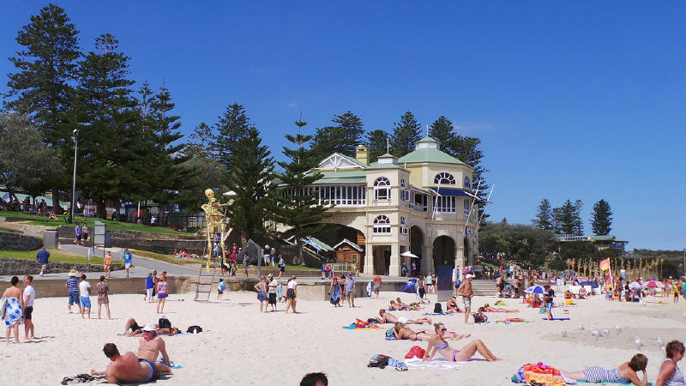

Slide 55
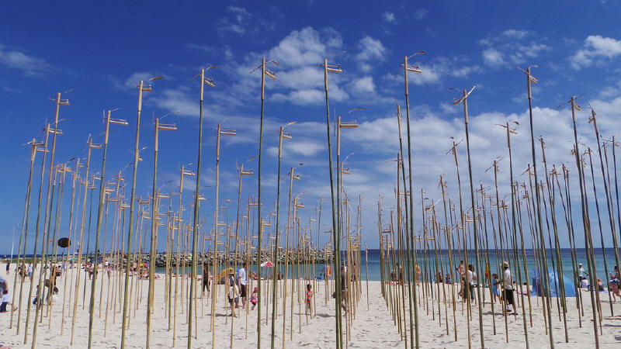

Slide 56
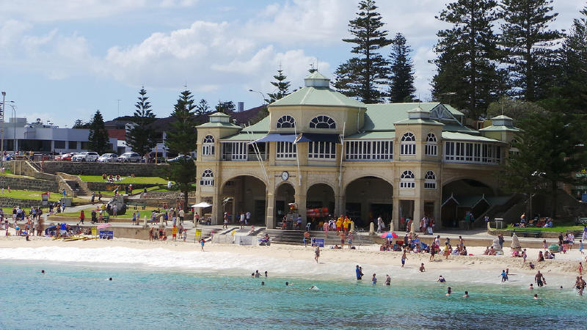

Slide 57
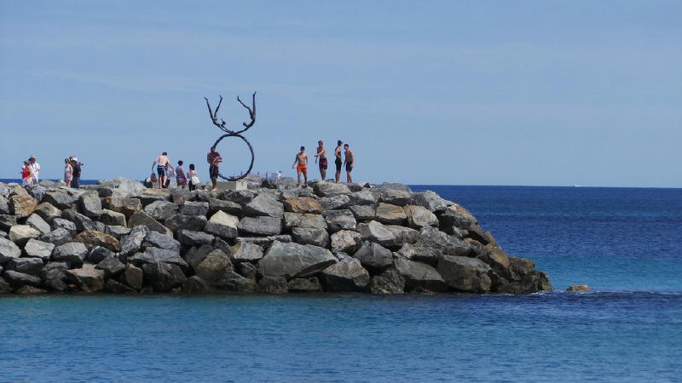

Slide 58


Slide 59


Slide 60
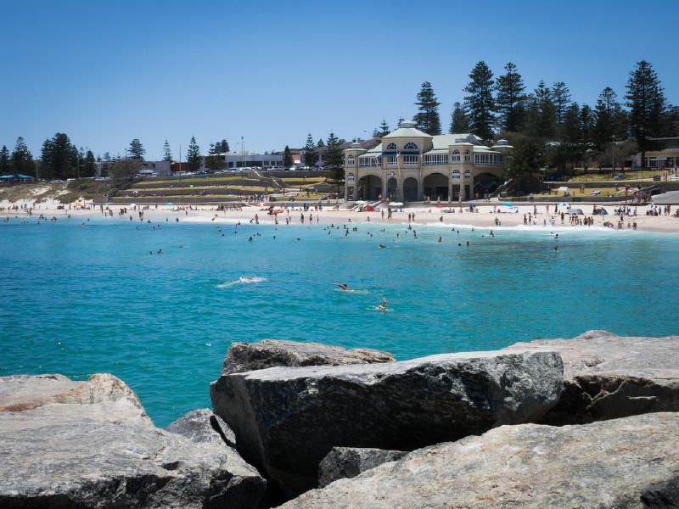

Slide 61
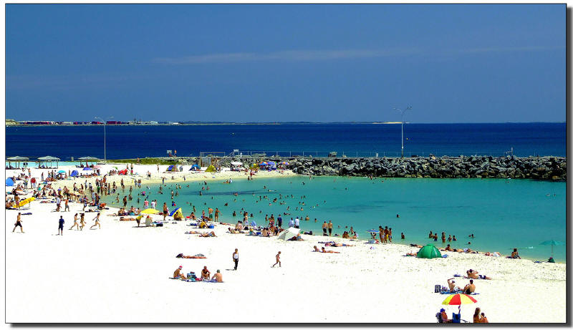

Slide 62
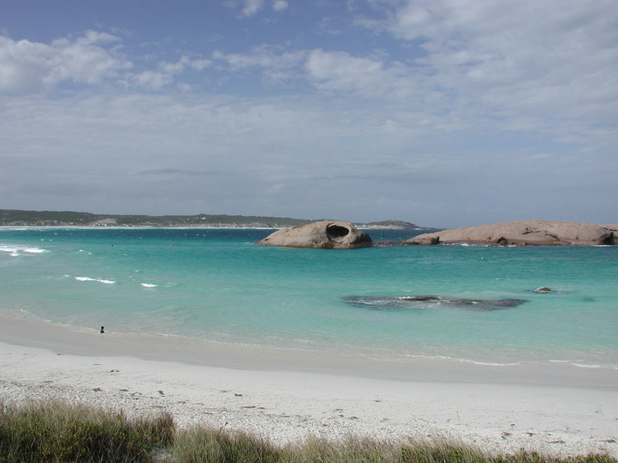
Western Australia - Esperance

Slide 63
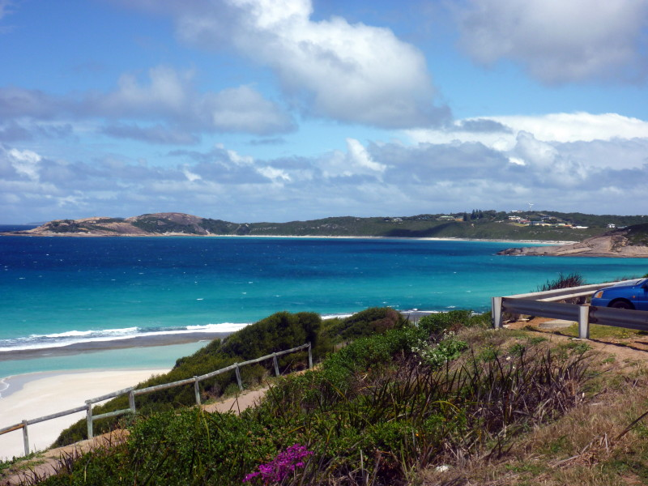

Slide 64


Slide 65


Slide 66


Slide 67
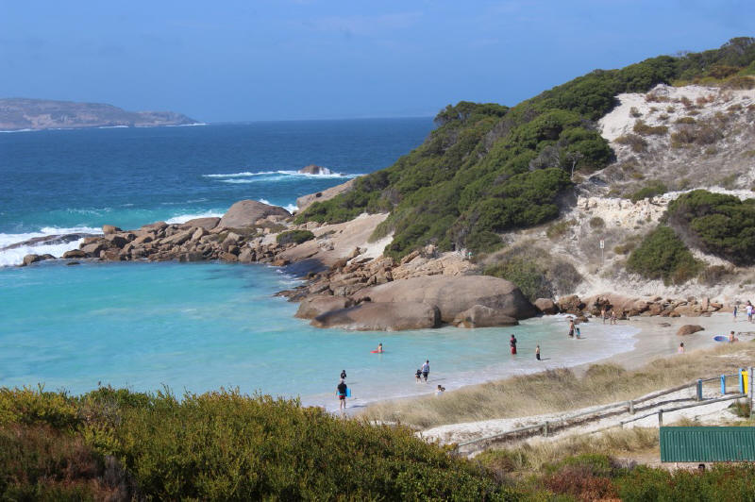

Slide 68
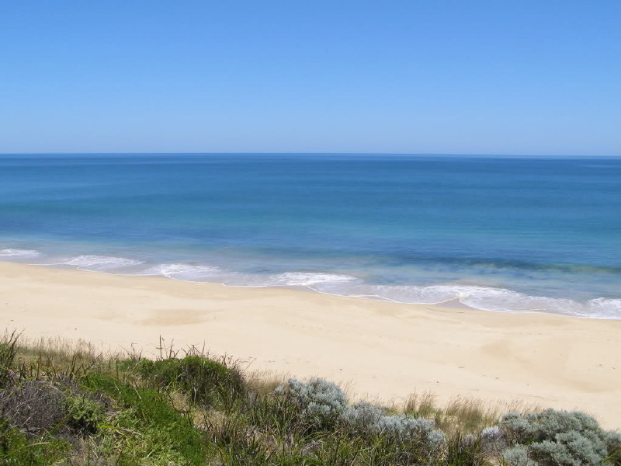
Western Australia - Bunbury

Slide 69
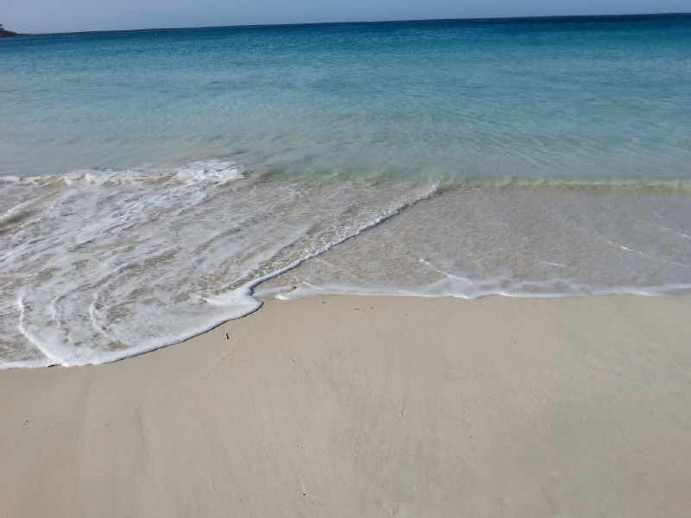
Western Australia - Bunker Bay

Slide 70
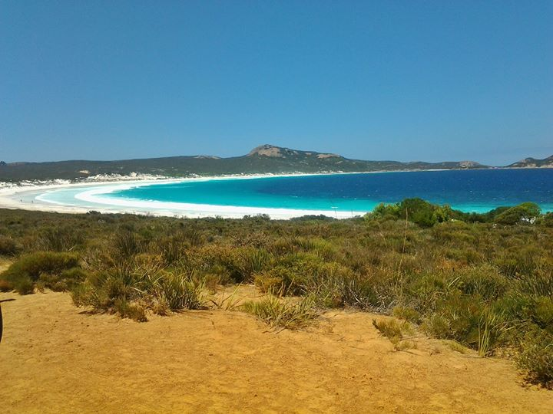
Western Australia - Lucky Bay

Slide 71


Slide 72

Western Australia - Fremantle

Slide 73
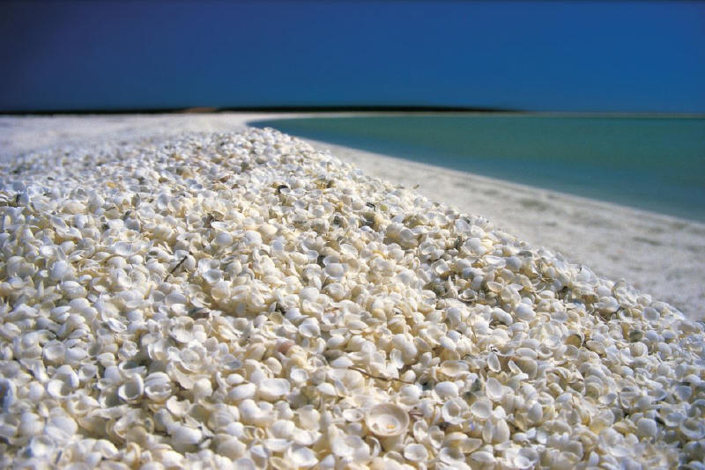
West Australia - Shell beach

Slide 74
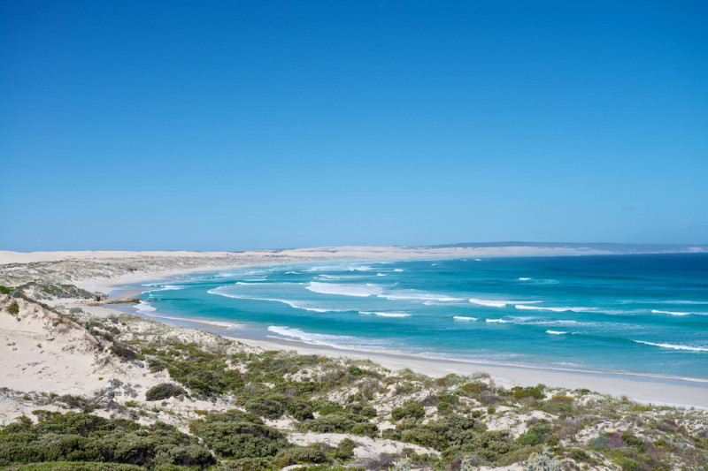
Western Australia

Slide 75


Slide 76

Western Australia - Wedge Island Beach

Slide 77

Western Australia - Yallingup

Slide 78

Western Australia - Hellfire Bay

Slide 79







¿Te ha gustado?
Puedes ver más entrando
Aquí
Además puedes recibir powerpoints en tu correo electrónico suscribiéndote aquí:

