Slide 1
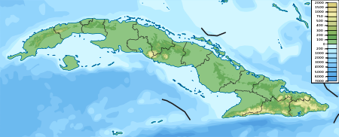
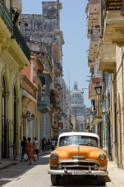
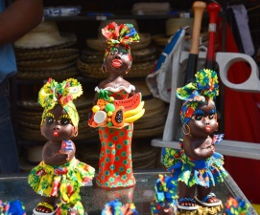
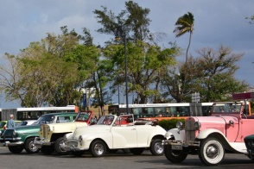
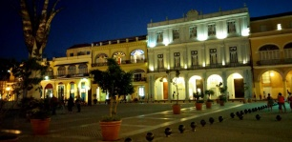
Havana - Cuba
Havana
Havana (La Habana) is the capital city, largest city, province, major port, and leading commercial center of Cuba. The city has a population of 2.1 million inhabitants, and it spans a total of 728.26 km² .
The city of Havana was founded by the Spanish in the 16th century and due to its strategic location it
Havana
Cuba
Havana – Location in Cuba
served as a springboard for the Spanish conquest of the Americas. King Philip II of Spain granted Havana the title of City in 1592.
Contemporary Havana can essentially be described as three cities in one: Old Havana, Vedado and the newer suburban districts. As typical of Cuba, Havana
experiences a tropical climate.
Old Havana from street level, with the Capitolio in the background
The city attracts over a million tourists annually.
Havana Craft-Work
In May 2015, Havana was selected as one of the so-called New 7 Wonders Cities.
Old Havana was declared a UNESCO World Heritage Site in 1982.
The cars in Havana
(Wikipedia)
© Isabela Pitish

Slide 2
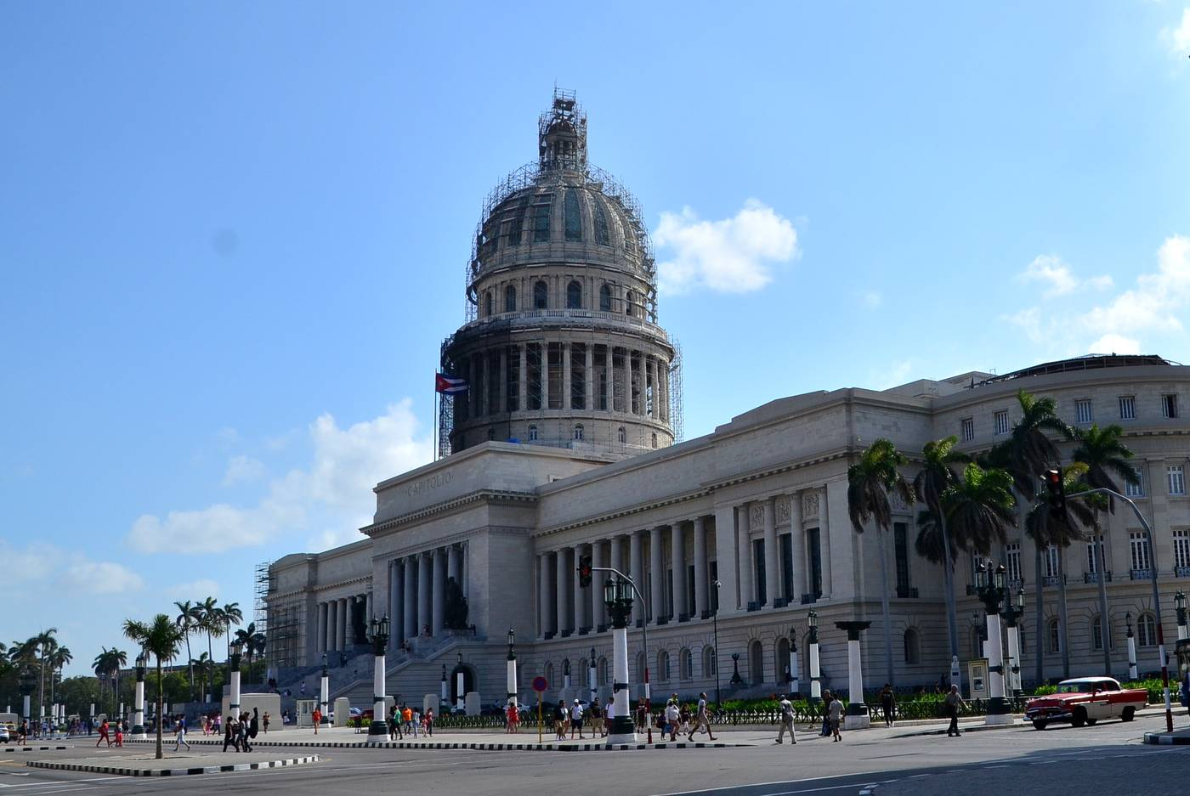
© Isabela Pitish

Slide 3
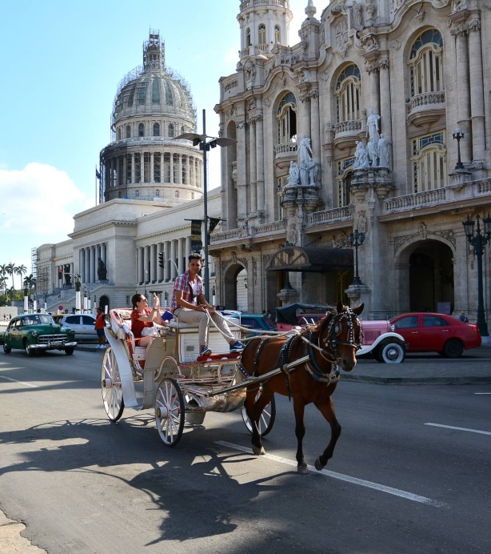
© Isabela Pitish

Slide 4
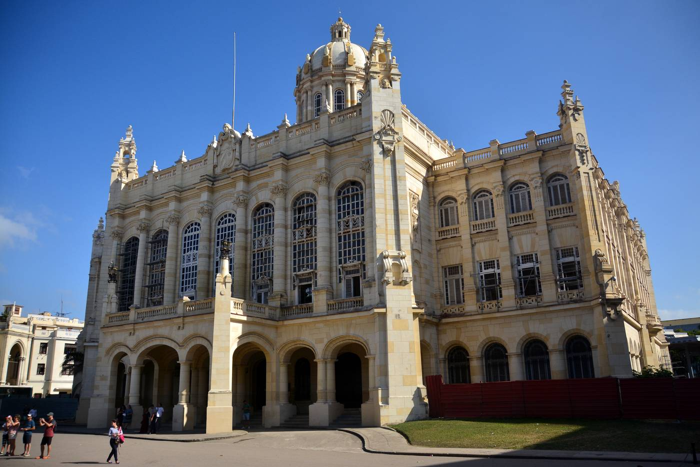
© Isabela Pitish

Slide 5
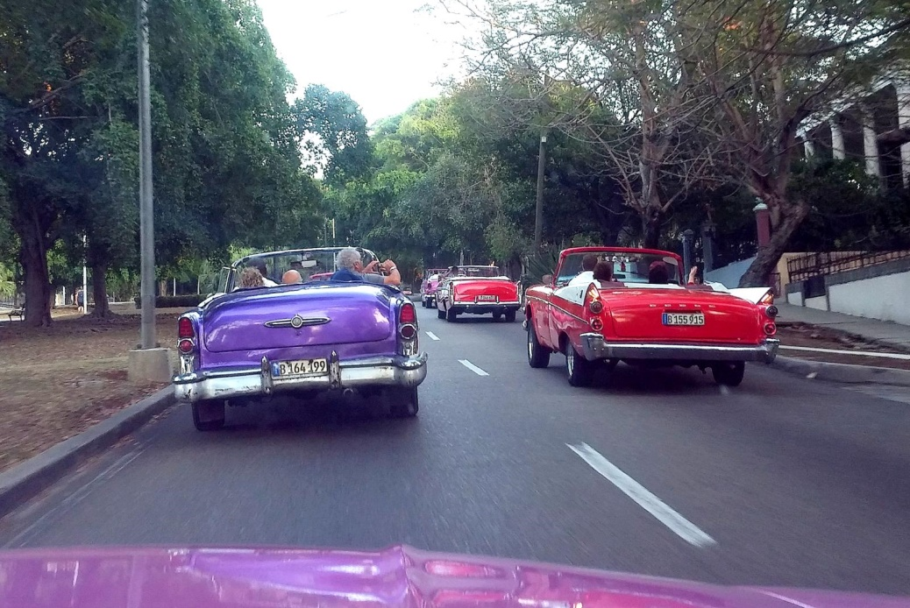
© Isabela Pitish

Slide 6
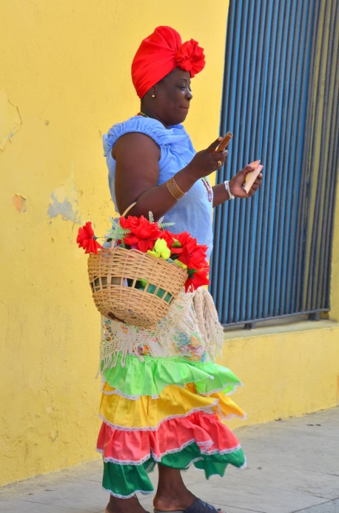
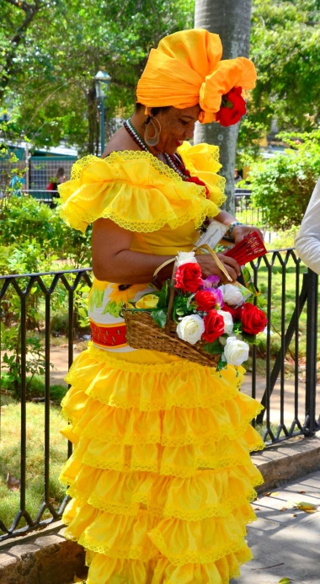
© Isabela Pitish
© Isabela Pitish

Slide 7
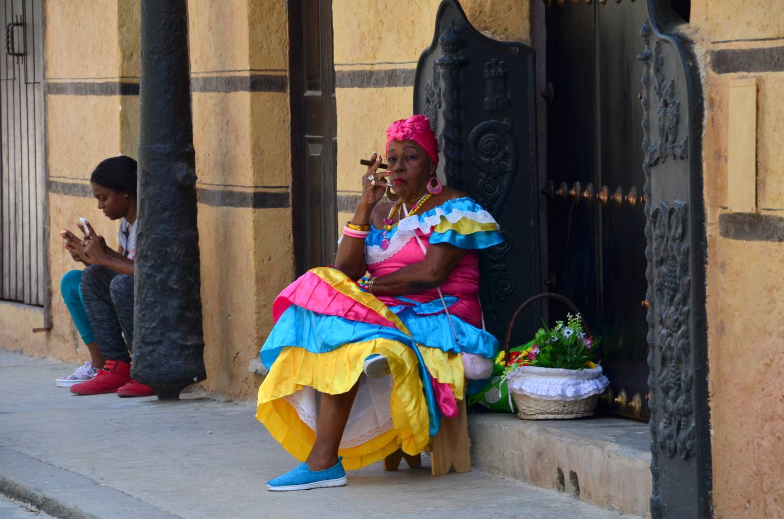
© Isabela Pitish

Slide 8
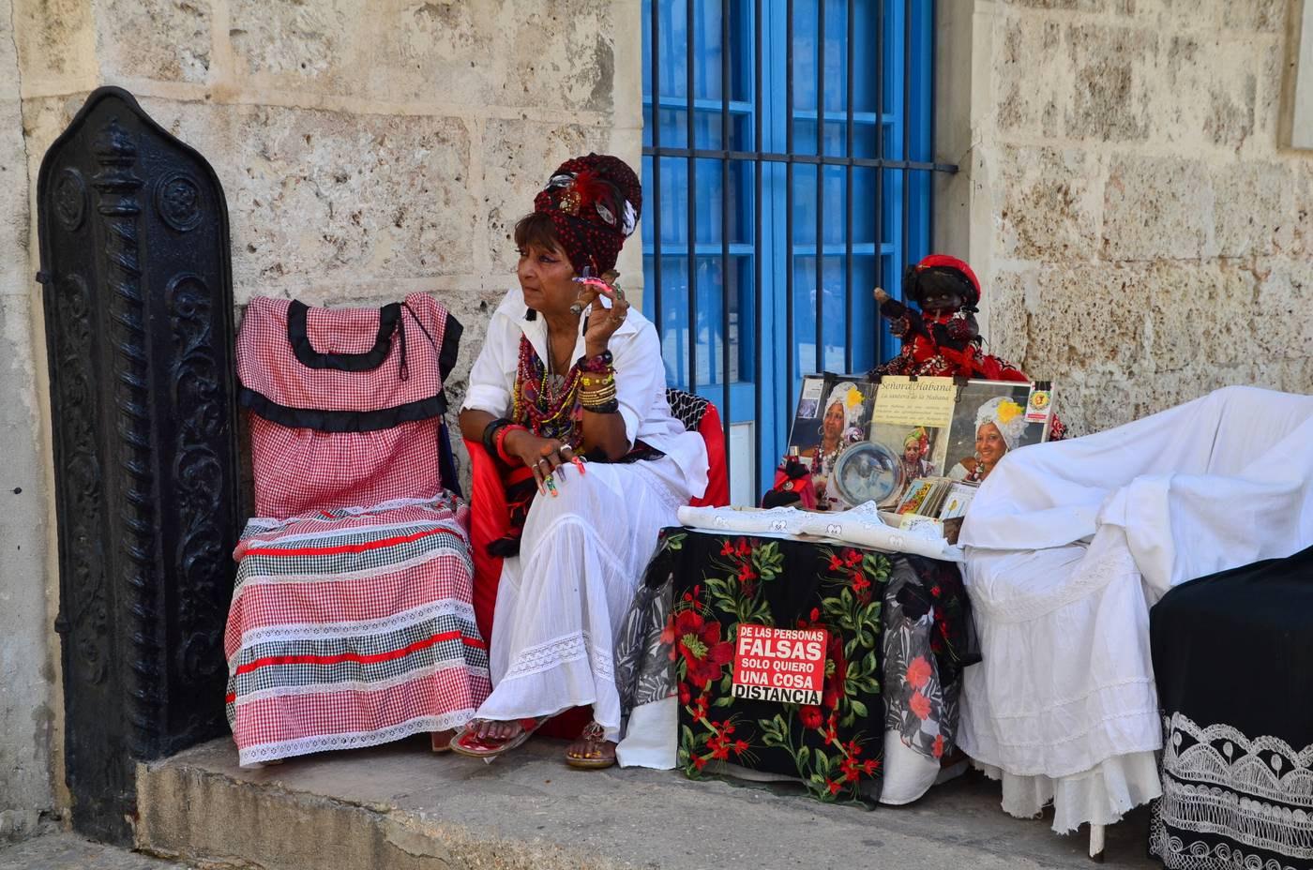
© Isabela Pitish

Slide 9
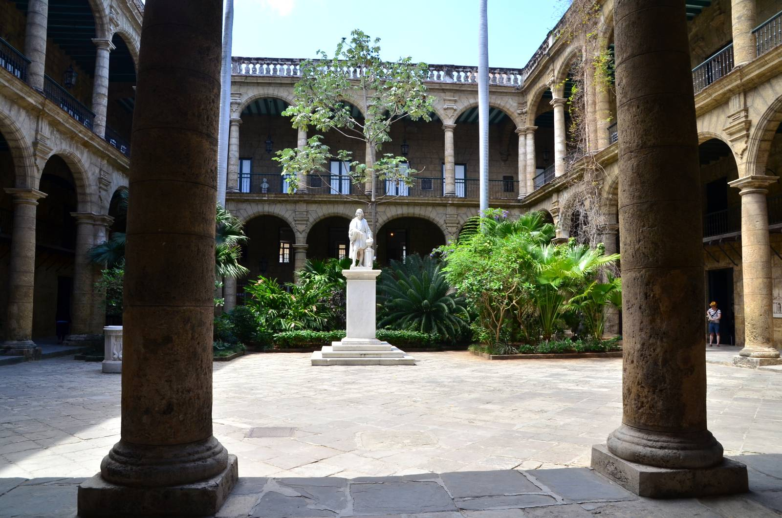
© Isabela Pitish

Slide 10
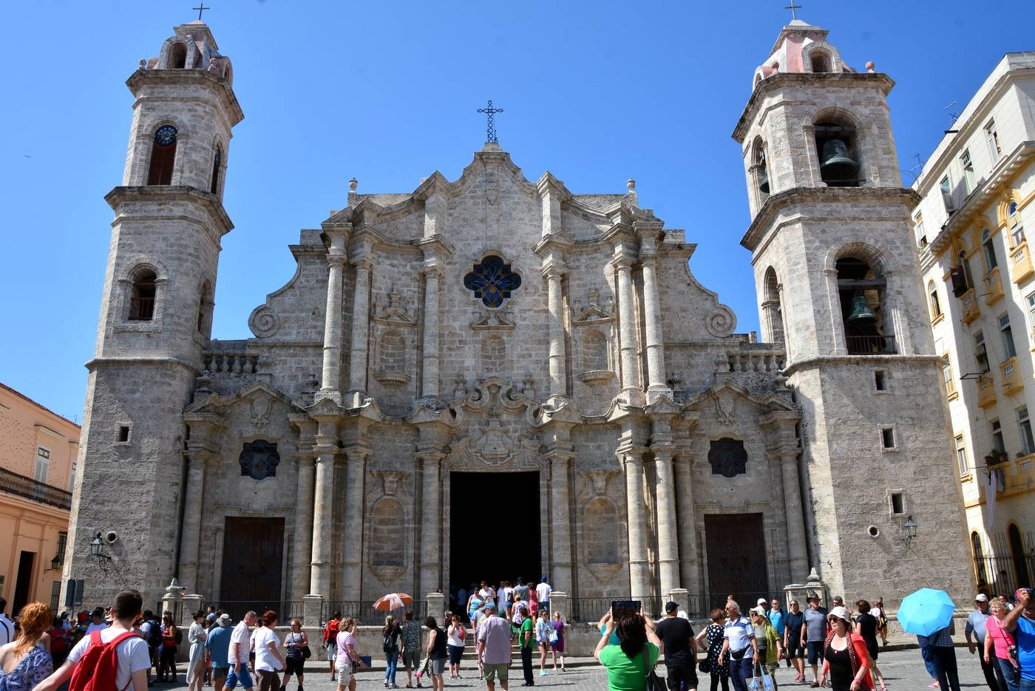
© Isabela Pitish

Slide 11
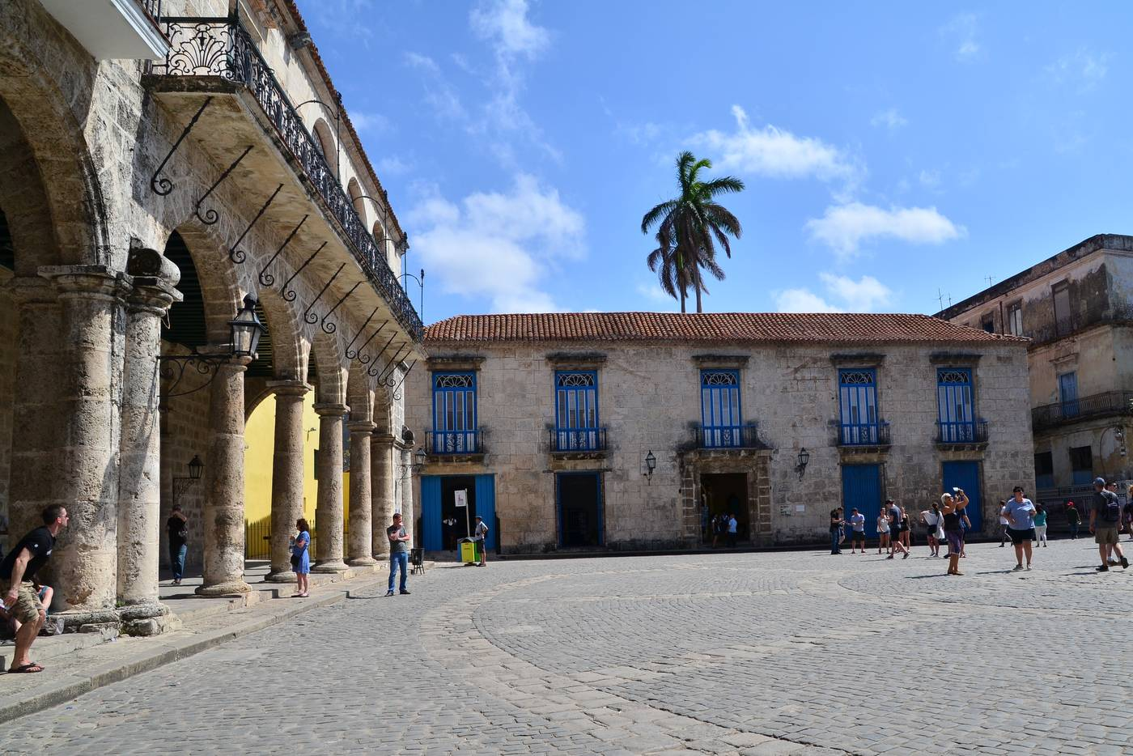
© Isabela Pitish

Slide 12
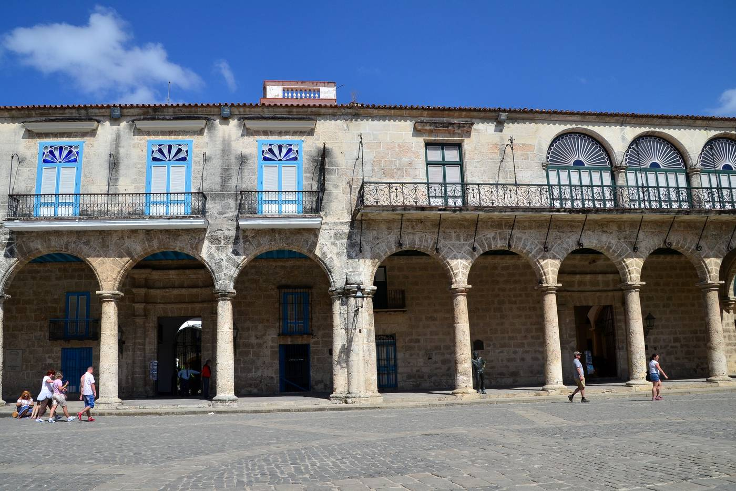
© Isabela Pitish

Slide 13
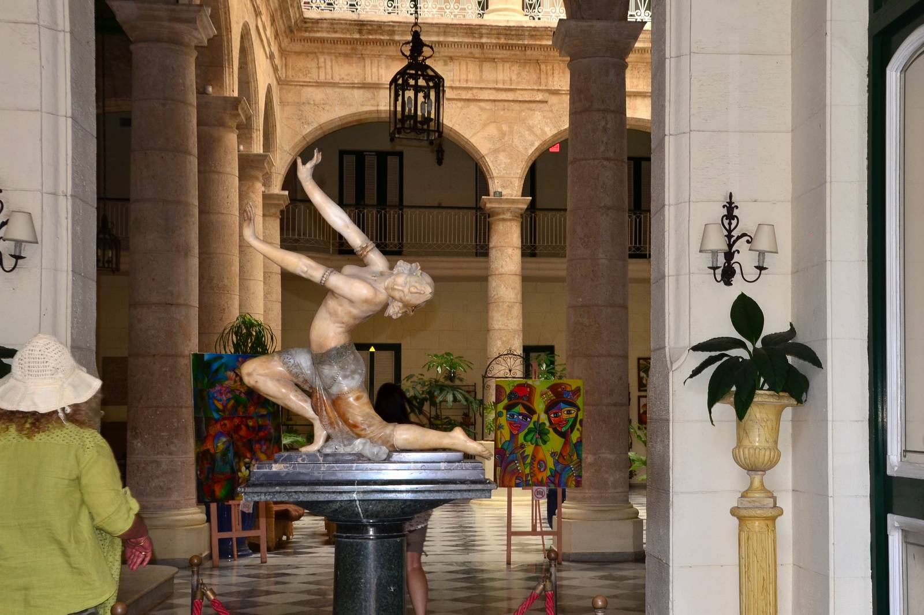
© Isabela Pitish

Slide 14
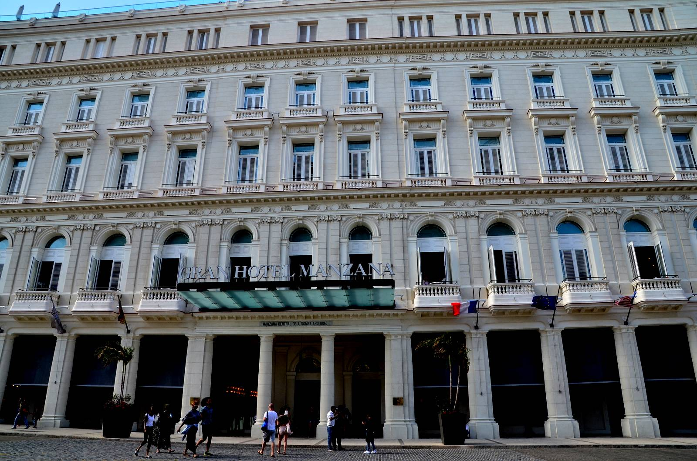
© Isabela Pitish

Slide 15
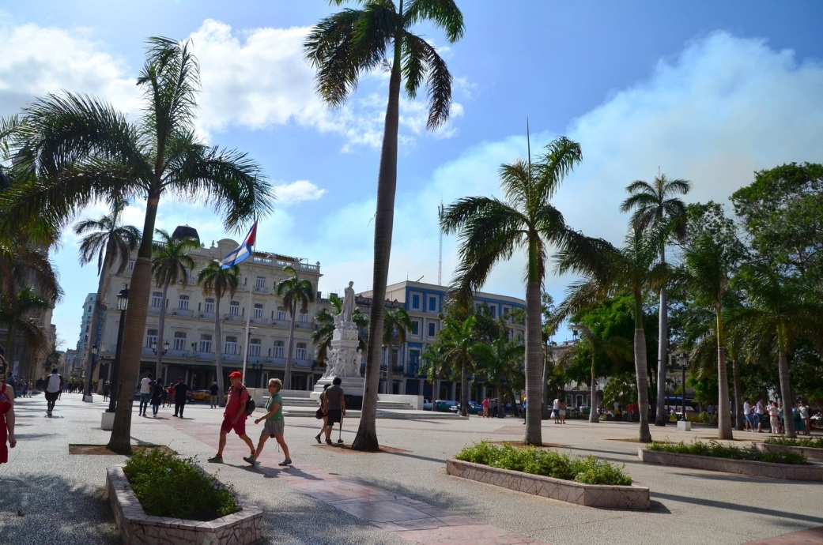
© Isabela Pitish

Slide 16
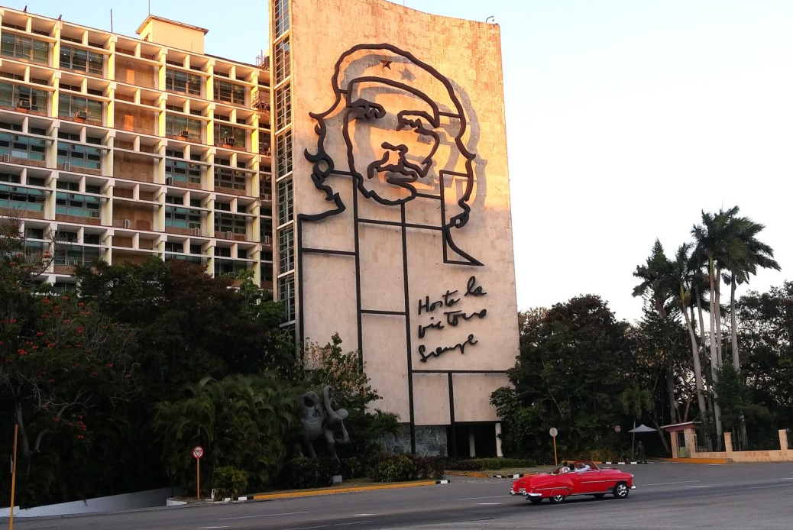
© Isabela Pitish

Slide 17
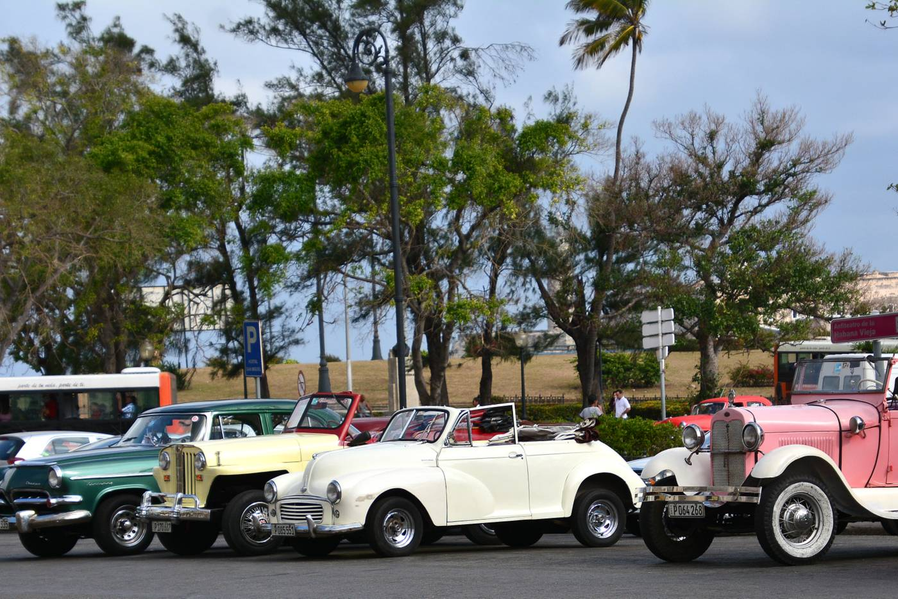
© Isabela Pitish

Slide 18
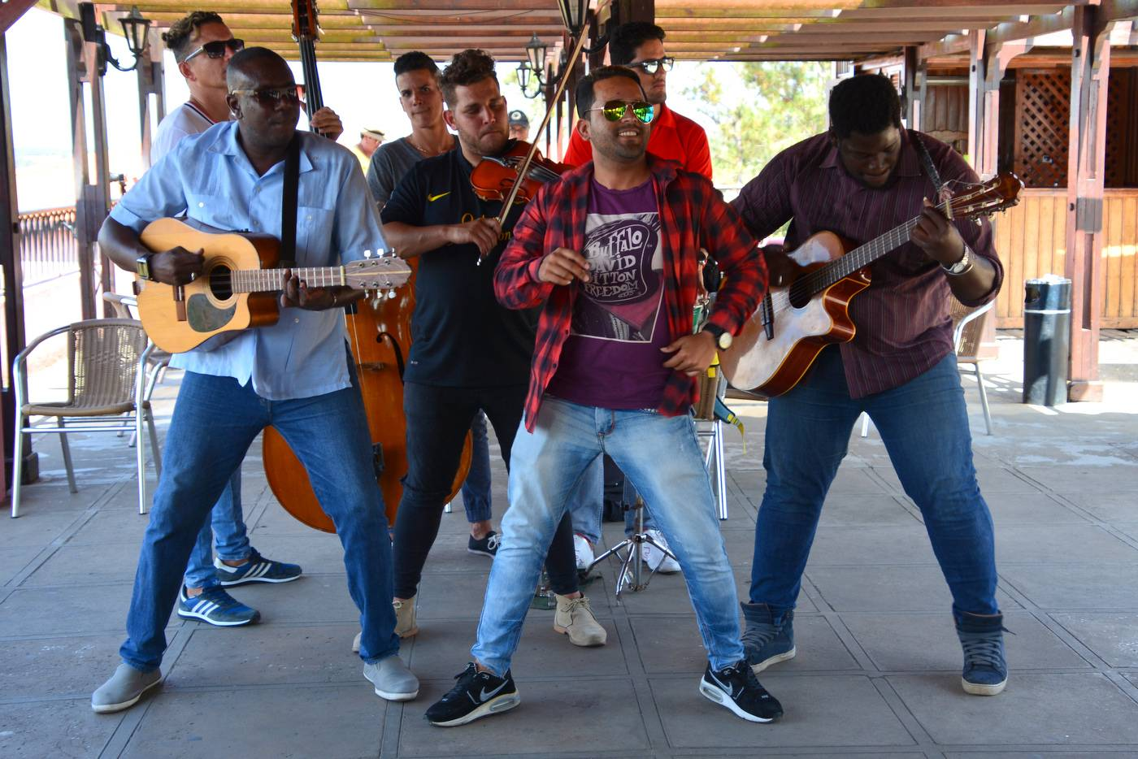
© Isabela Pitish

Slide 19
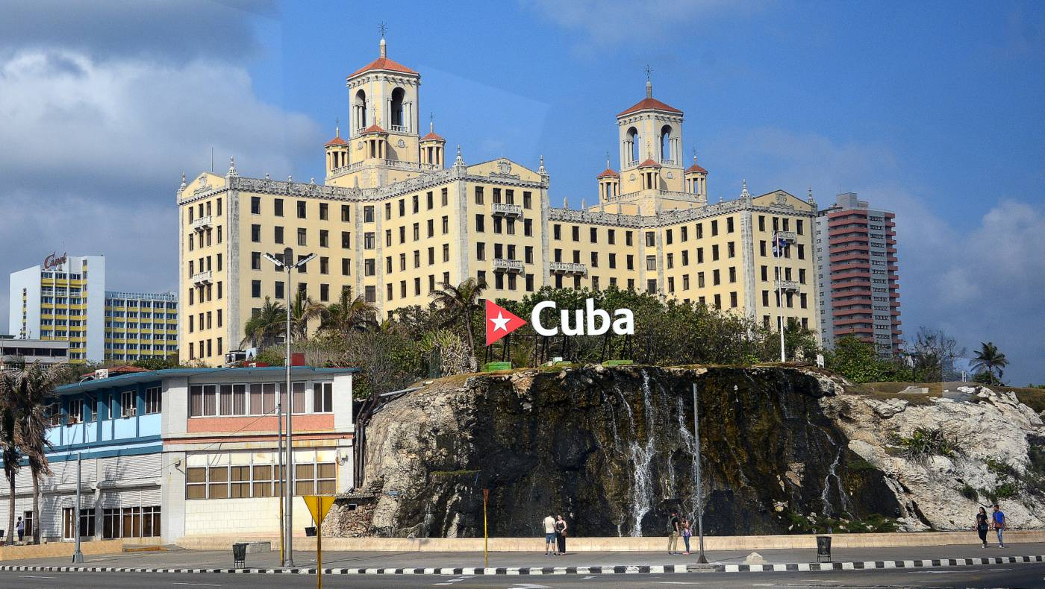
© Isabela Pitish

Slide 20
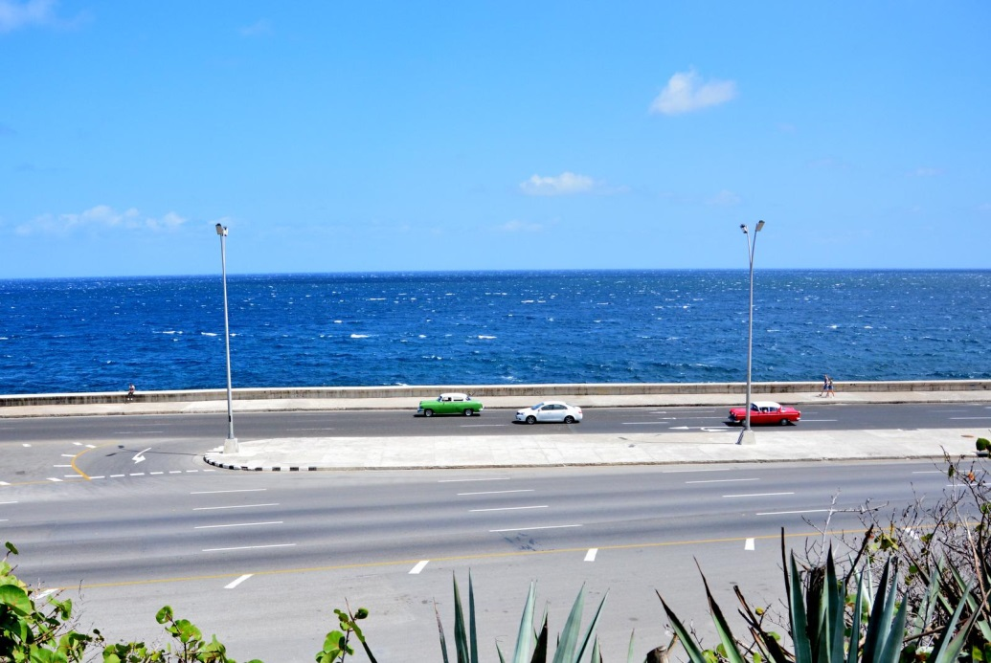
© Isabela Pitish

Slide 21
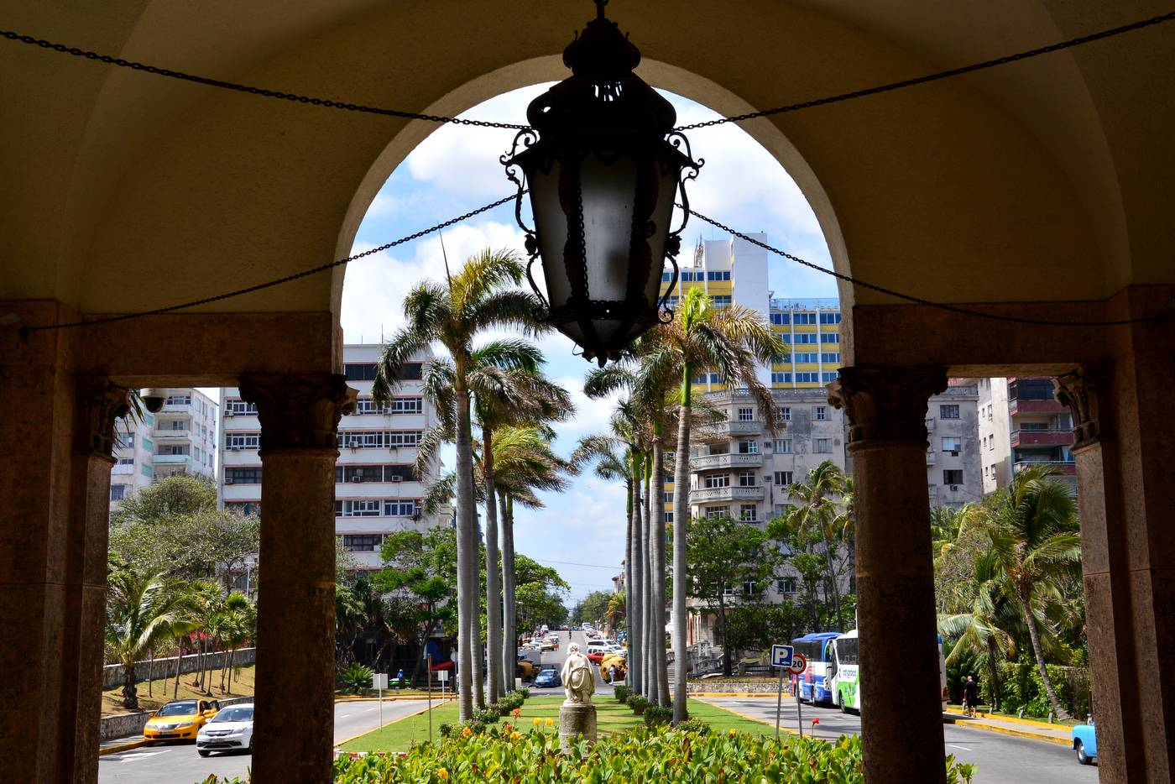
© Isabela Pitish

Slide 22
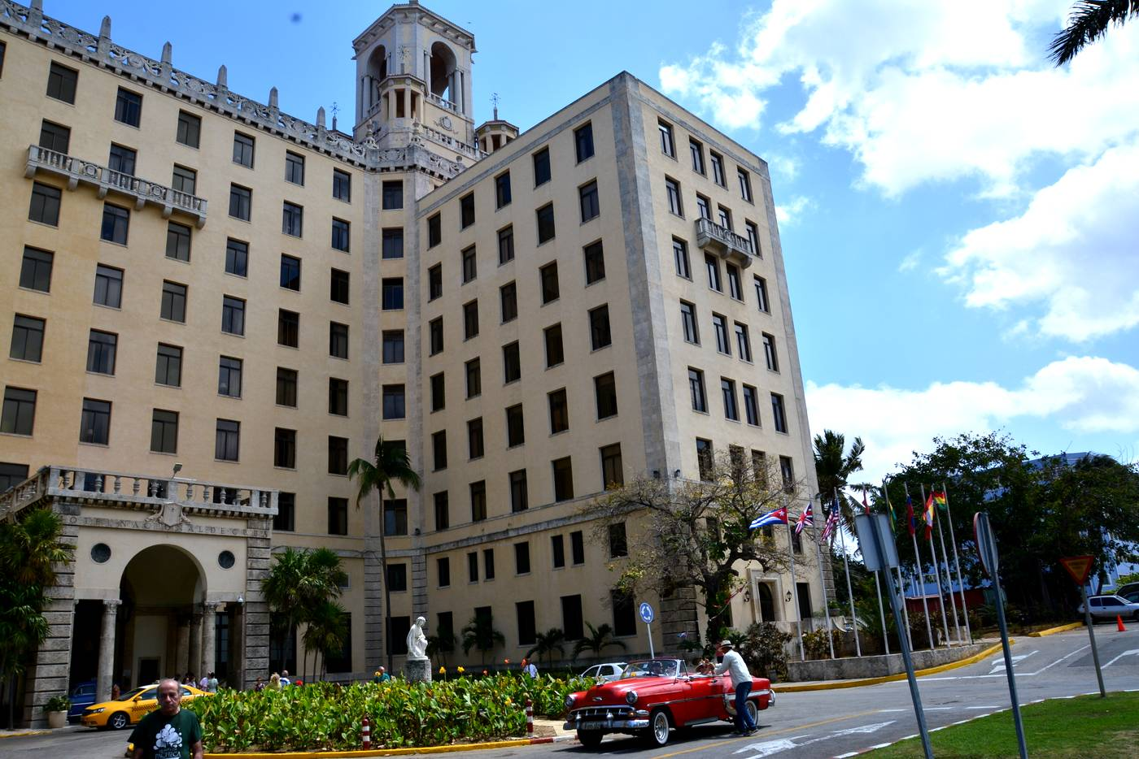
© Isabela Pitish

Slide 23
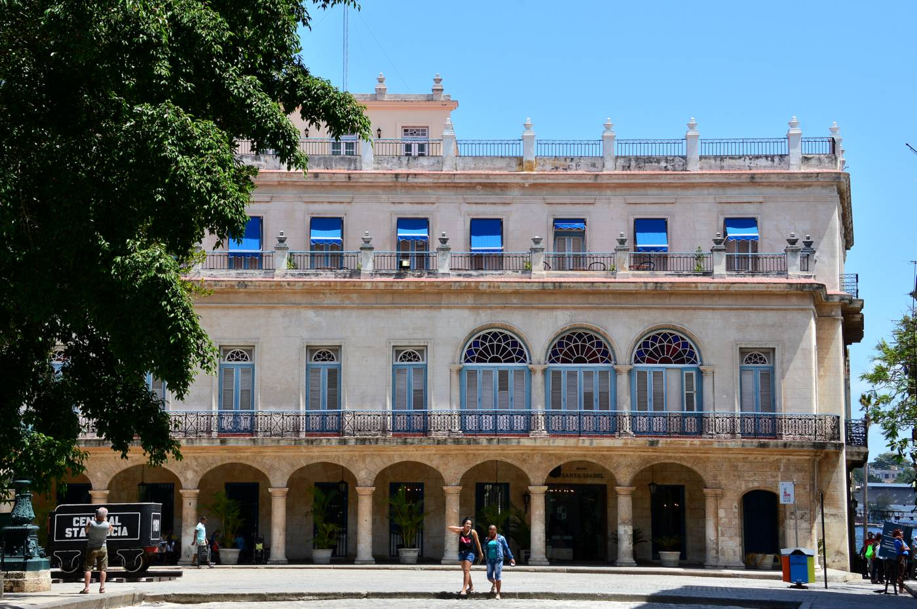
© Isabela Pitish

Slide 24
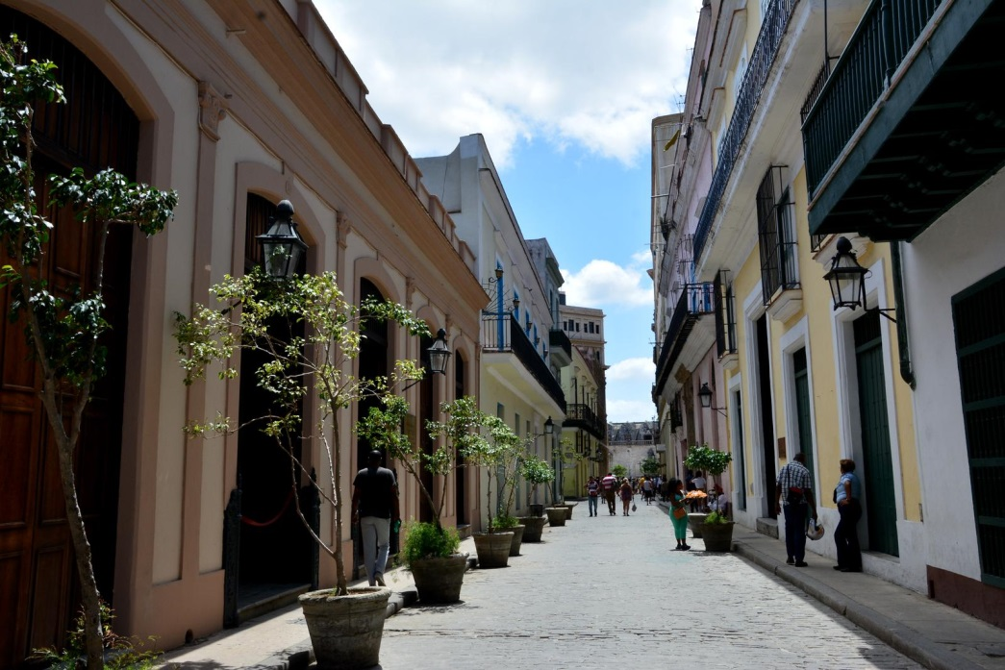
© Isabela Pitish

Slide 25
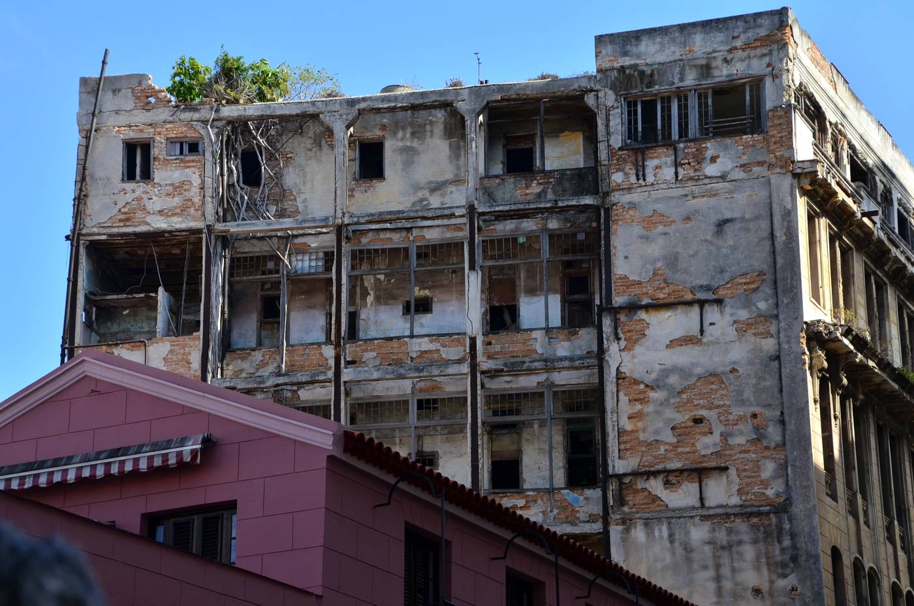
© Isabela Pitish

Slide 26
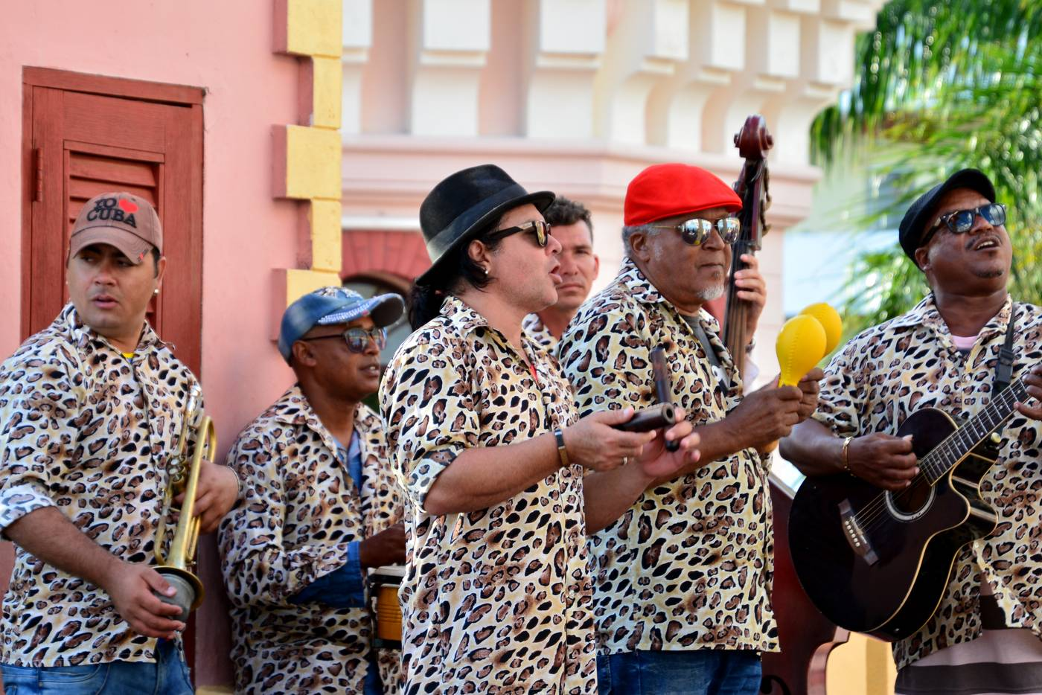
© Isabela Pitish

Slide 27
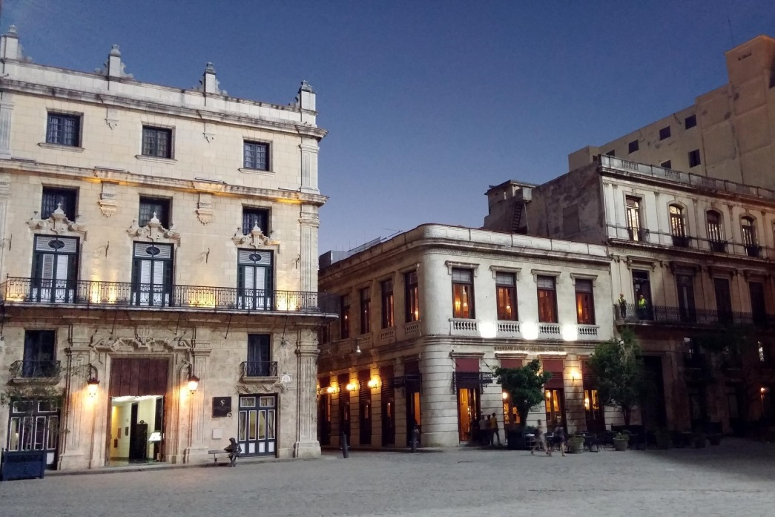
© Isabela Pitish

Slide 28
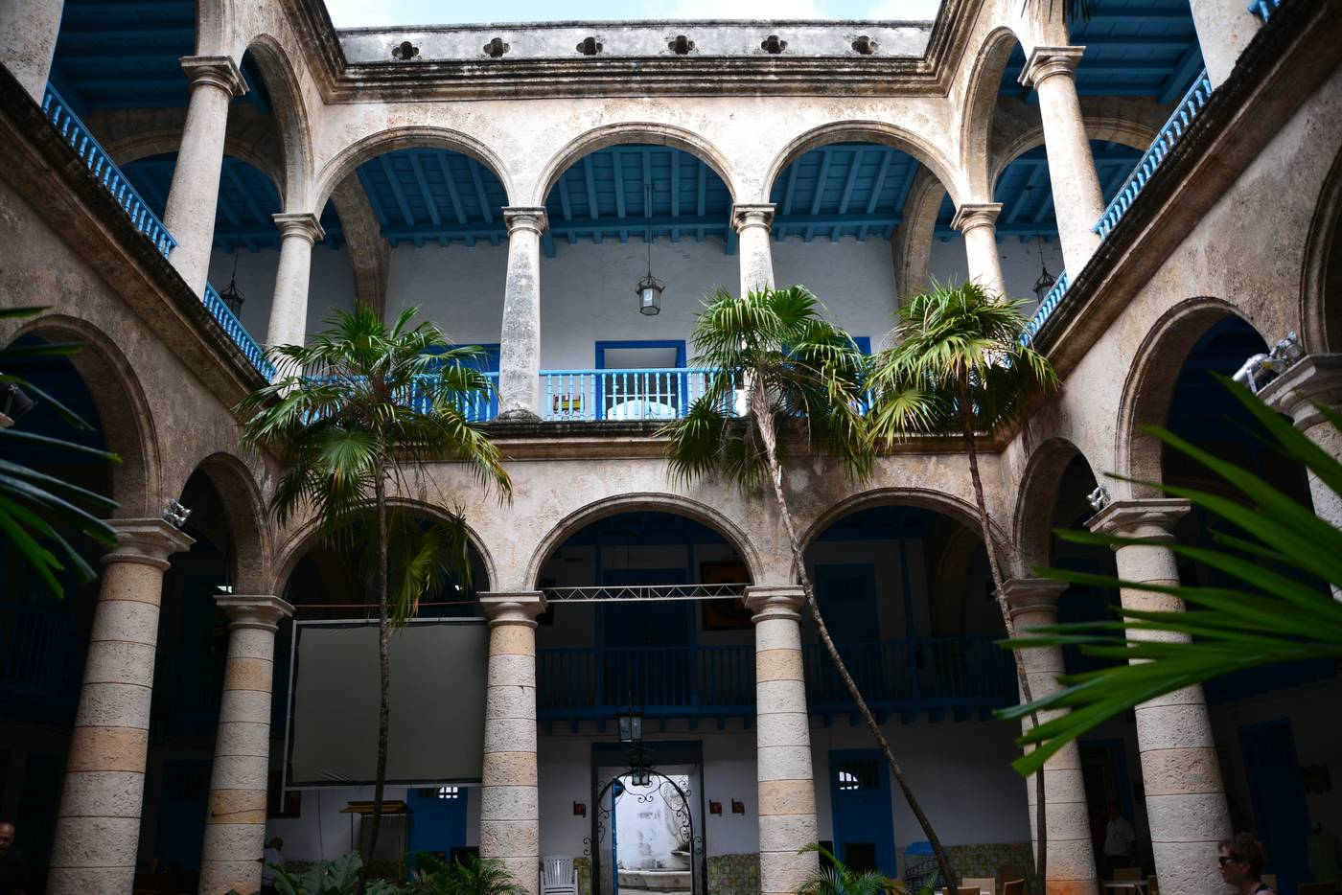
© Isabela Pitish

Slide 29
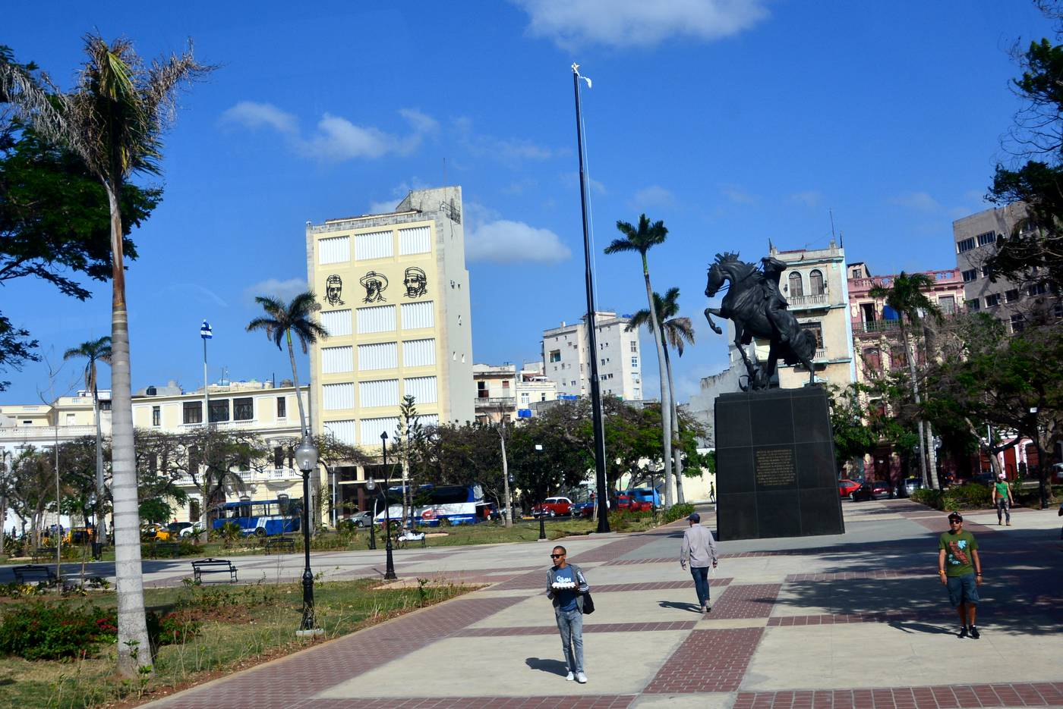
© Isabela Pitish

Slide 30
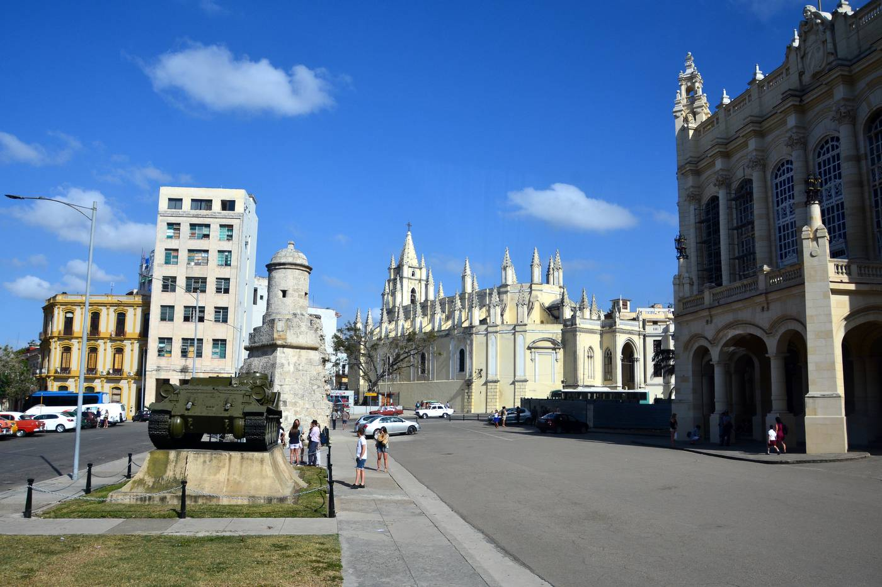
© Isabela Pitish

Slide 31
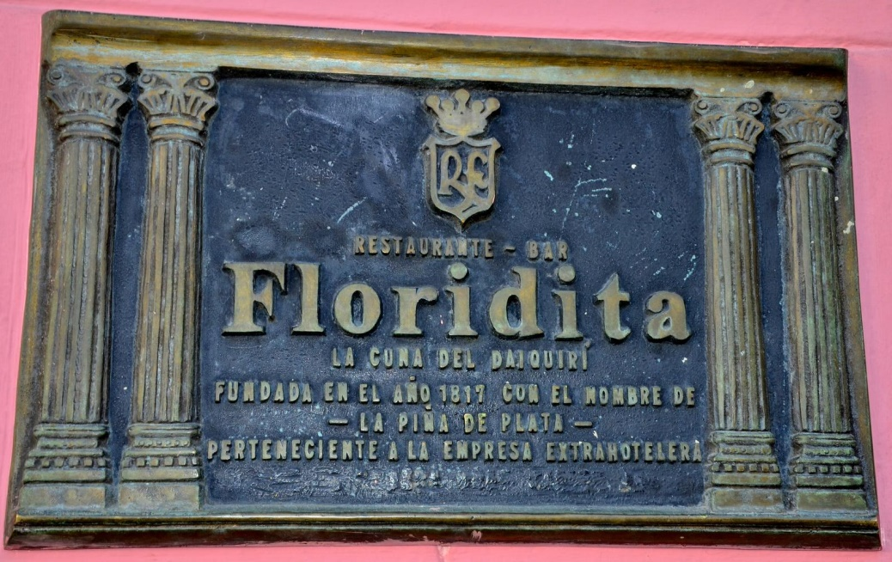
© Isabela Pitish

Slide 32
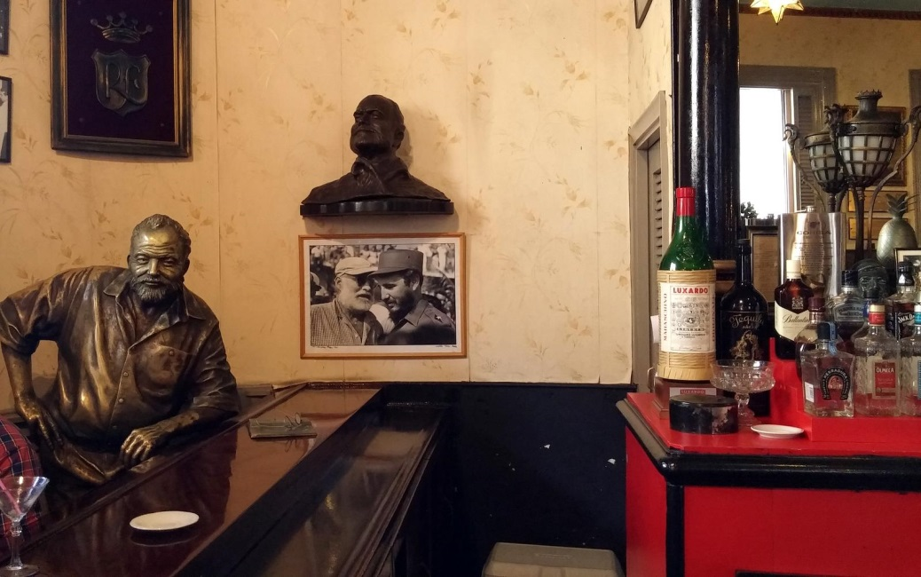
© Isabela Pitish

Slide 33
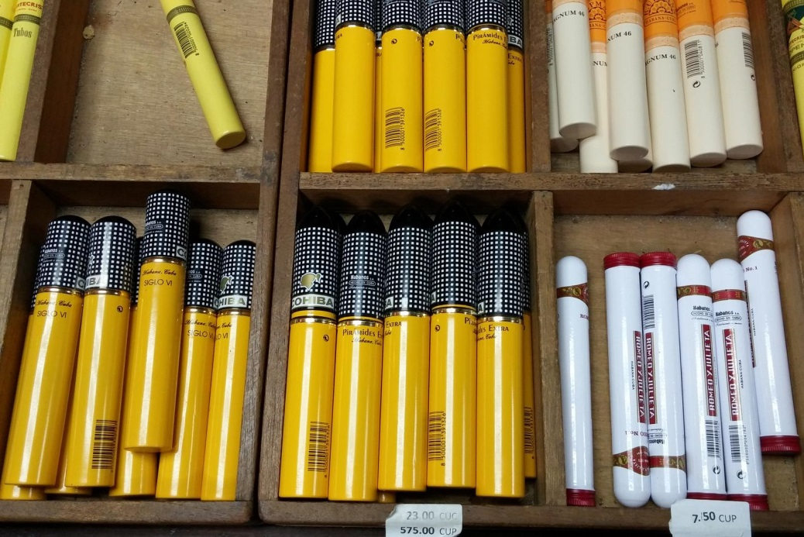
© Isabela Pitish

Slide 34
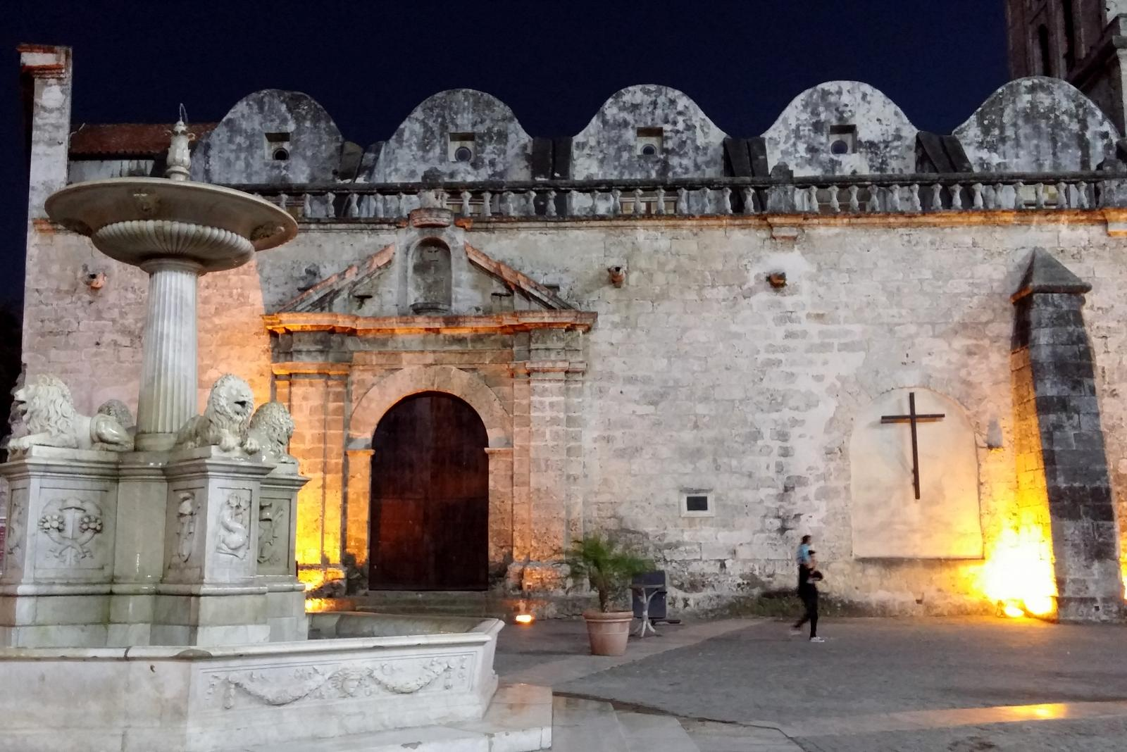
© Isabela Pitish

Slide 35
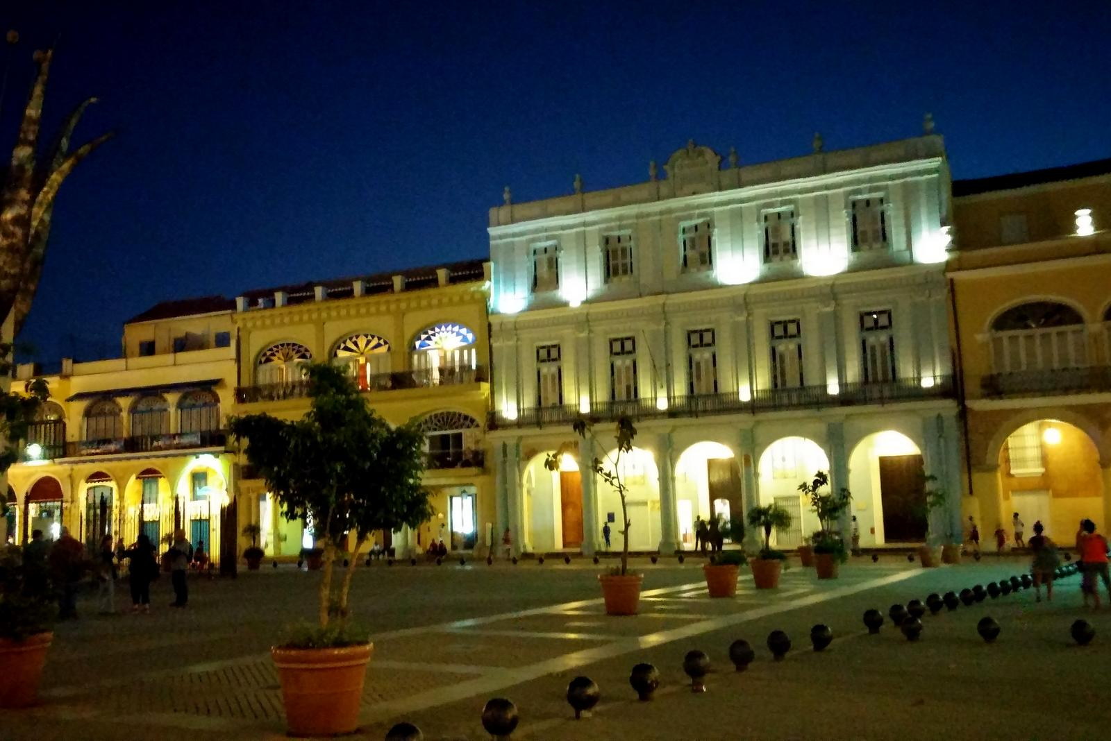
© Isabela Pitish

Slide 36
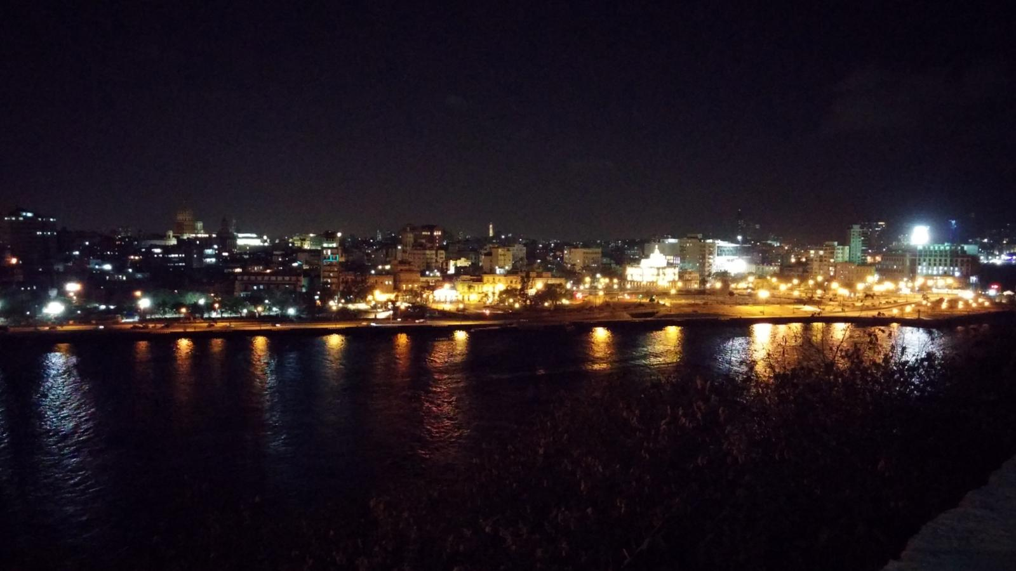
© Isabela Pitish
Created by Izabela & Miki Pitish
Music: Cubana - Guantanamera

Slide 37







¿Te ha gustado?
Puedes ver más entrando
Aquí
Además puedes recibir powerpoints en tu correo electrónico suscribiéndote aquí:

