Slide 1
Detroit City
United States

Slide 2
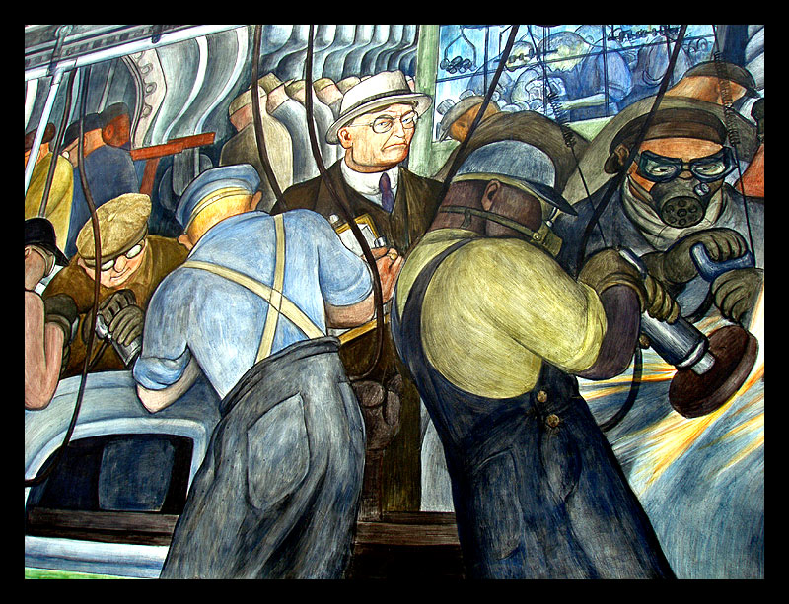
Detroit Industry 1 by pamastro

Slide 3
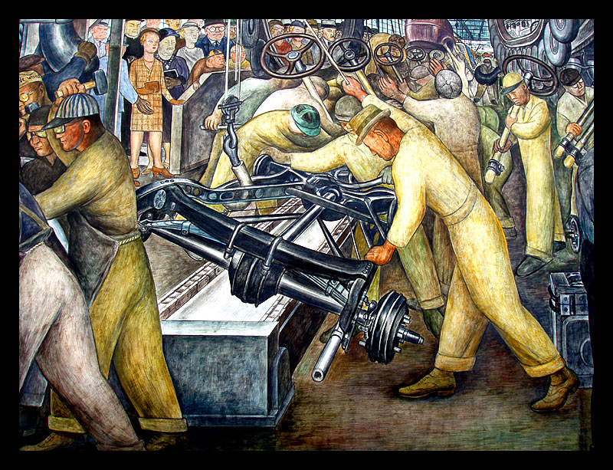
Detroit Industry 2 by pamastro

Slide 4
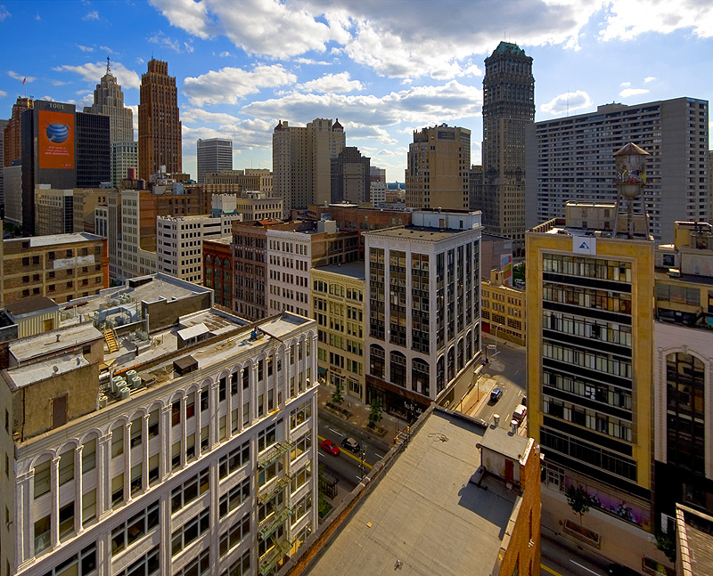
Merchant's Row by gsgeorge

Slide 5
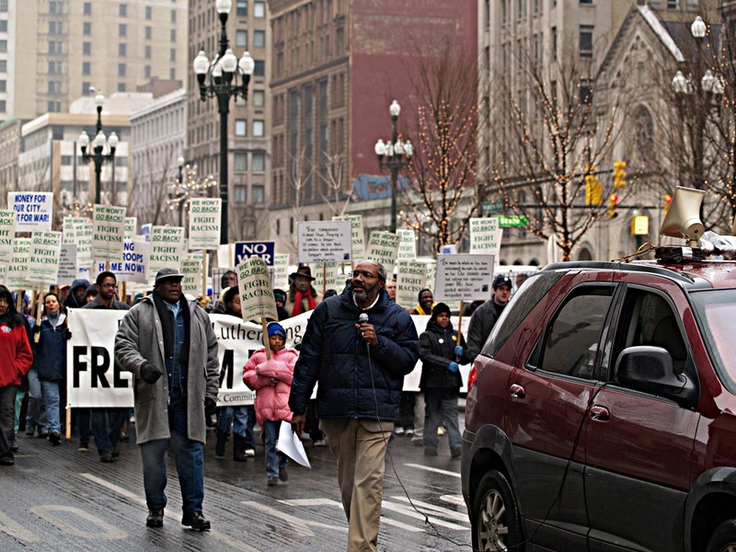

Slide 6
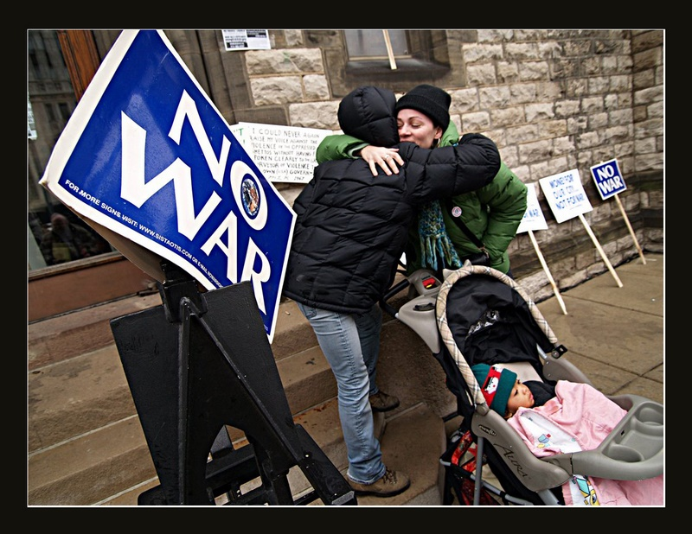
The Arab & the Jew...... by rafid76

Slide 7
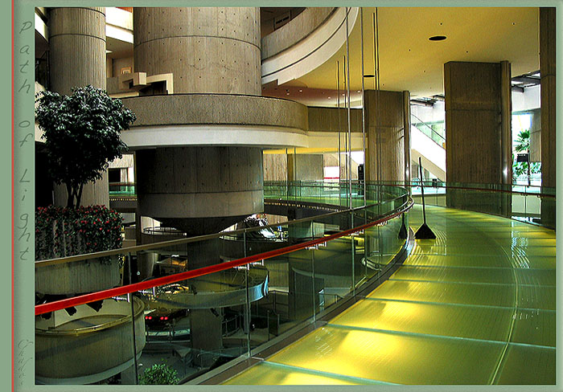
Path of Ligth by chados

Slide 8

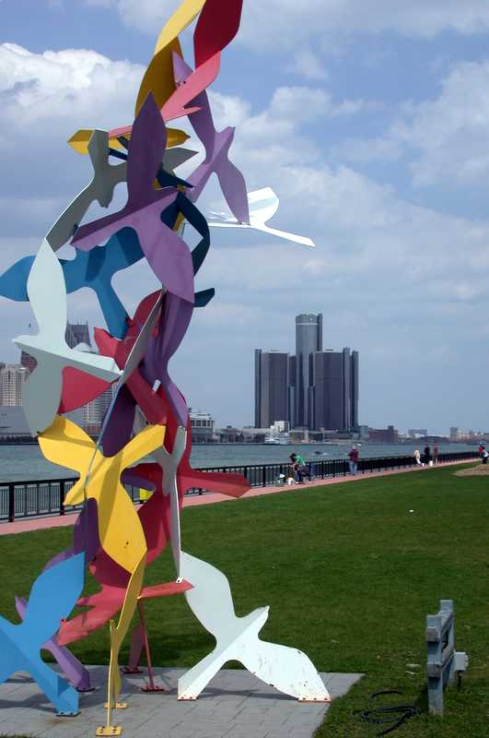
Detroit Skyline by fmartincic
untitled by dcole

Slide 9
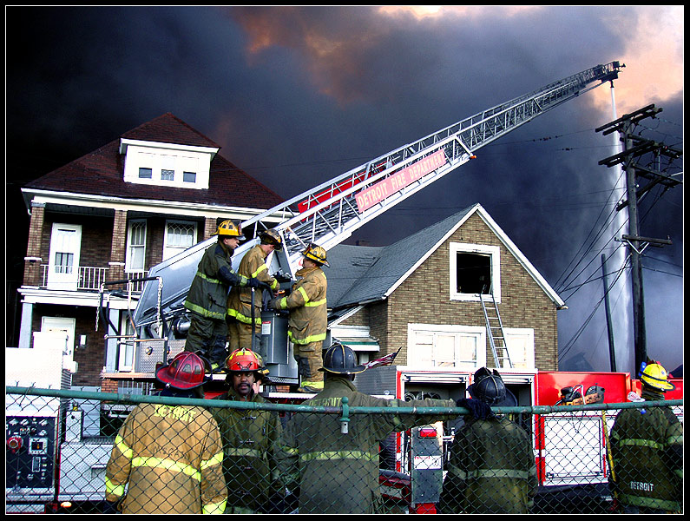
Firefighters in Motion by pamastro

Slide 10
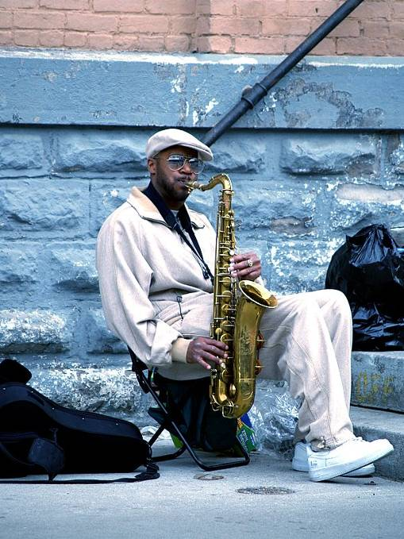
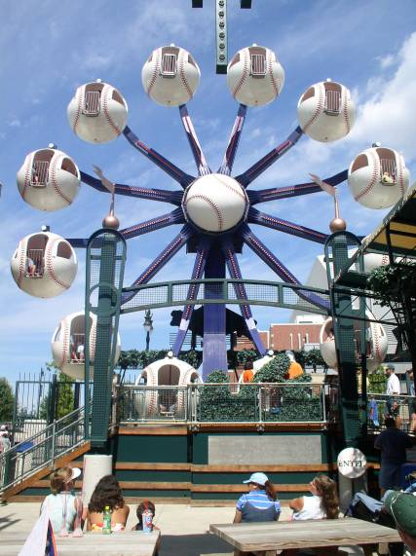
street jazz by rafid76

Slide 11
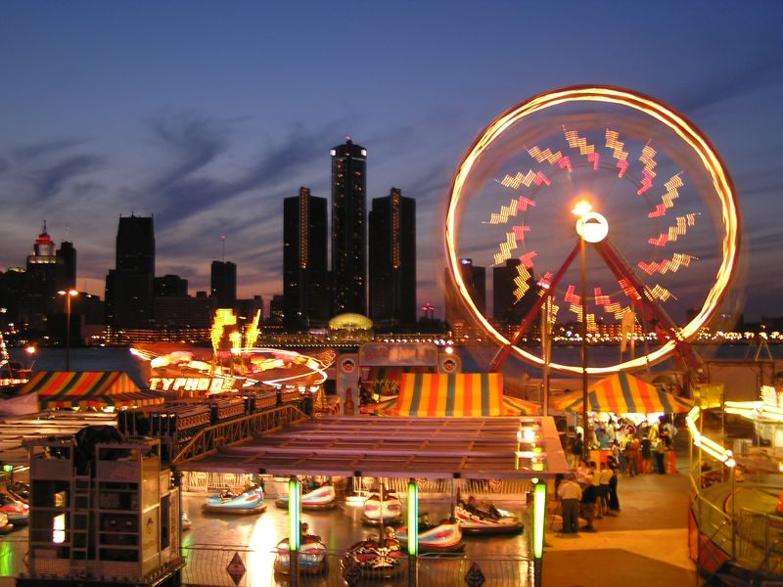
Detroit skyline by thewanderer

Slide 12
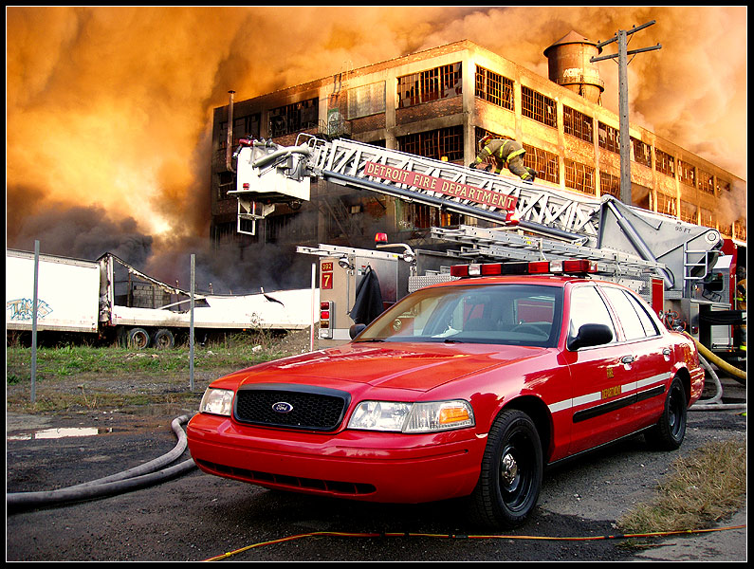
The Fires of Hell by pamastro

Slide 13
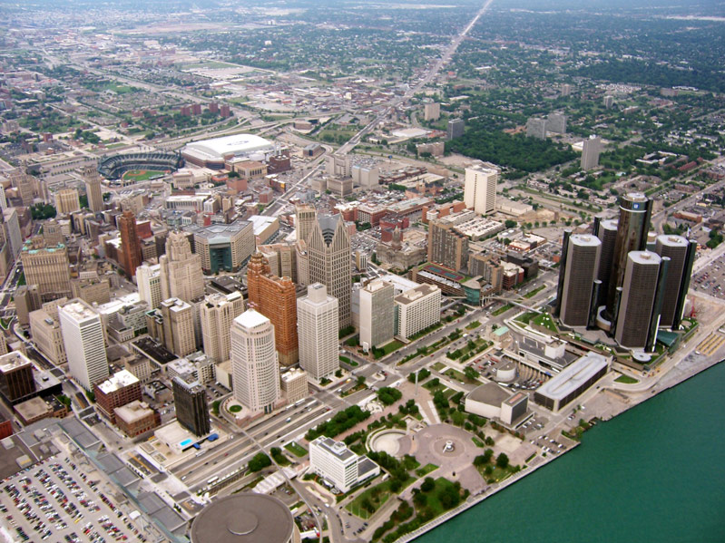
Detroit Flyby NE by belantis

Slide 14
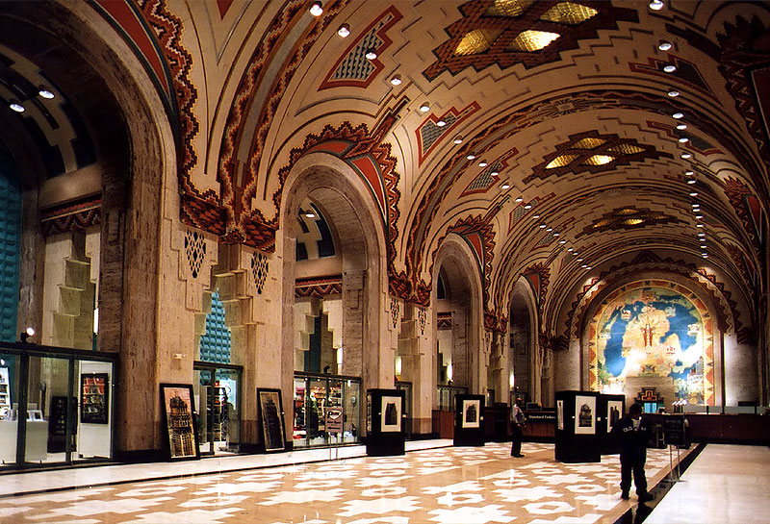
The Great Cathedral of Finance by pamastro

Slide 15
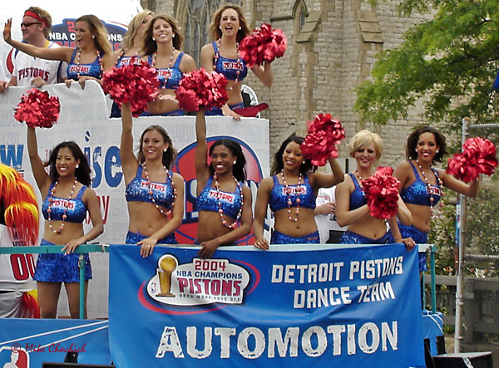
Automotion by mdchachi

Slide 16
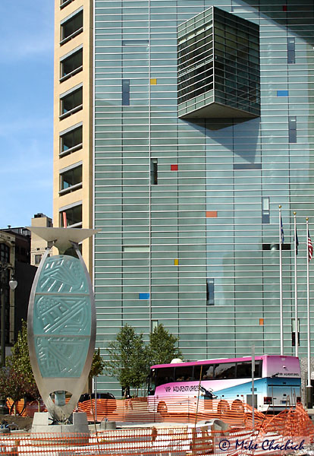
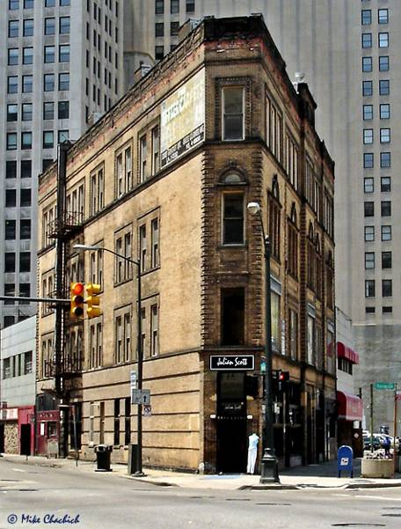
Detroit Corner by mdchachi
Monroe St Corner Marker by mdchachi

Slide 17
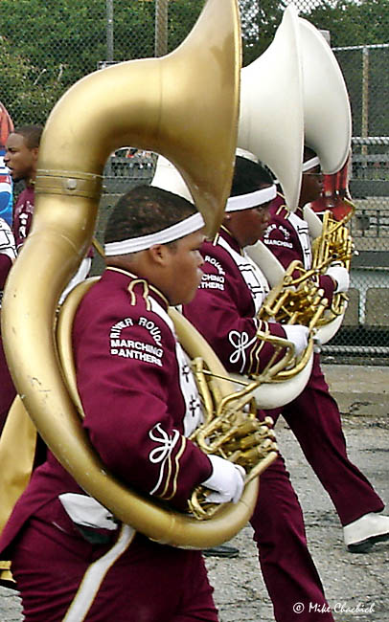
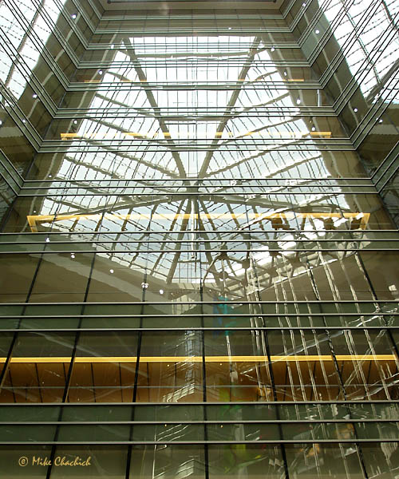
Tubas by mdchachi
Compuware Reflections by mdchachi

Slide 18
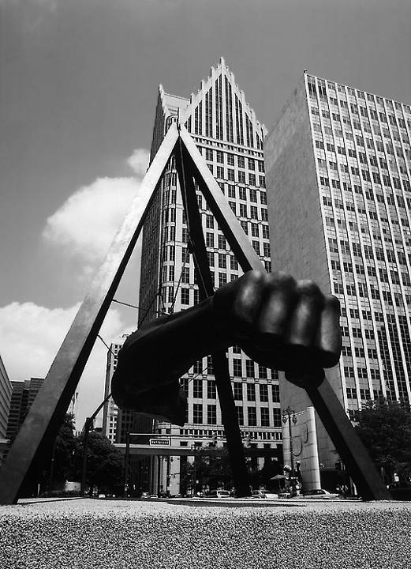
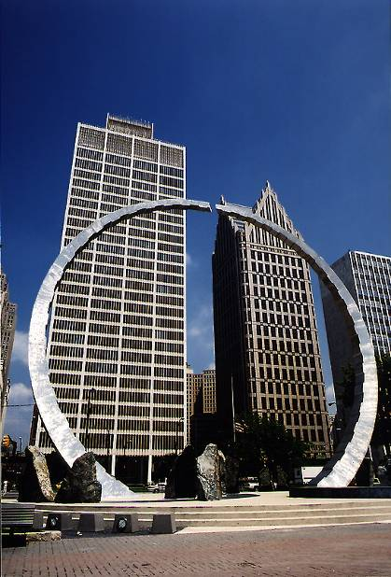
The Fist of Joe Louis by pamastro
The Workers' Monument by pamastro

Slide 19
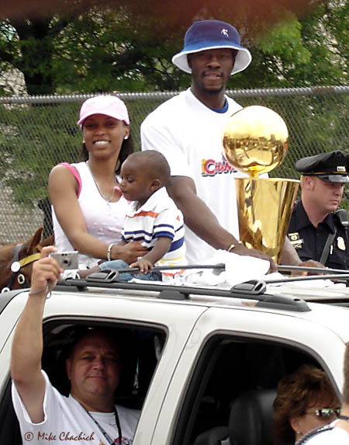
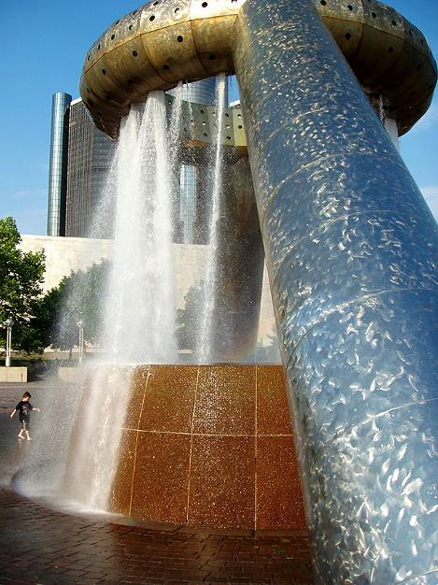
The Fountain by pamastro
Ben Wallace by mdchachi

Slide 20
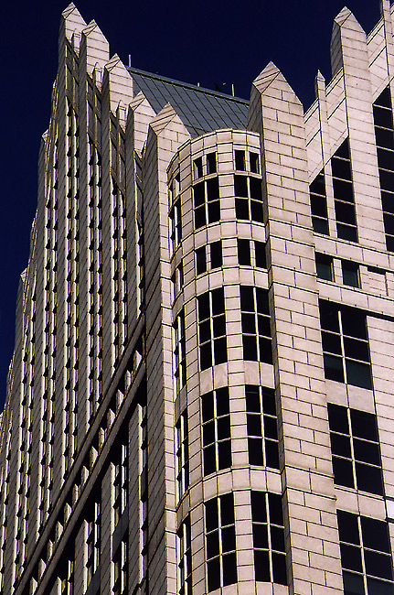
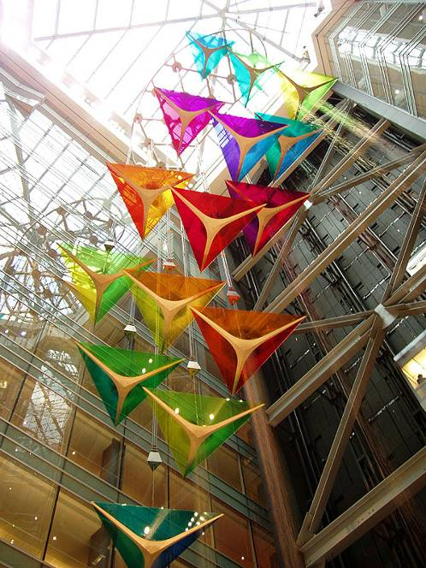
Ascension of the Triangles by pamastro
Building Against Blue Sky by pamastro

Slide 21

Copyright: David Holliday

Slide 22
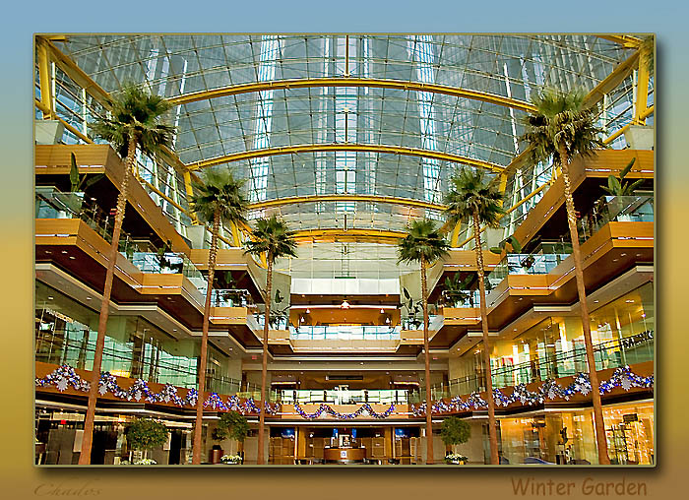
Copyright: Plamen Valchev

Slide 23
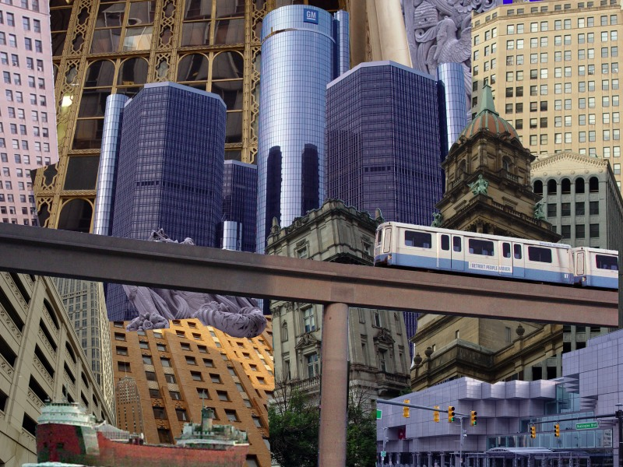
Glass, Bricks and Steel
Copyright: James Olsson

Slide 24
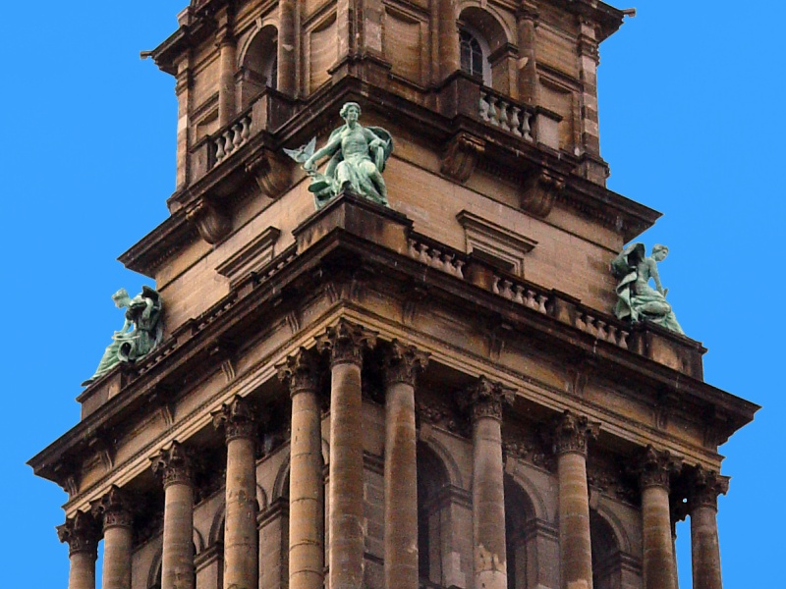
Copyright: James Olsson

Slide 25
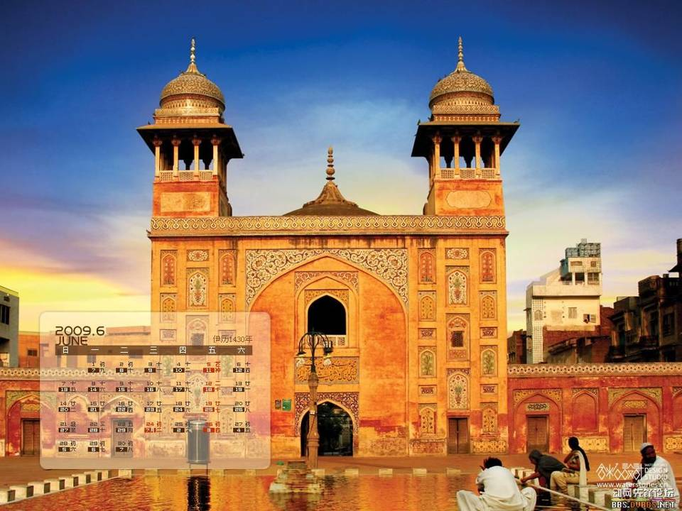

Slide 26
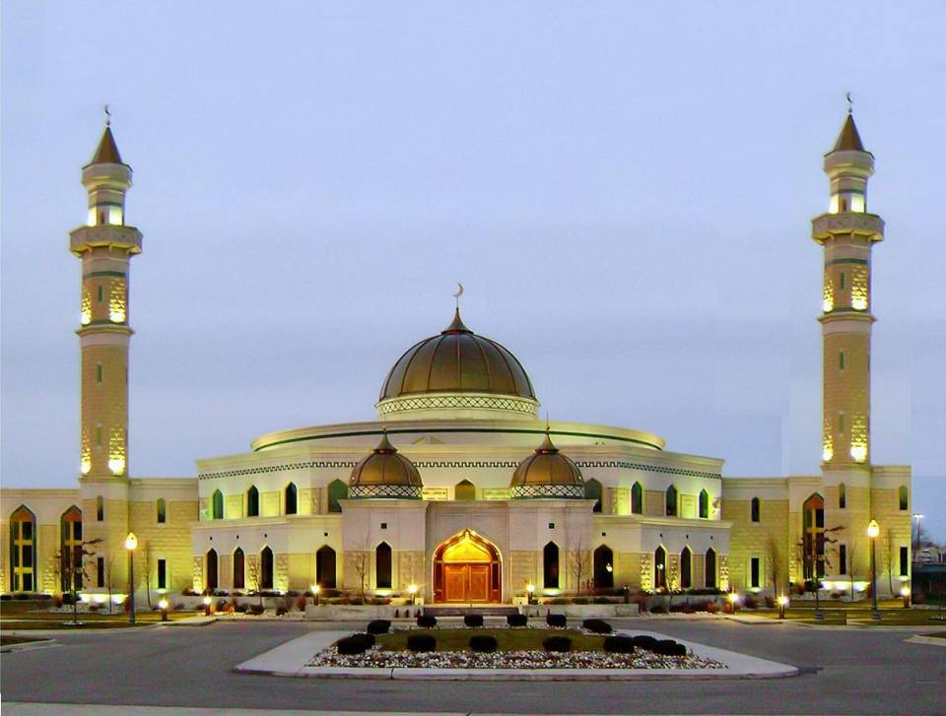

Slide 27
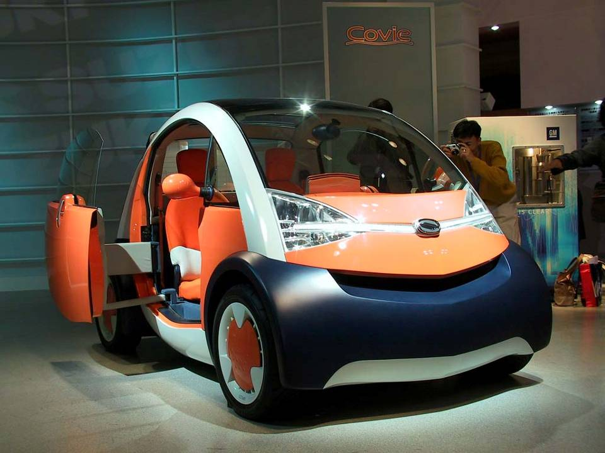

Slide 28
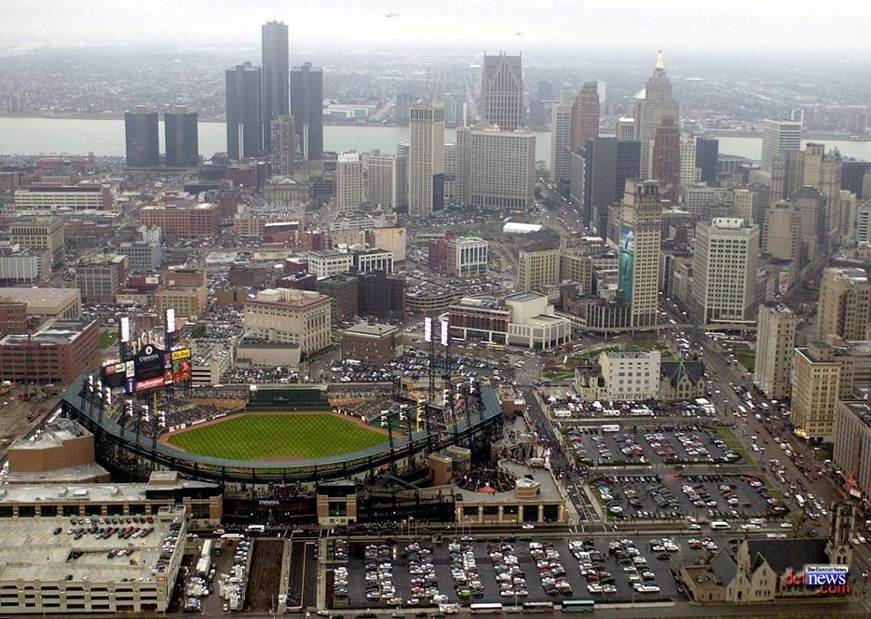

Slide 29
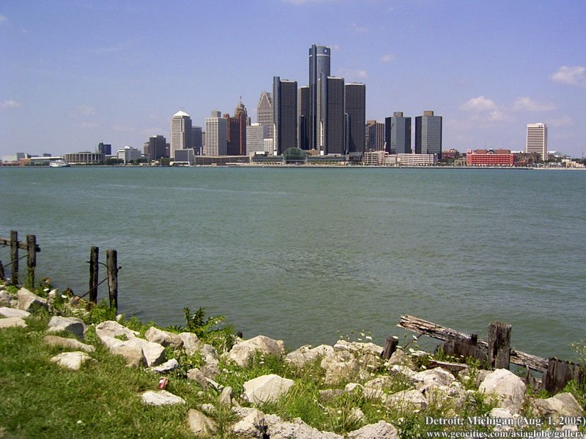

Slide 30
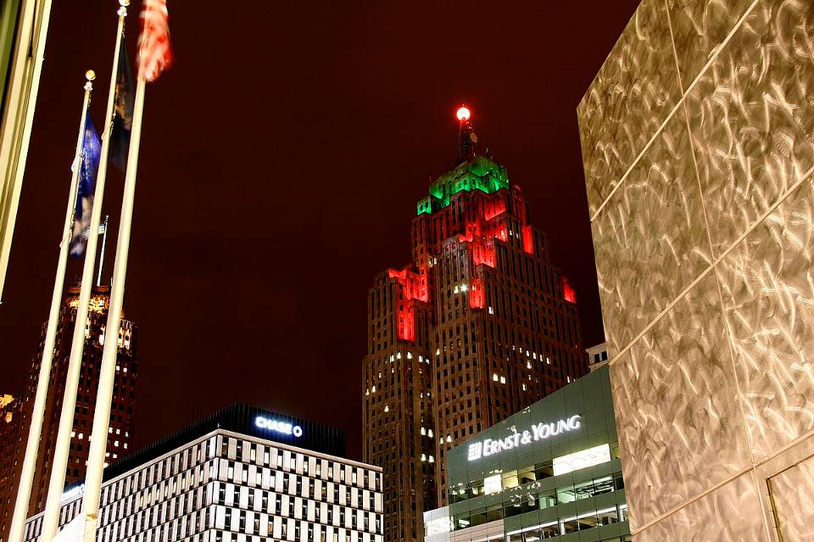

Slide 31
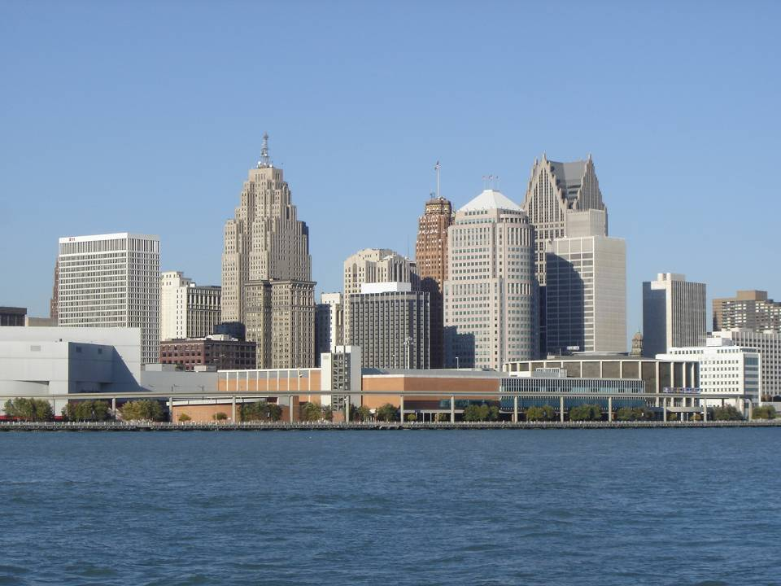

Slide 32
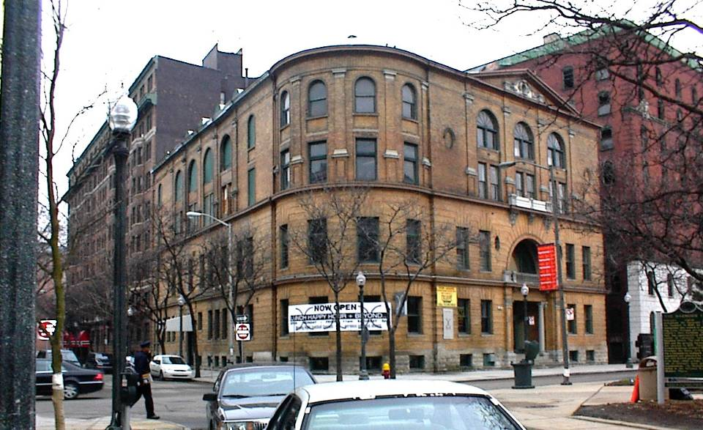

Slide 33
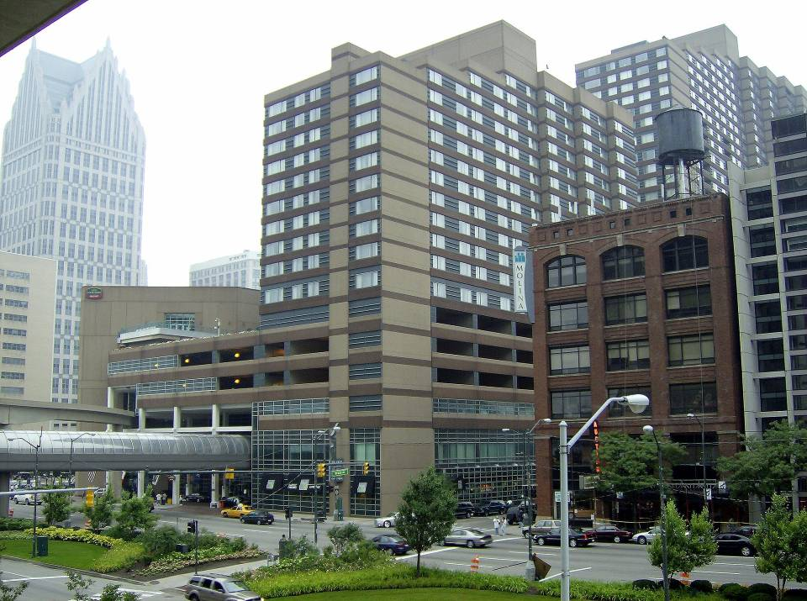

Slide 34
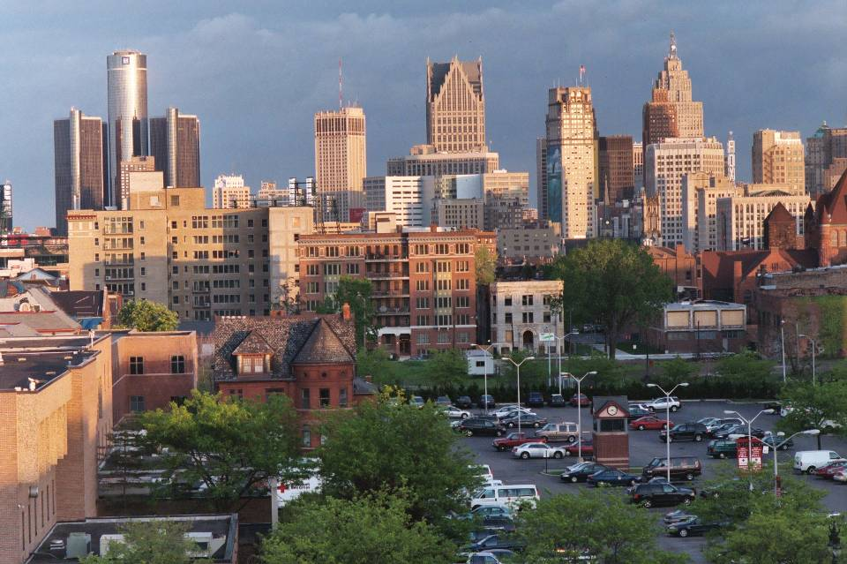

Slide 35
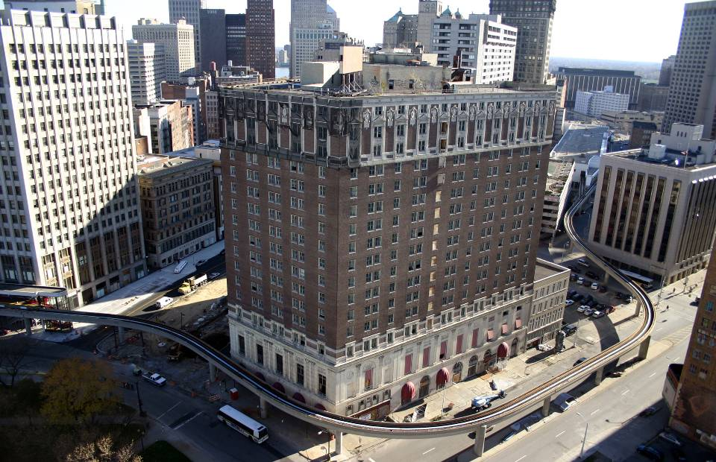

Slide 36
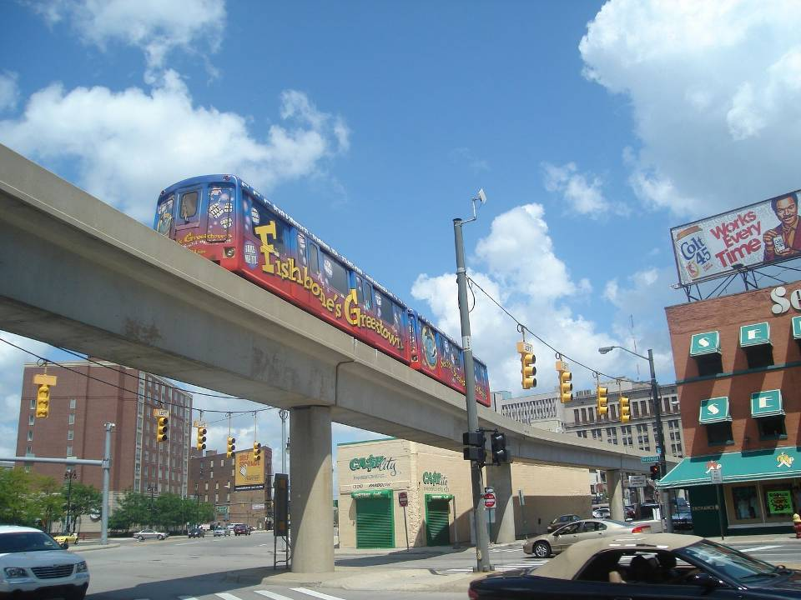

Slide 37
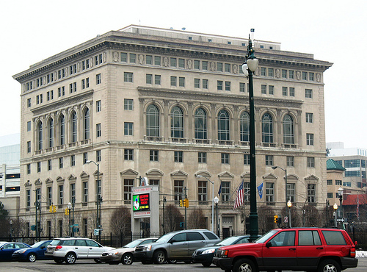

Slide 38


Slide 39
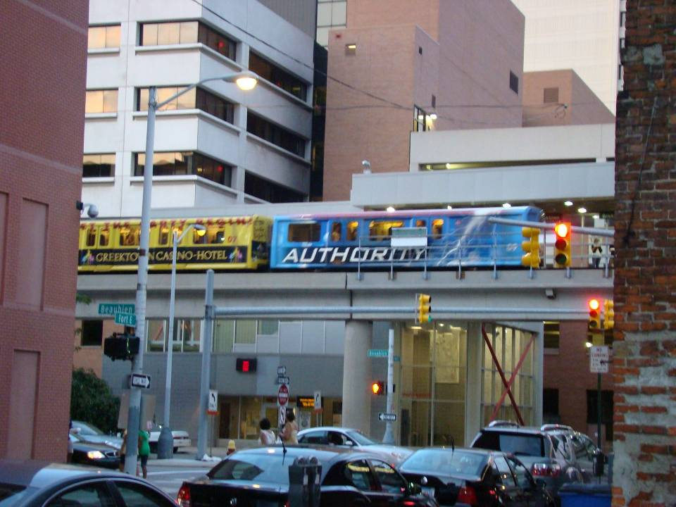

Slide 40
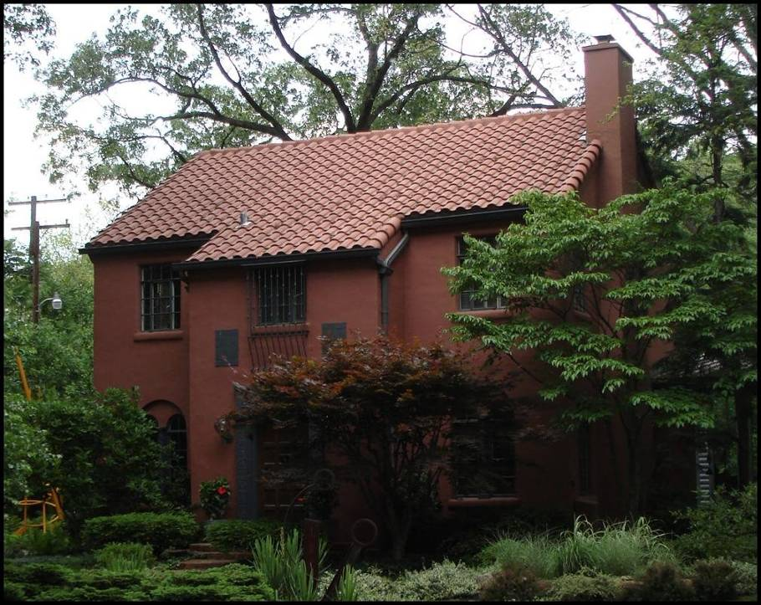

Slide 41
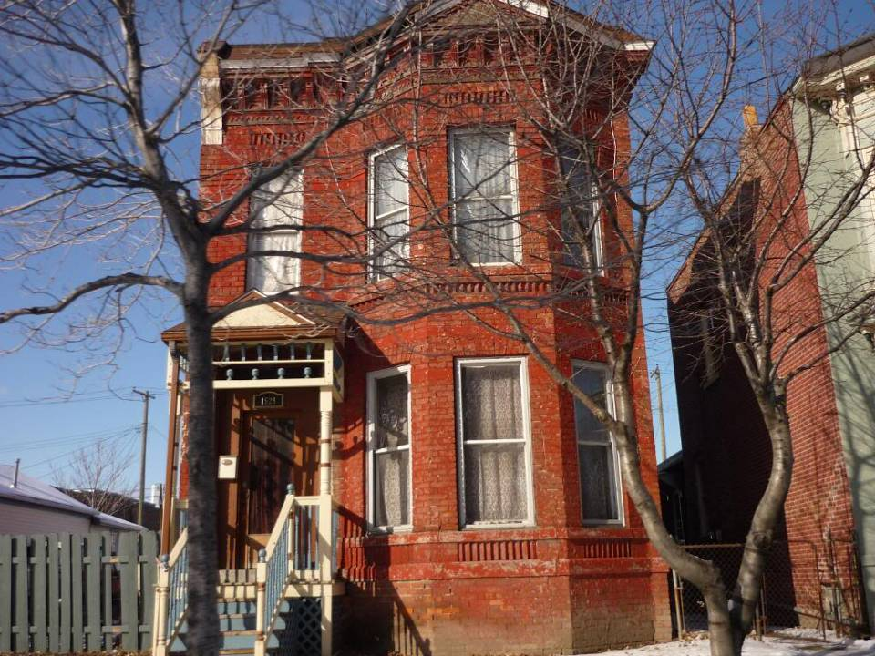

Slide 42
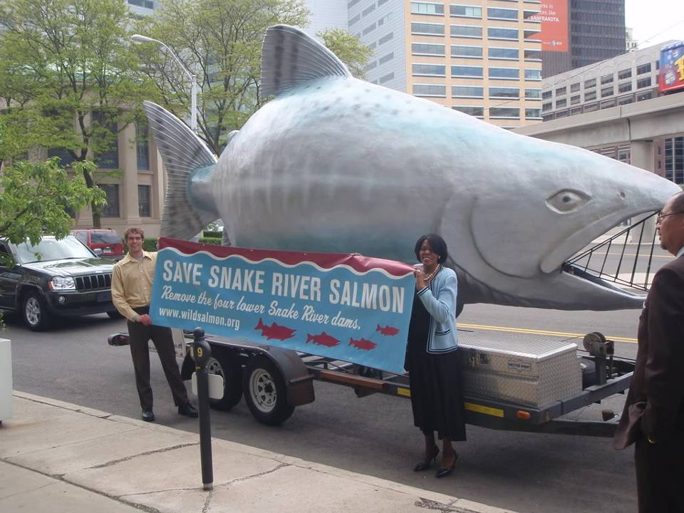

Slide 43
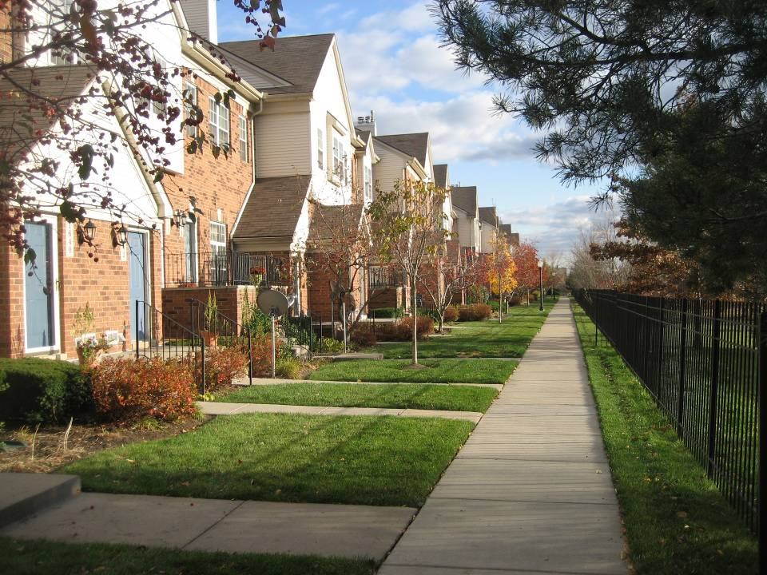

Slide 44
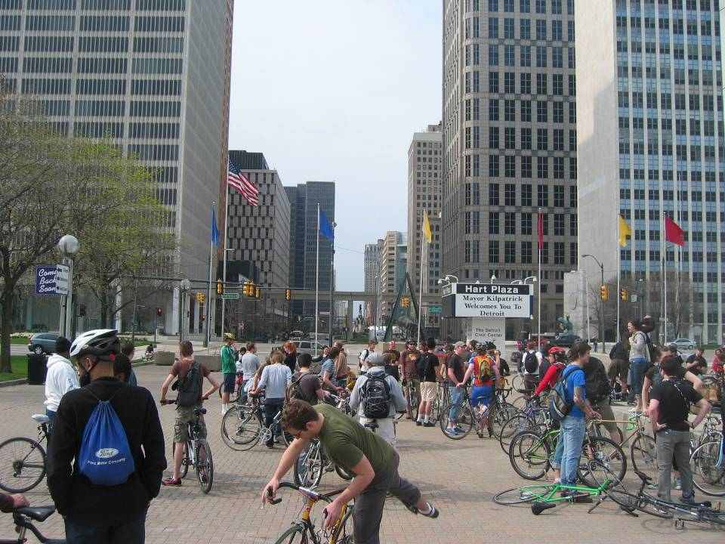

Slide 45
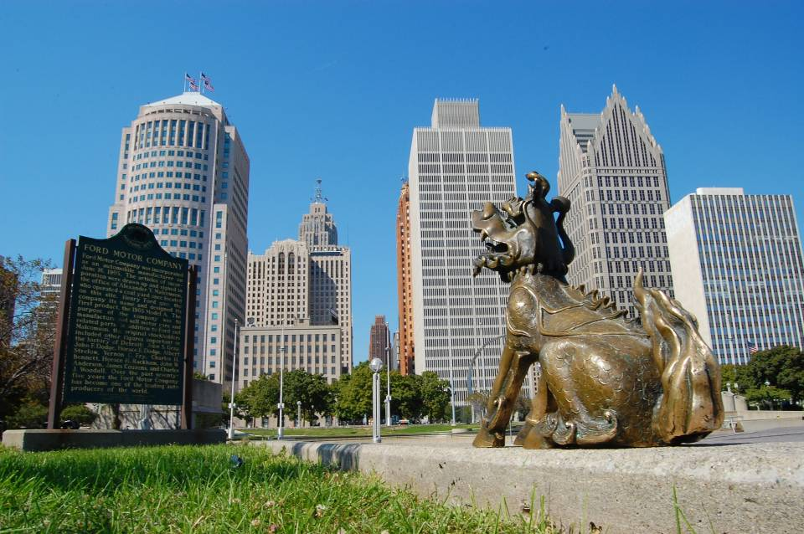

Slide 46
The end

Slide 47







¿Te ha gustado?
Puedes ver más entrando
Aquí
Además puedes recibir powerpoints en tu correo electrónico suscribiéndote aquí:

