Slide 1
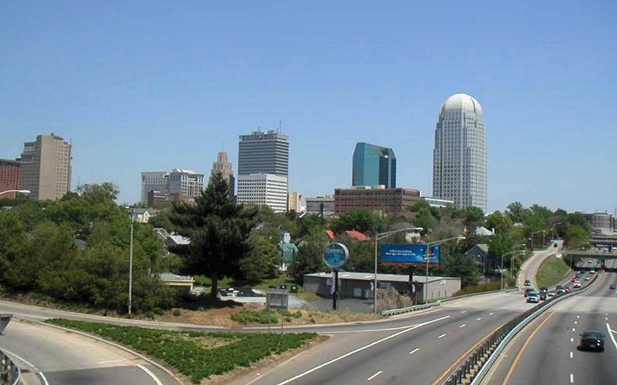
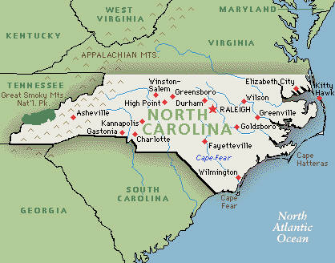

Winston-Salem
State of North Carolina

Slide 2
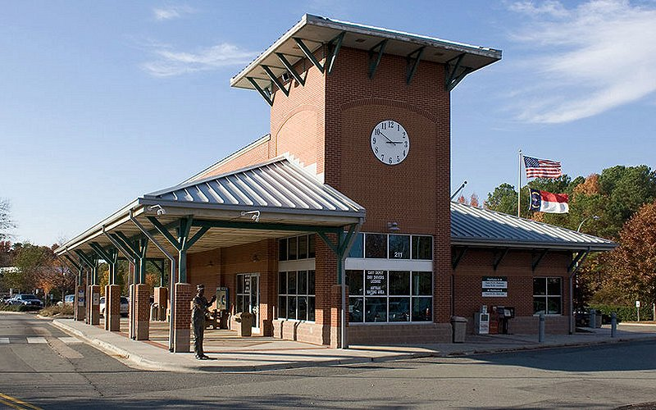
Cary Amtrak Station

Slide 3
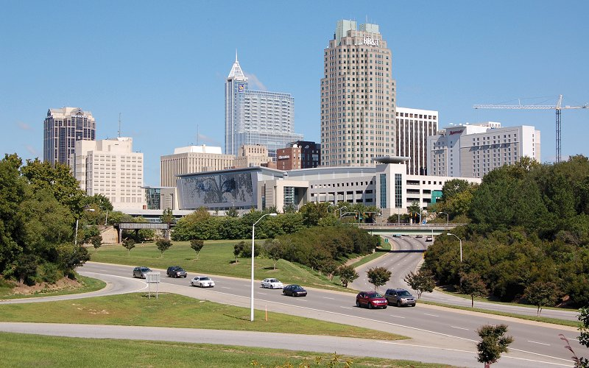
Raleigh from Western Boulevard

Slide 4
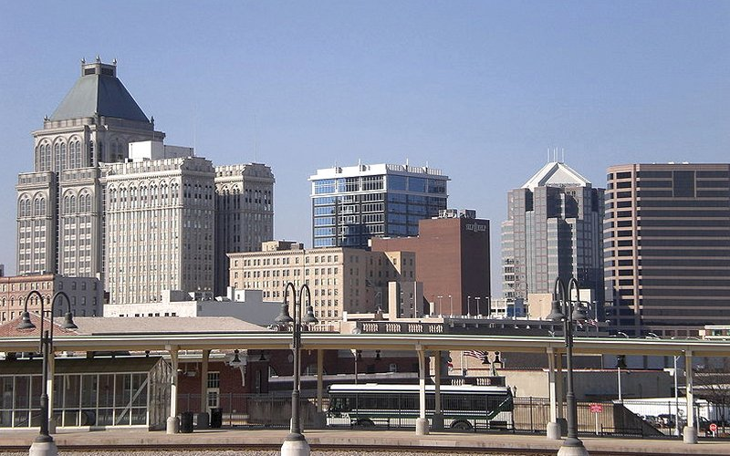
Greensboro Skyline

Slide 5
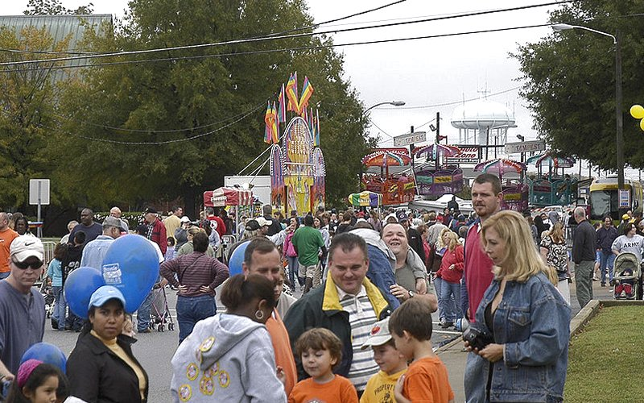
Lexington Barbecue

Slide 6
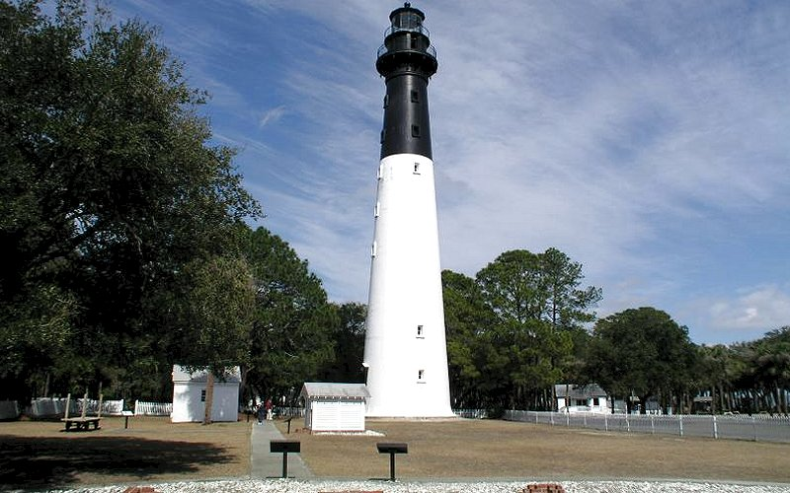
Hunting Island Lighthouse

Slide 7
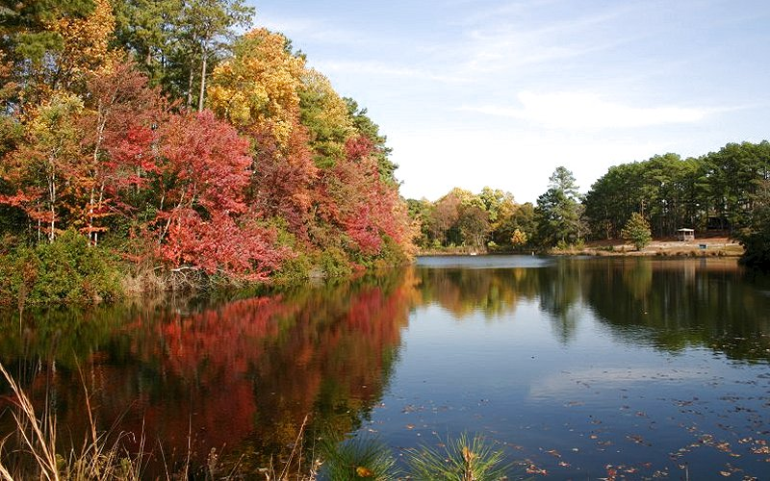

Slide 8
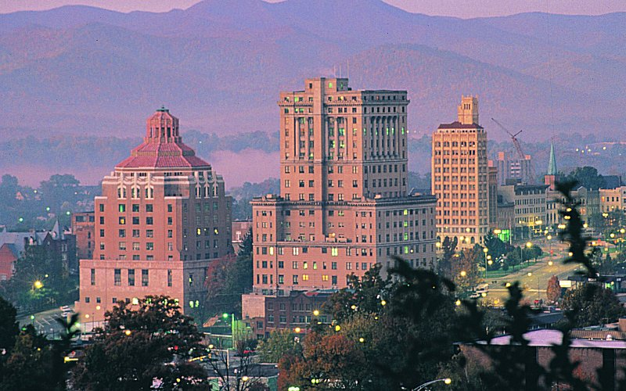
Asheville

Slide 9
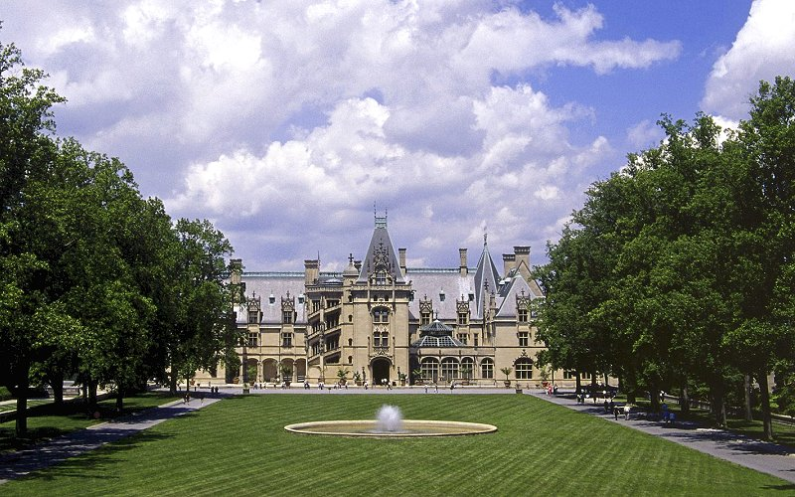
Biltmore Estate Asheville

Slide 10
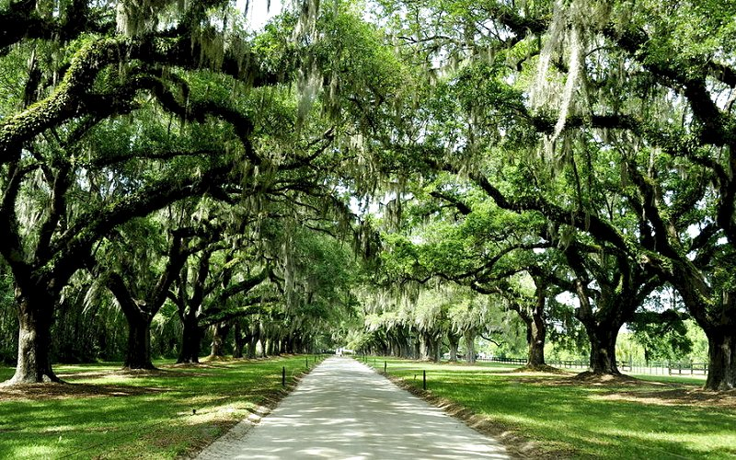
Boone Hall

Slide 11
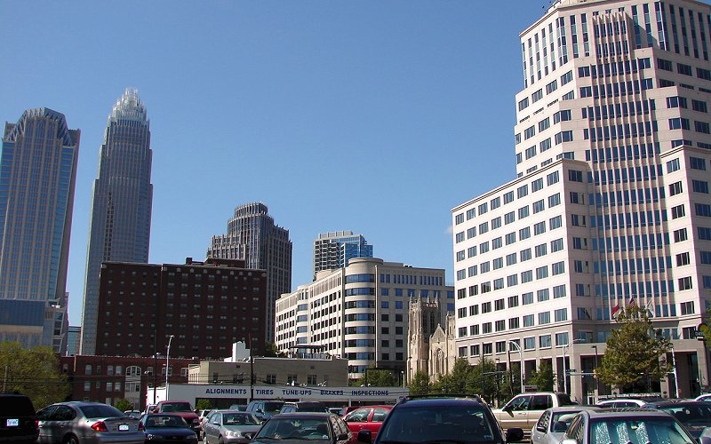
Charlotte

Slide 12
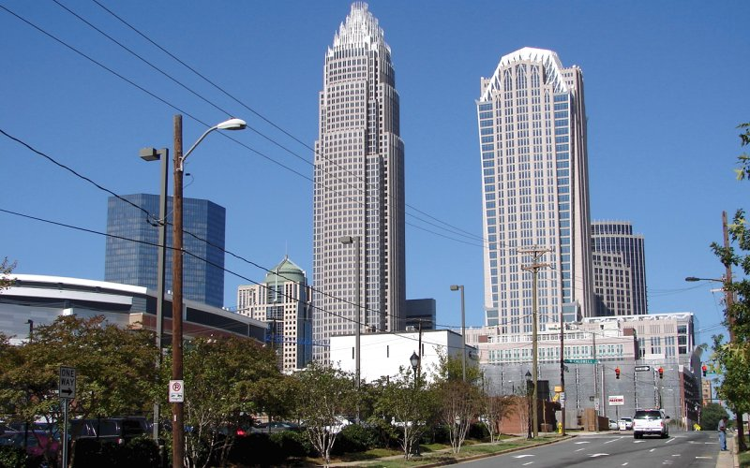
Charlotte

Slide 13
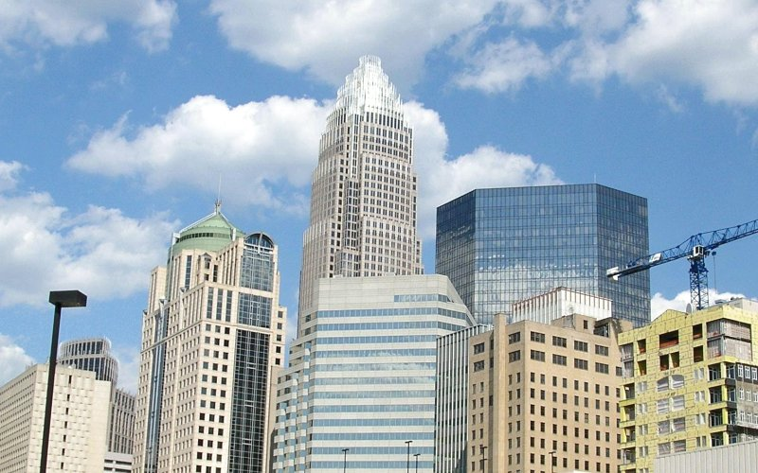
Charlotte

Slide 14
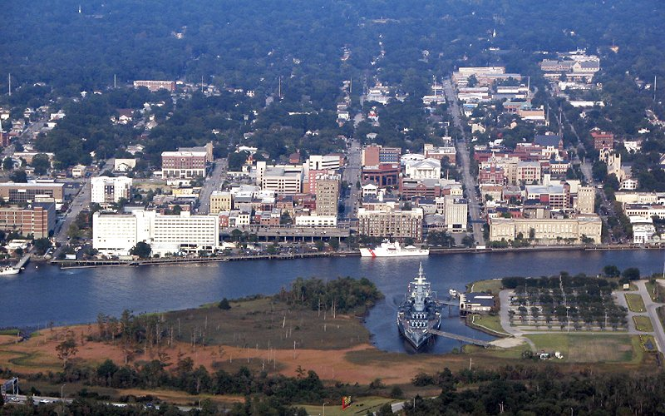
Downtown Wilmington

Slide 15
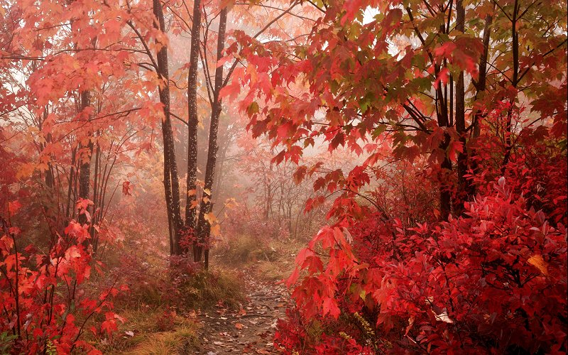
Fall Foliage Along the Blue Ridge Parkway

Slide 16
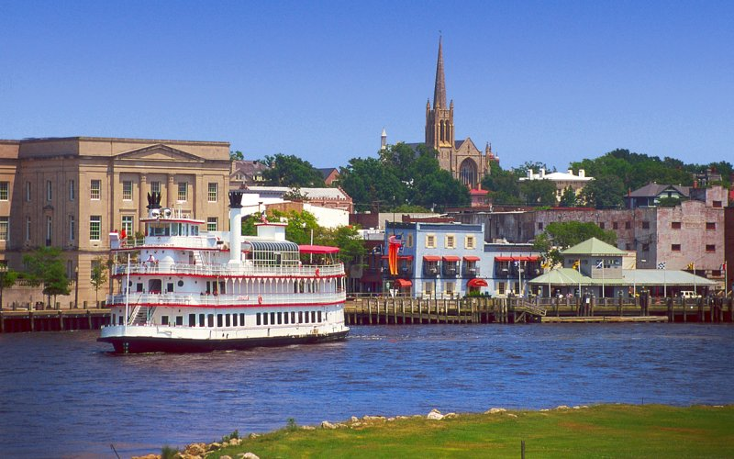
Historic Riverwalk Wilmington

Slide 17
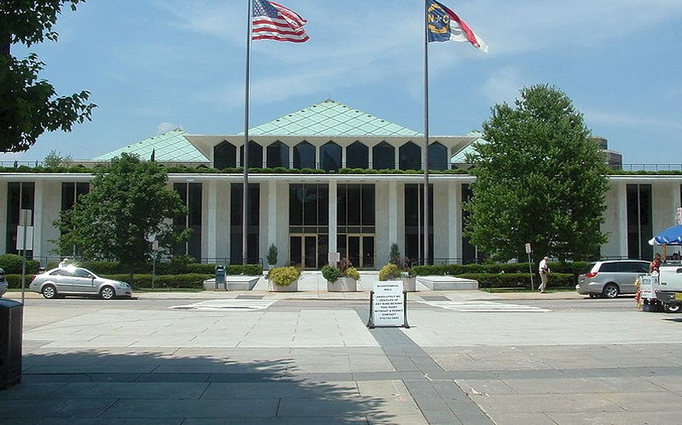
North Carolina State Legislative Building

Slide 18
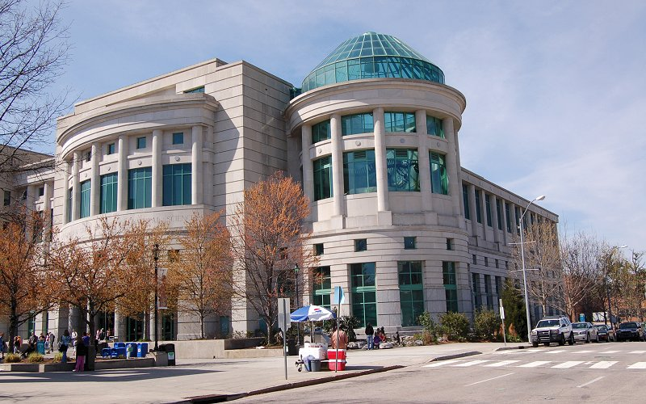
North Carolina Museum of Natural Sciences

Slide 19
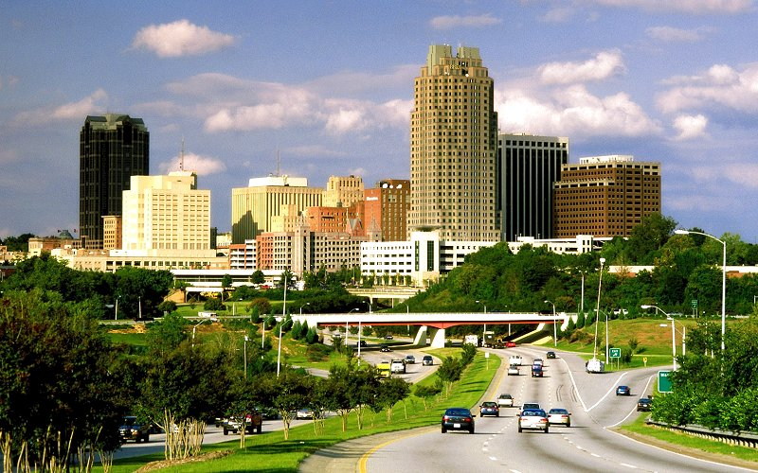
Raleigh

Slide 20
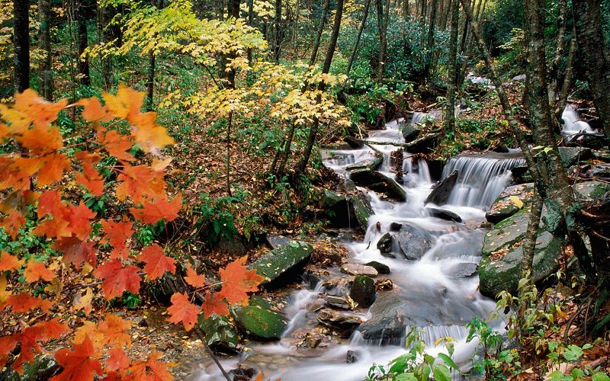
Grandfather Mountain

Slide 21
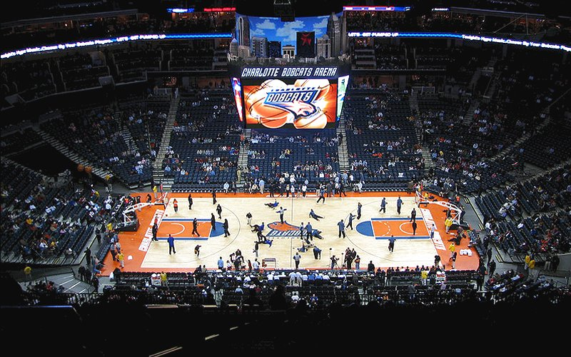
Time Warner Cable Arena, home to the Charlotte Bobcats

Slide 22
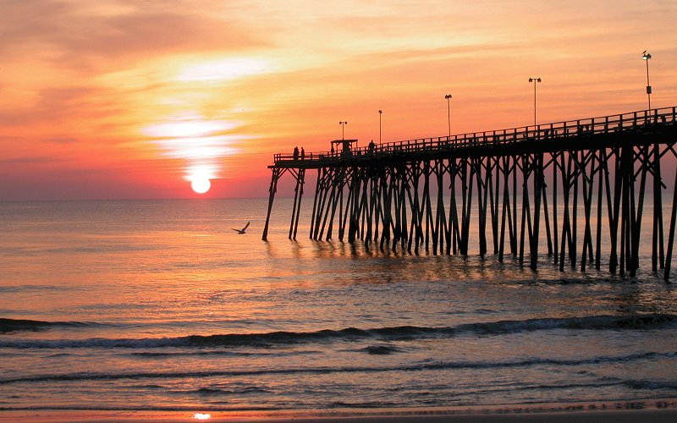

Music : “ Polka Party”
Die Flippers & James Last
Émile
Kure Beach Fishing Pier at sunrise Wilmington

