Slide 1
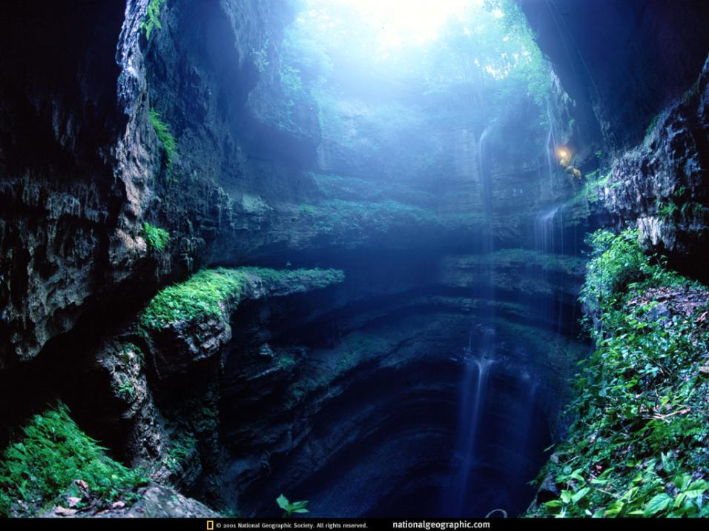
aLABAMA

Slide 2
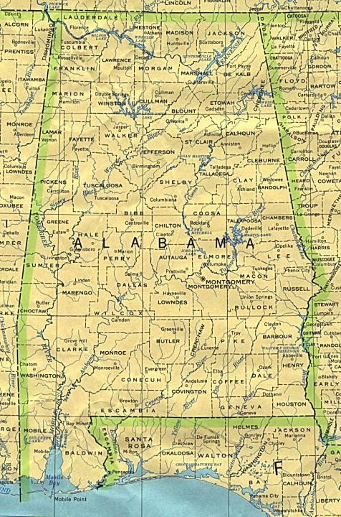
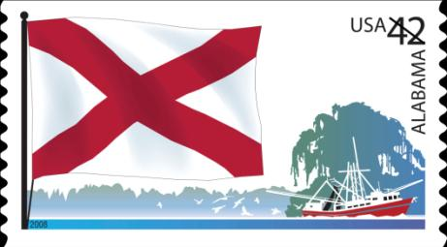
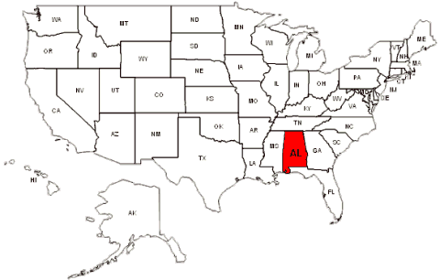
Alabama’s flag

Slide 3
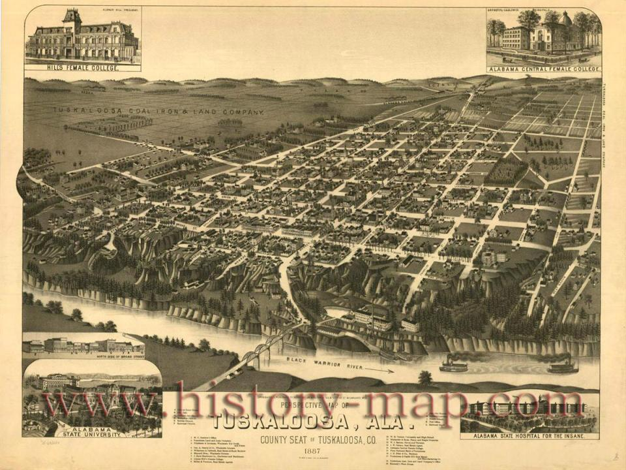

Slide 4
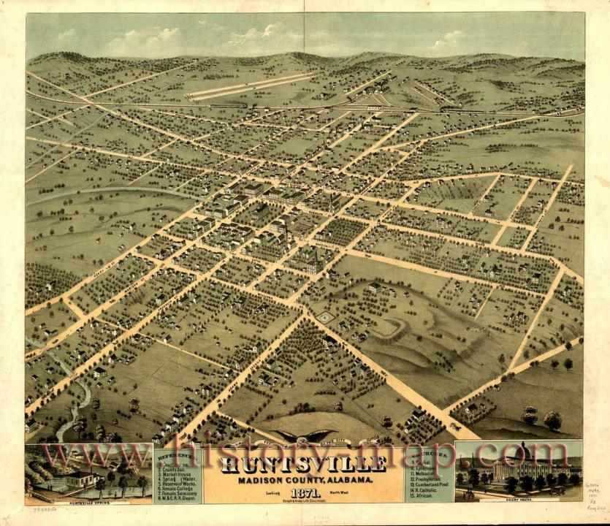

Slide 5
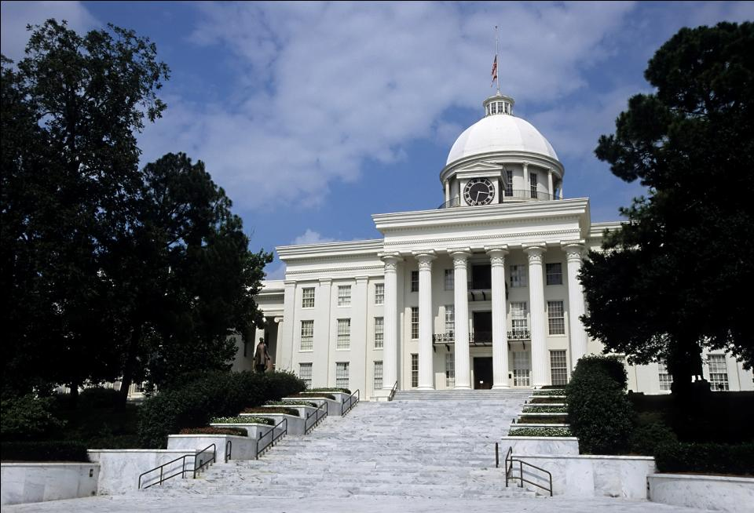

Slide 6
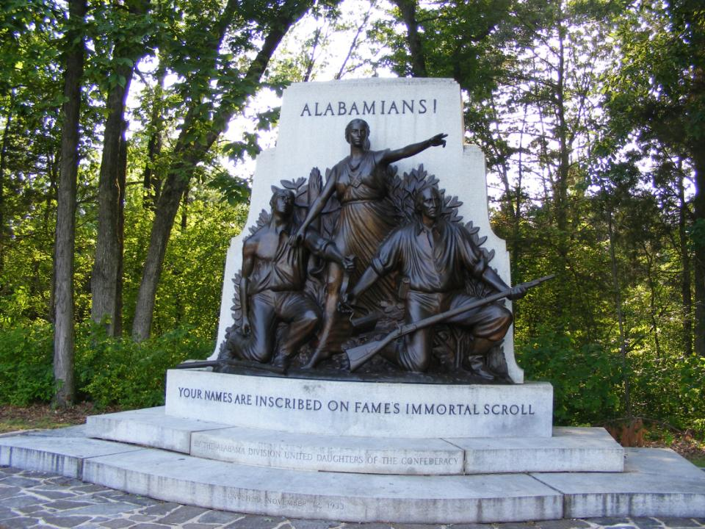

Slide 7
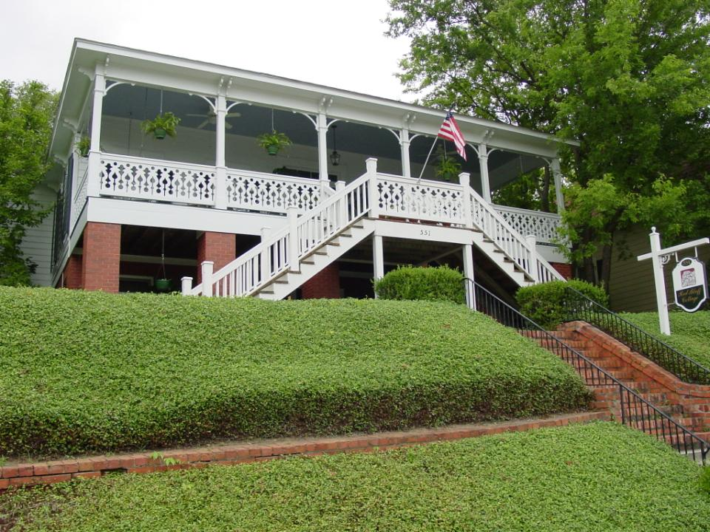

Slide 8

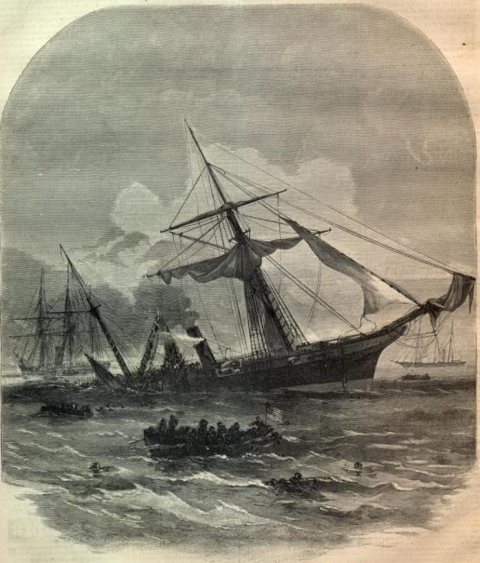
Civil war warship “Alabama”

Slide 9
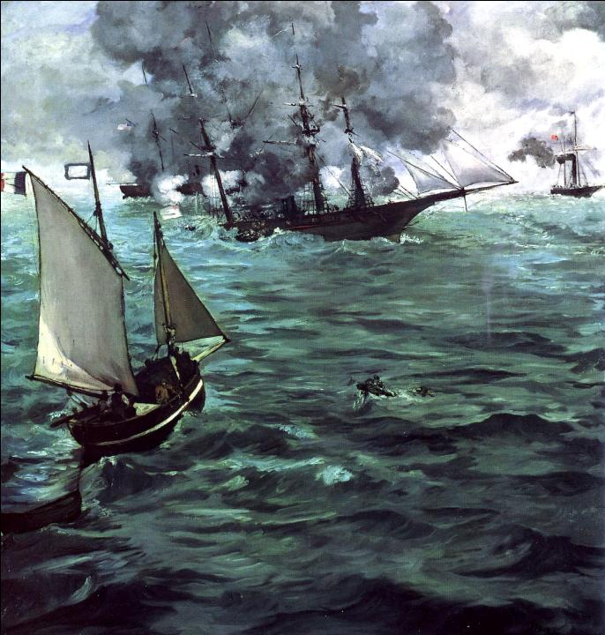


Slide 10
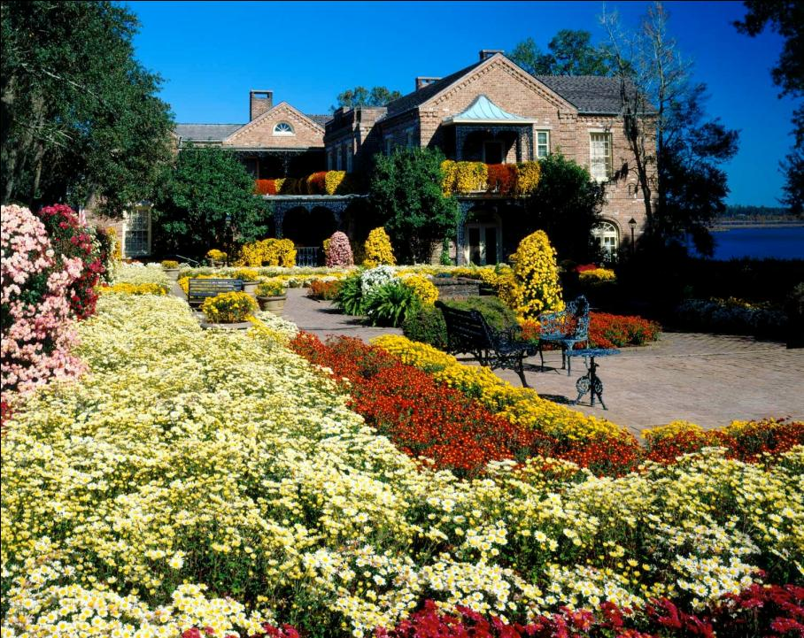

Slide 11
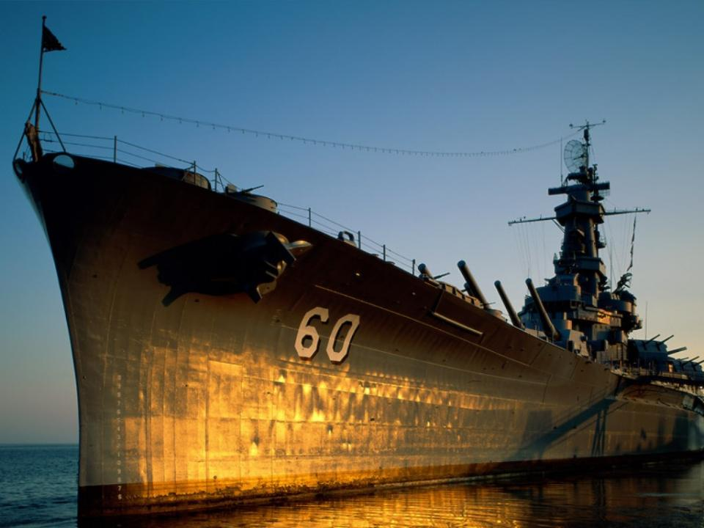
USS Alabama - Battleship Memorial Park Mobile Alabama

Slide 12
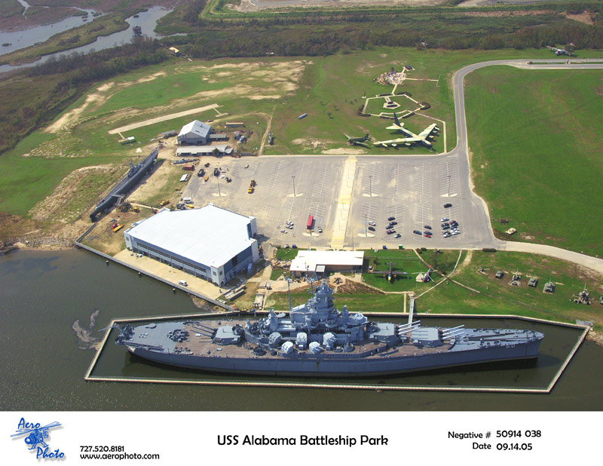

Slide 13
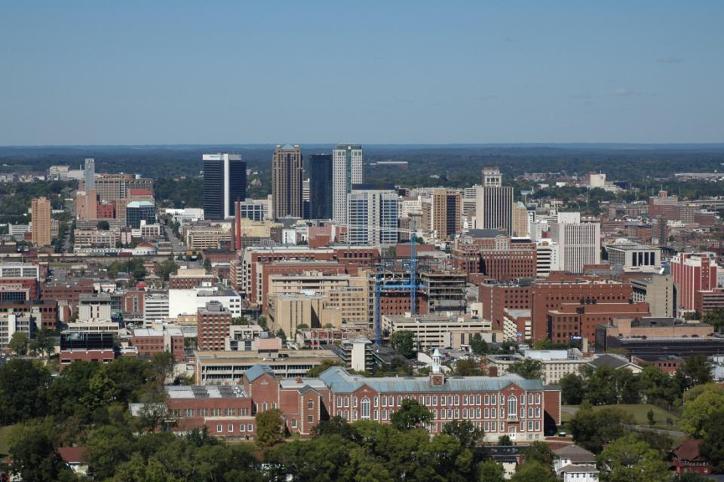

Slide 14
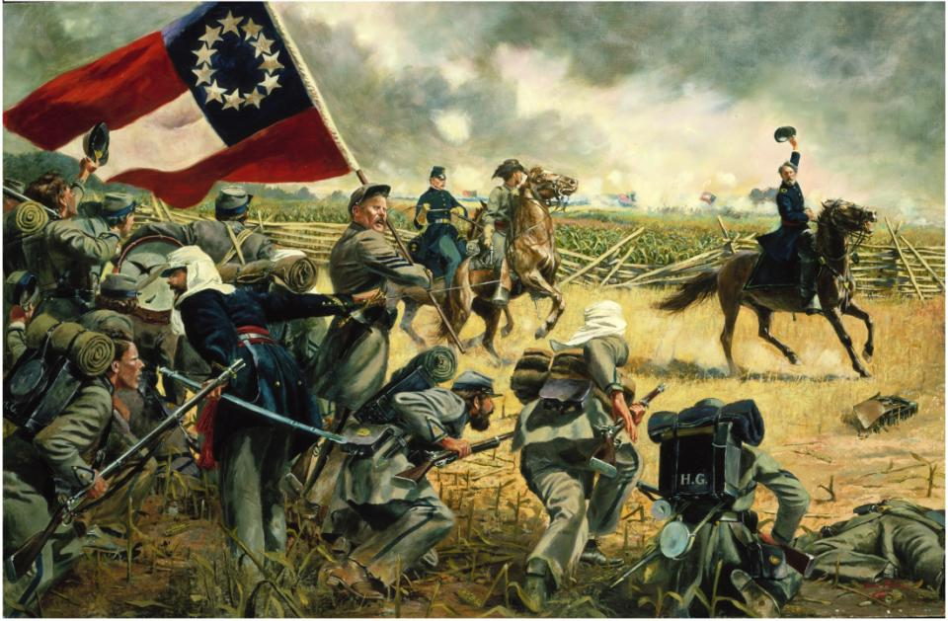
The Fourth Alabama by Don Troiani

Slide 15
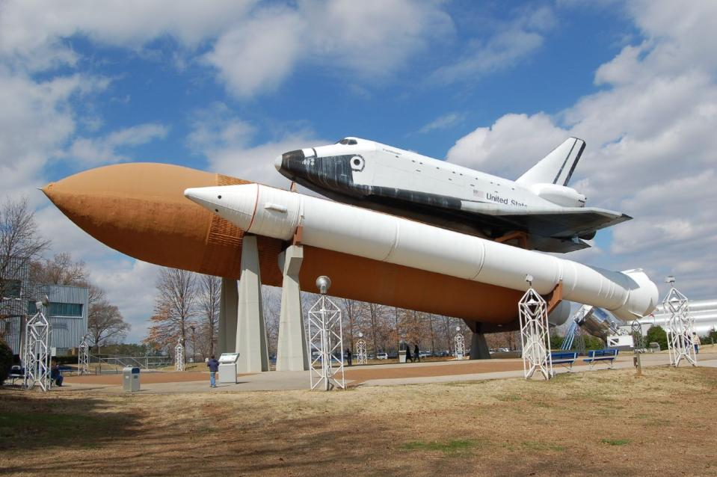

Slide 16
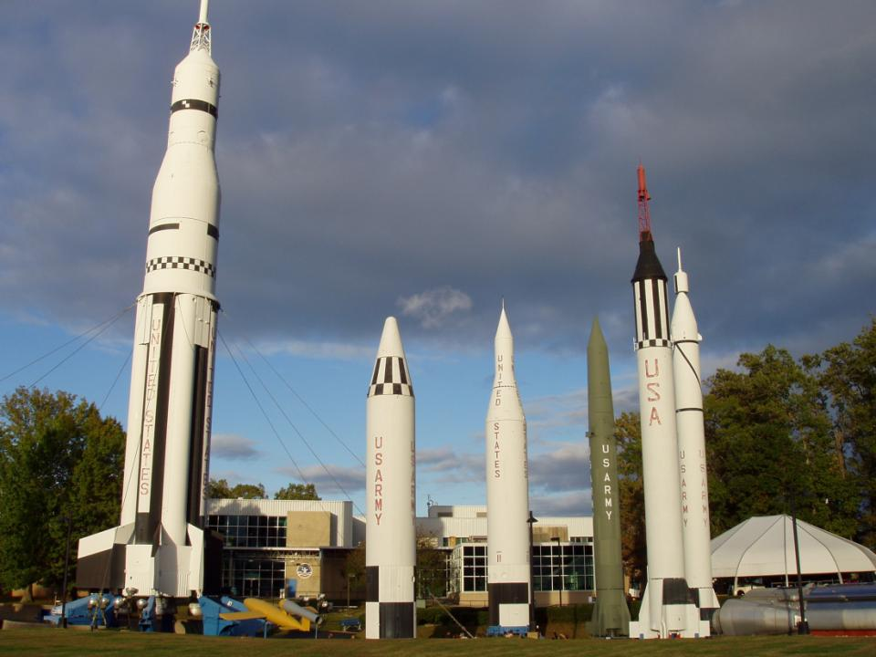

Slide 17

Fun with Alabama

Slide 18
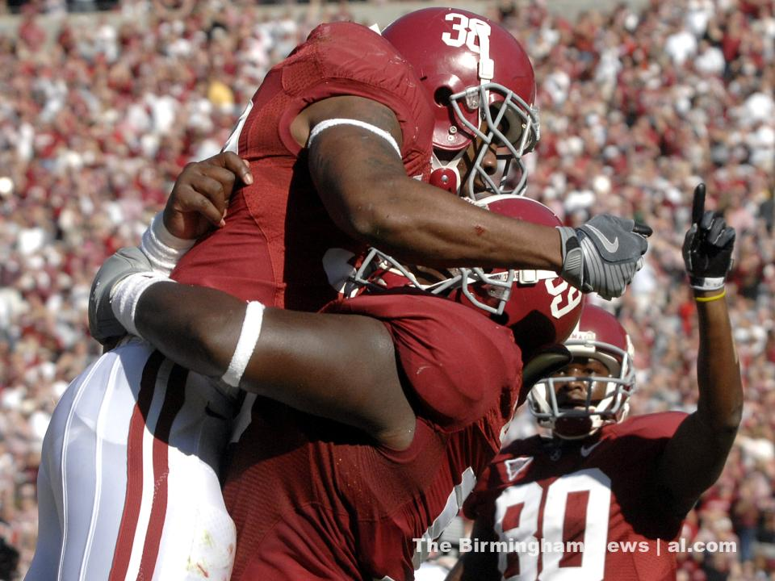

Slide 19
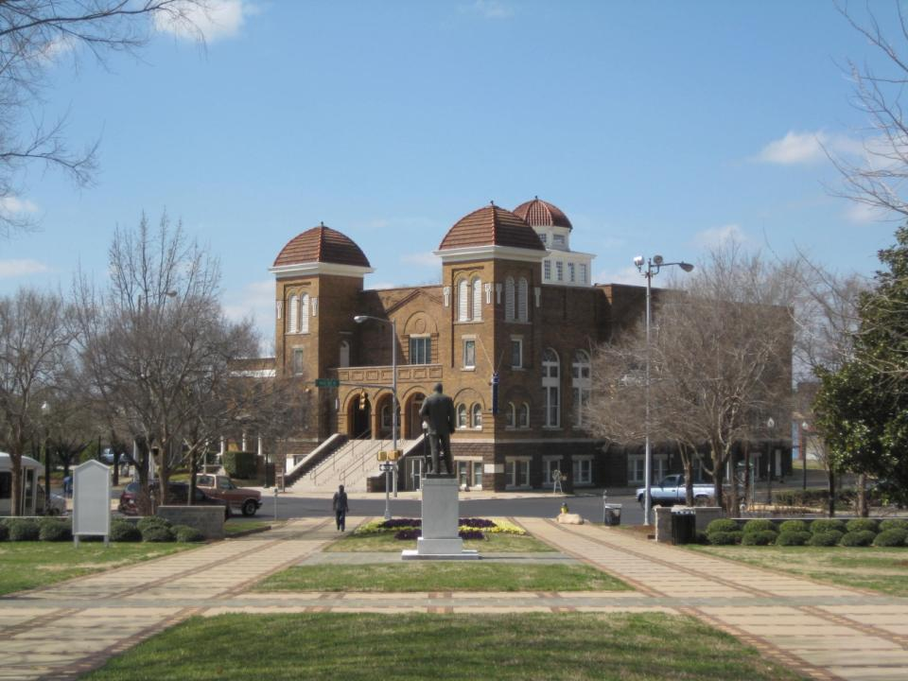

Slide 20
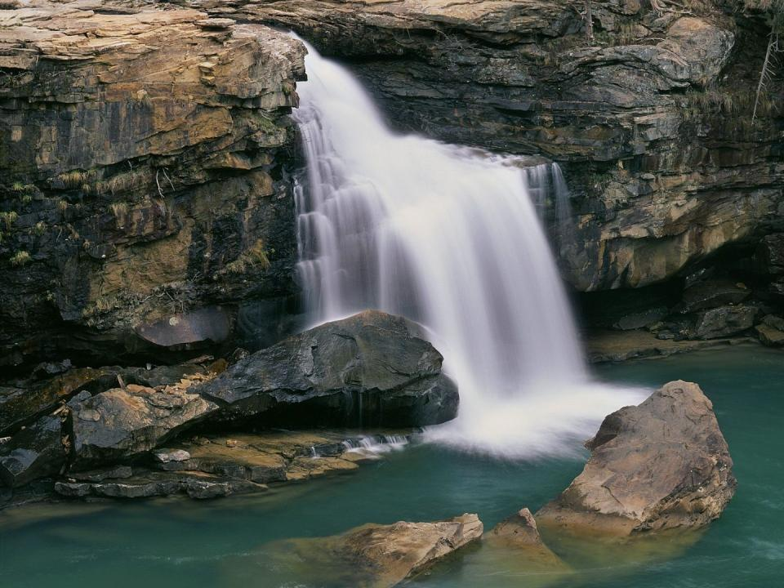

Slide 21
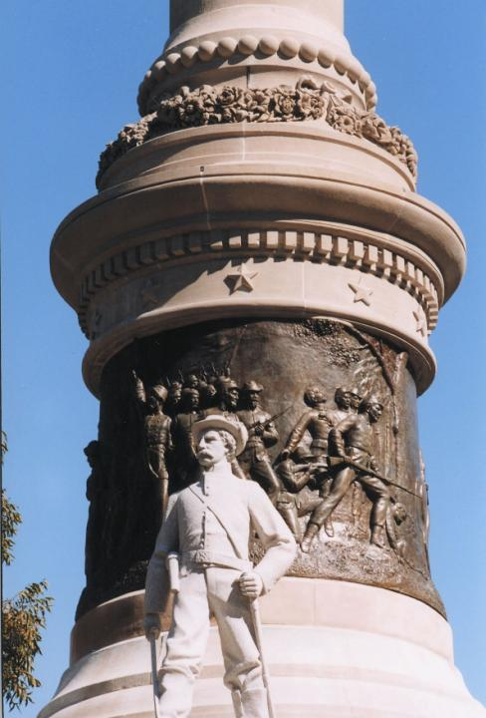
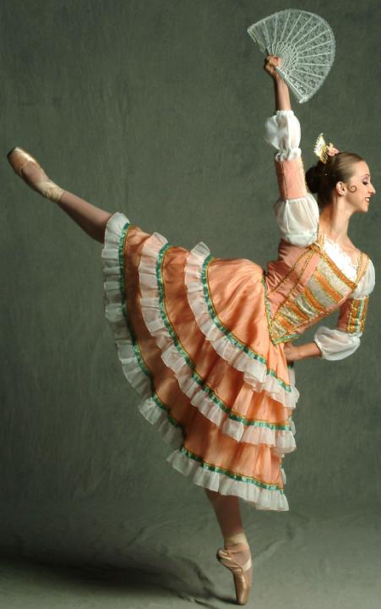

Slide 22


Slide 23


Slide 24
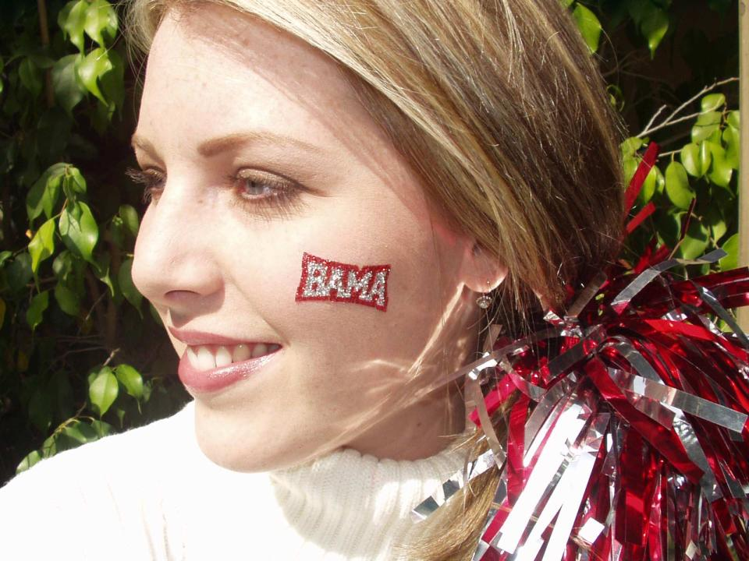

Slide 25

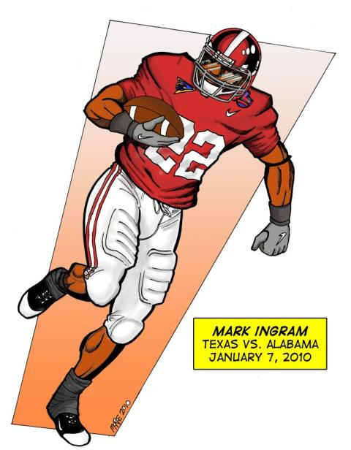

Slide 26
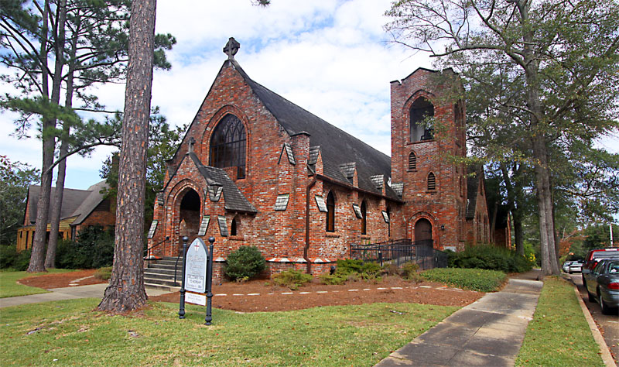
St Marks Chruch by asajernigan

Slide 27
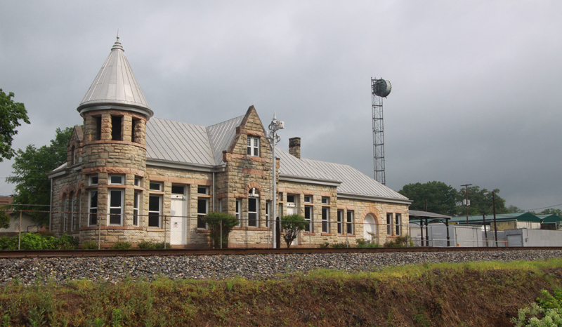
Ft. Payne Station by asajernigan

Slide 28
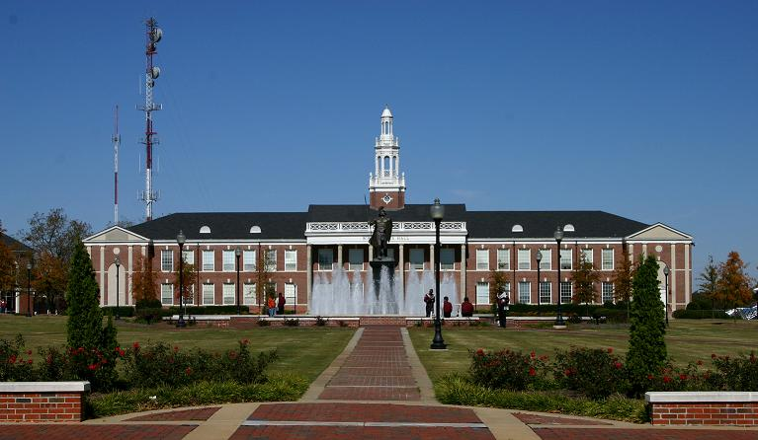
Bibb Graves Hall by asajernigan

Slide 29
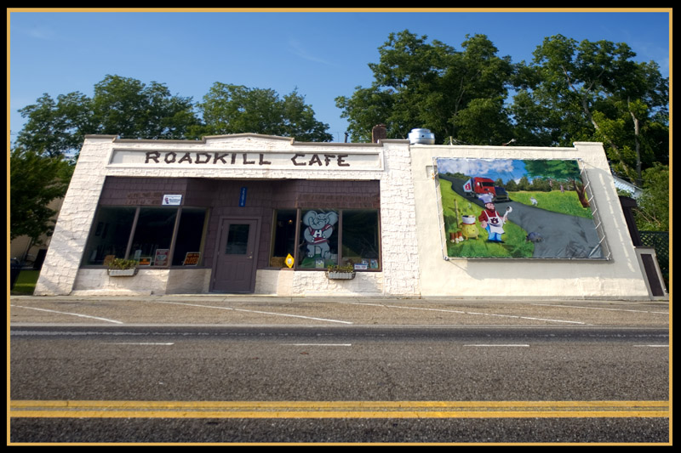
Alabama Fine Dining by fotoguy22

Slide 30
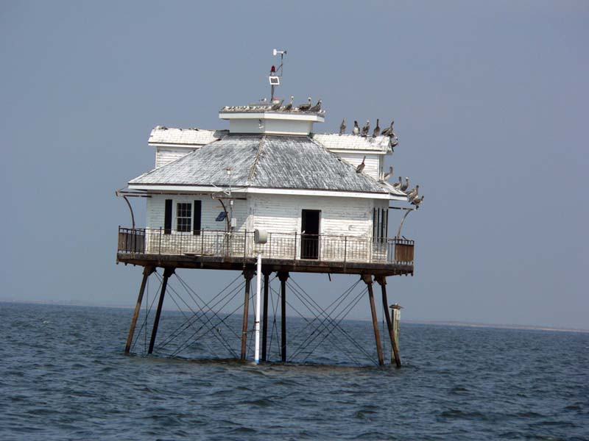
Some random house by afderrick

Slide 31
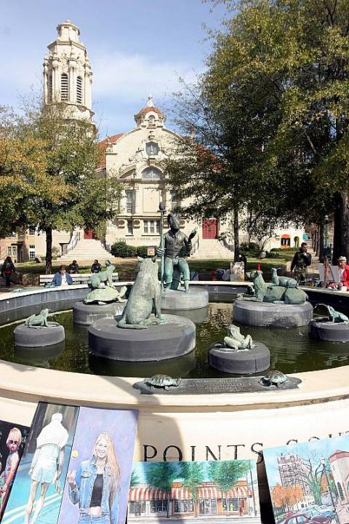
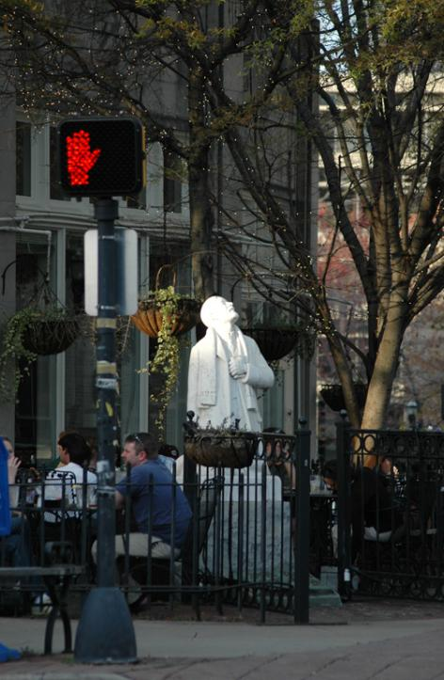
Five Points South by larryogay
Light Headed. by robshort

Slide 32
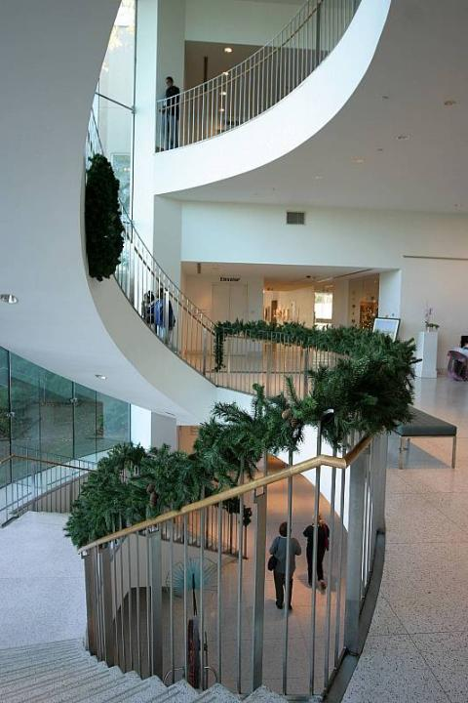
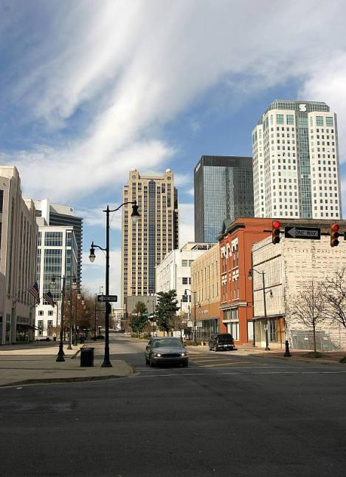
Birmingham, Alabama by larryogay
in the loop by larryogay

Slide 33
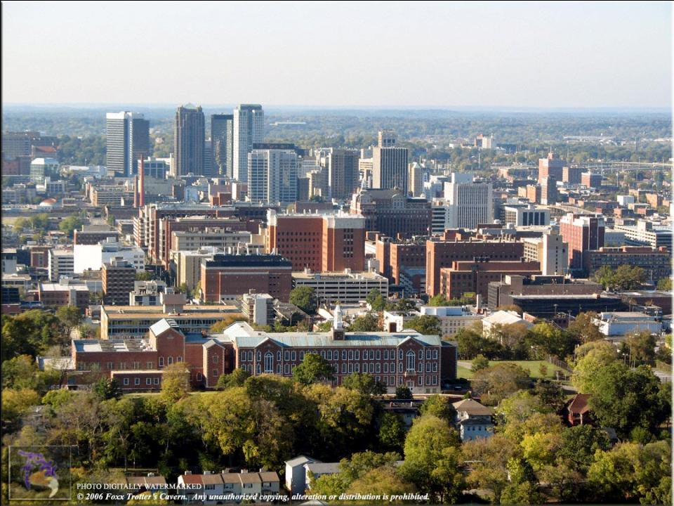
Birmingham

Slide 34
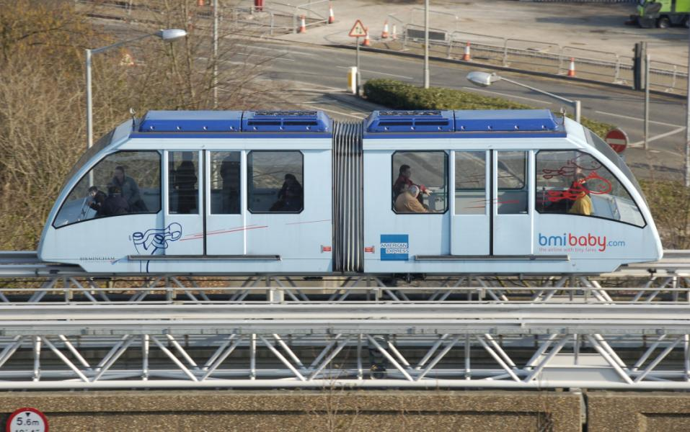
Birmingham

Slide 35
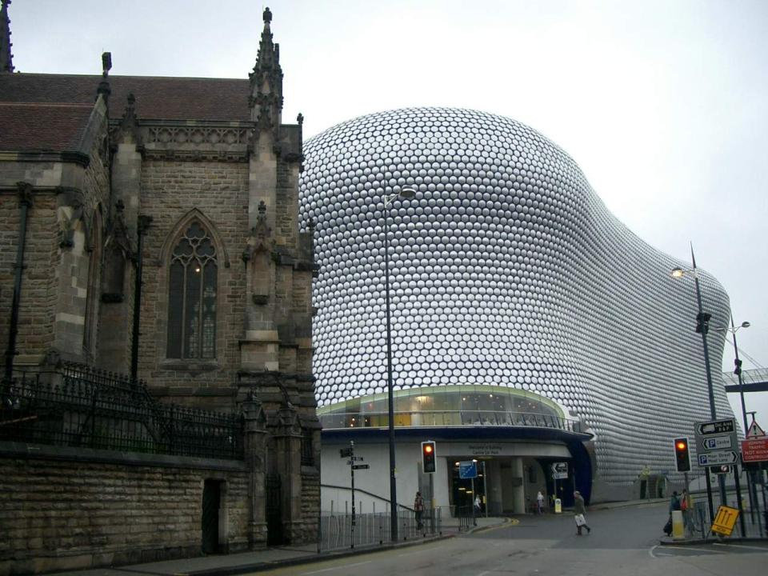
Birmingham

Slide 36
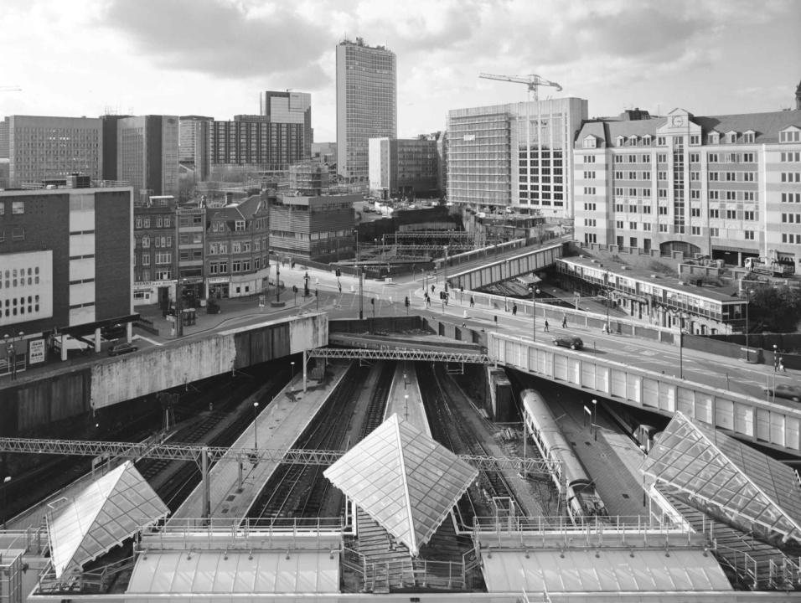

Slide 37
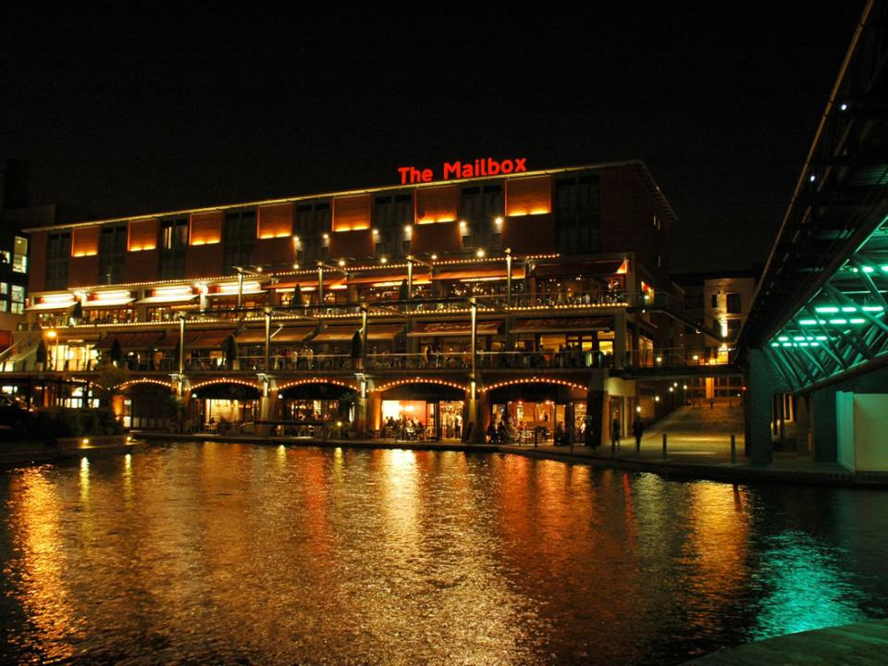
Birmingham

Slide 38
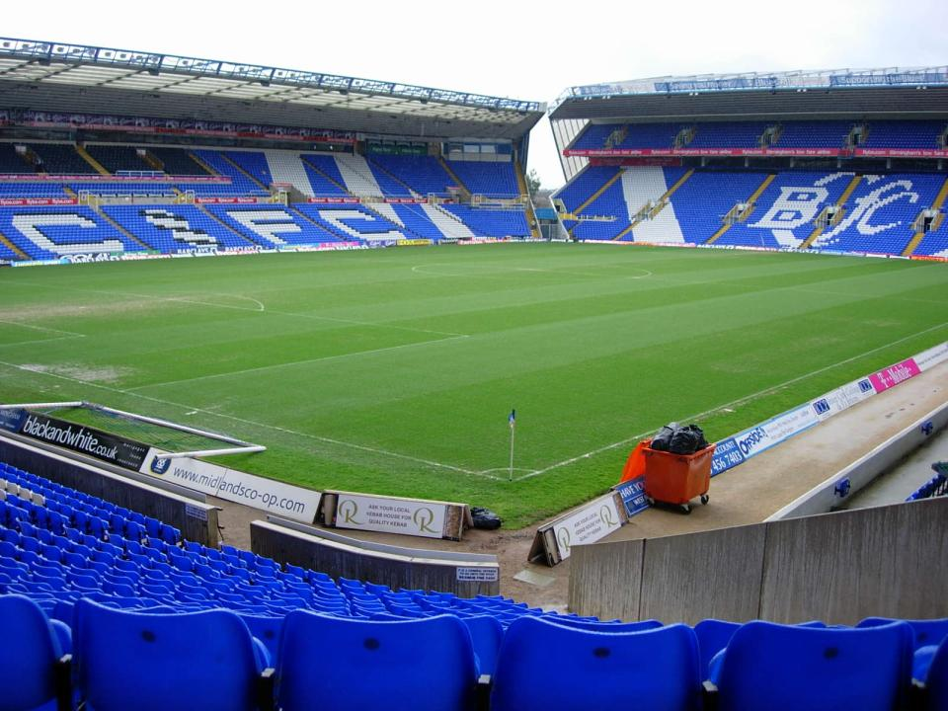

Slide 39
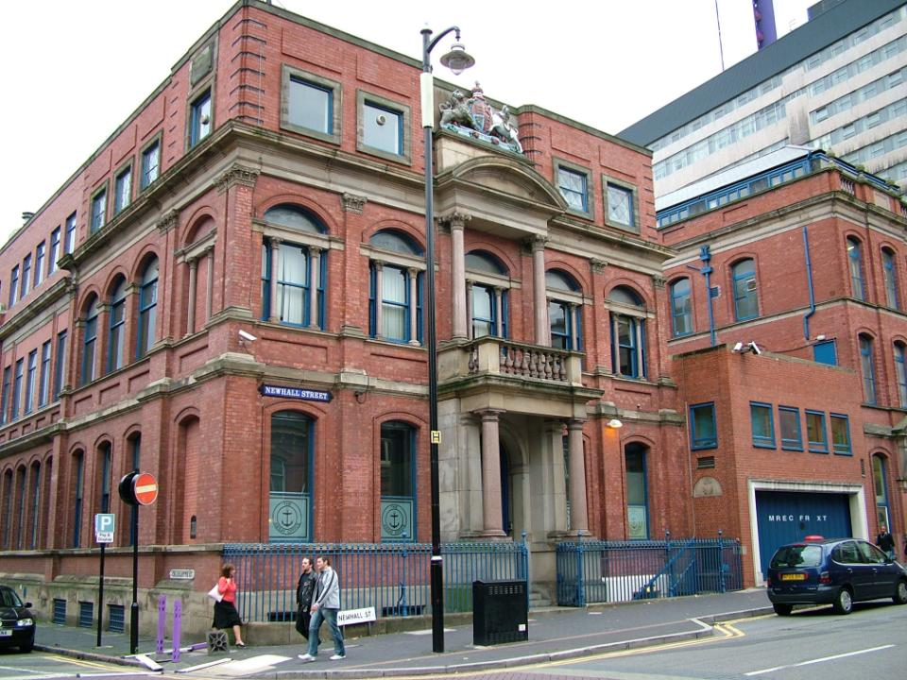

Slide 40
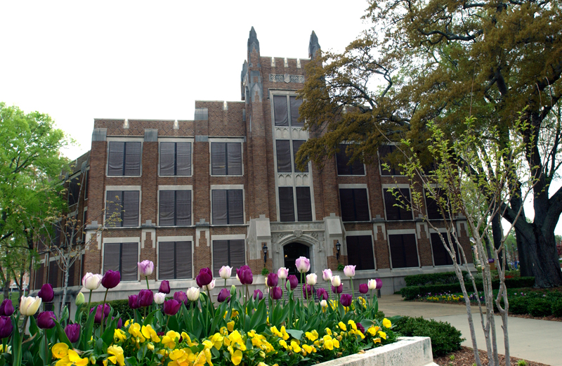

Slide 41


Miss Alabama

Slide 42


Slide 43
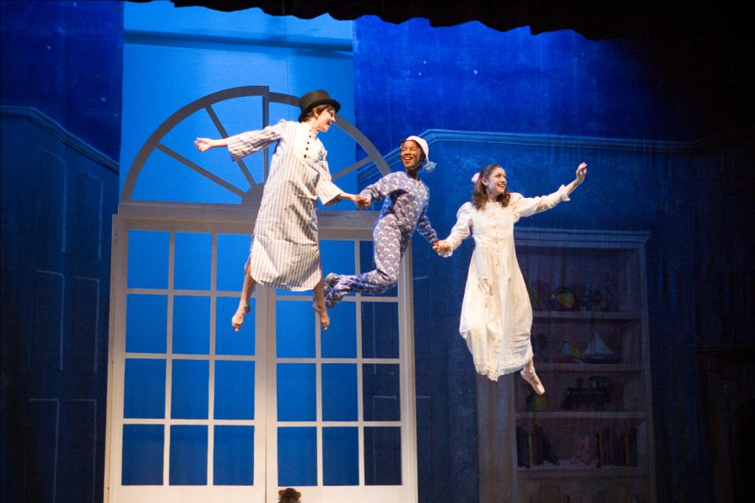

Slide 44


Slide 45

Copyright: Eric Tuck

Slide 46
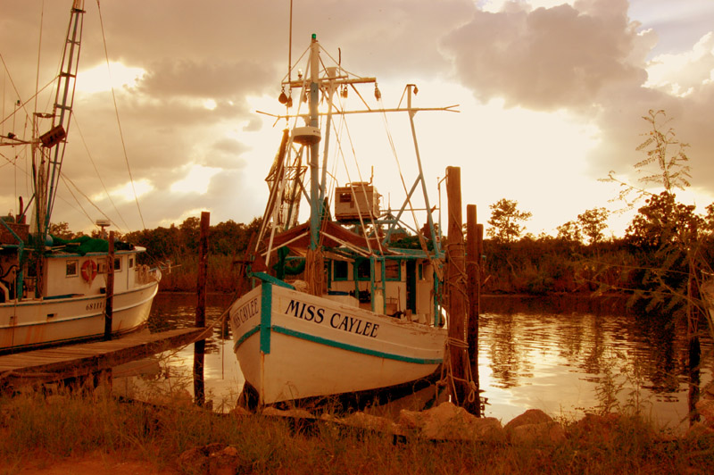
Copyright: Randy Martin

Slide 47


Copyright: Kathleen Amiee
Copyright: Kathleen Amiee

Slide 48
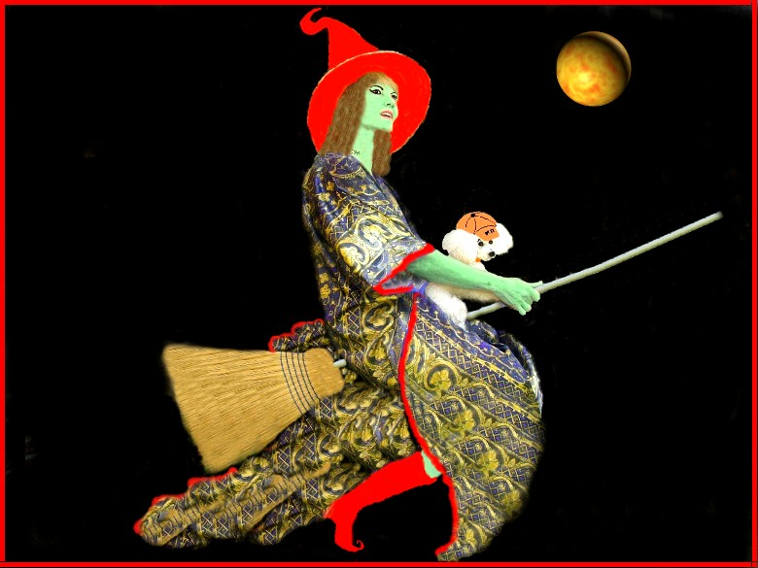
The End

Slide 49







¿Te ha gustado?
Puedes ver más entrando
Aquí
Además puedes recibir powerpoints en tu correo electrónico suscribiéndote aquí:

