Slide 1

“Inolvidable”
Π

Slide 2
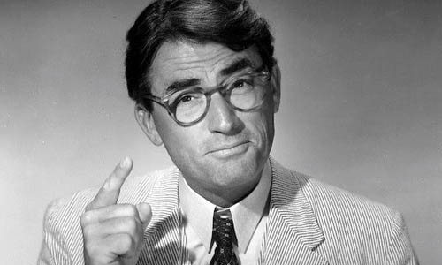

Slide 3
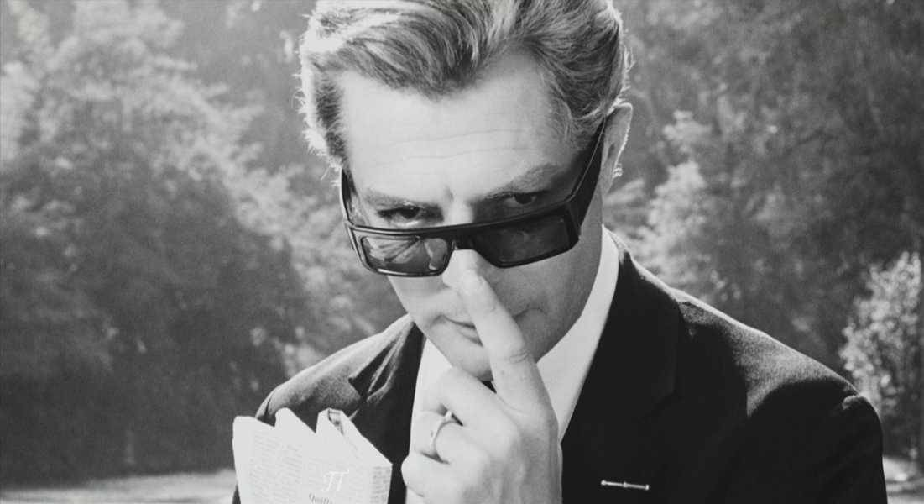

Slide 4
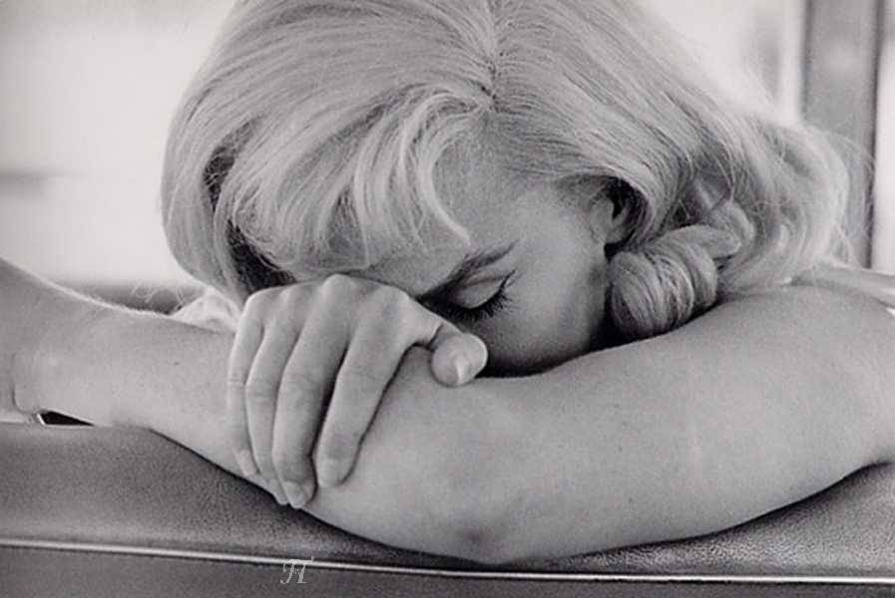

Slide 5
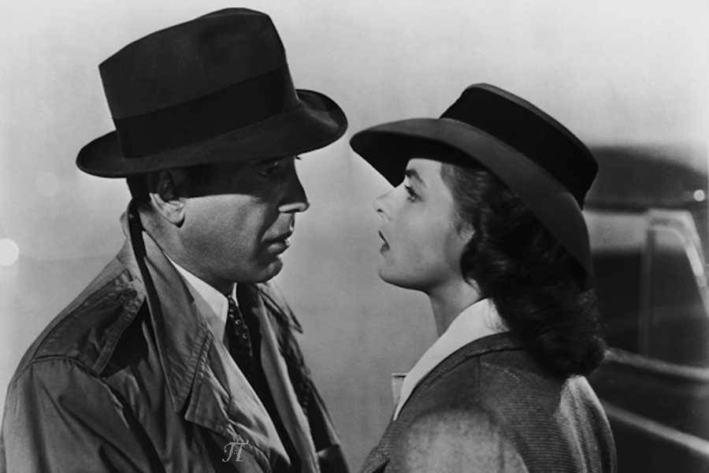

Slide 6
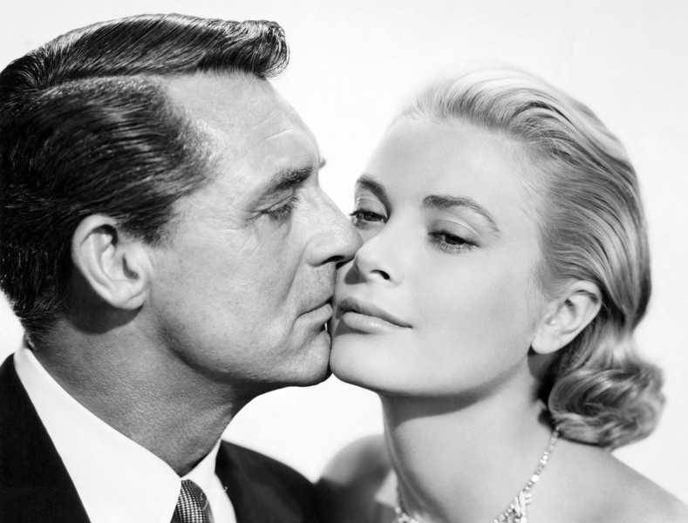

Slide 7
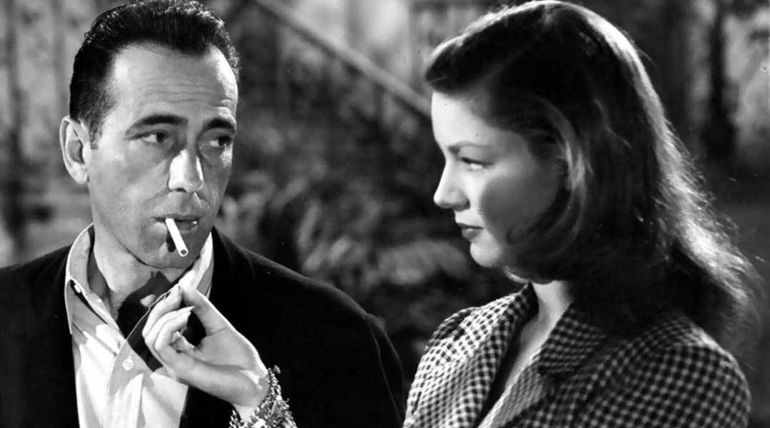

Slide 8
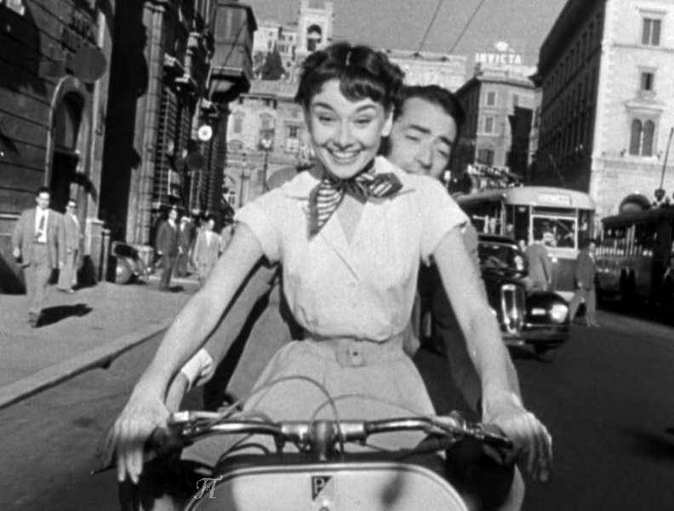

Slide 9
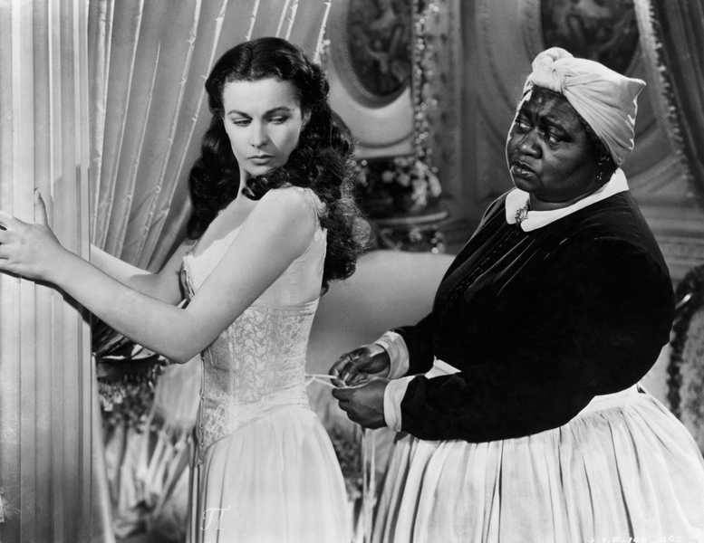

Slide 10
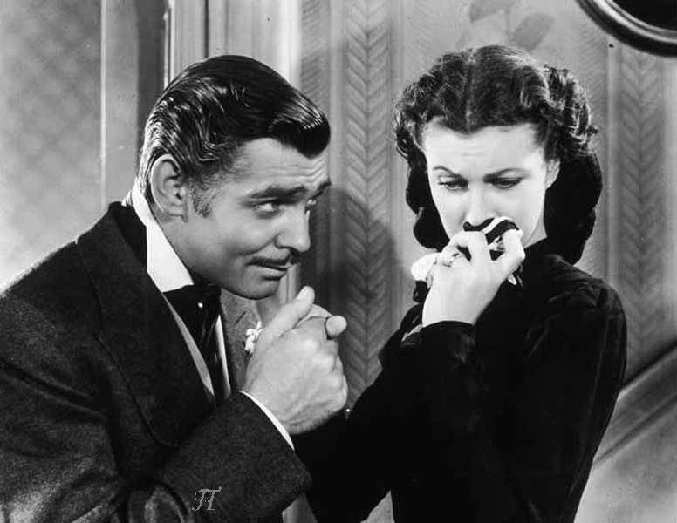

Slide 11
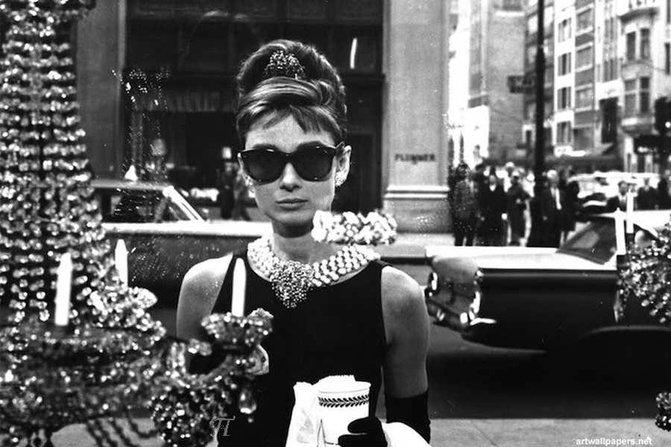

Slide 12
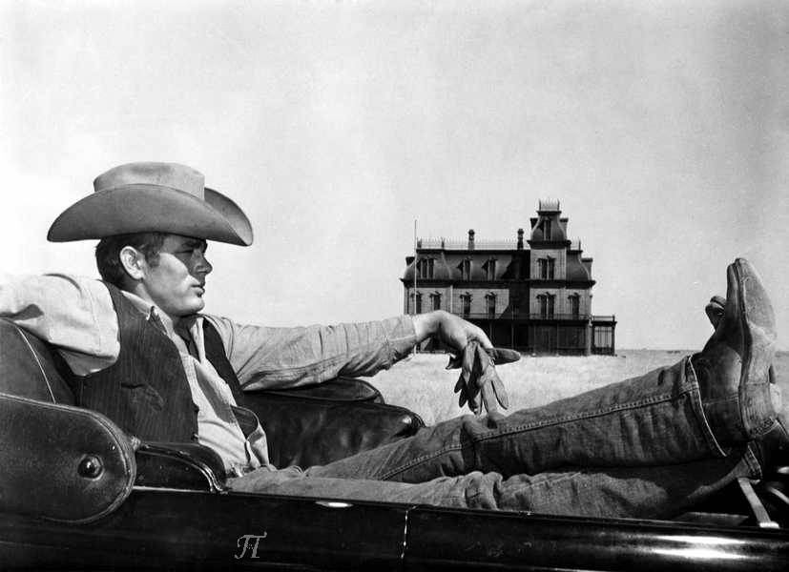

Slide 13
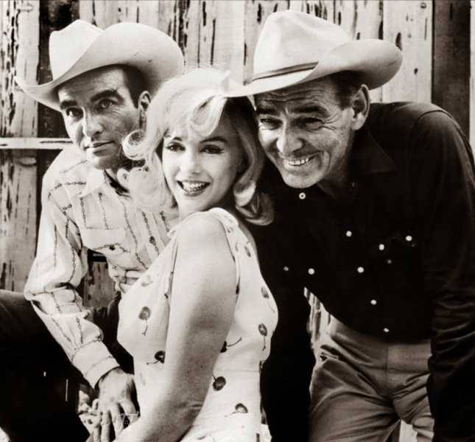

Slide 14
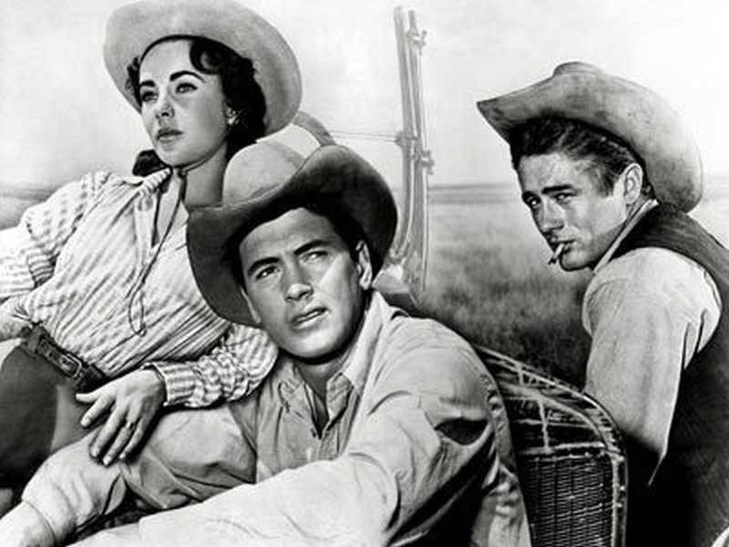

Slide 15
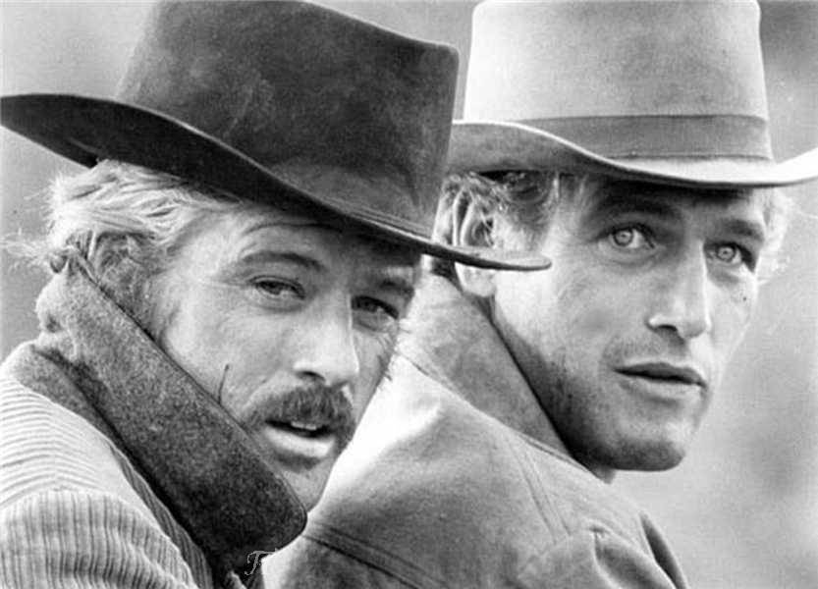

Slide 16
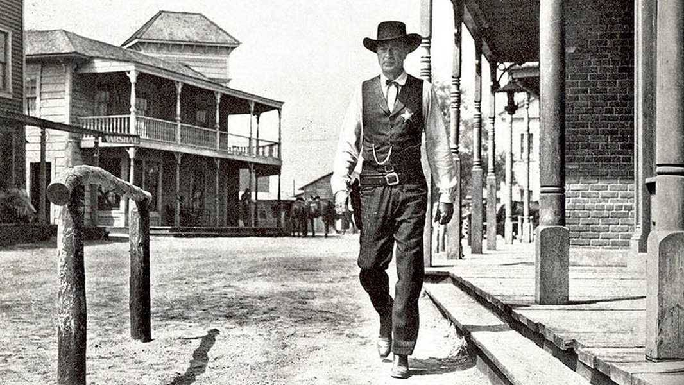

Slide 17
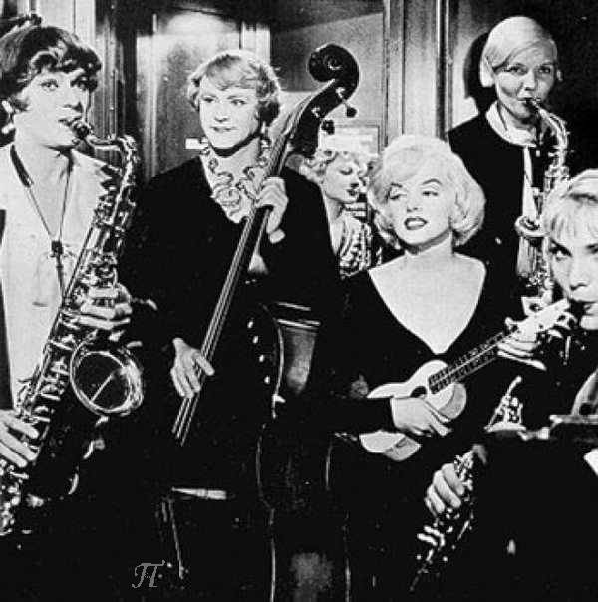

Slide 18
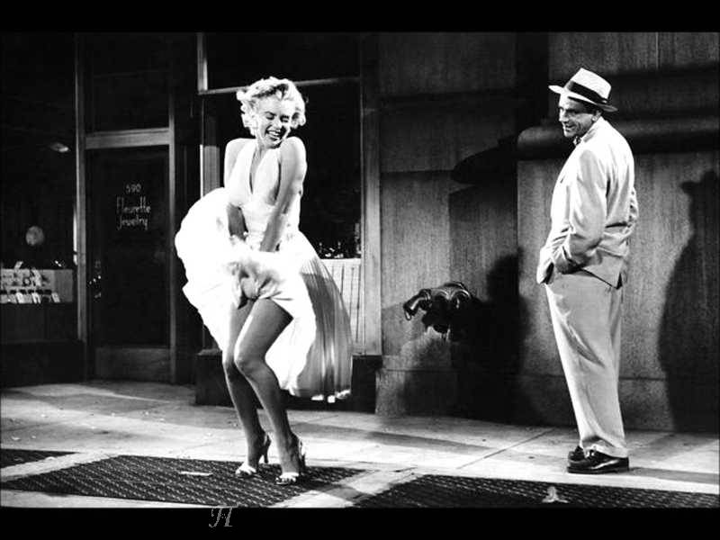

Slide 19
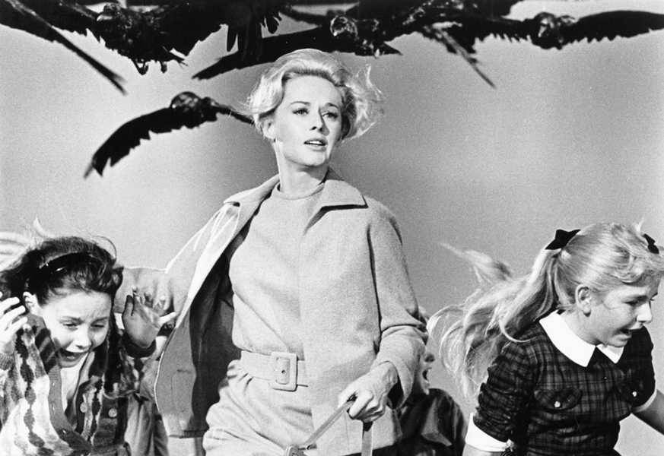

Slide 20
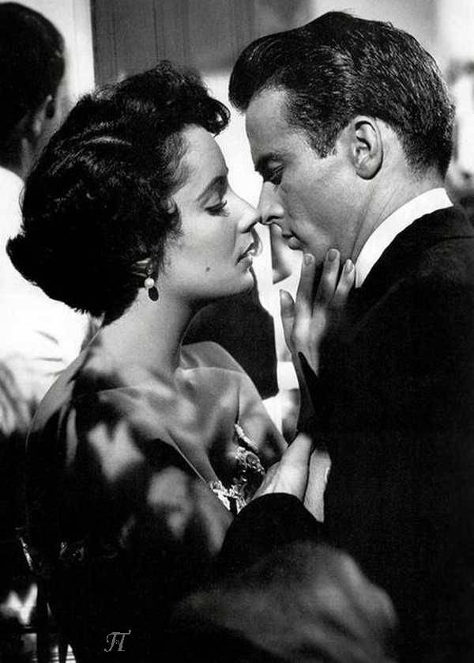

Slide 21
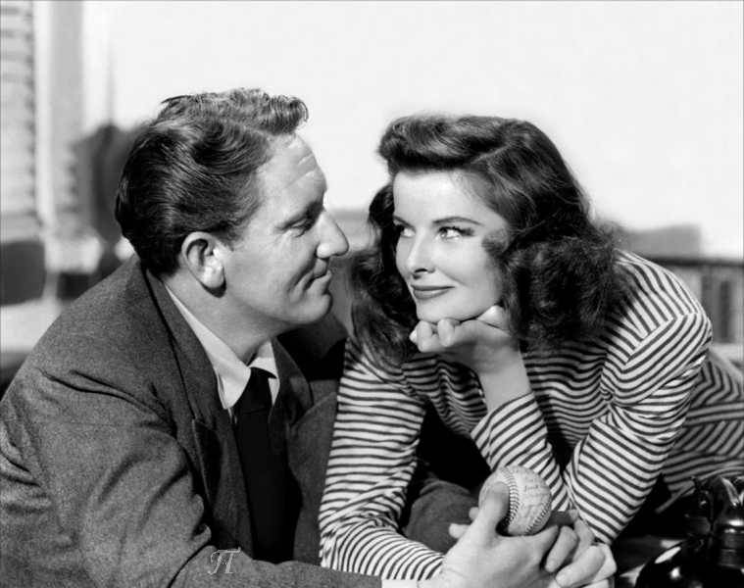

Slide 22
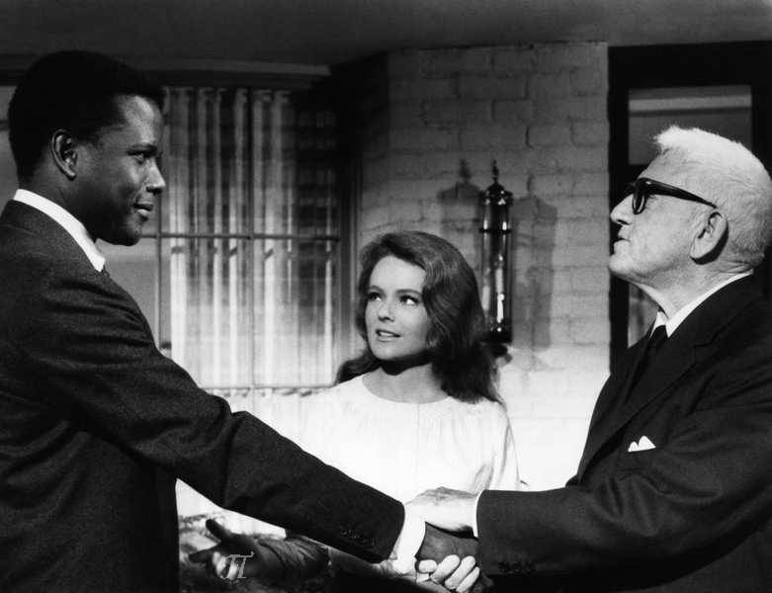

Slide 23
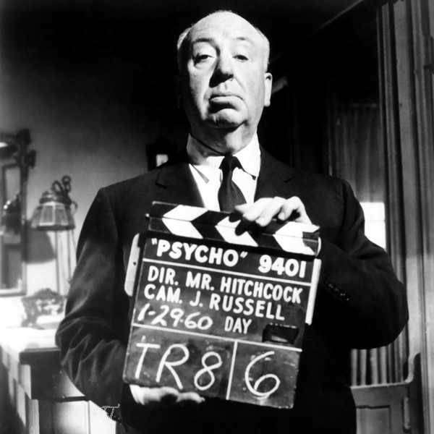

Slide 24
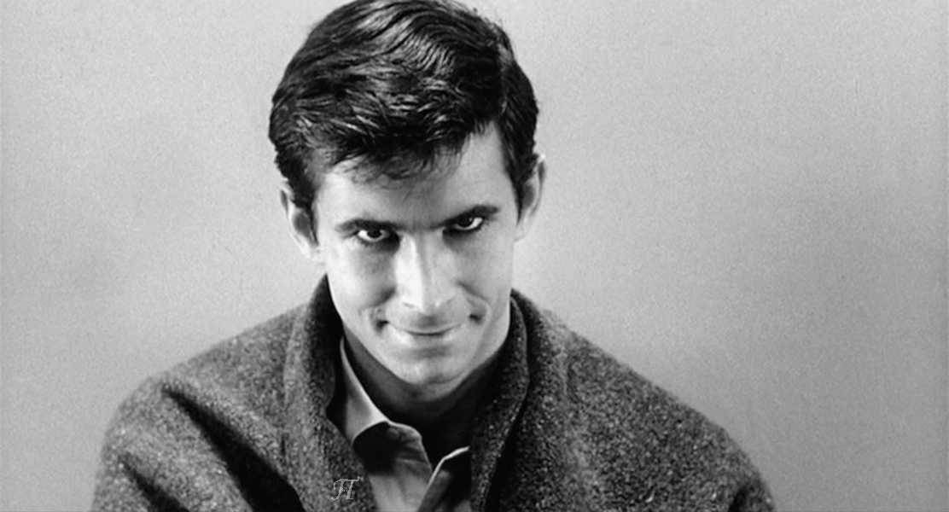

Slide 25
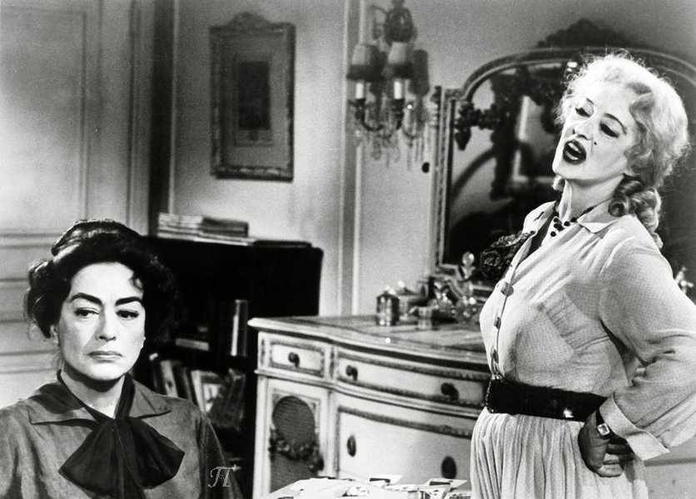

Slide 26
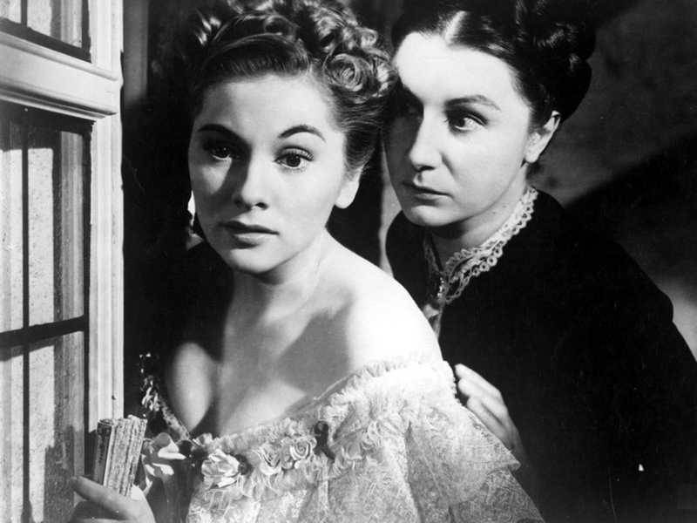

Slide 27
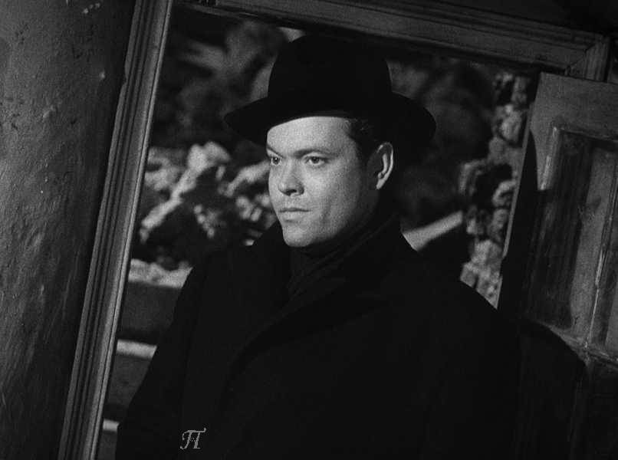

Slide 28
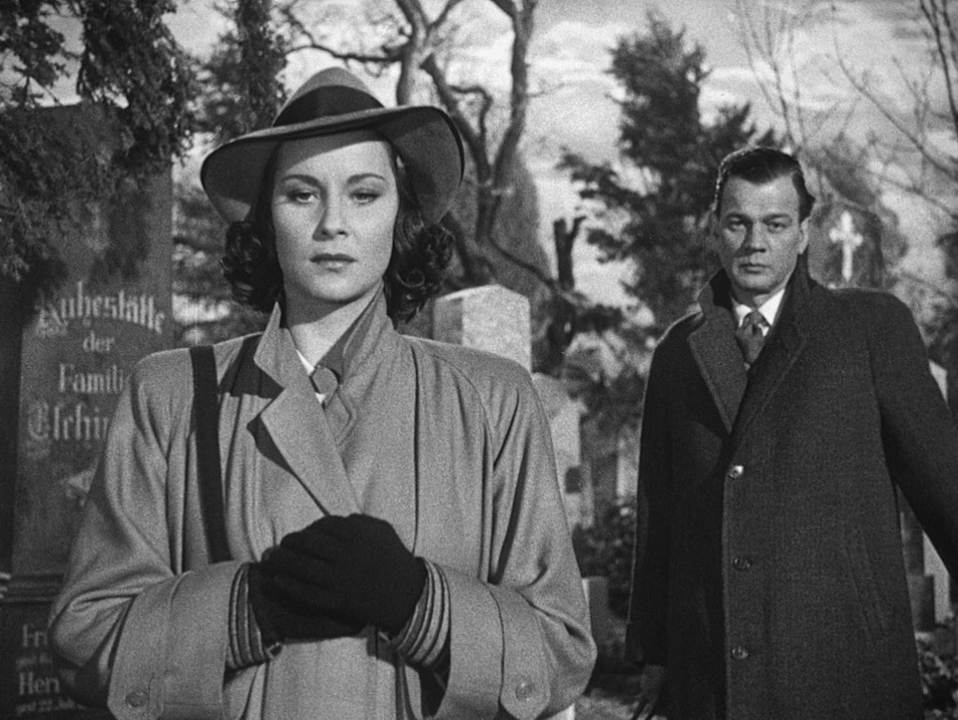

Slide 29
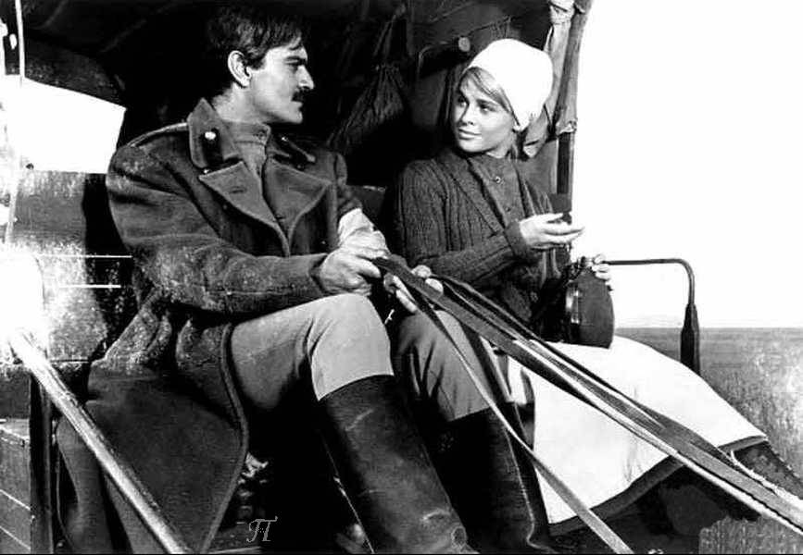

Slide 30
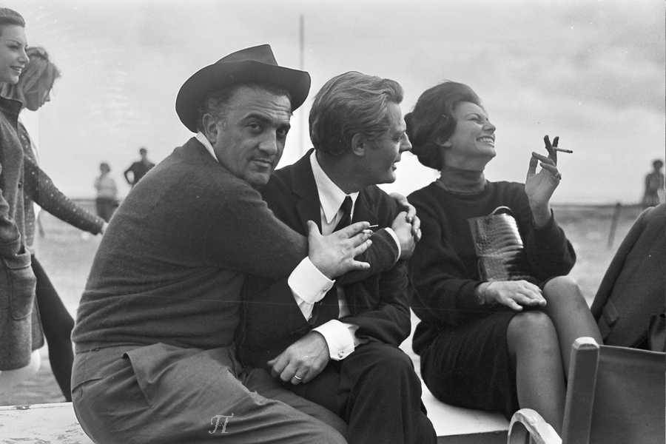

Slide 31
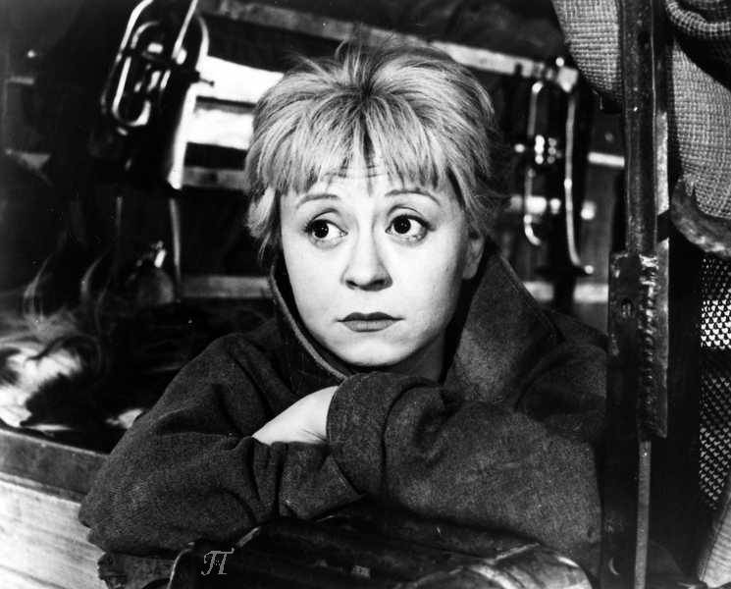

Slide 32
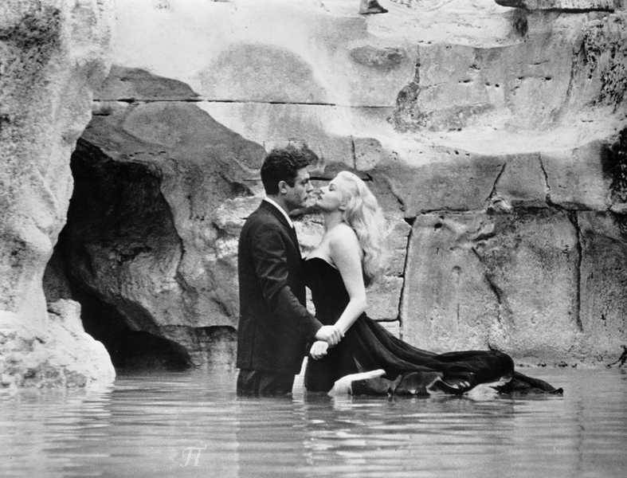

Slide 33
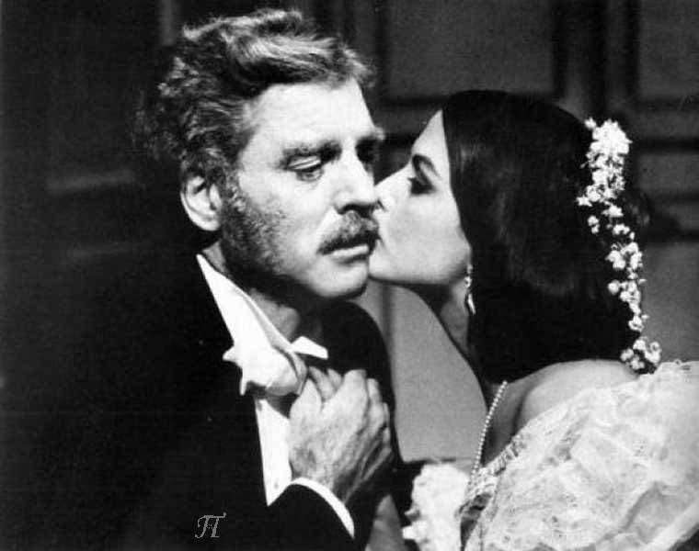

Slide 34
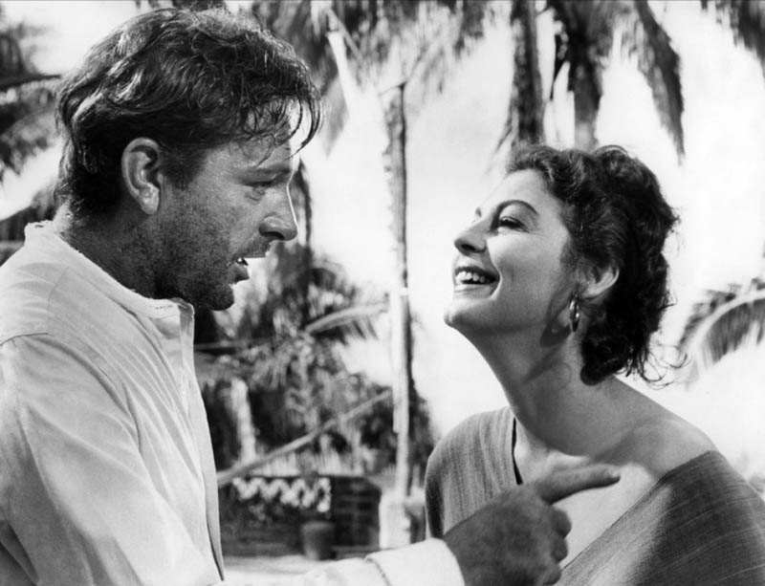

Slide 35
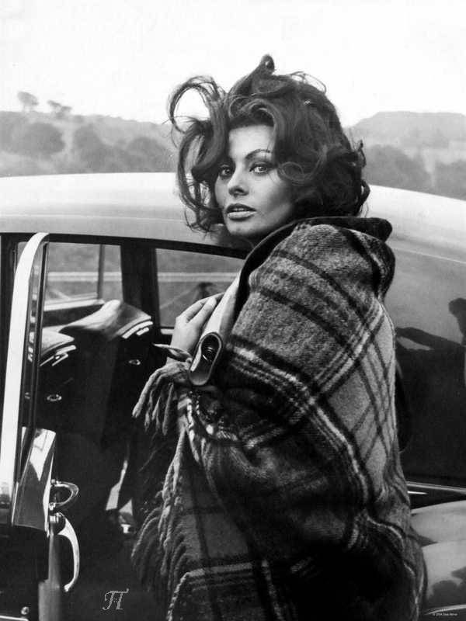

Slide 36
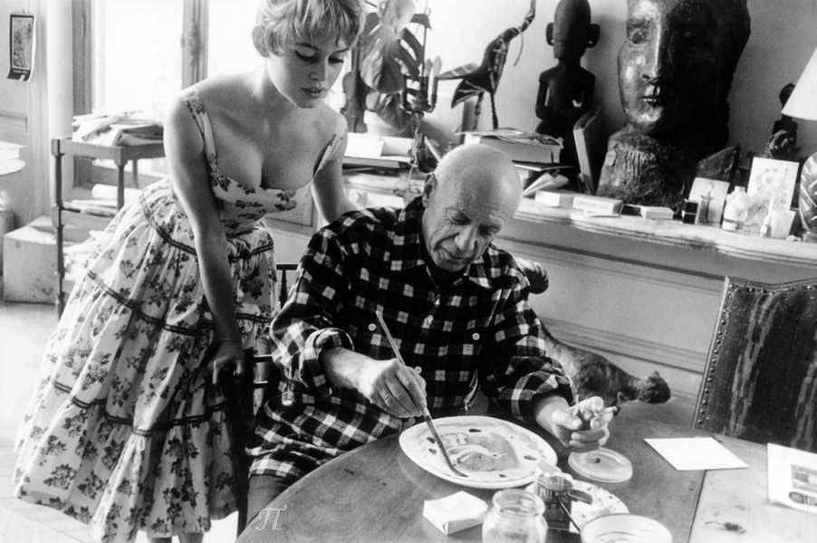

Slide 37
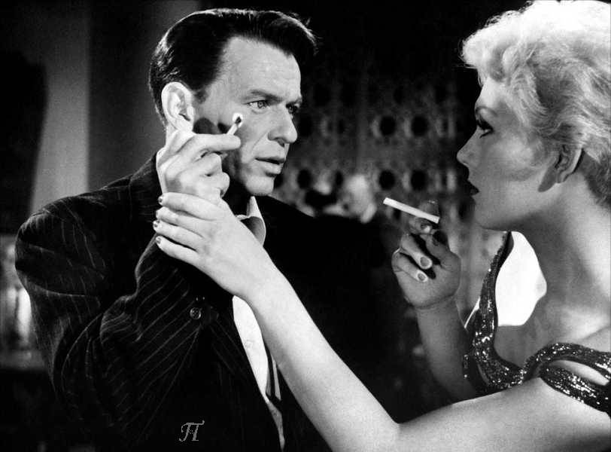

Slide 38
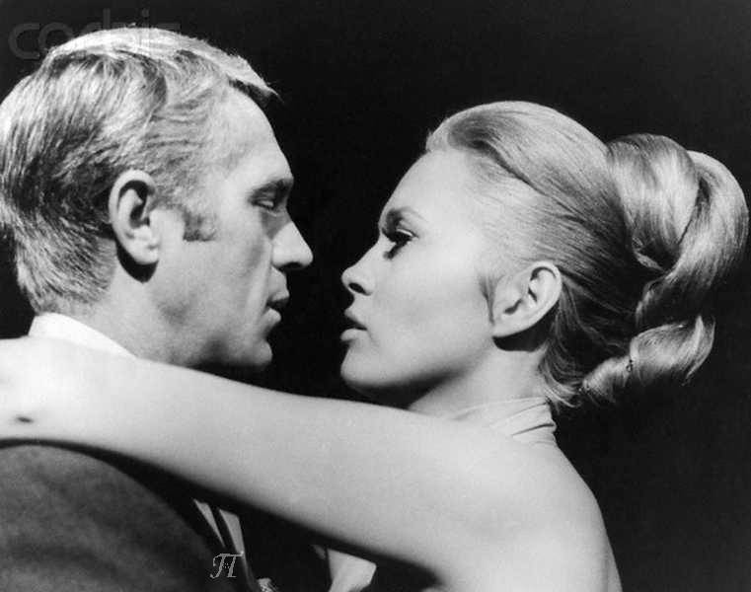

Slide 39
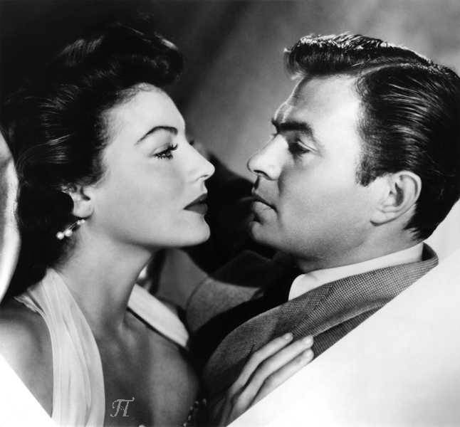

Slide 40
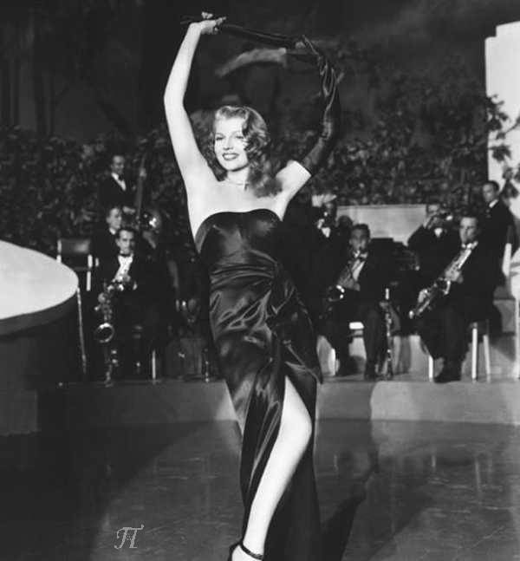

Slide 41
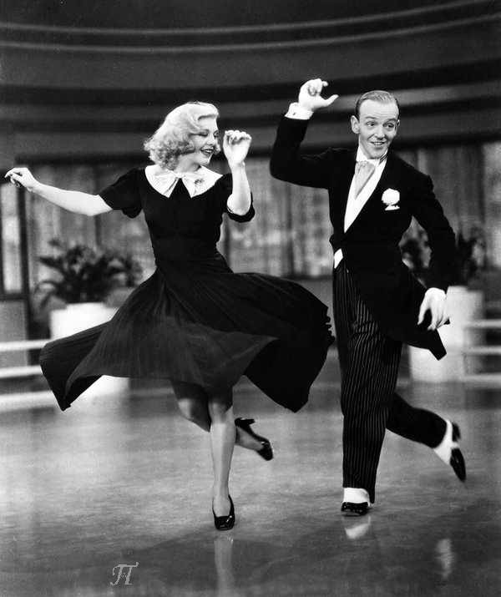

Slide 42
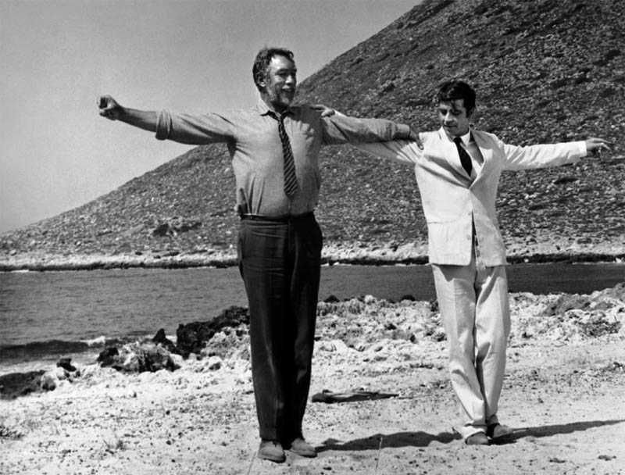

Slide 43
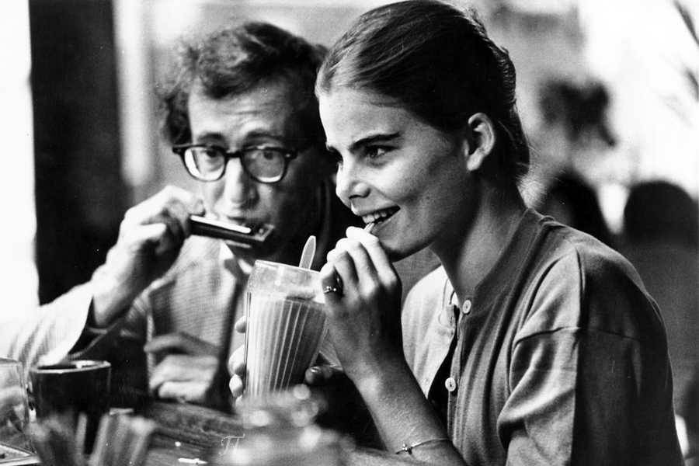

Slide 44
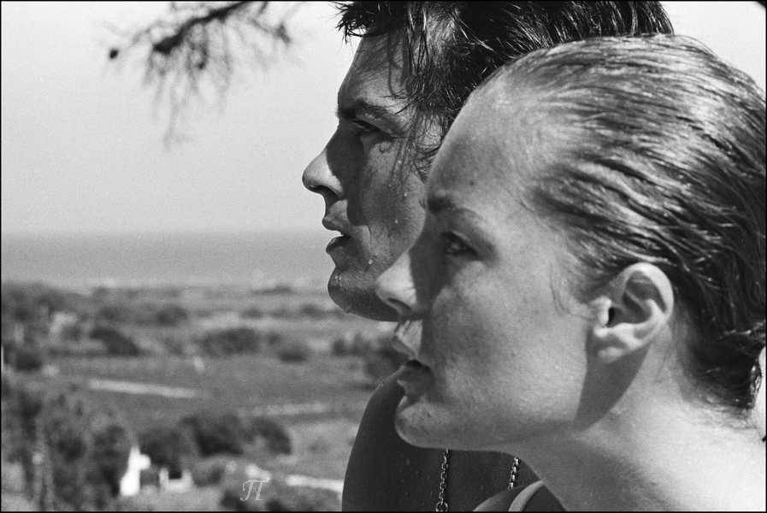

Slide 45


Slide 46
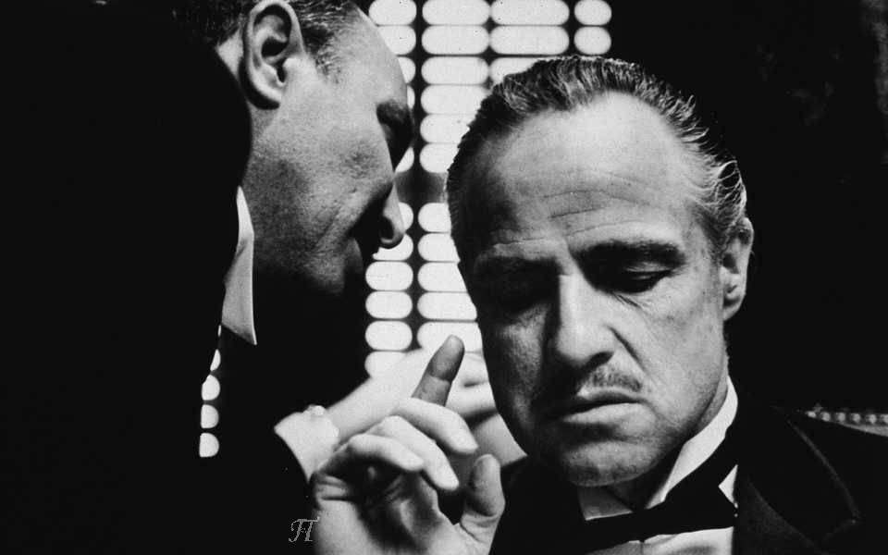

Slide 47
Unforgettable, that's what you are
Unforgettable though near or far
Like a song of love that clings to me
How the thought of you does things to me
Never before has someone been more
Unforgettable in every way
And forever more, that's how you'll stay
That's why, darling, it's incredible
That someone so unforgettable
Thinks that I am unforgettable too
Unforgettable in every way
And forever more, that's how you'll stay
That's why, darling, it's incredible
That someone so unforgettable
Thinks that I am unforgettable too
Compositor: Irving Gordon
Intérpretes: Nat King Cole y Natalie Cole

Slide 48


altapi1@gmail.com
Imágenes procedentes de Internet
Sin ánimo de lucro – Non profit
Π

Slide 49







¿Te ha gustado?
Puedes ver más entrando
Aquí
Además puedes recibir powerpoints en tu correo electrónico suscribiéndote aquí:

