Slide 1


.
FOTOS RARAS DE
FAMOSOS
Doris Day:: Que Sera, Sera

Slide 2
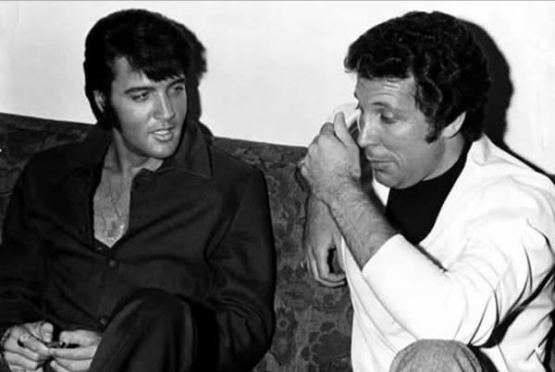
Elvis Presley and Tom Jones

Slide 3
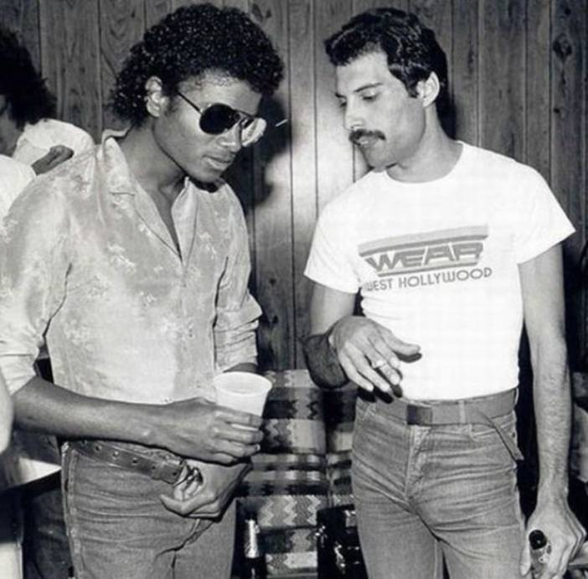
Michael Jackson and Freddie Mercury

Slide 4
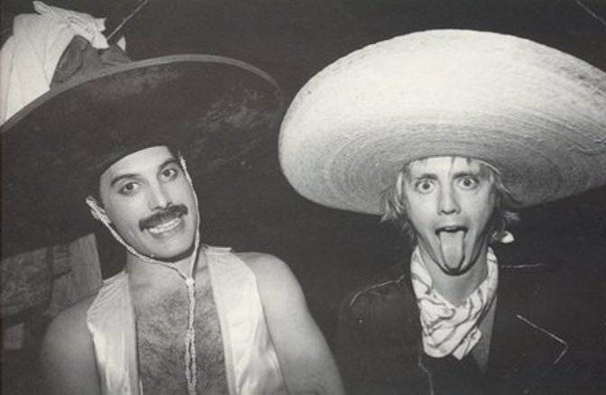
Freddie Mercury and Roger Taylor

Slide 5
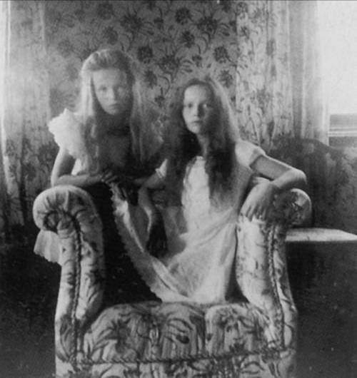
Olga and Tatiana Romanova

Slide 6
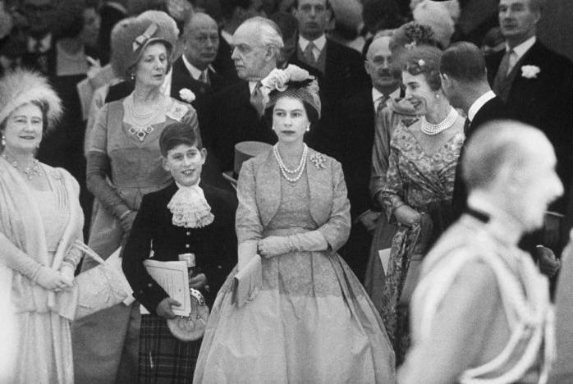
Prince Charles and Queen Elizabeth II

Slide 7
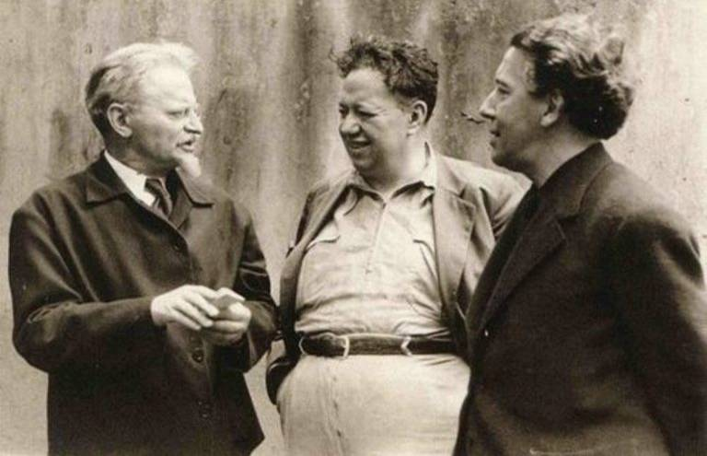
Leon Trotsky, Diego Rivera and André Breton

Slide 8
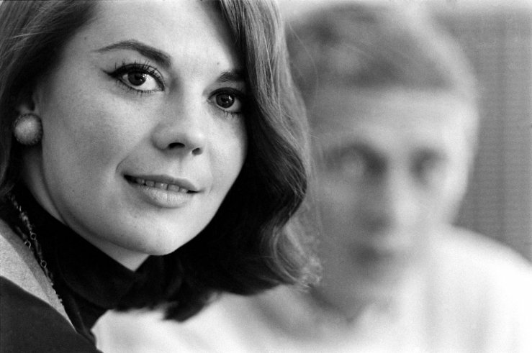
Natalie Wood

Slide 9
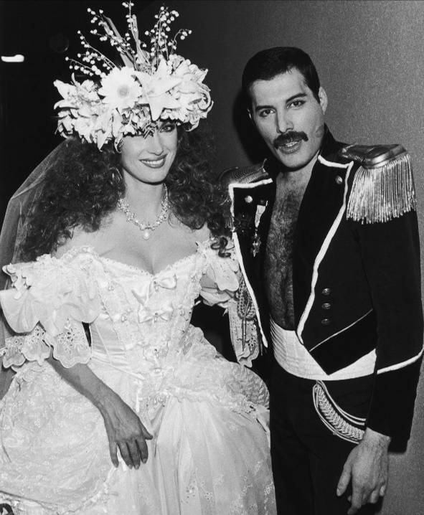
Freddie Mercury and Jane Seymour

Slide 10
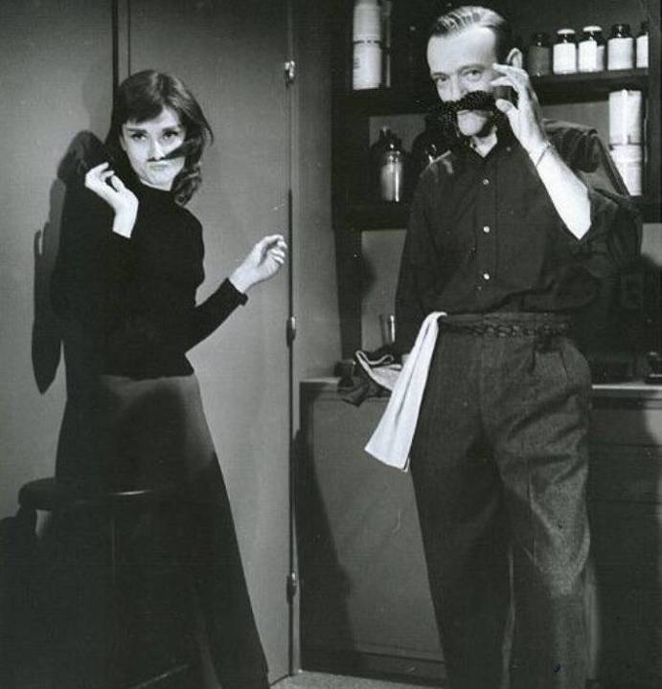
Fred Astaire and Audrey Hepburn

Slide 11
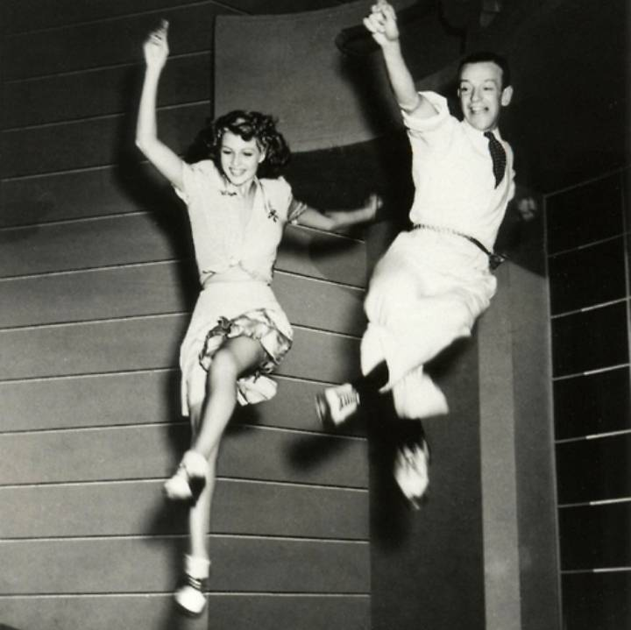
Rita Hayworth and Fred Astaire

Slide 12
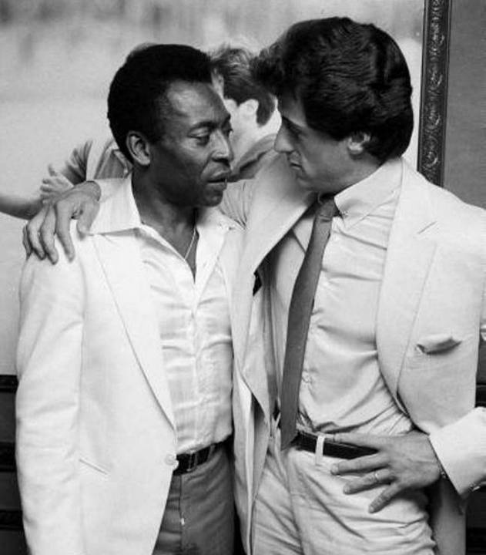
Pelé and Sylvester Stallone

Slide 13
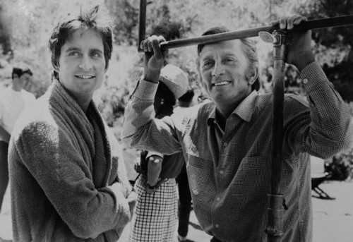
Michael and Kirk Douglas

Slide 14
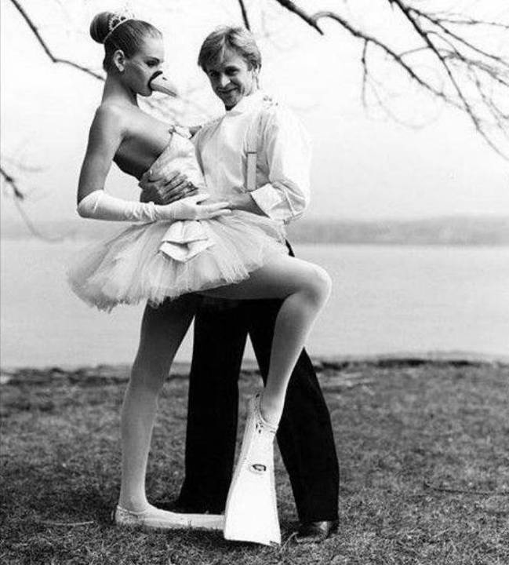
Mikhail Baryshnikov and Uma Thurman

Slide 15
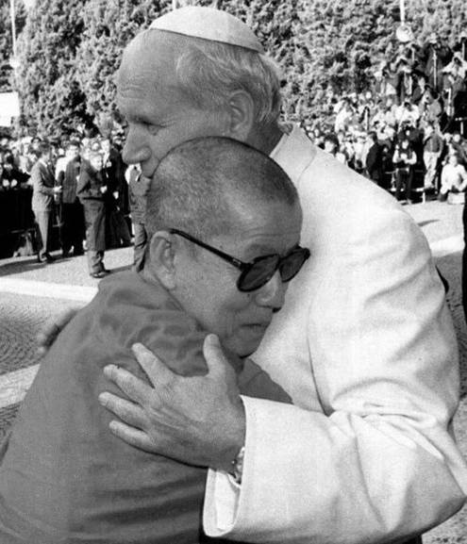
The Pope and the Dalai Lama

Slide 16
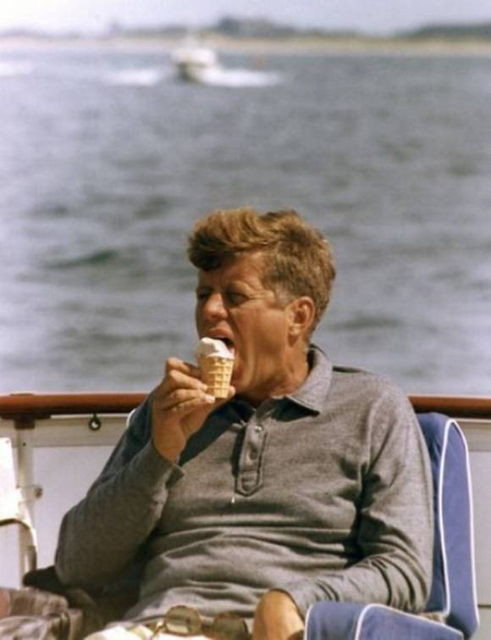
John F. Kennedy

Slide 17
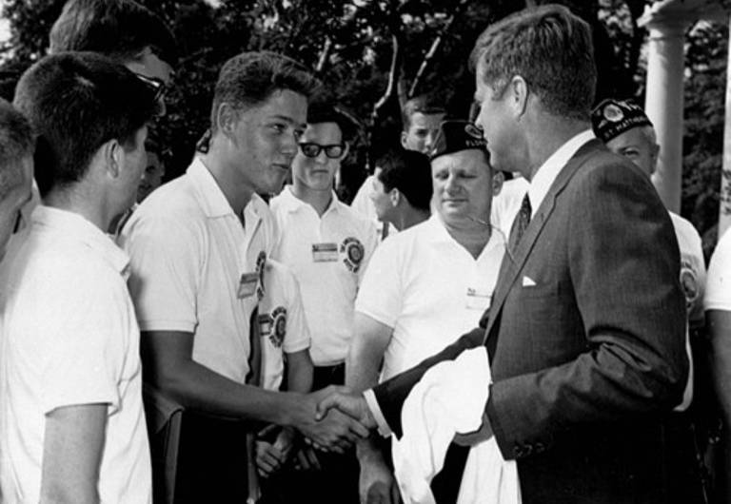
Bill Clinton and John F. Kennedy

Slide 18
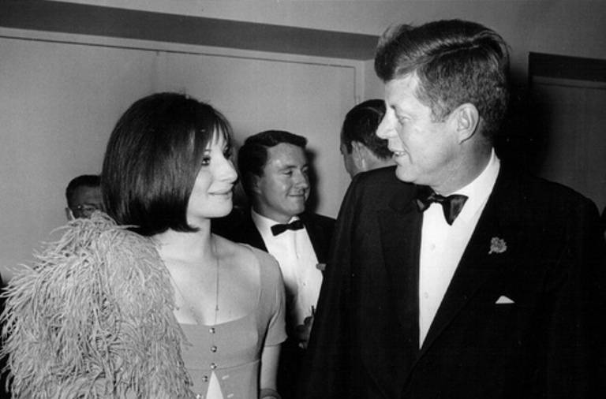
John F. Kennedy and Barbra Streisand

Slide 19
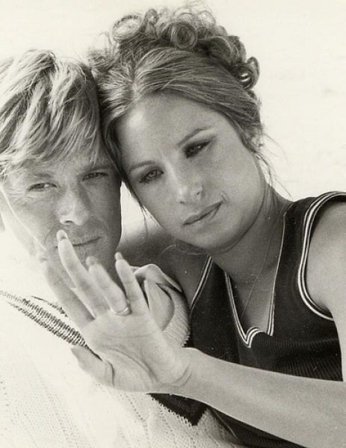
Robert Redford and Barbra Streisand

Slide 20
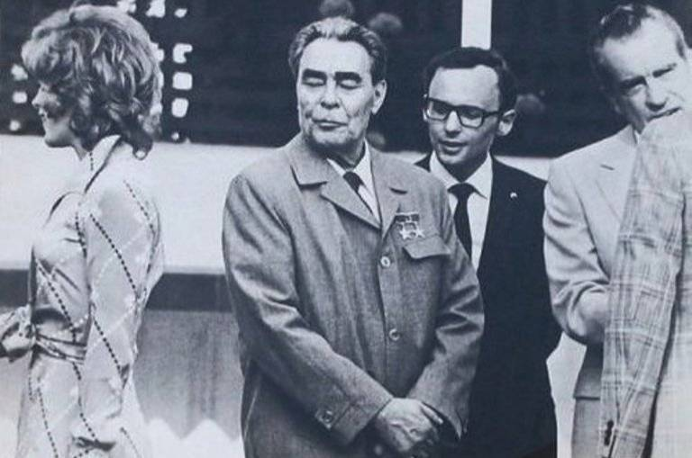
Leonid Brezhnev, Richard Nixon and Jill St John (Bond girl in Diamonds Are Forever)

Slide 21
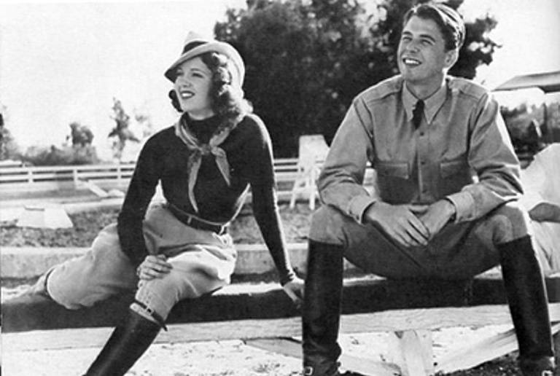
Lana Turner and Ronald Reagan

Slide 22
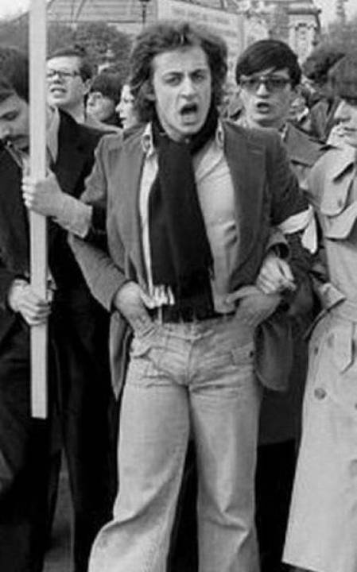
Nicolas Sarkozy

Slide 23
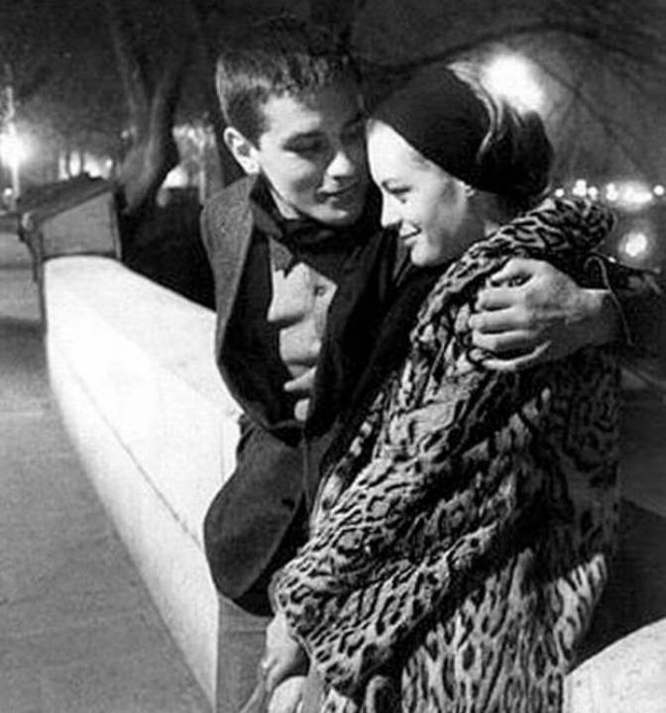
Romy Schneider and Alain Delon

Slide 24
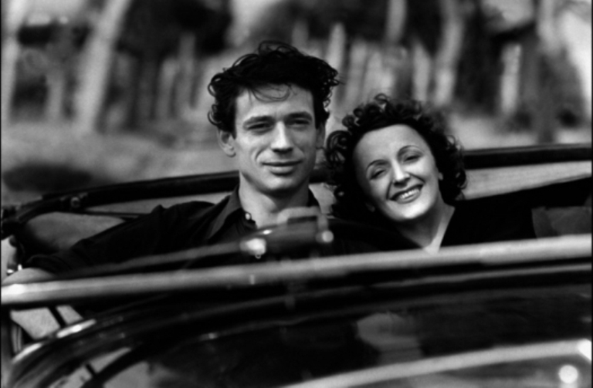
Yves Montand and Edith Piaf

Slide 25
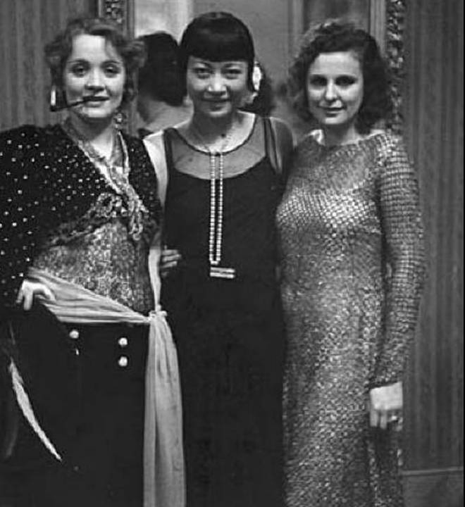
Marlene Dietrich, Anna May Wong and Leni Riefenstahl

Slide 26
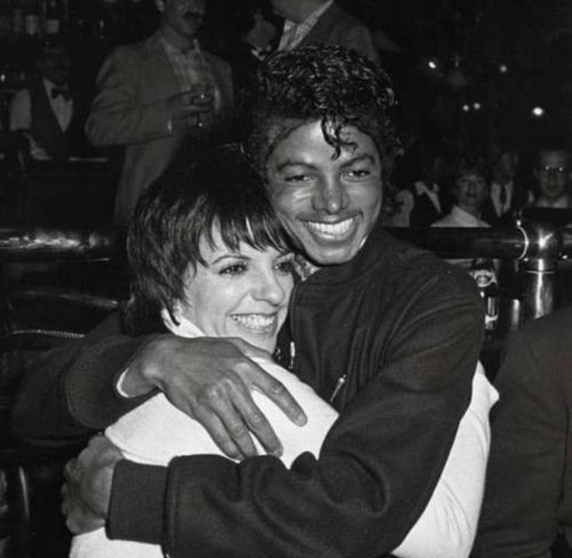
Michael Jackson and Liza Minnelli

Slide 27
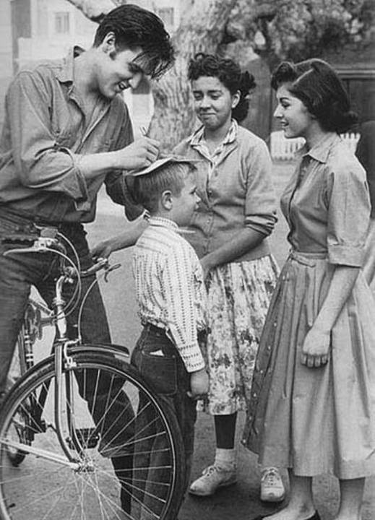
Elvis Presley

Slide 28
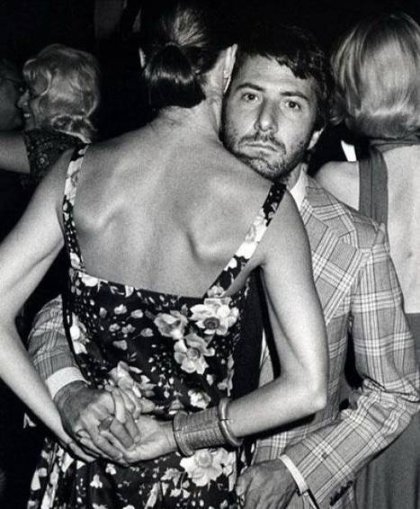
Dustin Hoffman

Slide 29
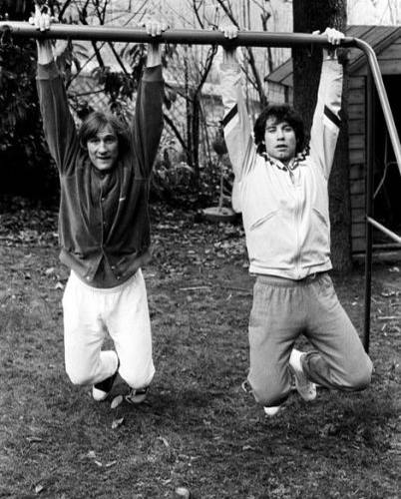
JohnTravolta and Gérard Depardieu

Slide 30
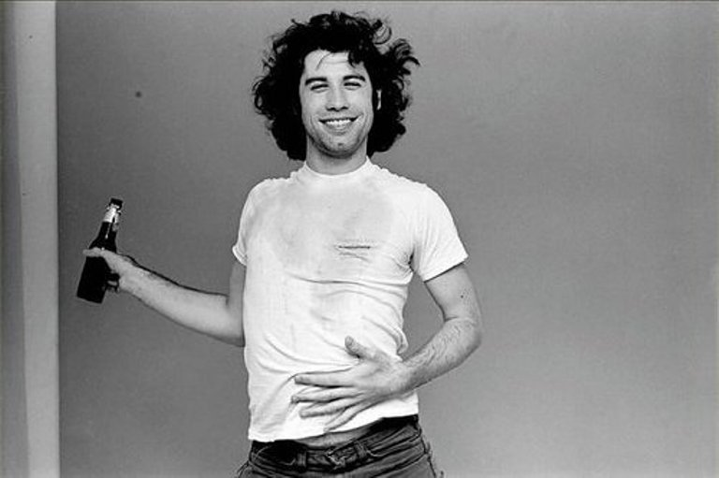
John Travolta

Slide 31
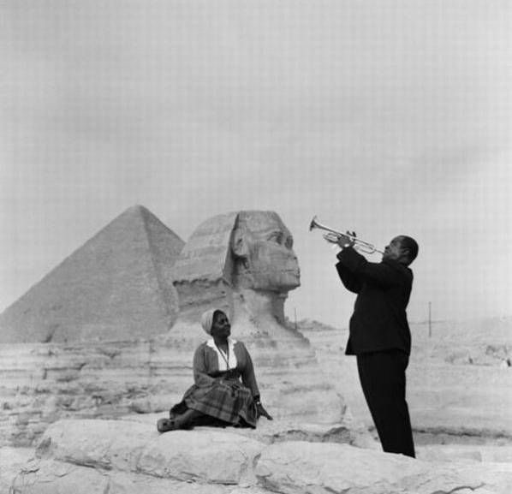
Louis Armstrong in Egypt

Slide 32
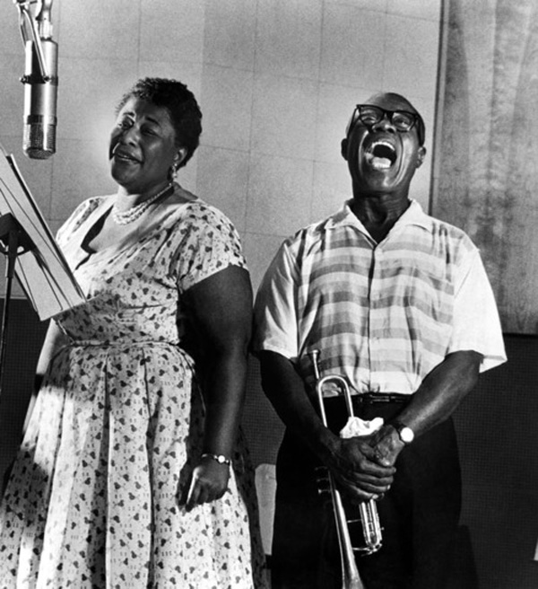
Ella Fitzgerald and Louis Armstrong

Slide 33
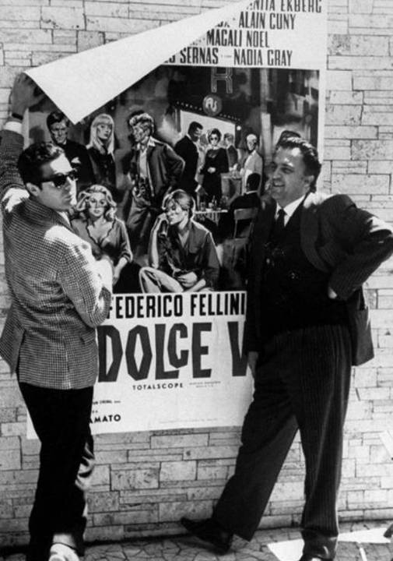
Marcello Mastroianni and Federico Fellini

Slide 34
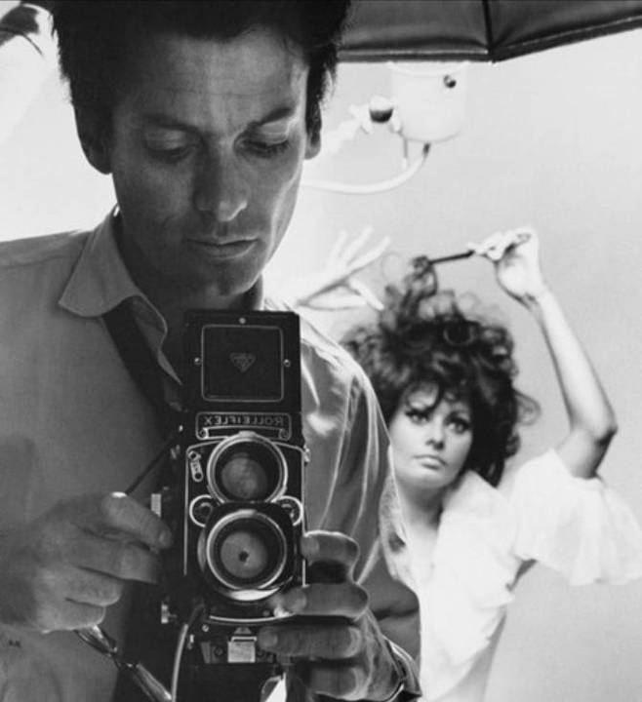
Photographer Richard Avedon and Sophia Loren

Slide 35
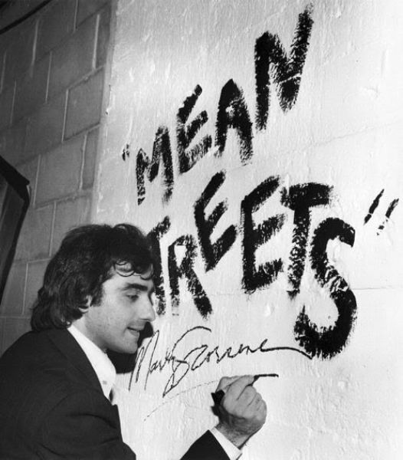
Martin Scorsese

Slide 36
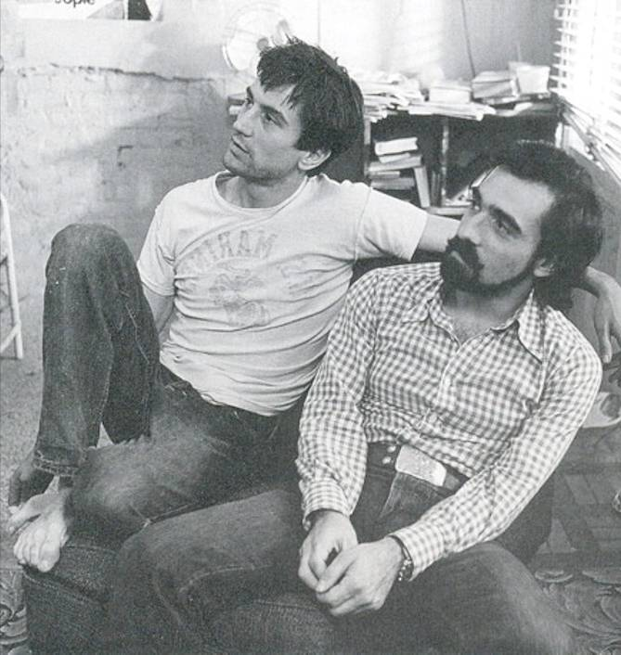
Robert De Niro and Martin Scorsese

Slide 37
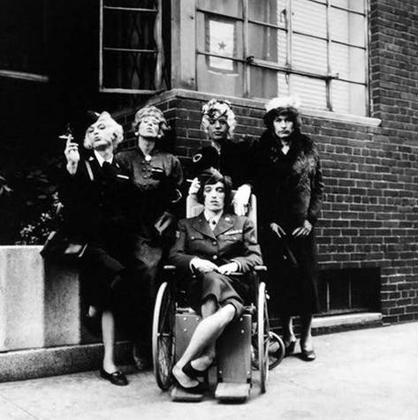
Rolling Stones

Slide 38
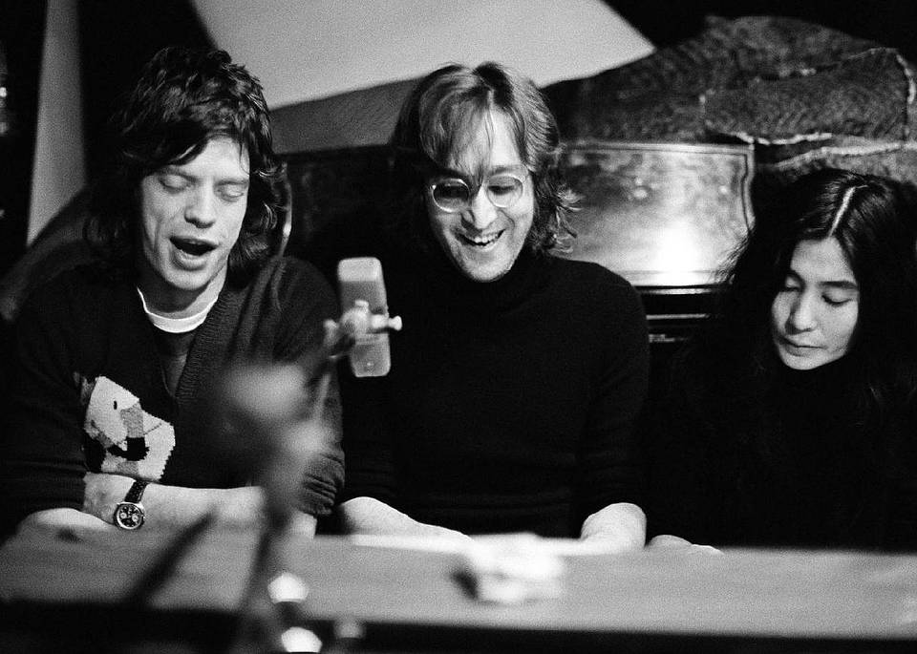
Mick Jagger , John Lennon and Yoko Ono

Slide 39
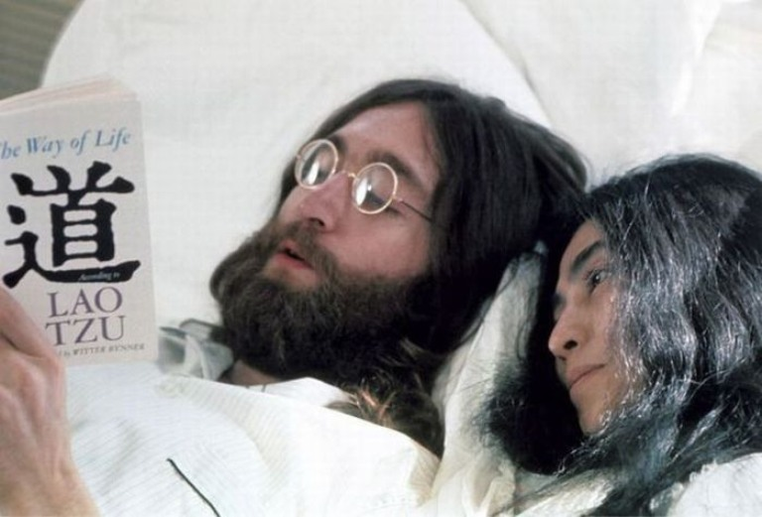
John Lennon and Yoko Ono

Slide 40
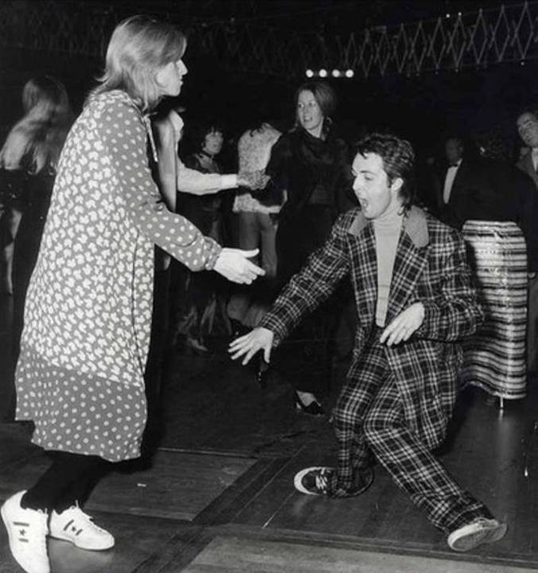
Paul McCartney and Linda

Slide 41
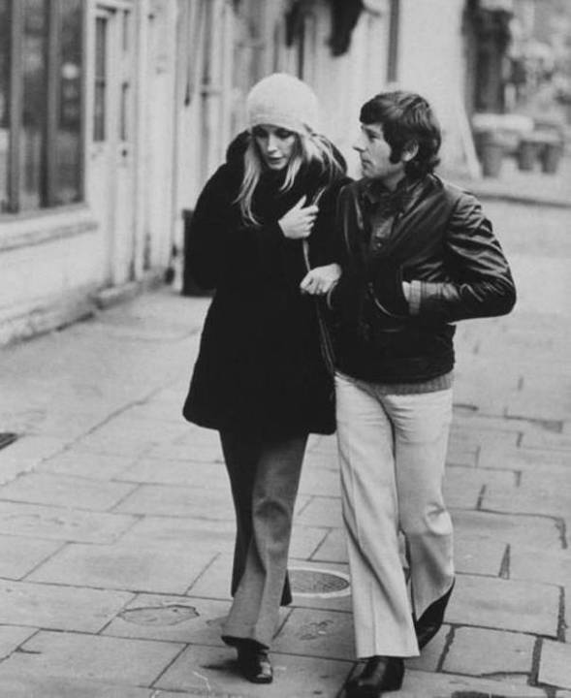
Roman Polanski
and Sharon Tate

Slide 42
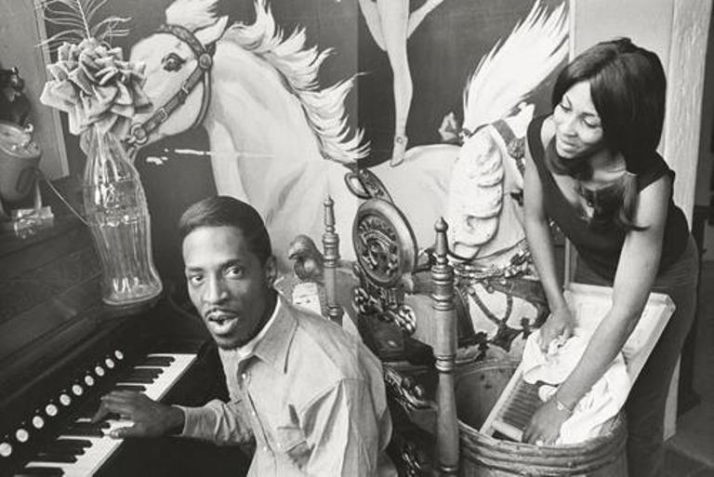
Ike and Tina Turner

Slide 43
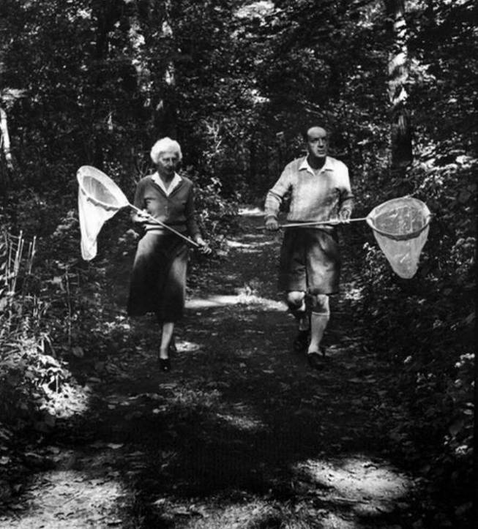
Vera and Vladimir Nabokov

Slide 44
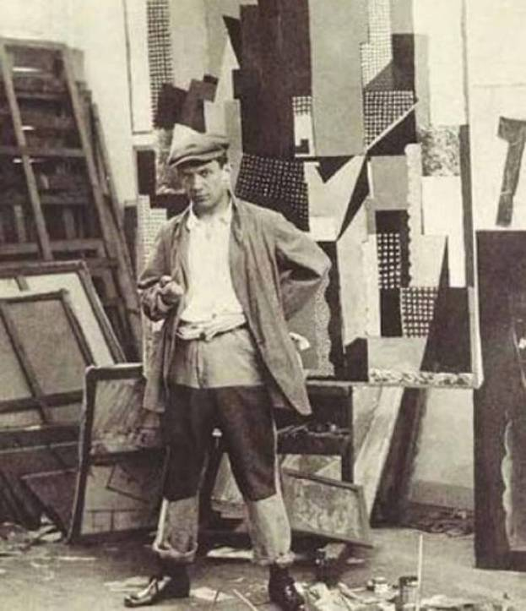
Pablo Picasso

Slide 45
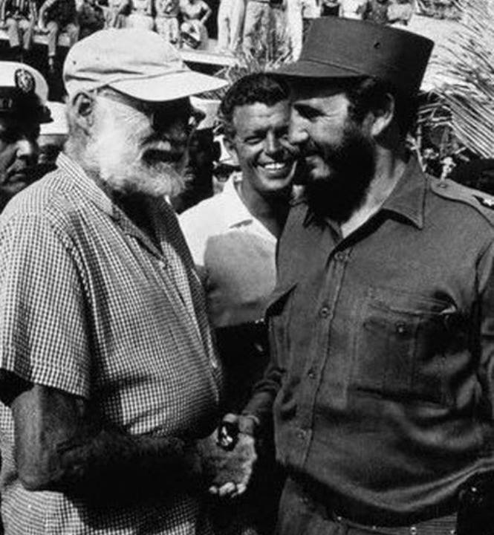
Ernest Hemingway and Fidel Castro

Slide 46
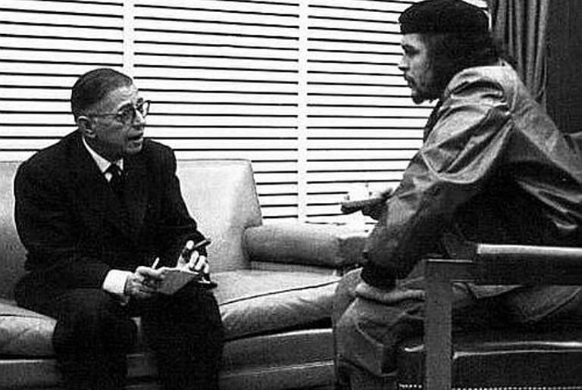
Che Guevara and Jean-Paul Sartre

Slide 47
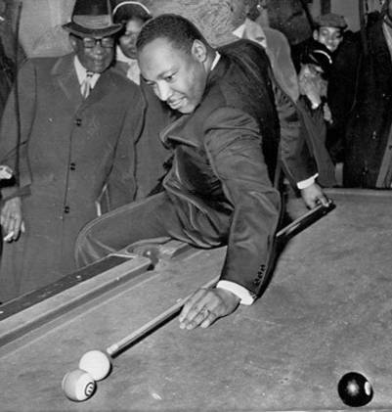
Martin Luther King Jr.

Slide 48
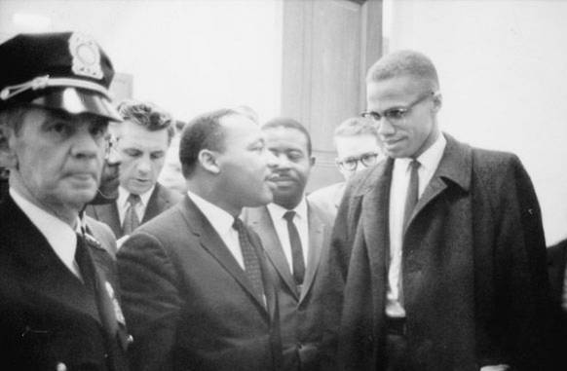
Martin Luther King Jr. and Malcolm X

Slide 49
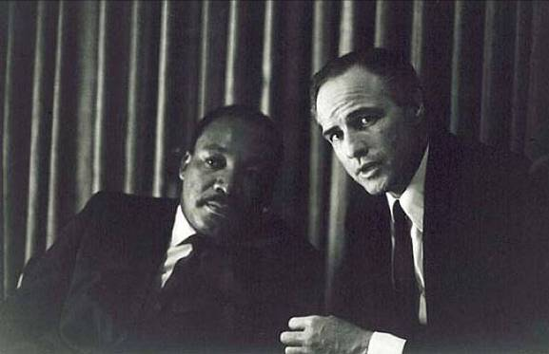
Martin Luther King Jr. and Marlon Brando

Slide 50
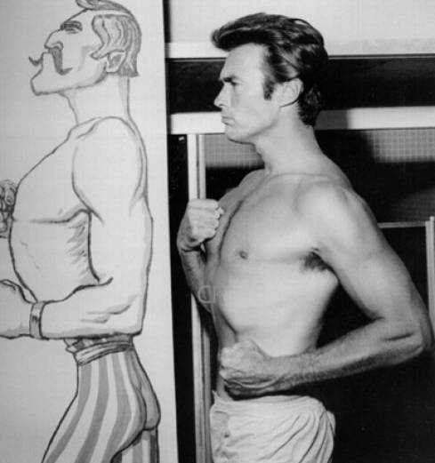
Clint Eastwood

Slide 51
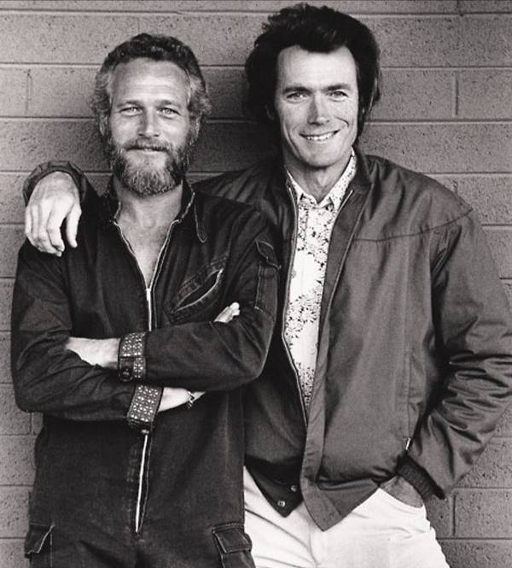
Paul Newman and Clint Eastwood

Slide 52

Charlie Chaplin and Vaslav Nijinsky

Slide 53

Charlie Chaplin and Gandhi

Slide 54

Charlie Chaplin and Albert Einstein

Slide 55

Frank Sinatra and Grace Kelly

Slide 56

Ian Fleming and Sean Connery

Slide 57

James Dean and Elizabeth Taylor

Slide 58

Johnny Cash and Ray Charles

Slide 59

Steve Jobs and Bill Gates

Slide 60







¿Te ha gustado?
Puedes ver más entrando
Aquí
Además puedes recibir powerpoints en tu correo electrónico suscribiéndote aquí:

