Slide 1
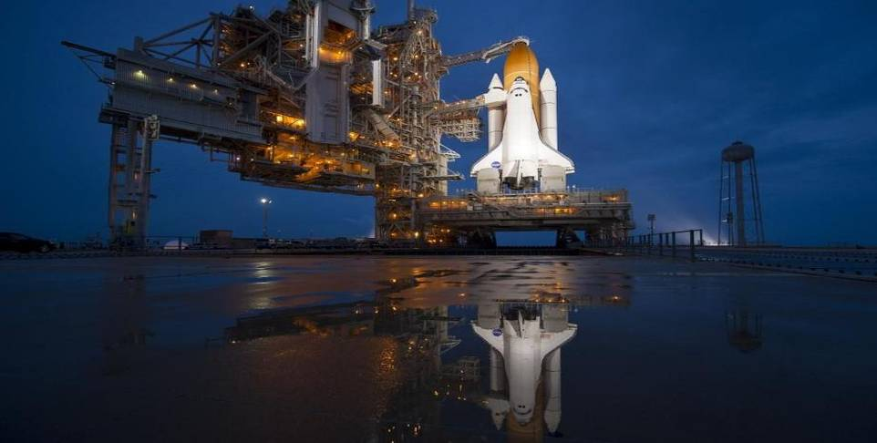


High
Up There…

Slide 2
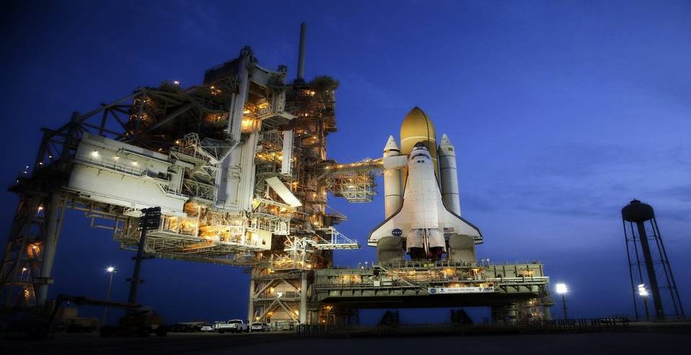

Slide 3
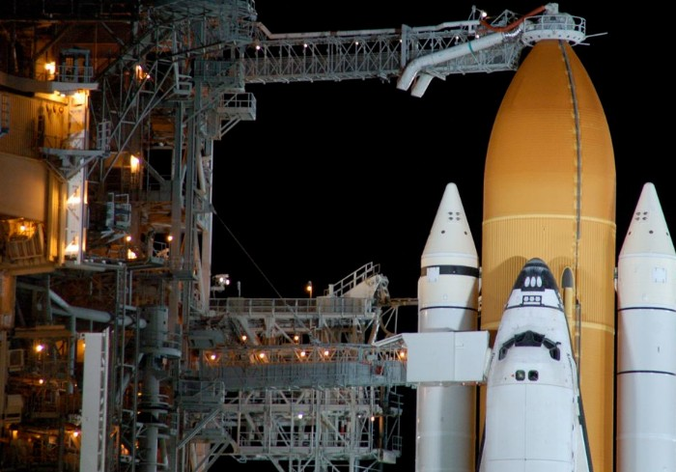

Slide 4
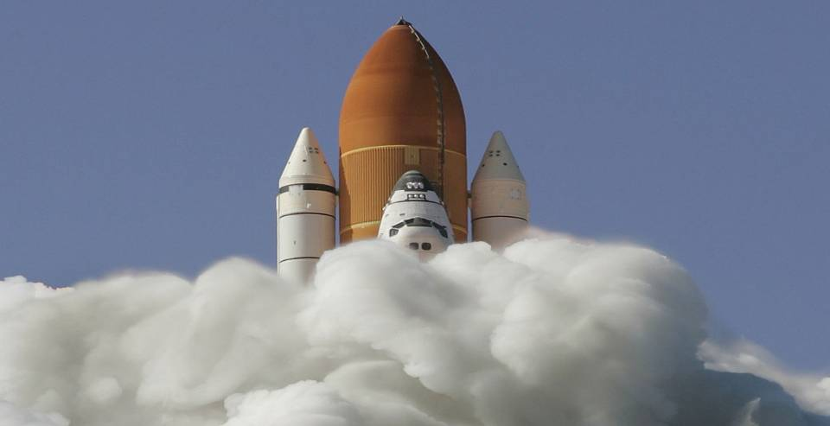

Slide 5
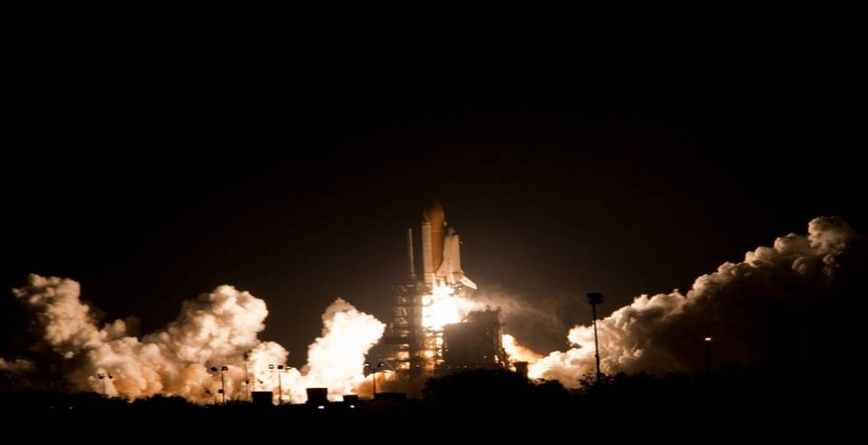

Slide 6
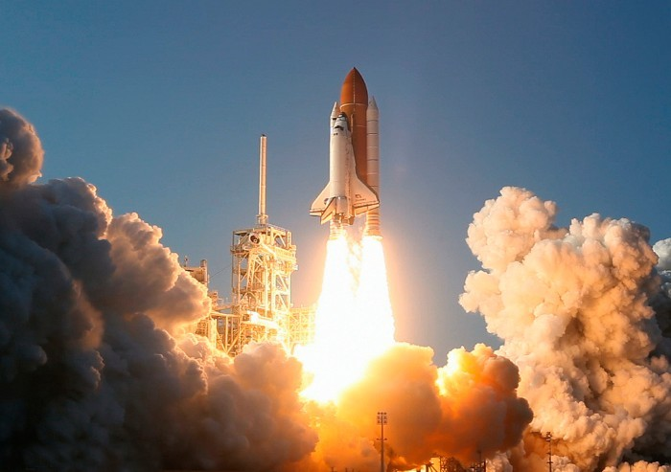

Slide 7
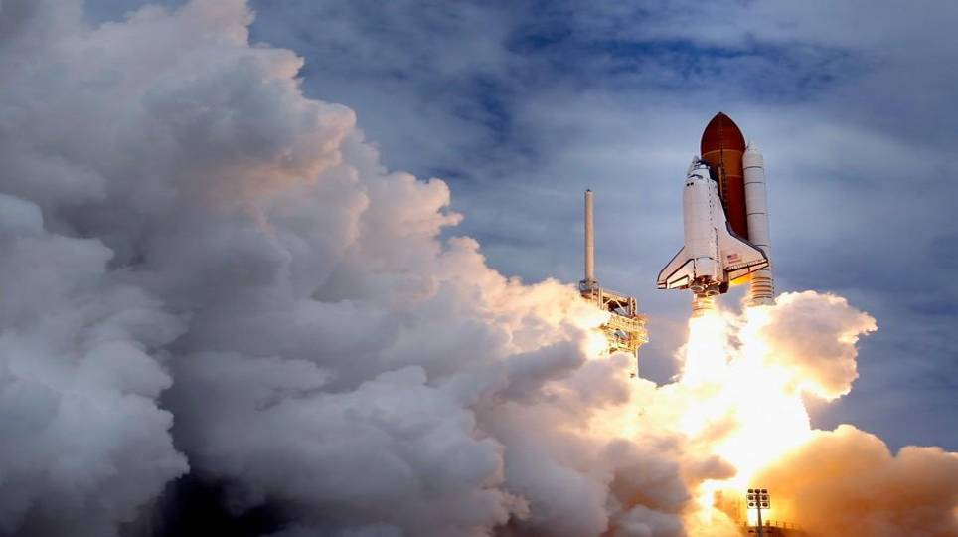

Slide 8
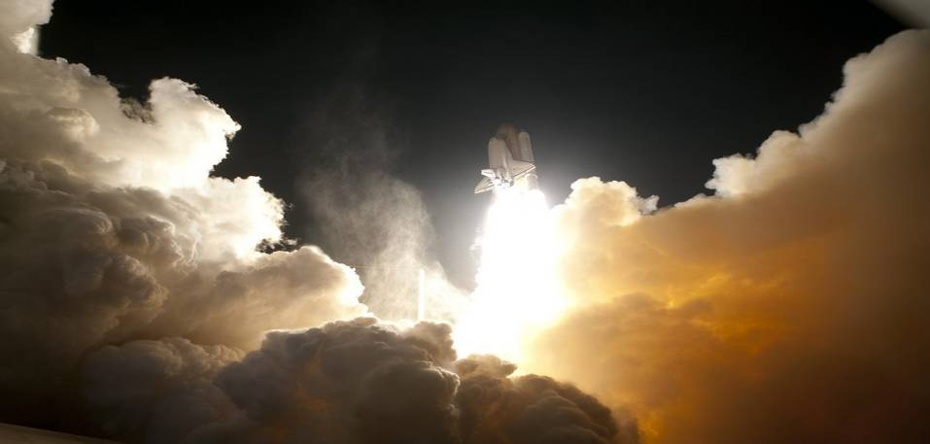

Slide 9
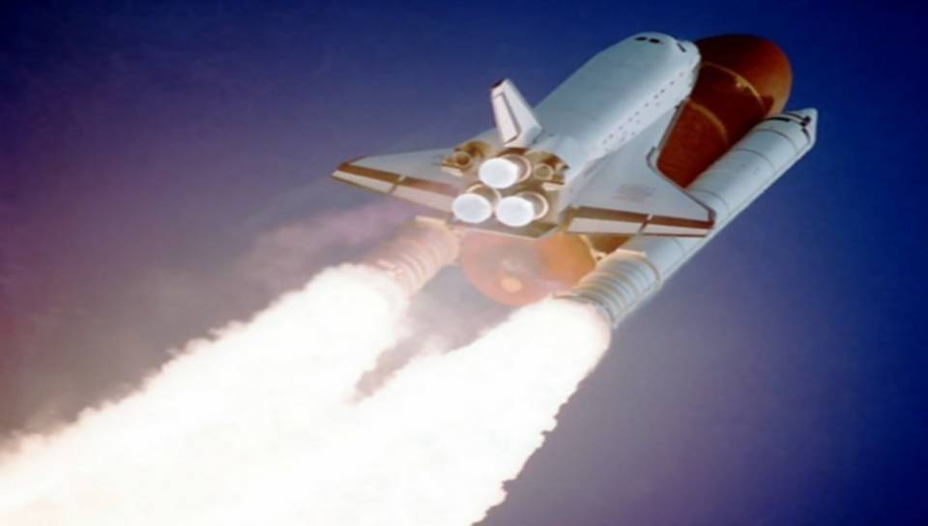

Slide 10
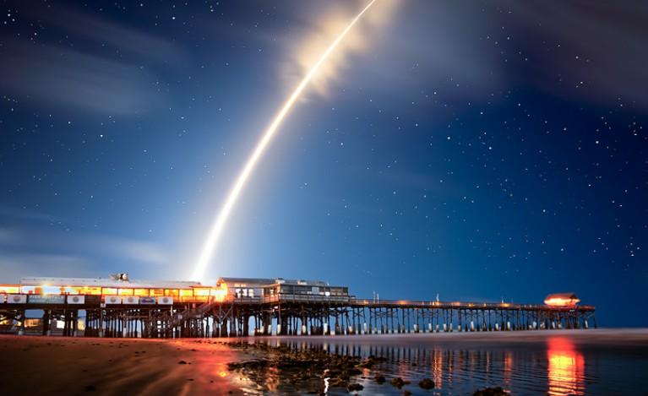

Slide 11
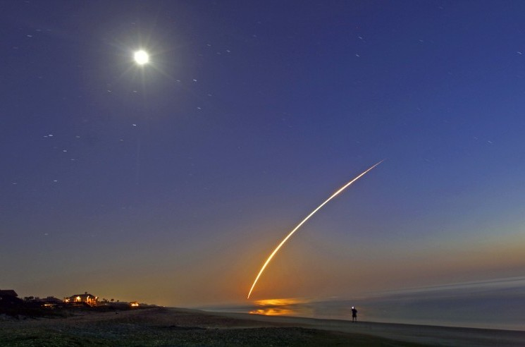

Slide 12
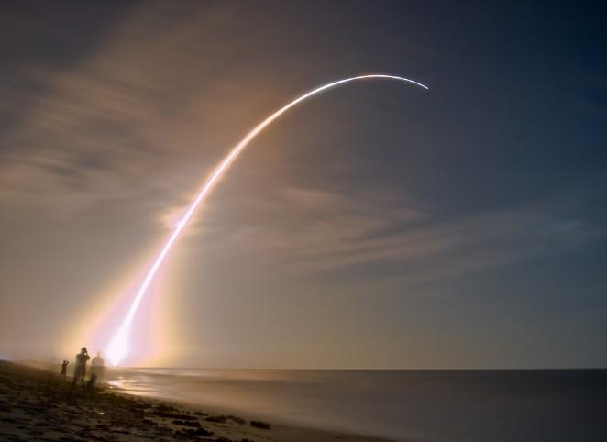

Slide 13
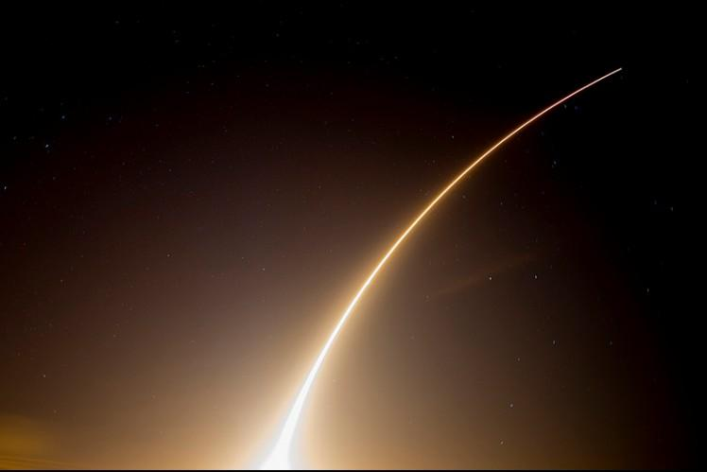

Slide 14
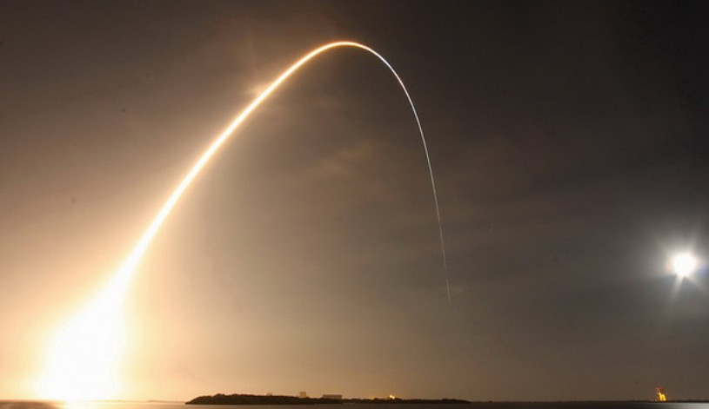

Slide 15
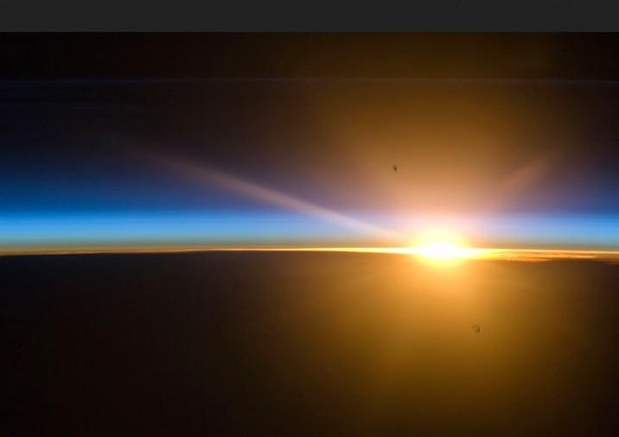

Slide 16
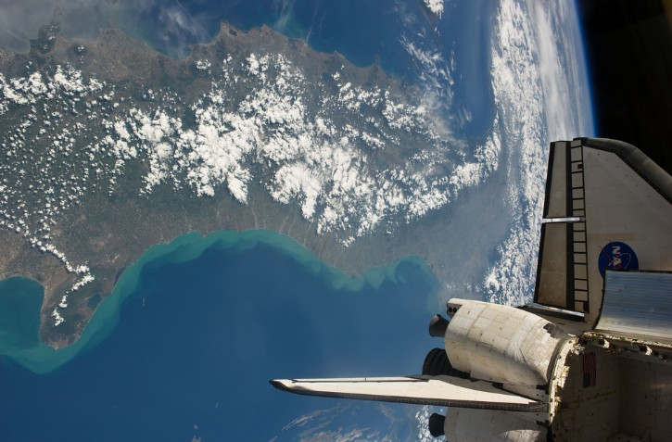

Slide 17
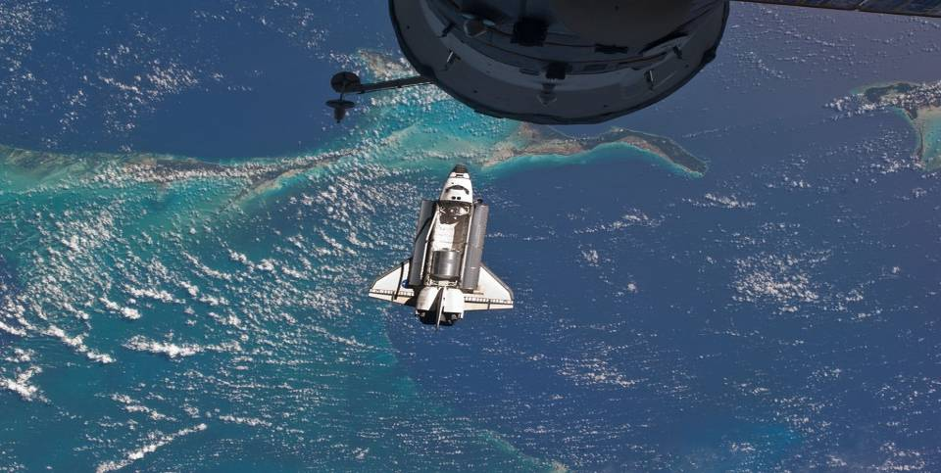
The shuttle approaches the ISS

Slide 18
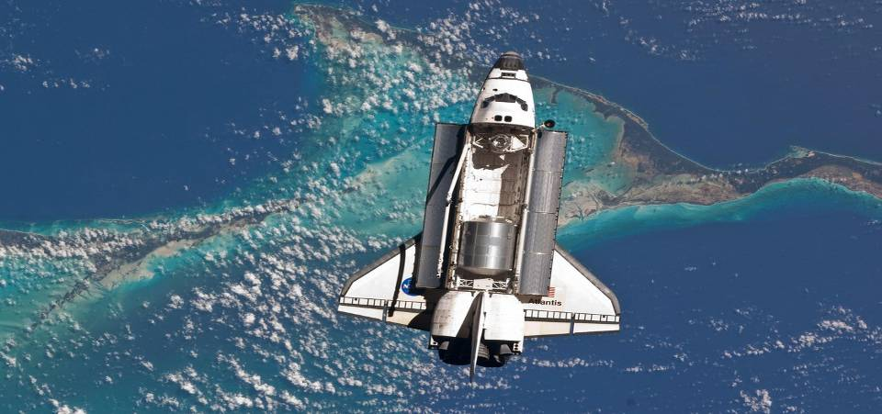
Transport of a habitable module for ISS

Slide 19
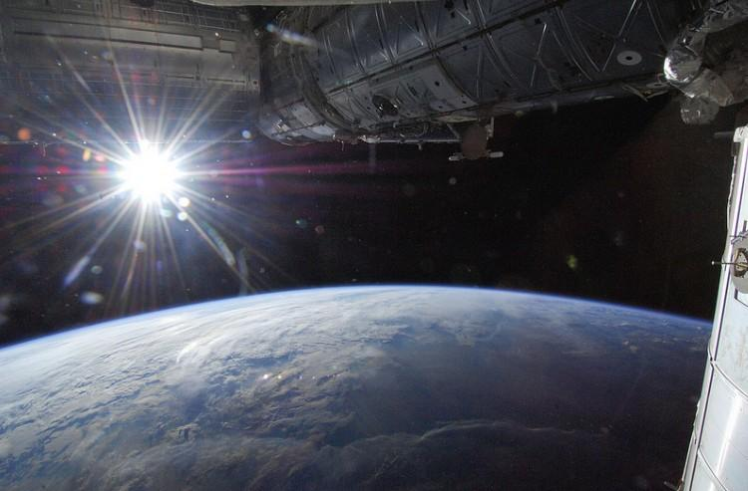

Slide 20
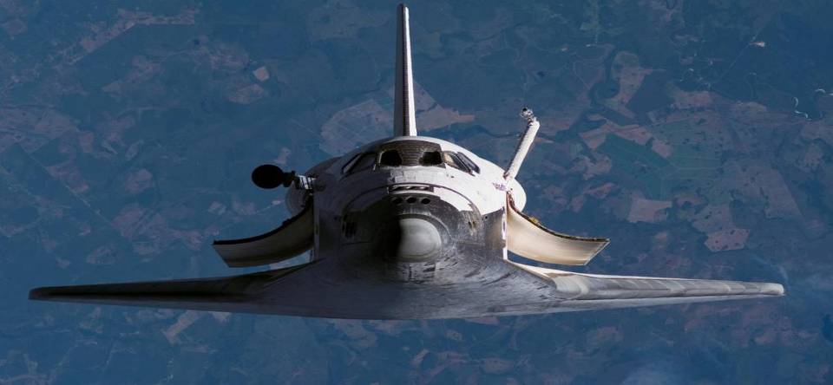

Slide 21
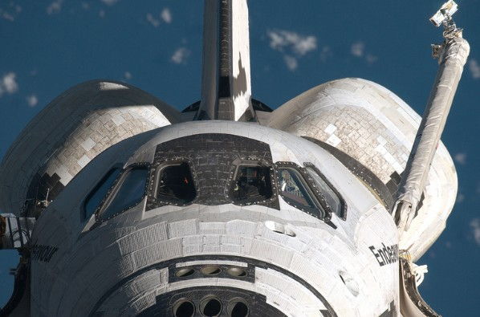

Slide 22
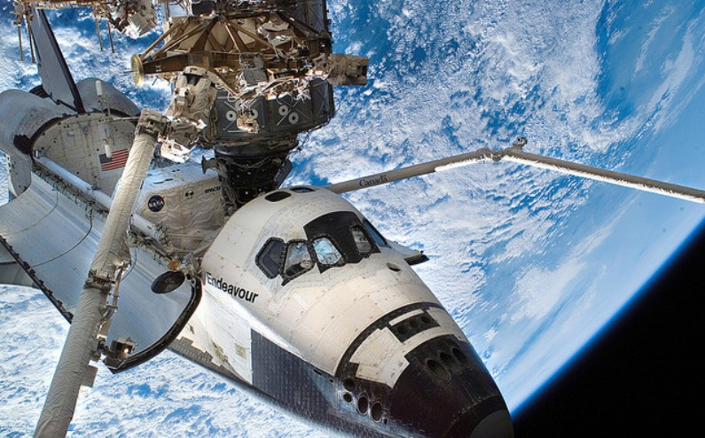
Docking with the ISS

Slide 23
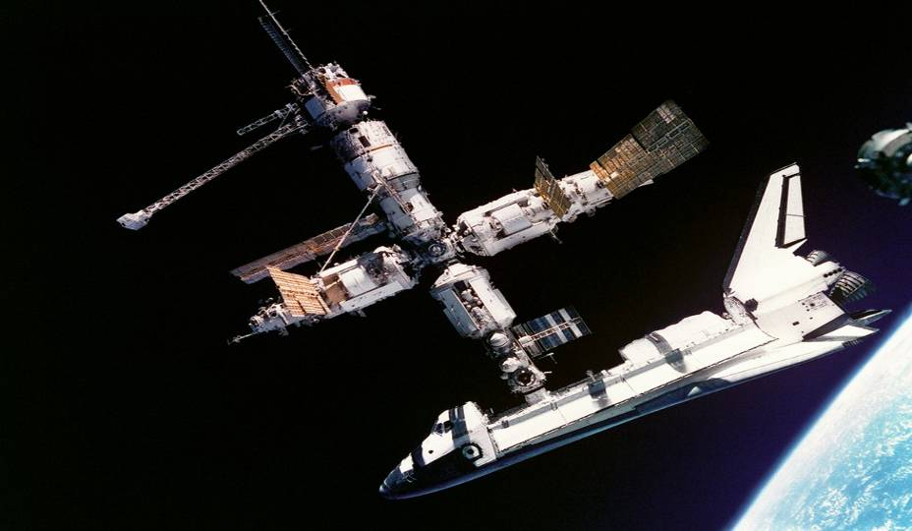

Slide 24
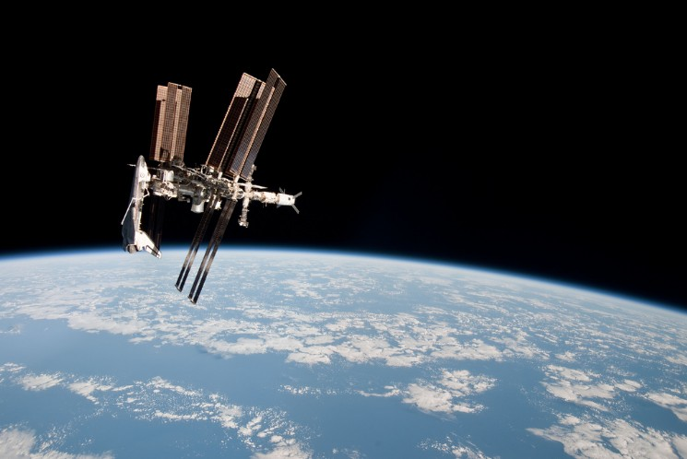

Slide 25
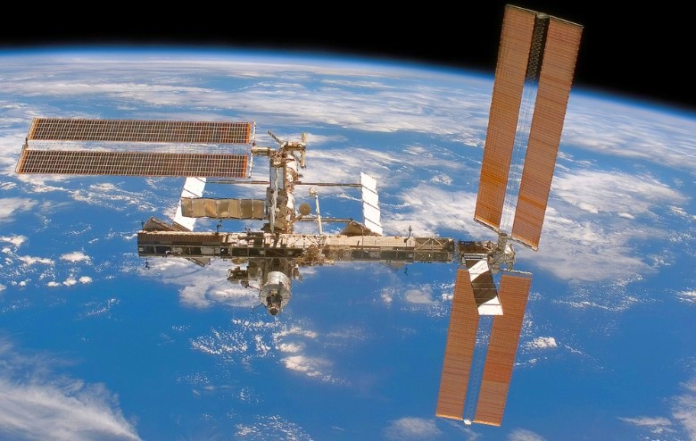

Slide 26
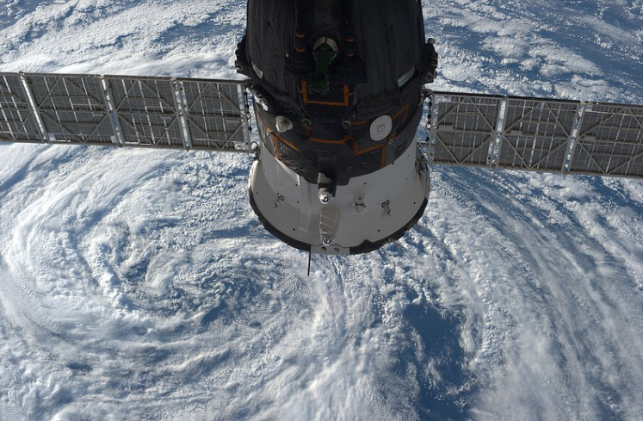
2 Soyuz docked permanently for evacuation

Slide 27
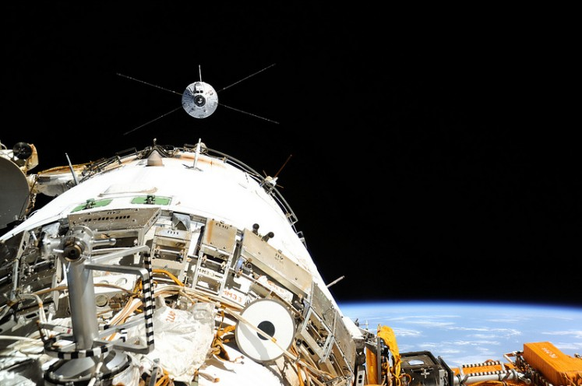
The European ATV cargo vehicle 4
on approach to securing

Slide 28
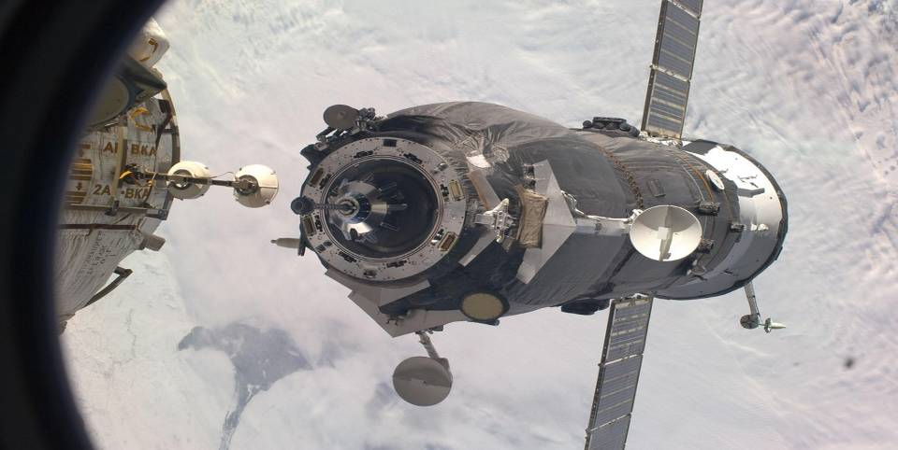
Russian Cargo Stowage Progress...

Slide 29
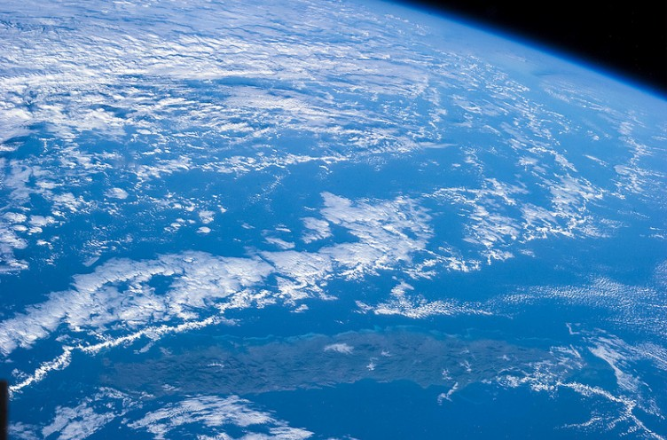
View on Earth…

Slide 30
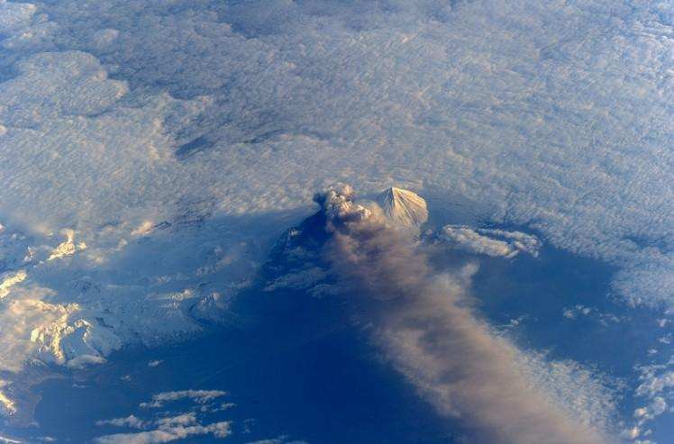
Pavlof Volcano Eruption (Aleutian Islands)

Slide 31
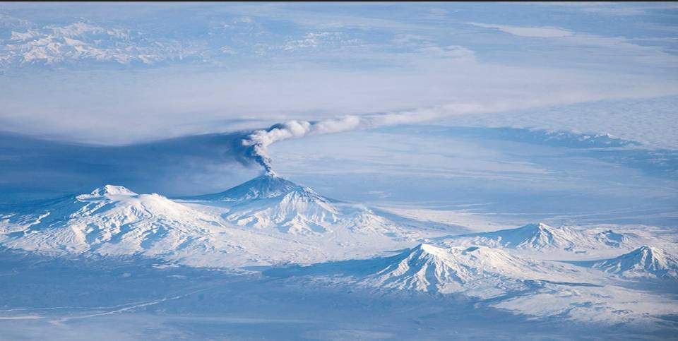
Eruption Volcano Kliushevskoi, Kamchatka

Slide 32
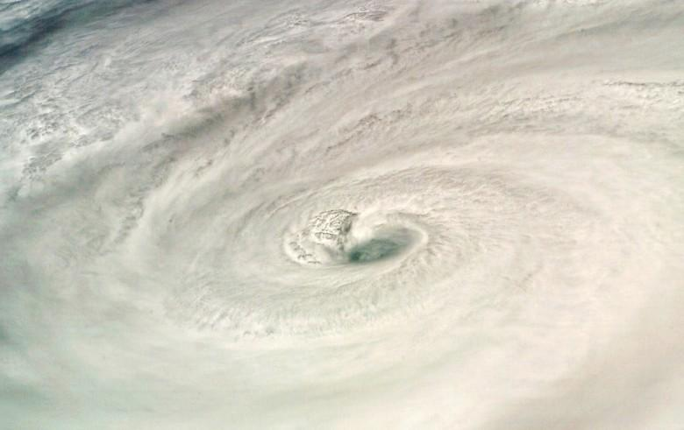
Hurricane Dean

Slide 33
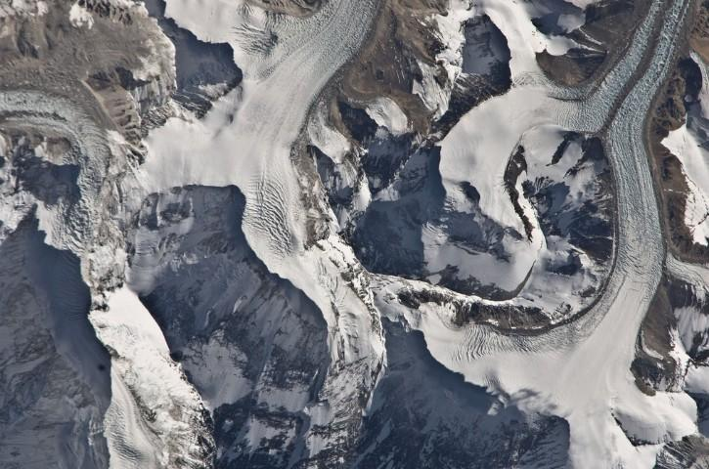
Mount Everest

Slide 34
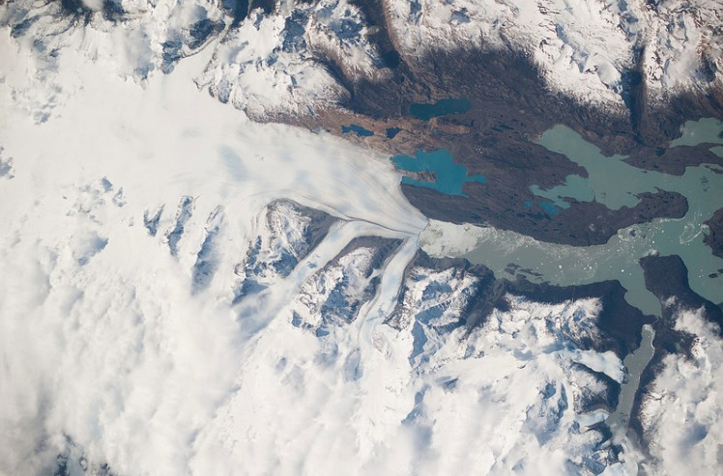
Upsala Glacier, Patagonia

Slide 35
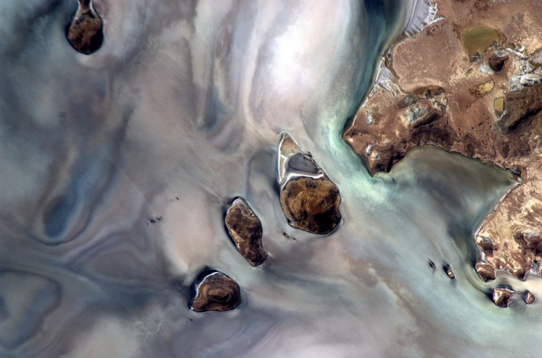
Salar de Uyuni, Bolivia

Slide 36
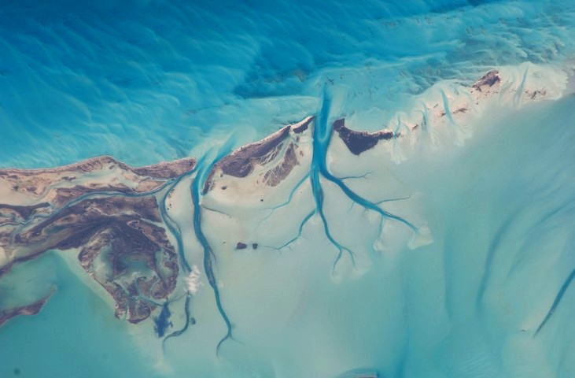
Long Island, Bahamas

Slide 37
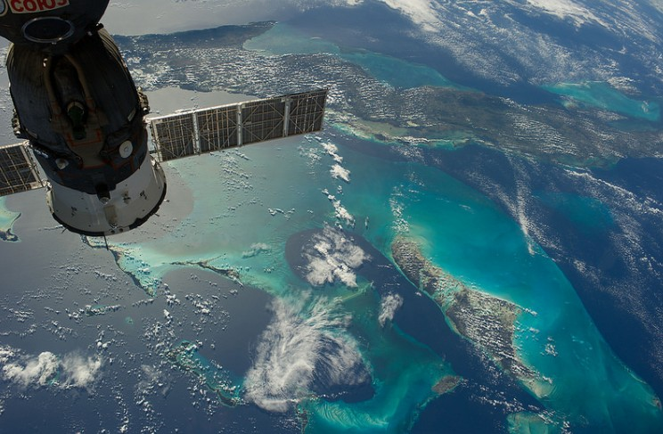
Cuba & The Bahamas

Slide 38
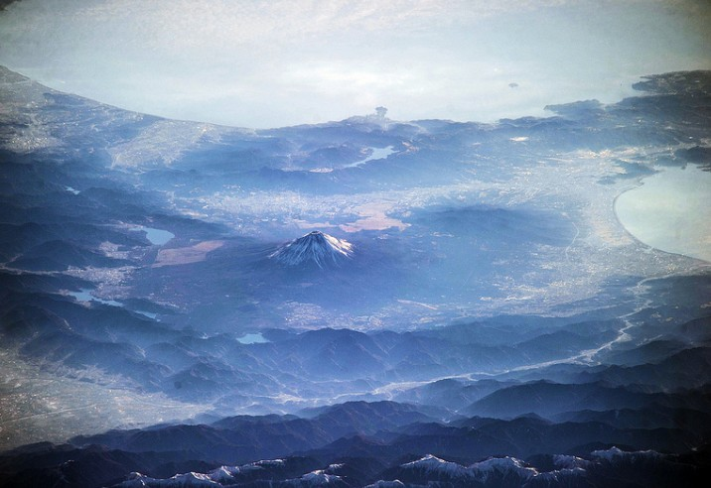
Mount Fuji, Japan

Slide 39
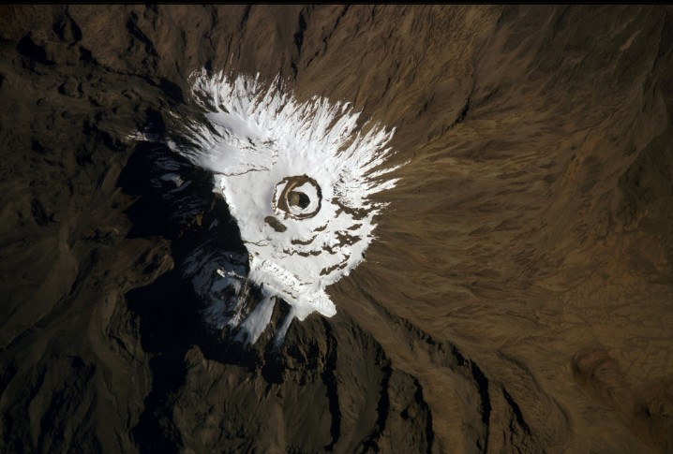
Kilimandjaro Tanzania

Slide 40
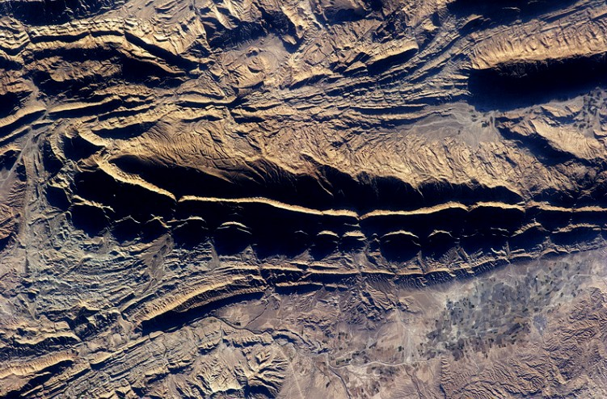
Iranian Desert

Slide 41
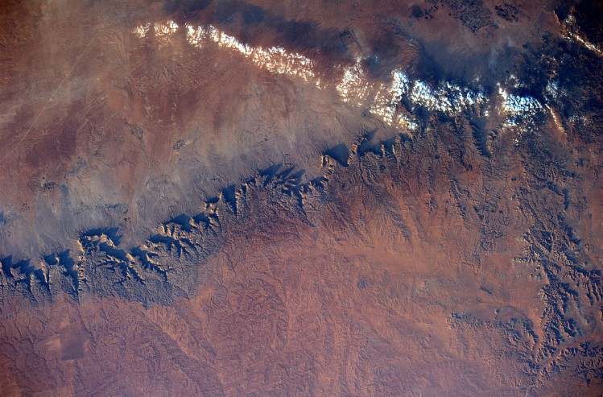
Lybian Desert

Slide 42
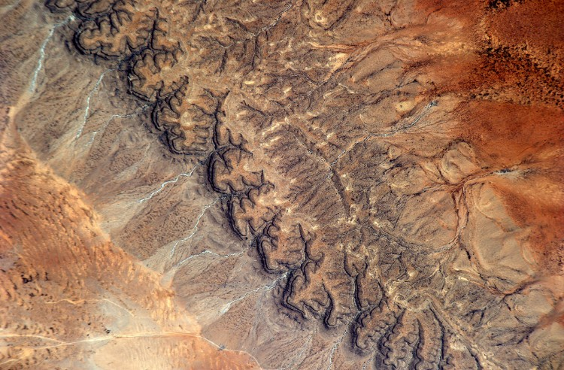
Somalian Desert

Slide 43
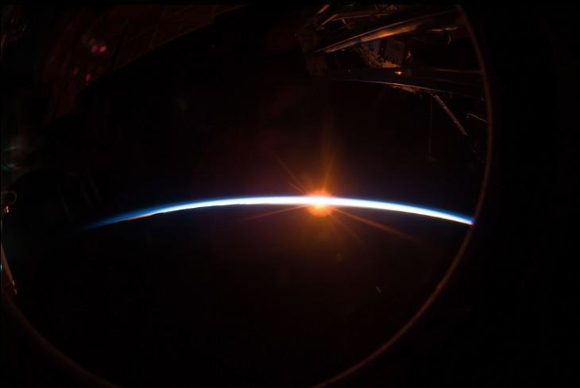
Sunset

Slide 44
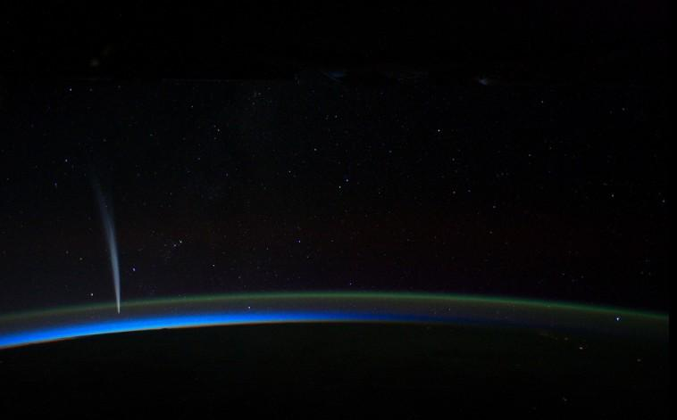
Comet Lovejoy seen from The ISS

Slide 45
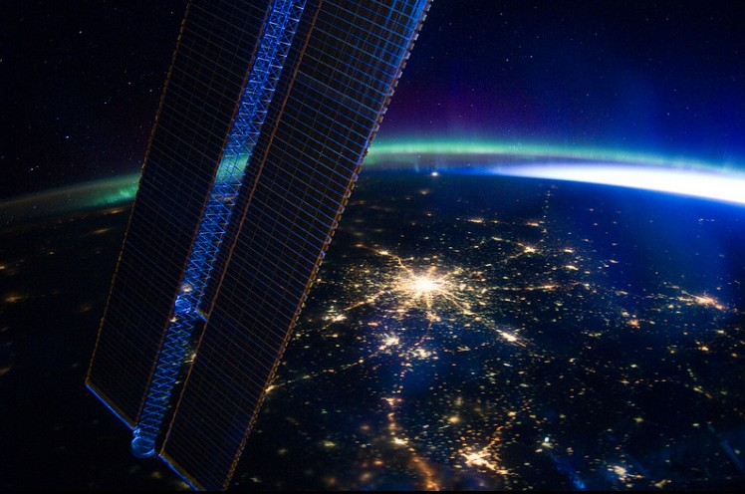
Moscow at Night…

Slide 46
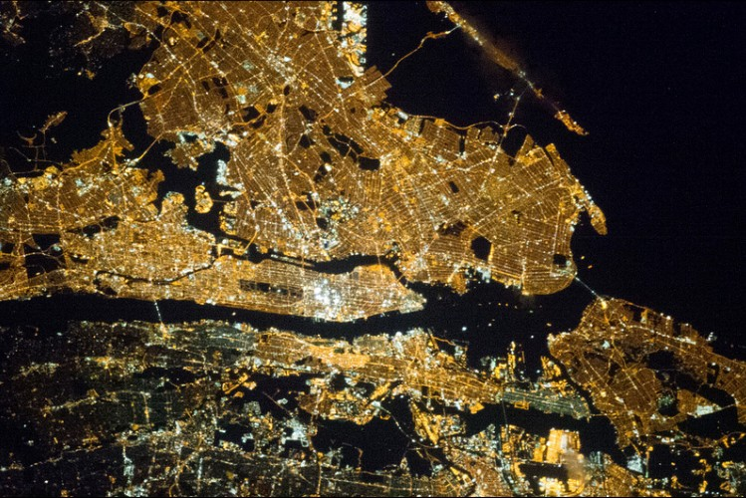
New York City

Slide 47
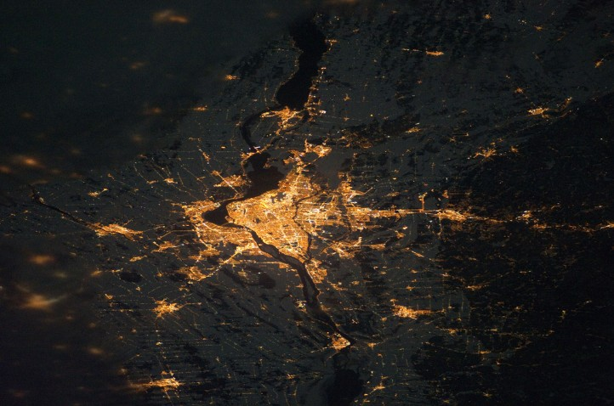
Montreal
MiddleEast at night

Slide 48
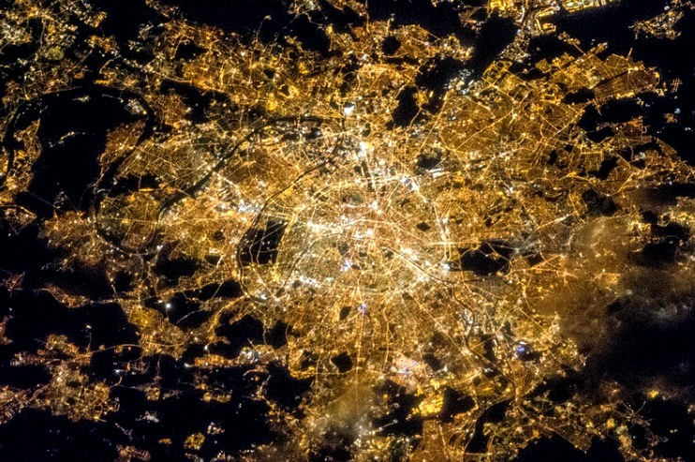
Paris

Slide 49
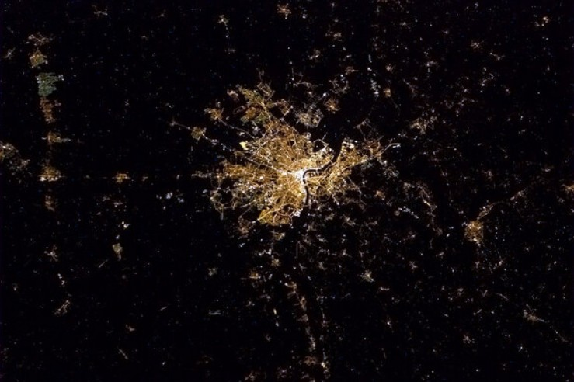
Bordeaux

Slide 50
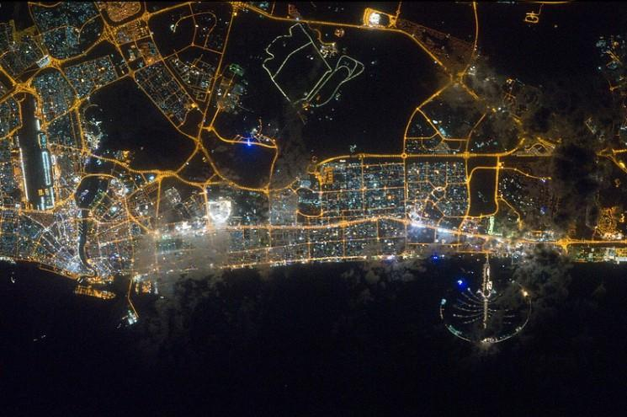
Dubaï

Slide 51

The International Space Station

Slide 52

Overview of The Beam

Slide 53


Slide 54

Spacewalk

Slide 55


Slide 56

Work on The Beam…

Slide 57


Slide 58

400 km of Vacuum

Slide 59


Slide 60


Slide 61


Slide 62


Slide 63


Slide 64

Russian Modules and Cargo

Slide 65


Slide 66

Maintenance on The Beam

Slide 67


Slide 68


Slide 69


Slide 70


Slide 71


Slide 72


Montage Marcus
Images from The Web
Copyright to all images and music
belong to their authors…
Music
Giuseppe Verdi : Nabucco

Slide 73







¿Te ha gustado?
Puedes ver más entrando
Aquí
Además puedes recibir powerpoints en tu correo electrónico suscribiéndote aquí:

