Slide 1
El museo de
Walter P. Chrysler
Si te gustan los carros
llena tus ojos y
despierta tus recuerdos
de los autos,

Slide 2
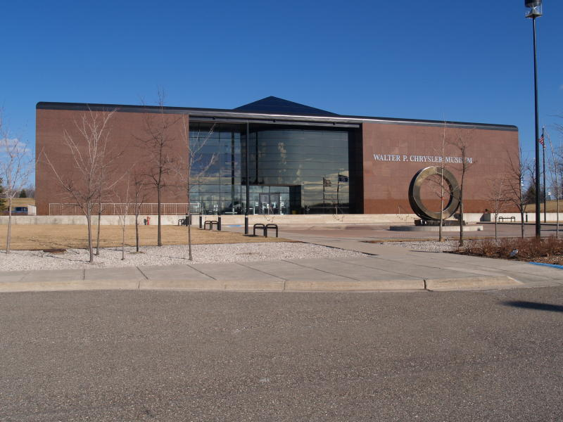

Slide 3
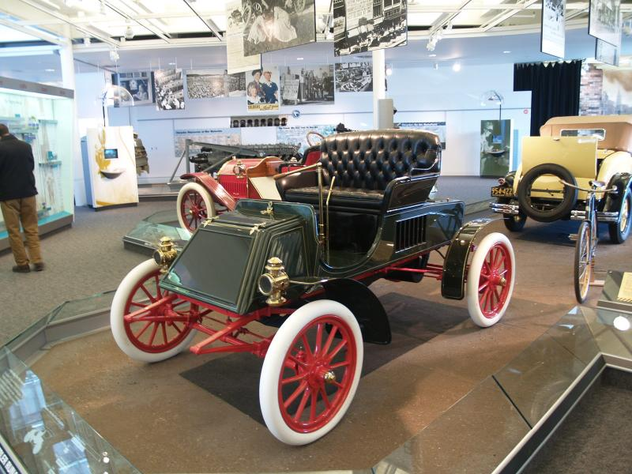
Rambler Runabout Model C 1902

Slide 4
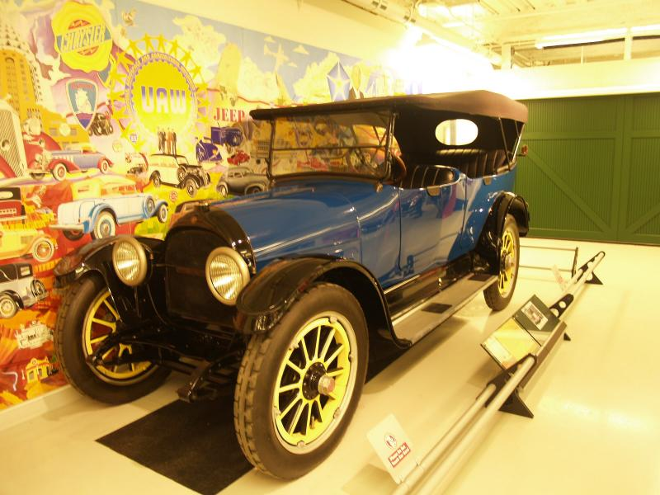
Willys-Knight Touring Car 1917

Slide 5
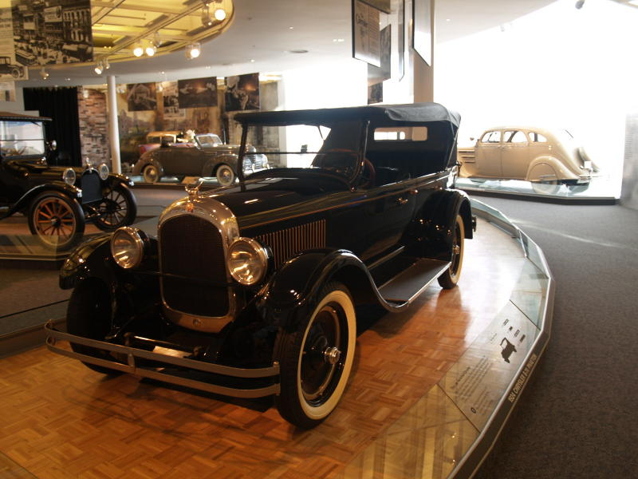
Chrysler Model B Phaeton 1924

Slide 6
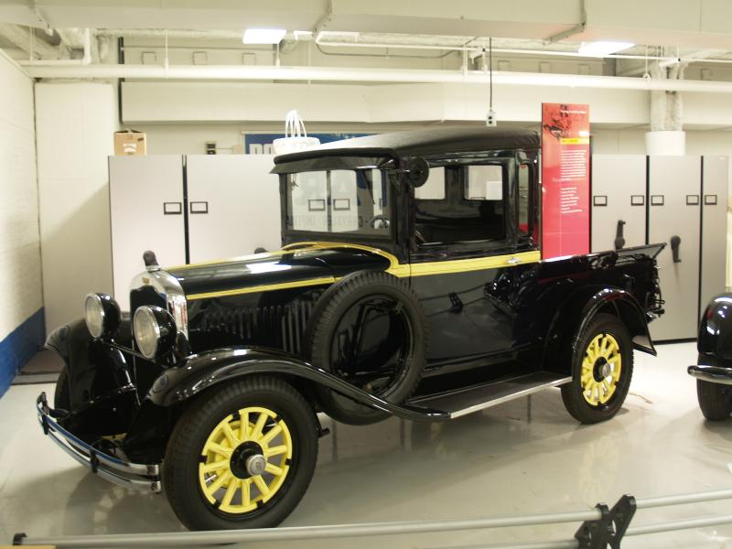
Dodge Half Ton Pickup Truck 1924

Slide 7
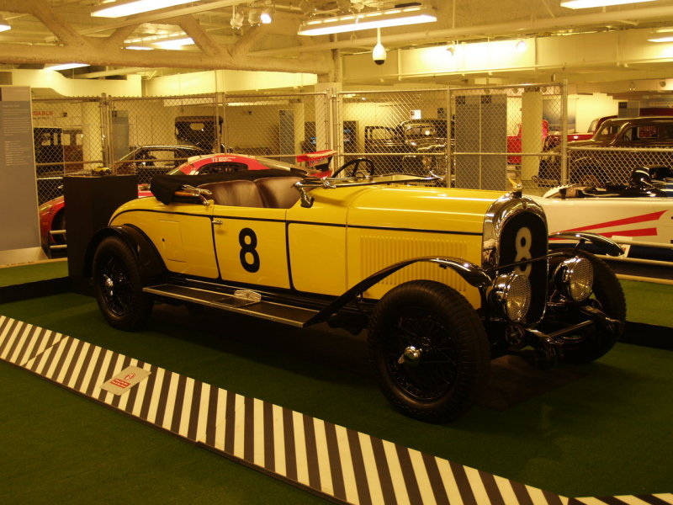
Chrysler Model 72 LeMans Racer 1928

Slide 8
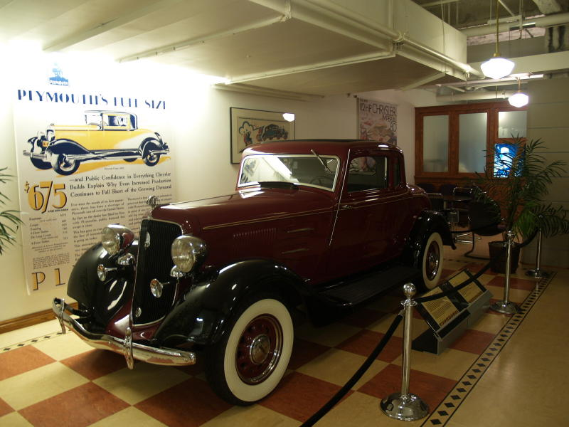
Plymouth Business Coupe 1928

Slide 9
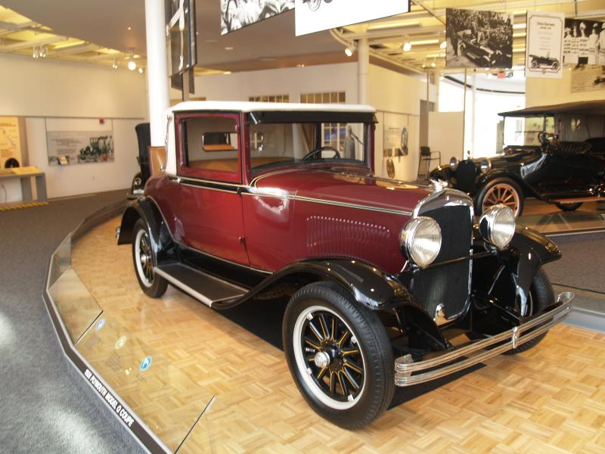
Plymouth Model Q 1928

Slide 10
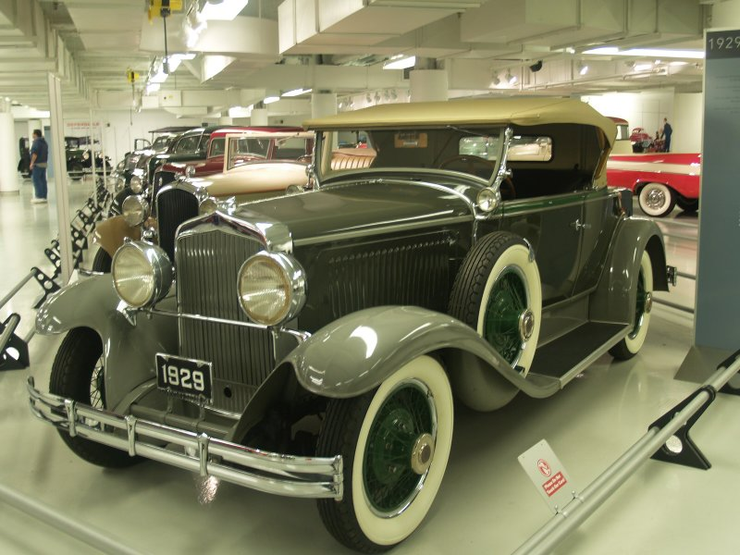
Chrysler DB Convertible Coupe 1929

Slide 11
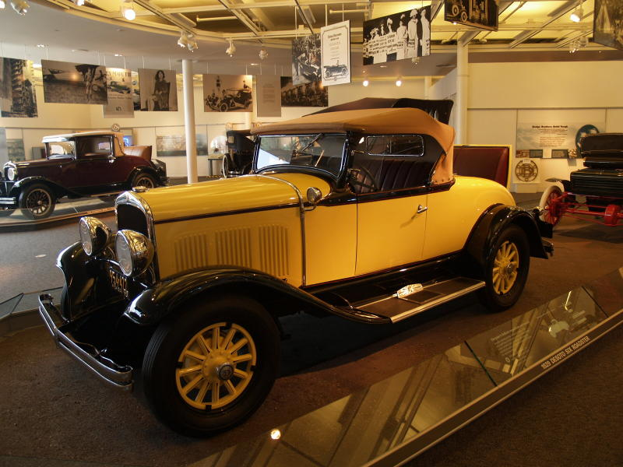
DeSoto Six Roadster 1929

Slide 12
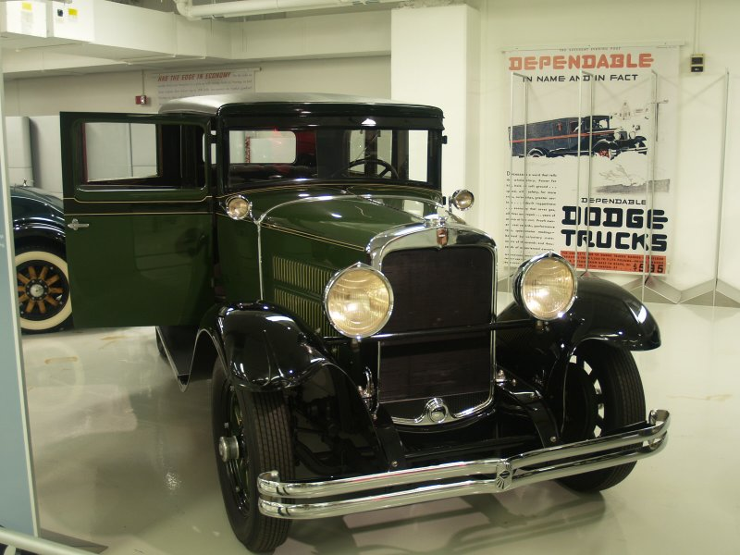
Nash 440 Special Six 1929

Slide 13
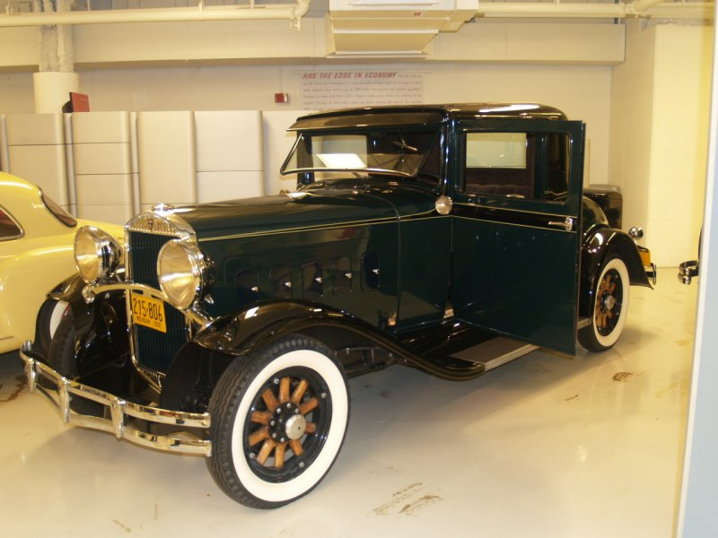
Hudson Model T Coupe 1930

Slide 14
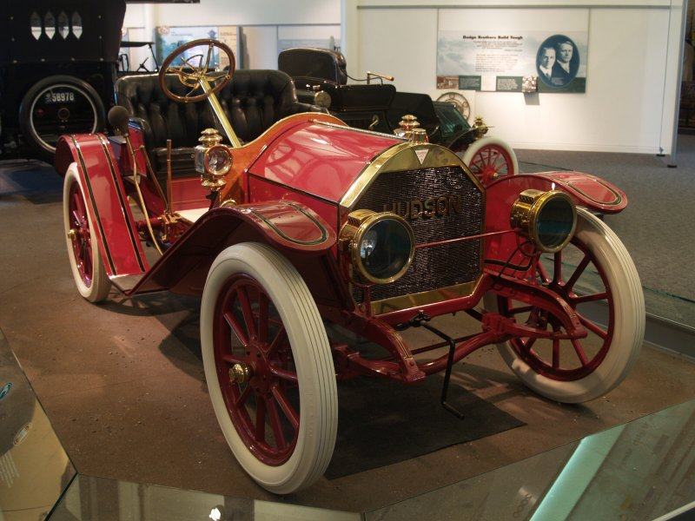
Hudson

Slide 15
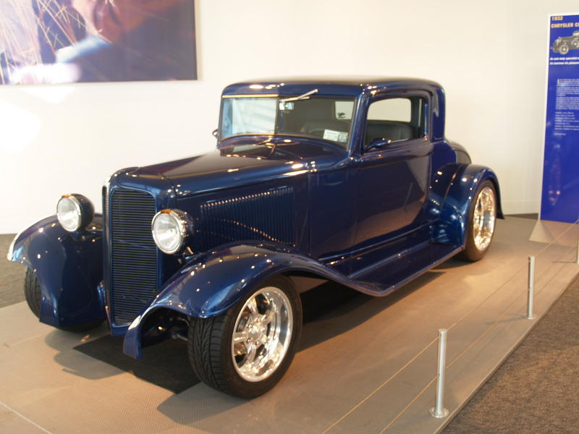
Plymouth Coupe Hot Rod 1932

Slide 16
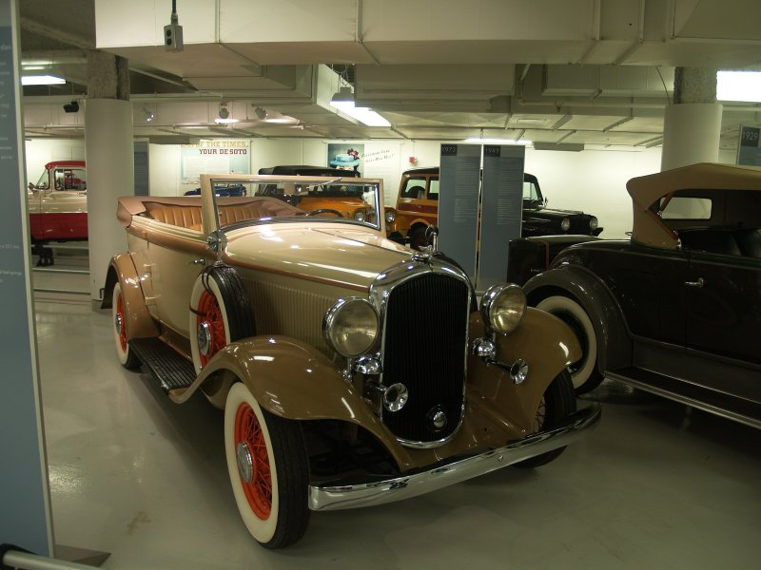
Plymouth PB Sedan Convertible 1932

Slide 17
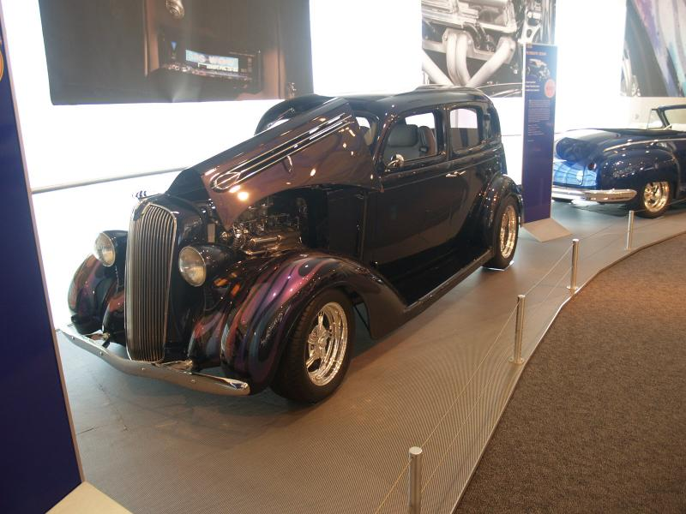
De Soto Sedan Custom Rod 1934

Slide 18
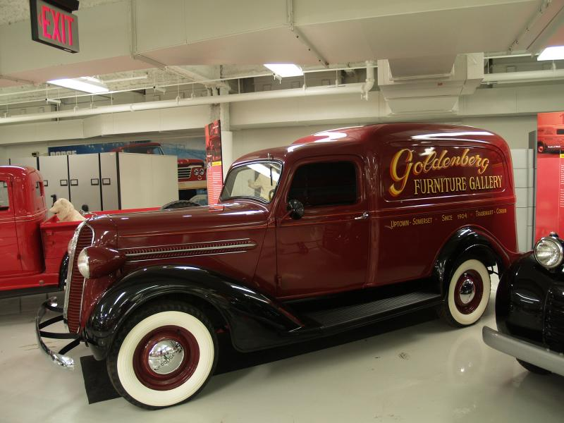
Dodge Sedan Delivery Panel Truck 1934

Slide 19
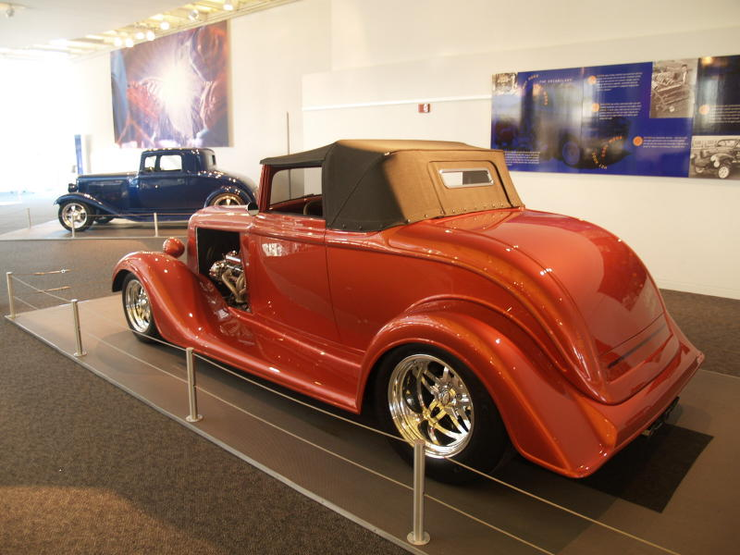
Plymouth Roadster Hot Rod 1934

Slide 20
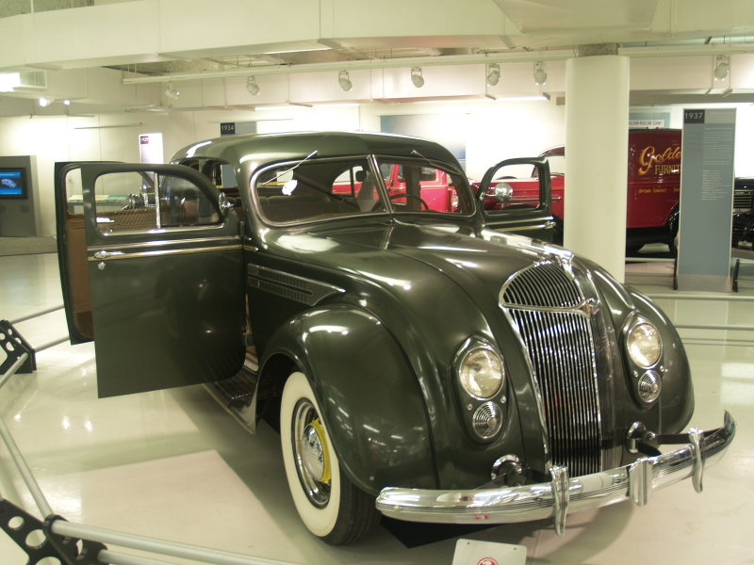
Chrysler Imperial Airflow Sedan 1934

Slide 21
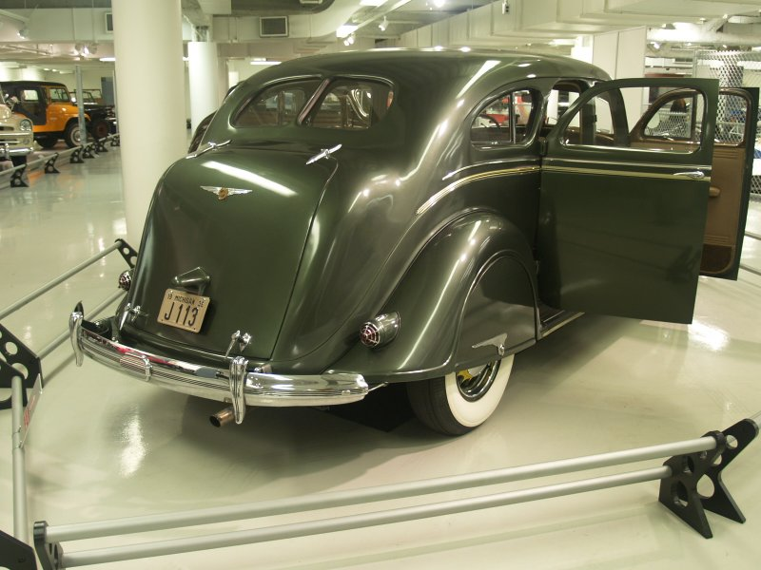
Chrysler Imperial Airflow Sedan 1934

Slide 22
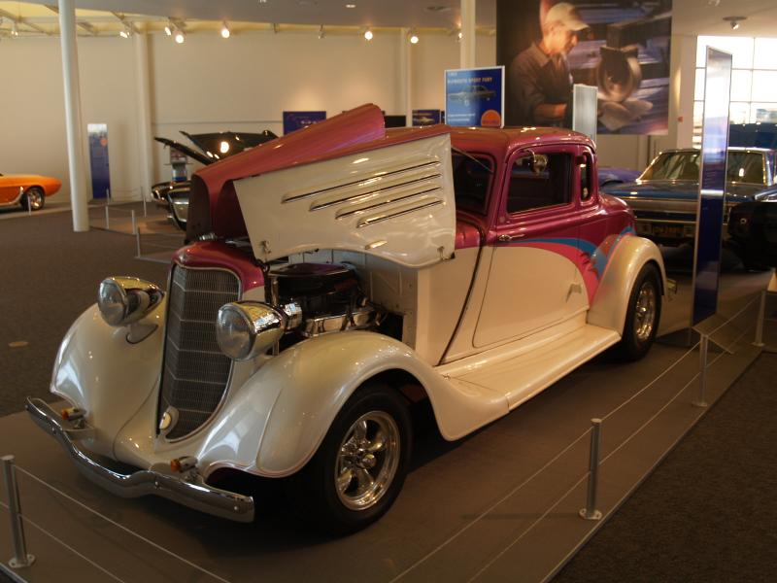
De Soto Coupe Custom Rod 1936

Slide 23
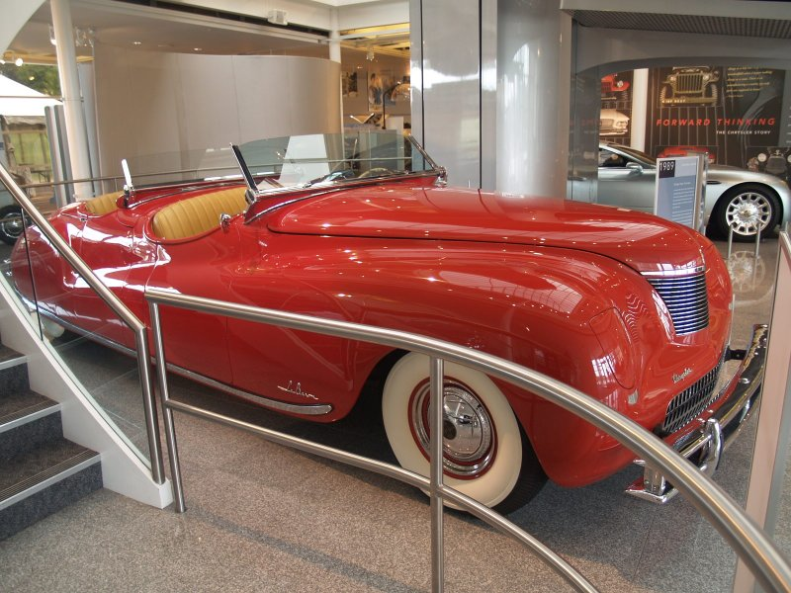
Chrysler Newport LeBaron Concept Car 1941

Slide 24
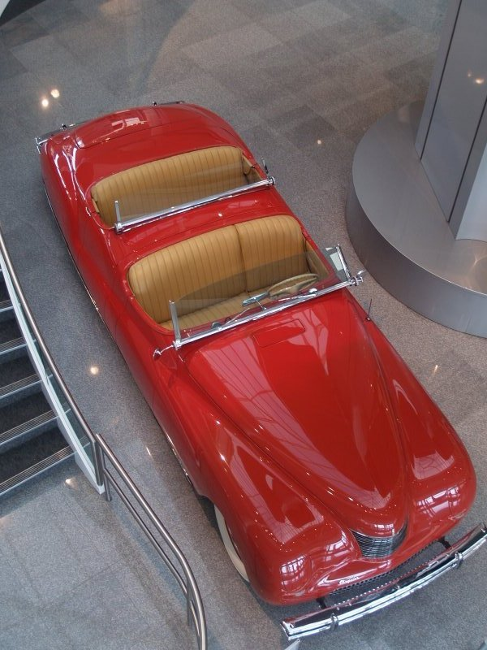

Slide 25
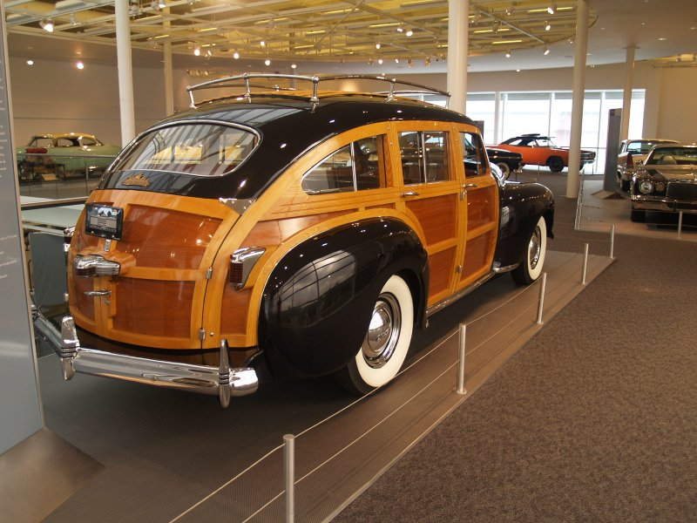

Slide 26
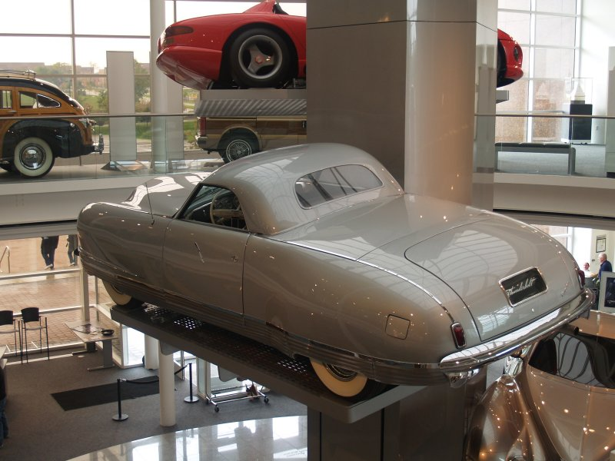
Plymouth Thunderbolt Concept Car 1941

Slide 27
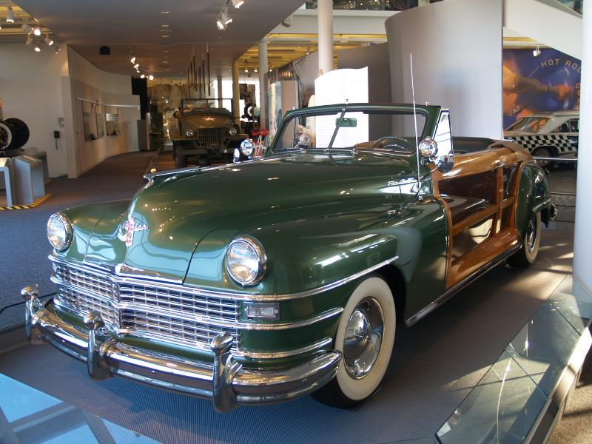
Chrysler Town And Country Convertible 1948

Slide 28
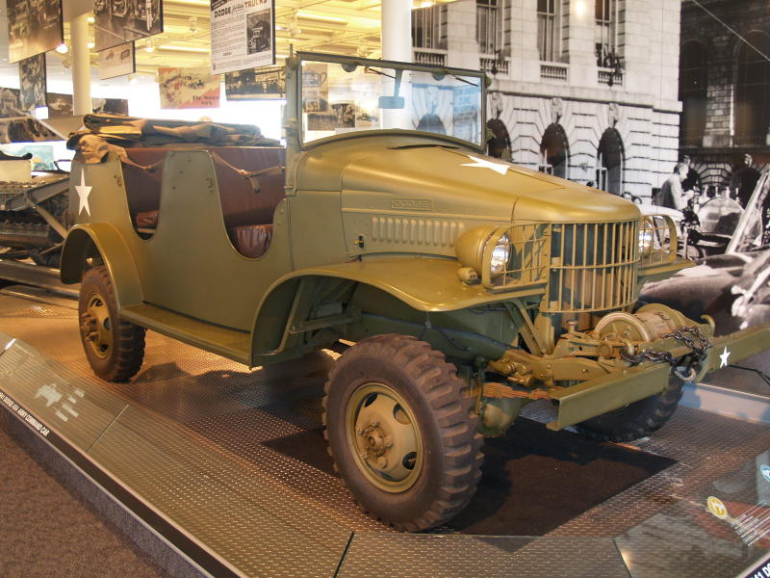
Dodge Command Car

Slide 29
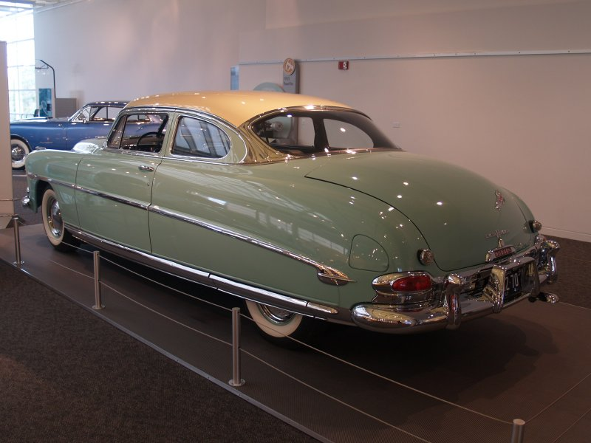
Hudson Hornet 1953

Slide 30
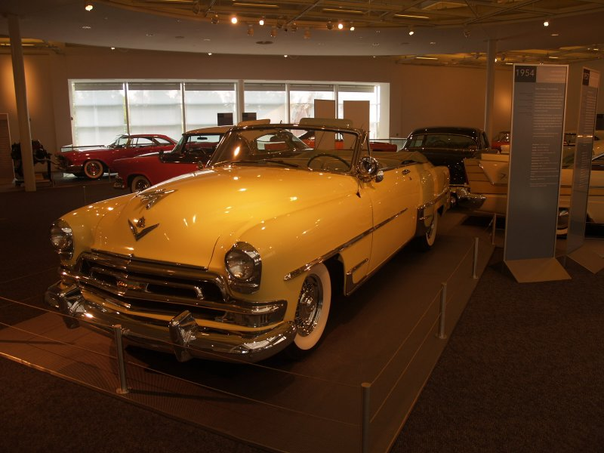
Chrysler New Yorker Special Convertible 1953

Slide 31
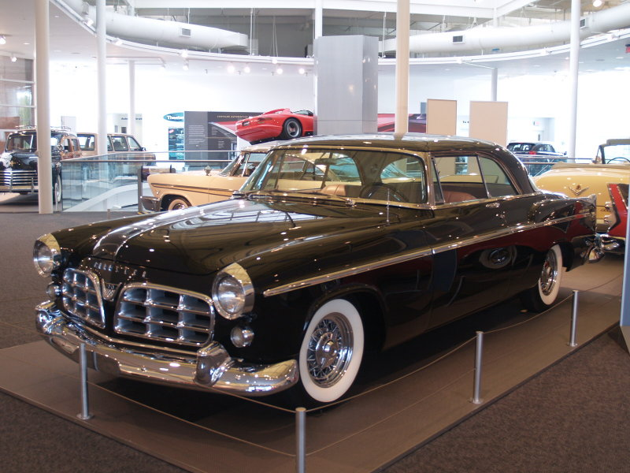
Chrysler 300 Coupe 1955

Slide 32
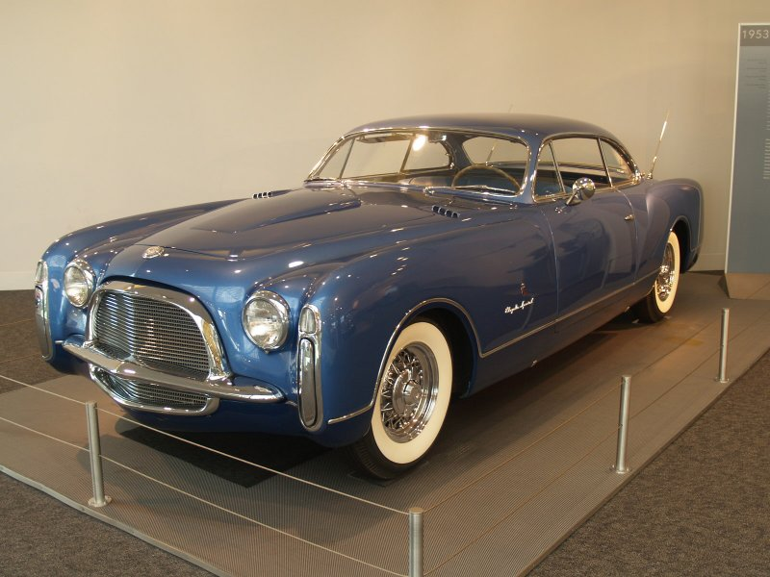
Chrysler Special 1957

Slide 33
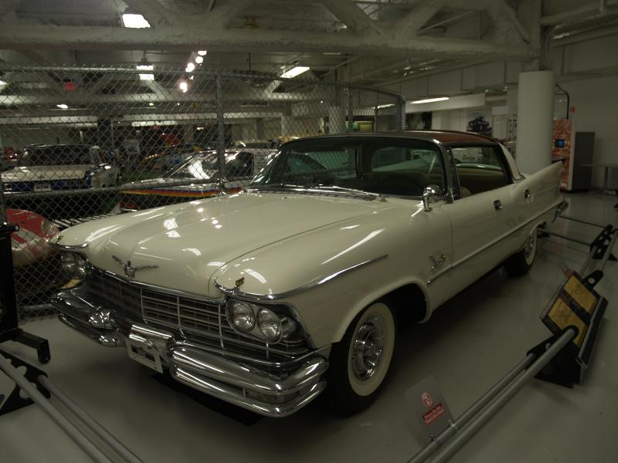
Chrysler Imperial 1957

Slide 34
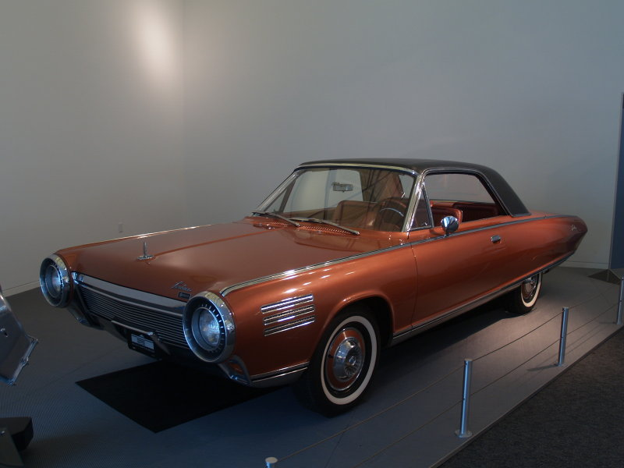
Chrysler Turbine Car 1964

Slide 35
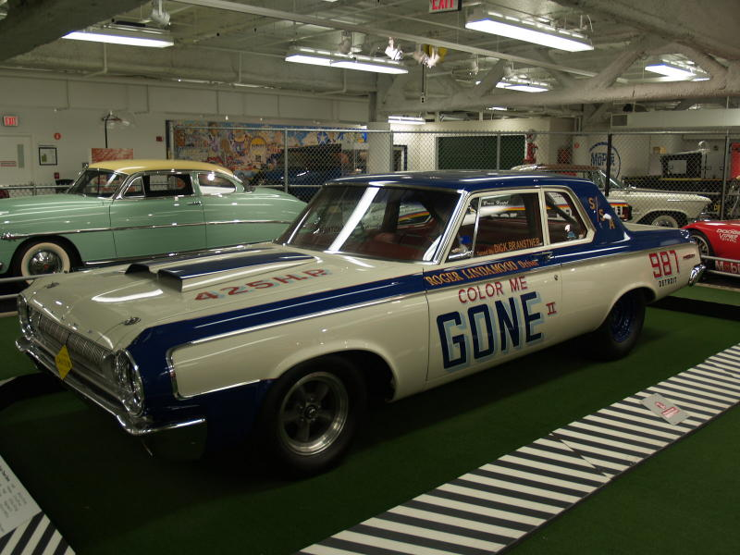
Dodge Drag Racer 1964

Slide 36
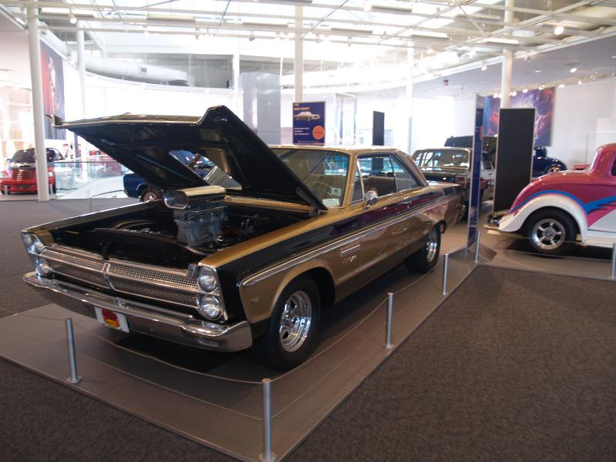
Plymouth Sport Fury Coupe 1966

Slide 37
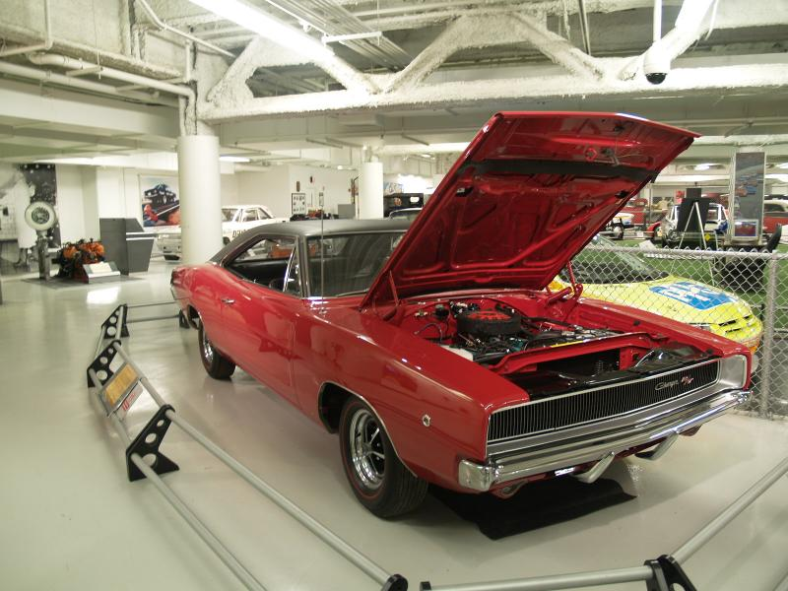
Dodge Charger 1968

Slide 38
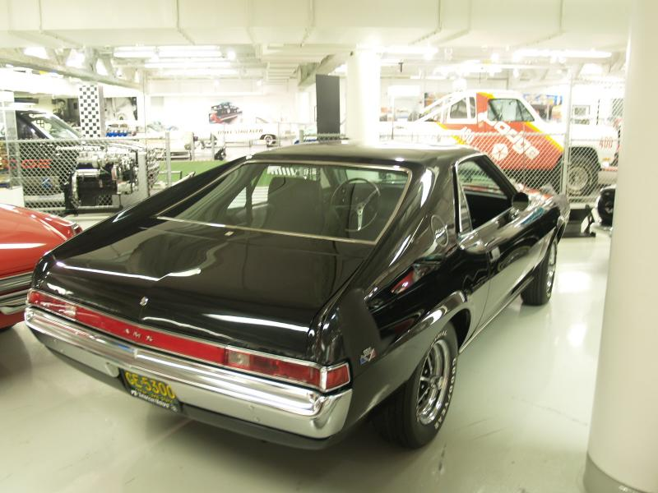
AMC AMX 1970

Slide 39
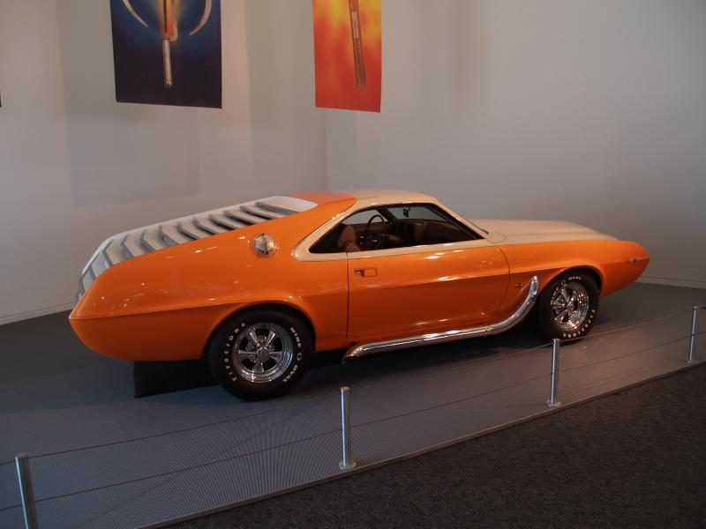
AMC AMX Custom 1970

Slide 40
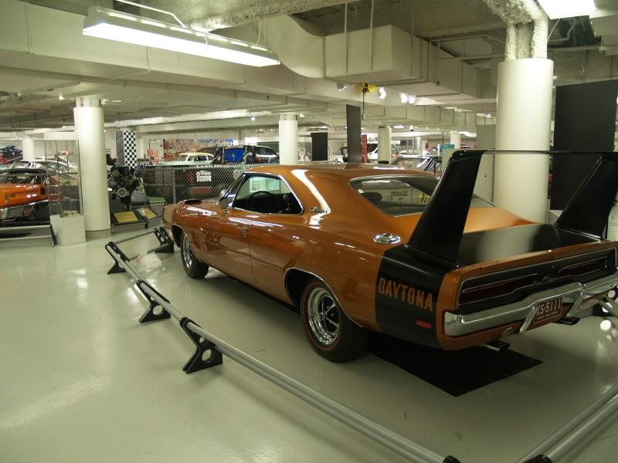
Dodge Charger Daytona 1969

Slide 41
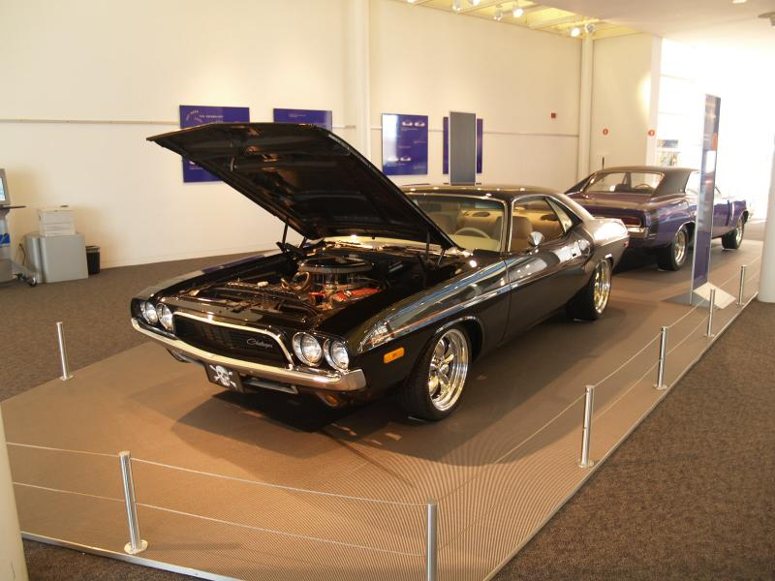
Dodge Challenger Hemi 1970

Slide 42
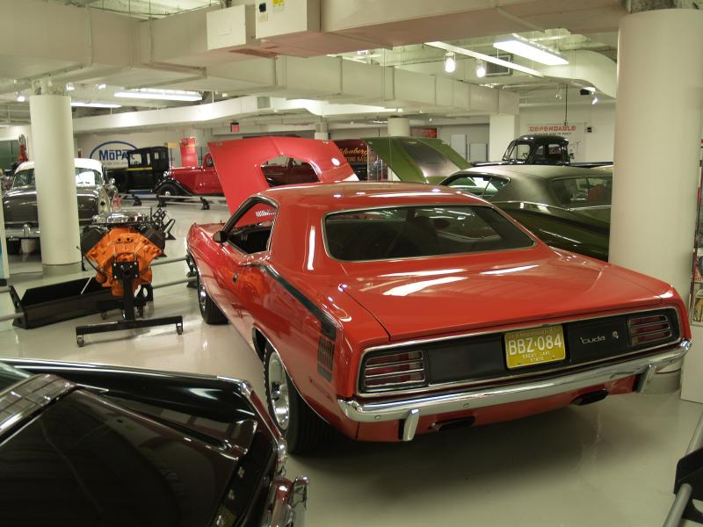
Plymouth Barracuda 1970

Slide 43
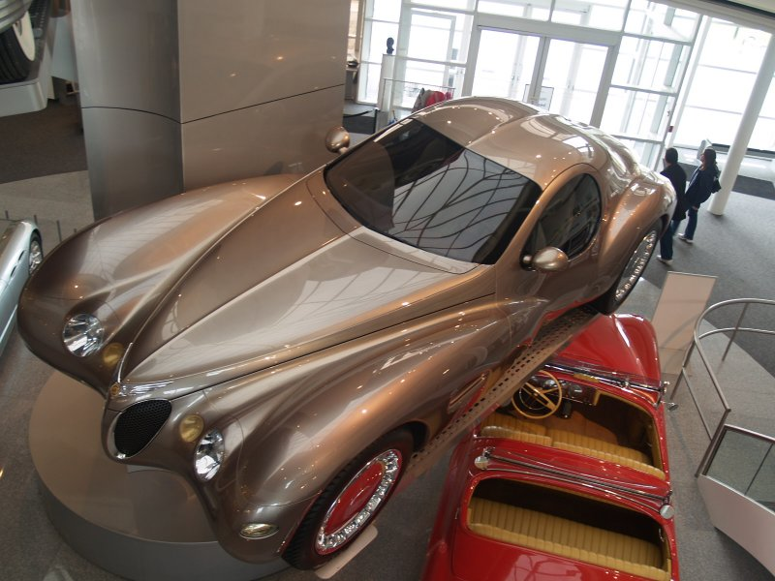
Chrysler Atlantic Concept Car 1995

Slide 44
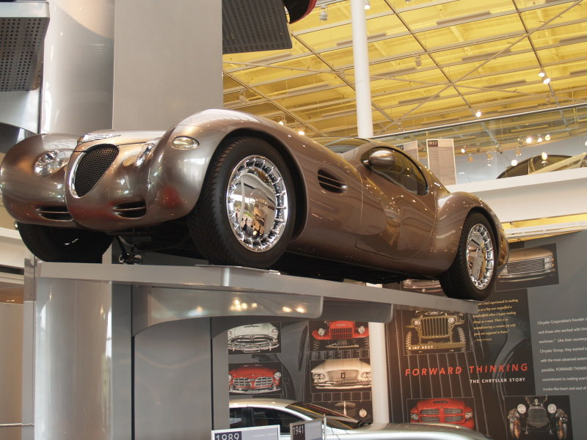
Chrysler Atlantic Concept Car 1995

Slide 45
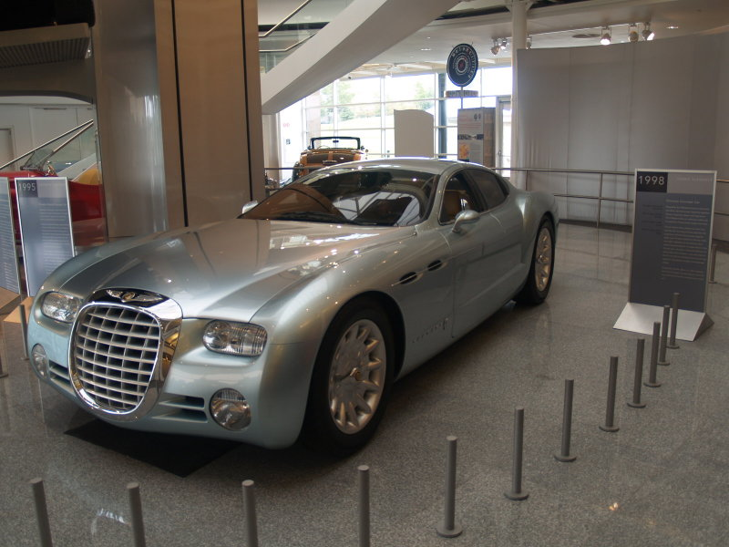
Chrysler Cronus Concept Car 1998

Slide 46
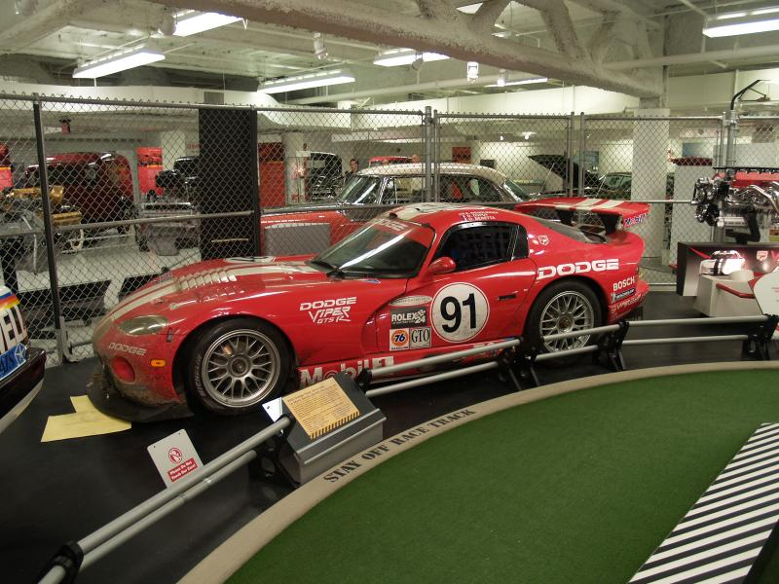
Dodge Viper, competidor das 24 Hs de Le Mans do ano de 2000

Slide 47
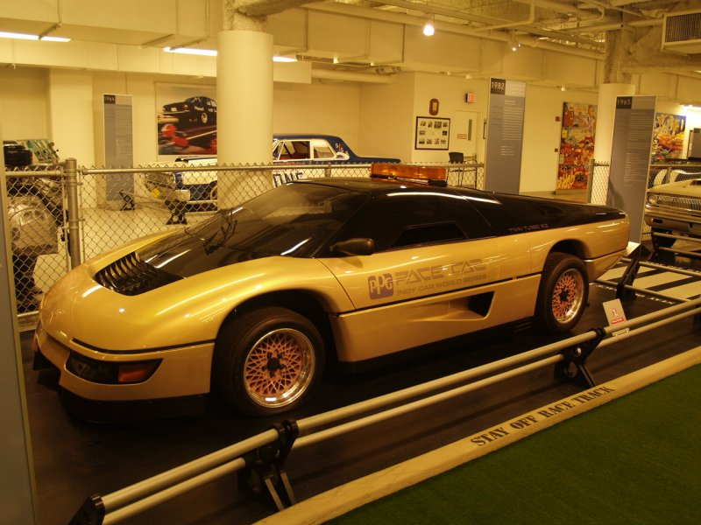
Dodge Turbo Interceptor, utilizado no filme “A Aparição”

Slide 48
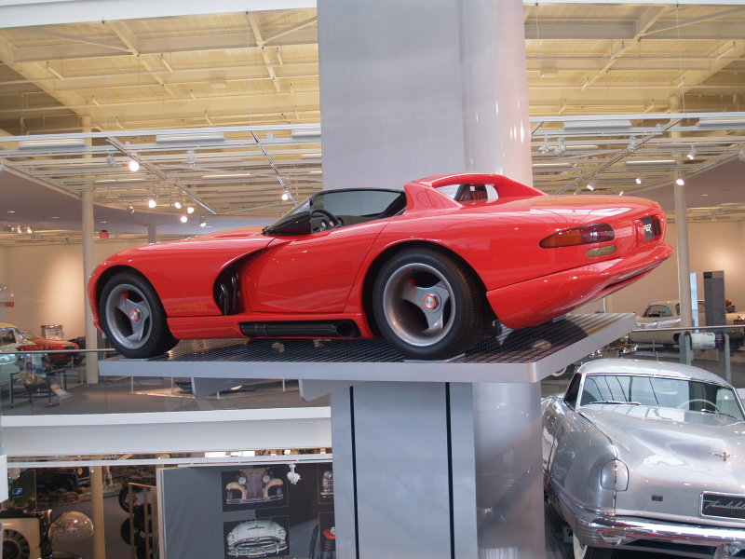
Dodge Viper RT/10 Concept 1989

Slide 49
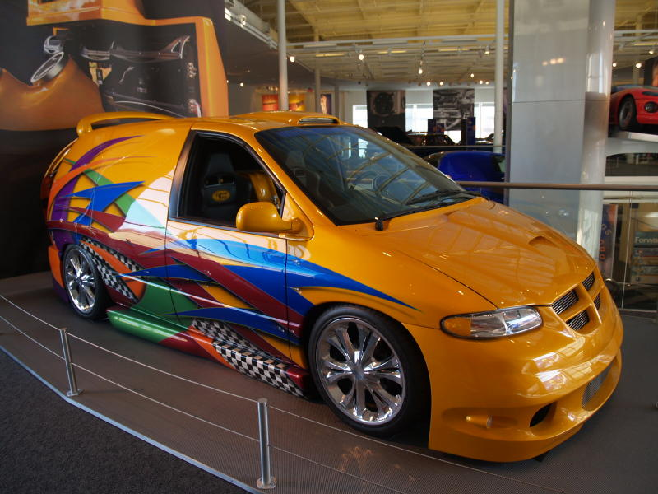
Dodge Caravan Pimp My Minnie Van

Slide 50







¿Te ha gustado?
Puedes ver más entrando
Aquí
Además puedes recibir powerpoints en tu correo electrónico suscribiéndote aquí:

