Slide 1
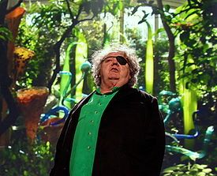
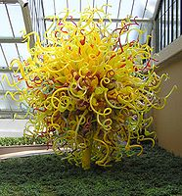
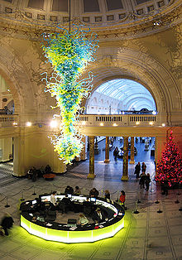
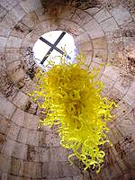
Chihuly
Dale Chihuly (born September 20, 1941, in Tacoma, Washington, United States) is an American glass sculptor and entrepreneur.
Chihuly
El escultor de vidrio
Chihuly graduated from Woodrow Wilson High School in Tacoma, Washington.
In 1967, he received a Master of Science in sculpture from the University of Wisconsin-Medison.
Dale Chihuly, 2010
In 1968, he studied glass in Venice on a Fulbright Fellowship
and received a Master of Fine Arts at the Rhode Island School of Design. In 1971, with the support of John Hauberg and Anne Gould Hauberg, Chihuly founded the Pilchuck Glass School near Stanwood, Washington.
The Sun at Kew Garden, London
In 1976, while Chihuly was in England, he was involved in a head-on car accident during which he flew through the windshield. His face was severely cut by glass and he was blinded in his left eye. After recovering, he continued to blow glass until he dislocated his shoulder in a 1979 bodysurfing accident. No longer able to hold the glass blowing pipe, he hired others to do the work. Chihuly and his team of artists were the subjects of the Documentary Chihuly Over Venice; the program was the first HDTV program to be broadcast in the United States when it aired in November 1998.
Blown-glass chandelier at Victoria and Albert Museum
Chandelier at the Tower of David, Jerusalem

Slide 2
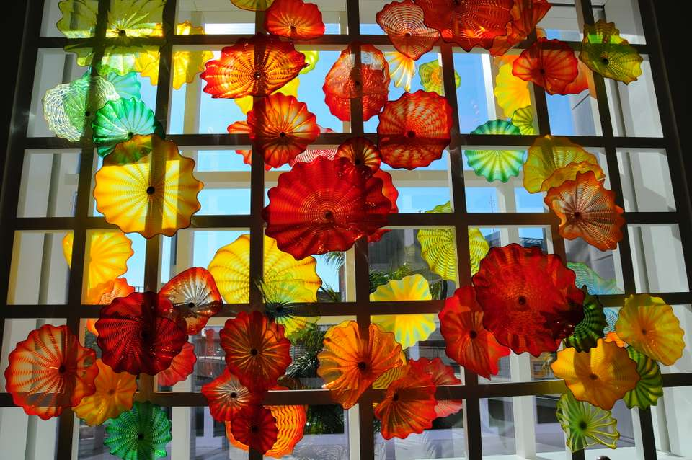
© Miki Pitish

Slide 3
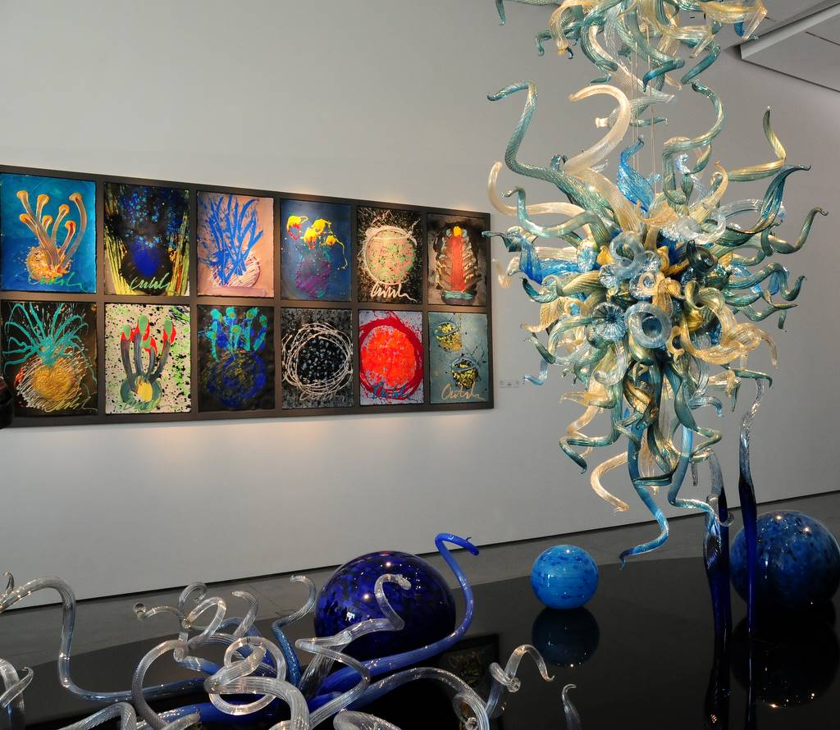
© Miki Pitish

Slide 4
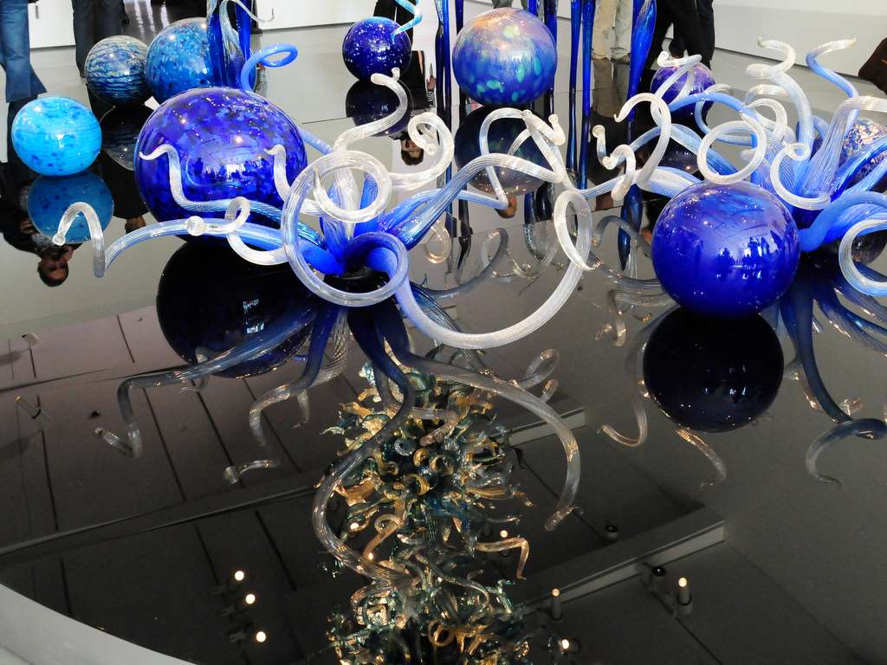
© Miki Pitish

Slide 5
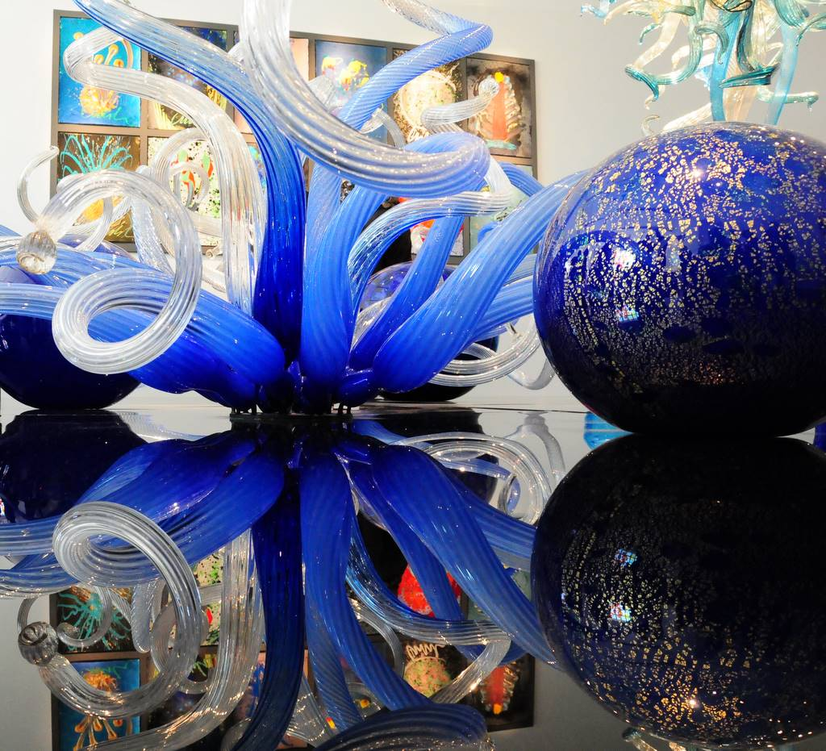
© Miki Pitish

Slide 6
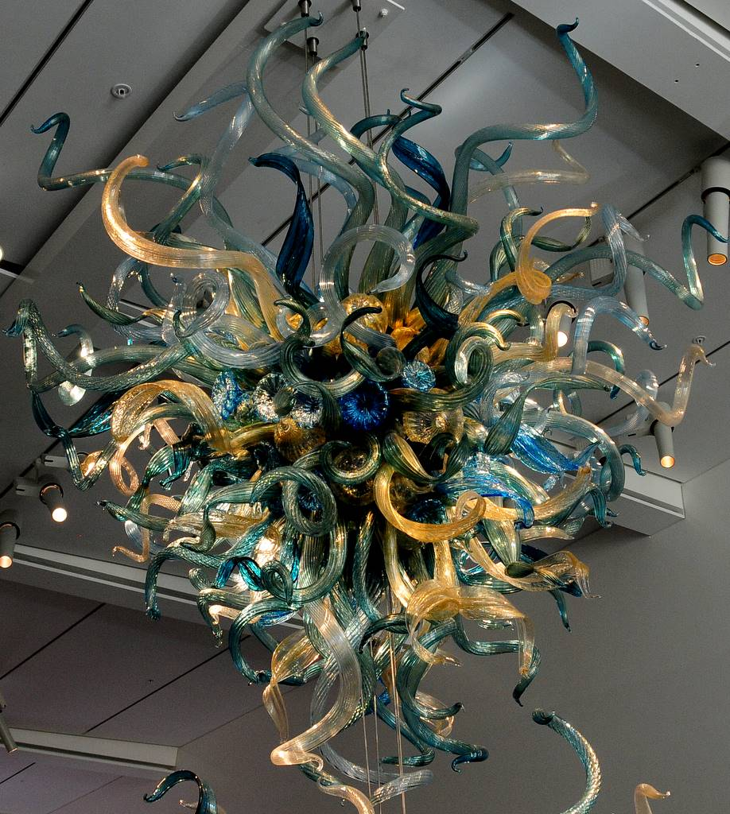
© Miki Pitish

Slide 7
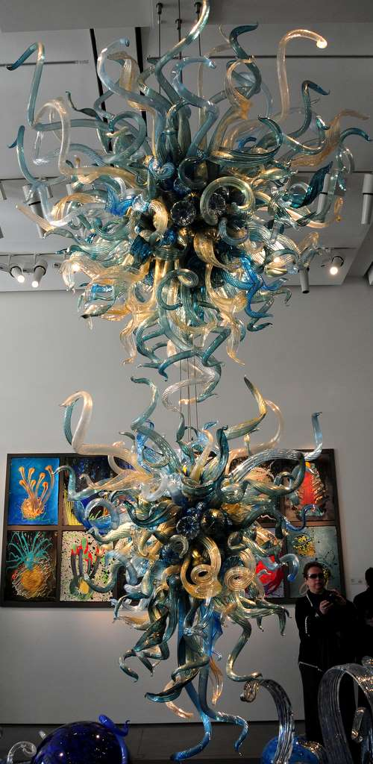
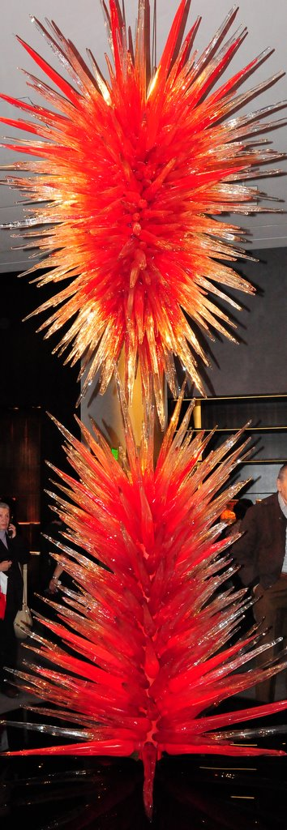
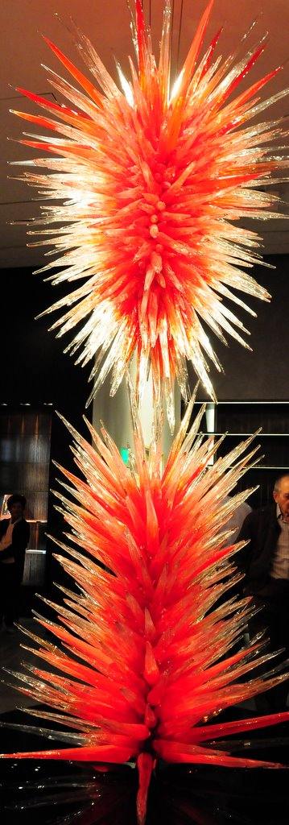
© Miki Pitish

Slide 8
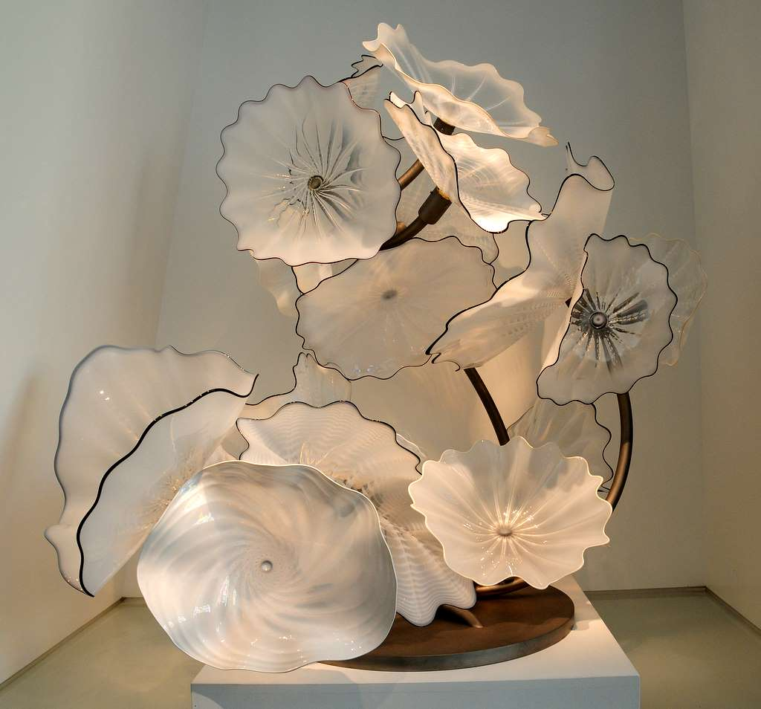
© Miki Pitish

Slide 9
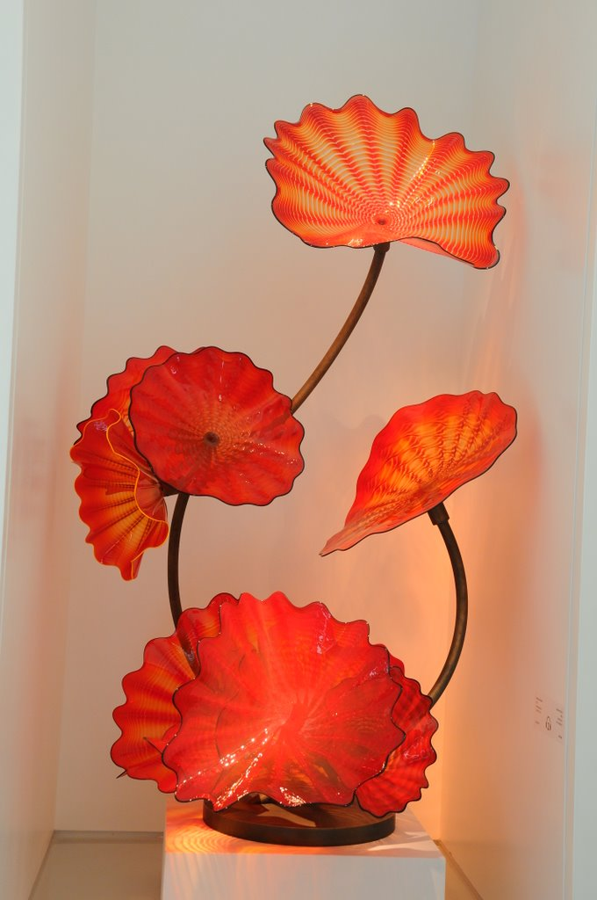
© Miki Pitish

Slide 10
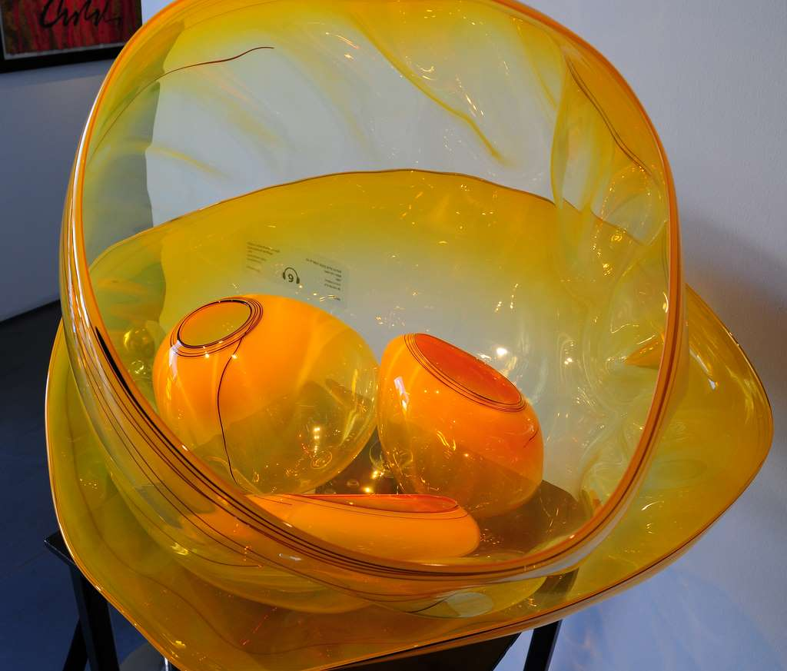
© Miki Pitish

Slide 11
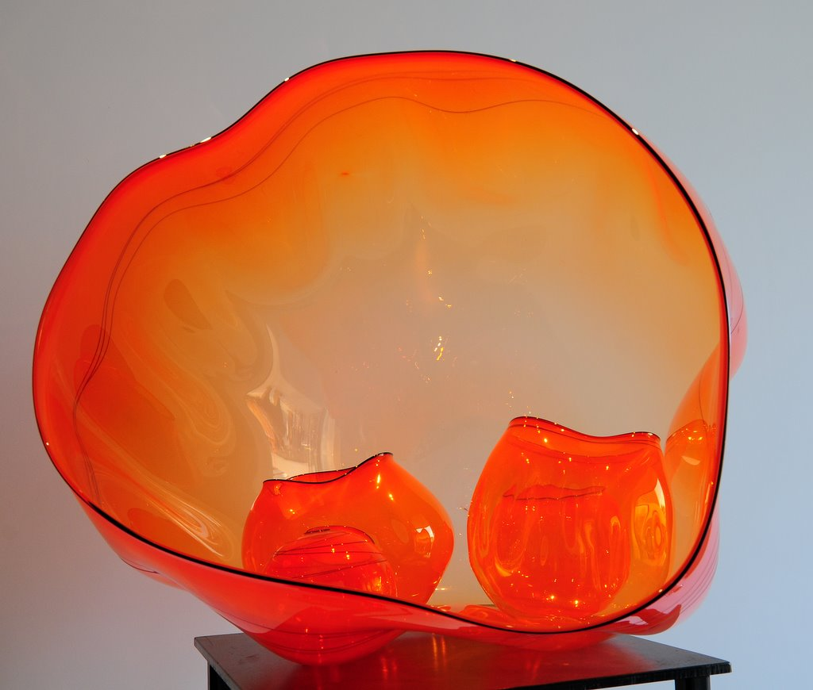
© Miki Pitish

Slide 12
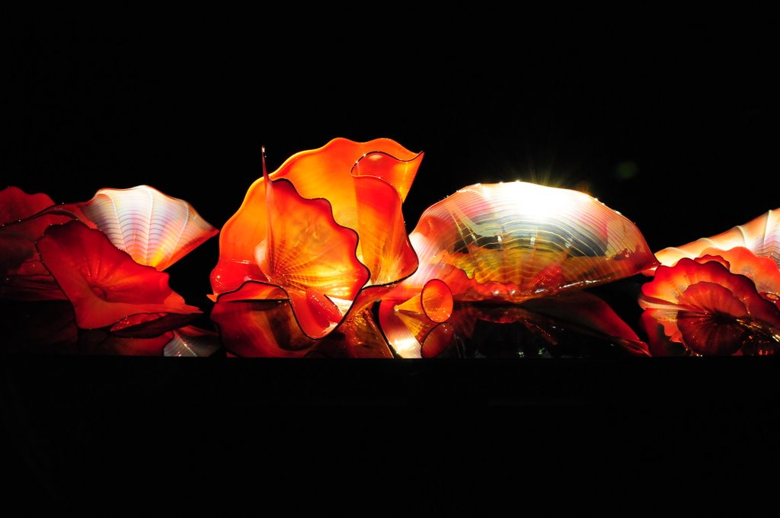
© Miki Pitish

Slide 13
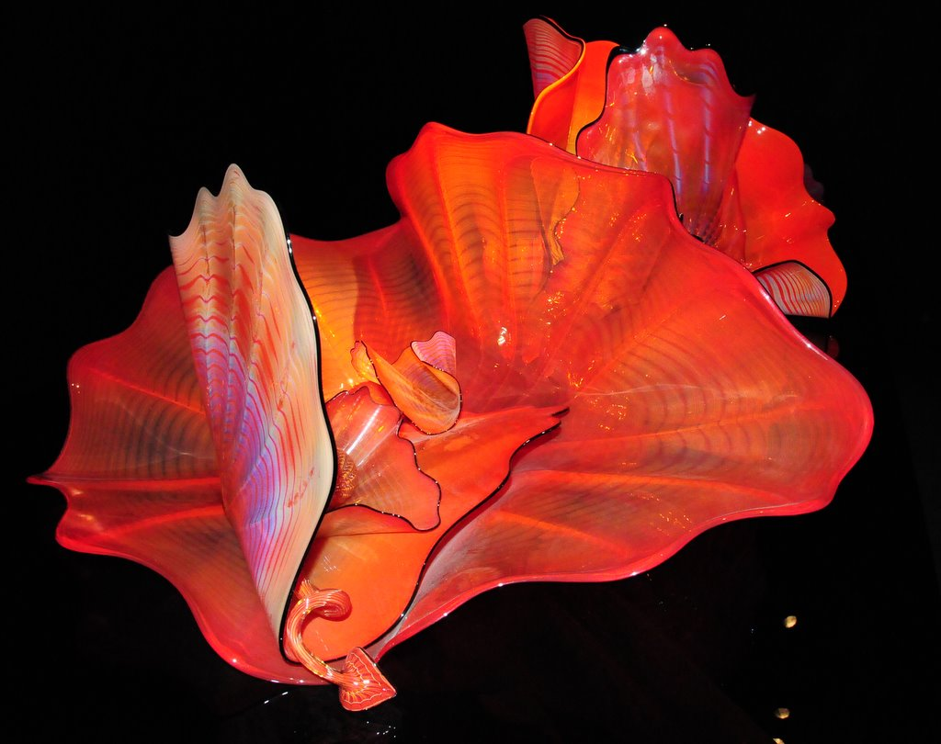
© Miki Pitish

Slide 14
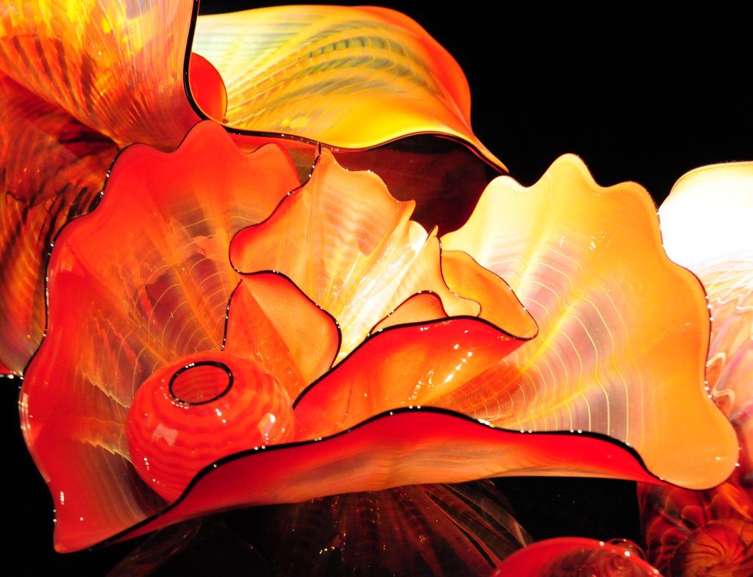

Slide 15
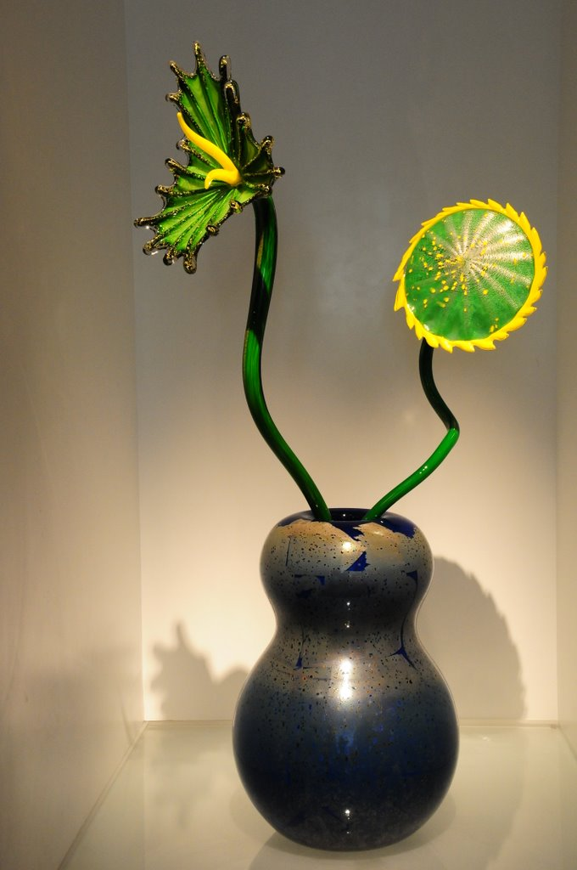
© Miki Pitish

Slide 16
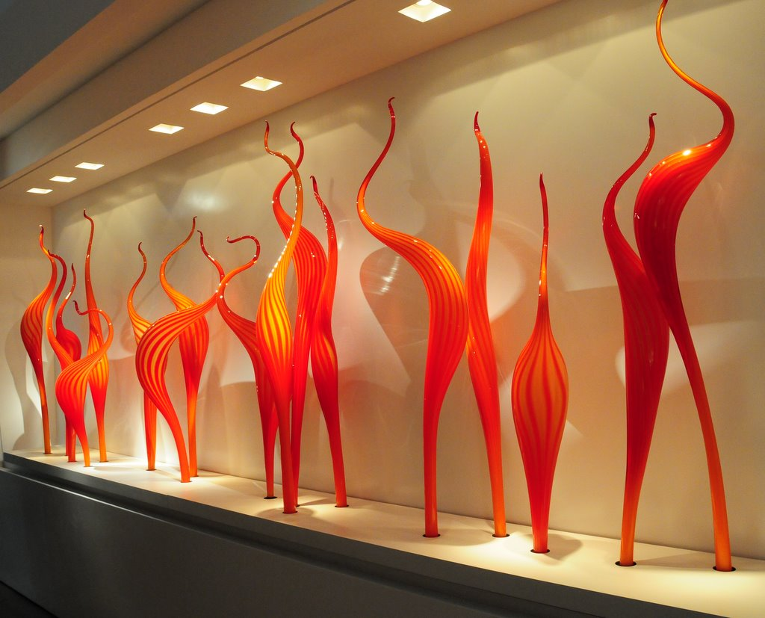
© Miki Pitish

Slide 17
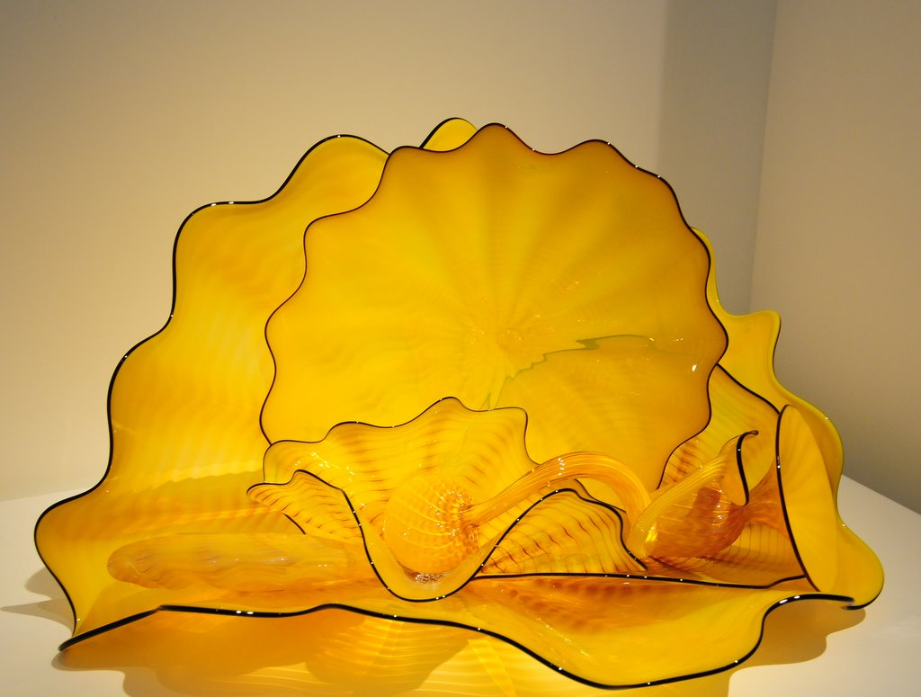

Slide 18
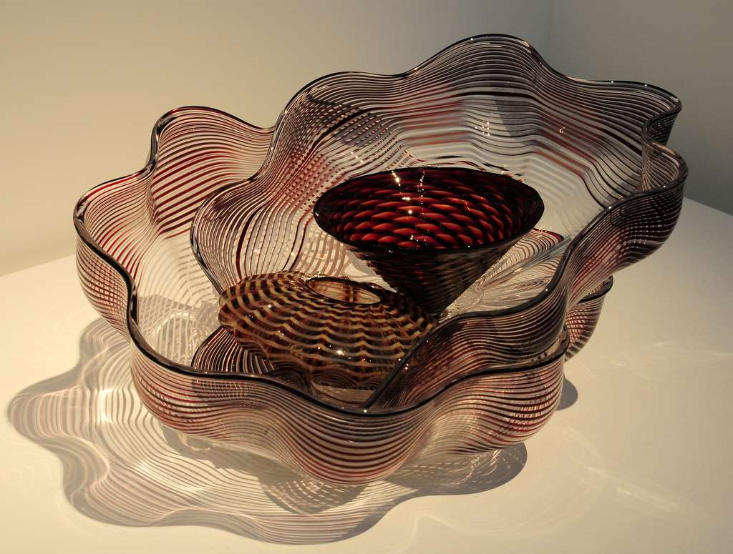
© Miki Pitish

Slide 19
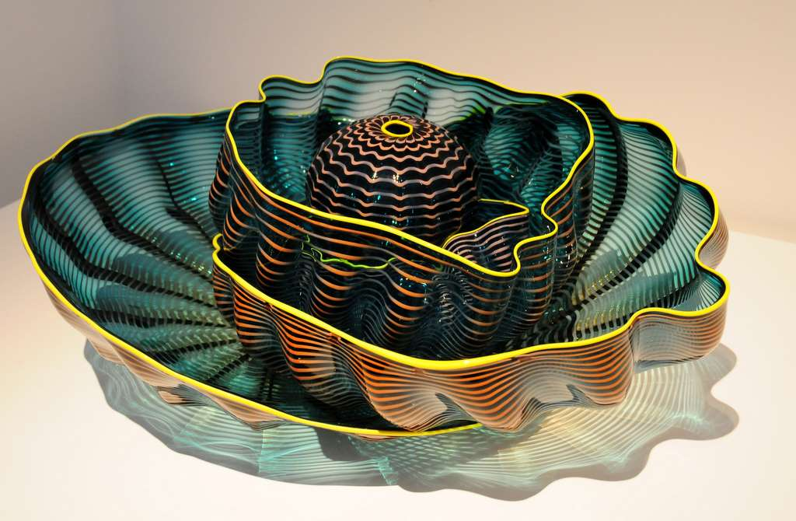
© Miki Pitish

Slide 20
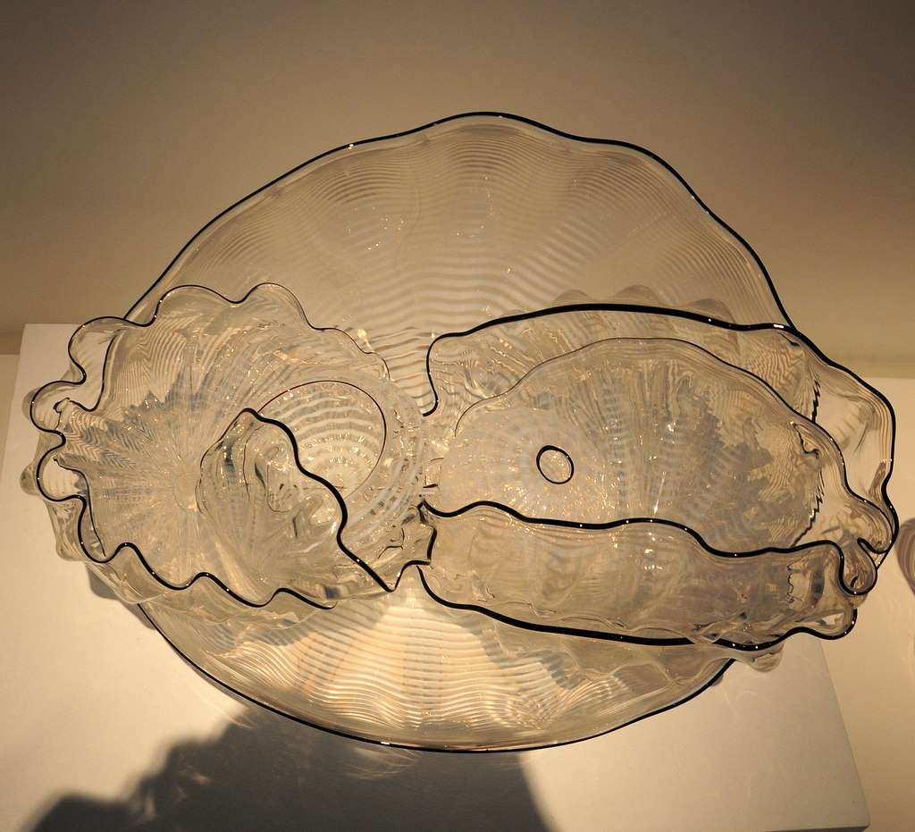
© Miki Pitish

Slide 21
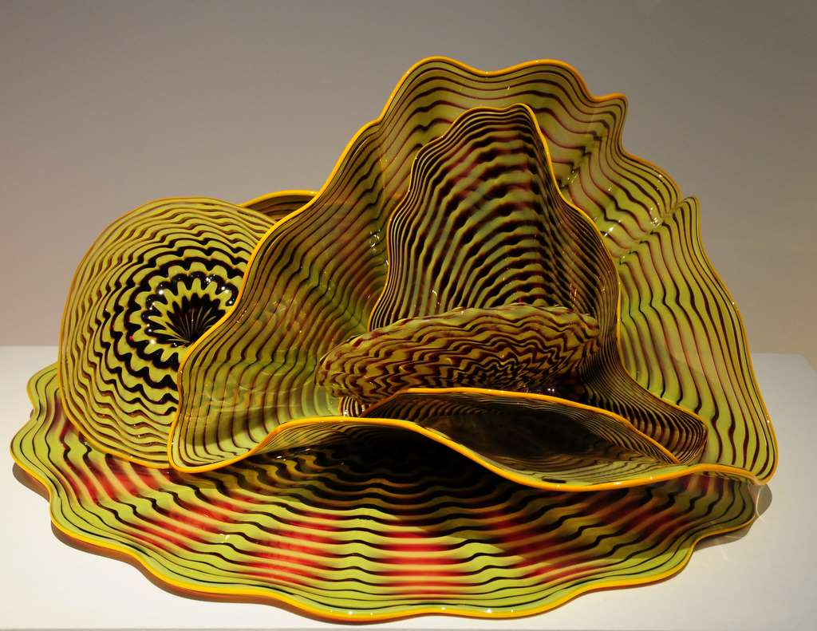
© Miki Pitish

Slide 22
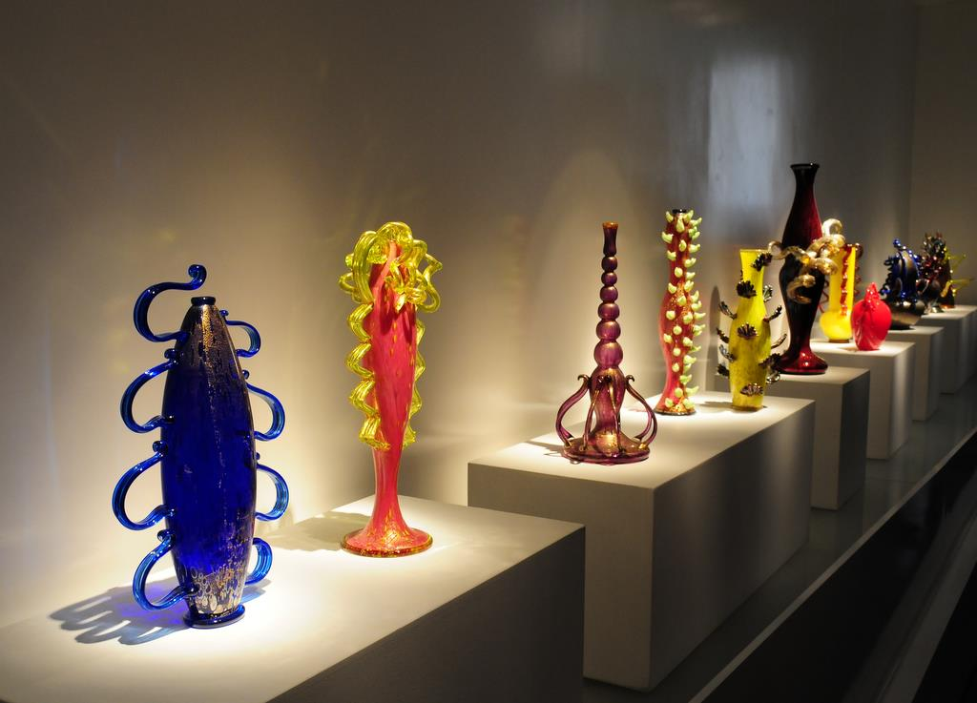
© Miki Pitish

Slide 23
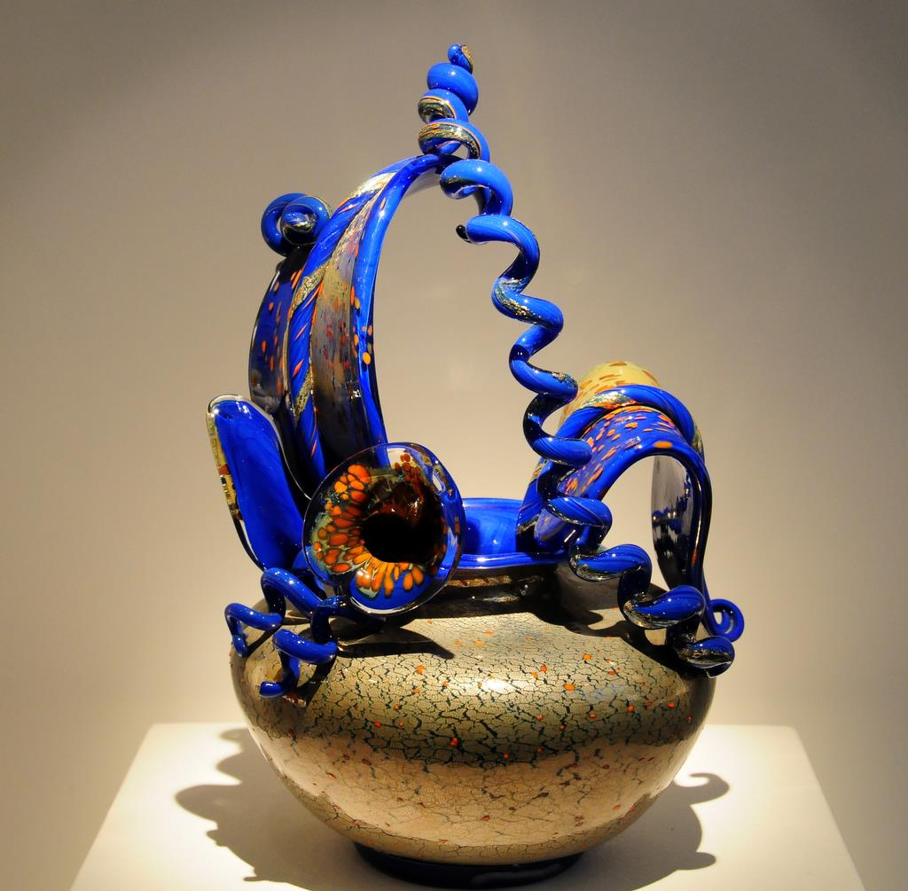
© Miki Pitish

Slide 24
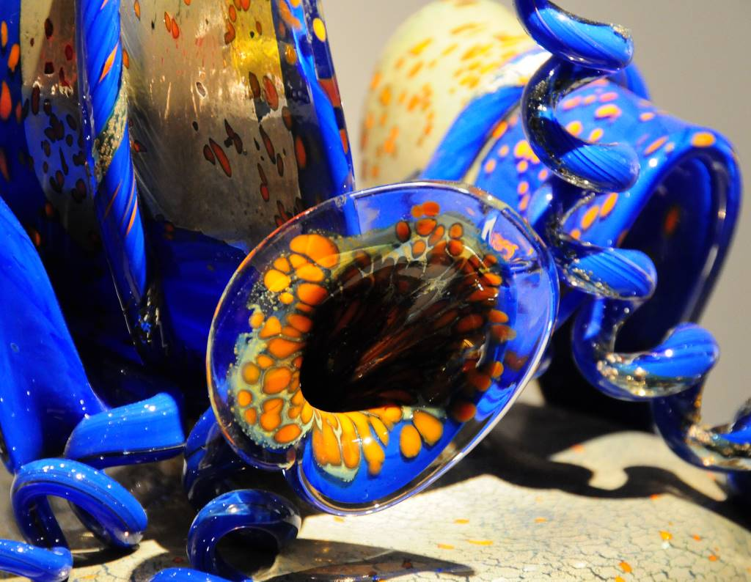
© Miki Pitish

Slide 25
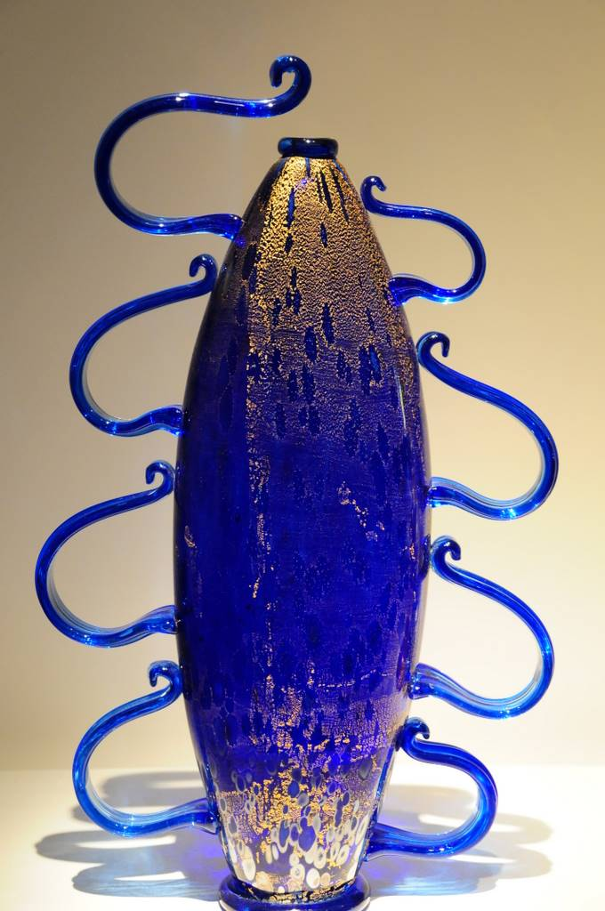
© Miki Pitish

Slide 26
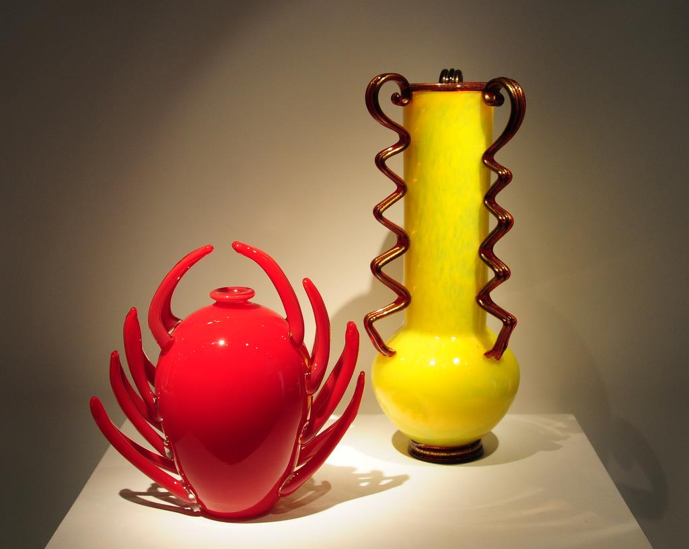
© Miki Pitish

Slide 27
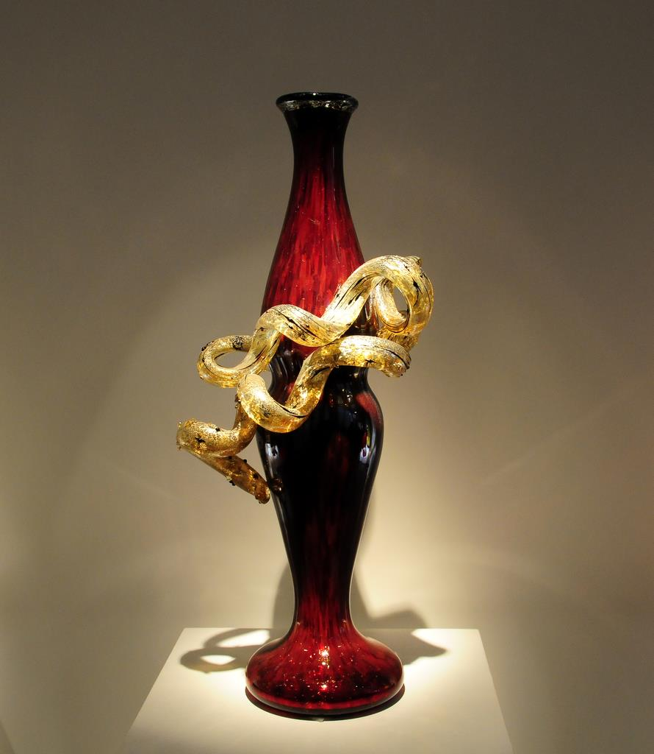
© Miki Pitish

Slide 28
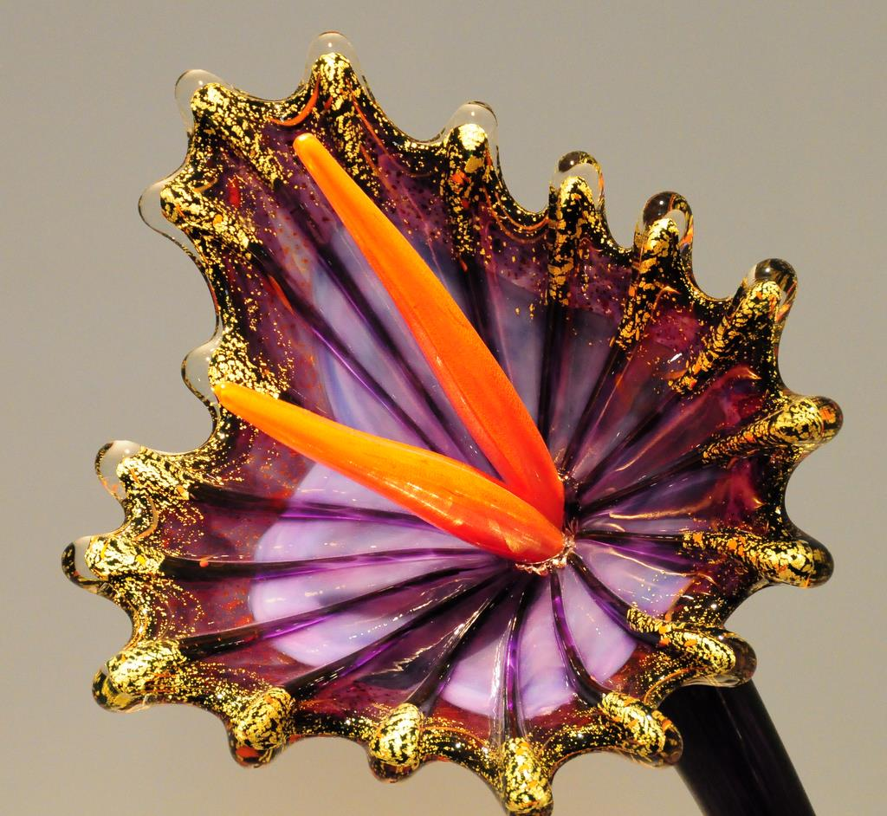
© Miki Pitish

Slide 29
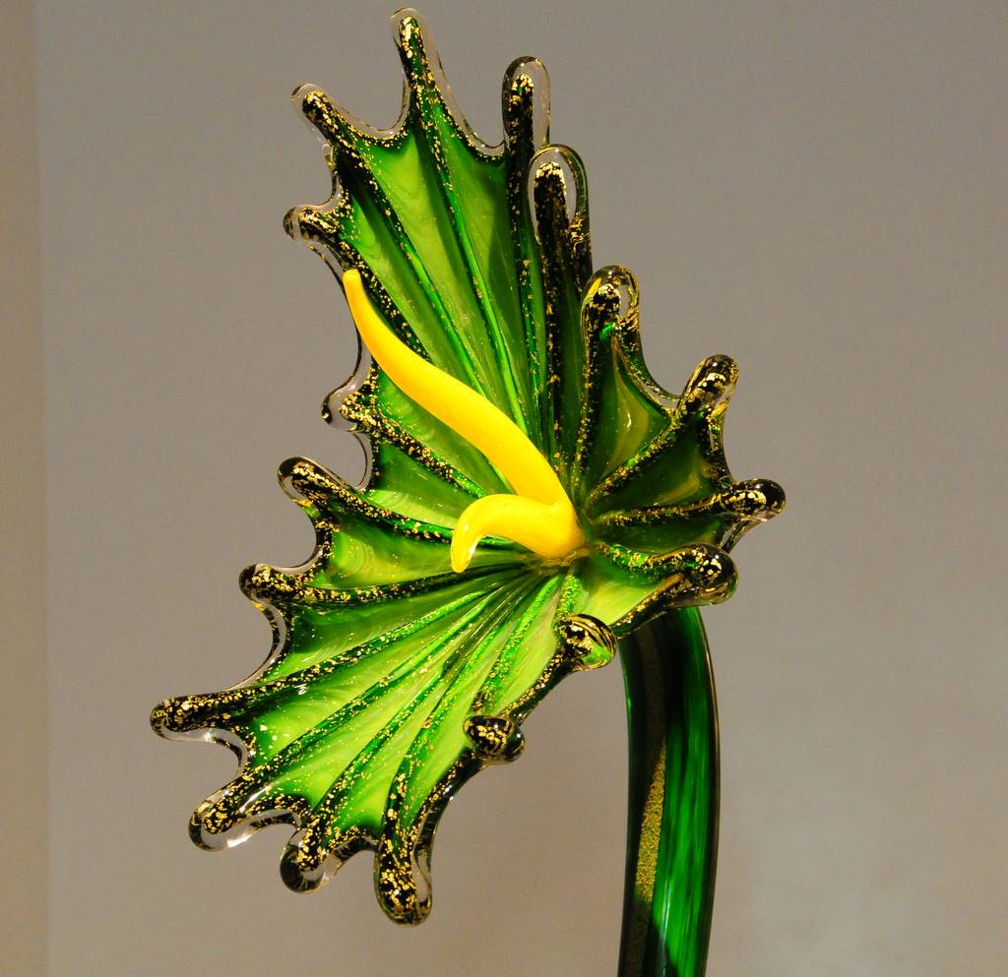
© Miki Pitish

Slide 30
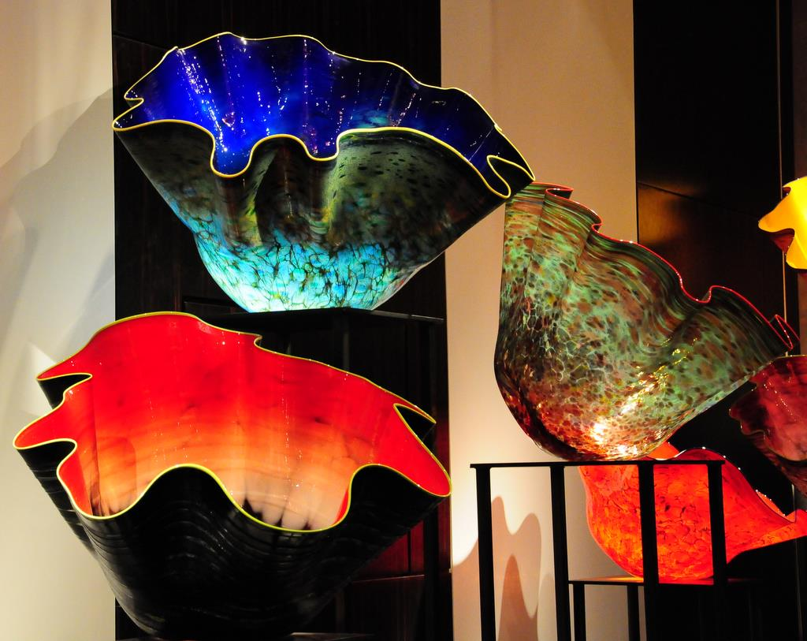
© Miki Pitish

Slide 31
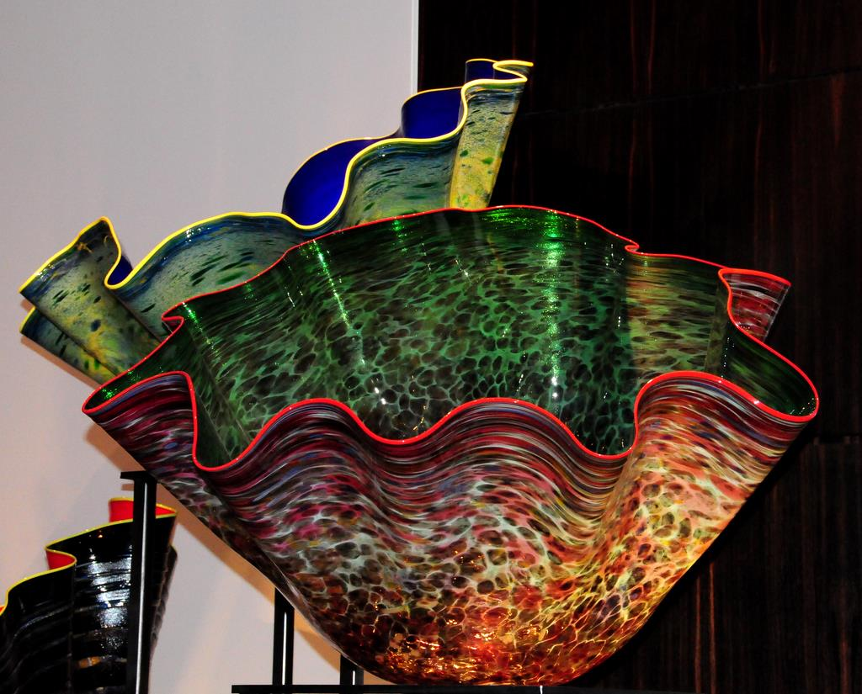
© Miki Pitish

Slide 32
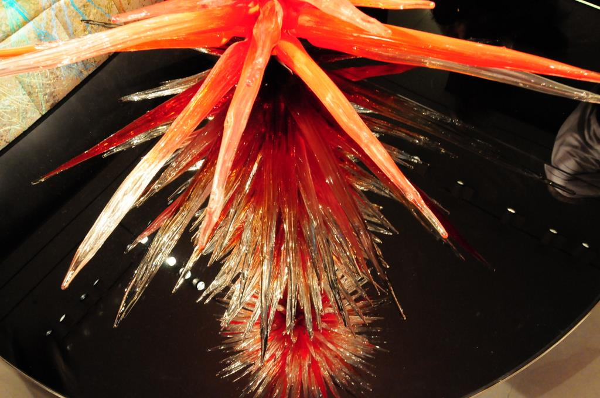
© Miki Pitish

Slide 33
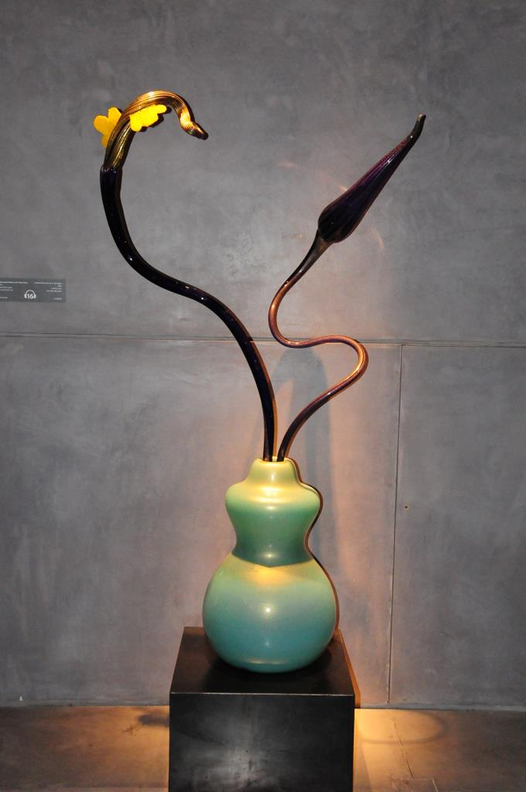
© Miki Pitish

Slide 34
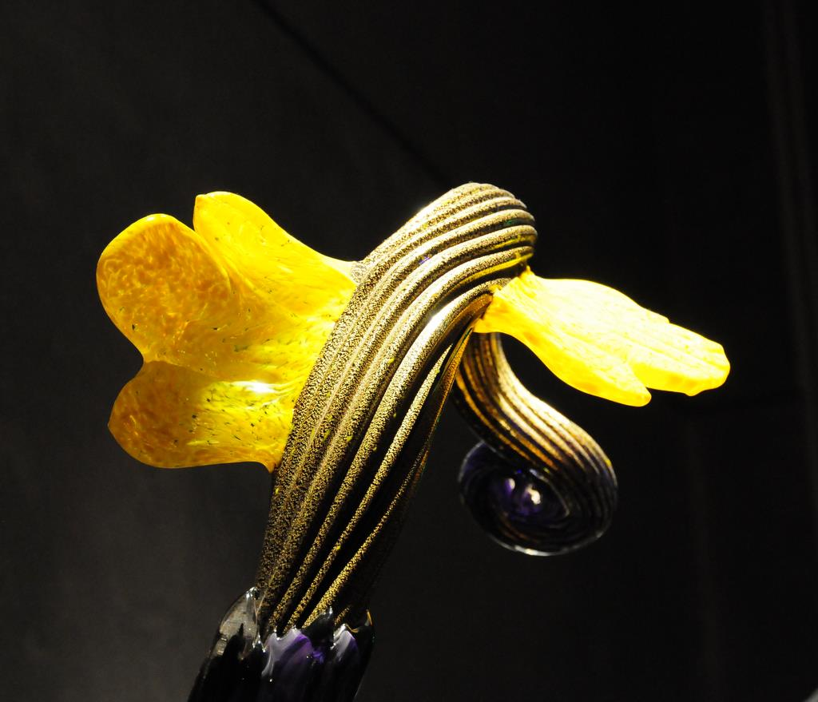
© Miki Pitish

Slide 35
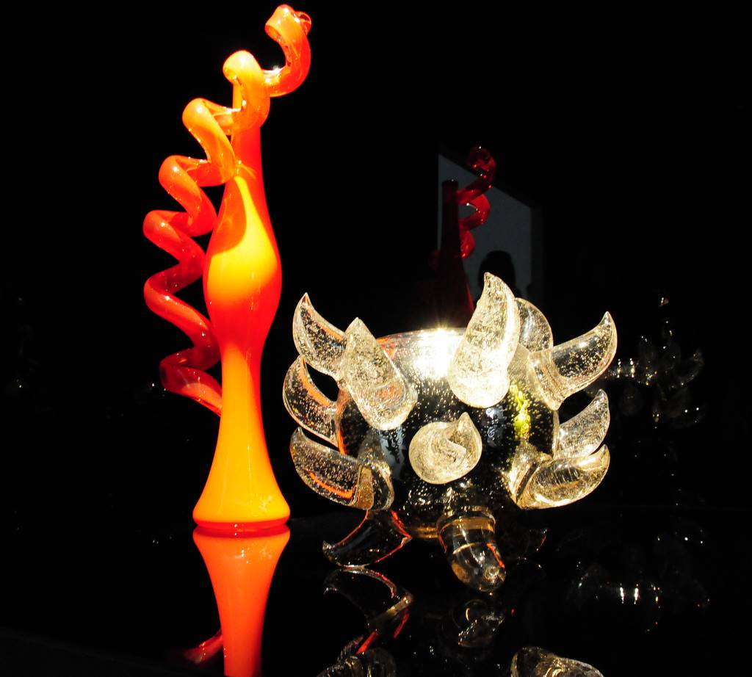
© Miki Pitish

Slide 36
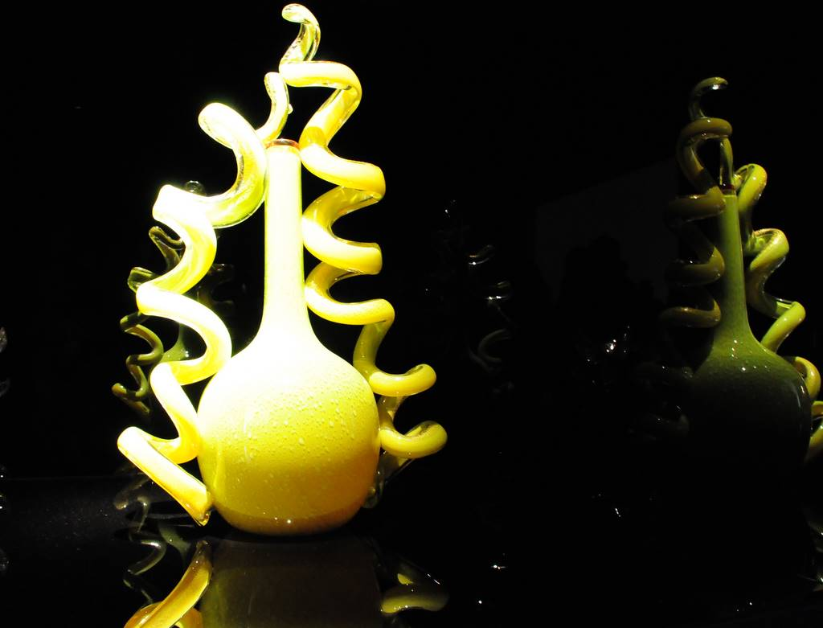
© Miki Pitish

Slide 37
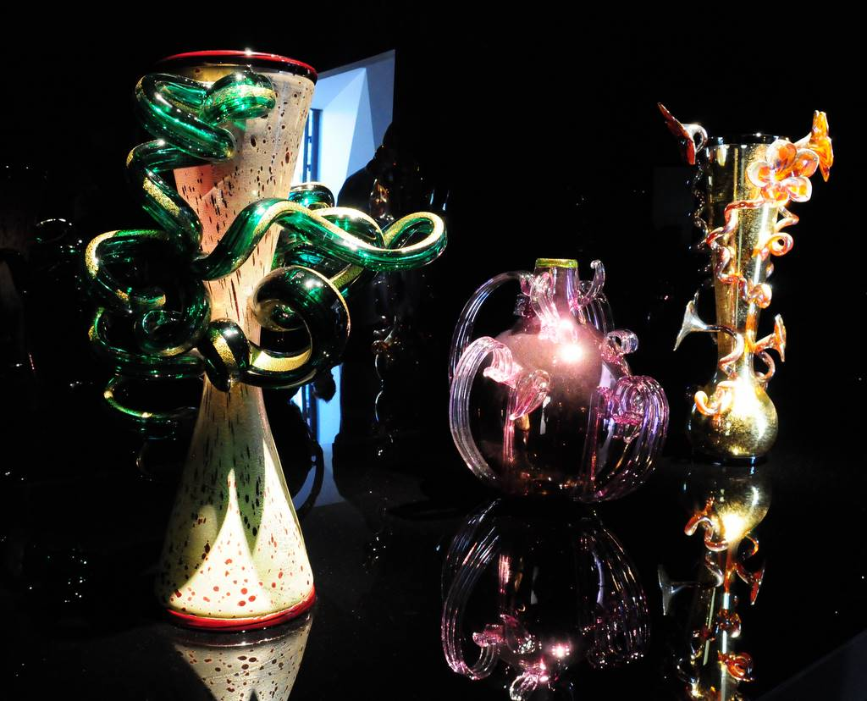
© Miki Pitish

Slide 38
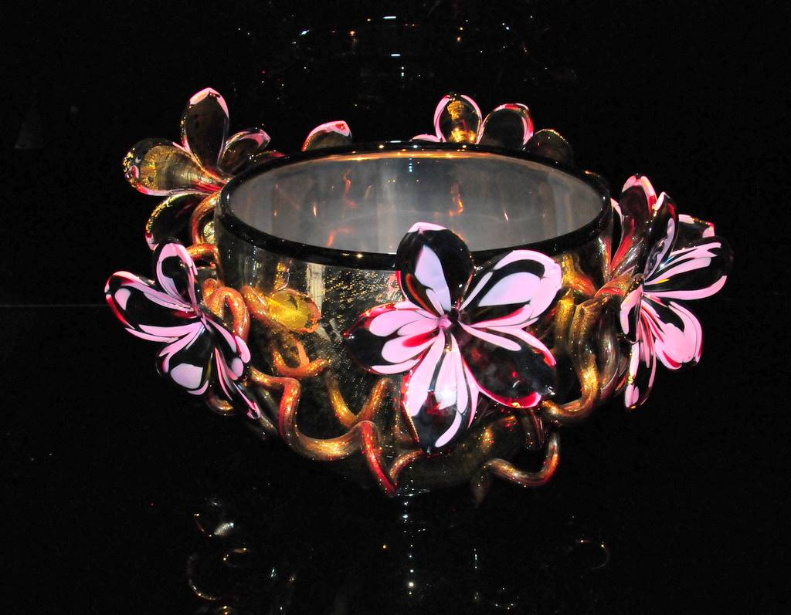
© Miki Pitish

Slide 39
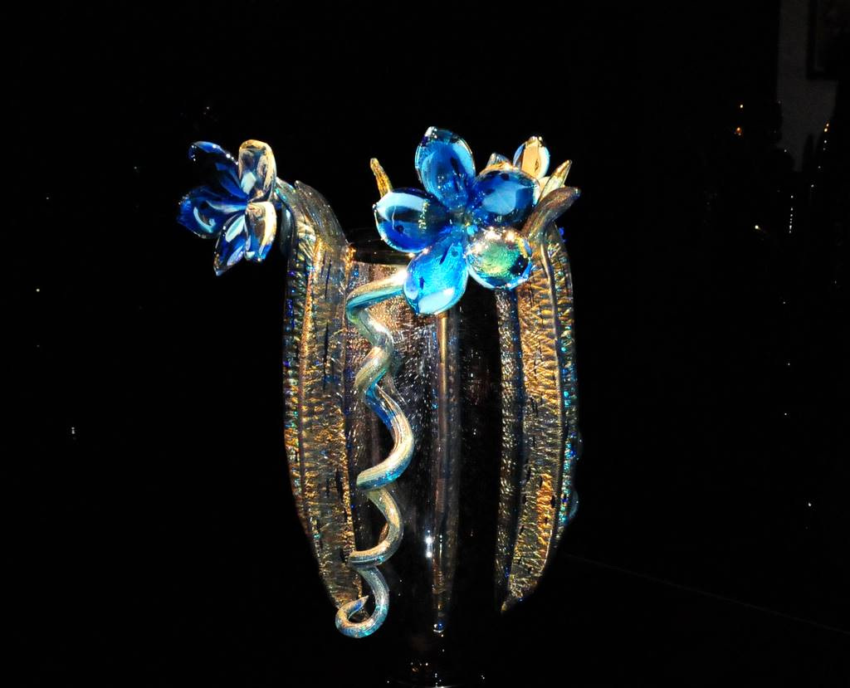
© Miki Pitish

Slide 40
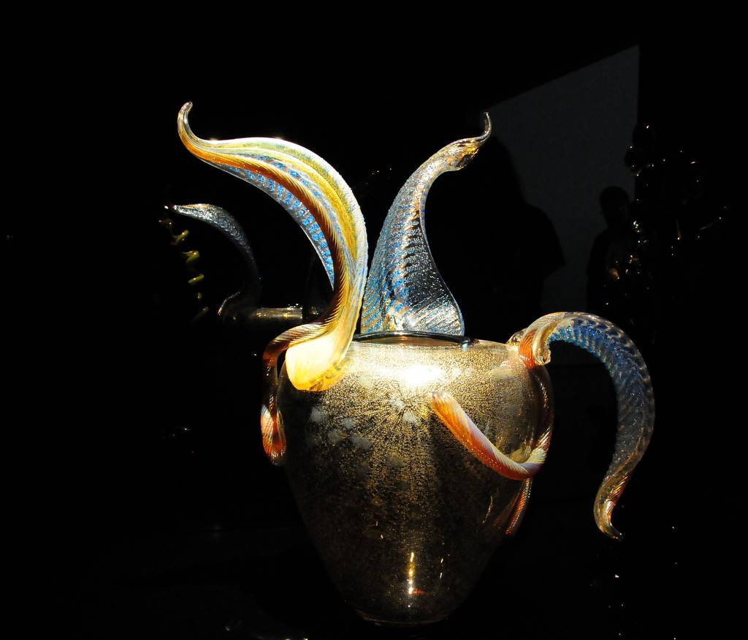
© Miki Pitish

Slide 41
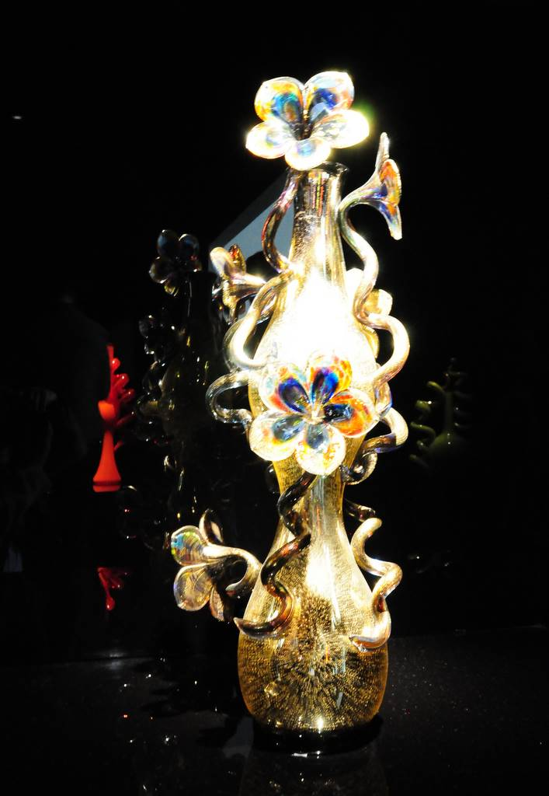
© Miki Pitish

Slide 42
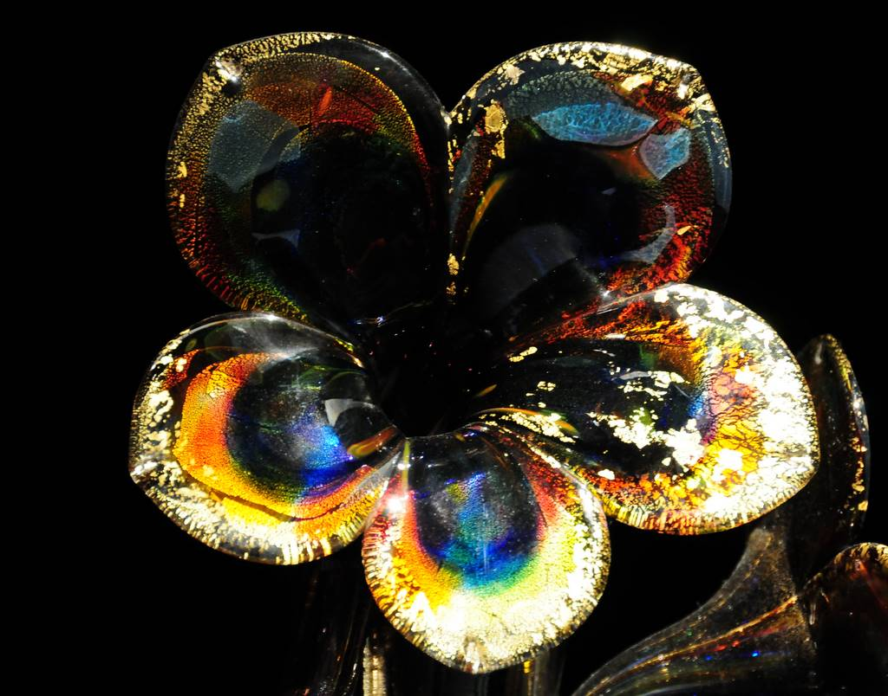
© Miki Pitish

Slide 43
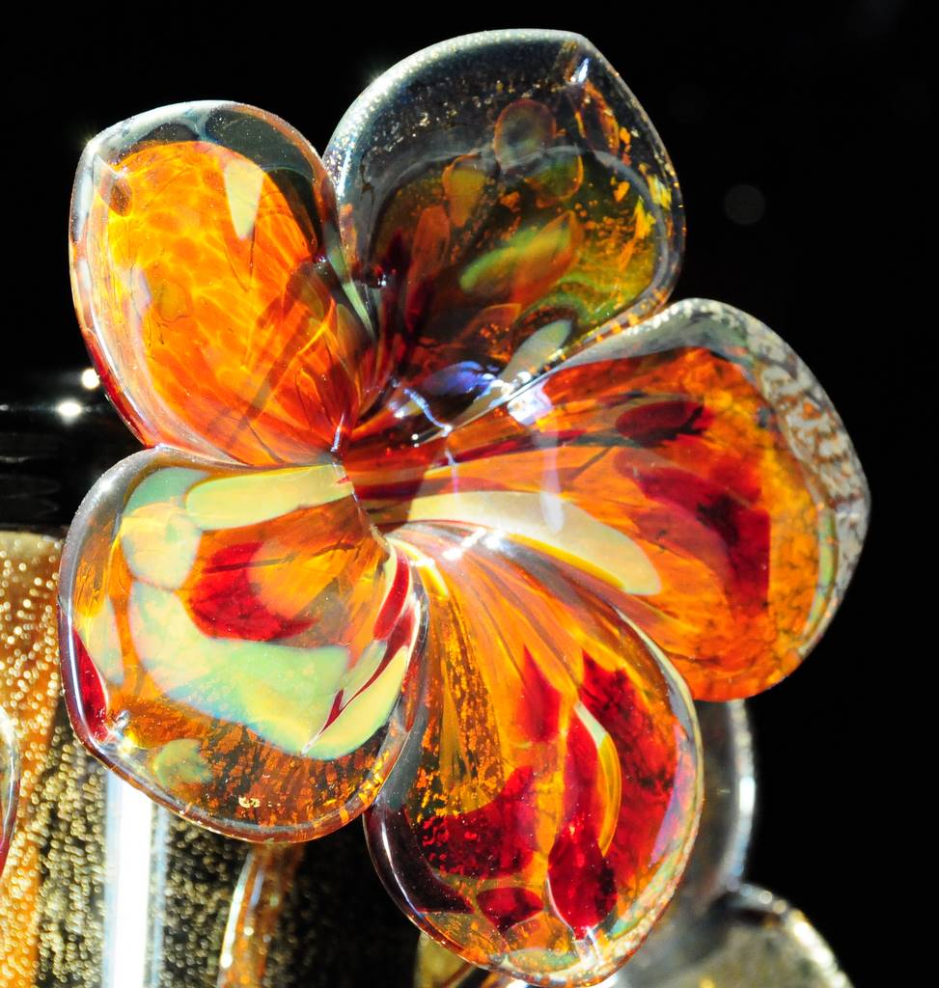
© Miki Pitish

Slide 44
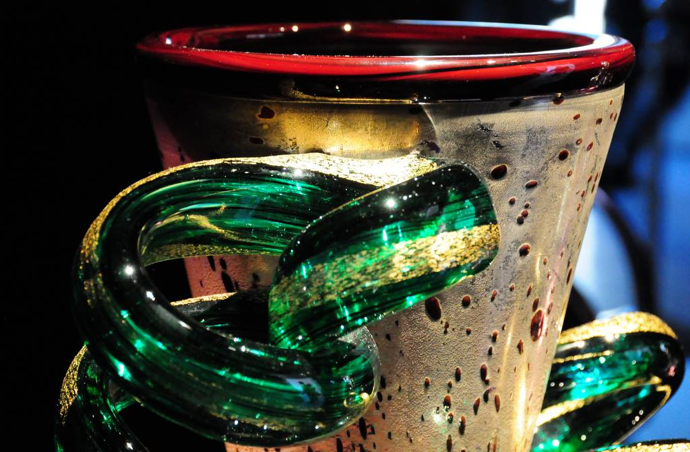
© Miki Pitish

Slide 45
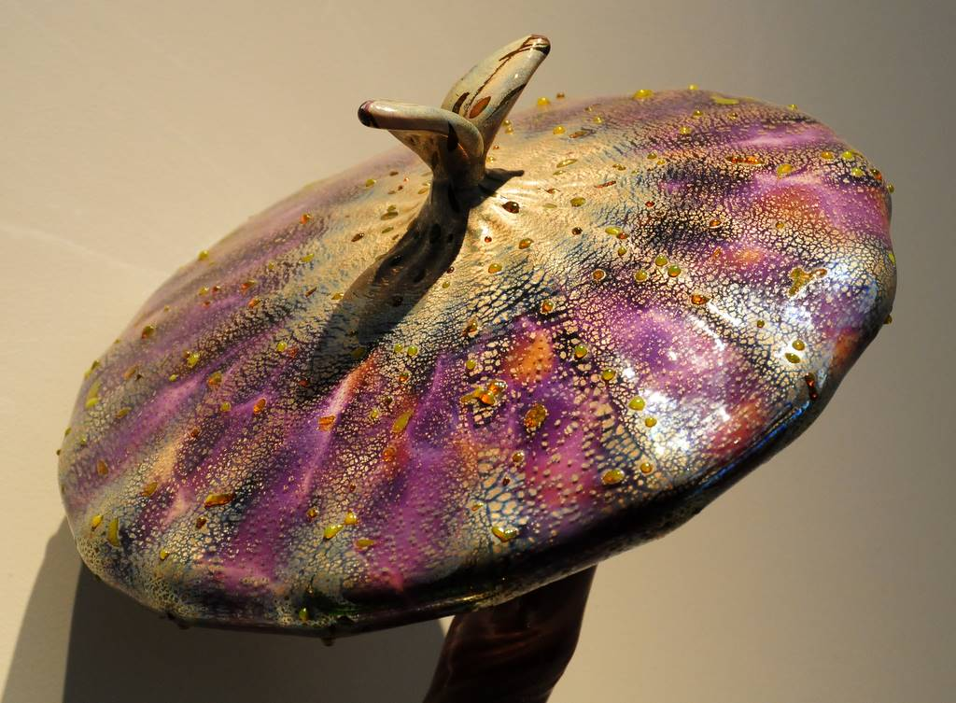
© Miki Pitish

Slide 46

© Miki Pitish

Slide 47

Music: Chopin – La Grande Polonaise

Slide 48







¿Te ha gustado?
Puedes ver más entrando
Aquí
Además puedes recibir powerpoints en tu correo electrónico suscribiéndote aquí:

