Slide 1
CABALLOS Y MULAS
En el pasado

Slide 2
Click

Slide 3
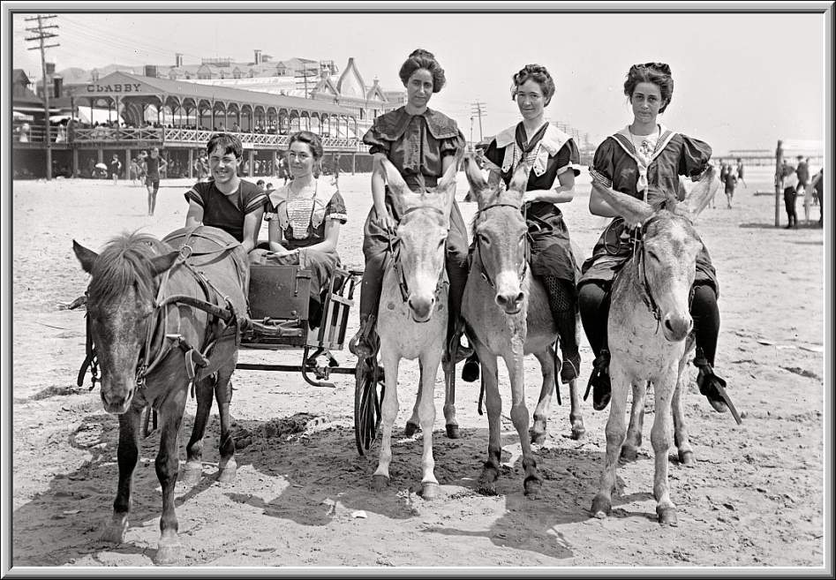
The Jersey Shore 1905

Slide 4
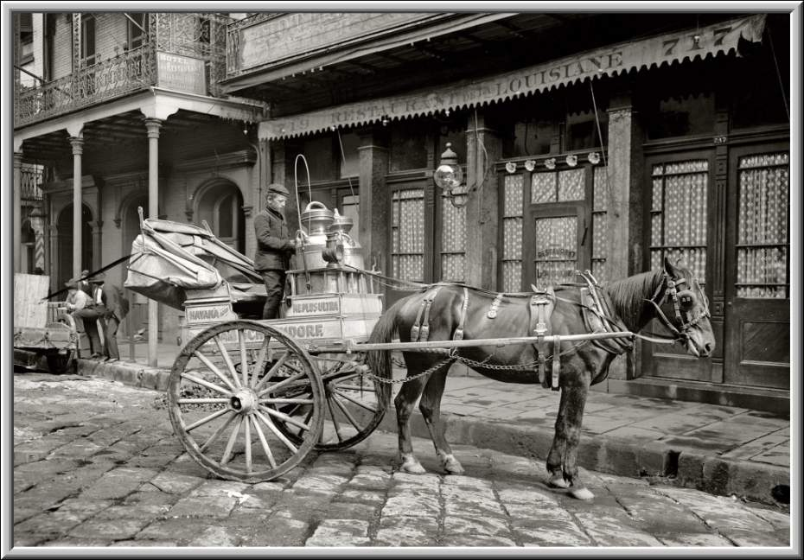
A New Orleans milk cart with a one-horsepower motor 1903

Slide 5
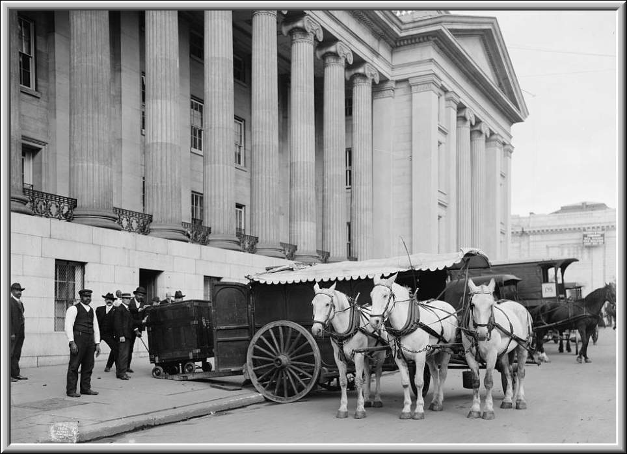
US Treasury currency wagon, Washington, DC 1904

Slide 6
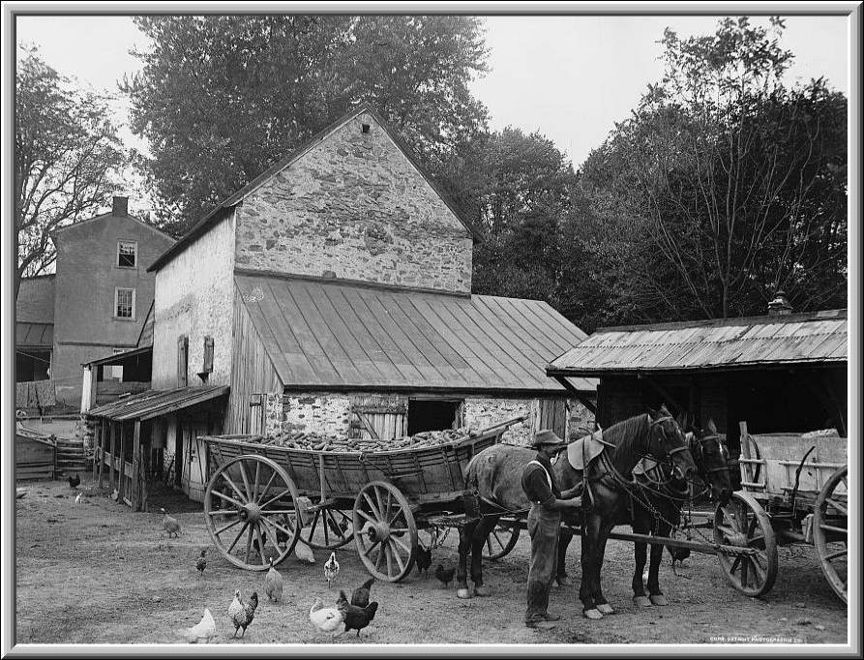
A farm yard, Germantown, Pa. 1899

Slide 7
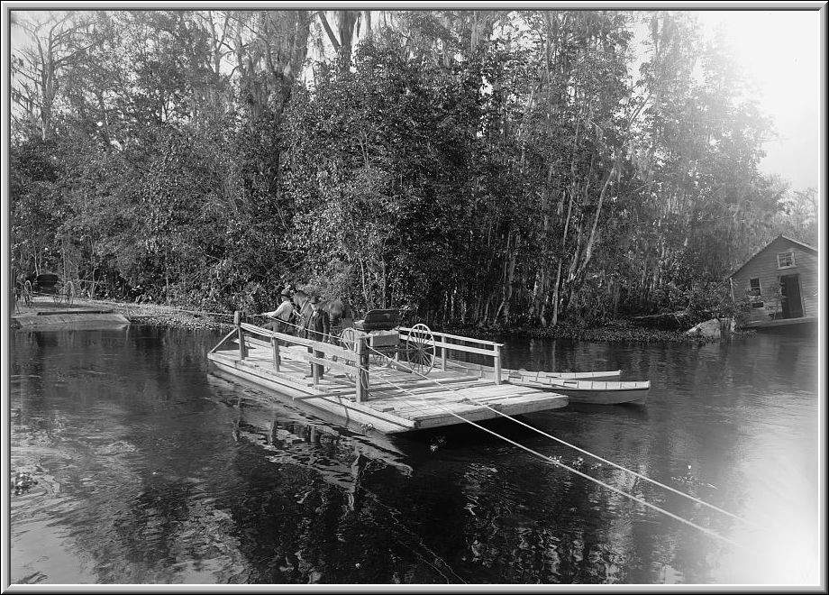
Ferry on the Ocklawaha river Florida 1898

Slide 8
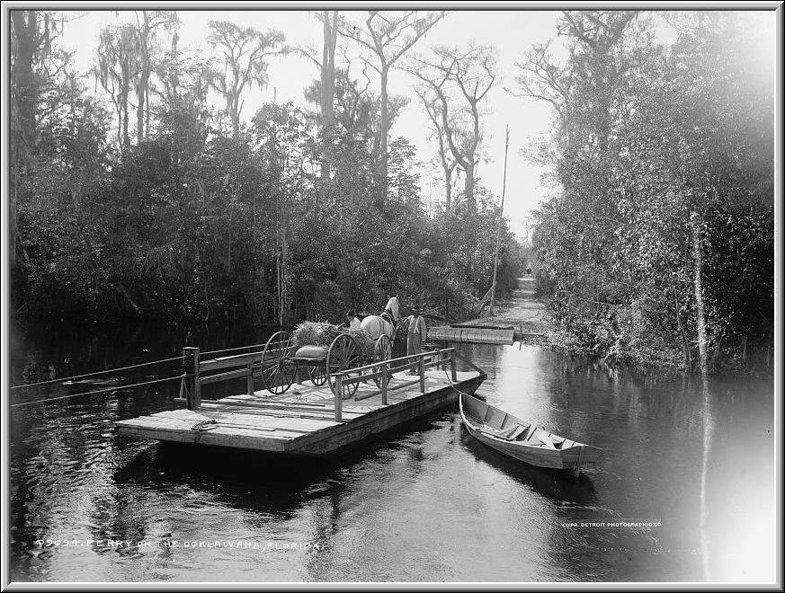
Ditto

Slide 9
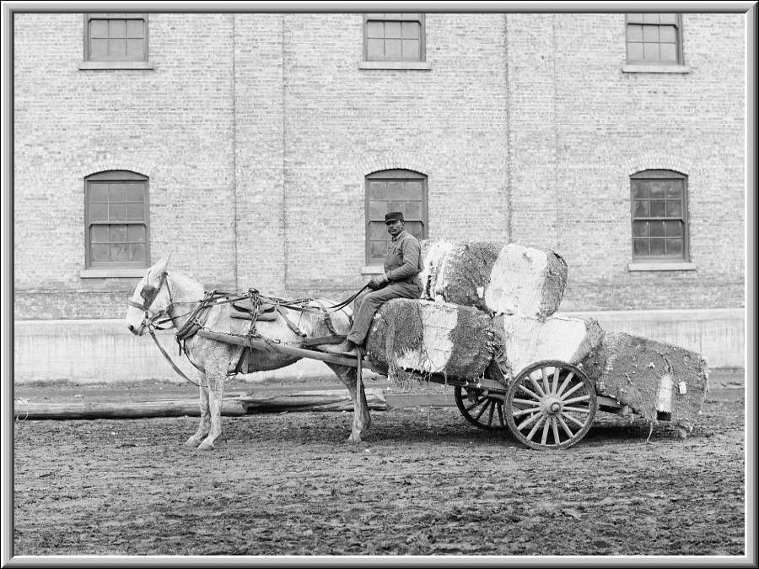
A typical cotton cart, Mobile, Ala. 1902

Slide 10
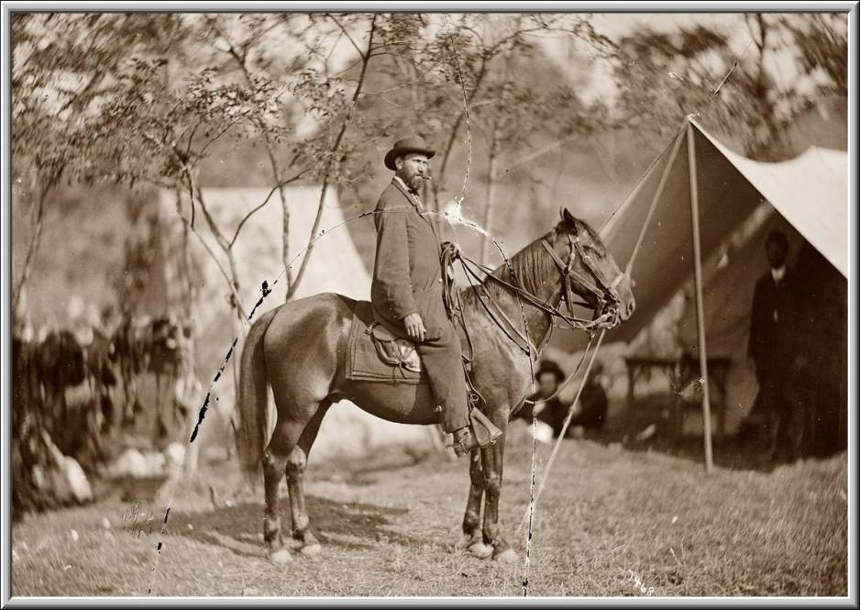
The famous and feared Allan Pinkerton of the Secret Service in Antietam, Maryland 1862

Slide 11
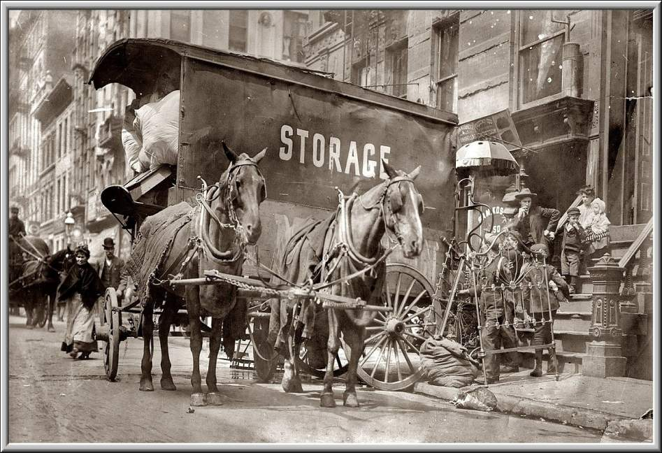
Getting evicted in New York 1908

Slide 12
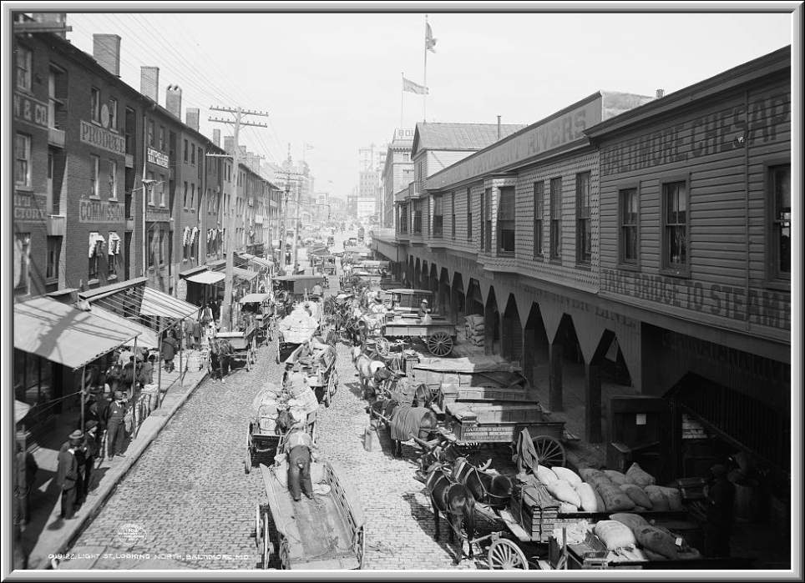
Baltimore, Md 1904

Slide 13
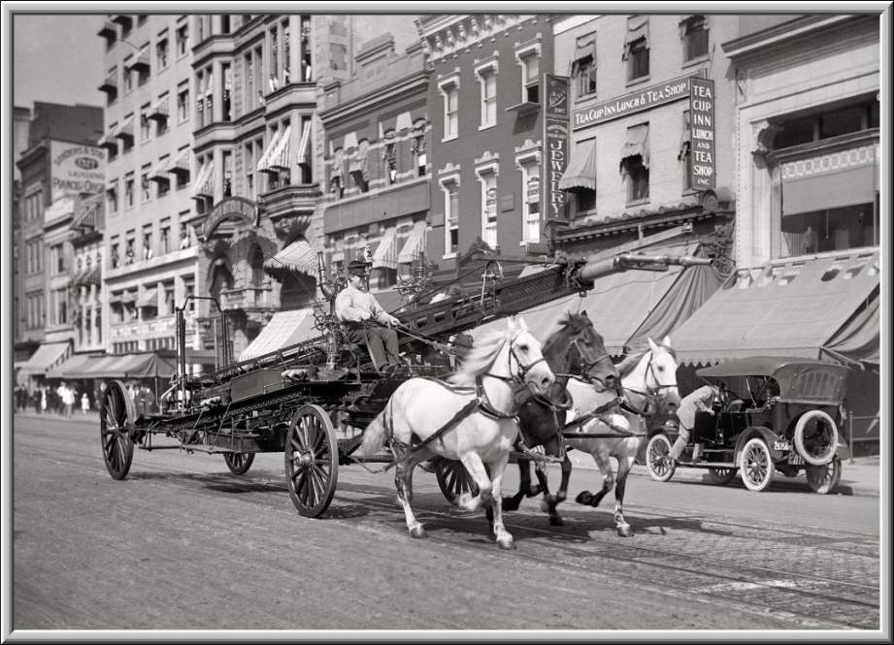
Three-horse team pulling a fire truck in full stride Washington, DC 1914

Slide 14
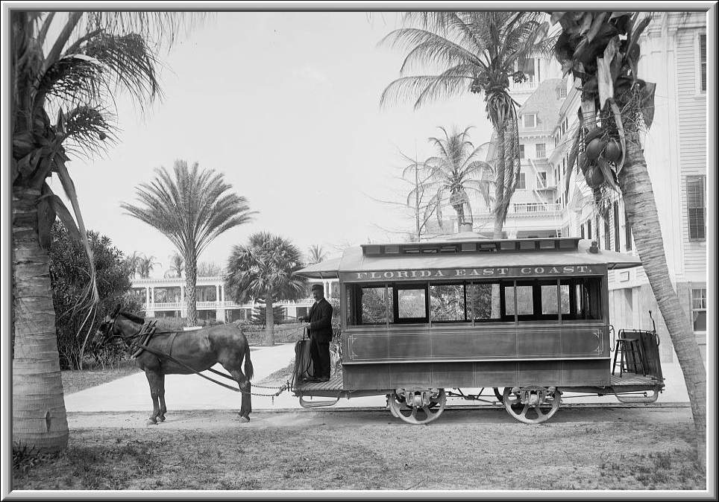
The Palm Beach Fl Trolley 1904

Slide 15
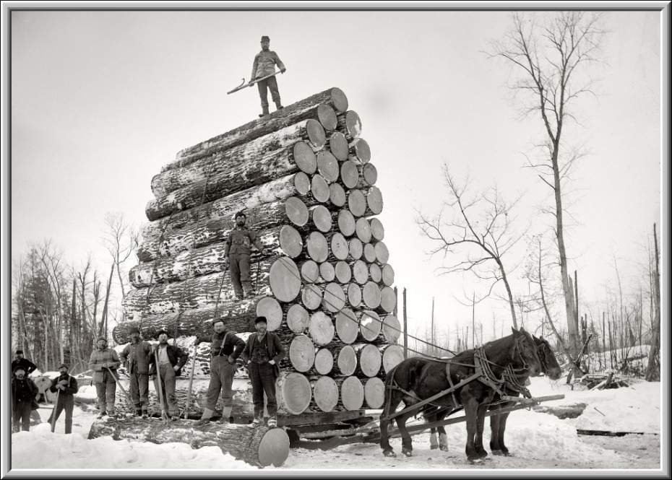
Pulling a big load in Ewen, Michigan 1893

Slide 16
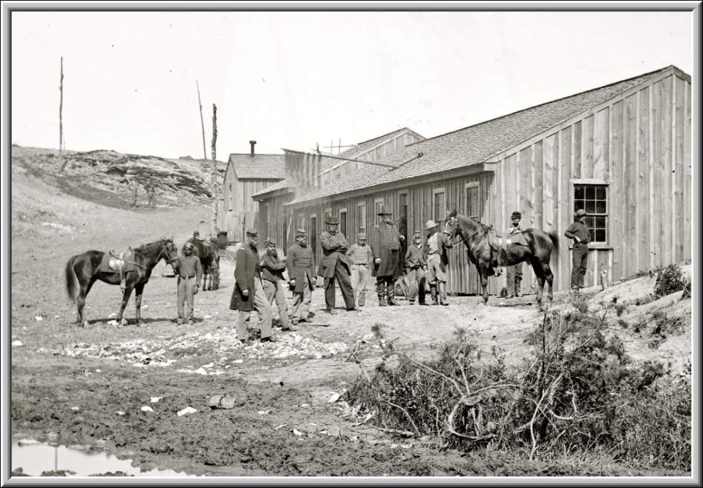
Federal troops at Confederate winter quarters near Yorktown, Virginia 1865

Slide 17
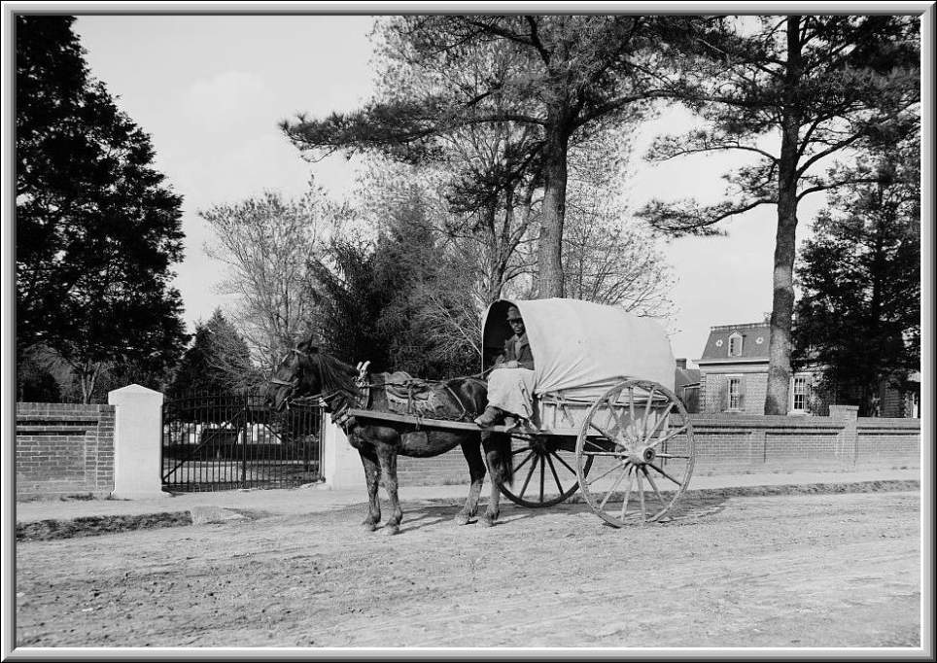
A Virginia vegetable cart 1899

Slide 18
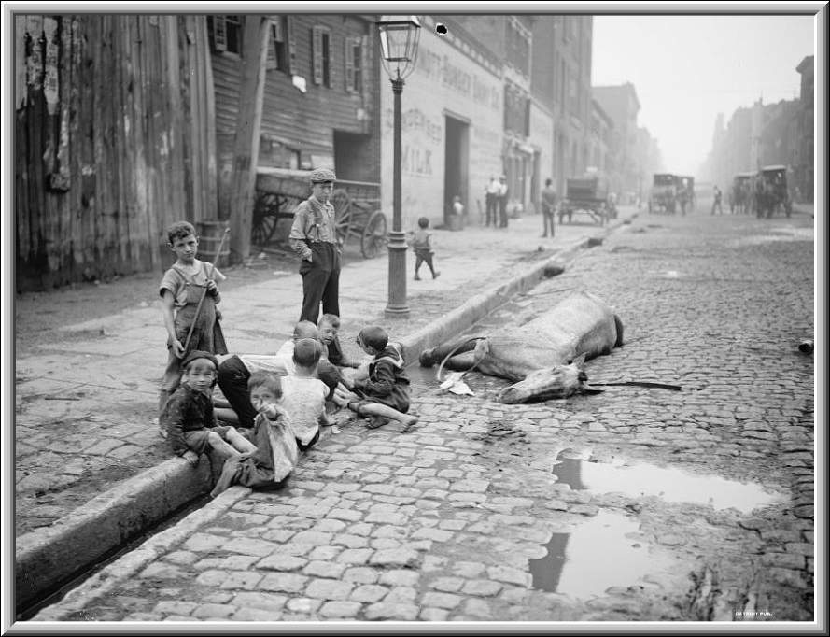
The close of a career in New York 1902

Slide 19
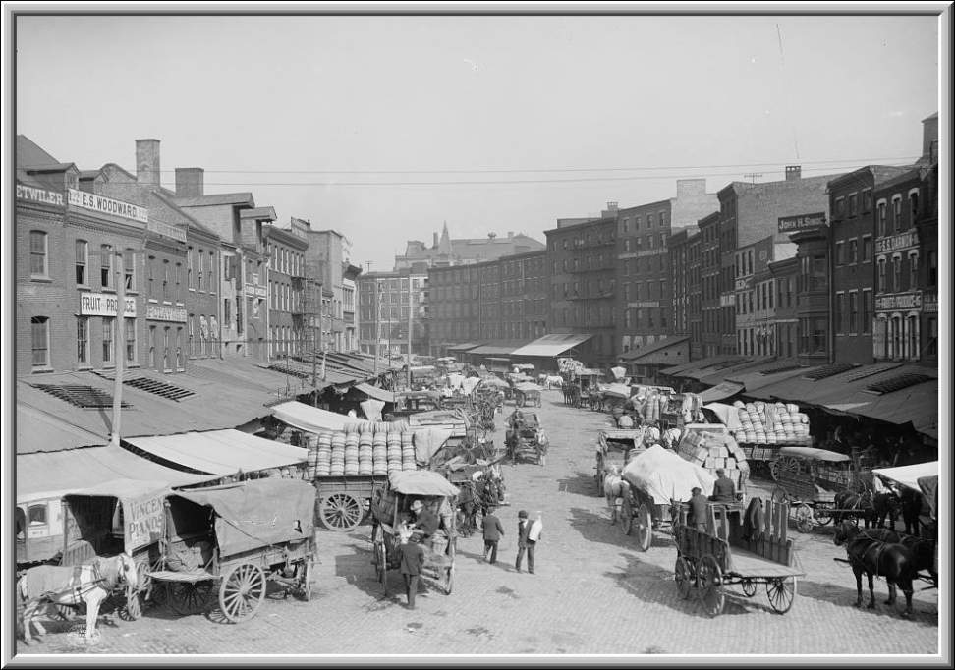
Dock Street, Philadelphia, Pa 1905

Slide 20
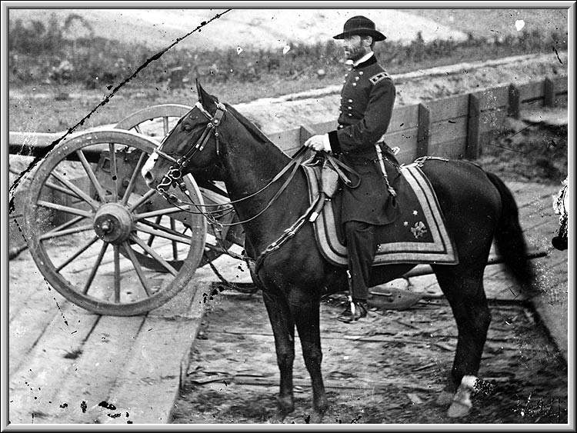
General William T. Sherman near Atlanta, GA 1864

Slide 21
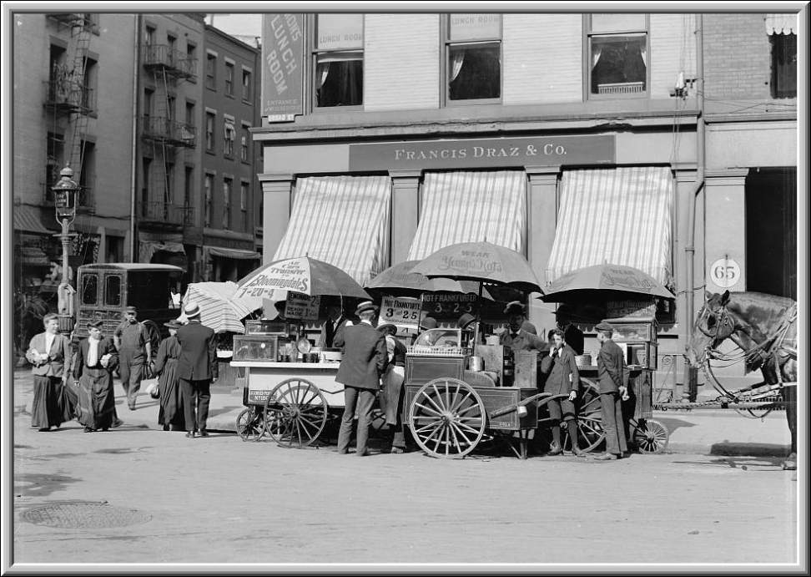
Broad St lunch carts, New York, NY 1904

Slide 22
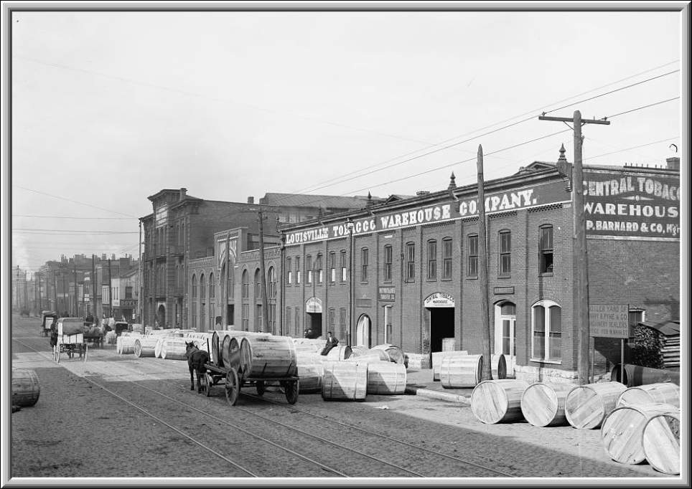
A Tobacco warehouse, Louisville, Ky 1902

Slide 23
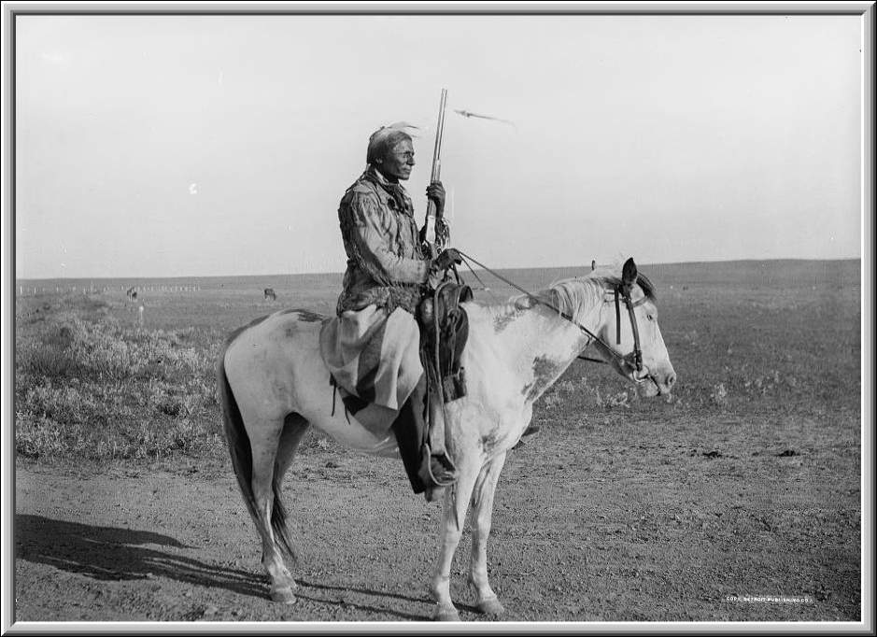
A Assinaboine indian, on guard on outskirts of camp 1898

Slide 24
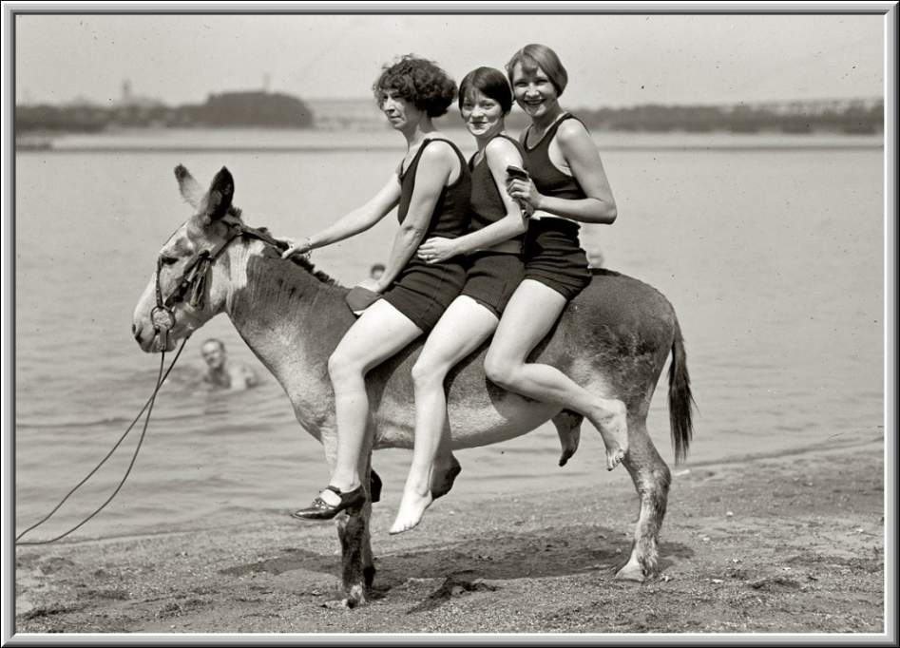
Hazel Watson, Eleanor Howell and Marjie Peacock at Arlington Beach 1922

Slide 25
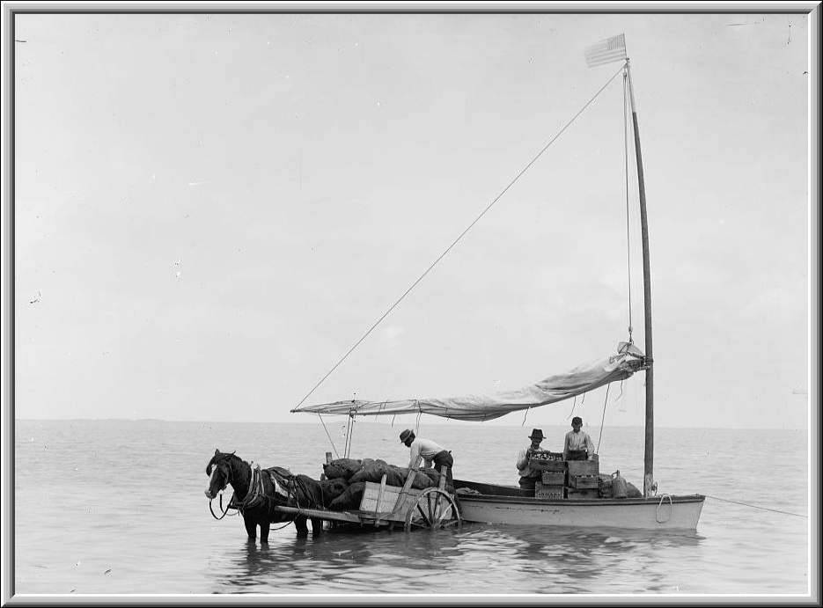
Coast traders, Key West, Fla 1898

Slide 26
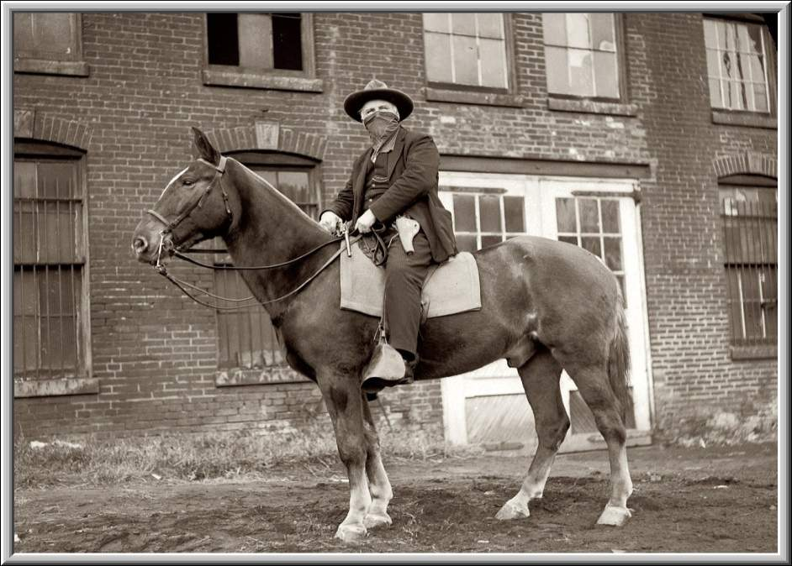
Pat Crowe former Jewel thief, train-robber, kidnaper and burglar in 1919

Slide 27
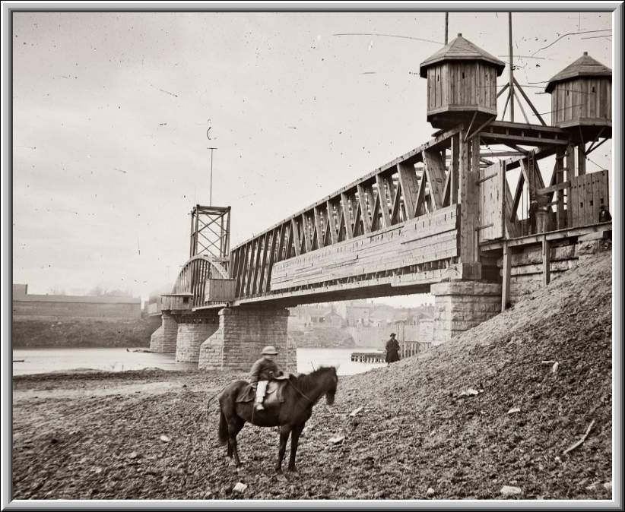
Fortified railroad bridge across the Cumberland River at Nashville, Tenn 1864

Slide 28
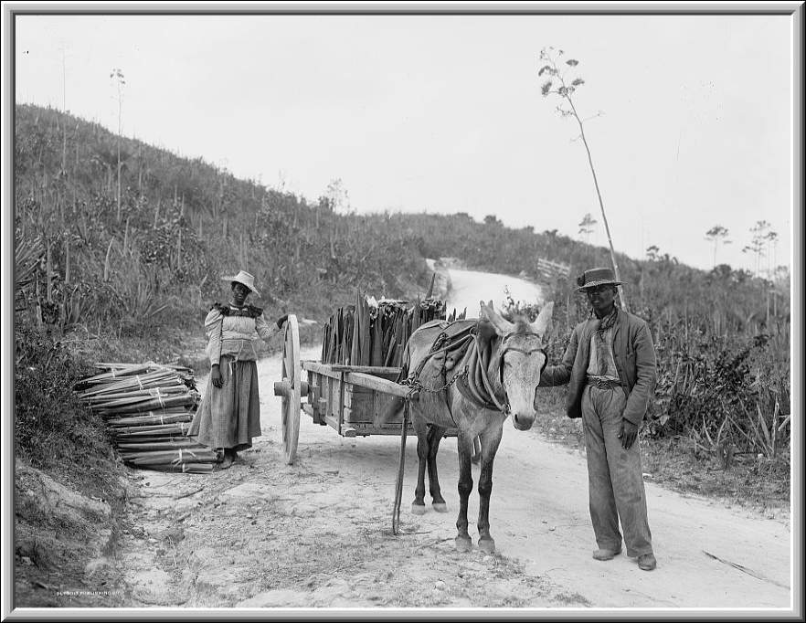
Gathering sisal, Nassau, Bahama Islds. 1898

Slide 29
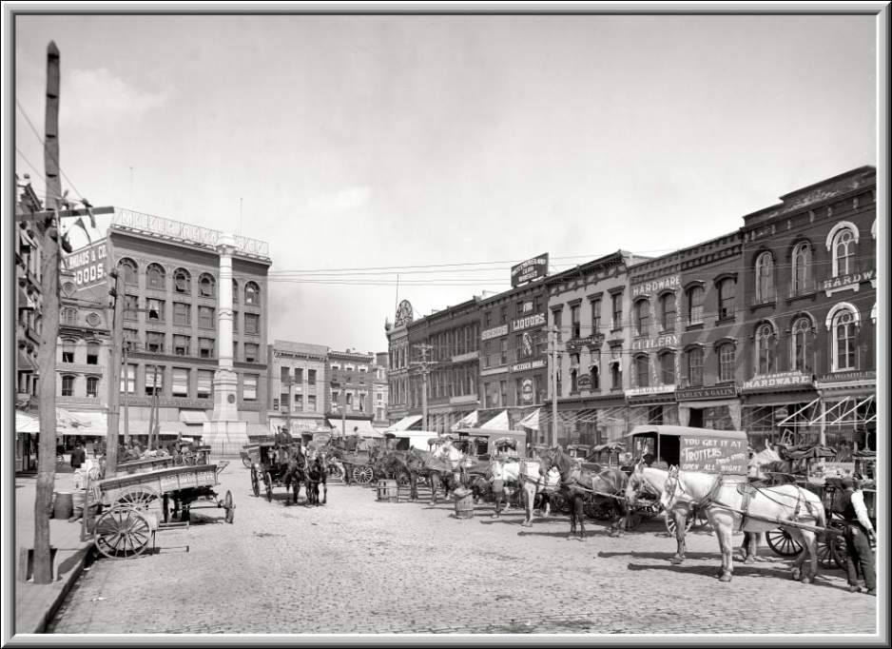
Norfolk, Virginia 1905

Slide 30
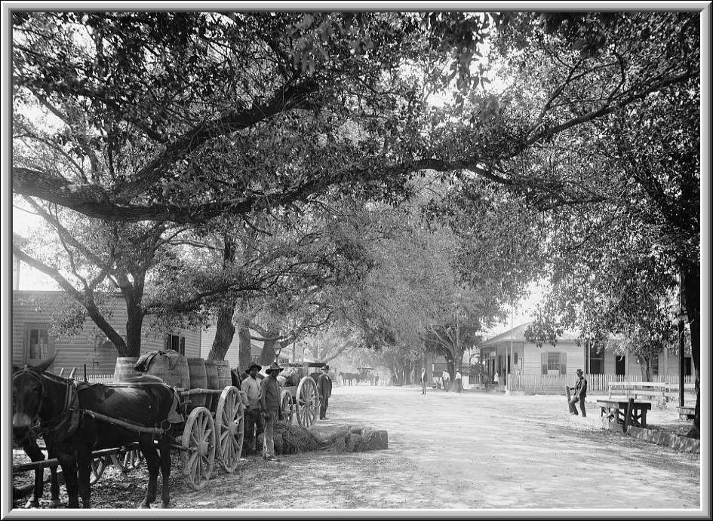
Ocean Springs, Miss 1899

Slide 31
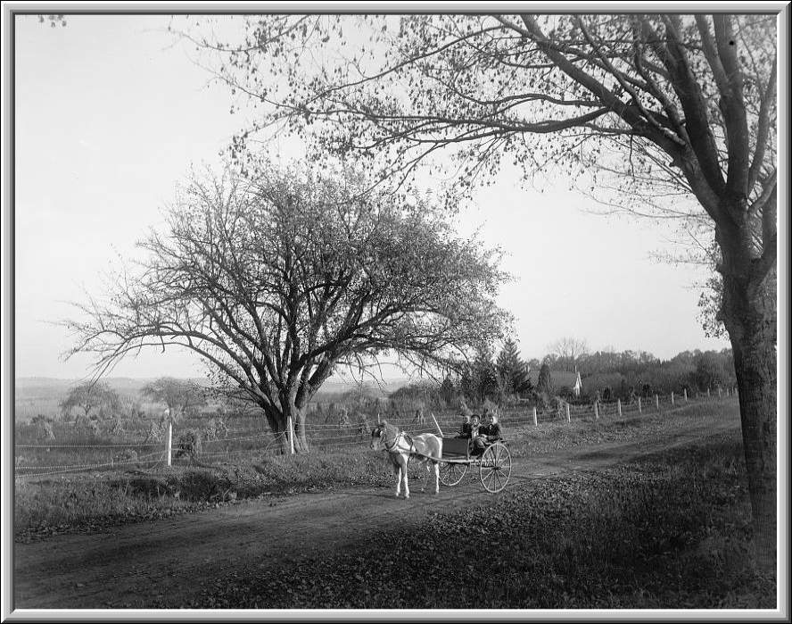
Basking Ridge, NJ 1897

Slide 32
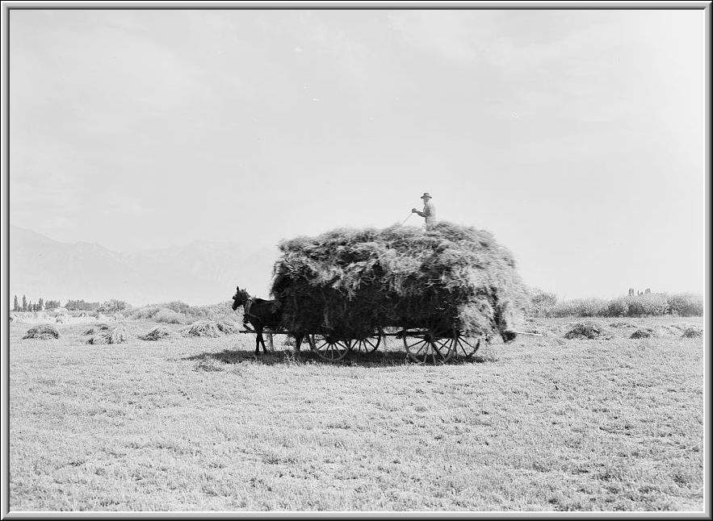
The End
Jordan, Utah 1898

Slide 33







¿Te ha gustado?
Puedes ver más entrando
Aquí
Además puedes recibir powerpoints en tu correo electrónico suscribiéndote aquí:

