Slide 1
Black & white illusion

Slide 2


If you like photography and optical illusion, the Spanish photographer Chema Madoz has the perfect combination for you! His unique style is not burdened with unnecessary details, always in black and white and witty jokes in each picture. The photographer creates this element of surprise by mixing two mutually unrelated objects that have at least one visually similar function or by placing objects in an unexpected visual composition.
Born in 1958, Madoz studied Art History at Complutense University in Madrid. At the same time he was attending courses in photography at the Center for Visual Arts. His first exhibition was in 1983 and up to now he is the author of numerous exhibitions, several albums and is recognized with various international awards.
If you look at his work, you can almost hear Madoz saying that things are not what they seem!

Slide 3
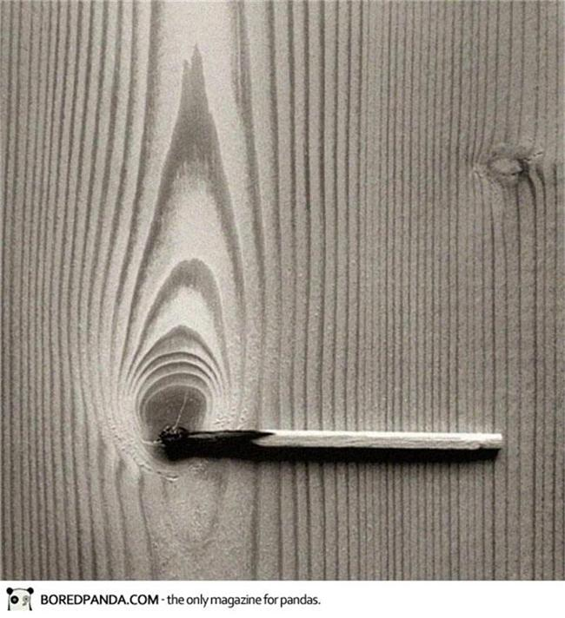

Slide 4
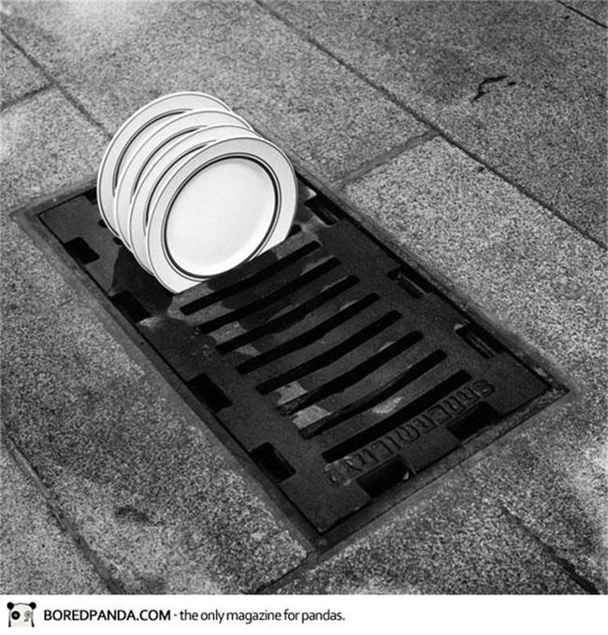

Slide 5
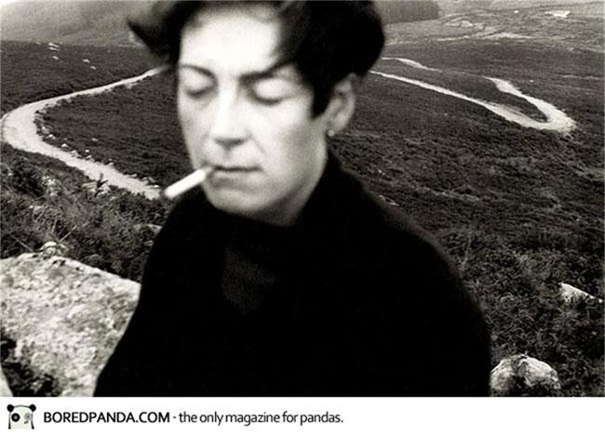

Slide 6
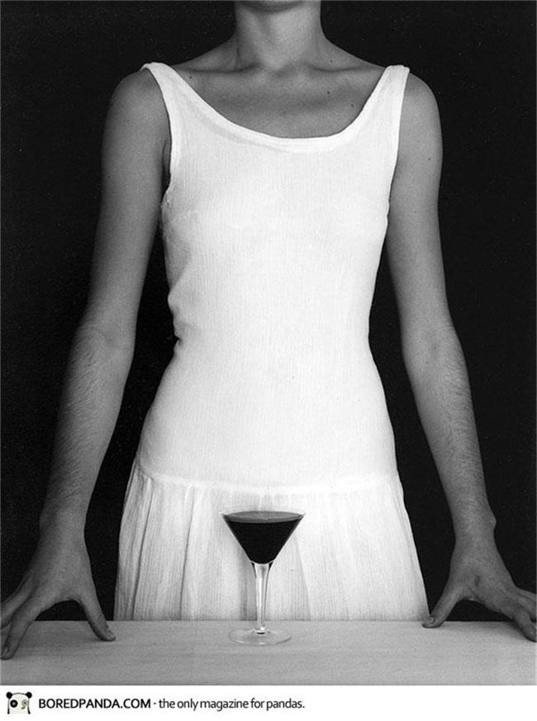

Slide 7
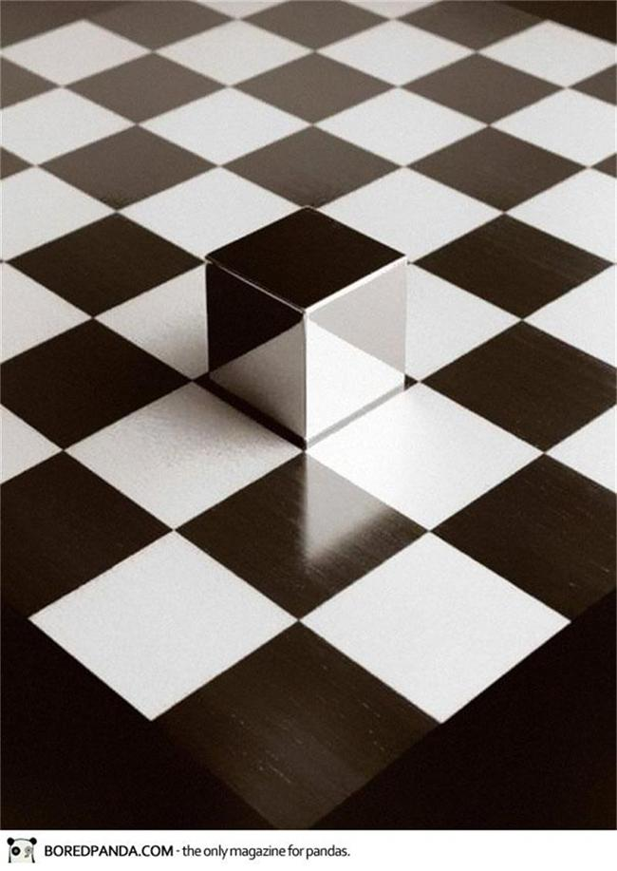

Slide 8
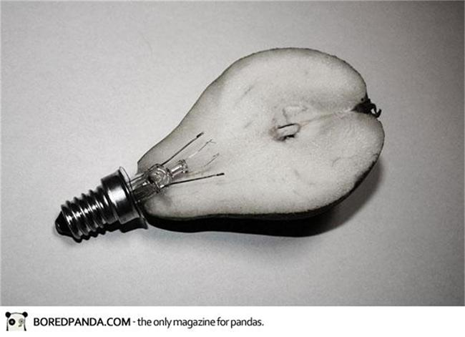

Slide 9
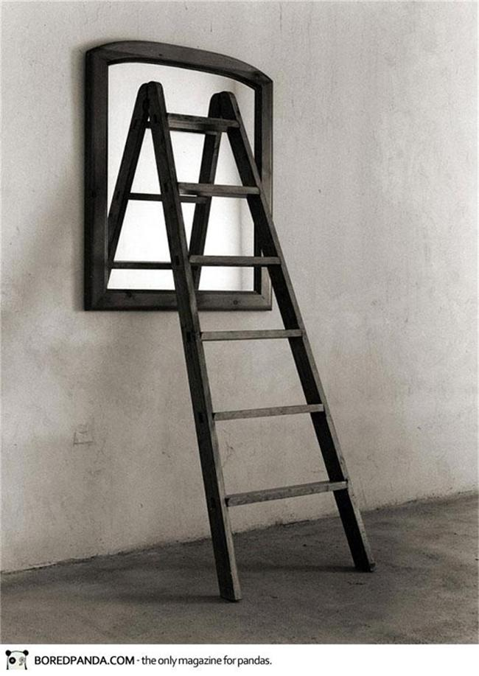

Slide 10
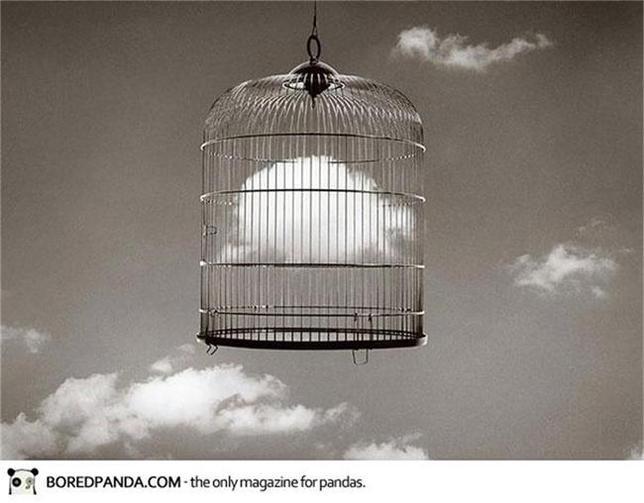

Slide 11
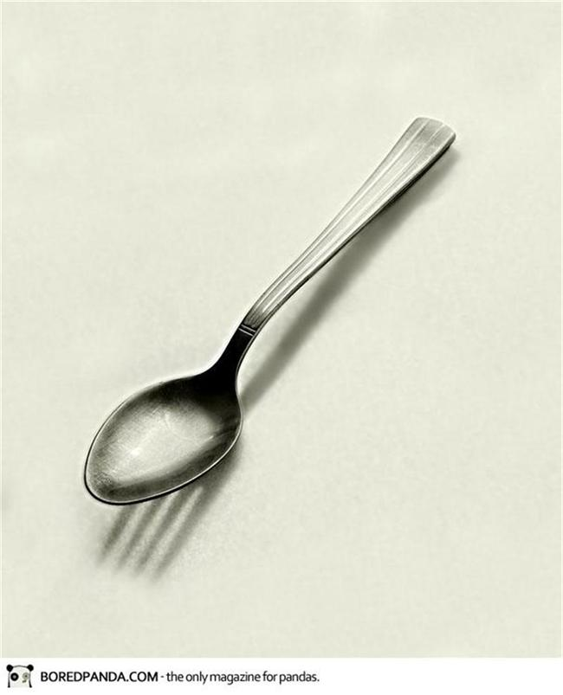

Slide 12


Slide 13
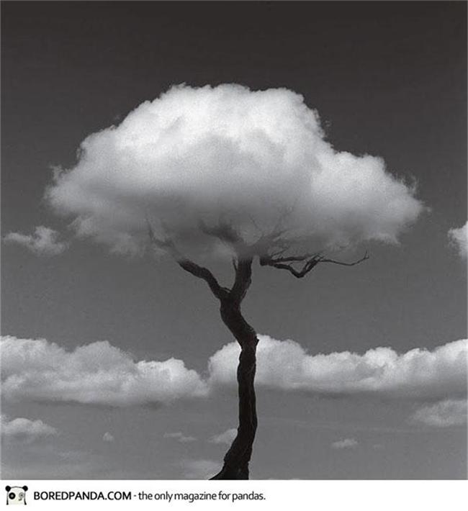

Slide 14
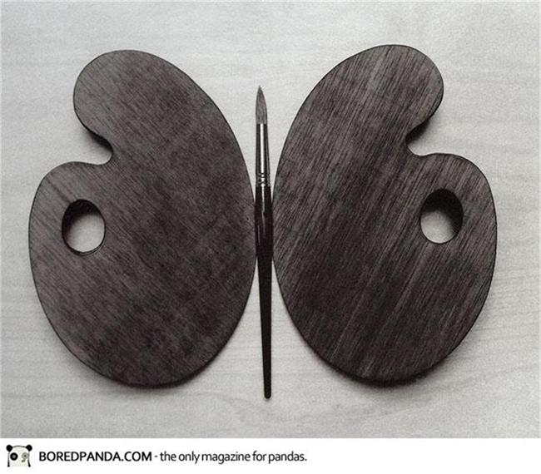

Slide 15
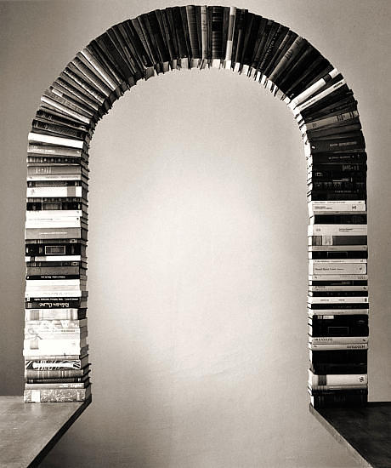

Slide 16
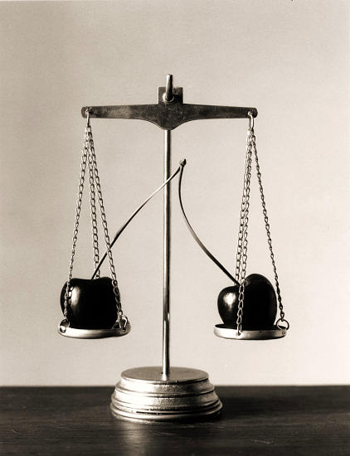

Slide 17
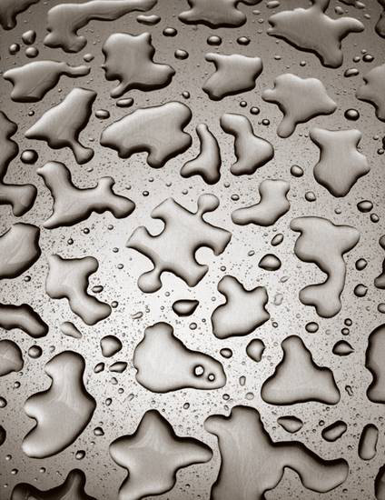
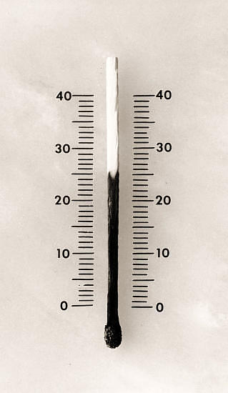

Slide 18
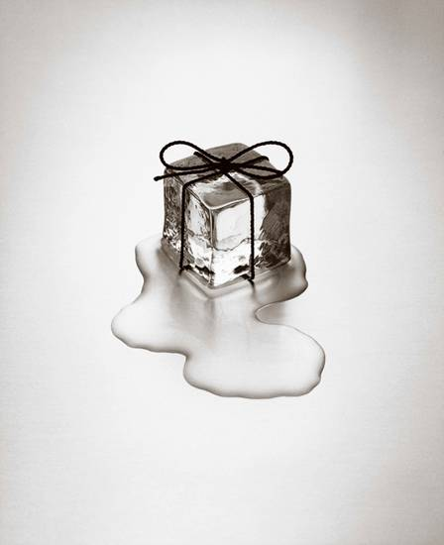

Slide 19
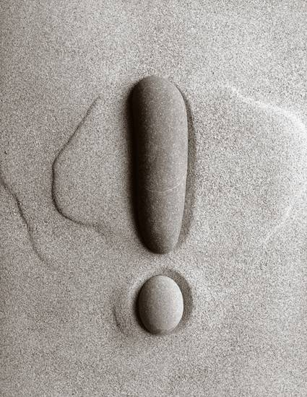

Slide 20
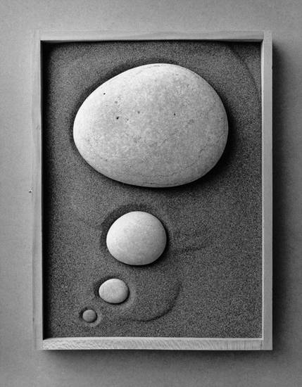

Slide 21
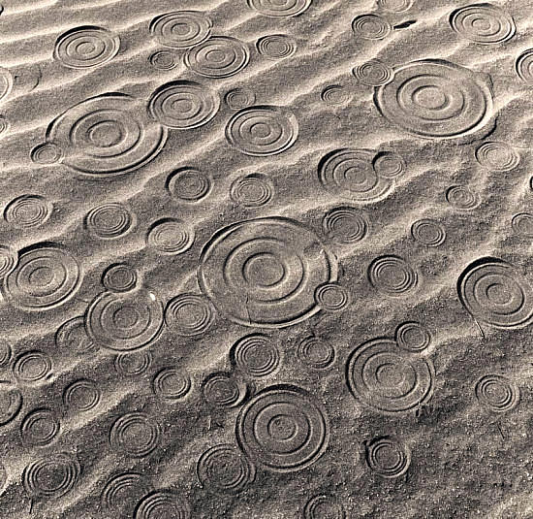

Slide 22
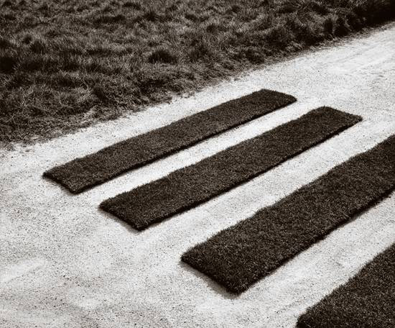

Slide 23
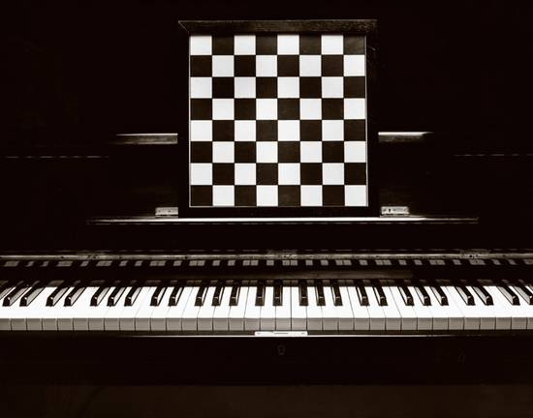

Slide 24
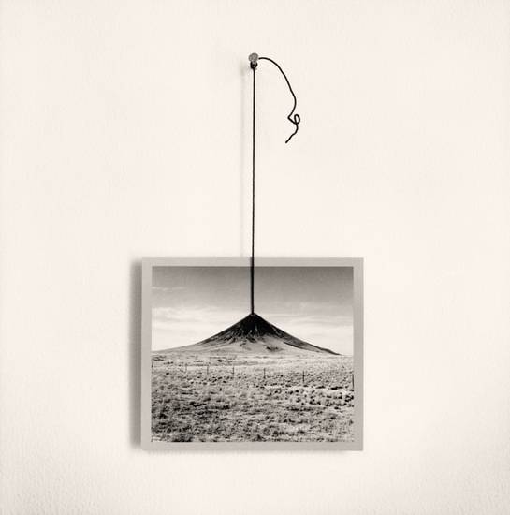

Slide 25
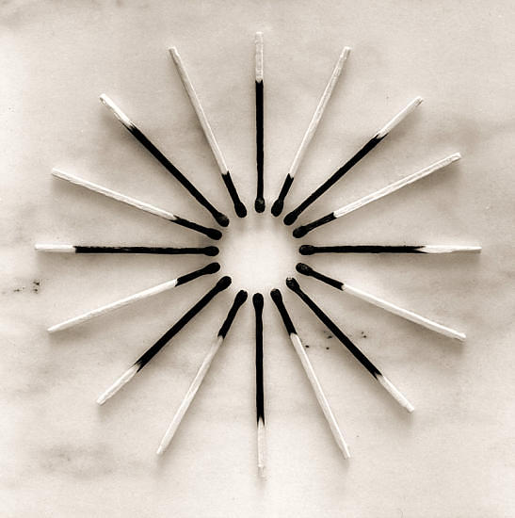

Slide 26
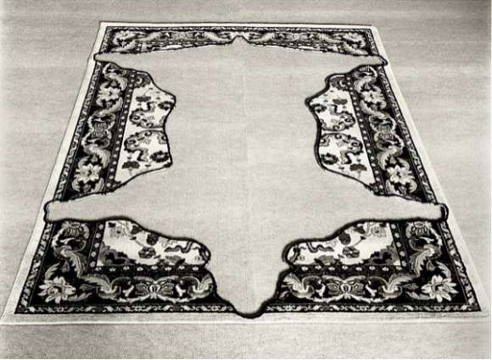

Slide 27


Slide 28
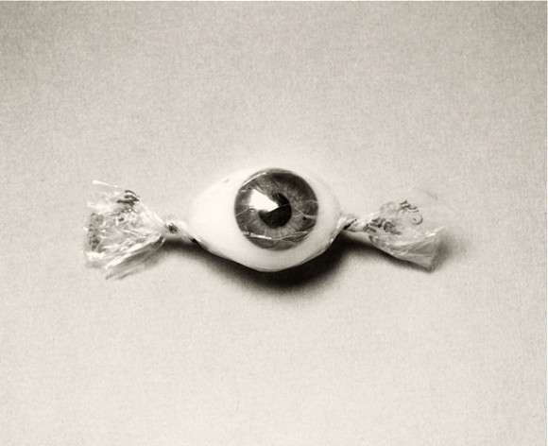

Slide 29


Slide 30
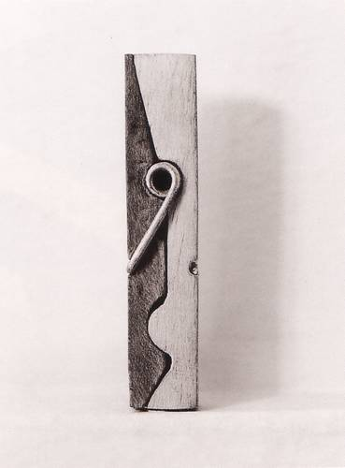


Slide 31
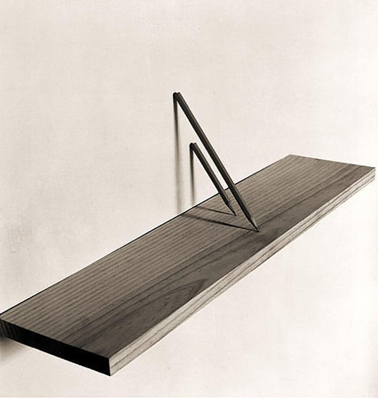

Slide 32
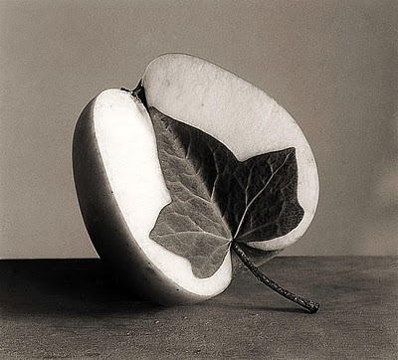

Slide 33
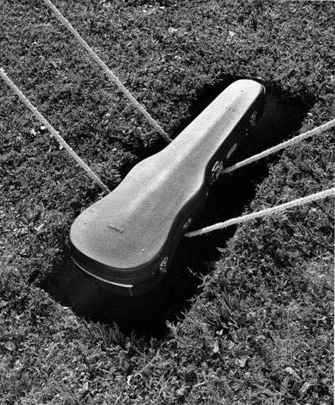

Slide 34


Slide 35
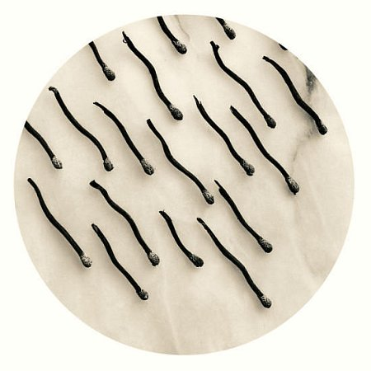

Slide 36
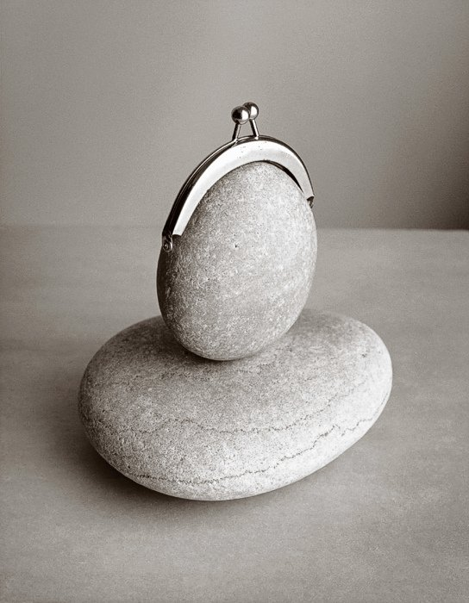

Slide 37
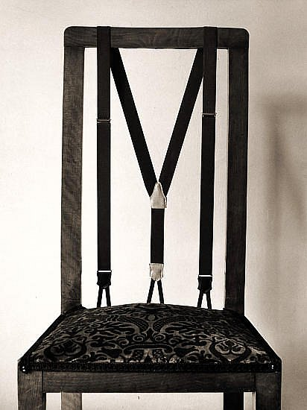

Slide 38
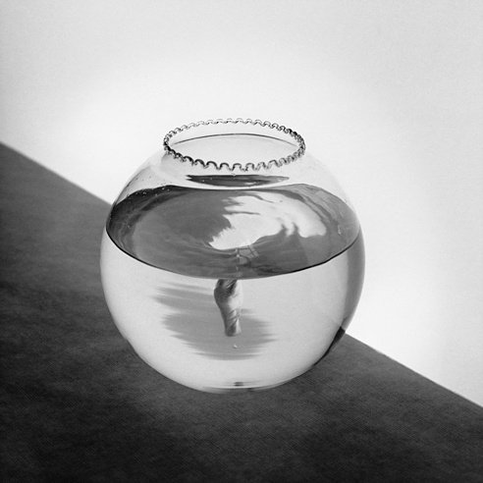

Slide 39
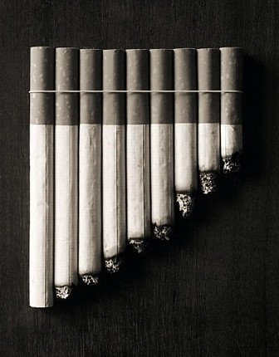

Slide 40
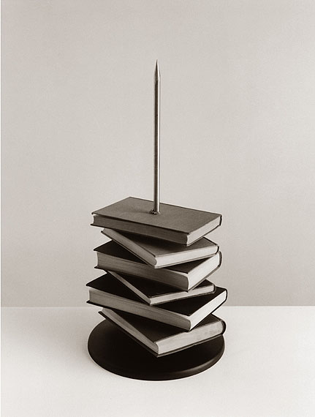

Slide 41
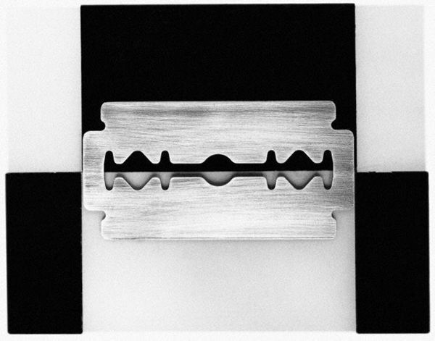

Slide 42
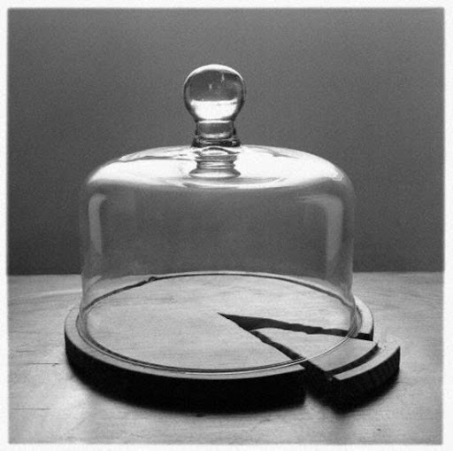

Slide 43
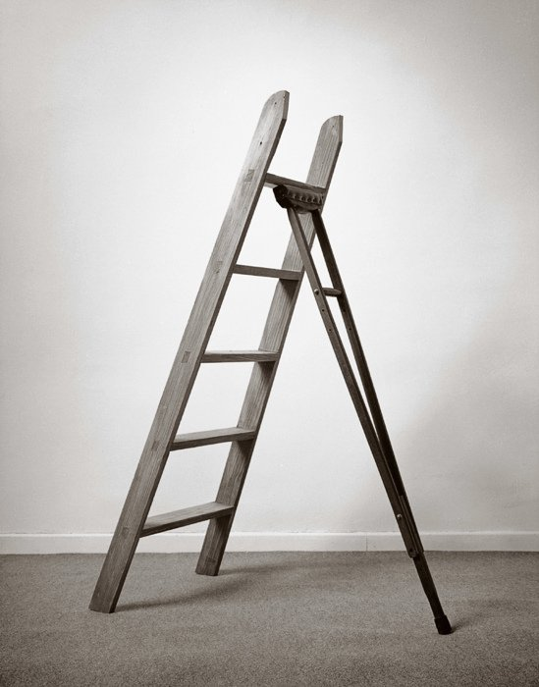

Slide 44
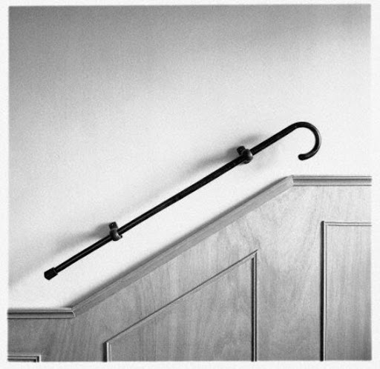

Slide 45
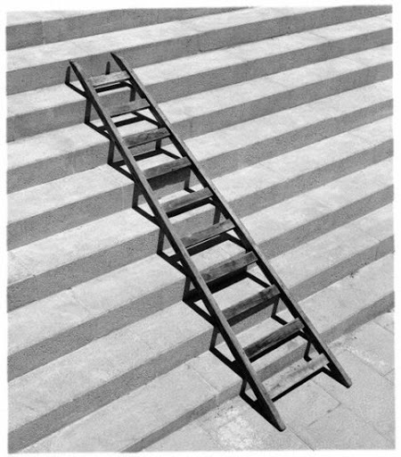

Slide 46
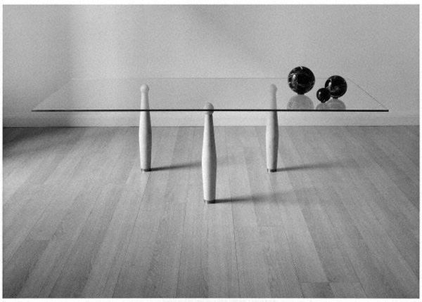

Slide 47
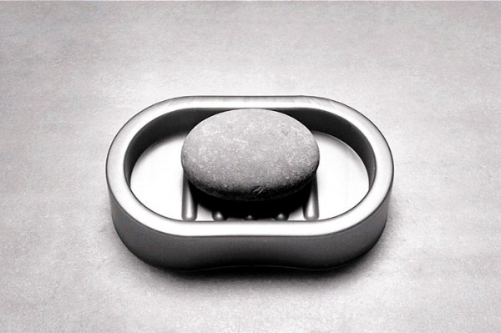

Slide 48
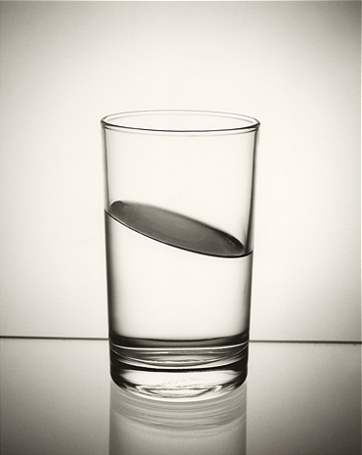

Slide 49


Slide 50
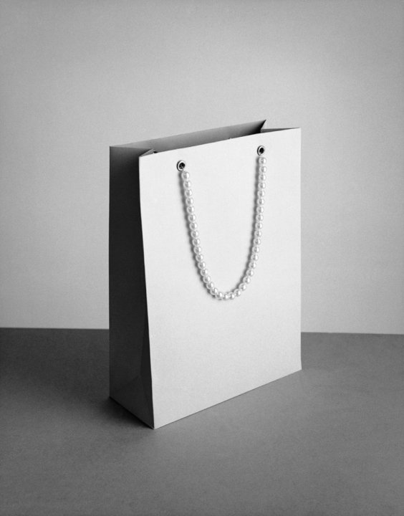

Slide 51
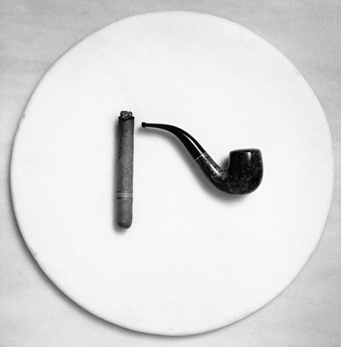

Slide 52


Slide 53
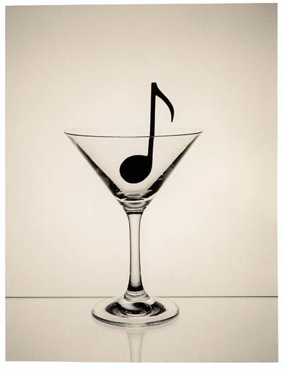

Slide 54
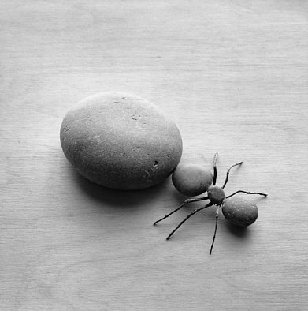

Slide 55
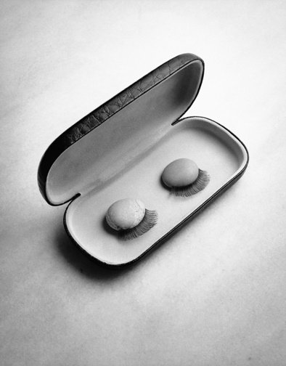

Slide 56
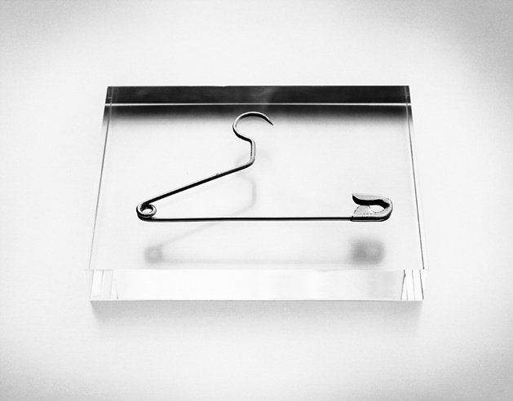

Slide 57
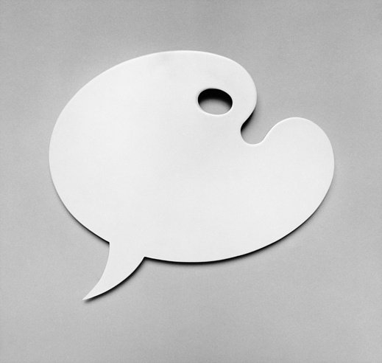

Slide 58


Slide 59


Slide 60


Slide 61


Slide 62



Slide 63


Slide 64


Slide 65


Slide 66


Slide 67


Slide 68


Slide 69


Slide 70


Slide 71


Slide 72


Slide 73


Slide 74


Slide 75


Slide 76


Slide 77


Slide 78


Slide 79


Slide 80


Slide 81


Slide 82


19.01.2014
Photos & information : Net
Created by Day

Slide 83



Accede a la sección que desees desde aquí:
Propia Creación
De la Red
Dedicatorias | Fechas Especiales | Graciosos
Historia y Arte | Lugares | Musicales
Naturaleza y Ciencias | Política | Reflexión
Religiosos | Románticos | Salud
Dedicatorias | Fechas Especiales | Graciosos
Historia y Arte | Lugares | Musicales
Naturaleza y Ciencias | Política | Reflexión
Religiosos | Románticos | Salud
Si deseas recibir pps periódicamente en tu correo electrónico subscríbete aquí:

