Slide 1
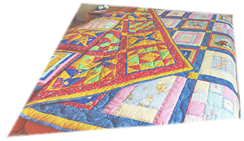
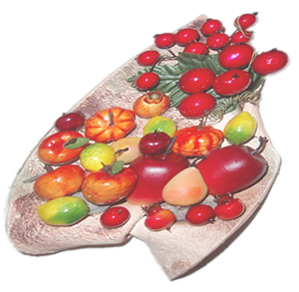
Patchwork
YVETA

Slide 2

Patchwork or "pieced work" is a form of needlework that involves sewing together pieces of fabric into a larger design. The larger design is usually based on repeat patterns built up with different fabric shapes (which can be different colors). These shapes are carefully measured and cut, basic geometric shapes making them easy to piece together.
Jitka

Slide 3
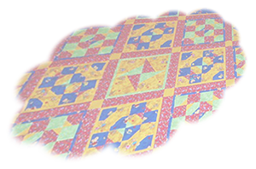
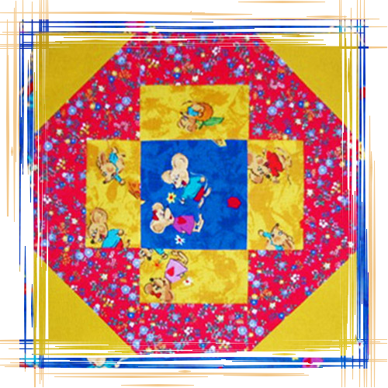
Jitka

Slide 4
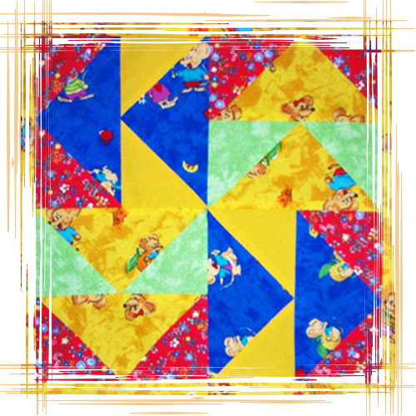
Jitka

Slide 5
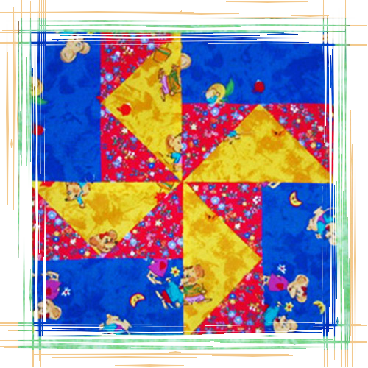
Jitka

Slide 6
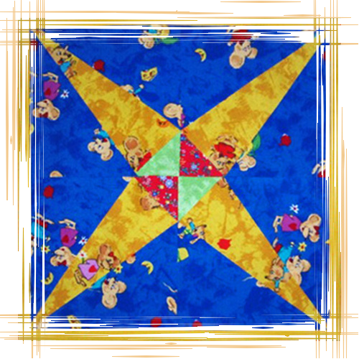
Jitka

Slide 7
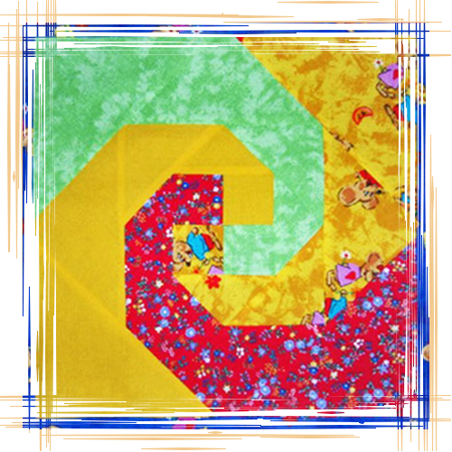
Jitka

Slide 8
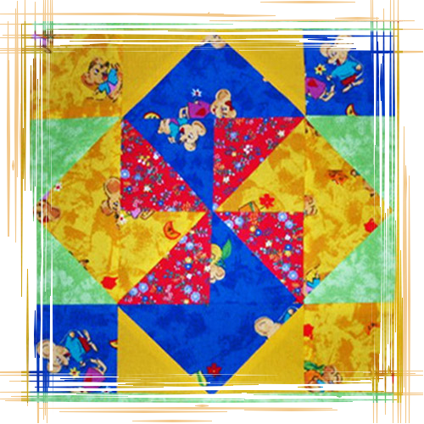
Jitka

Slide 9
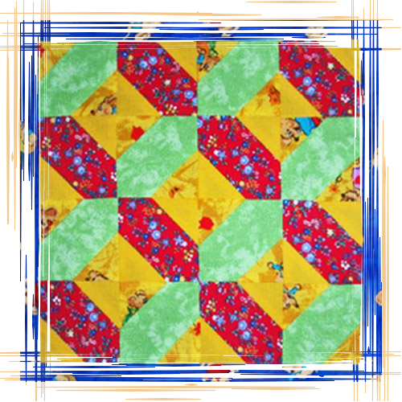
Jitka

Slide 10
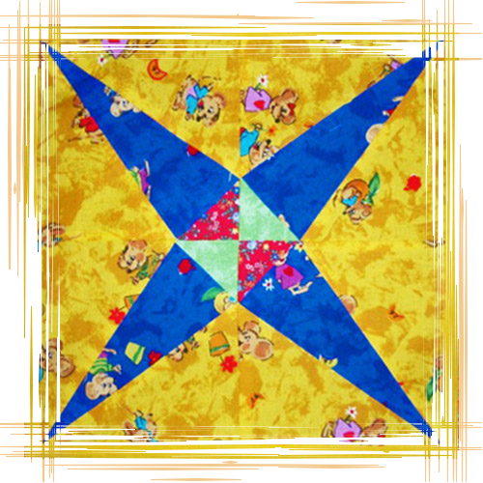
Jitka

Slide 11
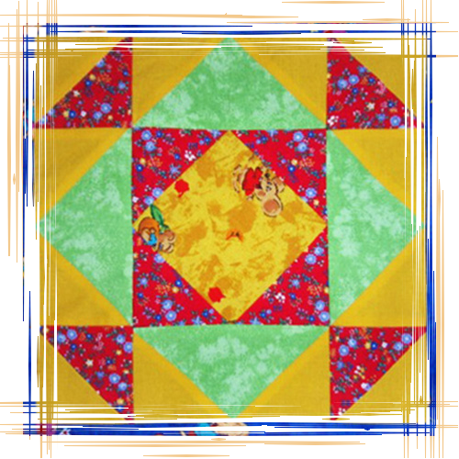
Jitka

Slide 12
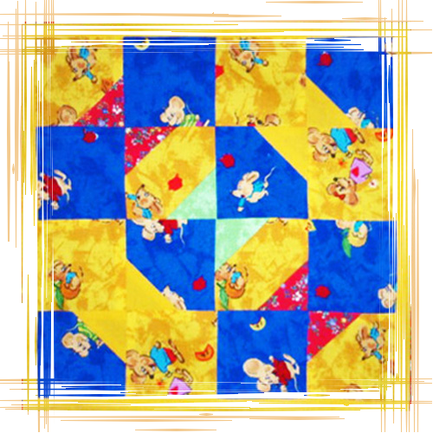
Jitka

Slide 13
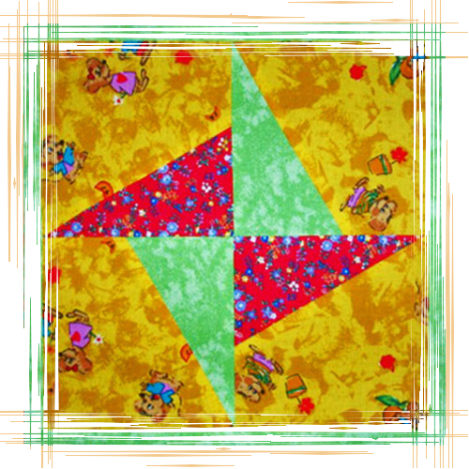
Jitka

Slide 14
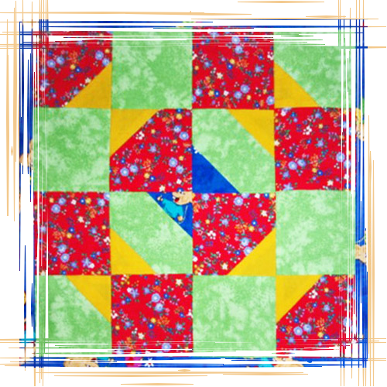
Jitka

Slide 15
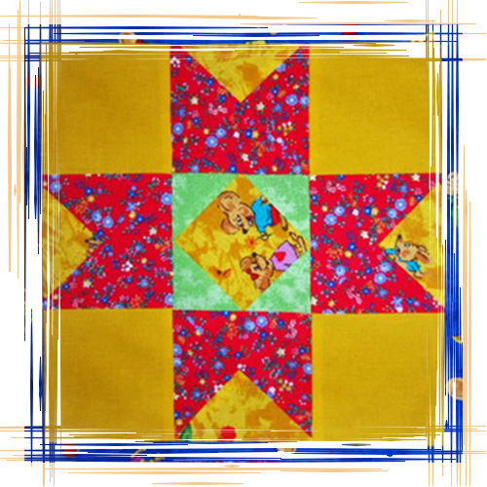
Jitka

Slide 16
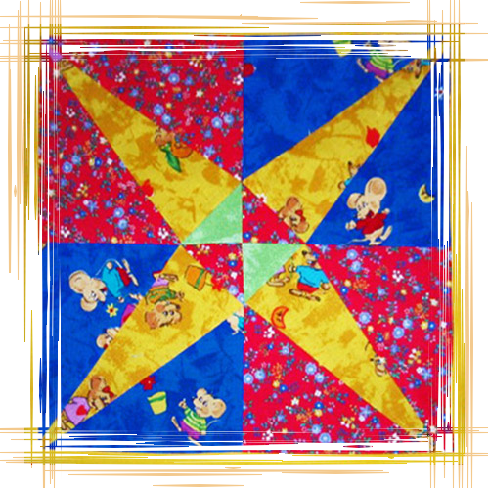
Jitka

Slide 17
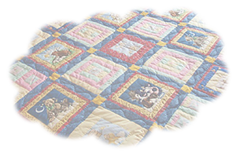
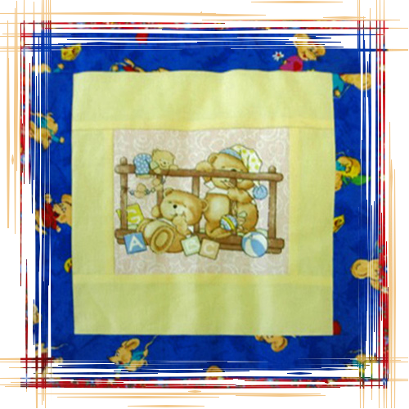
Jitka

Slide 18
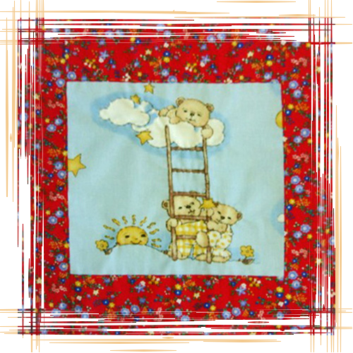
Jitka

Slide 19
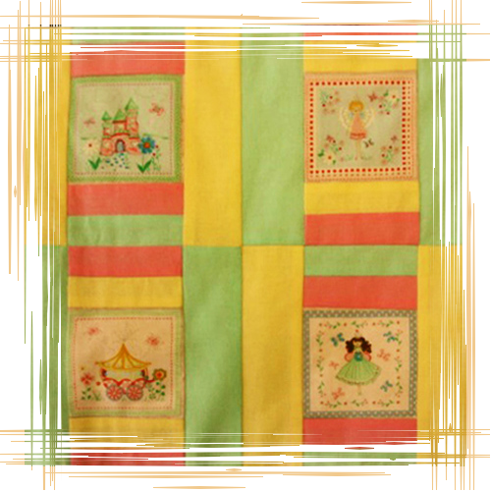
Jitka

Slide 20
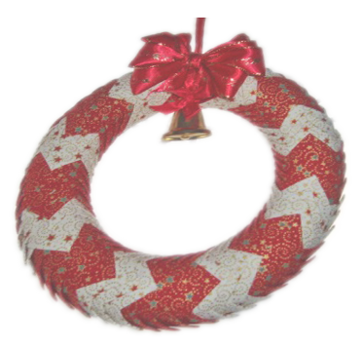
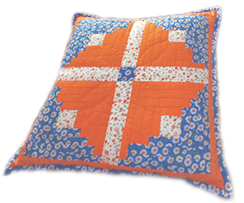
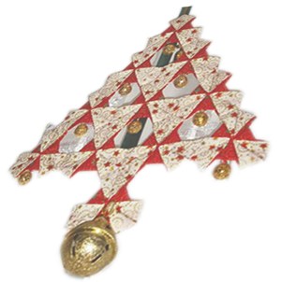
Jitka
THE END

Slide 21








¿Te ha gustado?
Puedes ver más entrando
Aquí
Además puedes recibir powerpoints en tu correo electrónico suscribiéndote aquí:

