Slide 1

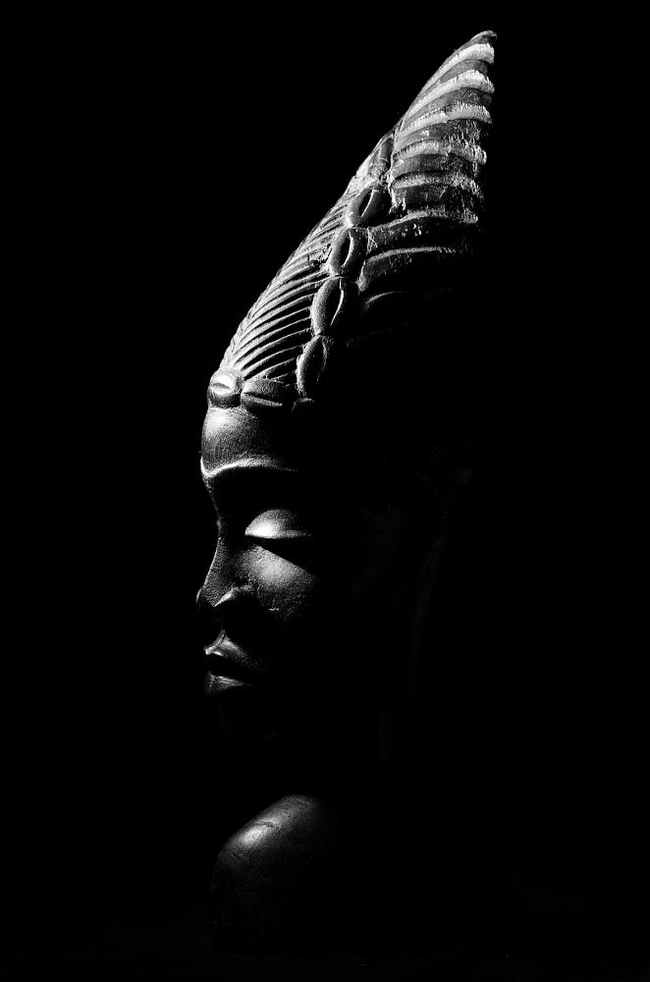
Damas
de Africa
Producción : Lalo y Steve
2018

Slide 2
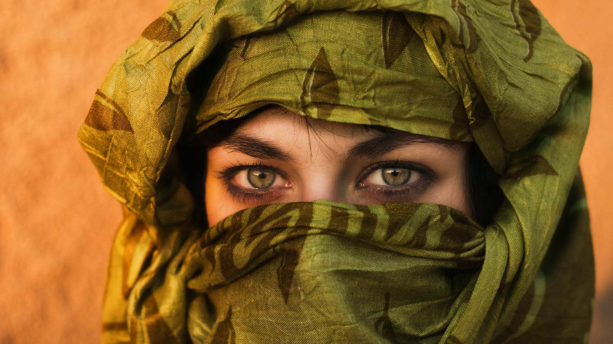
Algeria
Photography © by Pep Perez on 500px

Slide 3
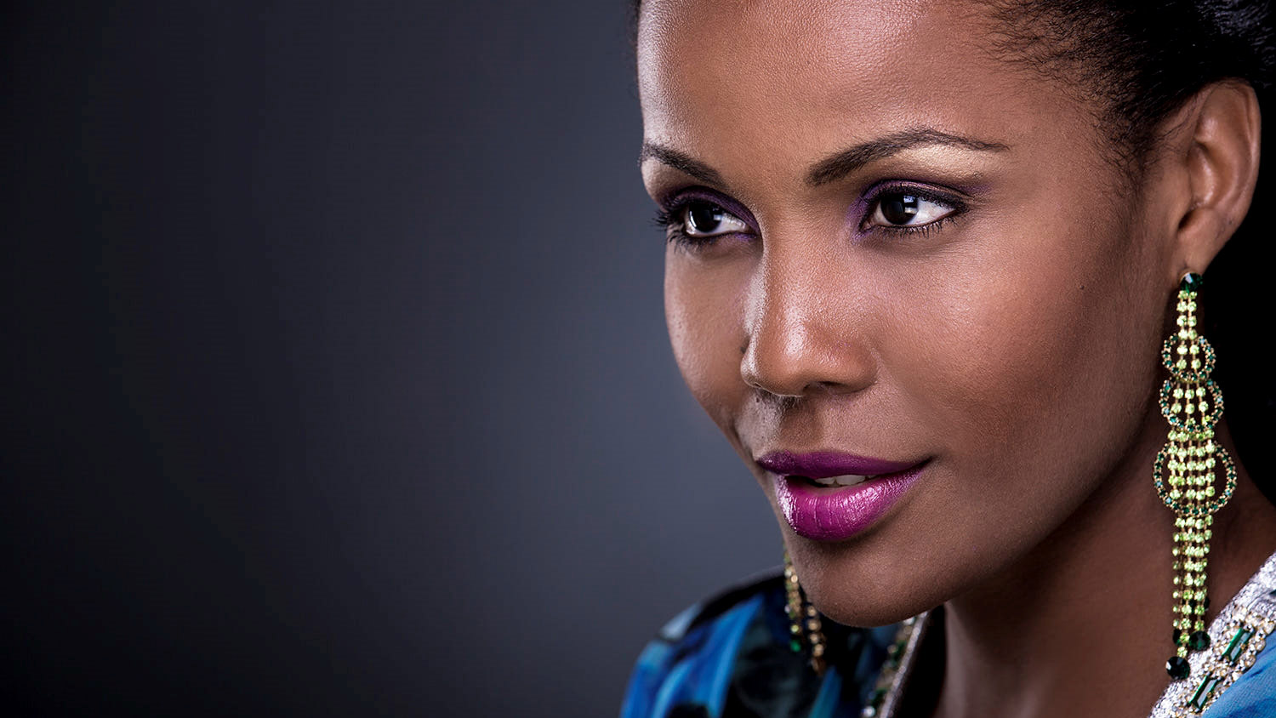
Angola
Photography © by Pedro Soares on 500px

Slide 4
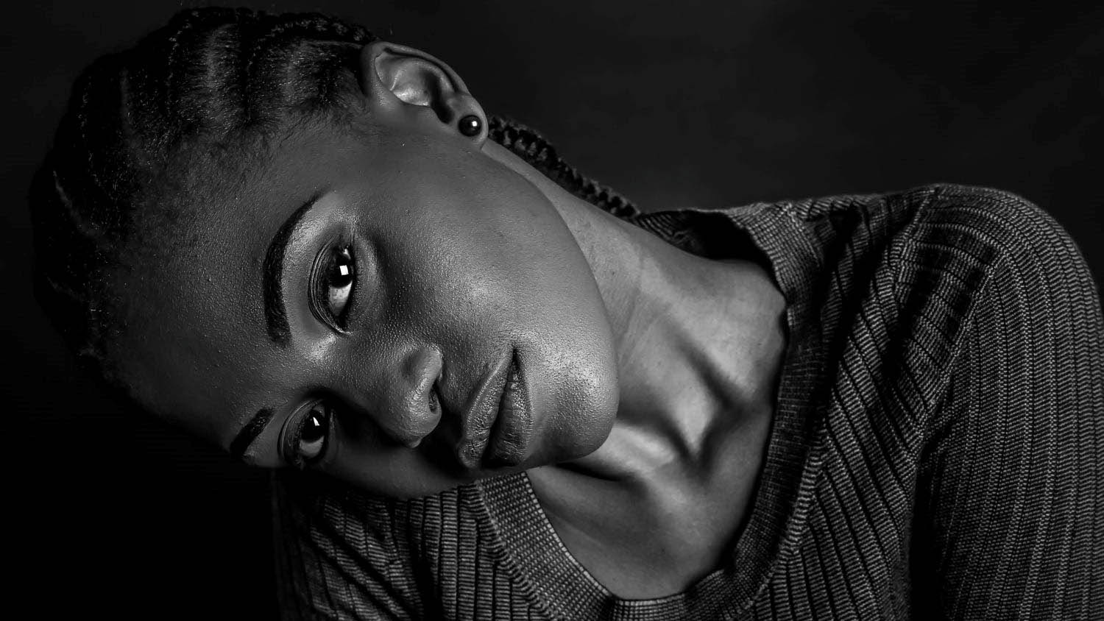
Botswana
Edit
Photography © by Thekiso Ramonaka on 500px

Slide 5
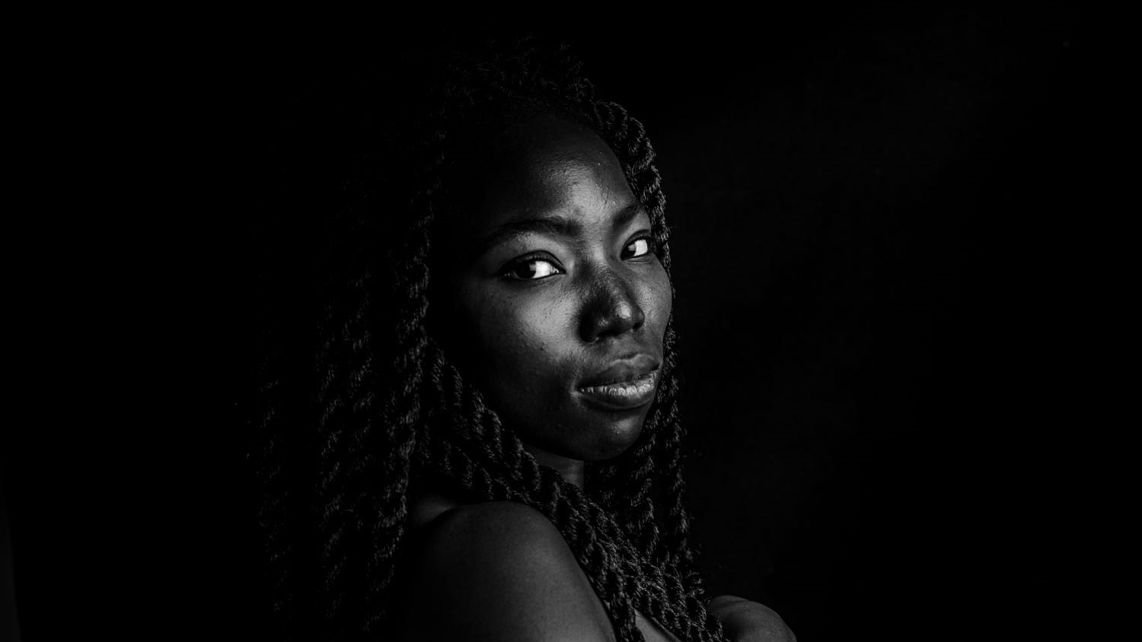
Burkina Faso
Nadia
Photography © by Germain Constantin on 500px

Slide 6

Cape Verde
Suwa
Photography © by Andrei Mihalache on 500px

Slide 7
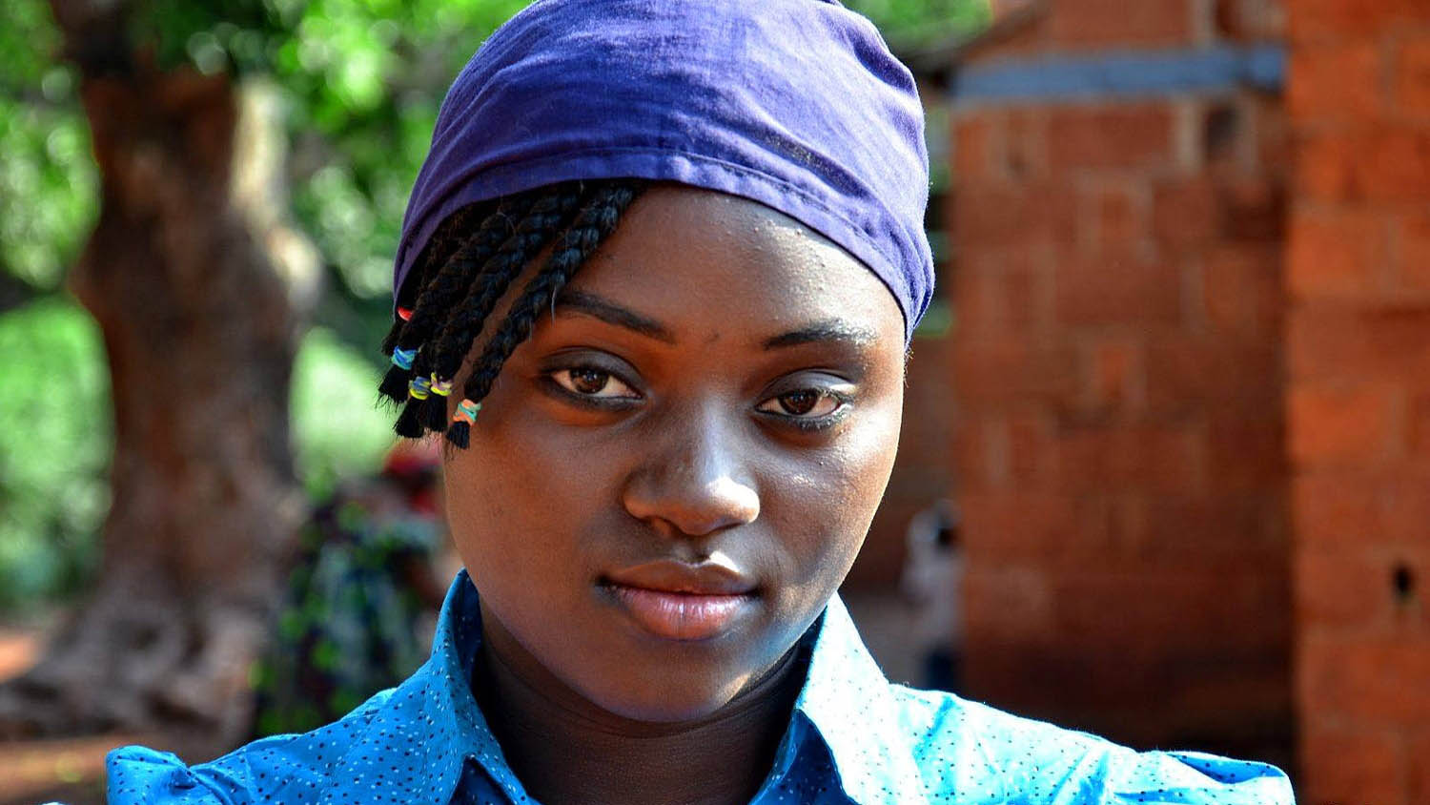
Central Áfrican Republic
Photography © by Shay Vaz Dias Hadas on 500px

Slide 8

Congo
Alexia
Photography © by Weiron Photo on 500px

Slide 9
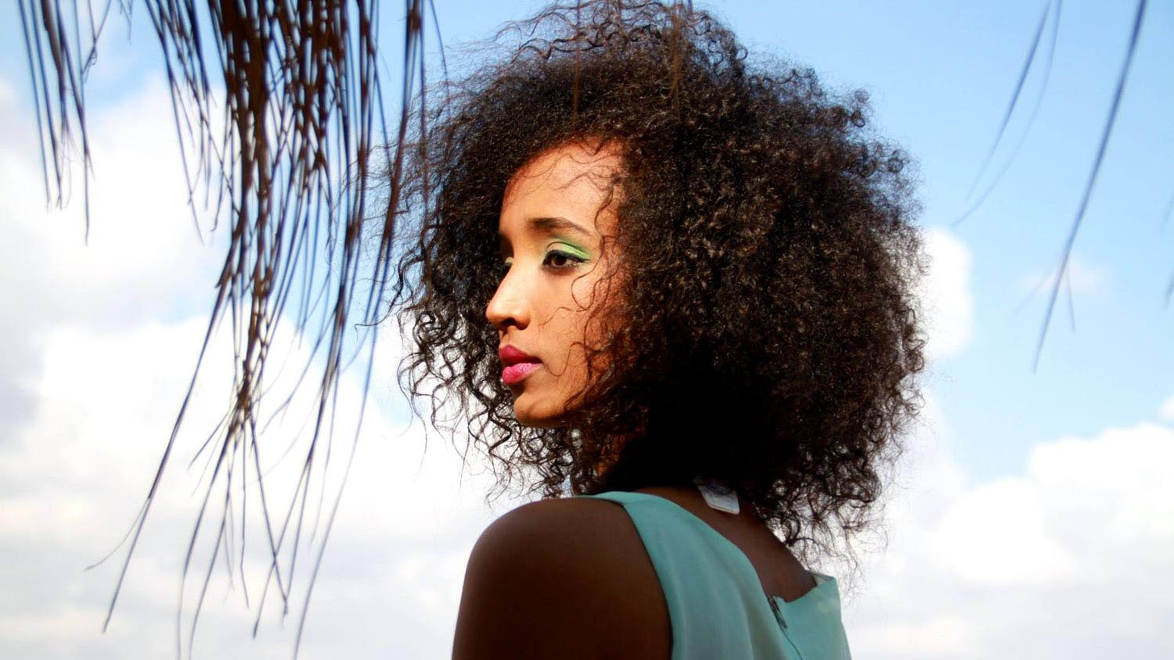
Djibouti
Photography © by Eric Escudier on 500px

Slide 10

Egypt
Synthia
Photography © by Gudaev Egor on 500px

Slide 11
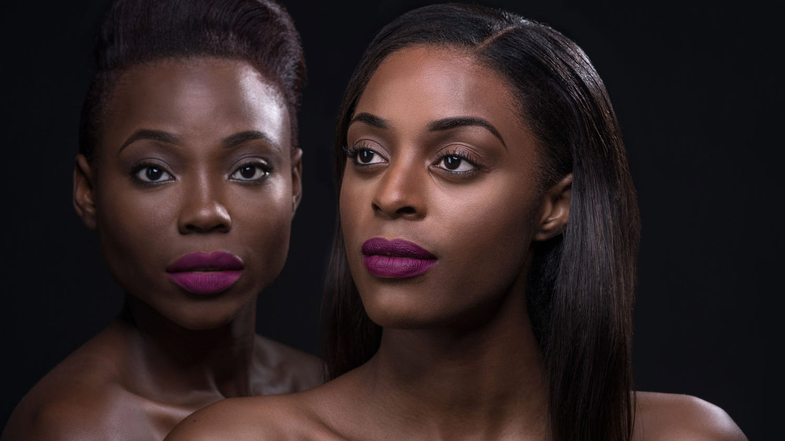
Equatorial Guinea
Photography © by Jan Ziegler Photography on 500px

Slide 12
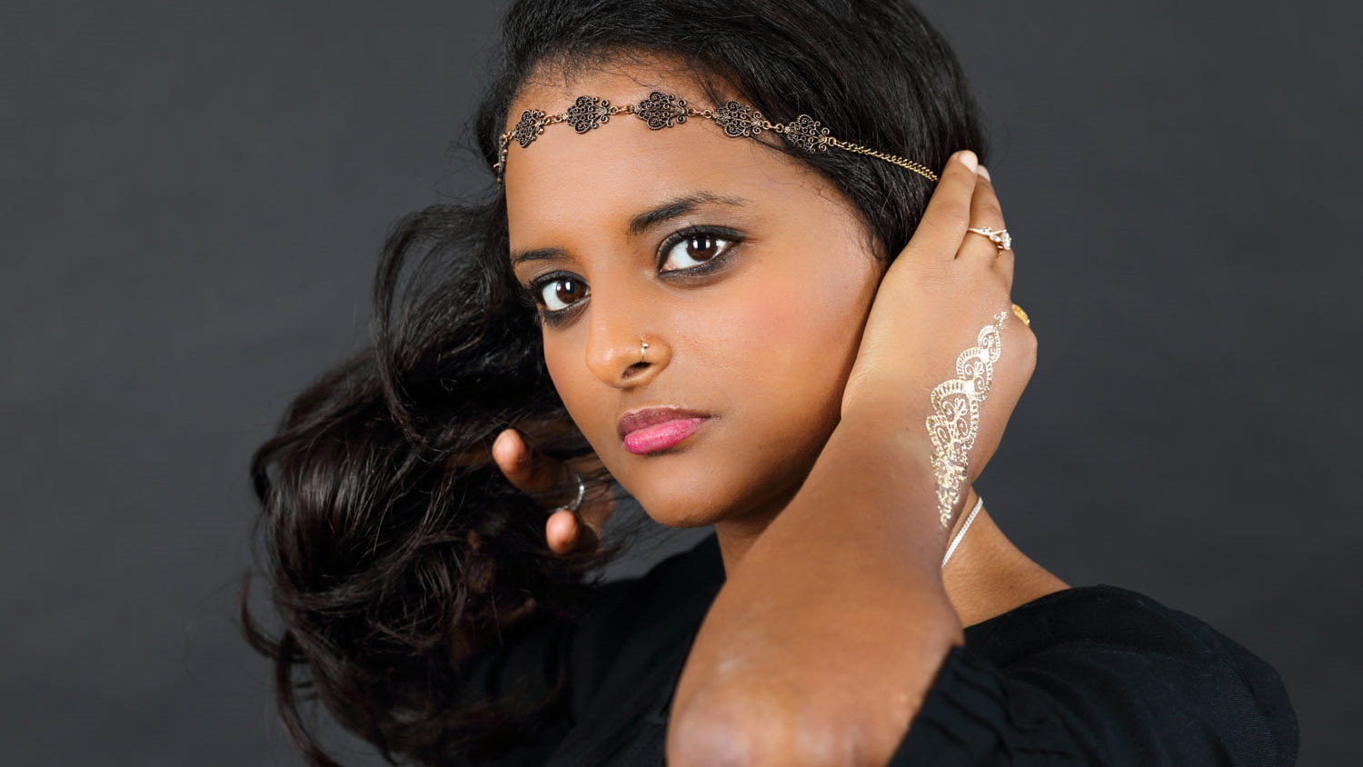
Eritrea
Yodite
Photography © by Maÿ Leyvraz on 500px

Slide 13
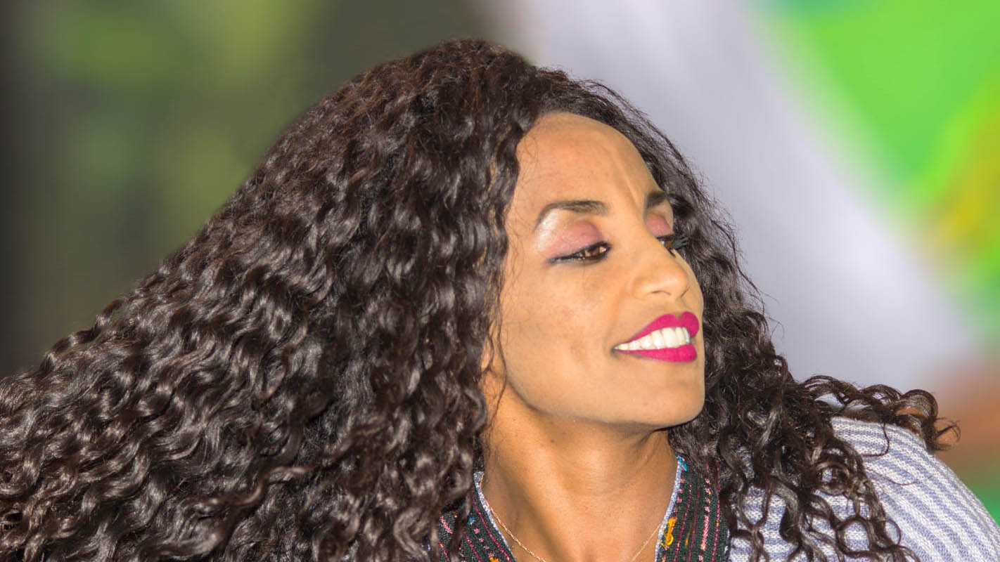
Ethiopia
Photography © by Sushant Kaul on 500px

Slide 14
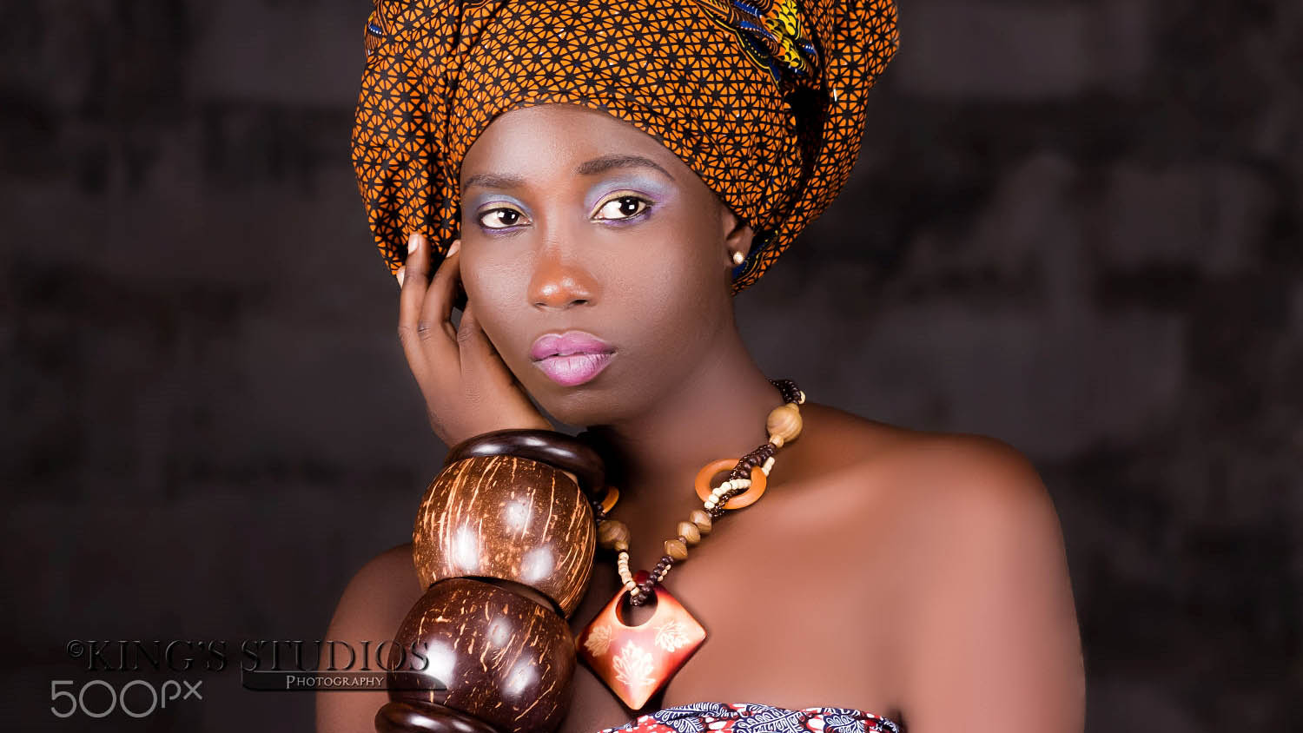
Gabon
Sheila
Photography © by King Cyril Mgbachi on 500px

Slide 15
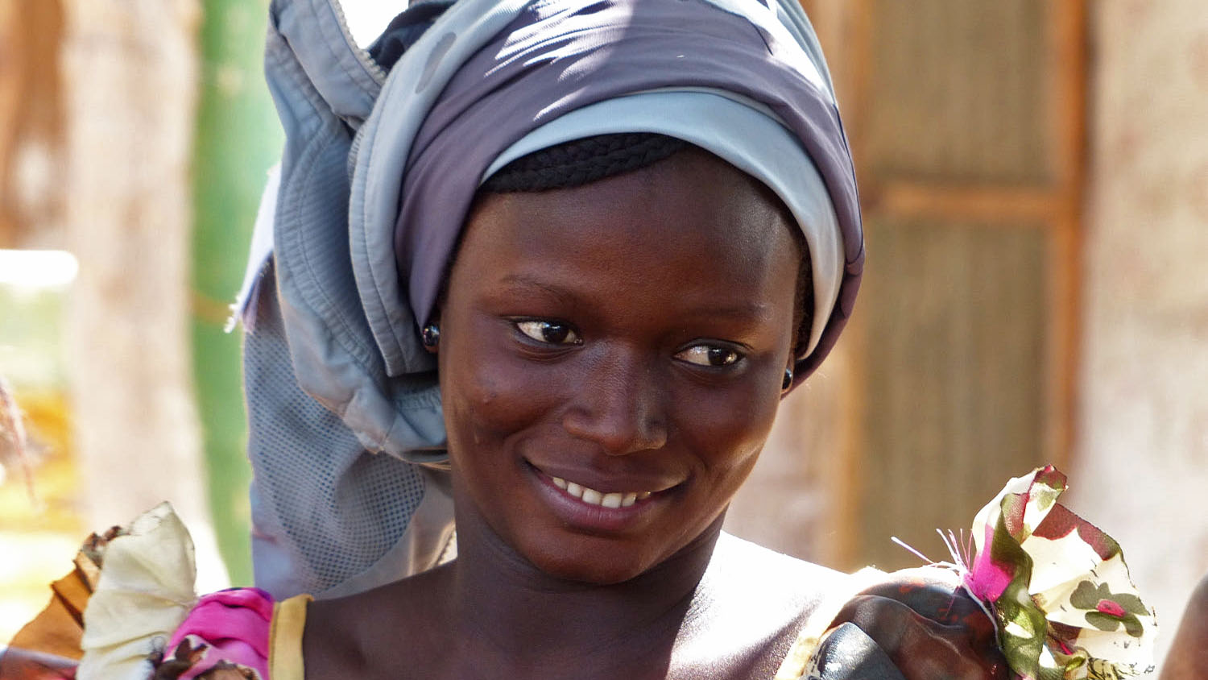
Gambia
Photography © by saleemceepee on 500px

Slide 16
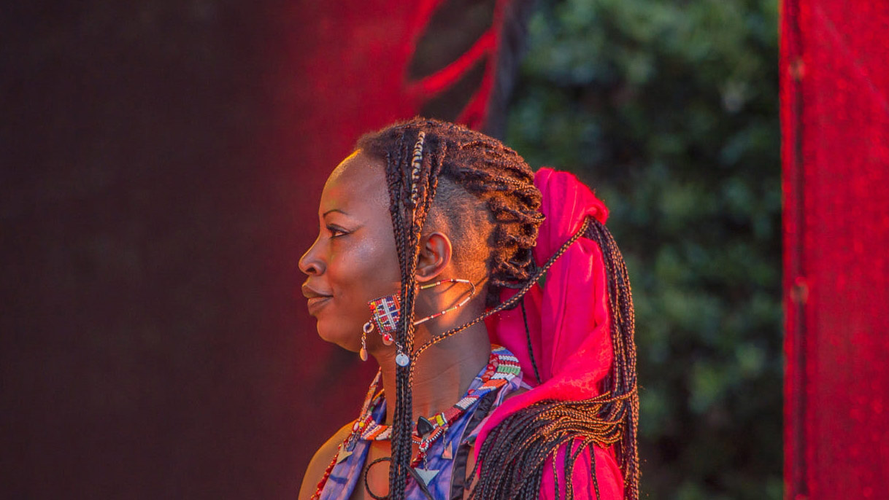
Ivory Coast
Dobet
Photography © by Barry Mills on 500px

Slide 17
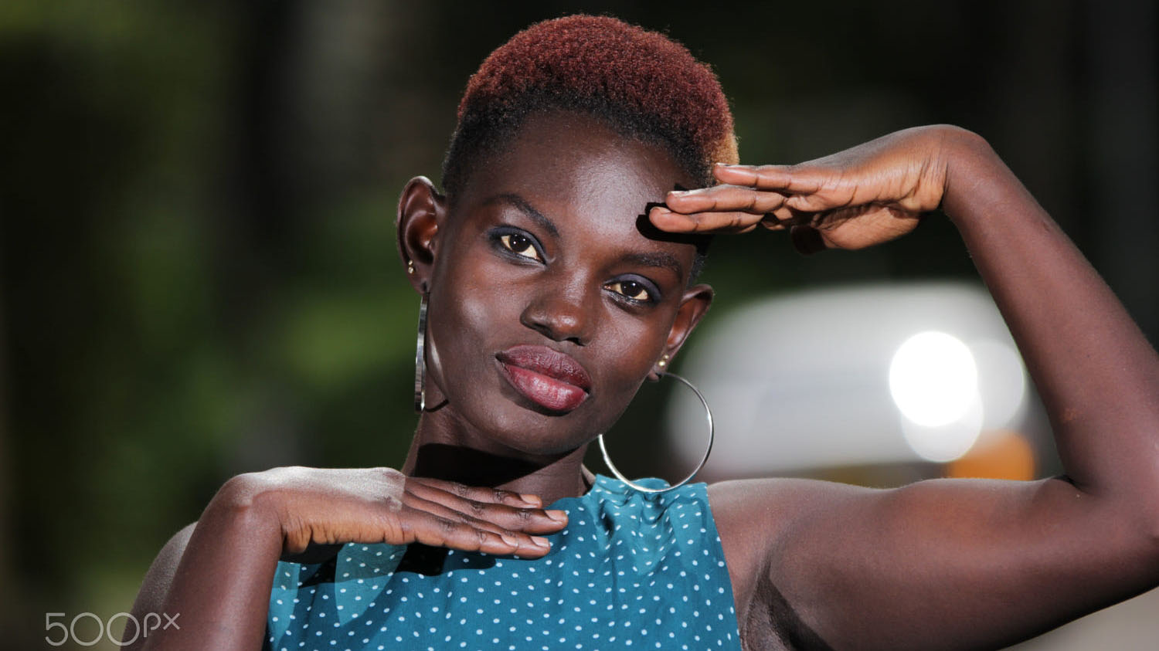
Kenya
Adoyo
Photography © by William Bolton on 500px

Slide 18
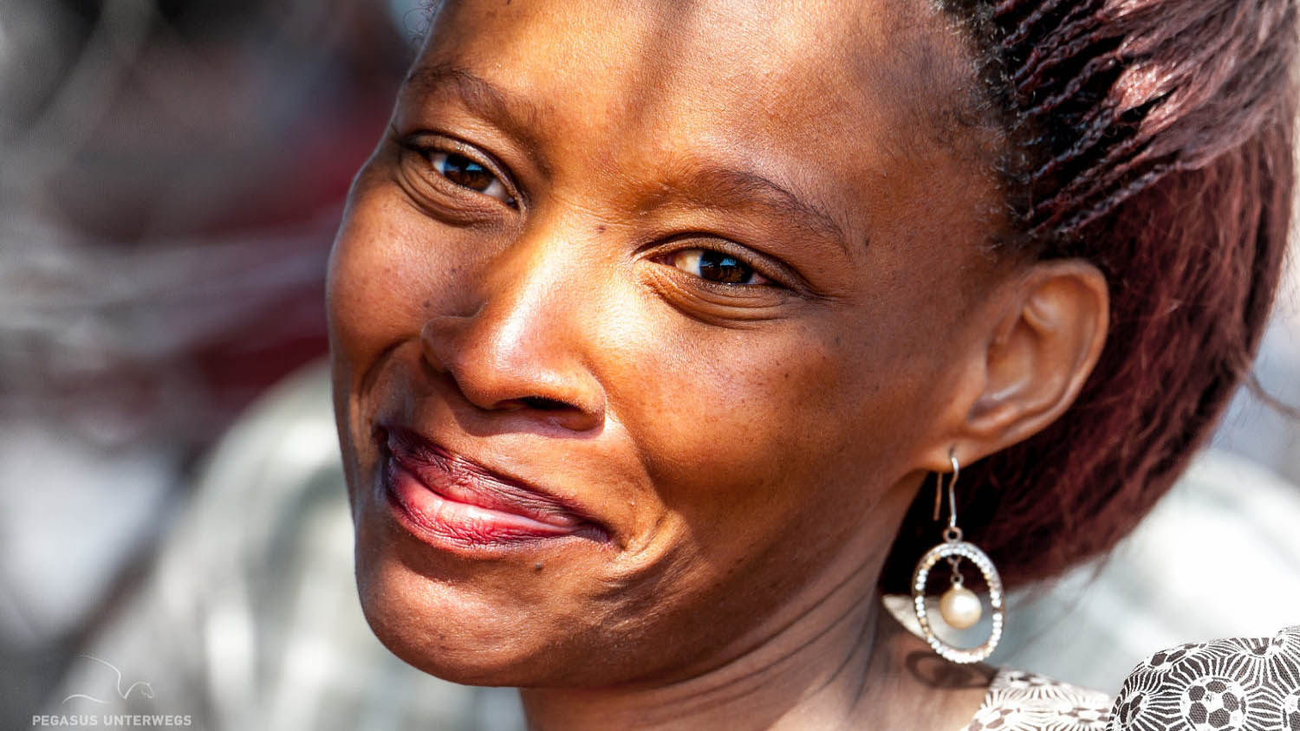
Lesotho
Photography © by Peter Strub on 500px

Slide 19
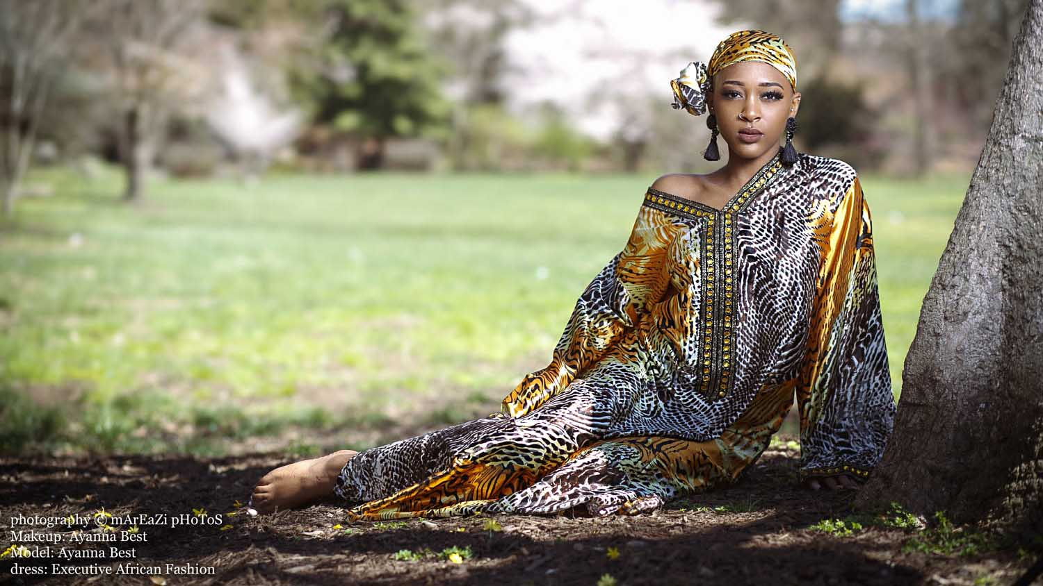
Liberia
Ayanna
Photography © mArEaZi pHoToS

Slide 20
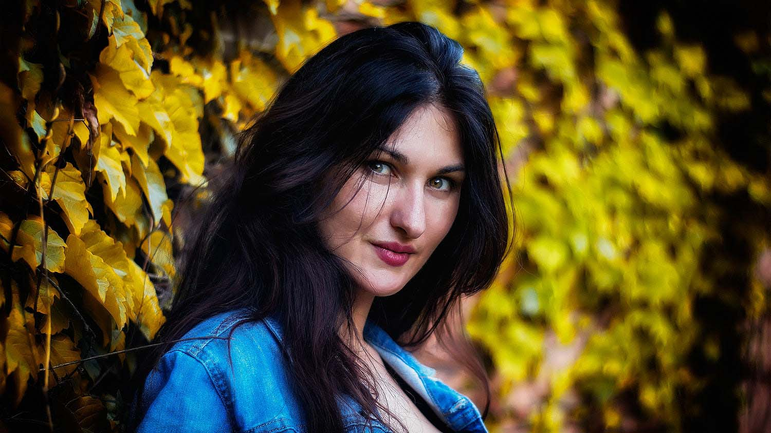
Madagascar
Egana
Photography © by Andrew Lucien A. on 500px

Slide 21
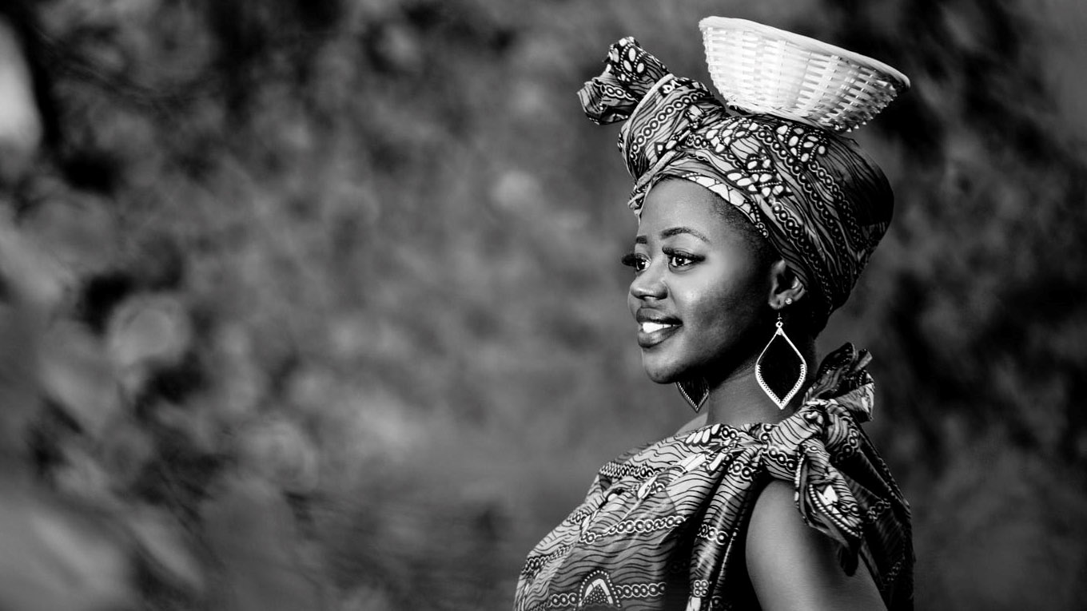
Malawi
Photography © e by Aubrey Alphapaul

Slide 22
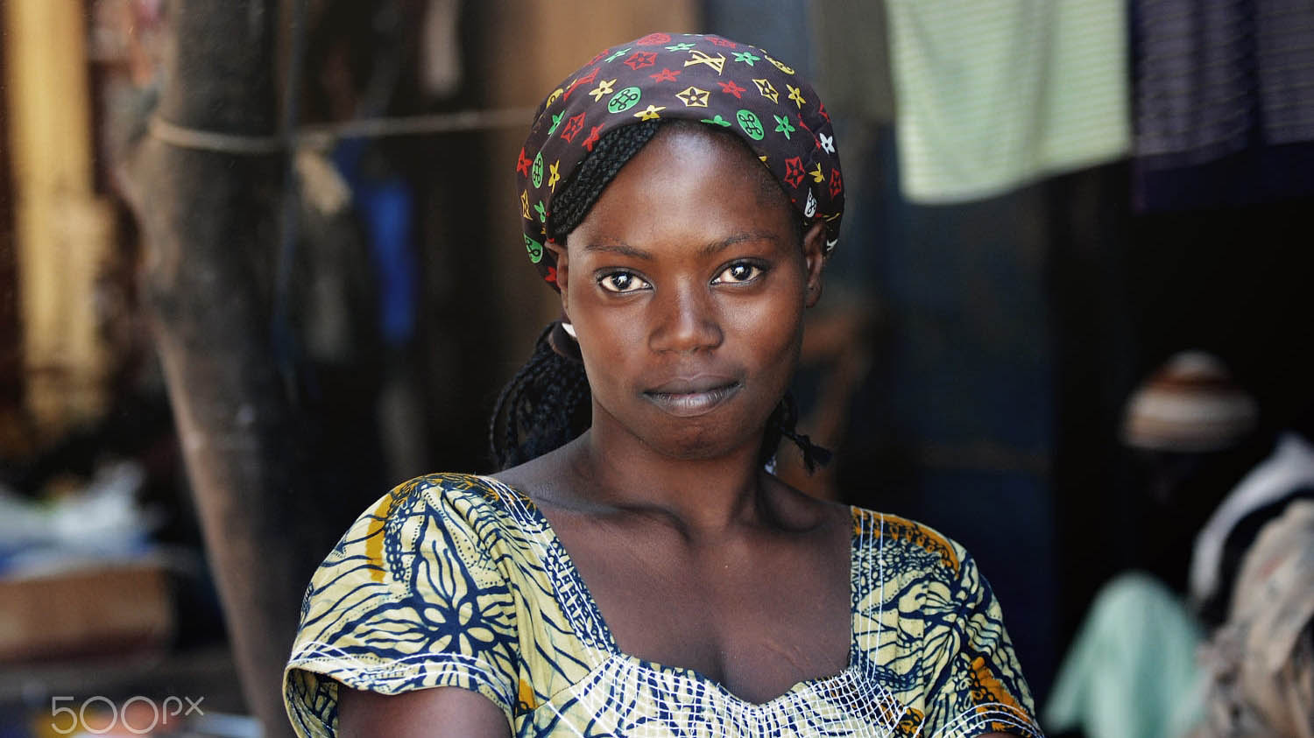
Mali
Photography © by ha ku on 500px

Slide 23
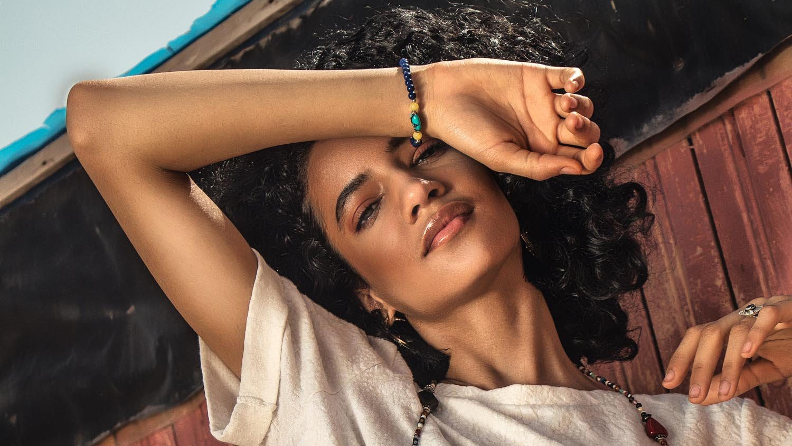
Mauritania
Photography © by Loue Armel thibaut on 500px

Slide 24
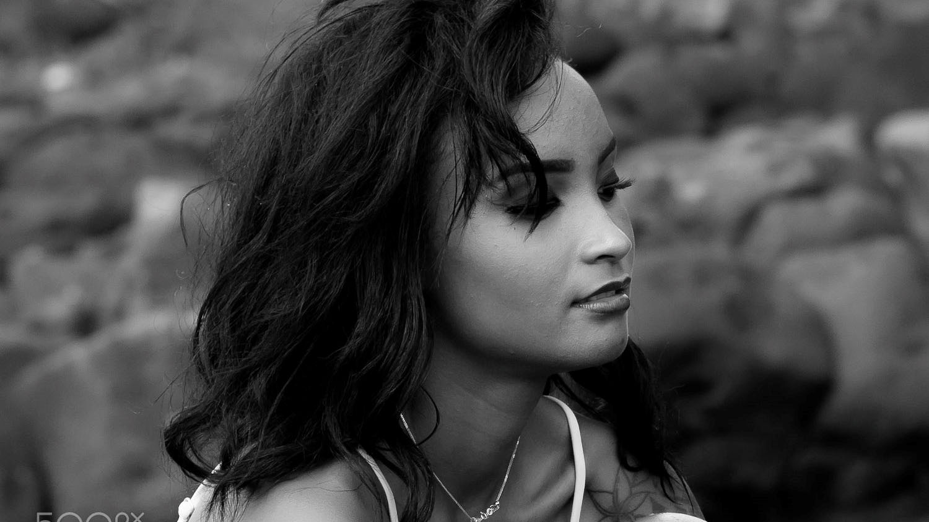
Mauritius
Photography © by Jerome Clarisse on 500px

Slide 25
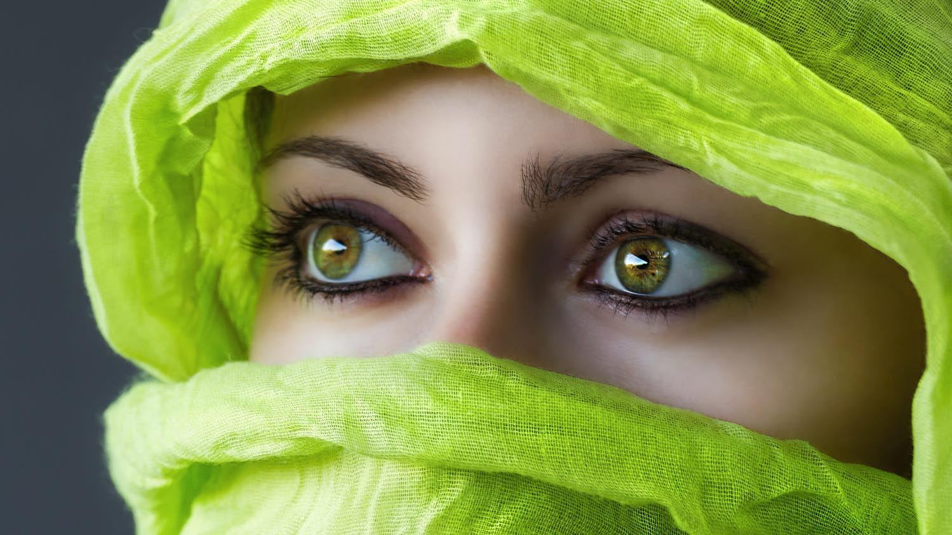
Morocco
Stephanie
Photography © by MS MatteoSala on 500px

Slide 26

Mozambique
Photography © by Jorgge Bee on 500px

Slide 27
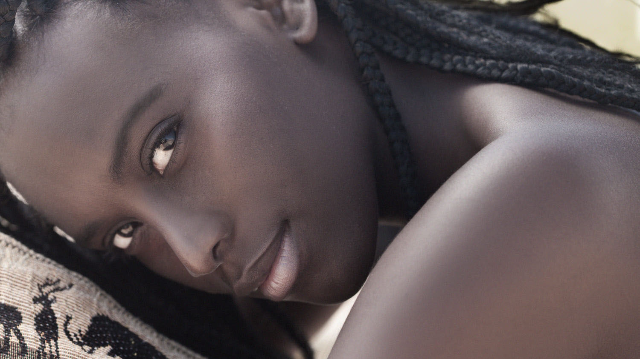
Namibia
Photography © by Joachim Bergauer on 500px

Slide 28
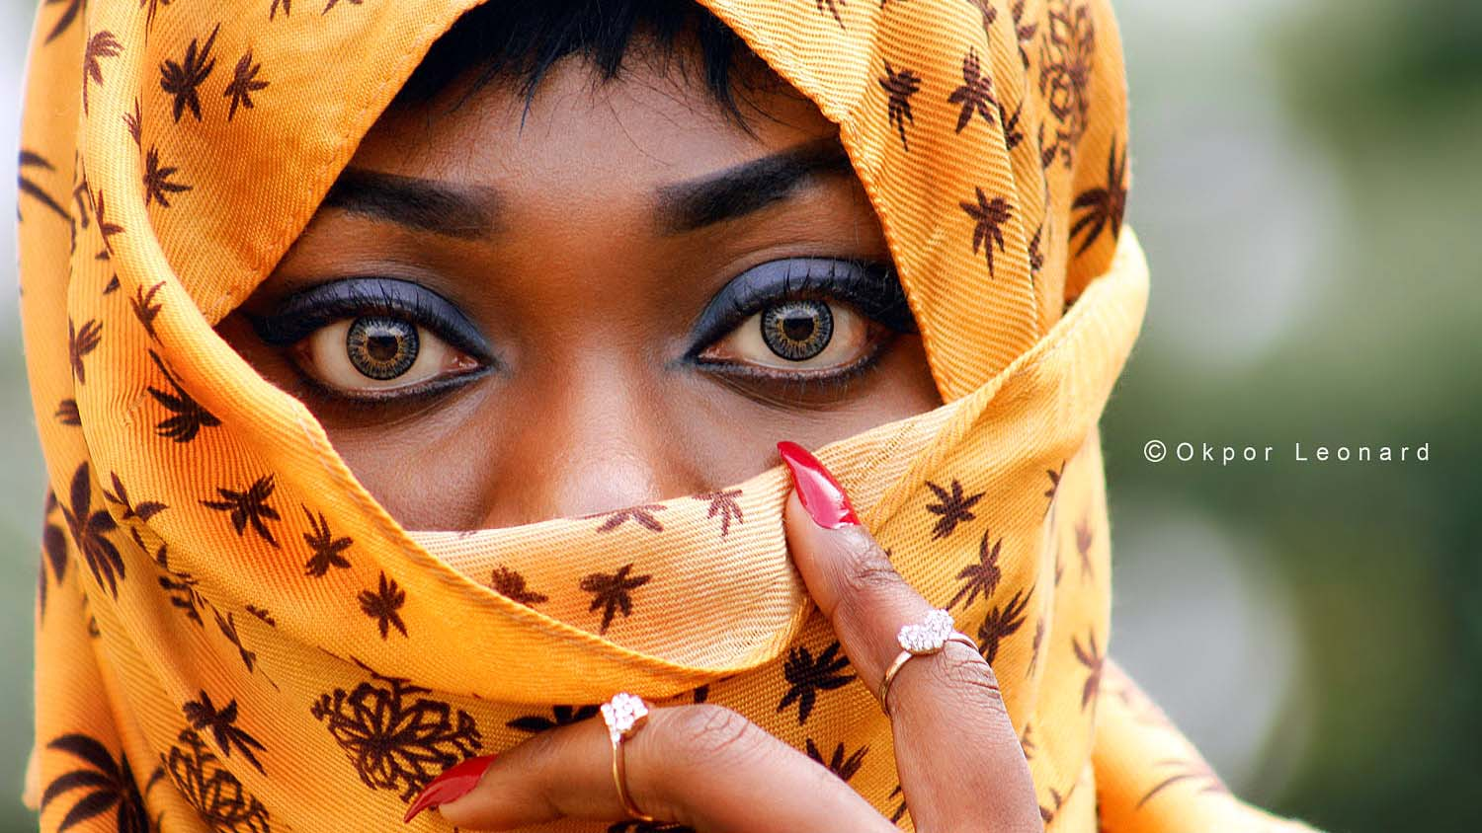
Nigeria
Ogechi
Photography © Okpor Leonard

Slide 29
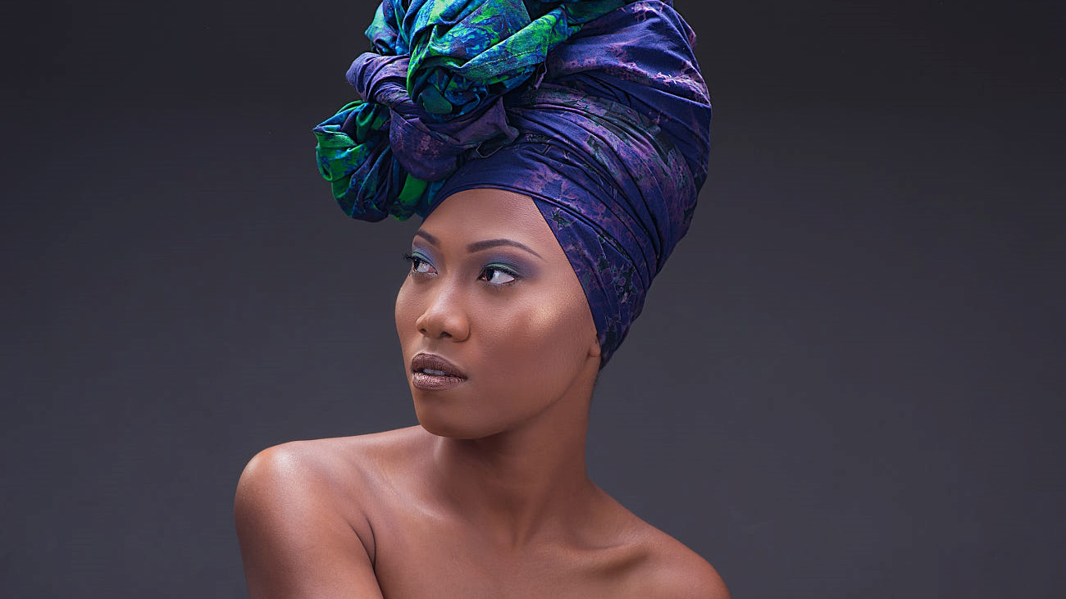
Republica del Congo
Photography @ Fuji Congo by Scott Kabongo on 500px

Slide 30
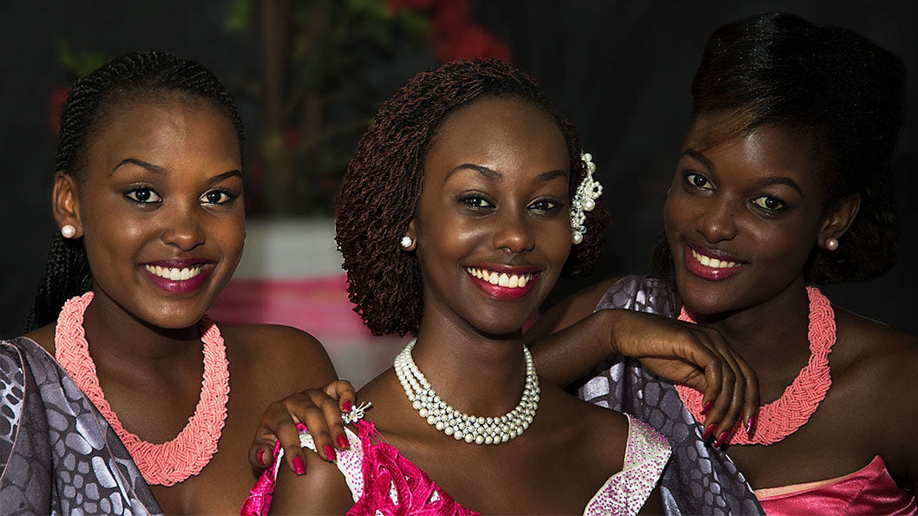
Rwanda
Photography © by Arnaud Florent Muhizi on 500px

Slide 31
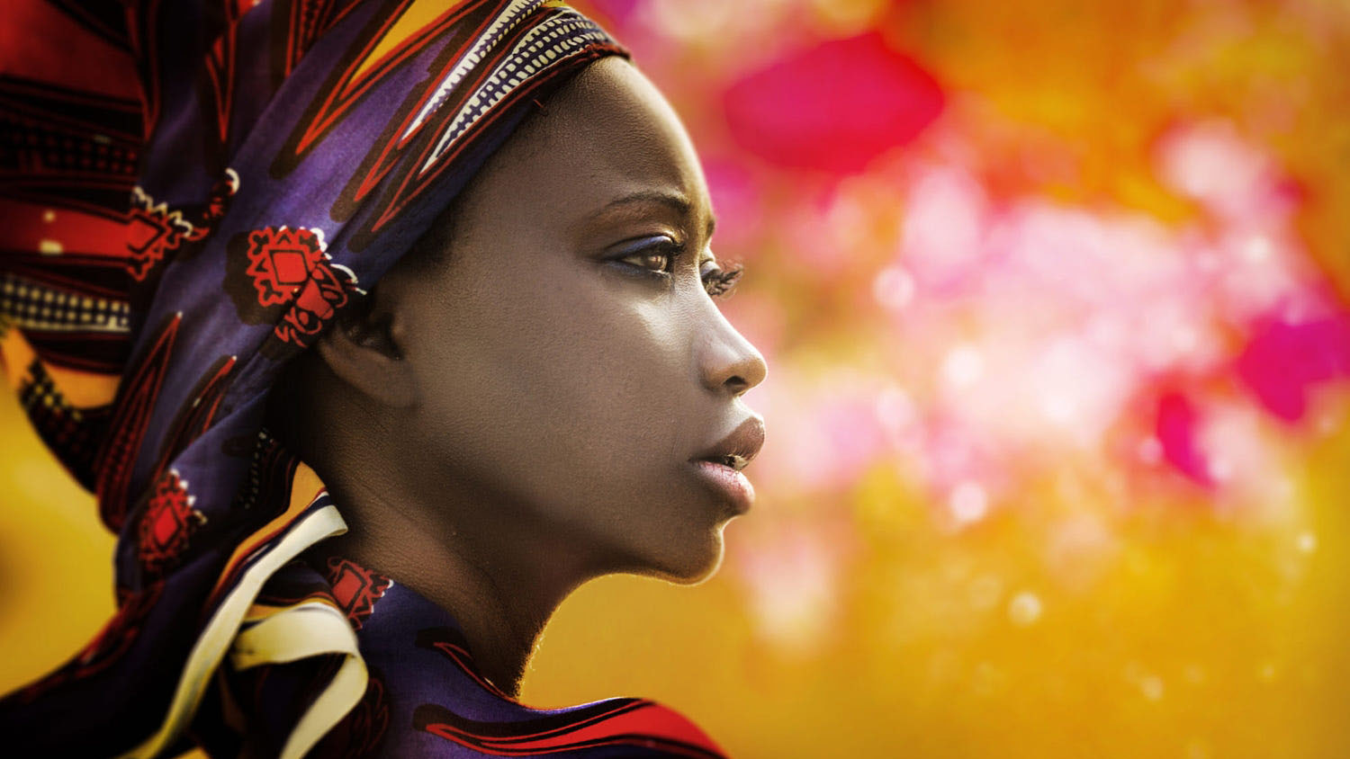
Senegal
Astou
Photography © by Joachim Bergauer on 500px

Slide 32
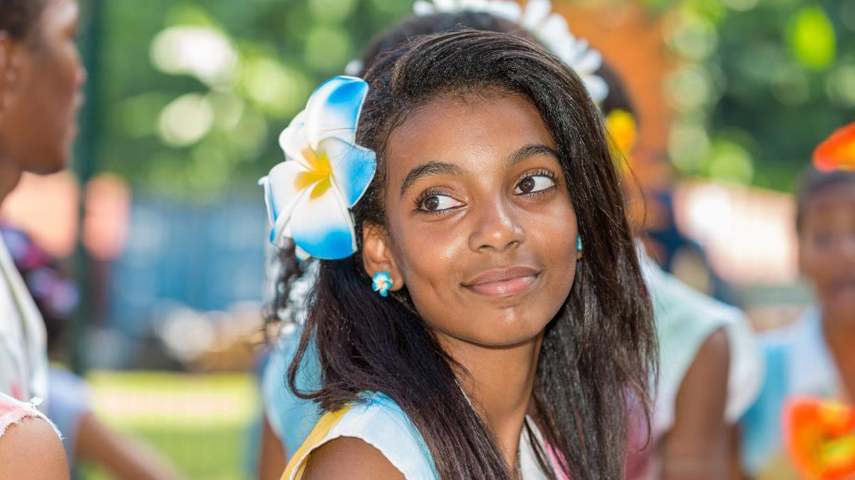
Seychelles
Victoria

Slide 33
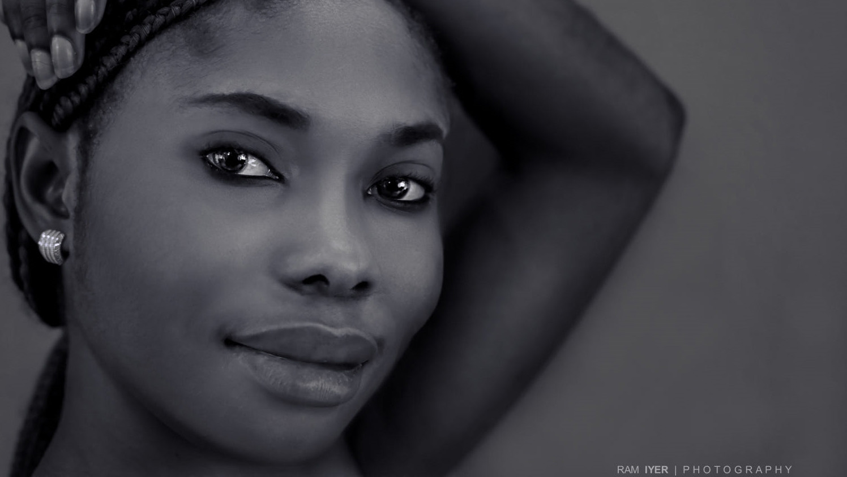
Sierra Leone
Photography © by Ram Iyer on 500px

Slide 34

Somalia
Nadri
Photography © by Heine Mann on 500px

Slide 35
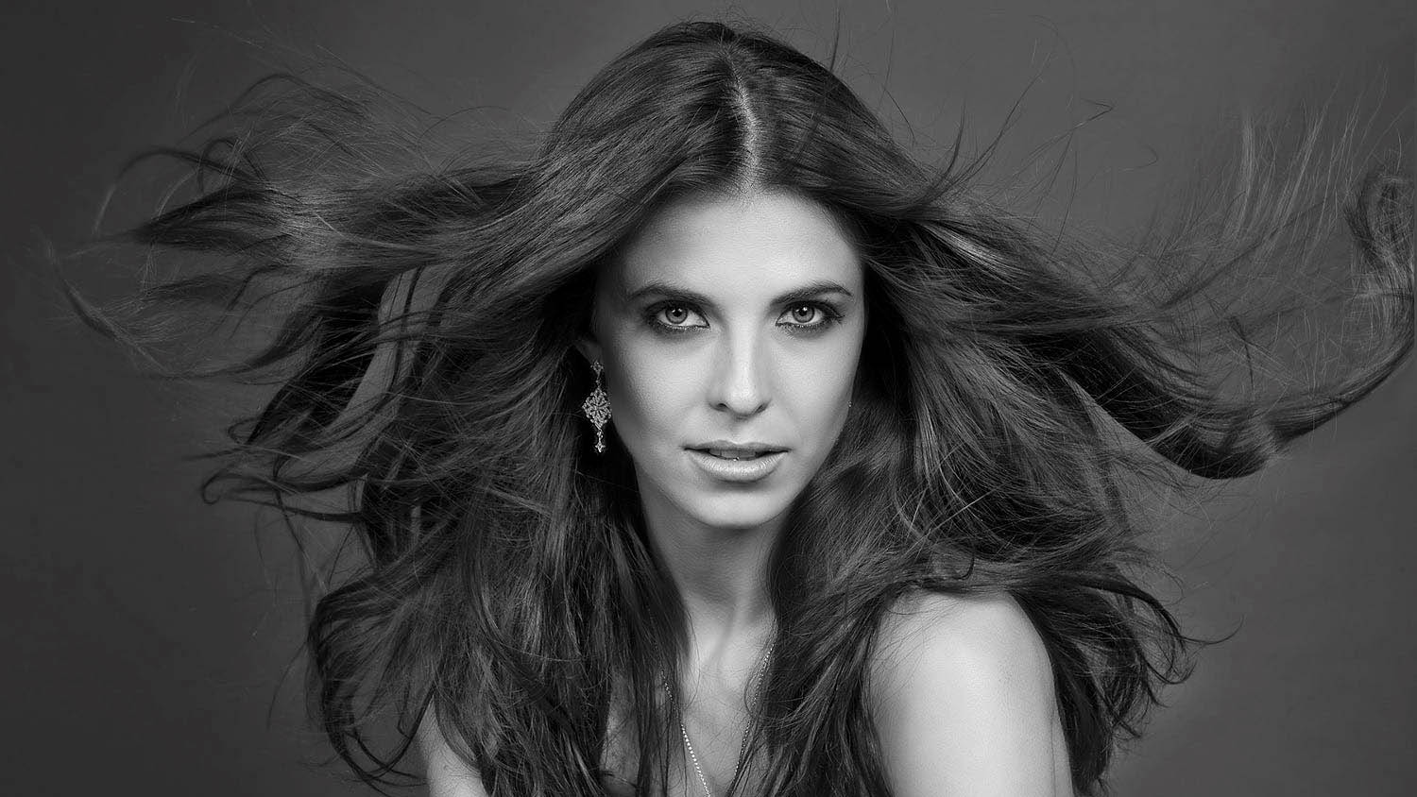
South Africa
Hanri
Photography © by Ralf Eyertt on 500px

Slide 36

South Sudan
Photography © by Eskandanow Karama on 500px

Slide 37

Sudan
Ray
Photography © by Ramah I. Adawi on 500px

Slide 38

Swaziland
Sasha
Photography © by Danielle Davenport on 500px

Slide 39
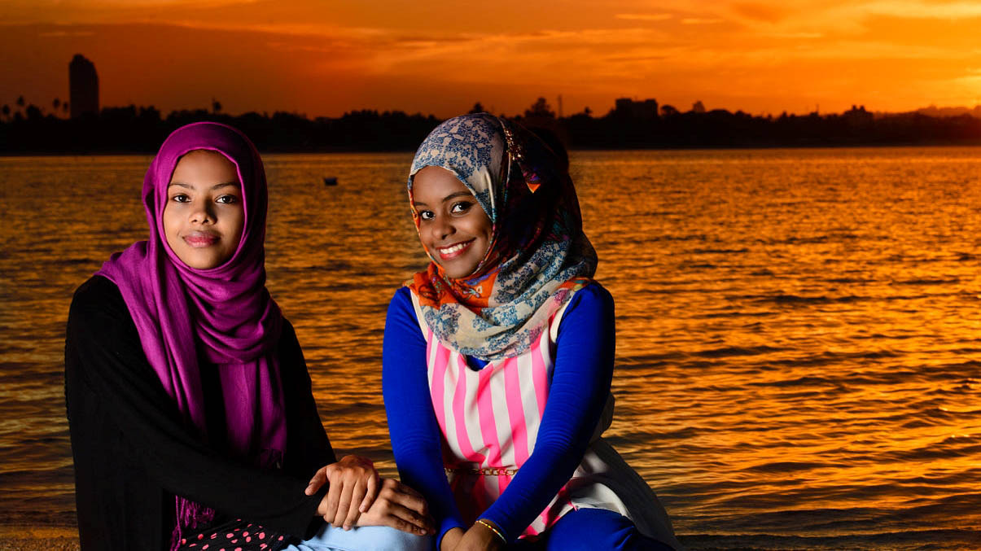
Tanzania
Photography © by Moiz Adamji on 500px

Slide 40
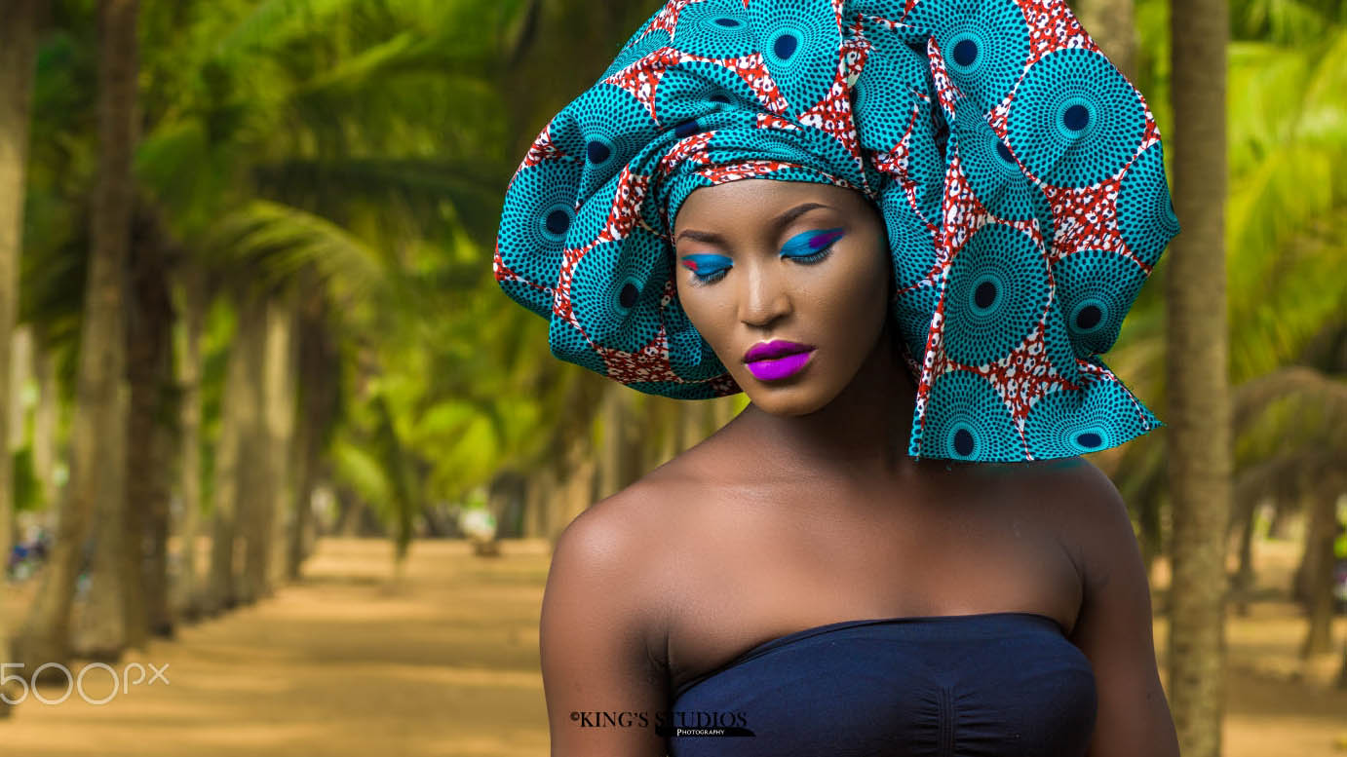
Togo
Photography © King‘s Studios on 500px

Slide 41

Tunisia
Photography © by Bilel Briki on 500px

Slide 42
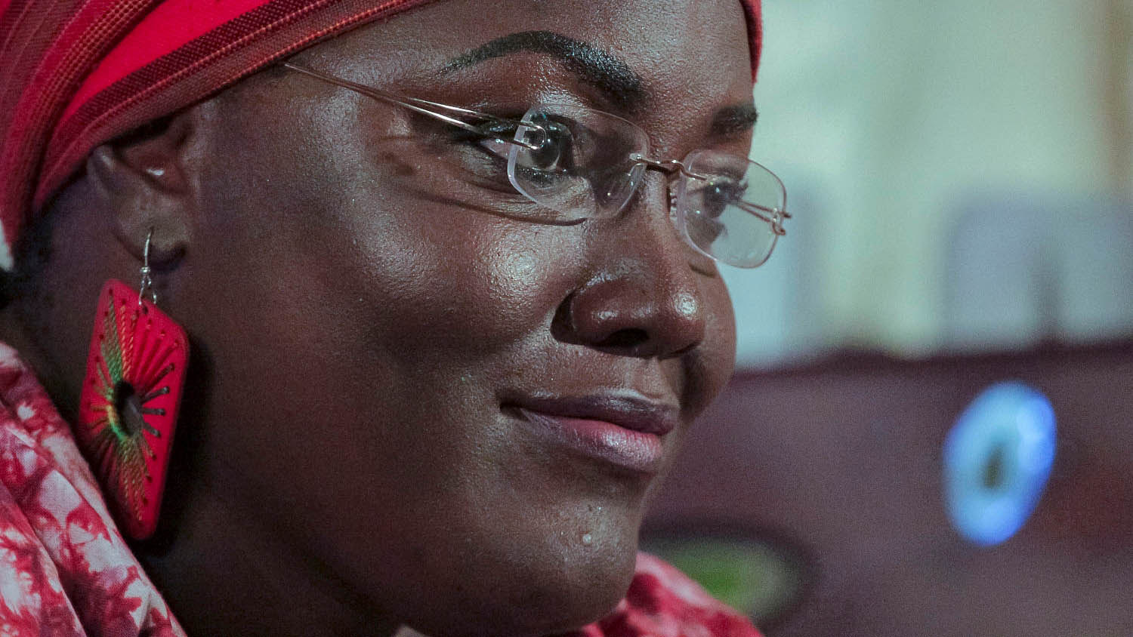
Uganda
Photography © by Arnold Ssebutiko on 500px

Slide 43

Zimbabwe
Photography © by Le Fu on 500px

Slide 44
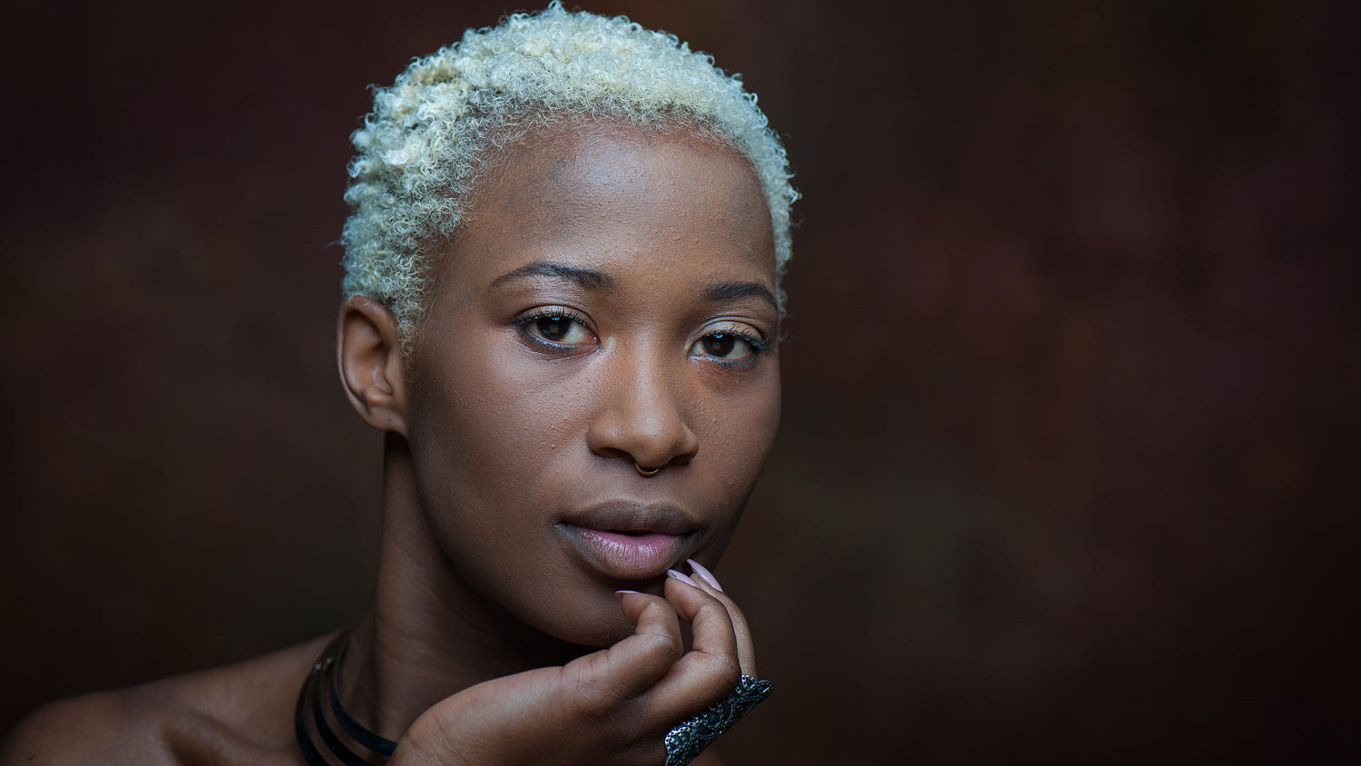
Zambia
Photography © by Reinier van de Pol on 500px

Slide 45
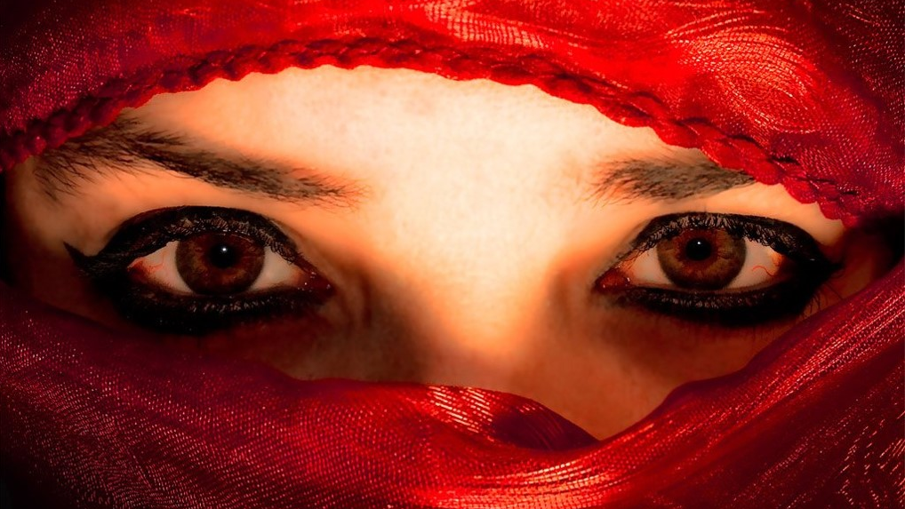




Gracias por su atención. Para ver pronto...
Imágenes : de la Web
Música : Herman Choir - Haleluya
Photography © by juanlamata

Slide 46







¿Te ha gustado?
Puedes ver más entrando
Aquí
Además puedes recibir powerpoints en tu correo electrónico suscribiéndote aquí:

